Slide 1
Apartment Rent Predication Web App
A Minor Project Report submitted to
SAM Global University
In partial fulfillment of the requirement for the
award of the degree of
BACHELOR OF TECHNOLOGY
Guided by Submitted by
Mr.Siddharth Jain Ma. Pradeep Rawat (22ENGG1AE03035)
(Professor) Ma. Shashikant Sahu (22ENGG1AE03045)
Miss. Kunika Ahirwar (22ENGG1AE03026)
Miss. Durgeshwari Verma (22ENGG1AE03021)

Slide 2
Project Objective
Main Goal:
To design and develop a machine learning-powered web application that predicts the monthly rent of residential apartments across major Indian cities.
Why It Matters:
Brings transparency to the rental market
Helps tenants avoid overpaying
Assists landlords in setting fair rent
Saves users time and effort

Slide 3

Problem Statement
The rental market in metropolitan cities lacks a reliable, real-time rent prediction tool.
- Rent varies drastically even within the same city
- Manual research is time-consuming and inaccurate
- Tenants may overpay; landlords may undercharge
- No intelligent tool exists for fair rent estimation

Slide 4
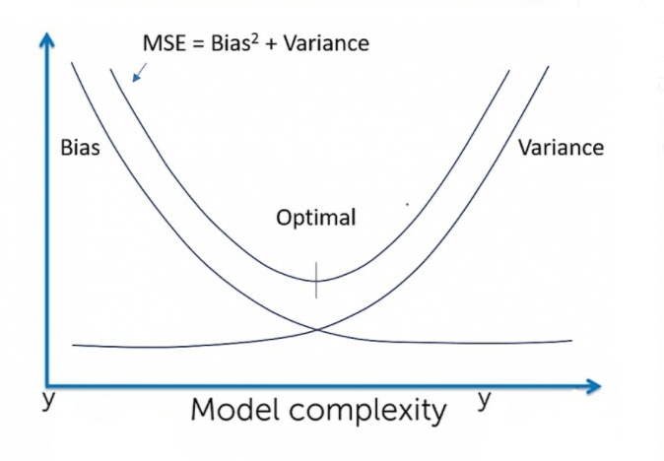
Literature Review
- Early methods used linear regression
- Machine Learning models (Random Forest, GBM) perform better
- Important features: Location, BHK, area, furnishing, tenant type
- Streamlit and Flask enable easy web integration

Slide 5


Proposed Solution
- Web App using Streamlit
- Backend: Random Forest Regressor trained on rent dataset
- Input: City, BHK, Area, Furnishing, etc.
- Output: Predicted Rent in ₹
- Hosted via Streamlit for instant predictions

Slide 6



Technology Stack
Frontend:
Streamlit (Python) , HTML , CSS
Backend:
- Python,
- Pandas,
- NumPy ,
- Scikit-learn for ML model
Deployment:
- Streamlit Localhost
- Pickle (.pkl) for model

Slide 7
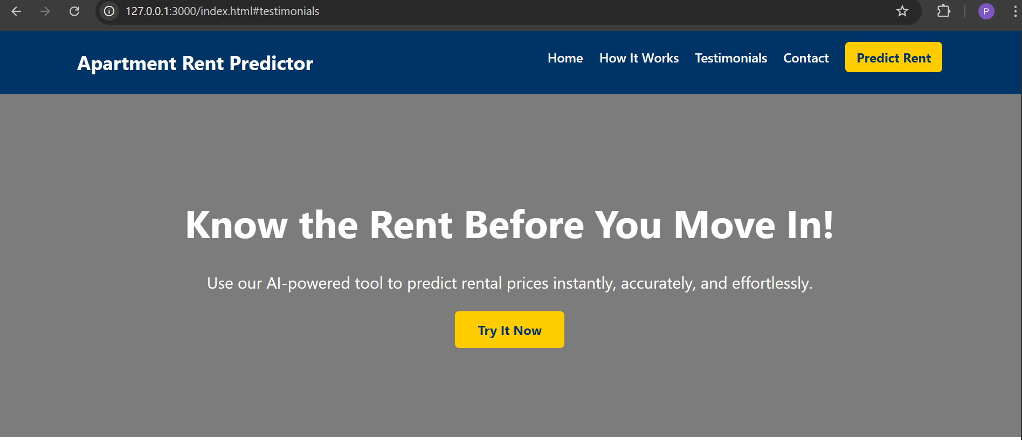
Modules and Features
1. Input Module: BHK, Area, City, etc.
2. Prediction Module: Random Forest Regressor
3. UI Styling: Custom HTML/CSS
4. Output Module: Rent displayed instantly

Slide 8
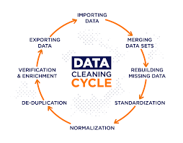

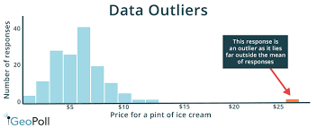
Challenges Faced
- Missing values & inconsistent data
- Categorical feature encoding (City, Status)
- Model tuning: RF > Linear Regression
- Streamlit UI limitations for styling
- Deployment and error handling

Slide 9



Future Scope
- Integration with 99acres, NoBroker, etc.
- Include geolocation & nearby amenities
- Use advanced models: XGBoost, AutoML
- Cloud deployment (AWS, Azure)
- Rent trend visualizations, user login

Slide 10
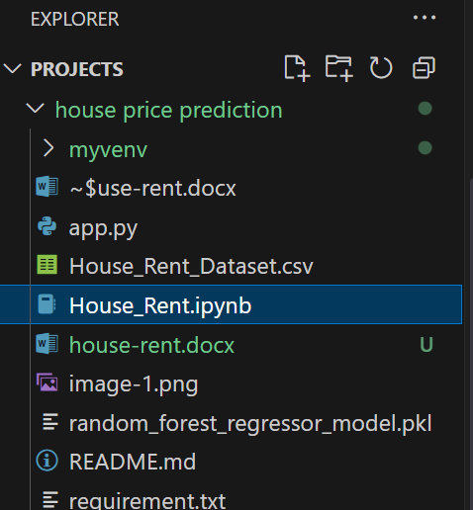
Project Structure
📁 Apartment-Rent-Predictor
├── app.py
├── House_Rent.ipynb
├── random_forest_model.pkl
├── requirements.txt
└── index.html
└── style.css

Slide 11
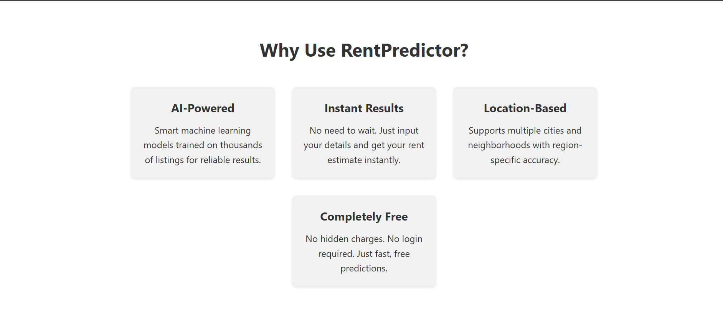
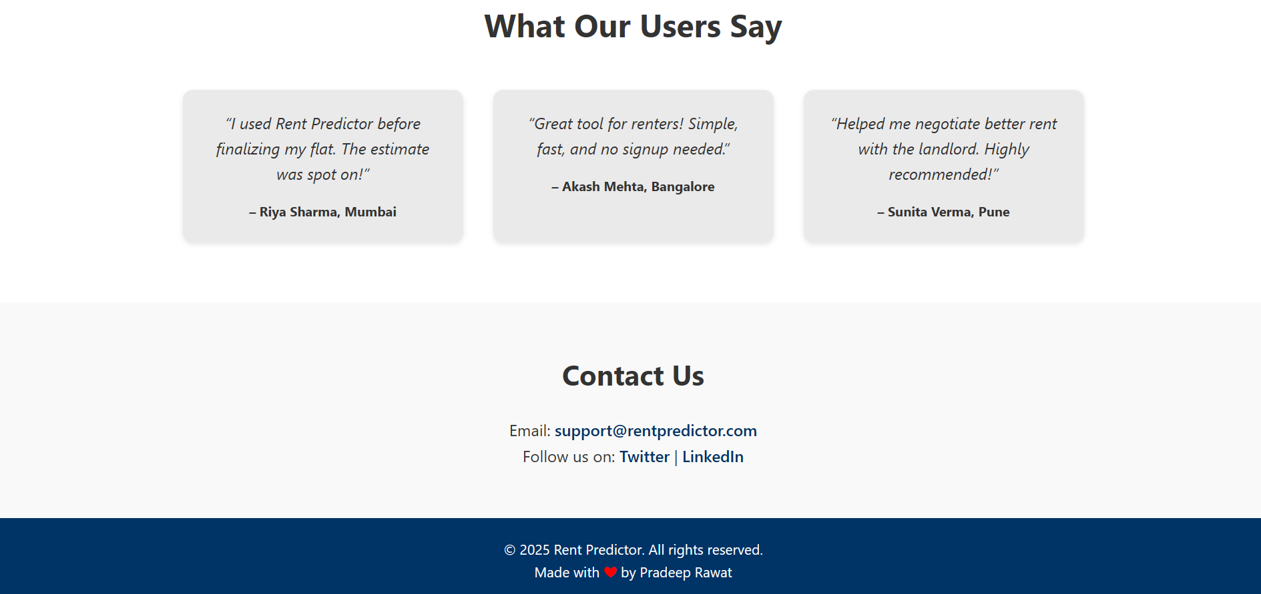
Web App Demo
- Simple Streamlit interface
- Input form for apartment details
- Instant prediction with rent displayed
- Includes navbar, hero, and contact section

Slide 12
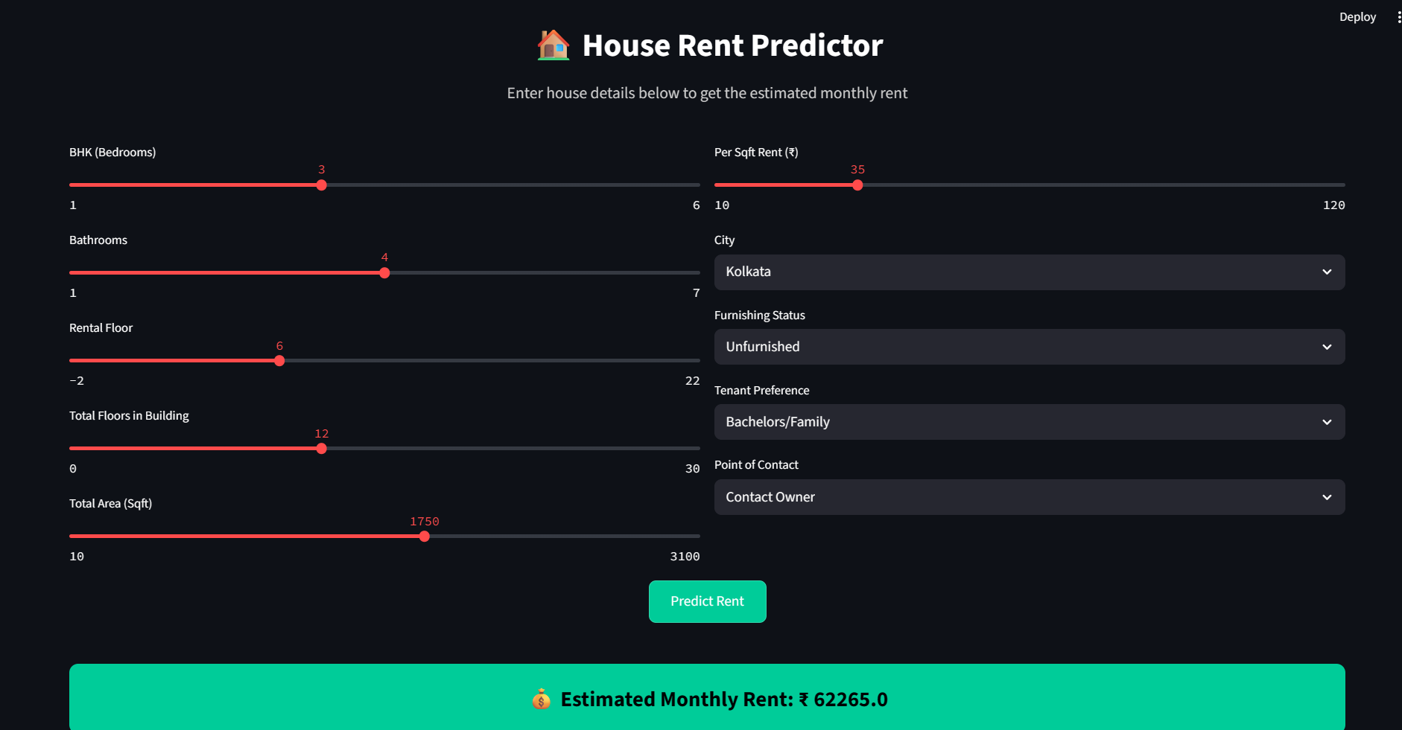
Conclusion
- Accurate rent prediction using ML
- User-friendly web deployment
- Useful for both tenants and landlords
- Can be extended for commercial platforms

Slide 13

Acknowledgment
Thanks to:
- Dr. Saurabh Mandloi (HOD)
- Mr. Siddharth Jain (Professor)
- Project team members & family

Slide 14

Q&A
Any Questions?

