Slide 1
SDN
What is SDN?
SDN(Software Defined Networks) consist of decoupled data and control planes.
In SND, software is used to setup new devices unlike in traditional networking.
Due to network virtualization in SDN, an abstract copy of the physical network is present at a centralized view.
Various controllers are available which are used to make network management and control applications through APIs.

Slide 2
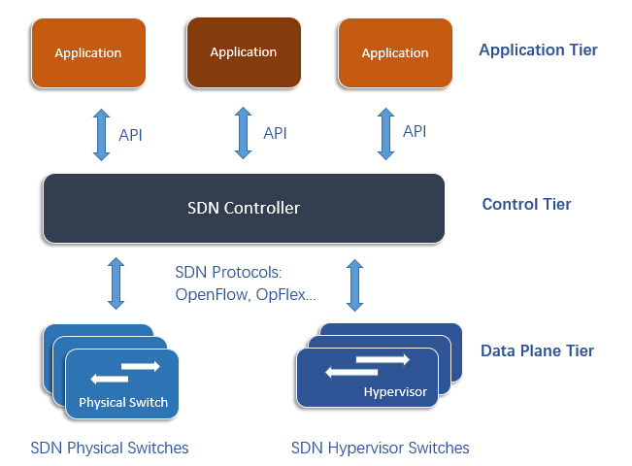
SDN: Architecture

Slide 3
Open Flow
What is OpenFlow?
Communication protocol in SDN architectures - enables the SDN controller to directly interact with the forwarding plane of network devices (switches and routers), so it can better adapt to changing business requirements.
To work in an OpenFlow environment, any device that wants to communicate to an SDN controller must support the OpenFlow protocol.
Through this interface, the SDN controller pushes down changes to the switch/router flow-table allowing network administrators to partition traffic, control flows for optimal performance, and start testing new configurations and applications.

Slide 4
Rest API
REST API(RESTful API) is an API used to communicate with the SDN controller.
We have written applications using REST API which includes our custom requirements of the controller alongwith the basic task of a controller.
We can write a simple python program and use REST API to communicate with the controller.

Slide 5
Collecting stats
To compare flowsense protocol with the methods using the polling we developed a program that will calculate the stats of the individual flows at a period of 10 seconds by using the pooling technique.
We are using RYU thread API . User needs to send the statistics request meassge(Example: OpenFlow FlowStatistics Request Message). Switch reply with statistics response message.
Here we prepared the RYU code to display statistics

Slide 6
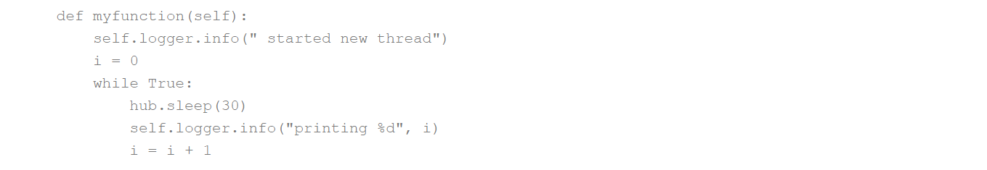
RYU Thread API
We will use the thread implementation of the RYU library to configure the statistics.
IMPORT THE LIBRARY
from ryu.lib import hub
Ex here we can write a separate thread that can run forever

Slide 7
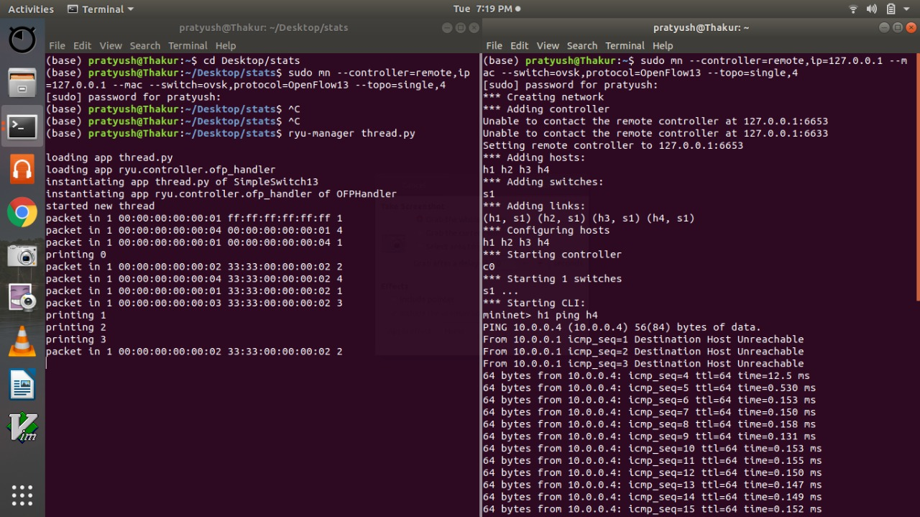
Continued …

Slide 8
Here in the above program we used command :
sudo mn –controller=remote, ip=127.0.0.1 –mac –switch=ovsk,protocol = OpenFlow13 – topo=single,4
in other terminal we used :
ryu-manager thread.py
Thread.py is using the code given in the previous slide along with the general switch implementation (simple_Switch)
# To initiate thread:
hub.spawn(self.myfunction)
In Output screenshot we can see that the values are being printed at the interval of 30 sec (since sleep 30 seconds being used

Slide 9
We will use similar method of continuous thread to calculate stats every 10 seconds by using polling mechanism in which we would be sending FlowStatistics Request Message
Logic :
1) Use RYU Thread (HUB) mechanism
2) In the thread ,send openflow statistics Request message at regular interval
3)Flow Statistics Response will be received as event, and display the bytes and packet counter values
Coding:
1) Use simple Switch as the base application
2) we require datapaths object of all the switches for generating the stats request message. hence we store the datapaths in the dictionary.

Slide 10
1) In the init routine , we declare it.
self.datapaths = {}
Datapath object is the instance that describes OpenFlow switch from which we received the given openflow message.
self.datapaths is used to add the datapath corresponding to flows.
2) In the switch features handler function, we store the the datapath object in the datapaths dictionary.
self.datapaths[datapath.id] = datapath
In a particular switch feature we are storing a particular datapath as a value corresponding to the key(which is internally generated id corresponding to switch (datapath.id)
3) Include hub library
from ryu.lib import hub (included for the thread)

Slide 11
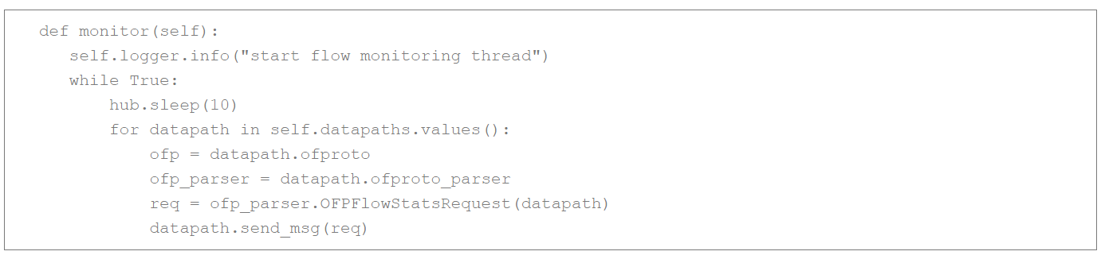
4) Start the thread in the init routine
self.monitor_thread = hub.spawn(self.monitor)
Here the thread function name is monitor
In the thread function, we process the datapaths(switches) dictionary, and generate the flowstats request message(without any match filter). It means we query the stats of all the flows in the switch

Slide 12
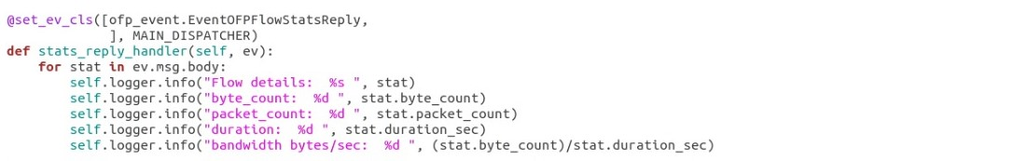
5) Flow Stats Response handling routine

Slide 13
RUNNING PROGRAM
start the mininet single topology
sudo mn –controller= remote,ip= 127.0.0.1 –mac –I 10.1.q.0/24 –switch ovsk,protocols=OpenFlow13 –topo=single,4
2) Run the application having switch and configured thread
ryu-manager flow_stats.py
3) Ping h1 to h4 for verification purposes
In output we will see that flows are flowing in between h1 and h4 eth_src and eth_dst being 00:00:00:00:00:04 and 00:00:00:00:00:01 and conversely
h1 ping h4

Slide 14
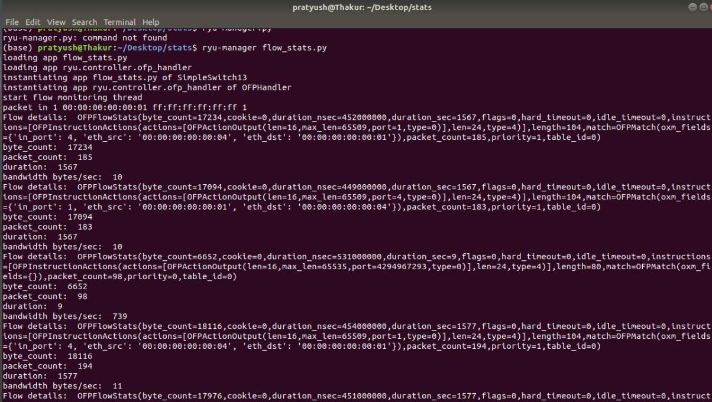
Flow Output

Slide 15
Using ofctl rest api
OFCTL : OpenFlow control using REST Interface
OFCTL REST application provides API to collect the stats
ryu.app.ofctl_rest application provides REST APIs for configure/update/retrive the switch flows /stats etc. This application helps you debug your application and get various statistics.
This application is not switch application.So provides very limited configuration
Steps to get stats :
Run mininet topology
sudo mn --controller=remote,ip=127.0.0.1 --mac --switch=ovsk,protocols=OpenFlow13 --topo=linear,4
2) Run the RYU OFCTL REST & Simple Switch application
ryu-manager ryu.app.simple_switch_13 ryu.app.ofctl_rest

Slide 16
3) Do pingall from mininet. and check the ovs flows
sudo ovs-ofctl –O OpenFlow13 dump-flows s1
4) Get all the switches
curl –X GET http://localhost:8080/stats/switches
Switch ids would be returned
5) Get the desc stats of the switch which specified with Datapath ID in URI.
curl –X GET http:localhost:8080/stats/desc/1
6) Get all flows stats of the switch which specified with Datapath ID in URI.
curl –X GET http:localhost:8080/stats/flow/1
Flows of switch with id1 are returned

Slide 17
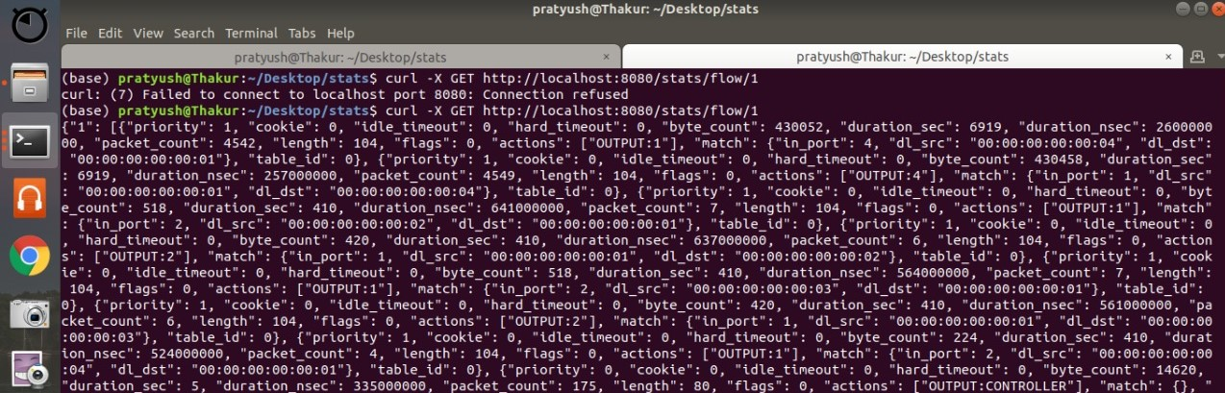

Slide 18
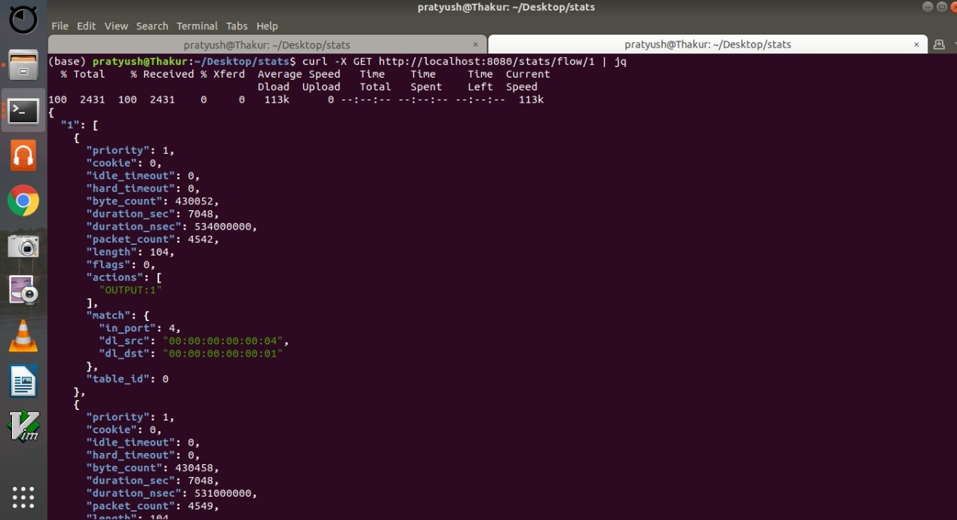
Flow stats in readable form:

Slide 19
Aggregate Flow Statistics:-Plan of Action
Objective:
Our objective is to measure the aggregate statistics in regular intervals.
Logic:
Setup a topology using Mininet.
Using RYU controller, send OpenFlow aggregate Flow Statistics Request message at regular interval via a thread.
A packet in event will be triggered on ping. The information of packets sent is logged.
Aggregate Flow Statistics Response will be received as an event.
This is used to display the bytes and packets counters.

Slide 20
Aggregate Flow Statistics Request/Response Message
Aggregate flow statistics request message:
The controller uses this message to query aggregate flow statistics.
Attributes: table_id, out_port, out_group, cookie, cookie_mask, match.
Aggregate flow statistics reply message:
The switch responds with this message to an aggregate flow statistics request.
It has an attribute ‘body’ which gives packet_count, byte_count, flow_count.

Slide 21
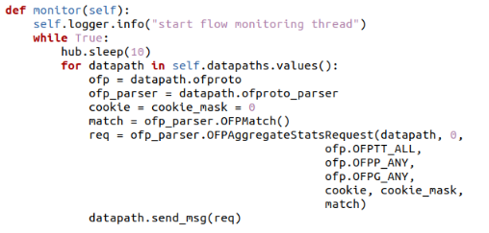
Aggregate flow statistics request message

Slide 22
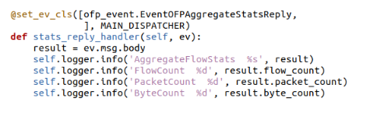
Aggregate flow statistics response message

Slide 23
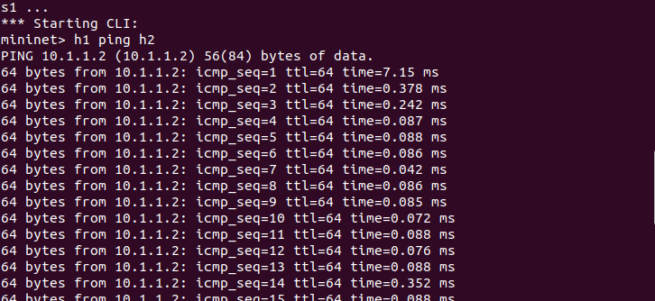
Sending packets for collecting aggregate stats

Slide 24
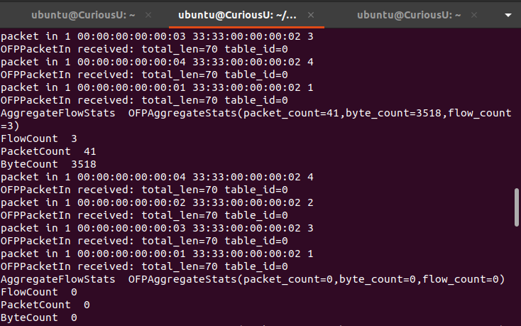
Aggregate Flow Stats

Slide 25
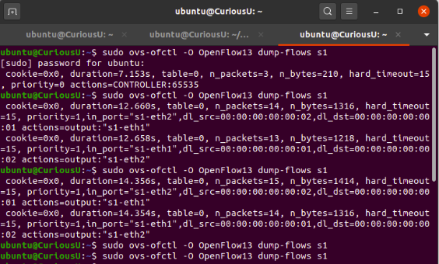
Timeout Result

Slide 26
Port Statistics
As Mentioned in previous Slides we can get the flow sides by using the commands explained.The next part includes getting the Port statistics of a switch
1)Port Statistics Request Message:-This message is used by controller to get the Statistics Message.The following is the format of port statistics
→ req = ofp_parser.OFPPortStatsRequest(datapath)
2) Port statistics Reply Message:Upon getting the statistics request Message from controller.Switch Replies with the statistics of port.
→ @set_ev_cls([ofp_event.EventOFPPortStatsReply,], MAIN_DISPATCHER)
def stats_reply_handler(self, ev):
for stat in ev.msg.body:
self.logger.info("Port statistics : %s ", stat)

Slide 27
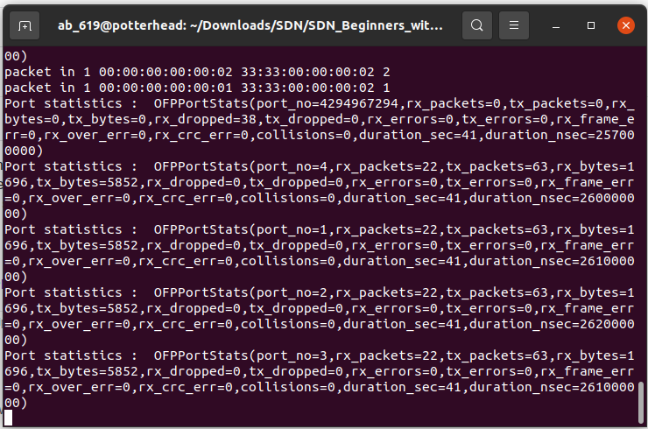
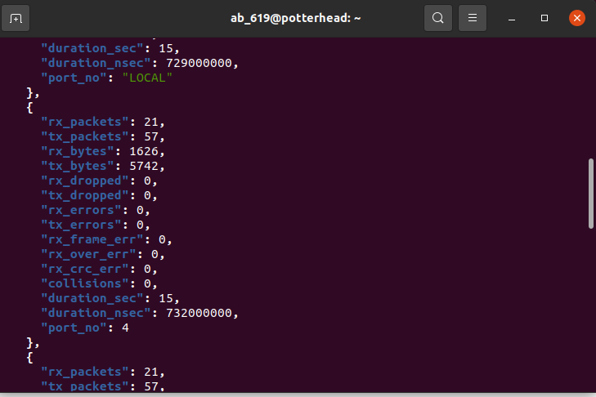
Port statistics Output

