Slide 1
Cyclistic Bike Share Analysis
Author - Rupesh Singh Thakur
Date - 23/02/2025

Slide 2
Introduction
Objectives
Cyclistic, a bike-sharing company, aims to increase the number of annual memberships by understanding the behavior of casual riders and annual members. This analysis explores user patterns to develop marketing strategies that encourage casual riders to convert into members.
Identify key differences in ride usage between casual users and member users.
Determine high-demand stations and peak usage times.
Suggest marketing strategies to boost annual membership.

Slide 3
Dataset Information
Source Cyclistic Open Data
Data Contains:
Ride Start and end times
Start and end station names
User type (casual vs member)
Ride duration and distance
Type of bike use (classic bike, electric bike, electric scooter)

Slide 4
Exploratory Data Analysis (EDA)
Ride distribution by month, quarter, weekday and hour by user (bar chart)
Member vs casual user comparison (pie chart)
Bike type usage (pie chart)
Popular start and end stations by users (stacked bar chart)

Slide 5
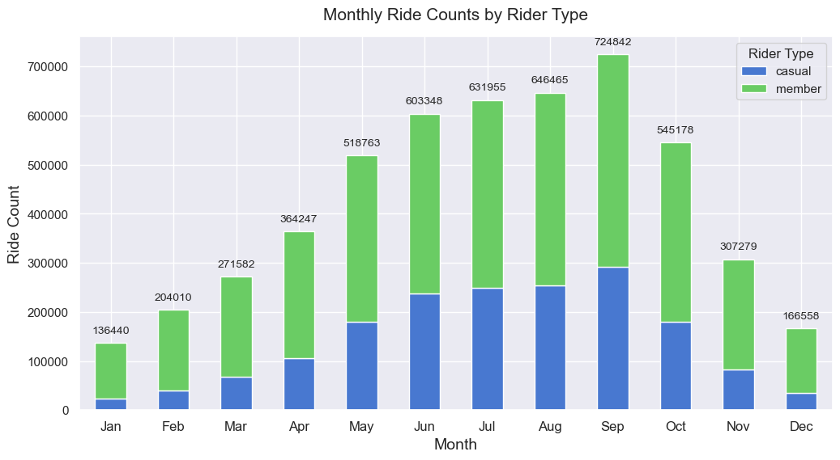

Slide 6
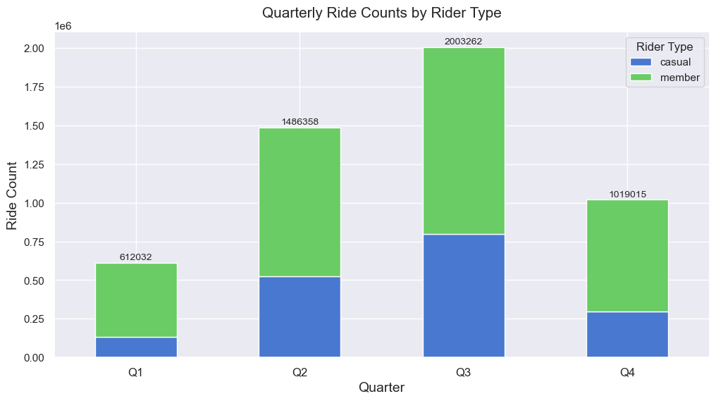

Slide 7
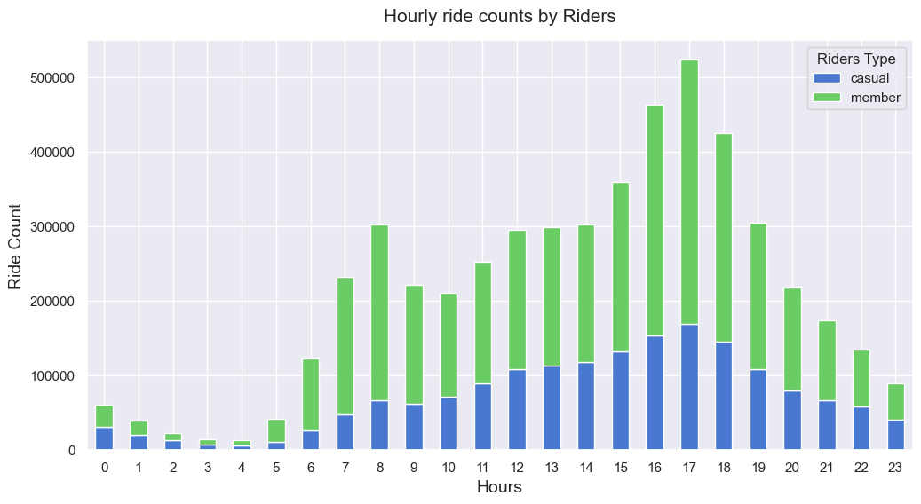

Slide 8
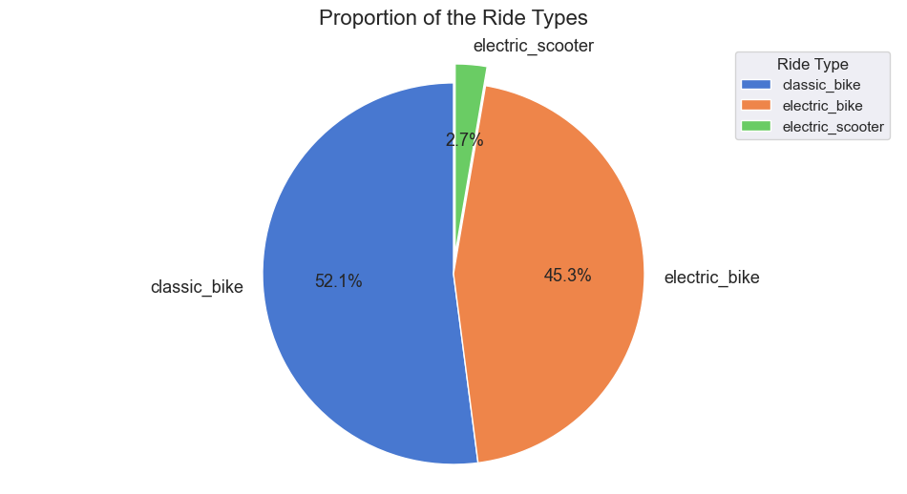

Slide 9
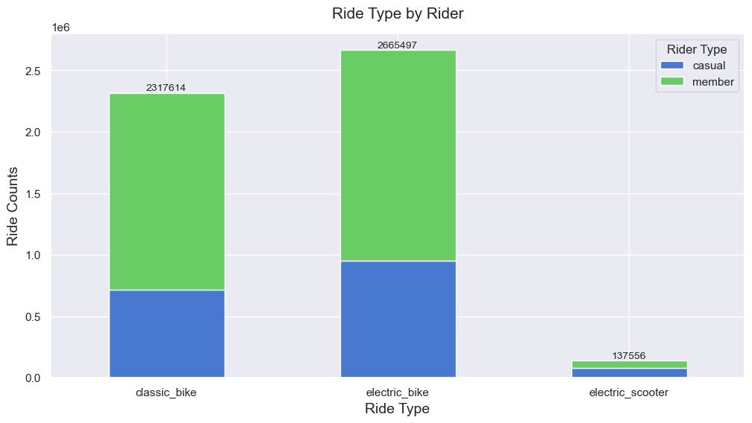
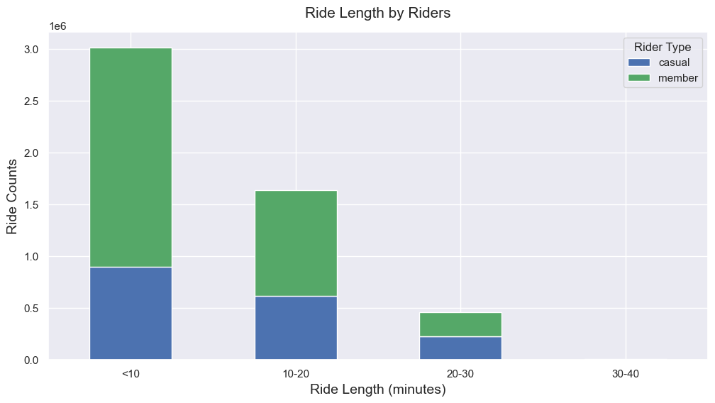

Slide 10
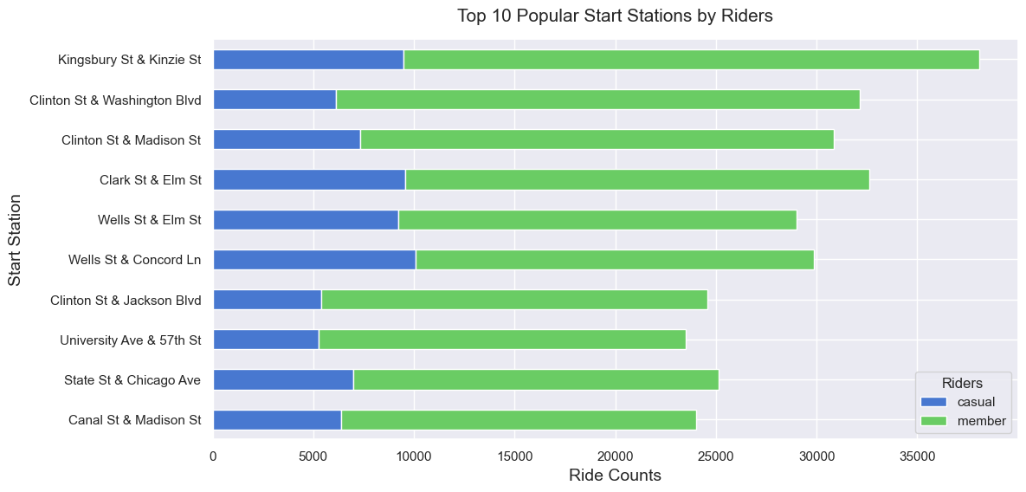

Slide 11


Slide 12
Key Insights
A bar chart revealed that ridership peak during the summer and declines in winter.
The highest number of rides occur in Q3(July-September), with over 2 million rides.
The lowest ride count in Q1 (January-March), suggesting seasonal effects.
Casual riders tend to use bikes for longer durations but take fewer rides.
Members take more rides but for shorter durations, indicating frequent short trips.
Some stations like such as “Kingsburry St Kinzie St” and “Clinton St & Washington Blvd” experience heavy ride volumes.
Classic bikes are the most used (52.1% of total rides), followed by electric bikes (45.3%)

Slide 13
Recommendations
Offer discounted membership plans for frequent casual users.
Implement loyalty programs for long-term casual riders.
Target high-usage casual riders with personalized promotions.
Increase availability of electric bikes due to growing demand.
Improve bike distribution at high-demand stations.
Consider expanding operations in peak-usage areas.

Slide 14
Conclusion
This analysis provides a clear understanding of how different user groups engage with Cyclistic’s services. By leveraging these insights, the company can optimize marketing strategies, enhance user experience, and ultimately increase annual memberships.

Slide 15
Thank You
Rupesh Singh Thakur
Freelance Data Analyst
Raipur, Chhattisgarh, India
Email: rupeshsingh.thakur05@gmail.com
Contact - +91-7415273933

