Slide 1

Online Delivery Restaurants Project HIMANSHU MOHAN THAKUR

Slide 2
The Grand Vision - Zomato's Global Ambition
Zomato, a leader in the online food delivery space, is looking beyond its current horizons. Our goal is ambitious: to expand our business by opening new restaurants in different countries. This strategic move aims to capture a wider customer base, catering to diverse price ranges and adapting to various cuisines, country by country. This presentation outlines our data-driven approach to achieving this vision

Slide 3
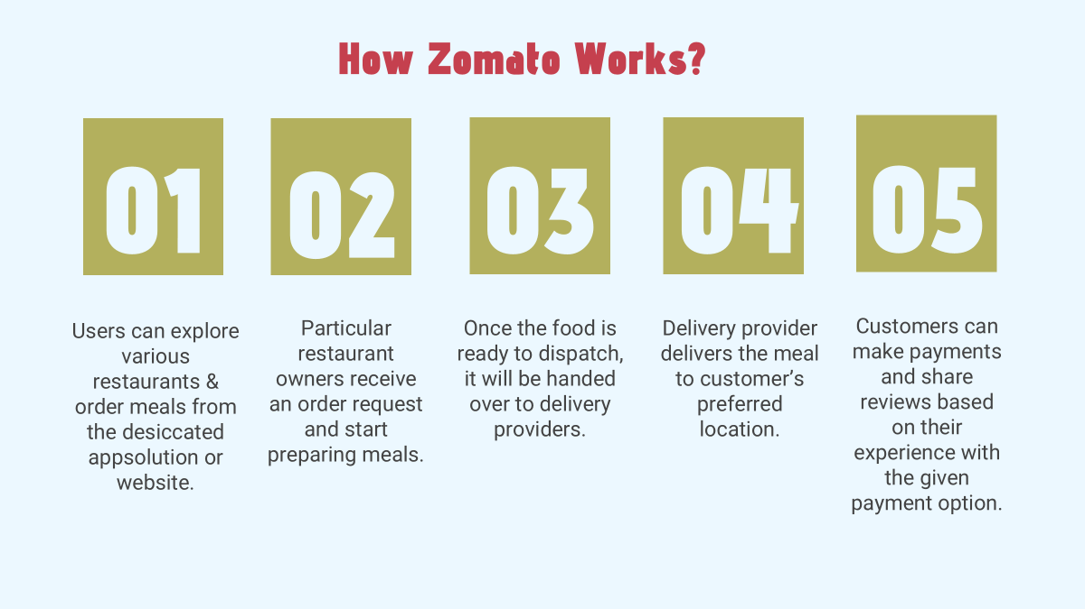

Slide 4
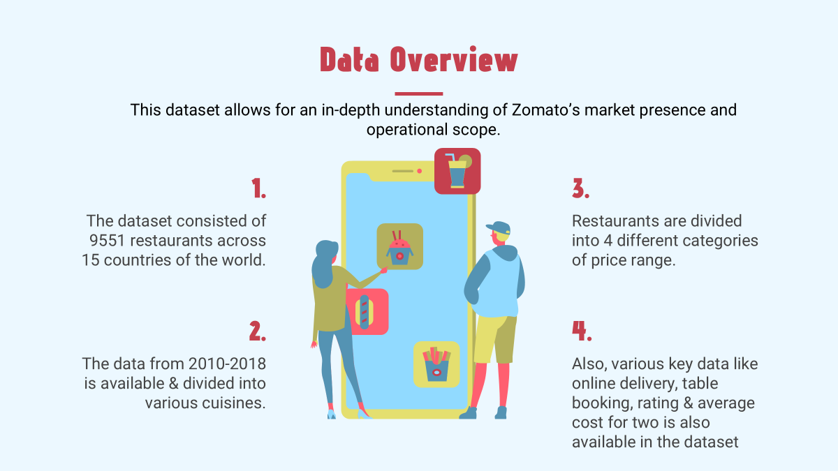

Slide 5
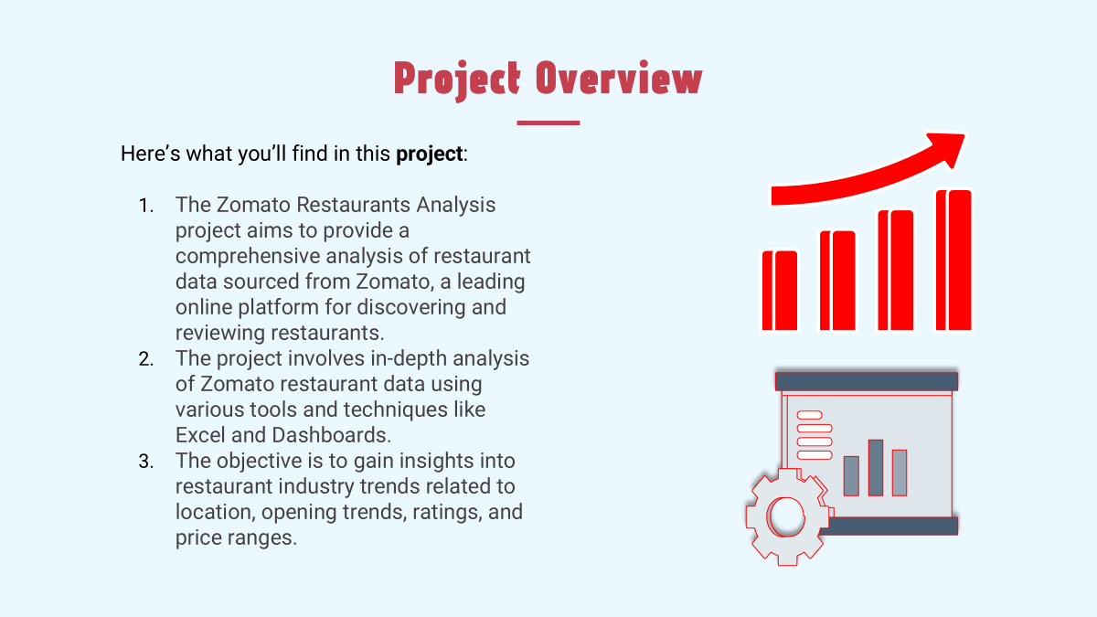

Slide 6

Introduction with Problem Statement
Zomato team wants to expand own business, opening new restaurants in different country to capture the maximum customers of different price range and cuisines according to country.
A dataset of food industry(restaurants) is Analysed and insights & information is derived from the data .
Purpose of the study is to initially analyse the data and draw certain information from it .

Slide 7
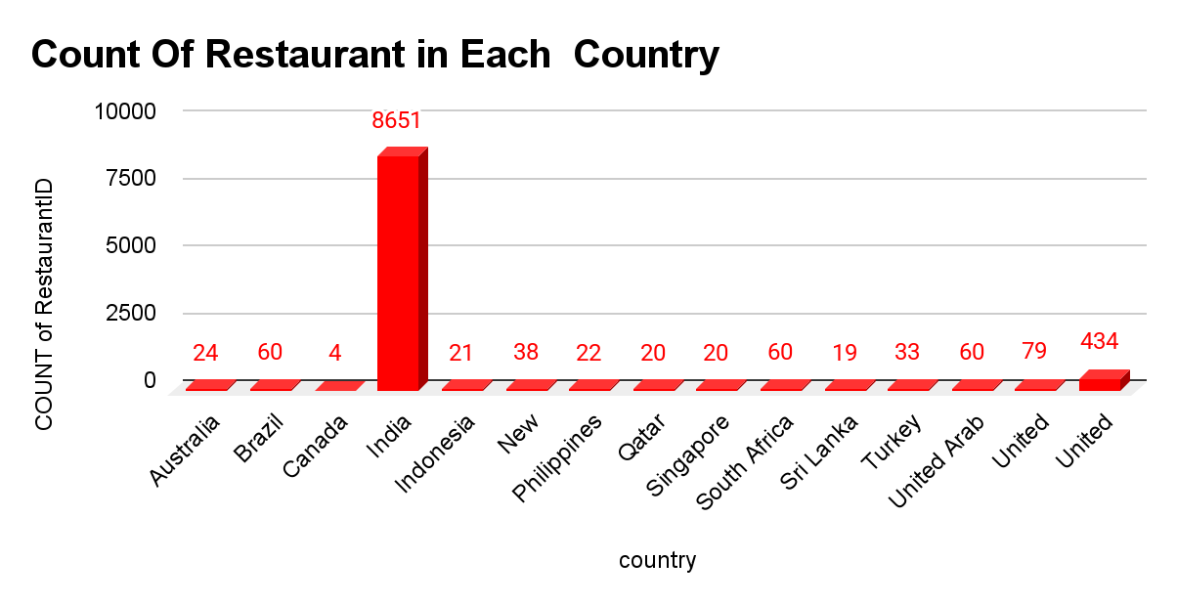
Market Research
Total Country -15
In all over world there are 9550
restaurants.
Total Number of Cuisines 1826.
Highest Number of Restaurants seen in India-8651
Lowest Number of Restaurants seen in Canada- 4
And 388 restaurants having above than Prize range 4 in India.

Slide 8
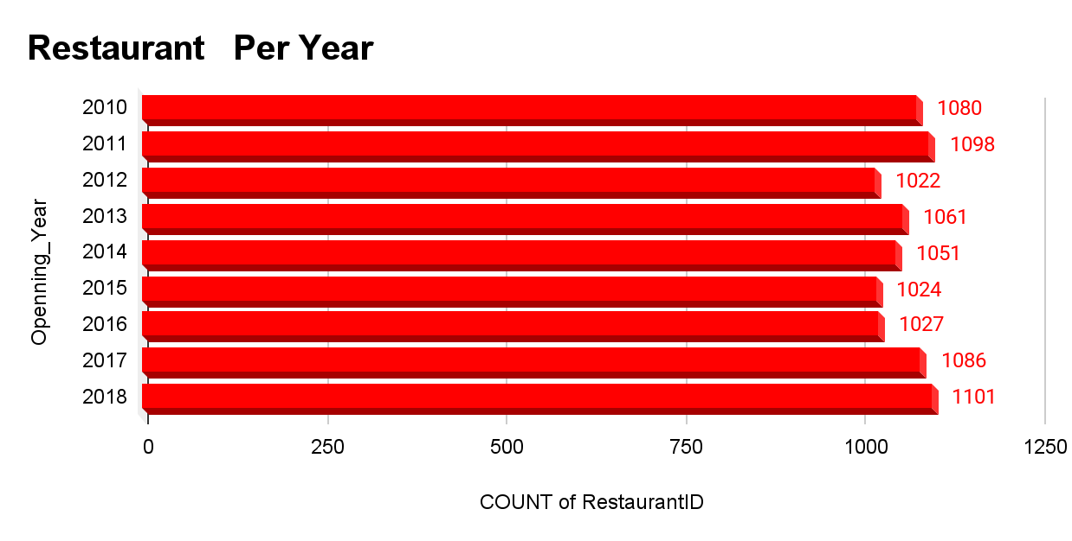
Market Research
According to our data, Every year more than 1000 restaurants are open all over the country from 2010 to 2018.
In Year 2018 had the highest opening of restaurants
There was a slowdown in openings
1000
1101
2012–2016
1022
2178
In Year 2012 had the lowest openings of restaurants
In 2010, 2011 has good number of opening restaurants.

Slide 9
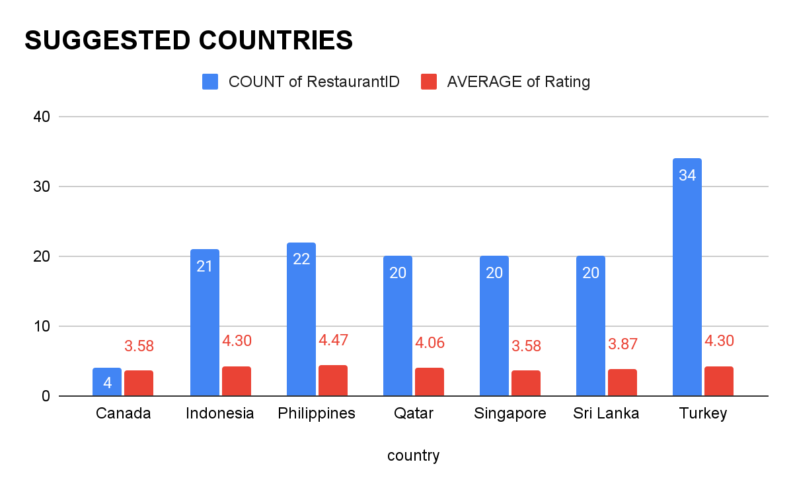
TARGET COUNTRY
According to our analysis we find some country there less than 40 restaurants are opened and average rating below than 4.5.
Canada have only 4 restaurants and have only 3.58 average rating this is best country to expend business.
Qatar, Singapore, Sri Lanka have 20 restaurants with good rating, so these country have our next target.

Slide 10
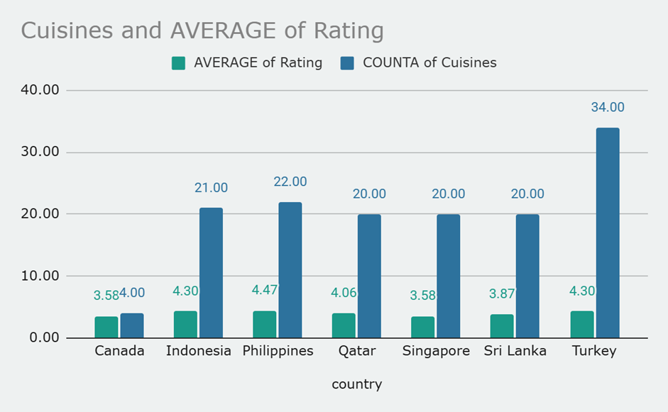
Cuisine Adaptation
On basis of our data, we can suggest only those cuisines which have greater than 3.5rating in the suggested country.
We only suggest those cuisines which have more than 3.5 average rating.
We also suggest number of cuisines country wise.
Maximum number of cuisines suggested in Turkey and the average of cuisines is 4.30

Slide 11
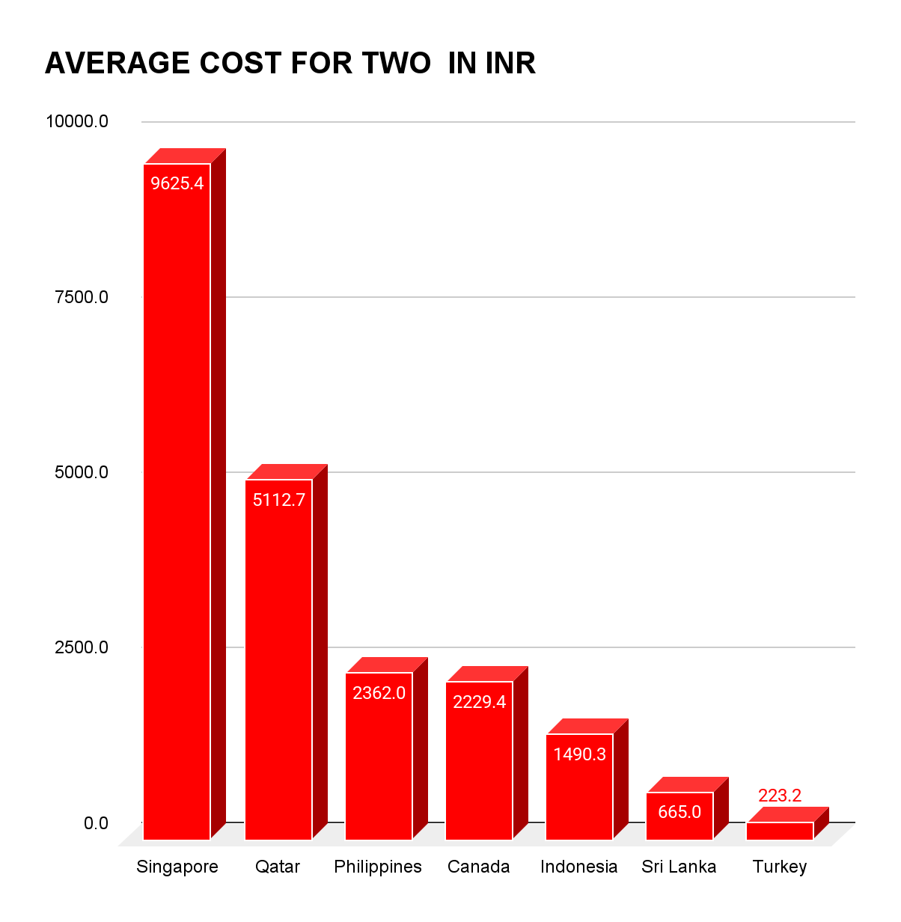
Financial Projections
On the basis of our analysis, we can control the expenditure on food to know the average price of two people spent on food.
We convert the all the country currency in INR
In Singapore we need to spend 9265 rs as average money for two people.
In Turkey people need to spend 223rs per two personal
So, we can serve the food under that budget.

Slide 12
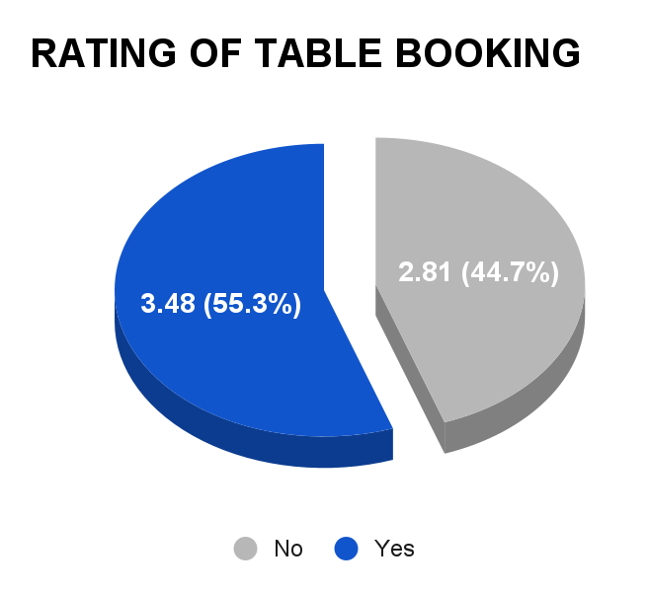
Marketing Strategy
Newer restaurants also offers the table booking option because the table booking affects the rating.
Average rating of table booking is 3.48 (55.3%).
Average rating of not booking table is 2.8 (44.7%)
So, People wants table booking system in new restaurants and the rating is also higher.
It can be Concluded – Table bookings should be offered and has direct relationship with ratings.

Slide 13
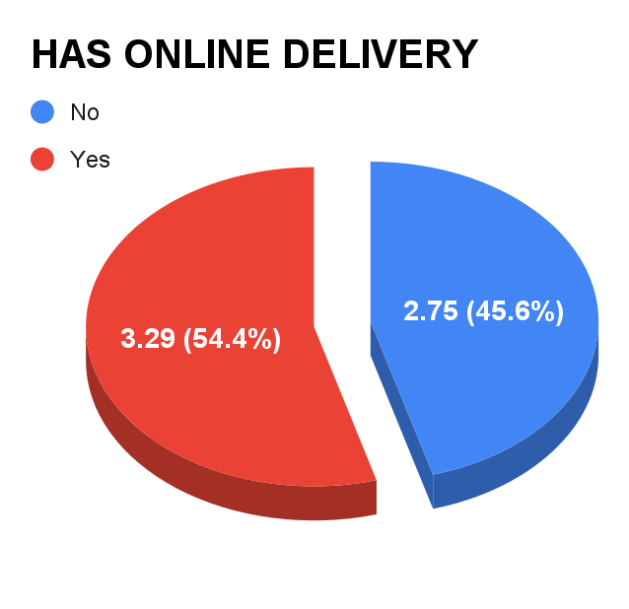
Marketing Strategy
We can also provide online delivery option because it also affects the rating of restaurants.
Average rating of Online delivery is 3.29 (54.4%).
Average rating of not having online delivery is 2.8 (45.6%)
So, People wants table booking system in new restaurants and the rating is also higher.
It can be Concluded – Table bookings and Online delivery should be offered and has direct relationship with ratings.

Slide 14
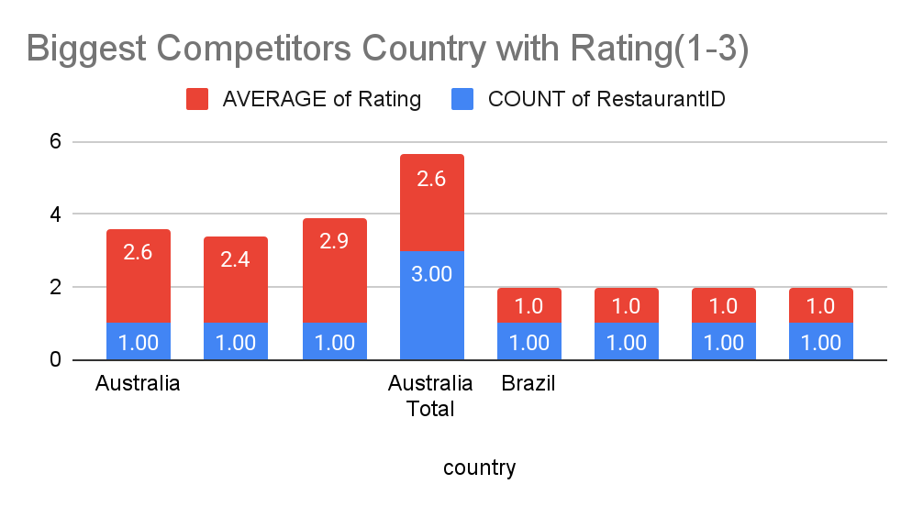
Competition in the Market
There are some Country here which will provide a lot of competition in the market.
India is biggest competitor in the market because 809 restaurants having grater than 4.5 rating.
India and Singapore both are biggest competitor in market those are average rating between 1-3.
As per our data 8652 restaurants are in India and 3561 restaurants are below than 3 rating.

Slide 15
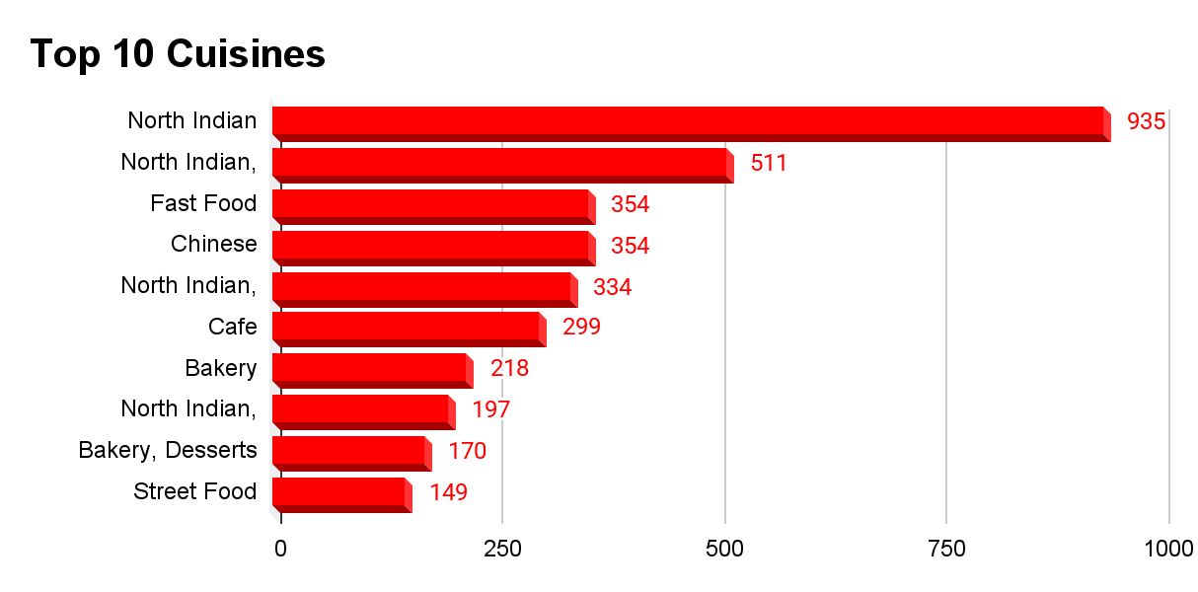
TOP 1O CUISINES
Based on the analysis of the dataset filtered by suggested countries, the top 10 most frequently served cuisines were identified using a Pivot Table. The list is ranked by the number of restaurant listings offering each cuisine.
nsight:
These cuisines dominate the restaurant landscape across the suggested countries, indicating strong customer demand and cultural preferences. North Indian, Chinese, and Fast Food lead the list, suggesting they are safe choices for market expansion or menu focus.
Recommendation:
Focus marketing and offerings on the most popular cuisines to match demand.
Consider including a few mid-ranked cuisines like Continental or Italian to appeal to diverse tastes.
Ensure quality and variety in top cuisines to maintain customer satisfaction.

Slide 16

Our Strategic Roadmap - Conclusion and Key Insights
Based on our comprehensive analysis, here are the key insights and strategic imperatives for Zomato's global expansion:
Promising Investment Opportunities: Canada, Qatar, Sri Lanka, Philippines, and Indonesia are identified as potential investment opportunities due to their relatively low number of restaurants and average ratings, suggesting untapped markets.
Navigating the Indian Market: While India is a massive market, entering it requires a robust strategy focused on quality to overcome the existing competition.
Prioritizing Service and Quality: Beyond just cuisine type, the quality of food, ambiance, and taste, along with excellent services, are paramount for success and impact ratings directly.
The Power of Convenience: Offering online food delivery and table booking services has a direct and positive impact on restaurant ratings, making them essential offerings for new establishments.
Strategic Pricing: Even with a moderate price range, a well-strategized approach that emphasizes good services can lead to a profitable restaurant.

Slide 17
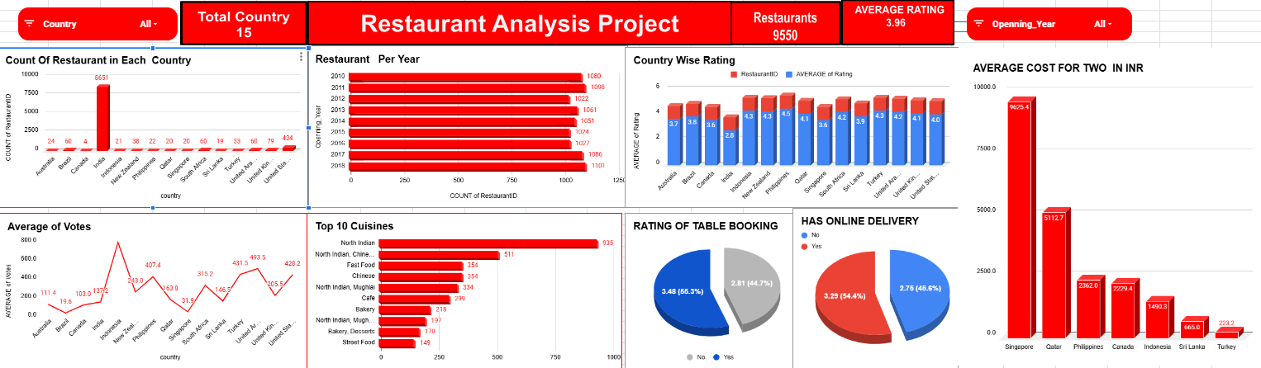
Dashboard

Slide 18


