Slide 1

Chinook Music Store Analysis
HIMANSHU MOHAN THAKUR

Slide 2
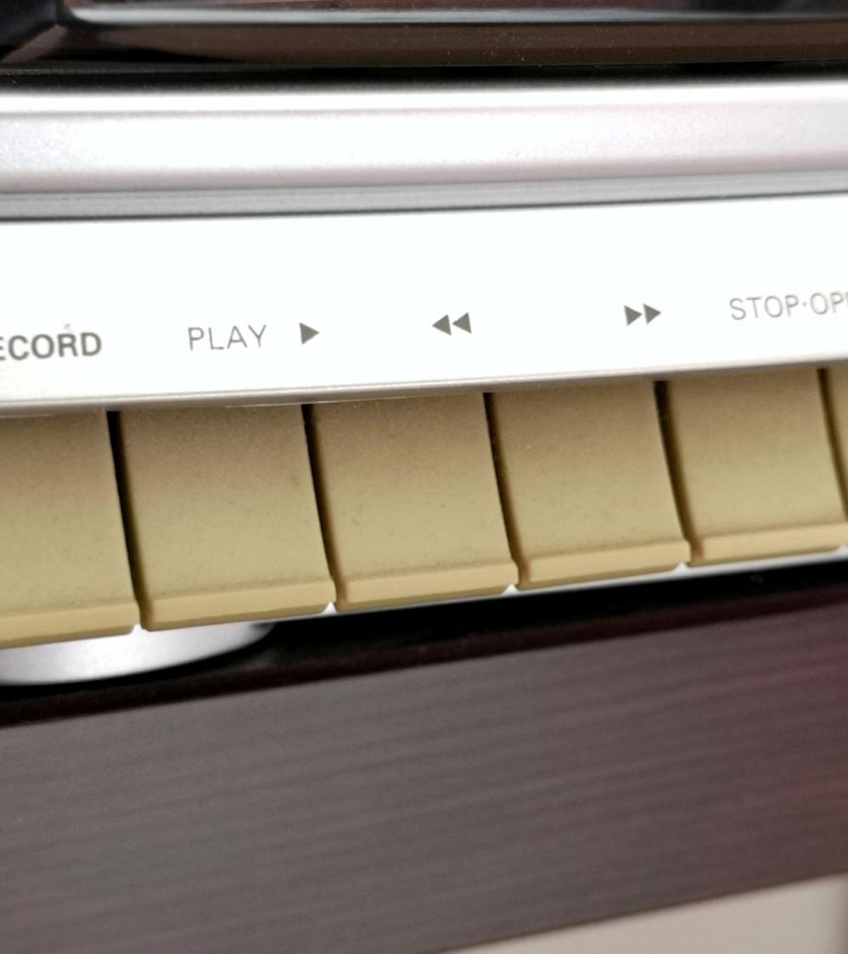
About Chinook
Chinook Music Services is a premier brand in the physical music records market, dedicated to delivering musical entertainment worldwide. With a global network of outlets and services, Chinook offers a comprehensive genre experience to its customers, ensuring diverse musical enjoyment for all.

Slide 3
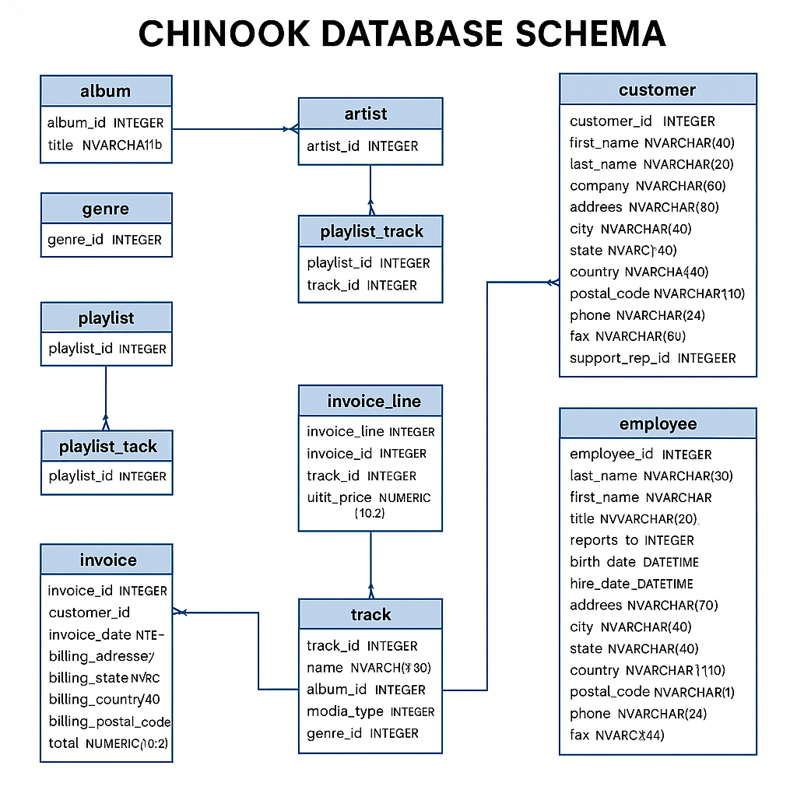
Chinook Database Schema
The Chinook Database is a sample relational database designed to represent a digital music store. The schema includes tables related to music, employees, customers, invoices, and playlists, capturing a realistic business scenario.
Key Highlights:
Artist → Album → Track: Represents the core music catalog.
Track is linked to MediaType and Genre for classification.
Playlist & Playlist Track model a many-to-many relationship between tracks and playlists.
Customer → Invoice → Invoice Line → Track: Captures customer purchases and itemized transactions.
Employee table includes a self-referential hierarchy and supports customer service through the SupportRepId.
This ER diagram clearly outlines the one-to-many and many-to-many relationships using foreign keys, forming the backbone of querying music data and customer activity.

Slide 4

Problem Statement
Sales Analysis
To analyze music record sales data to gain insights and make recommendations for the company's strategy in the physical music market.
Market Analysis
To derive insights based on the geographical location of customers and recommend strategies to increase company revenue.
?

Slide 5

Data Overview
This dataset allows for an in-depth understanding of Chinook’s market presence and operational scope.
The dataset consisted of 11 tables containing data related to the company.
The company has customer base from 24 different countries across the globe.
The tracks sold are of 25 different genres including Rock, Metal, Jazz & many more.
It also includes information regarding the album and the artist related to a track.
The invoice table records all the transactions in the company.

Slide 6

Methodology
Understanding The Data
Cleaning The Data
Exploring the Data
Deriving Key Insights

Slide 7
Objective Questions
Customer demographic breakdown based on location of Chinook's customer base?
Key Takeaways: -
It shows that the customers are from 24 different countries.
The customer demographic breakdown is very diversified.
Maximum number of customers are from USA.

Slide 8
Objective Questions
Calculate the percentage of total sales contributed by each genre in the USA
Key Takeaways: -
It shows that the ROCK genre is contributing most to the sales generated in the USA.
The 2nd and 3rd most selling genres are Alternative & Punk and Metal.

Slide 9

Objective Questions
What is the customer churn rate?
Key Takeaways: -
It shows that the customer retention is not good in the company.
The number of customers lost are high and needs immediate action to maintain the customer base.
New Promotional Campaings, Music Festivals and Sale Months should be launched so as to attract more customers.
Better customer service can also help in decreasing the churn rate.
40.82%

Slide 10
Subjective Questions
Customer Purchasing Behavior Analysis:
How do the purchasing habits (frequency, basket size, spending amount) of long-term customers differ from those of new customers? What insights can these patterns provide about customer loyalty and retention strategies?
Key Takeaways: -
It can be seen that Long term customers are better in all the aspects(frequency, basket size & total spending).
It shows that customer loyalty plays an important role in increasing the revenue of the company because the long term customers tend to buy more than the short term customers.
Therefore, the company should focus on the retention rate of the customers so as to increase the sales over time.

Slide 11
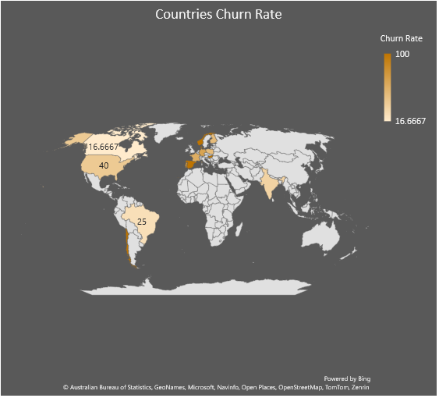
Subjective Questions
Regional Market Analysis:
Do customer purchasing behaviors and churn rates vary across different geographic regions or store locations? How might these correlate with local demographic or economic factors?
Key Takeaways: -
It is evident that the countries in Europe are having high churn rate.
It shows that economic factors play a crucial role in the sales of the company.
Therefore more number of advertisements should be launched in the countries with high economy and cheaper tracks should be sold in the coutries with low economy.
Population of countries also affect the sales.

Slide 12
Subjective Questions
Customer Risk Profiling:
Based on customer profiles (age, gender, location, purchase history), which customer segments are more likely to churn or pose a higher risk of reduced spending? What factors contribute to this risk?
Key Takeaways: -
The overall sales per month has a decreasing trend which shows that the sales had gone down during the 2nd last quarter .
But during last quarter sales are again increasing.
Therefore, it is seen that new promotional campaigns need to be done in those countries to reduce churn rate as well as maintain & increase the spending.

Slide 13

Recommendations
The company should focus on expanding its services to more number of countries to increase its customer base.
USA market should be focused and more promotional campaigns should be launched.
The company should work on decreasing the churn rate in the recommended countries.
Also, customer retention should be the first priority so that revenue can be increased.
‹#›

Slide 14
Recommendations
The sales over month trend should be maintained and increasing month over month
Using personal recommendations for each and every customer.
E-mail marketing techniques should be used to inform customers about new discounts and sales.
‹#›

Slide 15

“Music gives a soul to the universe, wings to the mind, flight to the imagination and life to everything.” ― Plato

Slide 16

Conclusion
Identified trends based on country, genre and artist.
Company needs more promotion and marketing and expansion in market size.
Customer retention will help in increasing the revenue of the company.
Analysed key performance metrics such as: -
Frequency of purchases per customer.
Basket size of each customer.
Spending amount of each customer.

