Slide 1

Python, Data Science & Machine Learning Integrated
CipherSchools
A training report
Submitted in partial fulfillment of the requirements for the award of degree of
B.Tech(CSE)
From 05/06/24 to 15/07/24
Name of student: Jyothir Raghavalu Bhogi Registration Number: 12201343

Slide 2
Declaration
I, Jyothir Raghavalu Bhogi,12201343 hereby declare that the work presented in this report titled "Python, Data Science & Machine Learning Integrated" is a record of original work carried out by me under the guidance of my mentors during my training at Cipher Schools from June 5, 2024, to July 15, 2024, and is submitted in partial
fulfillment of the requirements for the award of the degree of B.Tech in Computer Science and Engineering (CSE).
Name of the Student: Jyothir Raghavalu Bhogi
Reg no: 12201343

Slide 3


Training Certificate from CipherSchools

Slide 4
Acknowledgement
I am incredibly grateful for all the people who helped me completing this course with their invaluable guidance and support throughout the 4 weeks of course from 24th June to 24th July .From the moment I took the course, I took the time to get to know me and understand my goals for the course. They provided me with clear direction and expectations, and were always available to answer my questions and provide me the feedback. Throughout the training, Mr. Anurag Mishra sir provided me with invaluable insights and advice that helped me to grow as a professional. Their constructive feedback helped me to improve my skills and approach to my tasks, and their encouragement kept me motivated and focused. I am deeply thankful to everyone for their time and effort, and for their commitment to my success. . I would like to thank Human Resource Development Centre, LPU also for organizing such a wonderful summer training program.
Jyothir Raghavalu Bhogi Registration Number: 12201343

Slide 5
ABOUT CipherSchools
Company’s vision & mission:
CipherSchools is an educational video-streaming company based in India. We are the ultimate destination for Content Creators and Students who crave an exhilarating online learning experience. Our platform is designed to ignite your imagination, unleash your potential, and revolutionise the way you create, share, and learn. Since our inception in 2020, we have left an indelible mark on countless students around the globe, transforming their lives and empowering them to conquer new horizons.
Join us on this thrilling journey and be a part of our incredible success story.
Vision:
Envision a world where high-quality online learning is readily accessible to everyone, regardless of their location. At our core, we aspire to transform this vision into a tangible reality by becoming the go-to platform for anyone seeking free online learning experiences.
Mission:
We are on a mission to bridge the gap between passionate, unskilled students and seasoned industry
experts. By connecting these two groups, we aim to empower students and help them realise their career aspirations.
Origin and growth of company: Refer: https://www.linkedin.com/company/cipherschool/
Organisation chart of the company:
CEO & Founder: Mr. Anurag Mishra
Technical Department: Headed by Nitesh Kumar
Operations Department: Headed by Geetika
Marketing Team: Headed by Sanskar
Address of the company:
Chandigarh Citi Center(CCC), VIP Road, Punjab - 140603

Slide 6
Course Outline
Introduction to Data Science
Overview of data science and its importance
Introduction to the data science workflow
Key skills and tools in data science
Setting Up Your Environment
Anaconda Setup and Overview: Introduction to Anaconda,
installation, and management of Python environments.
Google Colab Notebook Overview: Getting started with Google
Colab for Python programming and data science projects.
Advanced Excel for Data Analysis
Advanced formulas and functions
Data cleaning and preparation techniques
PivotTables, PivotCharts, and Power Query
Python for Data Science
Python fundamentals (variables, data types, conditionals, loops)
Working with data using Pandas
Data manipulation and analysis with NumPy
Data Visualization
Principles of data visualisation
Introduction to Matplotlib and Seaborn
Creating interactive visualisations with Plotly
Introduction to Power BI
Getting started with Power BI Desktop○ Creating dashboards and reports
Power BI Service basics for sharing and collaboration
7. Data Preprocessing Concepts

Slide 7
Data cleaning and normalisation
Handling missing data
Machine Learning Algorithms
Supervised learning (linear regression, logistic regression, decision
trees, random forests, SVMs)
12. LIVE Project

Slide 8
Chapter-1
INTRODUCTION OF THE PROJECT UNDERTAKEN
Project Title : Mall Customer Segmentation
Objective: The primary objective of this project is to analyze customer data from a retail store and segment customers into distinct groups based on their purchasing behavior. By identifying these segments, the retail store can tailor its marketing strategies to better meet the needs of each customer group, ultimately enhancing customer satisfaction and boosting sales.
Use Case: Customer segmentation is a crucial aspect of customer relationship management (CRM) and marketing strategies. In the context of a retail store, understanding different customer segments allows the store to:
Develop Targeted Marketing Campaigns: Tailor promotions and advertisements to specific customer groups based on their purchasing habits and preferences.
Personalize Customer Experiences: Offer personalized recommendations and services to improve customer satisfaction and loyalty.
Optimize Product Offerings: Adjust inventory and product offerings to align with the preferences of different customer segments.
Increase Customer Retention: Implement strategies to retain high-value customers and reduce churn rates.
Enhance Sales and Revenue: Identify opportunities for cross-selling and up-selling to maximize sales and revenue.
By leveraging customer segmentation, the retail store can implement more effective marketing strategies, improve operational efficiency, and ultimately achieve a competitive advantage in the market.
Overview of the Dataset
Dataset Description: The dataset used in this project is the "Mall Customers" dataset, which provides information about customers from a mall. The dataset contains demographic and behavioral attributes of the customers, which can be used to perform segmentation. The dataset includes the following columns:
CustomerID: Unique identifier for each customer.
Gender: Gender of the customer (Male/Female).
Age: Age of the customer.
Annual Income (k$): Annual income of the customer in thousands of dollars.
Spending Score (1-100): Spending score assigned by the mall based on customer behavior and spending nature (1 being lowest and 100 being highest).
Dataset Snapshot:
Attributes:
CustomerID: A numerical identifier unique to each customer.
Gender: Categorical variable indicating the customer's gender.
Age: Numerical variable indicating the customer's age.
Annual Income (k$): Numerical variable indicating the customer's annual income in thousands of dollars.
Spending Score (1-100): Numerical variable indicating the spending score, a metric assigned by

Slide 9
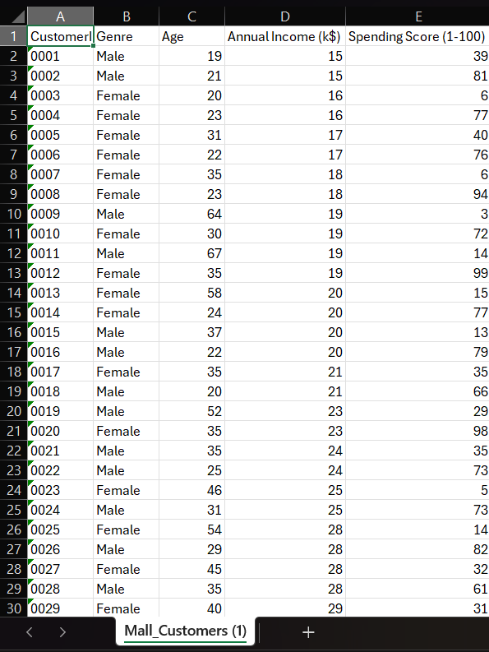
the mall based on customer spending behavior.
Purpose of the Dataset: The dataset is used to perform customer segmentation analysis. By examining the demographic and behavioral attributes of the customers, we aim to identify distinct groups of customers who exhibit similar purchasing behaviors. These insights will enable the retail store to develop targeted marketing strategies and enhance overall customer satisfaction.
Data Source: The dataset is publicly available and can be downloaded from Kaggle at the following link: Mall Customers Dataset on Kaggle.
Data Analysis and Segmentation: In this project, we will:
Clean the data to handle missing values and ensure consistency.
Perform Exploratory Data Analysis (EDA) to understand the distribution and relationships within the data.
Apply K-Means Clustering to segment customers into distinct groups.
Visualize the results using Matplotlib and Power BI to gain actionable insights.
Fig 1.1 Dataset

Slide 10
Chapter-2 Project Plan
TIMELINE:
Day 1:
Data Collection:
Identifying and Gathering Data Sources
Primary Data Source: Mall_Customers.csv
This dataset likely contains customer information such as demographics and purchasing behavior.
Ensure you have proper permissions to use this data for analysis.
Potential Additional Data Sources:
Transaction history data
Customer loyalty program data
Website browsing data (if applicable)
Social media data (if available and relevant)
Ensuring Suitable Data Format
Preferred Format: CSV (Comma-Separated Values)
Easy to read and process with various tools and libraries
Can be opened and edited in spreadsheet software if needed
Alternative Formats:
Excel (.xlsx) - Can be easily converted to CSV
JSON - Good for nested data structures
SQL database export - For larger datasets or when working with a database system
Data Collection Process
Locate the Data:
Identify where the Mall_Customers.csv file is stored (local drive, cloud storage, database, etc.)
Ensure you have the necessary access rights to retrieve the data

Slide 11
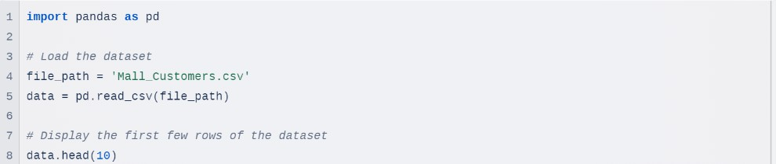
Verify Data Integrity:
Check the file size to ensure it's complete
Open the file in a text editor to verify it's not corrupted
Transfer the Data (if necessary):
If the data is on a remote server, use secure file transfer protocols (SFTP, SCP) to download it
If working in a cloud environment, ensure the data is in the correct storage bucket or directory
Document the Data Source:
Record the origin of the data
Note down any data dictionaries or metadata associated with the dataset
2. Data Cleaning:
Handling Missing Values
Missing values can significantly impact the analysis and modeling of datasets. Common strategies for handling them include:
Removal: Dropping rows or columns that contain missing values.
Imputation: Filling in missing values using statistical measures such as the mean, median, or mode. More advanced techniques like K-nearest neighbors (KNN) or Multiple Imputation by Chained Equations (MICE) can also be used.
Flagging: Creating a new feature that indicates whether a value was missing, allowing for further analysis.
Detecting and Removing Duplicates
Duplicate records can skew results, making it essential to identify and remove them. This involves:
Identifying Duplicates: Checking for rows that are identical across all or certain columns.
Removing Duplicates: Eliminating these duplicate rows to ensure each record is unique.

Slide 12
Correcting Inconsistencies and Handling Outliers
Inconsistent data can arise from various sources, while outliers can distort statistical analysis. Key steps include:
Inconsistencies: Standardizing formats across the dataset, such as date formats or categorical values (e.g., ensuring consistent naming conventions).
Outlier Detection: Identifying outliers using methods like the Z-score or Interquartile Range (IQR), and employing visualization techniques such as box plots to aid in detection.
Handling Outliers: Depending on the context, outliers can be removed or transformed to reduce their impact.
Normalizing or Standardizing Numerical Features
Normalization and standardization are crucial for algorithms that rely on the scale of data:
Normalization: Rescaling the data to a range of [0, 1] to ensure all features contribute equally.
Standardization: Centering the data around the mean with a unit standard deviation, which is particularly useful for algorithms sensitive to the scale of input data.
Additional Data Cleaning Steps
This encompasses various tasks to enhance data quality:
Correcting Data Types: Ensuring that each column has the appropriate data type (e.g., converting strings to dates).
Removing Irrelevant Features: Dropping columns that do not contribute to the analysis or
modeling efforts.
Feature Engineering: Creating new features based on existing data, which can provide additional insights or improve model performance.
Final Data Quality Check
After cleaning, it’s essential to perform a final check to ensure data quality. This includes:
Checking for Missing Values: Reviewing the dataset for any remaining missing values.
Checking for Duplicates: Confirming that there are no duplicate records left.
Summary Statistics: Analyzing summary statistics to understand the distribution and characteristics of the cleaned data.

Slide 13
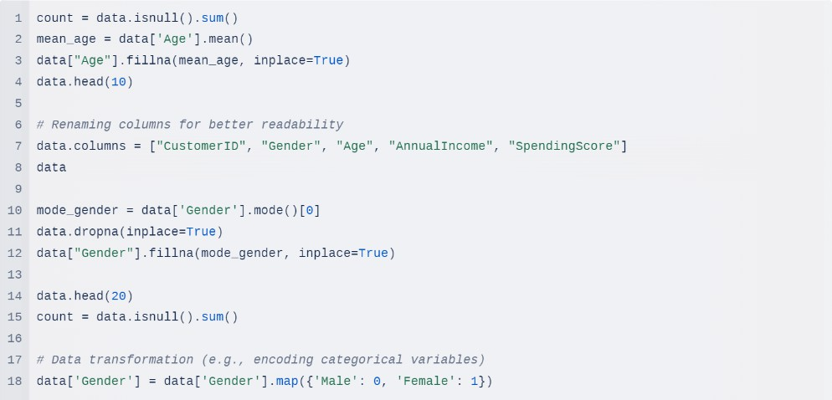
Day 2:
Exploratory Data Analysis (EDA):
Descriptive Statistical Analysis: Providing code to get a comprehensive summary of the dataset's main features.
Data Visualization:
Distribution of individual variables using histograms and count plots.
Relationships between variables using scatter plots, pair plots, and correlation heatmaps.
Identifying Key Trends, Patterns, and Anomalies: Guiding questions and code to analyze distributions and relationships in the data.
Formulating Hypotheses and Potential Segments: Suggesting potential customer segments based on the EDA and visualizing these potential segments.
Additional EDA Techniques:
Box plots for outlier detection
Violin plots for distribution comparison
Time series analysis (if applicable to your dataset)
Statistical Tests: An example of how to perform a t-test to compare spending scores between genders.

Slide 14
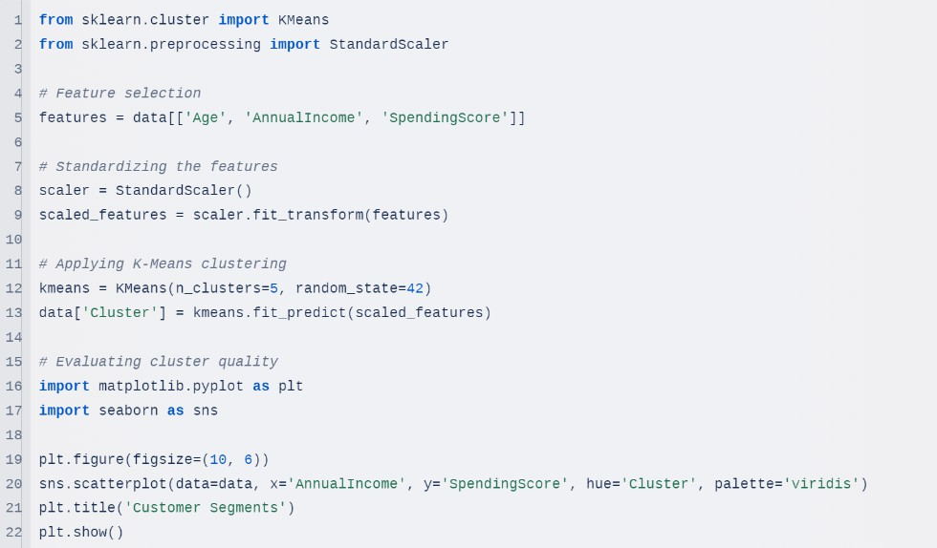
Clustering:
Select appropriate clustering algorithms (e.g., K-Means) for customer segmentation.
Determine the optimal number of clusters using methods like the elbow method or silhouette score.
Perform clustering on the dataset to group customers into distinct segments.
Validate the clustering results to ensure meaningful and actionable segments.
Example:
Day 3:
Visualization:
Create visualizations using Matplotlib and Seaborn to represent the characteristics of each customer segment.
Develop interactive dashboards in Power BI to allow stakeholders to explore segmentation results
dynamically.
Ensure visualizations are clear, insightful, and tailored to the needs of the audience.
Example:

Slide 15
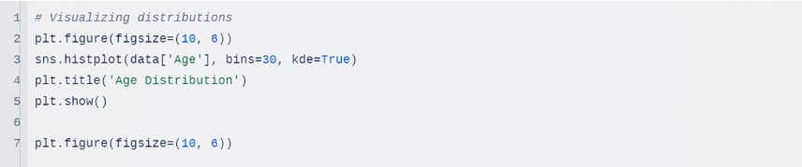
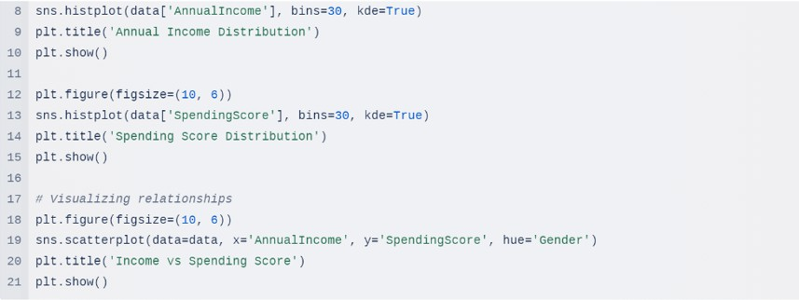
Documentation:
Compile a comprehensive report detailing the entire project, including objectives, methodology, results, and conclusions.
Document all steps taken during the data collection, cleaning, analysis, and clustering processes.
Include visualizations, charts, and insights derived from the analysis.
Provide recommendations based on the segmentation results and suggest future steps for the retail store.
Project Finalization, Resources, and Risks
Review and Finalize
The review and finalization phase is crucial for ensuring the project's success and delivering actionable insights to stakeholders.

Slide 16
Documentation Review
Compile all project documents, including:
Initial project proposal
Data cleaning methodology
EDA findings
Clustering methodology and results
Visualization scripts and outputs
- Ensure all documents are clear, concise, and free of technical jargon where possible.
2. Results Validation
Cross-validate clustering results with domain experts or business stakeholders.
Ensure that the identified customer segments align with business intuition and can inform actionable strategies.
Presentation Preparation
Create a compelling narrative that ties the technical work to business objectives.
Prepare a slide deck summarizing:
Project objectives
Methodology
Key findings
Customer segment profiles
Actionable recommendations
Develop talking points for each slide, anticipating potential questions from stakeholders.
4. Documentation Finalization
- Compile a comprehensive final report, including:
- Executive summary

Slide 17
Detailed methodology
Results and interpretations
Limitations of the analysis
Future recommendations
- Ensure all code is well-commented and stored in a version control system (e.g., Git).
5. Handover Preparation
Prepare handover documents for the team that will implement or act on your findings.
Create user guides for any tools or dashboards developed during the project.
Risks
Data Quality Issues
Risk: Incomplete or inaccurate data leading to misleading analysis and segmentation results.
Mitigation Strategies:
Conduct thorough data profiling at the start of the project
Implement robust data cleaning and validation processes
Use data quality metrics and set acceptable thresholds
Continuously monitor data quality throughout the project
Maintain open communication with data owners about any issues discovered
Algorithm Performance
Risk: Clustering algorithm may not perform well with the given data, leading to suboptimal segments.
Mitigation Strategies:
Experiment with multiple clustering algorithms (e.g., K-Means, Hierarchical Clustering, DBSCAN)
Use appropriate evaluation metrics (e.g., silhouette score, Calinski-Harabasz index)
Perform sensitivity analysis on algorithm parameters

Slide 18
Validate results with domain experts
Consider ensemble methods if single algorithms prove insufficient
Visualization Limitations
Risk: Static visualizations may not effectively convey insights to stakeholders.
Mitigation Strategies:
Develop interactive dashboards in Power BI for dynamic exploration
Use appropriate visualization types for different data and insights
Incorporate user feedback in dashboard design
Provide training to stakeholders on how to use and interpret the dashboards
Consider developing a web application for more complex interactive visualizations if Power BI is limiting
Scalability Issues
Risk: Analysis may not scale well with increasing data volume.
Mitigation Strategies:
Design data pipelines with scalability in mind
Use efficient algorithms and data structures
Consider cloud-based solutions for processing large datasets
Implement data sampling techniques for initial analysis and prototyping
Interpretability Challenges
Risk: Complex models or results may be difficult for stakeholders to understand and act upon.
Mitigation Strategies:
Focus on creating clear, business-oriented interpretations of technical results
Use visualization techniques to simplify complex relationships
Develop interactive tools that allow stakeholders to explore results at their own pace
Provide ongoing support and explanation to ensure proper understanding and application of insights
6. Changing Business Requirements

Slide 19
Risk: Business needs may evolve during the project, potentially invalidating some analysis.
Mitigation Strategies:
Maintain regular communication with stakeholders to stay aligned with business objectives
Design analysis pipelines to be modular and adaptable
Document assumptions and decision points throughout the project
Build flexibility into the project timeline to accommodate potential pivots
By thoroughly addressing these aspects of project finalization, resource management, and risk mitigation, you'll be well-prepared to deliver a successful customer segmentation project that provides actionable insights and value to your retail store.
Chapter-3
Technical Requirements Document
Data Sources:
Mall Customers Dataset:
The Mall_Customers.csv dataset is a comprehensive collection of data pertaining to customers who frequent a retail establishment. This dataset encompasses several key attributes, including:
Customer ID: A unique identifier for each customer, facilitating easy tracking and analysis.
Gender: This attribute categorizes customers as male or female, providing insights into gender-based preferences and behaviors.
Age: Age data helps in understanding the demographic distribution of customers, which can influence
marketing strategies.
Annual Income: This financial metric indicates the economic capacity of customers, allowing for segmentation based on spending potential.
Spending Score: A score assigned based on various factors, reflecting the customer’s purchasing
behavior and loyalty.

Slide 20
The data can be sourced from the store's internal management systems or obtained from publicly available datasets that represent a diverse range of mall customers. This dataset serves as the foundational basis for conducting customer segmentation analysis, providing essential insights into customer behavior and preferences, which are crucial for targeted marketing and improved service delivery.
Technologies:
Python:
Python is leveraged as the primary programming language for all aspects of data manipulation, analysis, and machine learning within this project. Its extensive libraries, such as Pandas, NumPy, and Scikit- learn, coupled with its versatility, make it an ideal choice for handling complex data tasks efficiently.
Google Colab:
Google Colab is an online platform that facilitates the execution of Jupyter notebooks in a collaborative
environment. It provides access to powerful computational resources, such as GPUs, which significantly enhance the efficiency of data analysis and model development processes.
Jupyter Notebook:
Jupyter Notebooks serve as an interactive environment where data analysis and modeling steps can be documented and executed. This platform allows for the seamless integration of code, visualizations, and explanatory text, making the analysis process more transparent and reproducible.
Pandas:
Pandas is a robust data manipulation library in Python that is essential for data cleaning, preprocessing,
and analysis. It provides flexible data structures, such as DataFrames, which are indispensable for handling structured data and performing complex data operations.
NumPy:
NumPy is a foundational package for scientific computing in Python, utilized for numerical operations and array manipulations. It supports large multi-dimensional arrays and matrices, making it a vital tool for mathematical computations and data analysis.

Slide 21
Matplotlib:
Matplotlib is a versatile plotting library that enables the creation of static, animated, and interactive visualizations in Python. It is instrumental in generating detailed plots that help in understanding data distributions and relationships, enhancing the interpretability of results.
Seaborn:
Seaborn is a statistical data visualization library built on top of Matplotlib. It simplifies the creation of
complex plots and provides a high-level interface for drawing attractive and informative statistical graphics, making it easier to convey insights from the data.
Scikit-learn:
Scikit-learn is a comprehensive machine learning library in Python that offers simple and efficient tools for data mining and analysis. It includes various algorithms, such as K-Means clustering, which is pivotal for segmenting customers into distinct groups based on their purchasing behavior and attributes.
Power BI:
Power BI is a powerful business analytics tool that enables the creation of interactive dashboards and
reports. It allows users to visualize and share insights derived from the customer segmentation analysis, making the findings accessible to stakeholders and facilitating data-driven decision-making.
Architecture:
The project architecture is designed to follow a structured approach, encompassing data preprocessing, exploratory data analysis (EDA), customer segmentation, and visualization. The key components of the architecture include:
1. Data Ingestion:
- Import data from various sources, such as CSV files and databases, into a Jupyter Notebook or Google Colab for subsequent analysis.
2. Data Preprocessing:
- Clean the data by addressing missing values, removing duplicates, and correcting inconsistencies to ensure high data quality.

Slide 22
Normalize or standardize numerical features to ensure comparability across different scales, which is crucial for effective clustering.
Encode categorical variables into numerical formats when necessary, preparing the data for analysis.
Exploratory Data Analysis (EDA):
Conduct descriptive statistics to understand the distribution and central tendencies of the data.
Utilize visualizations (e.g., histograms, box plots, scatter plots) to uncover patterns, correlations, and anomalies within the dataset.
Formulate preliminary hypotheses regarding potential customer segments based on insights gained
from EDA findings.
Customer Segmentation:
Implement clustering algorithms, particularly K-Means, to group customers into distinct segments based on their purchasing behavior and other relevant attributes.
Evaluate the optimal number of clusters using techniques such as the elbow method or silhouette
score to ensure the resulting segments are meaningful and actionable.
Interpret the characteristics of each segment to understand the unique traits and behaviors of customers within each group.
Visualization:
Generate static visualizations using Matplotlib and Seaborn to represent the characteristics of each customer segment, including cluster profiles and segment distributions.
Develop interactive dashboards in Power BI to enable dynamic exploration of customer segments,
allowing users to filter and delve into specific segments for deeper insights.
Data Flow:
The data flow diagram outlines the sequential steps taken to transform raw customer data into actionable insights through segmentation and visualization:
1. Import Data:
- Load the customer dataset (Mall_Customers.csv) into the analysis environment (e.g., Jupyter Notebook, Google Colab).

Slide 23
2. Clean Data:
- Preprocess the data to ensure quality and consistency, which includes handling missing values, removing duplicates, and normalizing numerical features.
3. Analyze Data:
- Conduct EDA to gain initial insights and understand underlying patterns within the data. Use visualizations to explore data distributions and relationships.
Segment Customers:
Apply clustering algorithms, specifically K-Means, to segment customers into distinct groups based on their purchasing behavior and other relevant attributes.
Validate the clustering results and interpret the characteristics of each segment to derive actionable insights.
Visualize Results:
Create visual representations of the customer segments using Matplotlib and Seaborn for enhanced interpretability.
Develop interactive dashboards in Power BI, allowing stakeholders to dynamically explore the segmentation results and extract actionable insights.
By leveraging these technologies and adhering to a structured architecture, the project aims to deliver comprehensive customer segmentation insights that can inform targeted marketing strategies, enhance customer satisfaction, and ultimately improve sales performance.

Slide 24
Chapter-4 Project Implementation
Methodology
The Methodology section details the step-by-step approach taken to achieve the project objectives, including data collection, preprocessing, exploratory data analysis, clustering, and visualization.
Steps Taken:
Data Collection:
Gathered the Mall_Customers.csv dataset containing attributes such as customer ID, gender, age, annual income, and spending score.
Data Preprocessing:
Cleaned the data by handling missing values, removing duplicates, and correcting inconsistencies.
Normalized numerical features to ensure they were on a comparable scale.
Exploratory Data Analysis (EDA):
Performed descriptive statistical analysis to understand the distribution and characteristics of the data.
Used visualizations to identify key trends, patterns, and anomalies.
Customer Segmentation:
Applied the K-Means clustering algorithm to segment customers into distinct groups.
Determined the optimal number of clusters using methods such as the elbow method and silhouette score.
Validated the clustering results to ensure meaningful and actionable segments.
Visualization:
Created static visualizations using Matplotlib and Seaborn to represent the characteristics of each customer segment.
Developed interactive dashboards in Power BI to enable stakeholders to explore
segmentation results dynamically.

Slide 25
”” "Final call Custome segmentation. ipyi,b
Automaticalły generated by Colab.
Original *ile is located at
imoort paudas as pd
filegath = 'Mall Customers.csv'
data = pd.read_csv(file_path)
data . head(16)
count=data.ismull().sum()
mean age=data['Age'].meam()
data[”Age”).fillna(mean age,inplace=True)
data . head(16)
= P7-:li›’Ș fl i ’5 íl- L.t.T’ P:Fr.ili..’
data.columns = ["C ustomerID", "Gender", "Age", "Am,ualImcome ", "SpeudimgScore"]
I data
mode ender=data['Gender'j.mode()[oj
tyoe(mode euder)
mode euder
data.dropua(inplace=T’ue)
data[”Gende ”].fi1lna(mode gender,inplace= roe)
data.head(2u)
count=data.isnull().sum()
count
data[ ’ Gende ’ ] = data [ ' Gender ' ] . nap({ ' Inta Te ’ : 0, ' Fenałe ’ : 1} )
count=data.isuull().sum()
count
"' " '*T he C leaned Dat a set”* " " ”
I data
I " ” " EDA” ” "
data .descnibe( )
data.info()
data. shape
data.columns.tolist()
data.isnull().sum()
data.nunique()
'"t Visualizations"””
import paudas as pd
import matplotlíb.pyplot as pit
inport seaborn a s sns
sn s . set( style=”\'ihi legs i d”)

Slide 26
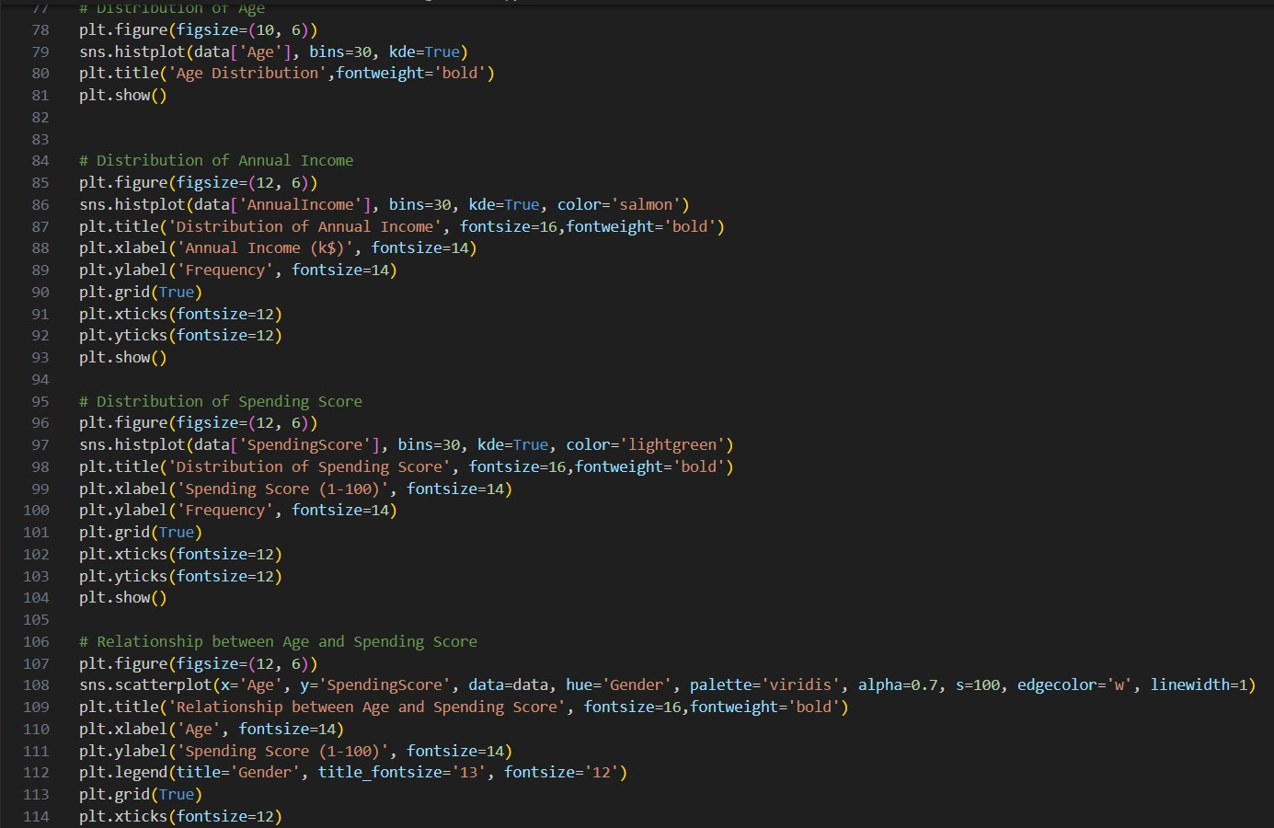
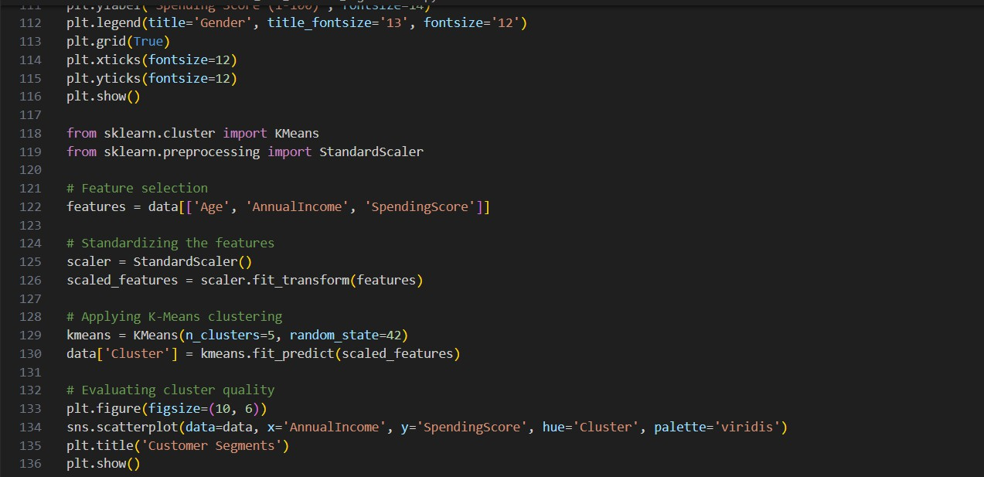

Slide 27
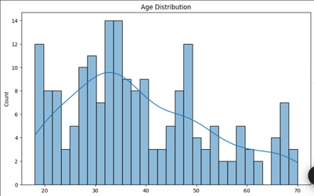
Results
The Results section presents the findings from the data analysis and clustering process, highlighting the key characteristics and insights for each customer segment.

Slide 28
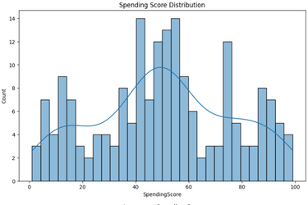
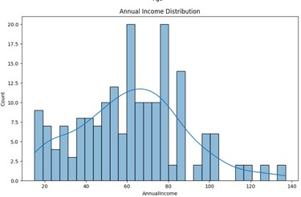
Additional Charts:
Supplementary visualizations providing deeper insights into customer segments and behaviors.

Slide 29
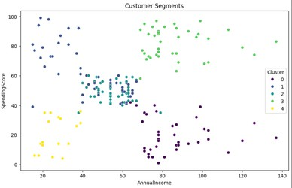

Slide 30
Chapter : 5 Conclusion and Insights report
Findings from Data Analysis and Segmentation:
Identified Distinct Customer Segments: Based on age, annual income, and spending score, we identified several distinct customer segments.
Segment 1: Younger customers with high annual incomes and high spending scores (high spenders).
Segment 2: Middle-aged customers with moderate annual incomes and moderate spending scores.
Segment 3: Older customers with lower annual incomes and lower spending scores (budget-conscious shoppers).
Segment 4: Mixed age group with high annual incomes but moderate spending scores (potential loyal customers).
Segment 5: Diverse age group with varying incomes and high spending scores.
Visualizations and Dashboards: Provided clear and actionable insights into the composition and behavior of each customer segment through static and interactive visualizations.
Key Insights:
1. Customer Segments and Their Characteristics:
Segment 1: High Spenders
Younger customers High annual incomes High spending scores
Segment 2: Moderate Spenders Middle-aged customers
Moderate annual incomes Moderate spending scores

Slide 31
Segment 3: Budget-Conscious Shoppers
Older customers
Lower annual incomes Lower spending scores Segment 4: Potential Loyal Customers
Mixed age group High annual incomes
Moderate spending scores
Segment 5: Diverse High Spenders
Diverse age group
Varying incomes
High spending scores
2. Variations in Customer Behavior:
Customer segments demonstrated significant variations in age, income, and spending behavior.
High spenders were generally younger with higher annual incomes, indicating a preference for luxury and premium products. Budget-conscious shoppers were more diverse in age but had lower incomes, reflecting a focus on cost-effective purchases.
3. Marketing Strategy Implications:
Understanding these segments allows for the creation of targeted marketing strategies that cater specifically to the needs and preferences of each group.
Tailoring marketing efforts can lead to increased customer satisfaction, loyalty, and overall sales performance.

Slide 32
Recommendations:
Develop Targeted Marketing Campaigns: Segment-Specific Strategies:
High Spenders: Focus on luxury and premium product promotions, exclusive events, and personalized experiences to maintain their high spending behavior.
Moderate Spenders: Offer value-for-money promotions, loyalty programs, and mid-range product recommendations to encourage consistent spending.
Budget-Conscious Shoppers: Highlight discounts, bundle offers, and cost-effective product options to attract price-sensitive customers.
Potential Loyal Customers: Develop loyalty incentives and personalized communication to nurture long-term relationships and increase spending.
Diverse High Spenders: Utilize a mix of premium and value-based promotions to cater to their varied preferences and increase engagement.
1. Personalize Promotions and Offers:
Use the insights from the segmentation analysis to tailor promotions and offers for different customer segments.
Implement personalized marketing techniques such as targeted emails, customized recommendations, and personalized advertisements.
Ensure that promotions resonate with the specific interests and needs of each segment to maximize their effectiveness.
2. Monitor and Update Segments:
Continuously monitor customer behavior and spending patterns to keep segments updated and relevant.
Use real-time data and analytics to track changes in customer preferences, market trends, and external factors influencing purchasing behavior.
Regularly revisit and refine segmentation criteria to adapt to evolving customer needs and market conditions.

Slide 33
Implement feedback mechanisms to gather insights from customers directly, ensuring that marketing strategies remain customer- centric and effective.
Implementation Plan:
1. Data-Driven Approach:
Establish a robust data collection and analysis system to continuously gather customer data and monitor trends. Utilize advanced analytics tools to process and interpret customer data for timely and actionable insights.
2. Cross-Functional Collaboration:
Engage various departments, including marketing, sales, and customer service, to ensure a unified approach to implementing targeted strategies.
Foster collaboration and communication across teams to align objectives and share insights.
3. Technology Integration:
Leverage CRM systems, marketing automation tools, and AI-driven analytics platforms to streamline the execution of personalized campaigns.
Implement interactive dashboards and visualization tools to enable dynamic exploration and understanding of customer segments.
By leveraging these key insights and implementing the recommendations, the retail store can enhance its marketing efforts, improve customer satisfaction, and achieve higher sales performance. Understanding and catering to the unique needs of each customer segment will foster stronger customer relationships and drive business growth.

Slide 34
Chapter: 6
References and Future Scope
References:
Mall Customers data.csv: The dataset used for analysis.
Libraries Used: Python, Pandas, NumPy, Matplotlib, Seaborn, Scikit-learn, Power BI, Google Colab.
Online Websites:
W3schools, link: https://www.w3schools.com/python/python_ml_k-means.asp
JavaTpoint , link: https://www.javatpoint.com/k-means-clustering-algorithm-in-machine- learning
Future Scope:
Advanced Segmentation Techniques
-Behavioral Segmentation: Moving beyond basic demographic segmentation to include behavior- based models that analyze purchase history, browsing patterns, and customer engagement.
Real-Time Segmentation: Implementing real-time data processing to dynamically adjust customer segments based on recent interactions and data inputs.
Clustering Algorithms: Using more advanced clustering algorithms like DBSCAN, Gaussian Mixture Models, or deep learning-based clustering for more nuanced segmentation.
Personalization and Targeting
Personalized Marketing: Using the segmented data to develop personalized marketing strategies, including tailored promotions, product recommendations, and targeted advertisements.
Customer Experience Management: Enhancing the customer experience by personalizing in-store experiences, such as customized store layouts, product placements, and personalized customer service interactions.

Slide 35
Integration with Other Data Sources
Social Media and Online Behavior: Integrating mall data with online behavior data from social media platforms to provide a holistic view of customer preferences and trends.
Cross-Selling Opportunities: Analyzing data from other retail locations or e-commerce platforms to identify cross-selling and up-selling opportunities.
Data Visualization Enhancements
Interactive Dashboards: Developing interactive dashboards that allow stakeholders to explore customer segments dynamically, drill down into specific data points, and visualize trends over time.
Predictive Visualizations: Incorporating predictive analytics into visualizations to forecast customer behavior and segment growth, helping in strategic decision-making.
Geospatial Visualization:Implementing geospatial analysis to visualize where different customer segments are located within the mall or across various malls, optimizing marketing efforts and resource allocation.
AI and Automation
Automated Segmentation Updates: Automating the segmentation process so that it continually updates as new data comes in, reducing manual effort and ensuring accuracy.
AI-Driven Insights: Leveraging AI to identify hidden patterns in customer behavior that may not be apparent through traditional analysis methods, providing deeper insights into customer needs.
6. Ethical and Privacy Considerations
-Privacy-Preserving Techniques:Implementing techniques like differential privacy to ensure customer data is protected while still allowing for meaningful segmentation and analysis.
- Ethical AI:Ensuring that the segmentation process does not lead to discriminatory practices, and that it is used to enhance customer satisfaction rather than exploit vulnerabilities.

Slide 36
Longitudinal Analysis
Trend Analysis Over Time : Analyzing how customer segments evolve over time, which can inform mall management about shifting demographics, preferences, and behaviors.
Impact of External Factors: Studying how external factors like economic changes, seasonal trends, or global events impact different customer segments.
ross-Sector Applications
Broader Retail Applications:Extending the segmentation model to other retail environments, such as e-commerce, supermarkets, or even service-based industries like banking or hospitality.
Consultancy and SaaS Products: Developing consultancy services or SaaS products that offer segmentation and visualization tools to other malls or retail businesses.
Customer Retention Strategies
Loyalty Programs: Designing and implementing loyalty programs based on segmentation insights, aiming to improve customer retention and lifetime value.
Churn Prediction: Using segmentation data to predict which customers are likely to churn and developing strategies to retain them.
By continuously enhancing the model, incorporating new data sources, and applying advanced techniques, the project can evolve from basic customer segmentation to a comprehensive tool that drives significant business value.

