Slide 1

CSE322
Formal Languages and Automation Theory
Lecture #0

Slide 2
Course Details
CSE322
LTP – 3 0 0 [Three lectures/week]
Credit- 3

Slide 3
Vision
To be a globally recognized school through excellence in teaching, learning and research for creating Computer Science professionals, leaders and entrepreneurs of future contributing to society and industry for sustainable growth.

Slide 4
Mission
To build computational skills through hands-on and practice-based learning with measurable outcomes.
To establish a strong connect with industry for in-demand technology driven curriculum.
To build the infrastructure for meaningful research around societal problems.
To nurture future leaders through research-infused education and lifelong learning.
To create smart and ethical professionals and entrepreneurs who are recognized globally

Slide 5
Course Outcomes
Understand Concepts and Abstractions for Automata as a Fundamental Computational Model
Understand algebraic formalisms of languages such asregular expressions, context-free grammar.
Compare different types of Grammars and design context free grammars for formal languages
Analyze the properties and structure of context-free languages
Understand the construction of Push Down Automata, including closure properties and their relationship with parsing techniques.
Understand algorithms and computability through the lens of Turing machines and relationship between various computational models.

Slide 6
Program Outcomes
PO1::Apply the knowledge of mathematics, science, engineering fundamentals, and an engineering specialization to the solution of complex engineering problems.
PO2::Identify, formulate, review research literature, and analyse complex engineering problems reaching substantiated conclusions using first principles of mathematics, natural sciences and engineering sciences.
PO3::Design solutions for complex engineering problems and design system components or processes that meet the specified needs with appropriate consideration for the public health and safety, and the cultural, societal, and environmental considerations.
PO4::Use research-based knowledge and research methods including design of experiments, analysis and interpretation of data, and synthesis of the information to provide valid conclusions.

Slide 7
Program Outcomes
PO5::Create, select, and apply appropriate techniques, resources, and modern engineering and IT tools including prediction and modelling to complex engineering activities with an understanding of the limitations.
PO6::Apply reasoning informed by the contextual knowledge to assess societal, health, safety, legal and cultural issues and the consequent responsibilities relevant to the professional engineering practice.
PO7::Understand the impact of the professional engineering solutions in societal and environmental contexts, and demonstrate the knowledge of, and need for sustainable development
PO8::Apply ethical principles and commit to professional ethics and responsibilities and norms of the engineering practice.

Slide 8
Program Outcomes
PO9::Function effectively as an individual, and as a member or leader in diverse teams, and in multidisciplinary settings
PO10::Communicate effectively on complex engineering activities with the engineering community and with society at large, such as, being able to comprehend and write effective reports and design documentation, make effective presentations, and give and receive clear instructions.
PO11::Demonstrate knowledge and understanding of the engineering and management principles and apply these to one’s own work, as a member and leader in a team, to manage projects and in multidisciplinary environments.
PO12::Recognize the need for, and have the preparation and ability to engage in independent and lifelong learning in the broadest context of technological change.

Slide 9
Program Specific Outcome
PSO1: Apply acquired skills in software engineering, networking, security, databases, intelligent systems, cloud computing and operating systems to adapt and deploy innovative software solutions for diverse applications.
PSO2: Apply diverse IT skills to design, develop, and evaluate innovative solutions for business environments, considering risks, and utilizing interdisciplinary knowledge for efficient real-time projects benefiting society.

Slide 10
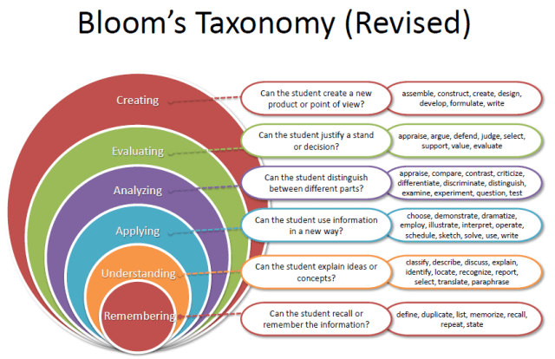
Revised Bloom’s Taxonomy

Slide 11
Course Contents
Unit 1 FINITE AUTOMATA: Definition and Description of a Finite Automaton, Deterministic and Non deterministic Finite State Machines, Transition Systems and Properties of Transition Functions, Acceptability of a String by a Finite Automaton, The Equivalence of DFA and NDFA, Mealy and Moore Machines, Minimization of Finite Automata, Basics of Strings and Alphabets, Transition Graph and Properties of Transition Functions, Regular Languages, The Equivalence of Deterministic and Non deterministic Finite Automata
Unit 2 REGULAR EXPRESSIONS AND REGULAR SETS : Regular Expressions and Identities for Regular Expressions, Finite Automata and Regular Expressions: Transition System Containing null moves, NDFA with null moves and Regular Expressions, Conversion of Non-deterministic Systems to Deterministic Systems, Algebraic Methods using Arden's Theorem, Construction of Finite Automata Equivalent to a Regular Expression, Equivalence of Two Finite Automata and Two Regular Expressions, Closure Properties of Regular Sets, Pumping Lemma for Regular Sets and its Application, Equivalence between regular languages: Construction of Finite Automata Equivalent to a Regular Expression, Properties of Regular Languages, Non-deterministic Finite Automata with Null Moves and Regular Expressions, Myhill-Nerode Theorem

Slide 12
Course Contents
Unit 3 FORMAL LANGUAGES : Derivations and the Language Generated by a
Grammar, Definition of a Grammar, Chomsky Classification of Languages, Languages and their Relation, Recursive and Recursively Enumerable Sets, Languages and Automata, Chomsky hierarchy of Languages REGULAR GRAMMARS
: Regular Sets and Regular Grammars, Converting Regular Expressions to Regular
Grammars, Converting Regular Grammars to Regular Expressions
Unit 4 CONTEXT- FREE LANGUAGES : Ambiguity in CFG, Leftmost and rightmost derivations, Language of a CFG, Sentential forms, Applications of CFG, Pumping Lemma for CFG, Derivations Generated by a Grammar, Construction of Reduced Grammars, Elimination of null and unit productions, Normal Forms for CFG: Chomsky Normal Form SIMPLIFICATION OF CONTEXT- FREE GRAMMARS :
Construction of Reduced Grammars, Greibach Normal Form

Slide 13
Course Contents
Unit 5: PUSHDOWN AUTOMATA AND PARSING : Description and Model of
Pushdown Automata, Representation of PDA, Acceptance by PDA, Pushdown Automata: NDPDA and DPDA, Context free languages and PDA, Pushdown Automata and Context-Free Languages, Comparison of deterministic and non- deterministic versions, closure properties, LL (k) Grammars and its Properties, LR(k) Grammars and its Properties, PARSING: Top-Down and Bottom-Up Parsing
Unit 6: TURING MACHINES AND COMPLEXITY : Turing Machine Model, Representation of Turing Machines, Design of Turing Machines, The Model of Linear Bounded Automaton, Power of LBA, Variations of TM, Non-Deterministic Turing Machines, Halting Problem of Turing Machine, Post Correspondence Problem, Basic Concepts of Computability, Decidable and Undecidable languages, RECURSIVELY ENUMERABLE LANGUAGE, Computational Complexity: Measuring Time & Space Complexity, Power of Linear Bounded Automaton, Variations of Turing Machine, Cellular automaton

Slide 14
Course Assessment Model
>=90% -- 5 marks
>=85% and <90% -- 4 marks
>=80% and <85% -- 3 marks
>=75% and <80% -- 2 marks
Each CA would be of 30 marks. Best 2 would be taken at the end (60 marks) which would be prorated out of 20
Marks break up
Attendance 5
CA(Best 2out of 3) 20
MTE 25
ETE 50
Total 100
MTE would be of 40 marks and it would be prorated to 25 at the end
ETE would be of 70 marks and it would be prorated to 50 at the end

Slide 15
Course Assessment Model
Marks break up
Attendance
CA(Best 2out of 3)
5
25
20
50
100
MTE
ETE
Total

Slide 16
Detail of Academic Tasks
AT1:Test1 (MCQ based)
(Before MTE)
Lecture #11
AT2:Test2(MCQ based)
(Before MTE)
Lecture #19
AT3:Test3(MCQ based)
(After MTE)
Lecture #33

Slide 17
Cohort
Government jobs
Higher studies

Slide 18
SkillSet
Analytical Thinking
Problem-Solving
Programming Skills

Slide 19
Blended Learning
Hands-On Exercises: Implement hands-on sessions where students use software tools to model and simulate automata and formal languages.
Software: Tools like JFLAP can be used for practical exercises.

Slide 20
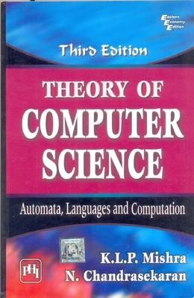
Text /Reference Book
Text Book
Theory of Computer Science: Automata, Languages and Computation
Author: KLP Mishra and N. Chandrasekaran

Slide 21
MOOCS Details
Course Name :Introduction to Automata, Languages and Computation
Details:
Category :Computer Science and Engineering
Credit Points :3
Link:https://onlinecourses.nptel.ac.in/noc24_cs71/preview
Organization :- Swayam
Academic Benefits : All ATs will be exempted

Slide 22
OER(Open Education Resource)
Course Code | Course Title | Unit mapped | Broad topic | OER Type | Title of OER | *%age unit mapped with OER (approx) | Source URL
CSE322 Formal Languages and Automation Theory |  | Unit 1 | FINITE AUTOMATA | Reading material (Pdf ) | CSE322 | 80% | https://www.seas.upenn.edu/~cis2620/notes/cis262sl1-aut.pdf
 |  | Unit 2 | REGULAR EXPRESSIO NS AND REGULAR SETS | Reading material (Pdf ) | CSE322 | 80% | https://www.seas.upenn.edu/~cis2620/notes/cis262sl1-aut.pdf
 |  | Unit 3 | FORMAL LANGUAGE S | -- | CSE322 | 70% | https://www.cs.colostate.edu/~massey/Teaching/cs301/RestrictedAccess/Slides/301lecture05.pdf

Slide 23
OER(Open Education Resource)
Course Code | Course Title | Unit mapped | Broad topic | OER Type | Title of OER | *%age unit mapped with OER (approx) | Source URL
CSE322 Formal Languages and Automation Theory |  | Unit 4 | CONTEXT- FREE LANGUAGE S | -- | CSE322 | 90% | https://www3.cs.stonybrook.edu/~pramod.ganapathi/doc/theory-of-computation/ContextFreeGrammars.pdf
 |  | Unit 5 | PUSHDOWN AUTOMATA AND PARSING | -- | CSE322 | 90% | https://www3.cs.stonybrook.edu/~pramod.ganapathi/doc/theory-of-computation/ContextFreeGrammars.pdf
 |  | Unit 6 | TURING MACHINES AND COMPLEXITY | -- | CSE322 | 70% | https://www3.cs.stonybrook.edu/~pramod.ganapathi/doc/theory-of-computation/TuringMachines.pdf

Slide 24
Main Perspective
The main perspectives are:
Why are we learning Automata Theory?
What would we do with it?

Slide 25

Why Study Automata Theory?

Slide 26
..contd..
Automata theory tells very important equivalence between
a language: some -- usually -- infinite set of strings
a grammar: the finite set of rules to generate that language
an automaton: the abstract processing device that can recognize that language

Slide 27
..contd..
Automata theory is the study of abstract computational devices
Abstract devices are (simplified) models of real computations
Computations happen everywhere: On your laptop, on your cell phone, in nature, …
Why do we need abstract models?

Slide 28
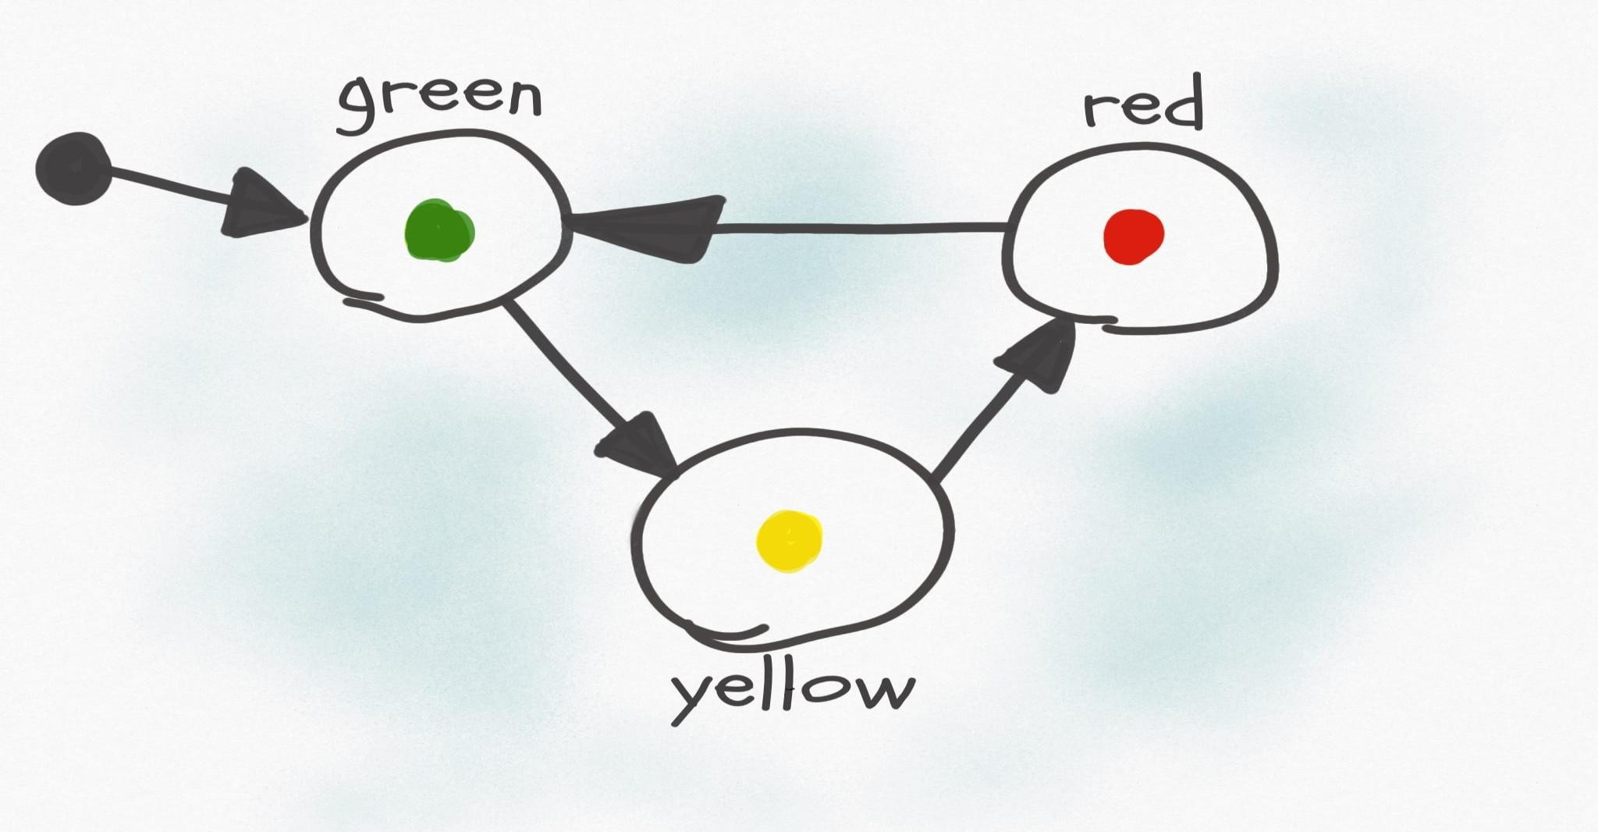
..contd..

Slide 29
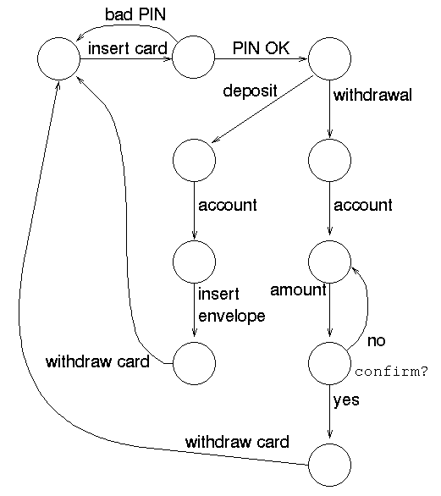
..contd..

Slide 30
..contd..
Such devices are difficult to reason about, because they can be designed in an infinite number of ways
By representing them as abstract computational devices, or automata, we will learn how to answer such questions

Slide 31
What would we do with it ?
There are numerous applications of Formal languages and Automata Theory like:
Text processing, Compilers and Hardware Design
Motors and Vending machines
Sensors and Transducers
Automata Simulators
And many more ….

Slide 32
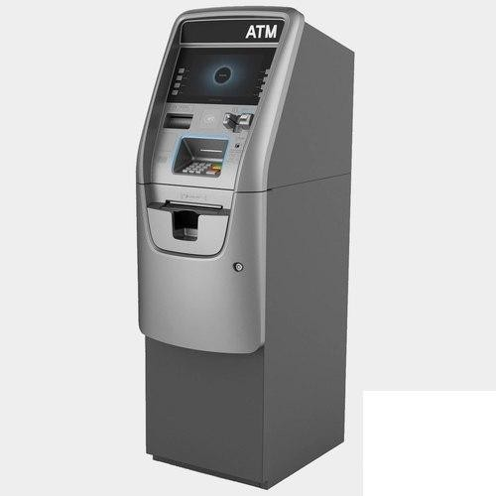
ATM MACHINE

Slide 33
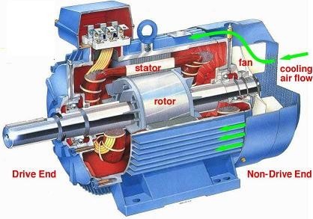
Motor

Slide 34
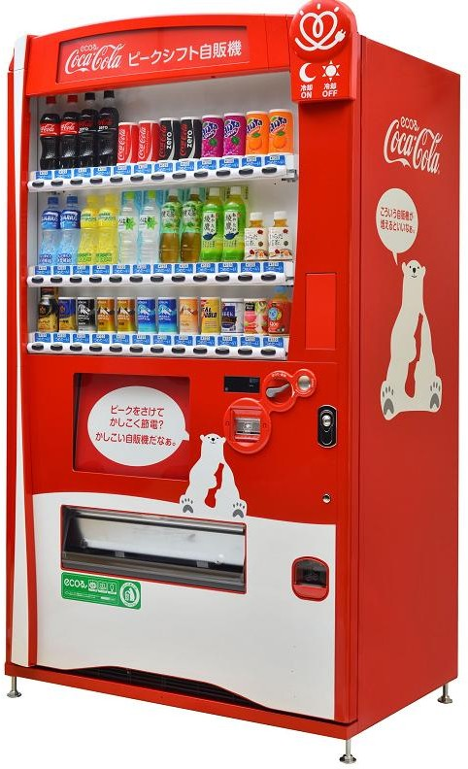
Vending machine

Slide 35
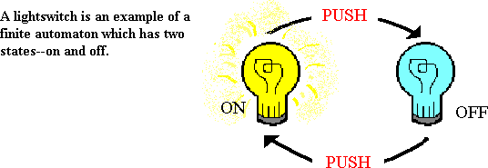
UNIT 1: Finite Automata

Slide 36
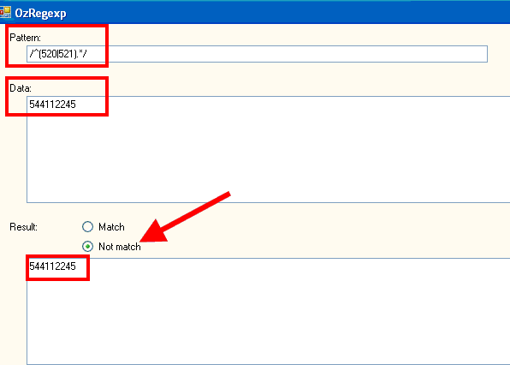
UNIT 2: Regular Expressions and Regular Sets

Slide 37
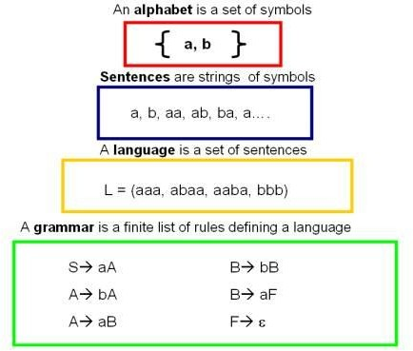
UNIT 3: Formal Languages & Regular Grammar

Slide 38
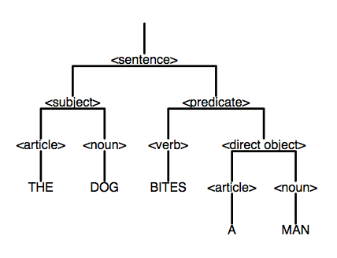
UNIT 4: Context Free languages and Simplification of context free grammar

Slide 39

UNIT 5:Push Down Automata & Parsing

Slide 40
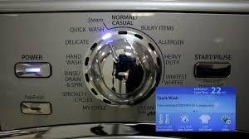
UNIT 6: Turing Machine and Complexity

Slide 41

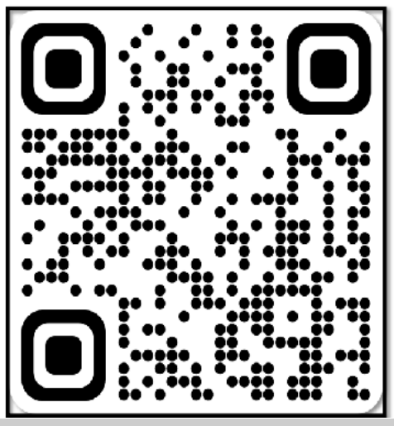
Zero Lecture - Feedback

Slide 42

Follow this for getting instant solution for your Academic queries:

Slide 43
Next Class : Finite Automata

