Slide 1
Σχεδιασμός και Υλοποίηση Γεννήτριας Χωροχρονικών Δεδομένων Μεγάλου Όγκου για Αποτίμηση Υπηρεσιών Κοινωνικής Δικτύωσης
Διπλωματική Εργασία
Θάλεια-Δήμητρα Δούδαλη
Notes:
<number>
<number>

Slide 2
Thesis contribution
Design and implementation of a parameterized generator of spatio-temporal and textual social media data
Creation of a large dataset using the generator
Storage of the dataset into an Hbase distributed database system
Scalability testing of the Hbase cluster

Slide 3
Motivation
Era of Big Data
Polymorphic social media data
Transition to distributed storage and processing tools
Limited access to such data due to privacy restrictions
Restricted evaluation of distributed data management tools

Slide 4
Generator
Spatio-temporal and textual data
Users of social networking service
Daily Check-ins to Points of Interest leaving a review and rating
GPS traces indicating the routes
Static Map representation

Slide 5
Source Data
Real Points of Interest crawled from TripAdvisor
136409 points = 13 GB JSON file
Storage in PostgreSQL
PostGIS extension offers functions and indexes for geographic data types

Slide 6
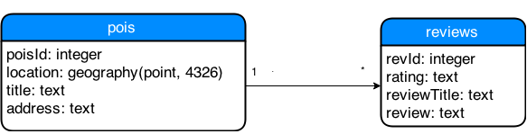
Source data schema

Slide 7
Input Parameters
userIdStart, userIdEnd
startTime, endTime
startDate, endDate
dist, maxDist
chkNumMean, chkNumStDev
chkDurMean, chkDurDev

Slide 8
Implementation
Check-ins:
Number of daily check-ins defined using a gauss distribution
First ever check-in = home location
First check-in randomly chosen using uniform distribution
It should be in maxDist range from home
Rest check-ins of the day should be in walking distance (parameter dist)
Assign random rating and review using uniform distribution

Slide 9
Implementation
Path between check-ins:
Google Directions API
JSON response file containing the path and duration
Encoded polyline representation of the path
Extracted geographical points as GPS traces

Slide 10
Implementation
Timestamps:
First check-in of the day → startTime
Duration of each visit → Gauss distribution
Time of next check-in = time of previous one + duration of visit + duration of walk
Should not exceed endTime
GPS trace timestamp = splitted walk duration

Slide 11
Implementation
Trips:
Travel location equivalent to home
Available travel days = 10% (endDate – startDate)
Trip duration = Gauss with μ = 5 and σ = 2
Decision to start trip → coin toss every day

Slide 12
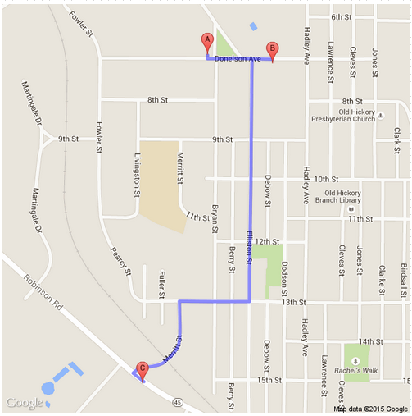
Static Map

Slide 13
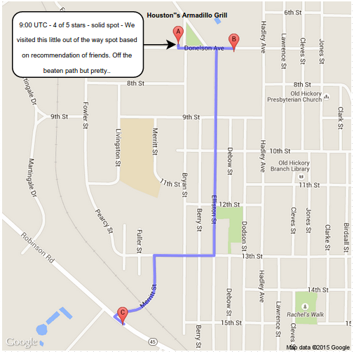
Static Map

Slide 14
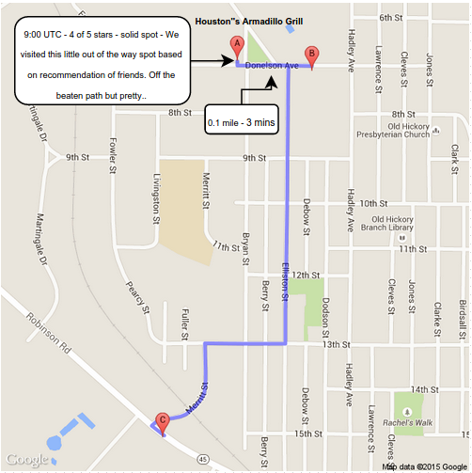
Static Map

Slide 15
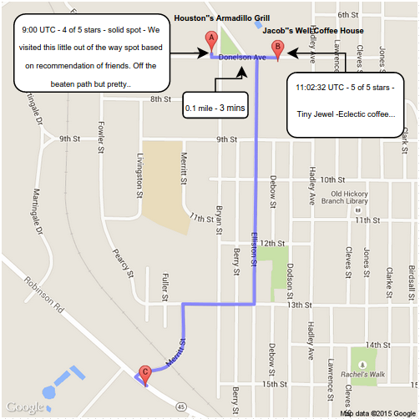
Static Map

Slide 16
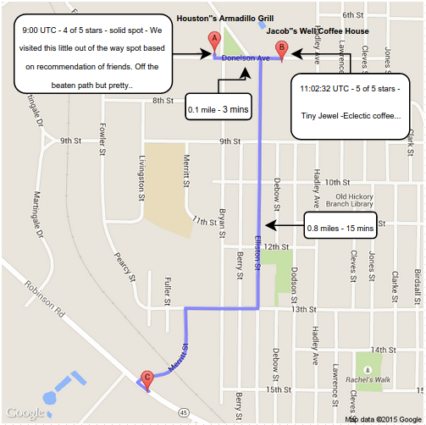
Static Map

Slide 17
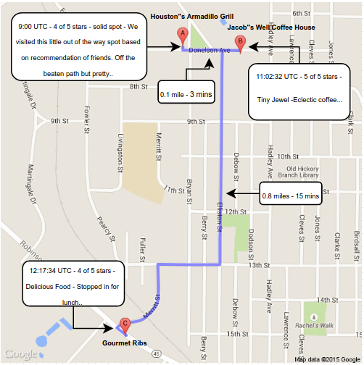
Static Map

Slide 18
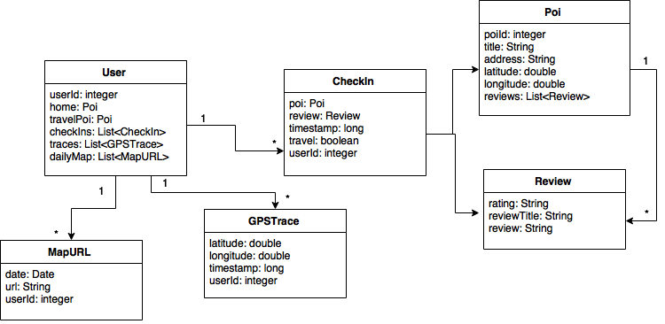
Generator Attributes

Slide 19
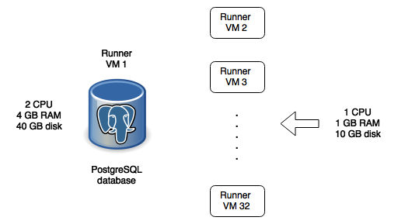
Generator Deployment Setup

Slide 20
Execution Input Parameters
chkNumMean = 5 chkNumStDev = 2
chkDurMean = 2 chkDurStDev = 0.1
maxDist = 50000.0 dist = 500.0
startTime = 9 endTime = 23
startDate = 01-01-2015 endDate = 03-01-2015

Slide 21
Generated Dataset
9464 users with 2 months daily routes
1,586,537 check-ins → 641 MB
38,800,019 GPS traces → 2.4 GB
Added a 14 GB twitter friend graph

Slide 22
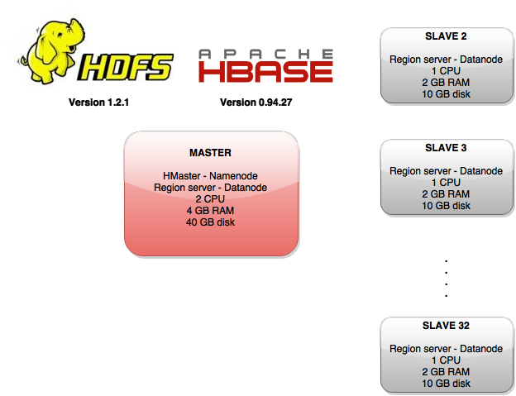
HBase cluster

Slide 23
HBase data model
Friends table
Row: user id
Column Qualifier: friend user id
Cell Value: friend user id
Check-ins table
Row: user id
Column Qualifier: timestamp
Cell Value: check-in data
GPS traces table’
Row: user id
Column Qualifier: “lat long timestamp”
Cell Value: GPS trace data

Slide 24
Queries
Get the most visited points of interest of a certain user’s friends
Get the check-ins of all the friends of a specific user for a certain day into chronological order (News Feed)
Get the number of times that a user’s friends have visited the user’s most visited POI
Implemented using HBase coprocessors on data balanced region servers

Slide 25

Workload generation setup

Slide 26
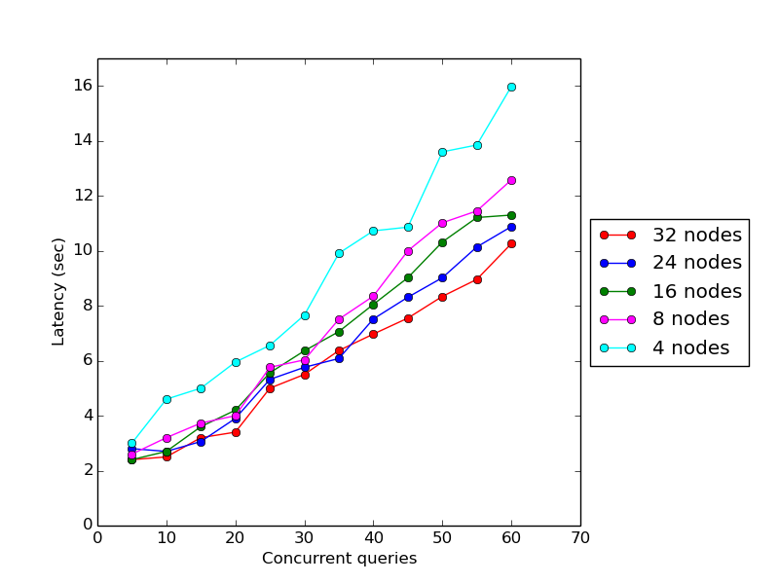
Scalability Testing

Slide 27
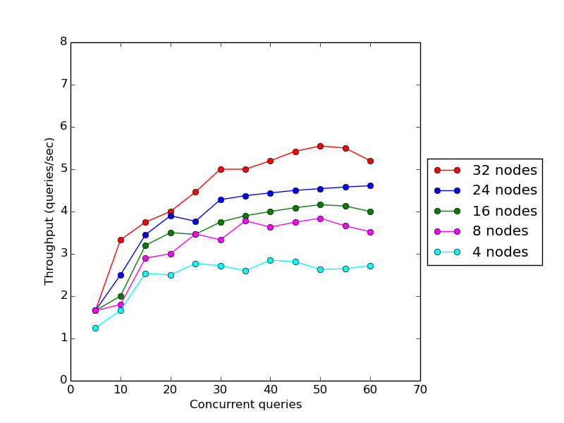
Scalability Testing

Slide 28
Conclusion
HBase cluster is scalable for the specific data storage model of the dataset produced by the generator
HBase provides indeed good performance and data management tools for Big Data social networking services

Slide 29

Questions

