Slide 1

Mini iCARE
Dr. Thalia Rodriguez
23 July 2025

Slide 2
The task given
Create a dashboard that takes a university URL, scrapes admissions info, processes it with basic NLP, stores it in a database, and displays it in a searchable table.
Implemented:
Developed a crawler to start from the main university page, navigate to undergraduate admissions, then follow links to relevant subpages
Built functions to extract required data such as application deadlines, course lists, and course details
Implemented a data storage pipeline using SQLite with structured tables
Created an interactive Streamlit dashboard to display and filter the extracted data

Slide 3
UniversityScraper
is a modular Python tool that crawls university websites to locate and extract key undergraduate information—such as courses, requirements, deadlines, and scholarships—by navigating between relevant pages using heuristic rules and HTML parsing.
PROS:
Modular Design: Functions are cleanly separated, making the code easier to read, maintain, and extend
Fallback Logic: Use of multiple heuristics and fallback strategies (e.g. checking headers, paragraph content, keyword matching) to improve robustness.
Filtering: filtering of URLs to avoid irrelevant sections like "postgraduate", "clearing", or "research".
CONS:
Testing: The code currently lacks formal unit and integration tests
Rule-Based NLP: the implementation relies in keyword and pattern matching, rather than NLP models or libraries (like spaCy, transformers, etc.)

Slide 4
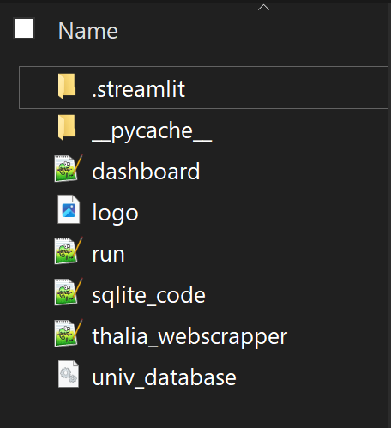
The dashboard either extracts data from the database or triggers the scraper.
If triggered, the scraper runs functions in thalia_webscraper to crawl and collect data, then uses sqlite_code functions to save it.
For data exploration, Streamlit offers a manual interface without requiring SQL, though the backend relies on SQL.

Slide 5













BA Accounting url
BA Acting url
Courses: name, degree, offer level, UCAS code,..
BA English url
Courses url
Deadlines: university, entry year, date, action
Deadlines url
University url
UniversityScraper
University undergrad
url
Requirements url
University database
sqlite
Universities: name, url, undergrad url, scholarship url, requirements url
Scholarships url
5

Slide 6

CURRENT SCHEMA
Courses:
id PRIMARY KEY AUTOINCREMENT, univ_name, course_name, course_url, degree, hons, offer_level, ucas_code, course_length, start_date, location, deadline_apply, FOREIGN KEY (univ_name) REFERENCES universities(univ_name)
Deadlines:
id PRIMARY KEY AUTOINCREMENT, univ_name, entry_year, date, action, FOREIGN KEY (univ_name) REFERENCES universities(univ_name)
University database
sqlite
Universities:
University_name PRIMARY KEY, university_url, undergrad_url, scholarship_url, requirements_url

Slide 7
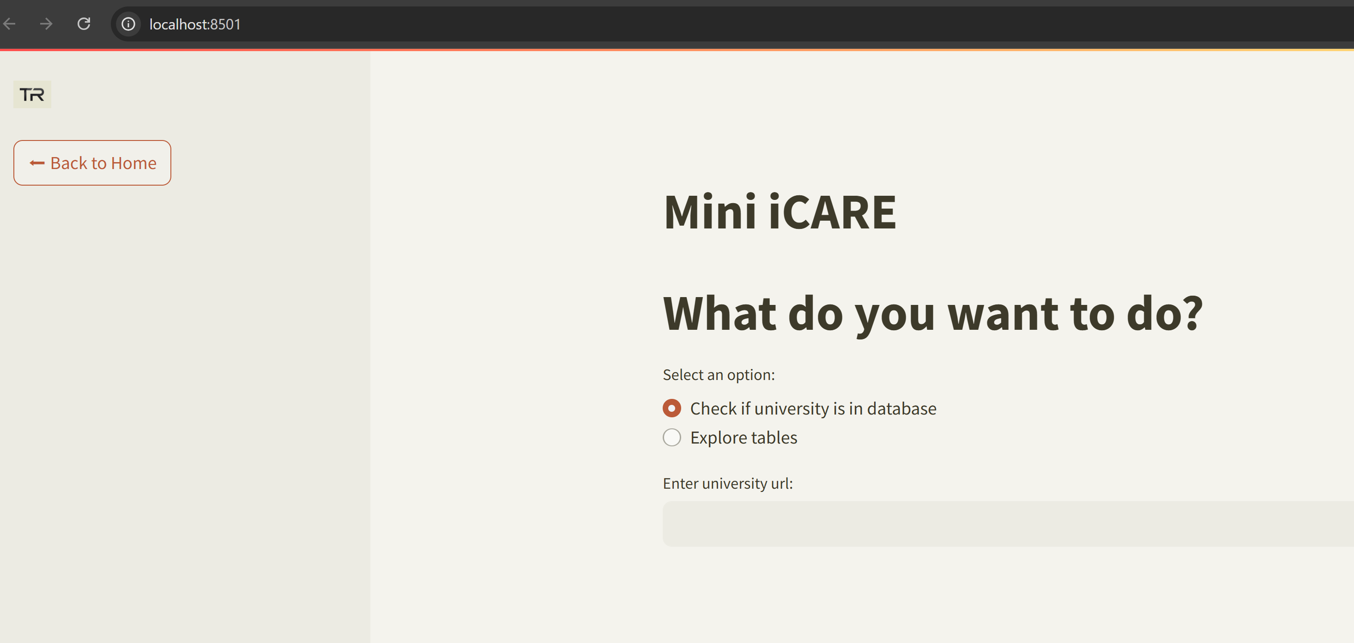
Homepage starts with options:

Slide 8
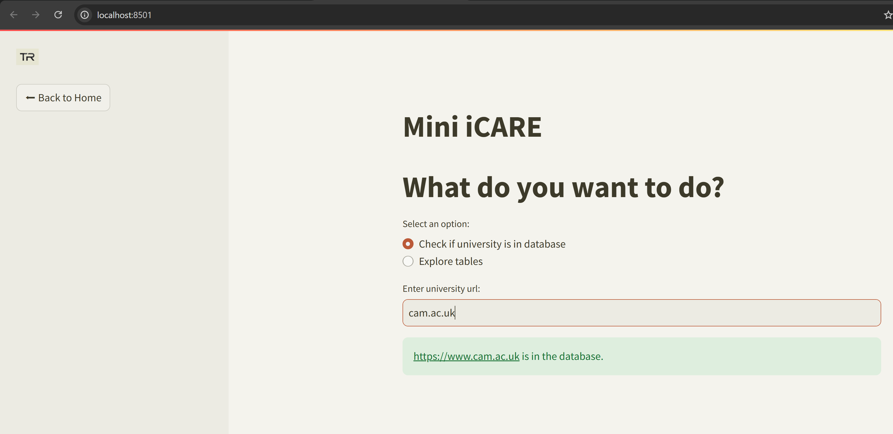
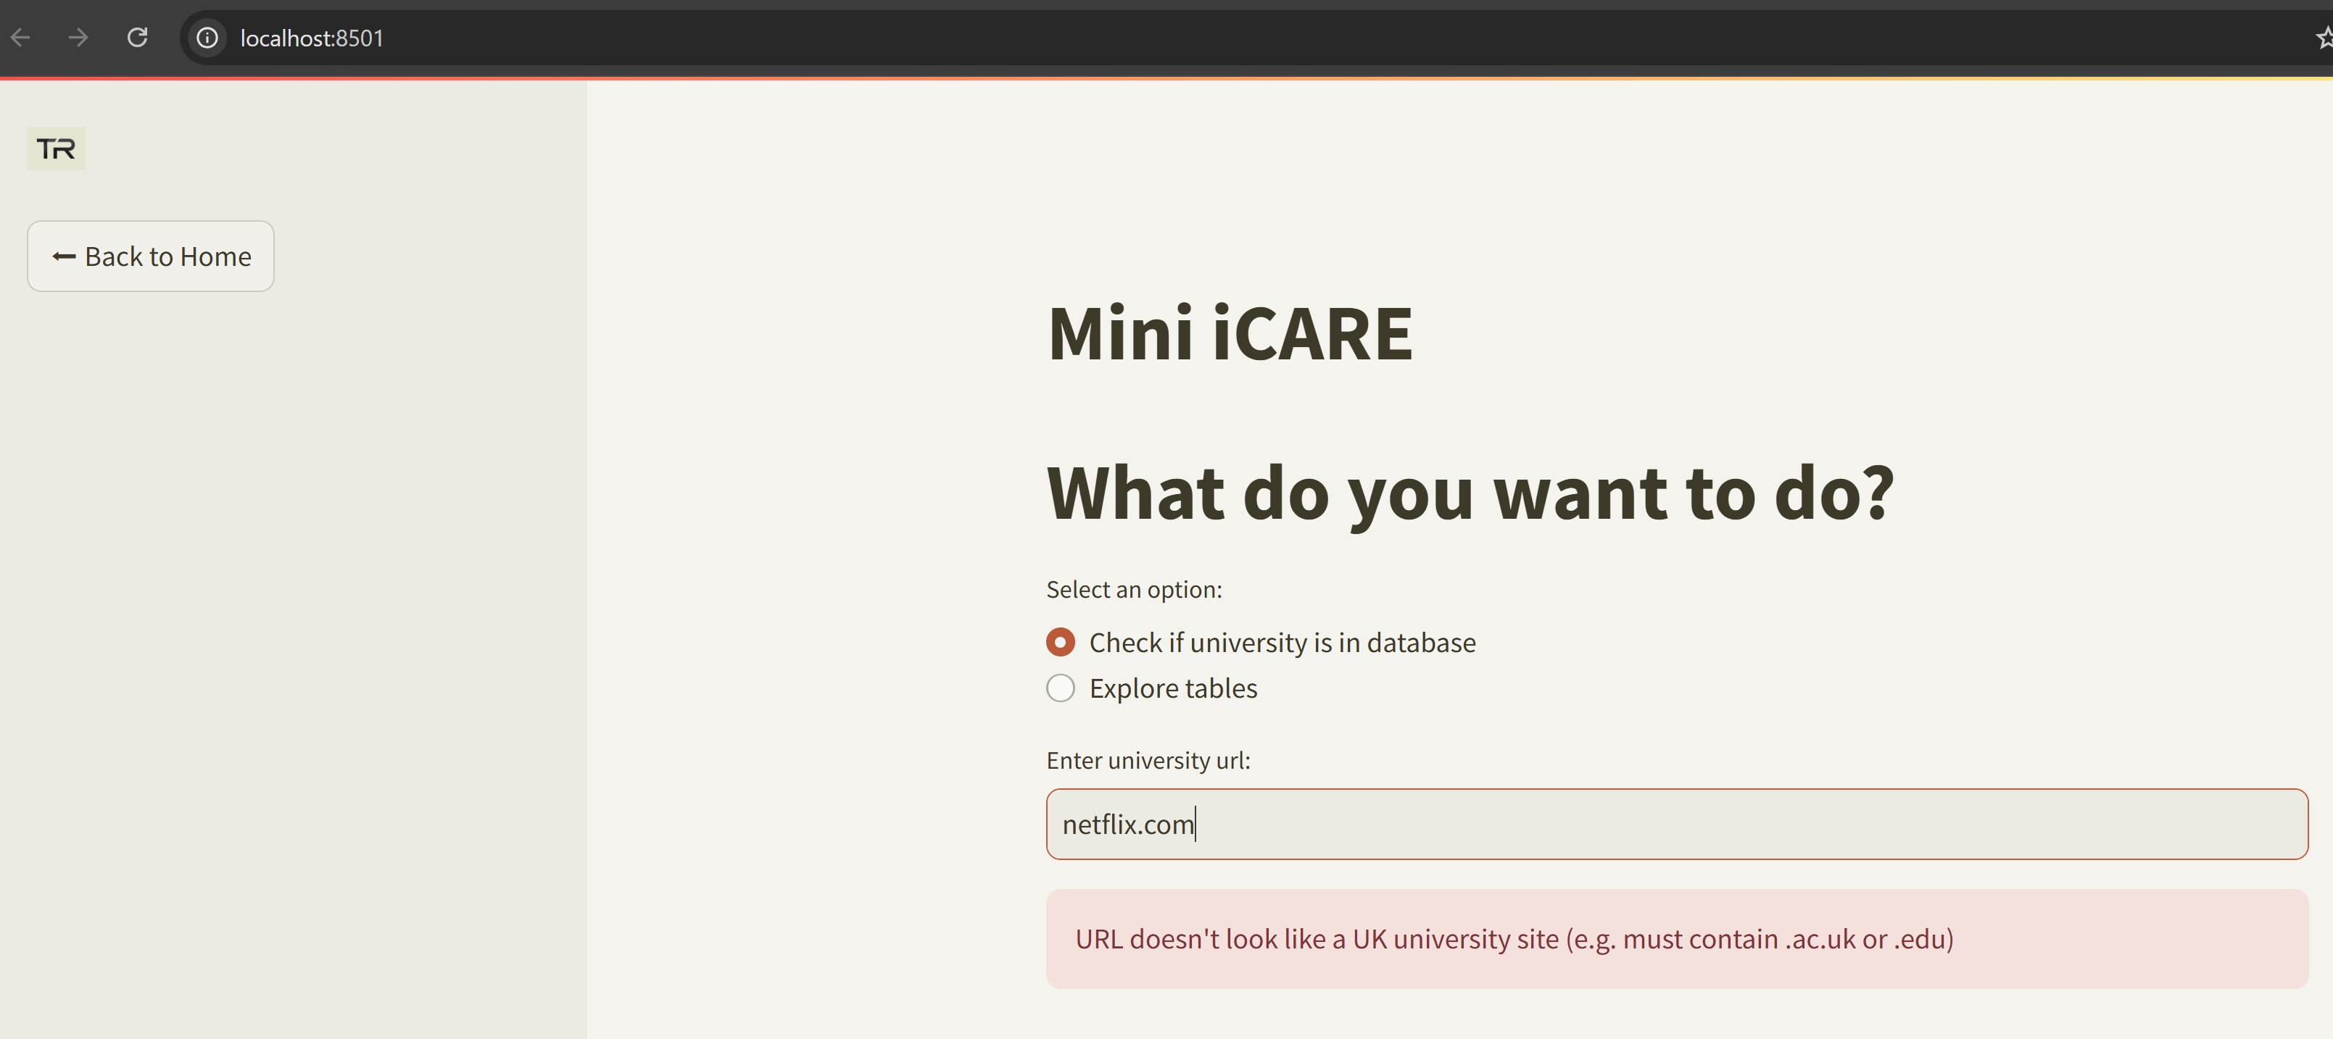
Checks if url in database, also if url is valid

Slide 9
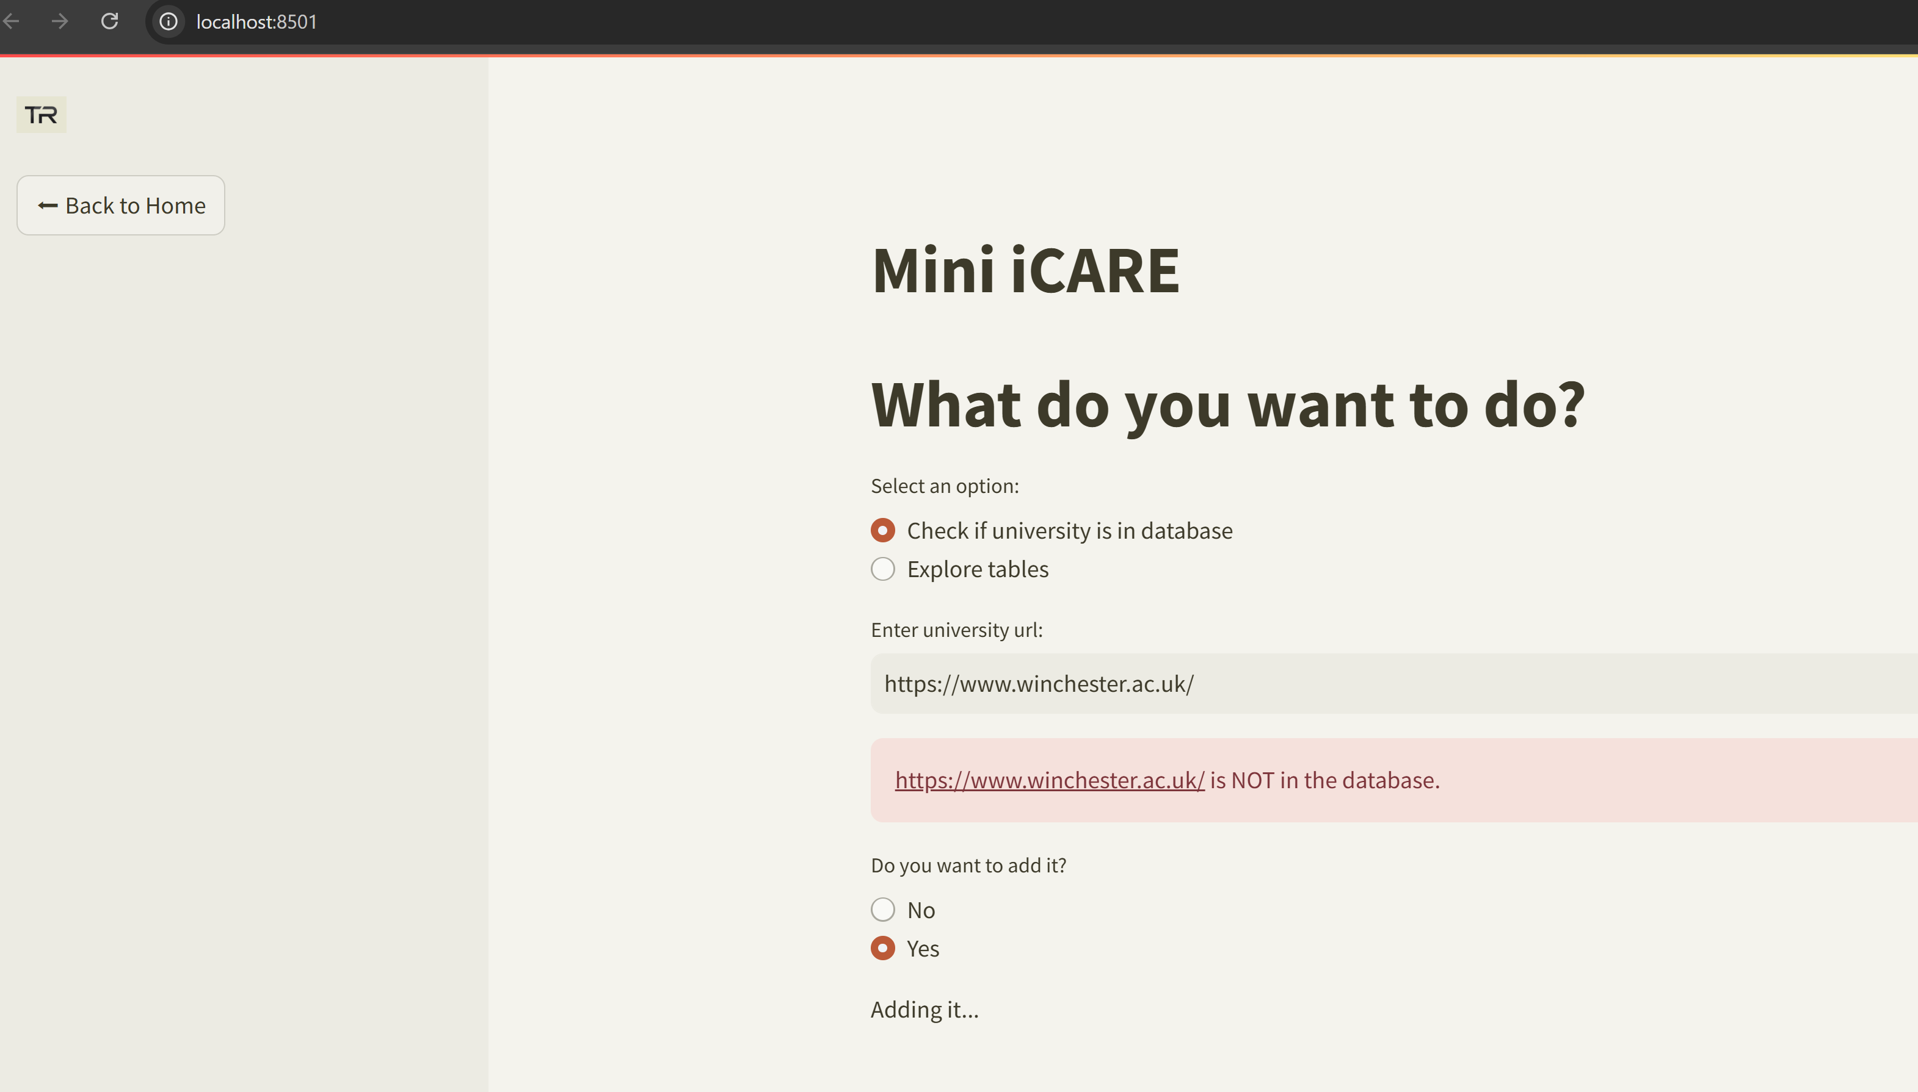
If university is not in database option to run the webscraper will run and data will be sent to tables

Slide 10
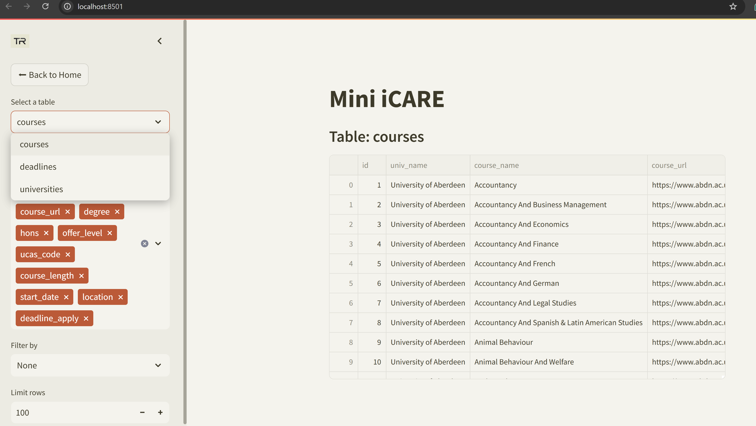
We can explore current tables

Slide 11
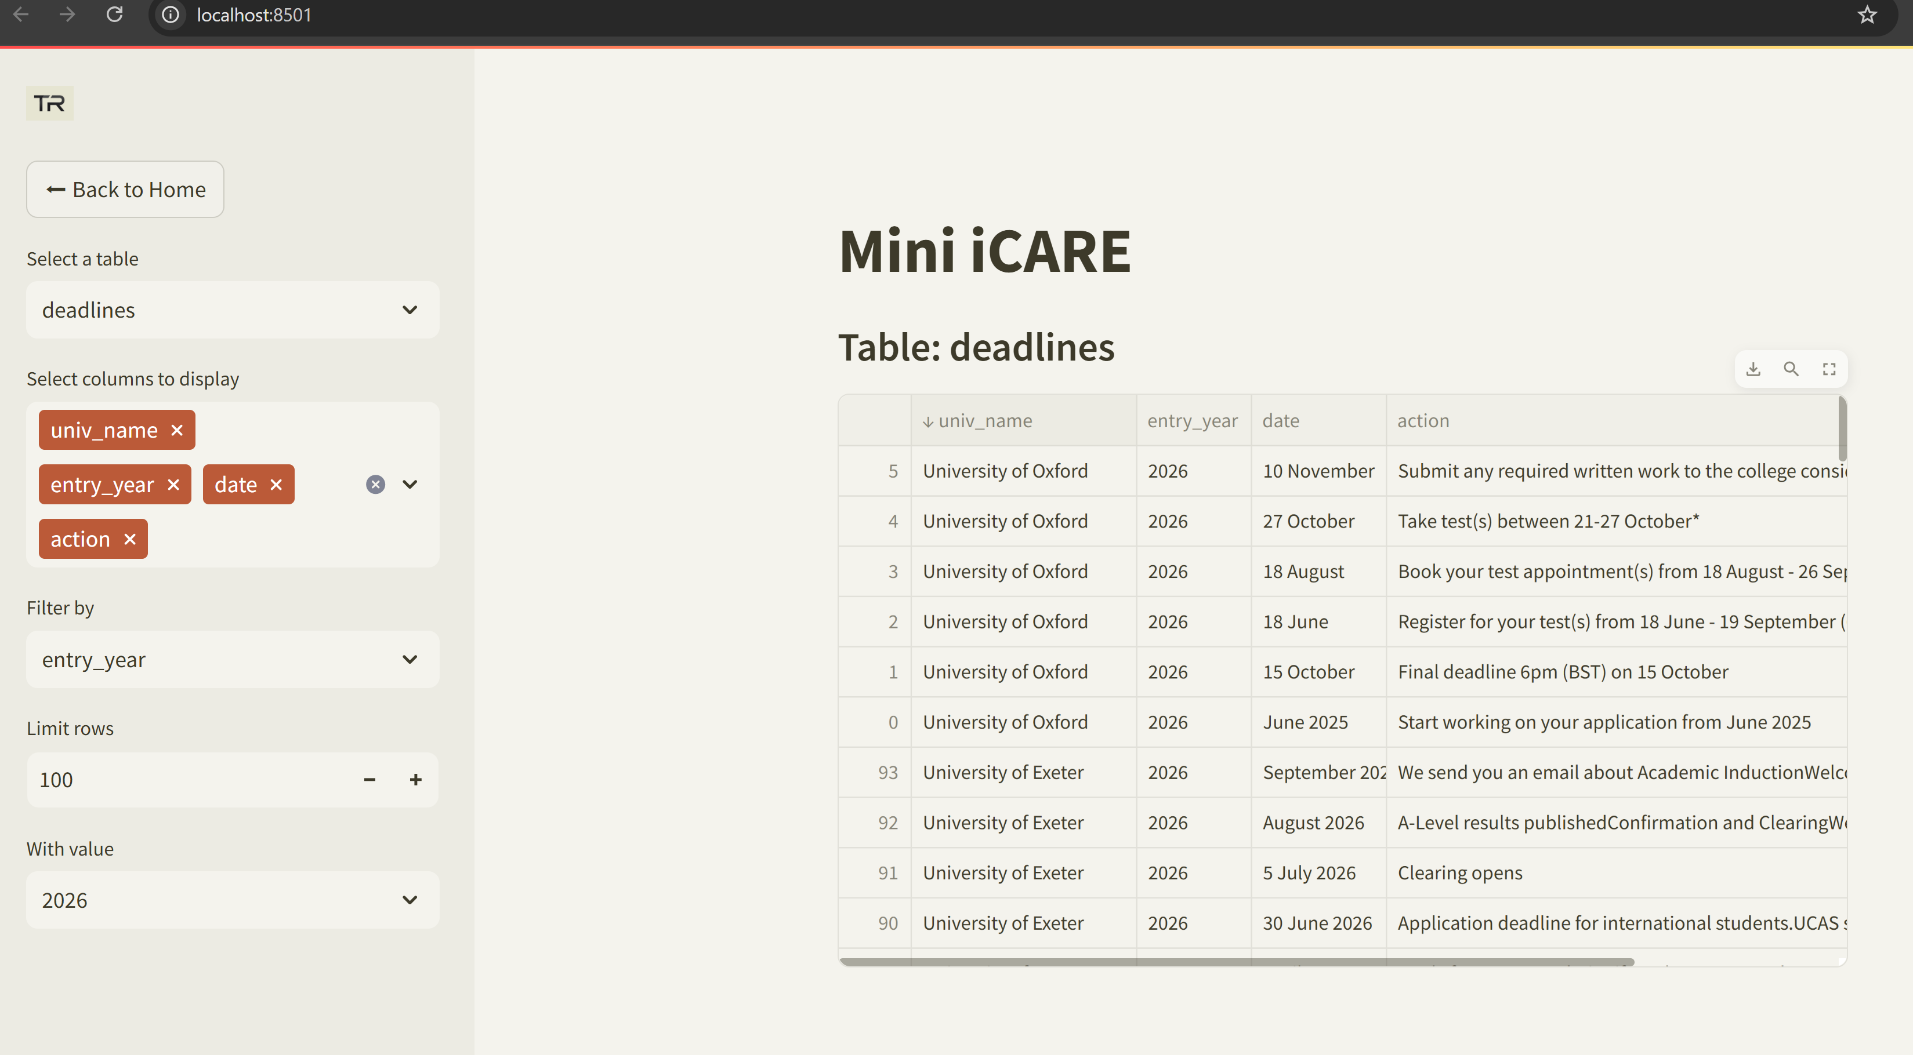
You can sort tables with cursor in streamlit
Select columns
Column to filter Value to use with filter
Number of rows

Slide 12
Thank you! Questions?
The project demonstrates a modular and efficient web scraping system integrated with a user-friendly dashboard, enabling seamless data collection, storage, and exploration without requiring technical expertise.
Future improvements could include enhanced test coverage and more advanced NLP.

