Slide 1
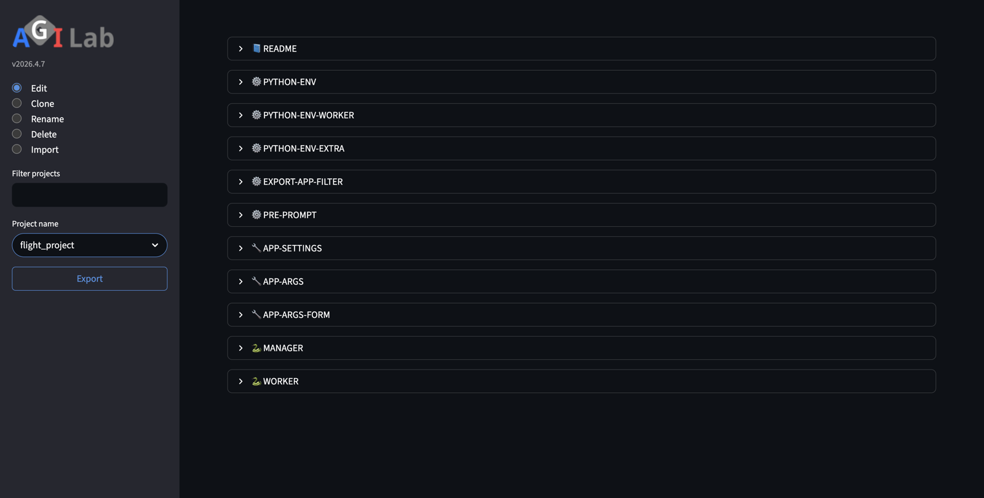
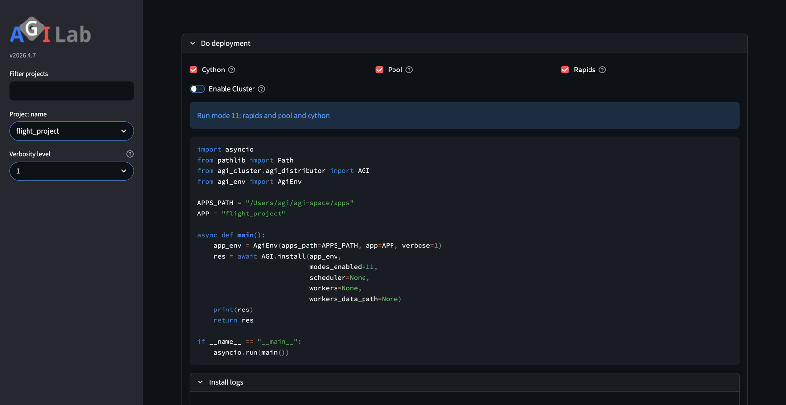
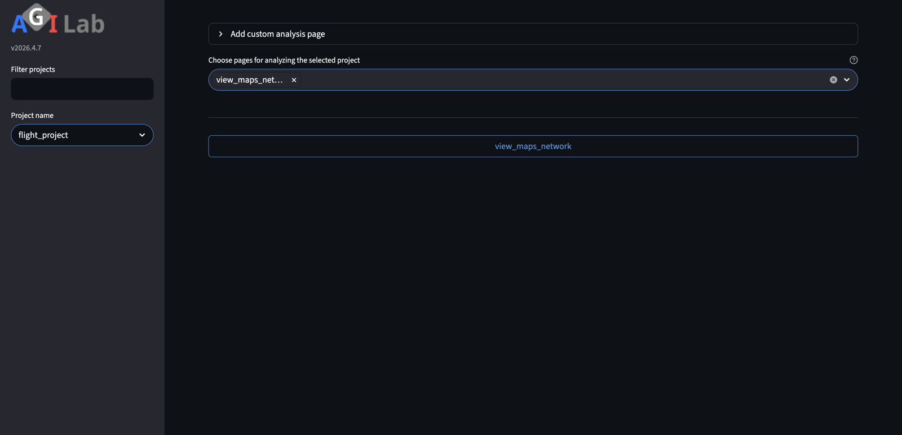
NEWCOMER-SAFE PROOF
AGILAB First Proof
Slideshow companion for the newcomer-safe `flight_project` story
PROJECT
1
2
3
ORCHESTRATE
One app
Stay on `flight_project` and keep the first story narrow.
One path
Use PROJECT, then ORCHESTRATE, without side-shell glue.
One result
End on visible evidence in ANALYSIS rather than raw logs.
Select the built-in app and keep its context visible.
ANALYSIS
Goal: prove the safest AGILAB path once before branching into notebooks, clusters, or packaged installs.
Run the local proof through one controlled path.
Visible result, not infrastructure noise.

Slide 2
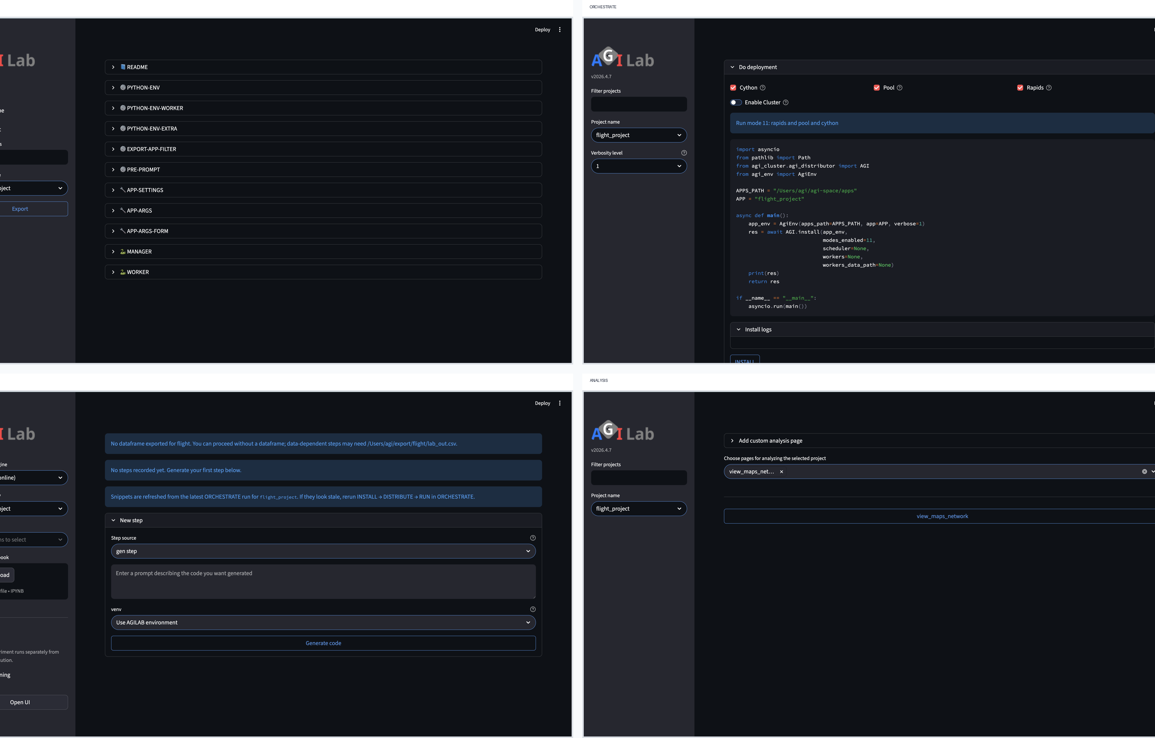
STORY LOGIC
Why This Path
The first proof is deliberately smaller than the full tour.
UI FLOW
Visible app context
PROJECT is not just a launcher. It keeps the selected app legible while you run it.
Controlled execution
ORCHESTRATE packages and runs the local path without asking the viewer to infer shell state.
Readable proof
ANALYSIS is the payoff: a result a technical audience can parse in seconds.
PROJECT → ORCHESTRATE → ANALYSIS is the newcomer-safe route through the UI.
Narration: this is the smallest AGILAB story that still proves real workflow control and a visible result.

Slide 3
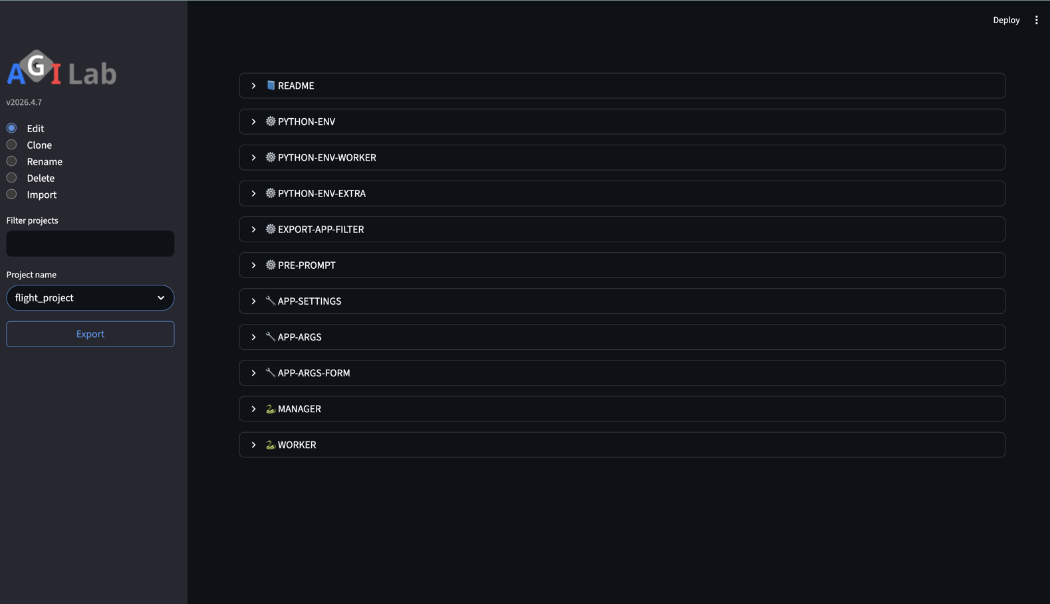
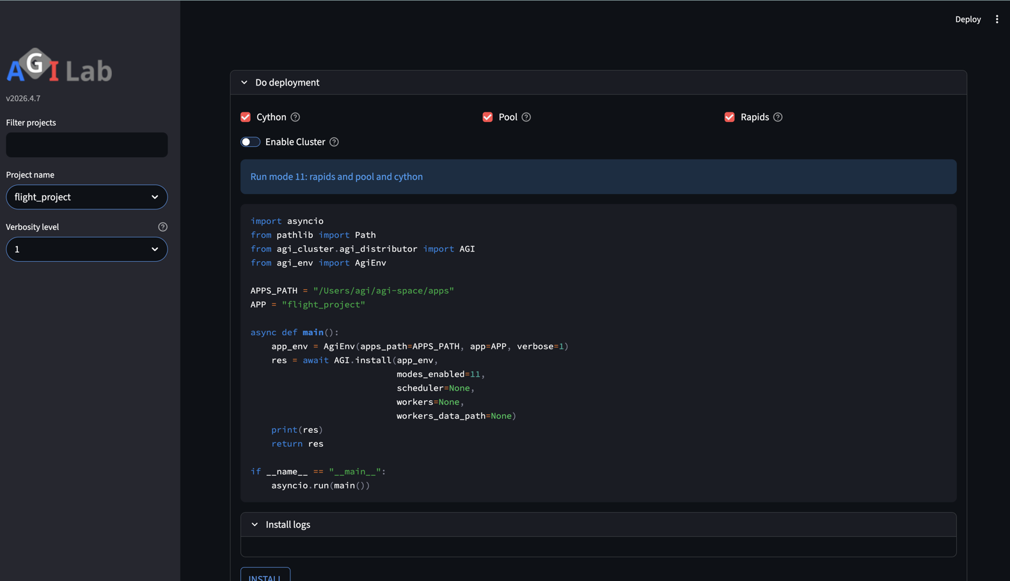
EXECUTION PATH
Select And Run
PROJECT sets the app context; ORCHESTRATE executes the local proof.
1 PROJECT
2 ORCHESTRATE
PROJECT
ORCHESTRATE
Choose `flight_project` and keep the scenario visible.
INSTALL, then EXECUTE through the local path.
— Use `flight_project`: the first proof is not about breadth; it is about getting one clean end-to-end run.
— Keep the visual story simple and operator-visible so the evidence reads immediately.

Slide 4
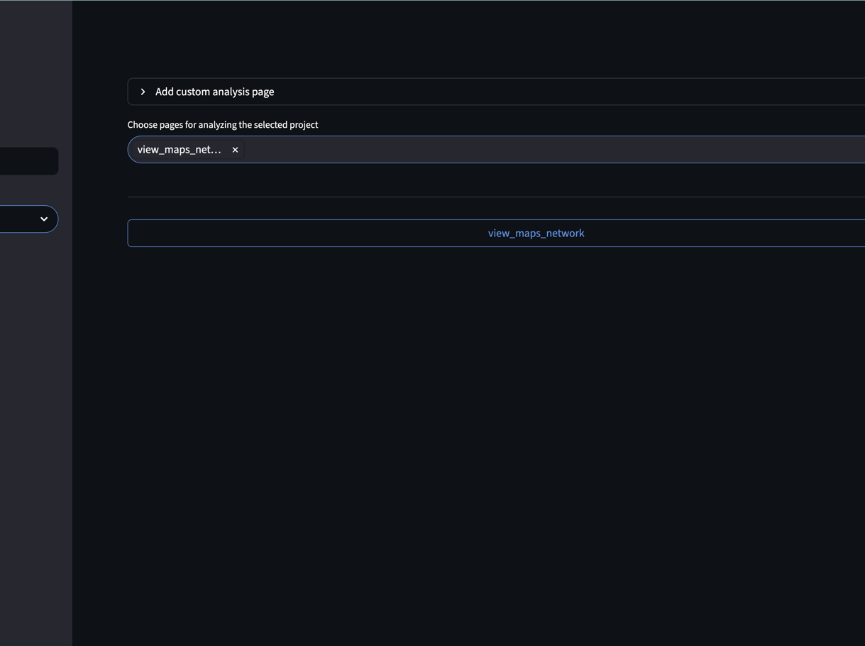
PROOF STATE
End On Evidence
ANALYSIS is where the first proof becomes concrete.
ANALYSIS
Proof condition
Fresh output under `~/log/execute/flight/` plus a readable ANALYSIS result means the newcomer hurdle is cleared.
Why this matters
The point is not that AGILAB ran somewhere. The point is that it ended on visible evidence a reviewer can inspect.
VISIBLE RESULT
Close the story on the result screen. That is what makes the first proof credible in one glance.
Readable result screen, centered as the payoff of the first proof.

