Slide 1
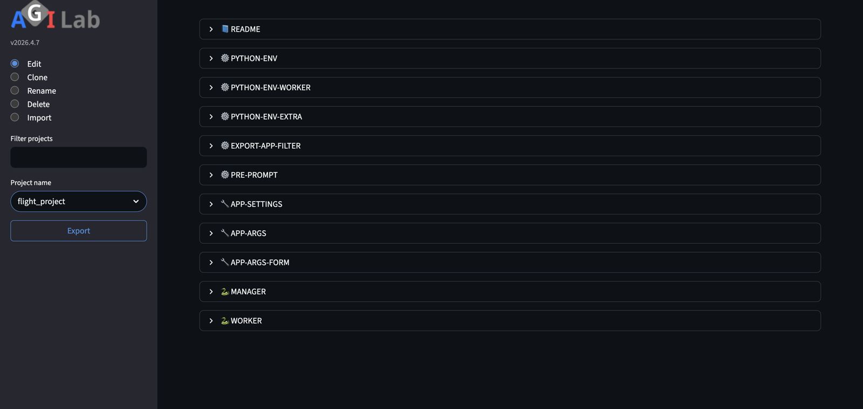
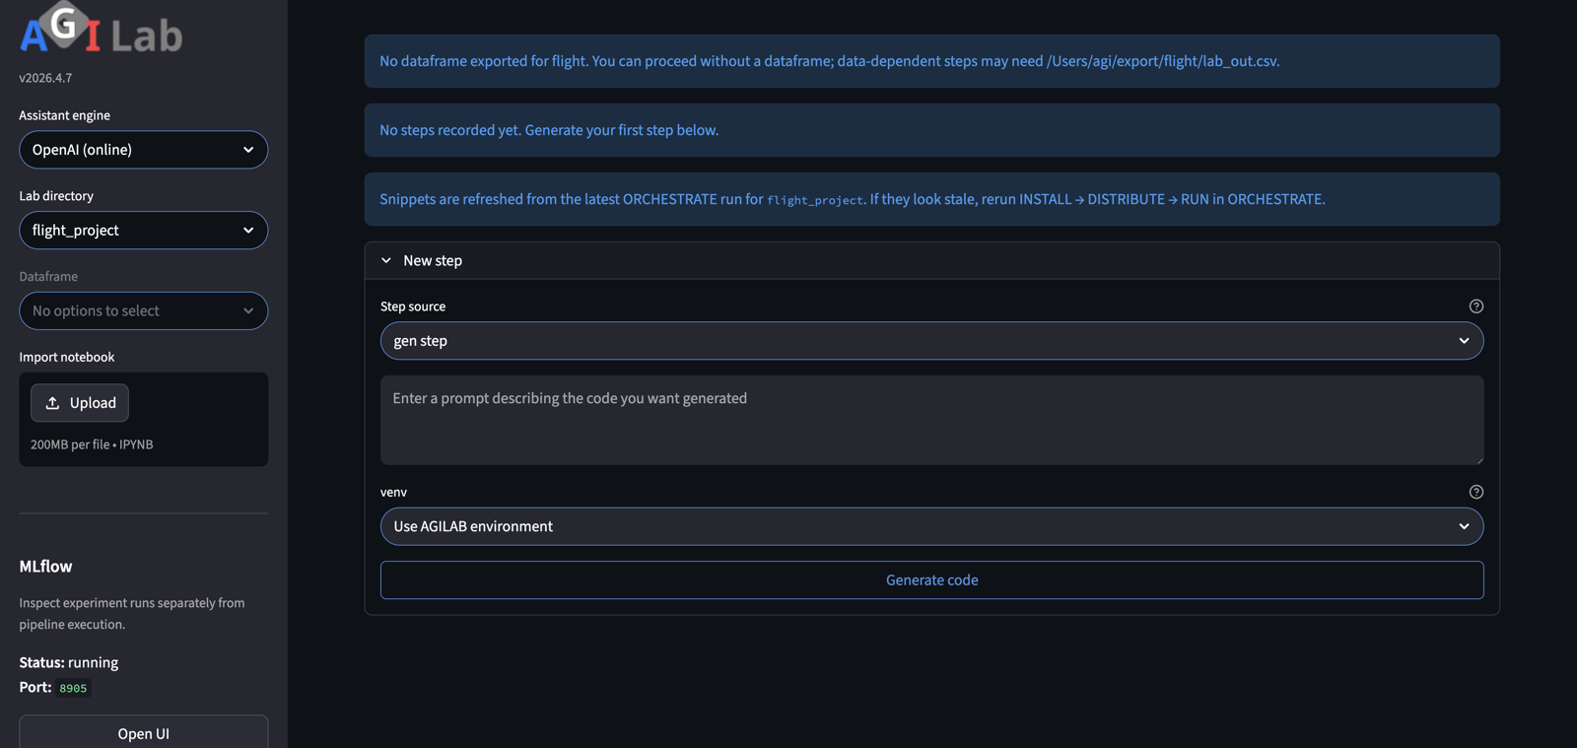
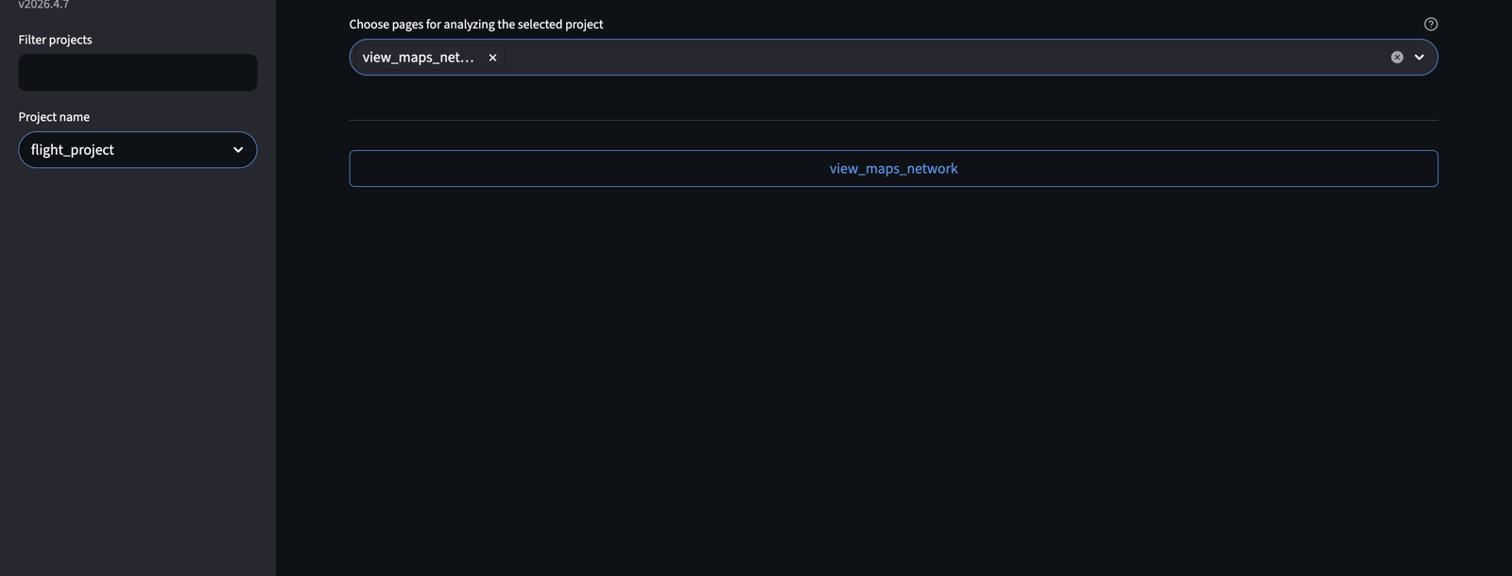
PUBLIC WORKFLOW STORY
AGILAB Full Tour
Slideshow companion for the `uav_relay_queue_project` public workflow story.
PROJECT
PROJECT
ORCHESTRATE
PIPELINE
ANALYSIS
PIPELINE
Goal: show the four-page AGILAB story without asking the viewer to replay a hosted runtime or watch a video.
App and scenario are visible from the start.
A
B
ANALYSIS
Replayable path
The run is not just executable once; the workflow is made explicit.
Readable payoff
End on queue or route evidence that a technical reviewer can scan fast.
The run becomes an explicit tracked workflow.
Readable end-state evidence.

Slide 2
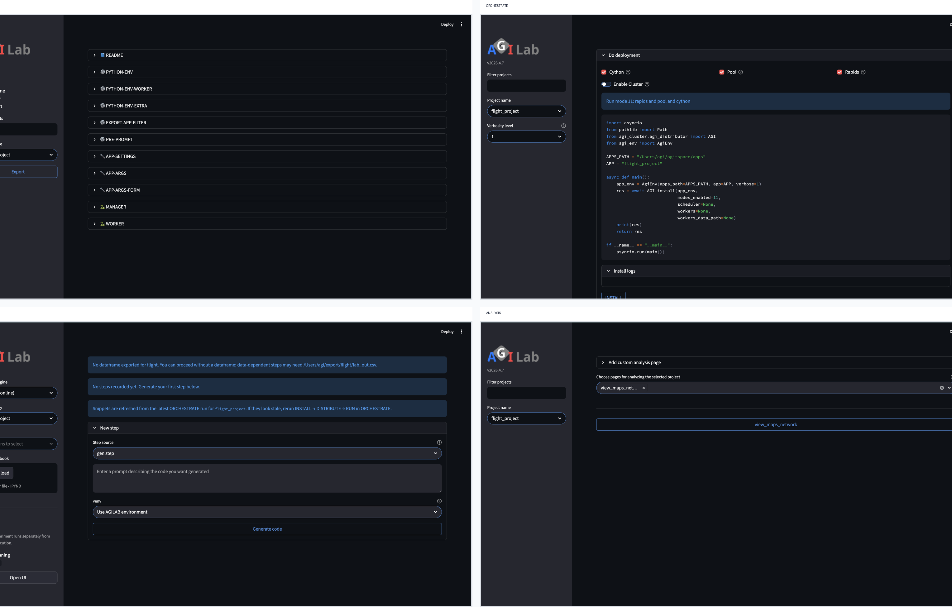
WORKFLOW CONTRACT
The Full Workflow Story
This is the stronger README and public-tour narrative.
FOUR PAGE FLOW
Explicit context
PROJECT anchors the app and scenario instead of hiding setup inside an implicit shell state.
Replayable workflow
PIPELINE shows that execution steps and artifacts can be inspected and rerun, not only re-described.
Technical payoff
ANALYSIS lands on queue or route evidence that justifies the workflow story.
The story is the page sequence, not isolated screenshots.
Narration: AGILAB turns a lightweight experiment into an explicit, reviewable workflow instead of a one-off script path.

Slide 3
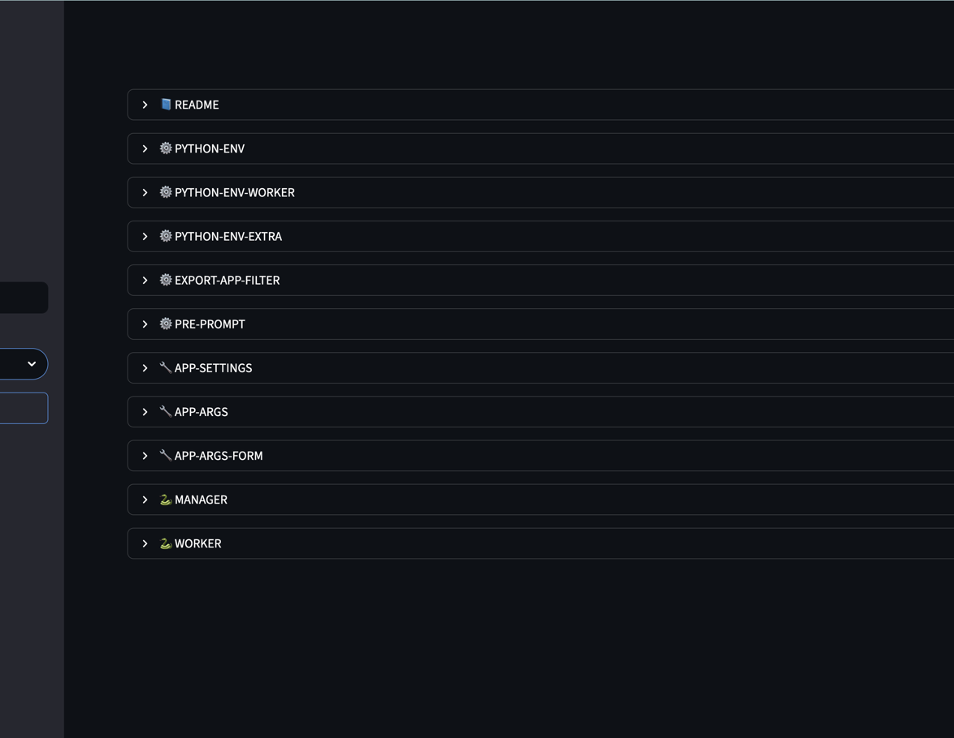
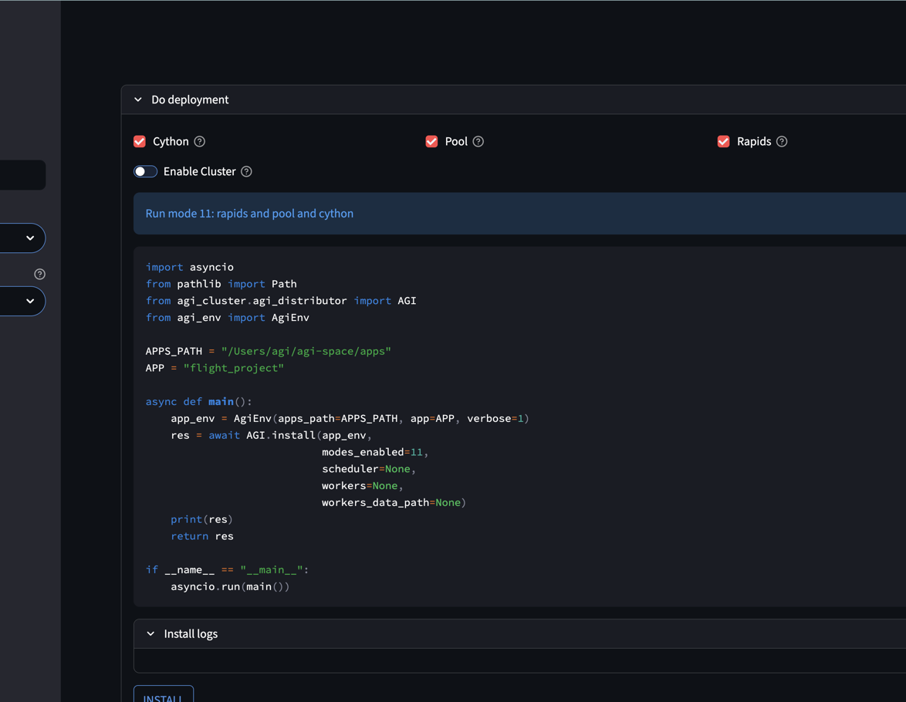
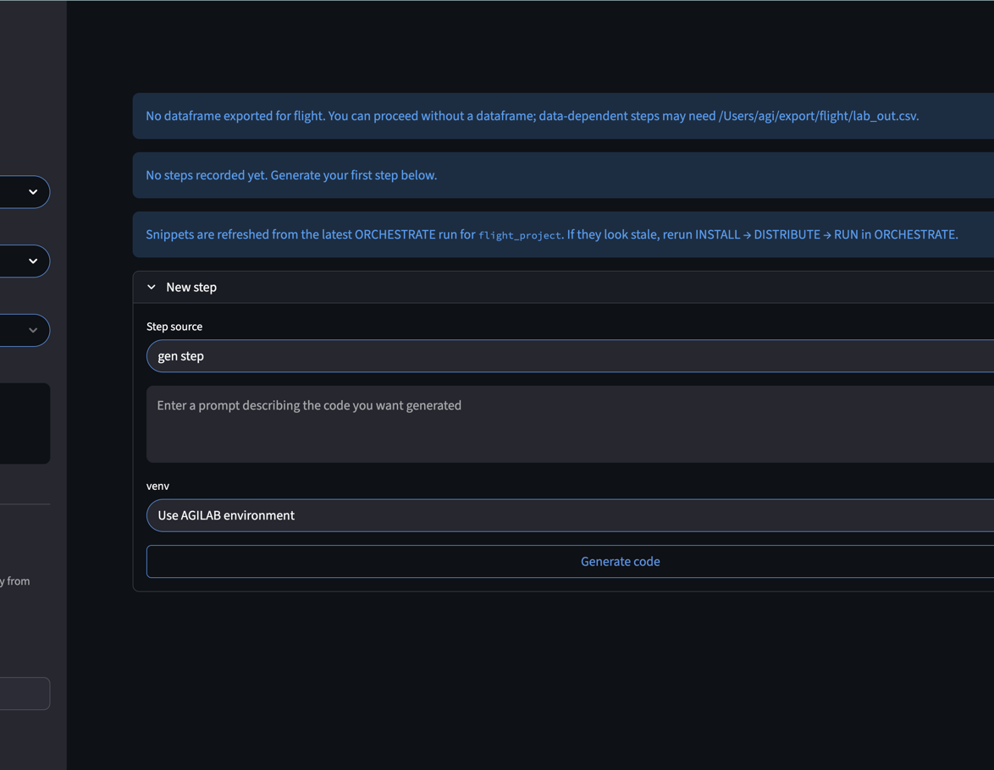
PAGE SEQUENCE
Project To Pipeline
PROJECT and ORCHESTRATE establish the run; PIPELINE makes it explicit.
1 PROJECT
2 ORCHESTRATE
3 PIPELINE
Select `uav_relay_queue_project` and keep the scenario visible.
Trigger the run through one packaged path.
Show that the execution path is tracked and replayable.
— The deck works only if the viewer reads these as one route through the product, not as disconnected screens.
— That is why PIPELINE matters in the full tour and not in the newcomer-safe first proof.

Slide 4
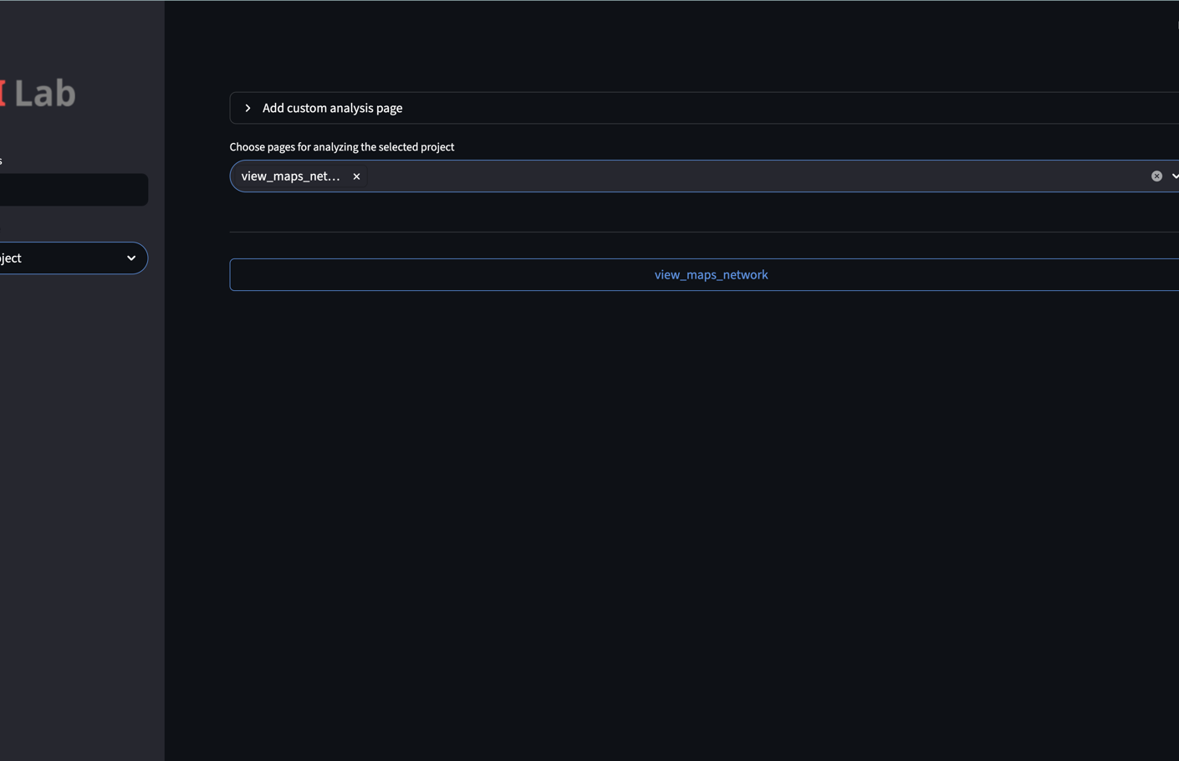
TECHNICAL PAYOFF
End On Queue Evidence
ANALYSIS carries the technical payoff of the full tour.
ANALYSIS
What the viewer should retain
AGILAB did not just execute a scenario. It kept the workflow explicit all the way to a readable technical result.
Why this deck exists
It gives the README and docs a skimmable public demo surface without requiring a hosted runtime or video playback.
FULL TOUR
Queue or route evidence is where the public tour becomes credible.
The point of the full tour is not breadth for its own sake. It is explicit workflow plus visible queue evidence.

