Slide 1
AGILAB Demo Slideshow
Public screenshots deck for README, docs, and narrated walkthroughs
Built from tracked AGILAB screenshots, not local-only demo captures.
Best used as a skimmable companion to the short video demos.
Keep the message stable: one app, one control path, one visible result.

Slide 2
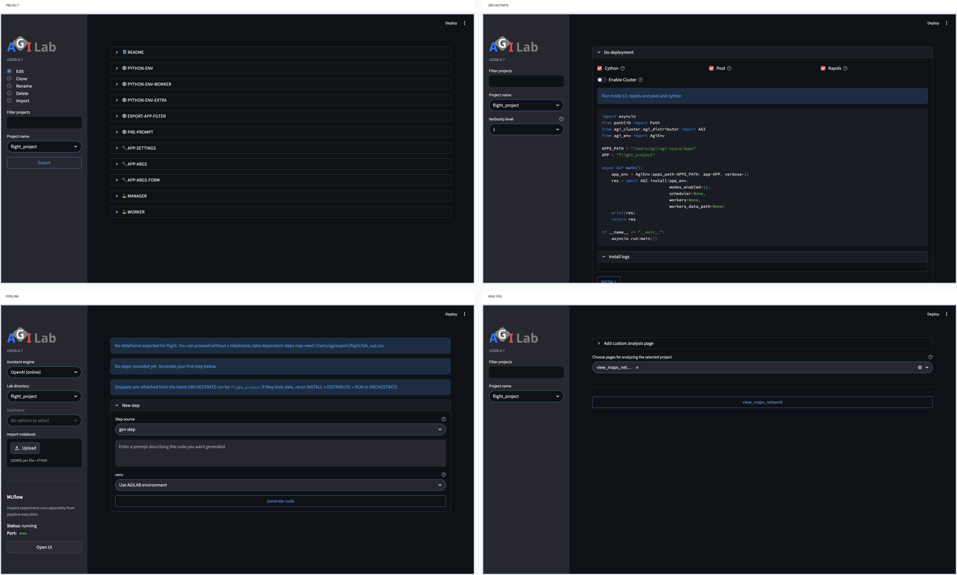
AGILAB Core Flow
The stable four-page story used in the public intro
Pages: PROJECT -> ORCHESTRATE -> PIPELINE -> ANALYSIS
Message: AGILAB keeps the app, runtime path, and visible result aligned.
Use this slide as the orientation frame before drilling into screenshots.
Narration: AGILAB packages, runs, replays, and ends on visible evidence instead of shell glue and raw logs.

Slide 3
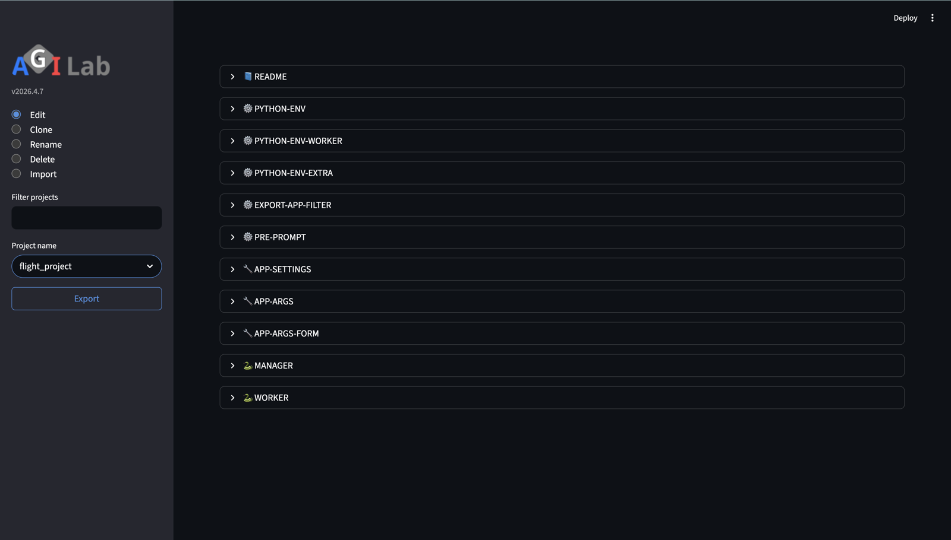
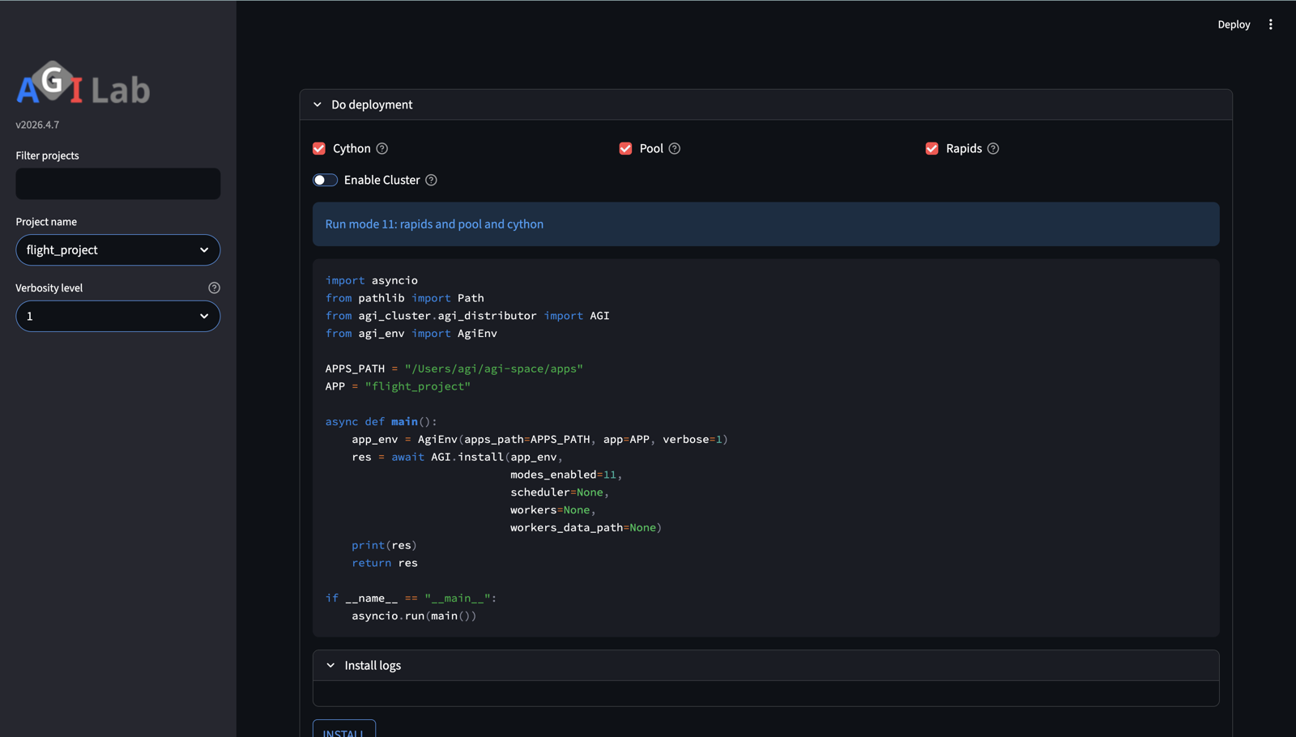
First Proof Path
PROJECT and ORCHESTRATE in the newcomer-safe local flow
Use `flight_project` for the safe first proof: select the app in PROJECT, then INSTALL and EXECUTE in ORCHESTRATE.
End the spoken story on fresh output and a visible analysis result, not on raw infrastructure logs.

Slide 4
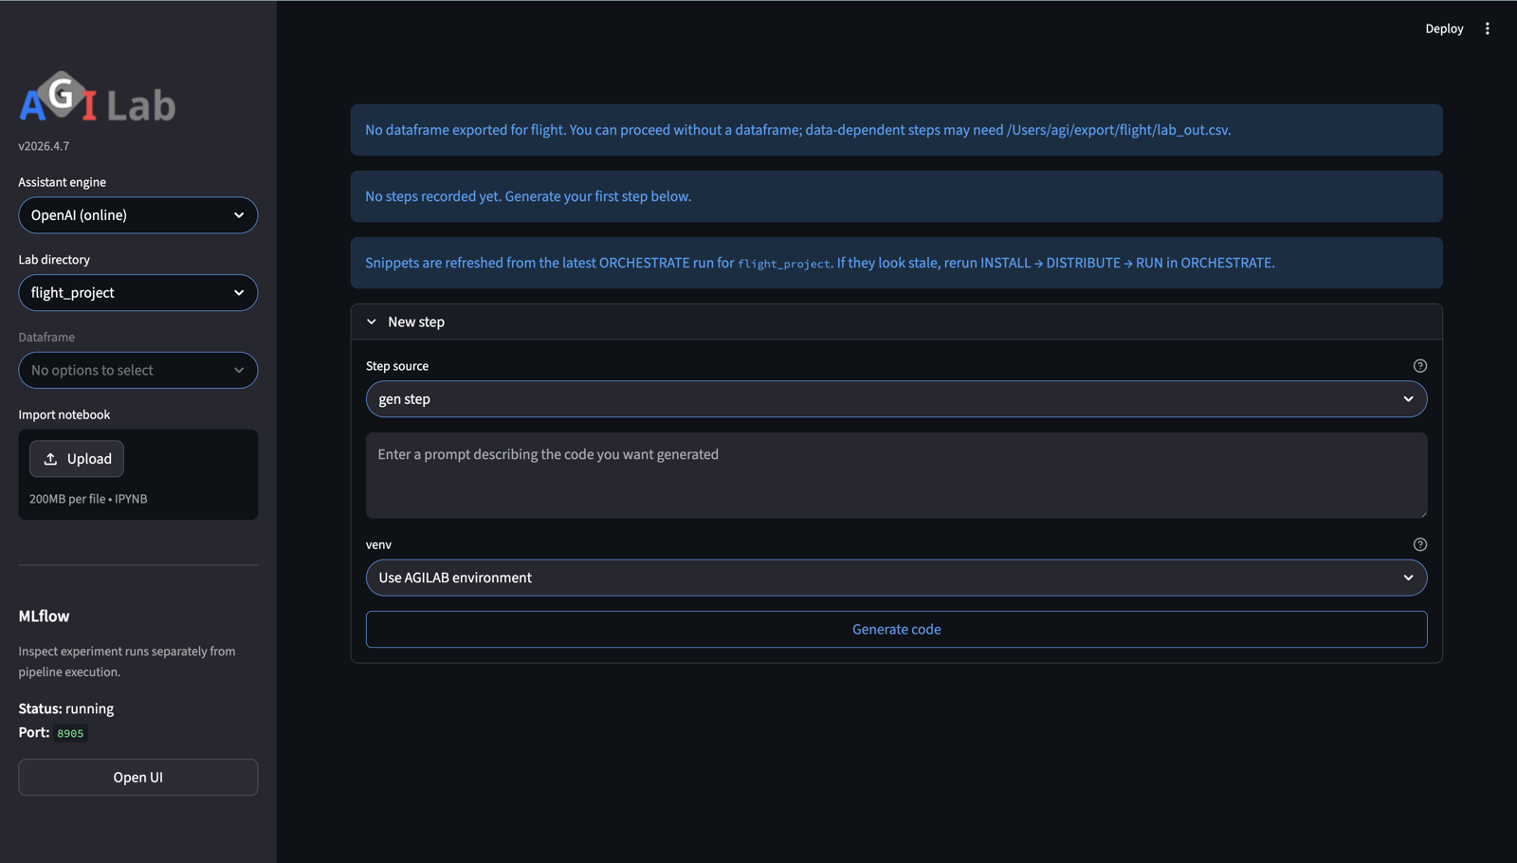
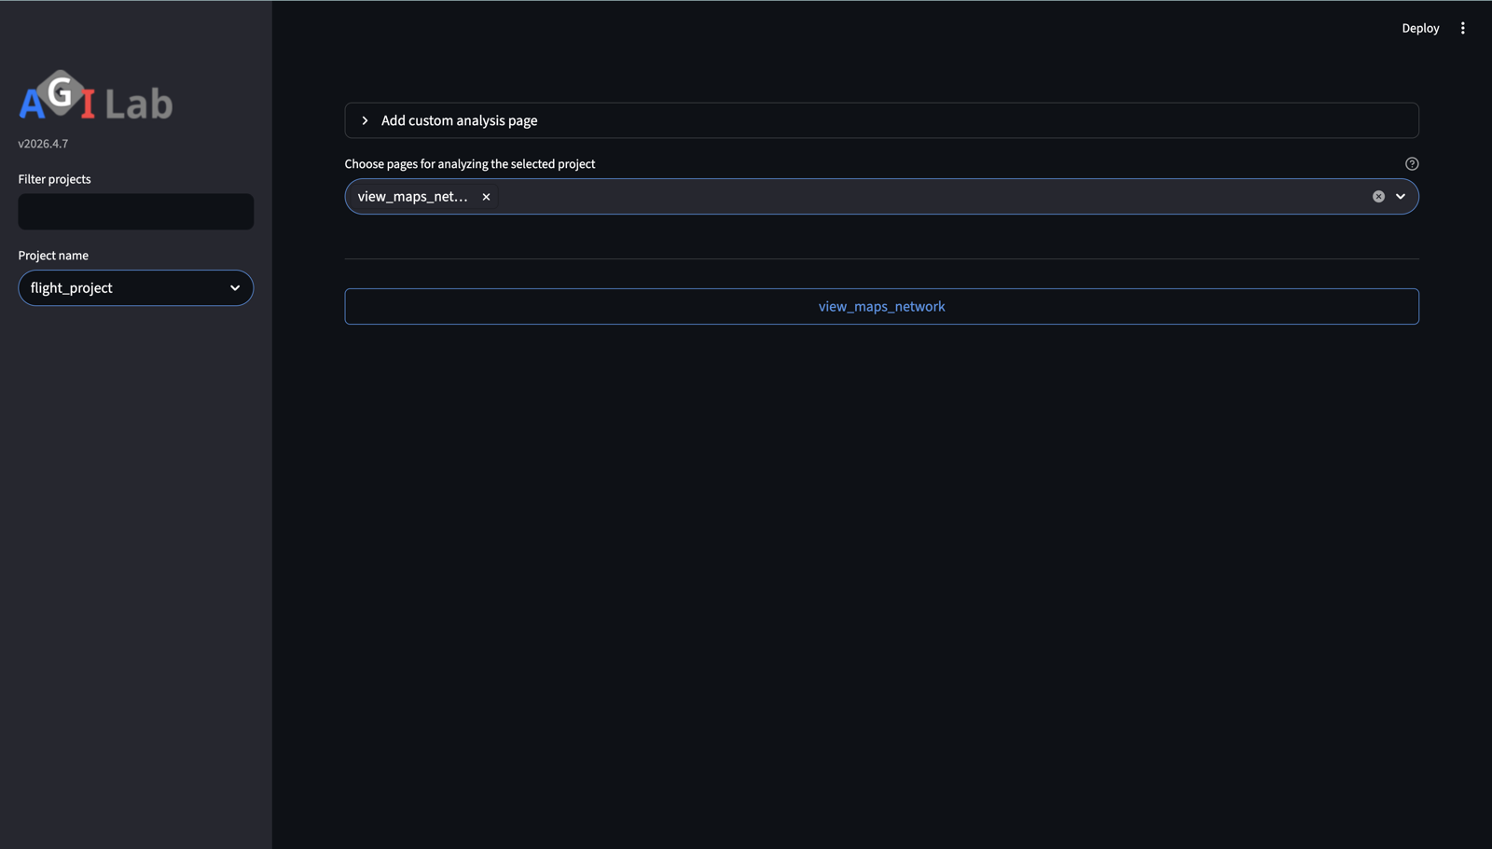
Full Tour Path
PIPELINE and ANALYSIS for the replayable workflow story
Use `uav_relay_queue_project` when you want the stronger technical story: explicit replayable steps in PIPELINE and visible evidence in ANALYSIS.
The slideshow should complement the video, not replace the message with new claims.

