Slide 1
LSP Specification
Latest edits are written in red

Slide 2
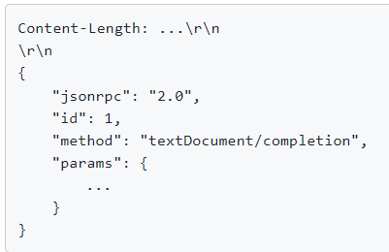
LSP Specification structure & JSON-RPC
Written in Typescript
Content uses JSON-RPC structure
JSON-RPC = remote function calls
Remote Procedure Call made through a Request or Notification message
Primitive and Structured JSON types
Currenlty, the protocol assumes one language server instance serves only one tool

Slide 3

JSON-RPC structure
Request Object example :
{ jsonrpc: “2.0”, method: “methodName”, params: {x: “x”, y: “y”, …}, id: String or Number or NULL }
Notification Object example :
{ jsonrpc: “2.0”, method: “methodName”, params: {x: “x”, y: “y”, …}, }

Slide 4
JSON-RPC structure
Response Object example : { jsonrpc: “2.0”, result: has type of the object returned by the called method, REQUIRED if success, NOT EXIST if error. error: always REQUIRED on error, NOT EXIST if success, must be an object, see Error Object. id: REQUIRED, same value as the id in its corresponding request object, if error then NULL. }
Error Object example : { code: Number of the error type, (see list of error codes) message: String desc of error, data: additional info, Primitive of Structured }

Slide 5
Capabilities
Groups of features supported by a language and an editor
It has to be announced by the language server and the development tool
When implementing a LSP tool, you have to specify the Client and Server sides capabilities:
Registering capabilities
Static registration
Client and server register for capabilities during the initializing process only once
Dynamic registration
Allows language servers to add or remove support for various capabilities at runtime without a reinitialization of the server
If the client supports dynamic registration, the server can later send a client/registerCapability request to the client
Useful for servers that support multiple clients with different capabilities
Allows the server to tailor its feature set for each client, more features for clients that can handle them, and simplifying its behavior for others
Be more efficient by only providing features that are actually used by the client, saving computational resources

Slide 6
Response ordering
Responses are sent in the same order as their corresponding requests in general
Server can decide to use a parallel execution strategy but should no affect correctness of responses

Slide 7
Useful JSON structures
URI : link of the document in the server
Position in a text is like an ‘insert’ character in an editor
Range is an interval between ‘start’ and ‘end’, comparable to a selection
TextDocumentItem : object that contains the document’s uri, language, version and content of the opened text document
LocationLink : link between a source and a target location
MarkedString : either a markdown string or a code-block that provides a language and a code snippet

Slide 8
Document type
Text document : represented as strings
Notebook document : collection of notebooks cells, has a type, unique resource URI
Notebook cells : holds the actual text content, composed of a NotebookCellkind, a unique documentUri and other additional information
Notebook cell kind : either code or markdown content
The actual content of the notebook cell is stored in a text document that is also synced with all documents

Slide 9
Document Synchronization
Client support for textDocument/didOpen, textDocument/didChange and textDocument/didClose is mandatory
Server must implement all three or none (they are not relevant if the document is read only)
Defined in TextDocumentSyncKind, values : None, Full or Incremental
If the language of the document is changed, client needs to send a didClose followed by didOpen notifications
Did notifications : the client notifies the server if the document was open, changed, saved or closed
Will Save: notification sent by the client to the server before checking if the client is allowed to save the file. It is followed by a Did save notification
Will save wait until : saves an array of all the changes the document has undergone before saving it

Slide 10
Main features
Language features
Go to definition feature
Returns a result of type LocationLink[] with the definition corresponding to the element where the the client sent the request.
Code completion
Suggests completion items in the editor
Servers can choose to not resolve every item for performance issues
Generally the client’s job to provide filtering and sorting of items based on the server’s list of items
Server can help the client by specifying attributes like filterText or sortText for each completion item
Hover
When cursor is hovered over a symbol, server responds with relevant information, such as type signatures, documentation comments, etc.
Returns a Hover Object with its contents within a MarkedString[] or a MarkupContent
Document Symbols
Returns a SymbolInformation[] (list of all symbols in the document) or DocumentSymbol[] (same but with hierarchy between the symbols which is better)

Slide 11
Main features
Language features
Publish diagnostics
Sends potential compiler errors, warning, etc. to the client
Sends a Diagnostic object to the client, containing the corresponding data
Server’s responsibility to re-compute changes in the file and push them to the client

Slide 12
LSP supported version by VS Code
LSP Features supported by VS Code → Link to the list of features VS code client can implement
« Starting with Visual Studio 2017 version 15.8 support for the Common Language Server protocol is built into Visual Studio Code »
Yojson (yojson.Yojson) (ocaml-community.github.io)
Request parsing on Client and Server sides
OCaml JSON parser library → Link to the Ocaml JSON parser library (server side)
Client is written in Javascript/Typescript if the client side is VS Code : Language Server Extension Guide for VS Code
Typescript and Javascript have JSON parsing functionalities, check : Typescript Specification

Slide 13
Syntactic vs Semantic document analysis
Syntactic features
are concerned with the structure of the code
how it's written rather than what it means
Work on the syntax tree generated by parsing the source code and do not require understanding the context or meaning behind the code
The feature acts on the form or structure of the code, such as its formatting or syntax highlighting
Deals with code folding, bracket matching, or indentation
Can be performed without understanding the types, or execution of the program

Slide 14
Syntactic vs Semantic document analysis
Semantic features
needs an understanding of the meaning of the code, such as what symbols represent, how they're used, or the logic of the program
Often involves type checking, scope definition, and understanding the links between various parts of the code
involves navigating the code, like going to a symbol's definition, implementation, or finding all references of a symbol in the project
Helps with understanding the code's behavior, such as through hover tooltips that show information about variables or functions, signature help, or providing diagnostics

Slide 15
LSP specification structure
Language features supported by VS Code
Code comprehension features | Coding features
Find references Go to definition Hover Document highlight Document symbols Publish diagnostics | Completion Formatting Range formatting Code actions Signature help Rename

Slide 16
LSP specification structure
Methods names starting with:
nothing = lifecycle messages
$/ = protocol implementation dependent methods, not implementable in all clients or servers -> check if OCaml is single threaded synchronous programming language
textDocument/ = methods used in the scope of the opened document, language features
window/ = methods used in the scope of the UI, less about the code, more about communicating with the user
workspace/ = methods used in the scope of the entire workspace, everything related to file versioning

Slide 17
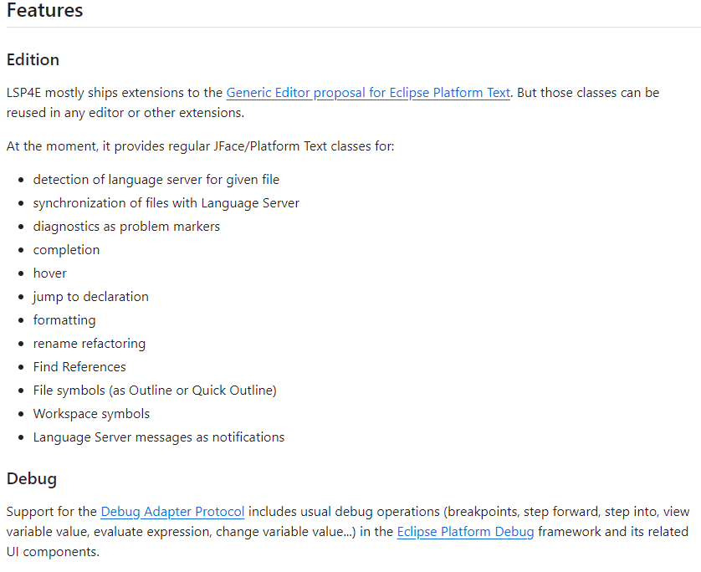
LSP in Eclipse IDE
LSP4E : GitHub - eclipse/lsp4e: Language Server Protocol support in Eclipse IDE
Supported features :

Slide 18
Main LSP features to be developed in priority
Most implemented features found in 3 popular editors (VS Code, Eclipse and Emacs) were :
Code navigation
Go to definition
Find references
Code completion
Formatting
Diagnostics/Project errors
Symbol Highlight

Slide 19
Frama-C
Latest version 28.1 Nickel, March 1, 2024
Open source, C code analyzer, collaborative framework
Static analysis, manipulate functional specifications and prove that the source code satisfies them
Dynamic analysis with E-ACSL, performs runtime verification, complementing static analysis
C code must follow C99 ISO standard, each analyzer comes in form of a plug-in
ACSL is the default language for expressing a property
Frama-C executables : batch version and GUI, specify options in the command line, debugging etc, defining env vars

Slide 20
Frama-C plugin development
Setting up plugins : 2 kinds : internal and external, 1st one is automatically installed while other needs to be installed separately
plugin must be compiled with the same compiler as Frama-C.
Frama-C CIL extension (kernel) can produce C + ACSL AST to write plugins, Cil module, ViewCfg = output the control flow graph of a function,
Access to the AST of C functions : need to use Cil_types module, everything is well defined in the github kernel services https://github.com/Frama-C/Frama-C-snapshot/blob/master/src/kernel_services
ViewCFG tutorial module : (available in frama-c nickel plugin tutorial) slide 22 : C code and its Control-flow Graph (CFG) using DOT Cfg visualizer that parses the output .dot file
We can interface out plug-in with other plug-ins : example interfacing viewcfg tutorial plug in with EVA plug-in that displays reachable states : see slide 22
Difference between yojson & frama_c_kernel.json : Frama-C API (for more details)

Slide 21
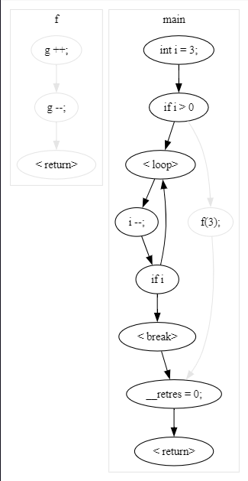
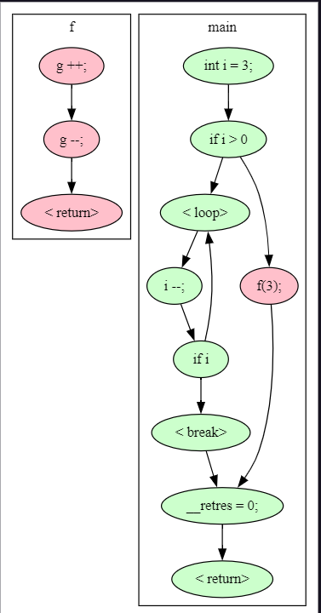
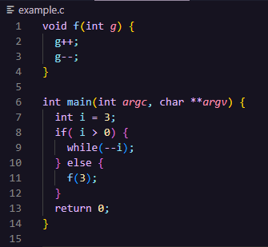
Frama-C plugin development
dune exec -- frama-c example.c
dune exec -- frama-c example.c -eva -then -cfg
CFG

Slide 22
Cc_doc
4 main modules : parsing, cparsing, linking, common
Type structure for ACSL annotations : ensures, requires, assert, assumes, loop invariant
Uses Cil_types to access AST, (ACSL or C ??)

Slide 23
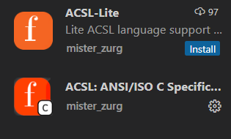
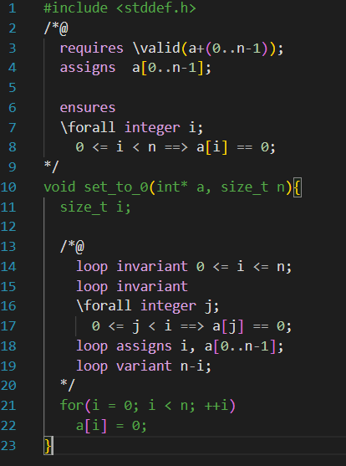
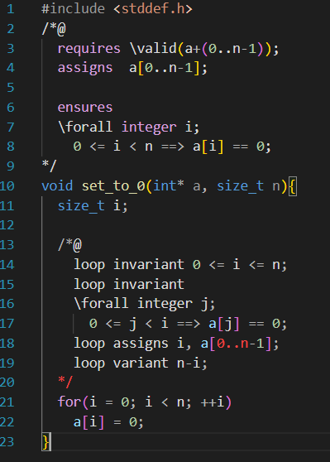


Existing Frama-C VS Code extension
Two ACSL related VS Code extensions exist in the VS Code Marketplace
Both are create by the same author, according to the descriptions both are basically the same The second one seems more complete. ACSL-Lite repo link : https://github.com/MisterZurg/acsl-lite ACSL: ANSI/ISO C Specification Language : https://github.com/MisterZurg/acsl-ansi-iso-c-specification-language
Code completion feature works, but is not a smart completion (suggests the rest of the word according to the context and not just list the completion items in alphabetical order)
Syntax coloration is better in ACSL-lite. Both include VS Code’s IntelliSense.

Slide 24
VS Code IntelliSense
Code completion aid, latest version in 2022 : https://learn.microsoft.com/en-us/visualstudio/ide/using-intellisense?view=vs-2022
“Visual Studio Code IntelliSense is provided for JavaScript, TypeScript, JSON, HTML, CSS, SCSS, and Less out of the box. VS Code supports word based completions for any programming language but can also be configured to have richer IntelliSense by installing a language extension.” https://code.visualstudio.com/docs/editor/intellisense#:~:text=Visual%20Studio%20Code%20IntelliSense%20is,by%20installing%20a%20language%20extension.

