Slide 1
Fred default presentation template
Fred · Design system
The design the slide-generator agent uses when no custom template is provided
Fred open source project · Apache-2.0
Notes:
Layout: Fred Title. Opening slide, dark. title up to ~60 characters; subtitle one sentence; meta = author, team and date; kicker optional (event, client or category).

Slide 2
Agenda
Contents
01
Design principles
02
Openings and sections
03
Text and comparison layouts
04
Visual layouts
05
Data layouts
06
Process, people and code
07
Closings and free canvases
Notes:
Layout: Fred Agenda. Up to 7 entries, each a two-digit number and a heading of up to ~45 characters; unused entries are removed.

Slide 3
One palette, one typeface, one motif
Design principles
Aa
Navy
Indigo
Periwinkle
Teal
Slate
Mist
Arial, one family
0F134F
4851C3
9CA4FF
1C8199
575A8A
F3F4F9
Titles 28–44 pt bold
Body 14–20 pt regular
Navy carries openings, sections and closings; white carries content. Indigo is the single action colour.
The Fred tile, a square with 13.5 % rounded corners, is the only motif: grids, markers, the brand mark.
Every colour is a theme colour, so swapping the theme restyles every layout and chart.
Captions 12 pt slate
KICKER 11 PT CAPS
Notes:
Layout: Fred Title Only. Free composition below the title: diagrams and anything the other layouts cannot express. Keep 0.6 in side margins and the 1.85 to 6.6 in content band; use scheme colours. This showcase slide shows the palette, built from scheme colours, so it follows the theme.

Slide 4

Knowledge assistants for every team
Product review · Q3
How Fred agents turned 4,800 documents into answers
Product team · October 2026
Notes:
kind: cover
label: Cover with picture
Cover with a picture on the right; use it when the deck has a hero image.

Slide 5
Designing agent workflows that people trust
Internal workshop
A light opening for document-style and printed decks
UX guild · Paris · 2026
Notes:
kind: cover
label: Cover, light
Light cover for document-style and printed decks.

Slide 6
Openings and sections
01
Navy for structure, with the tile grid as the signature
Notes:
Layout: Fred Section. Section divider, dark. section_number is a two-digit counter (01, 02…); title 1 to 6 words; subtitle optional.

Slide 7
Text and comparison
02
Indigo dividers break the rhythm in long decks
Notes:
Layout: Fred Section Accent. Section divider in the brand colour. Alternate with Fred Section to give long decks rhythm. Same placeholders as Fred Section.

Slide 8
Why a default template matters
Principles
Users without a corporate template still get a consistent, readable deck
Named layouts let the agent pick a frame by intent instead of drawing shapes
  Placeholder names are stable: title, body, image, chart…
Theme colours and fonts are defined once, so restyling means editing one file
Arial renders with identical metrics in PowerPoint and LibreOffice
Notes:
Layout: Fred Title and Content. Text slide. 3 to 6 bullets of at most ~90 characters; second level allowed. Prefer a more visual layout when the content allows it.

Slide 9
What the agent controls, and what it does not
Responsibilities
Which layout each slide uses
Text in every placeholder
Charts, tables and images
Which optional placeholders to remove
Colours, fonts and sizes
Positions and margins
Slide numbers and backgrounds
Decorative tiles and brand mark
Notes:
Layout: Fred Two Content. Two parallel lists of similar length, 2 to 6 bullets each.

Slide 10
Three rules behind every layout
Design pillars
Intent first
Theme driven
Fail-safe
Each layout answers one communication need: compare, prove, explain, show. The agent picks by intent.
No hard-coded colour. Decorations and placeholders use scheme colours, so a new theme restyles everything.
Empty placeholders disappear, generous boxes absorb long text, and every image is cropped to fit.
Notes:
Layout: Fred Three Columns. Three ideas side by side (pillars, principles, offers). Headings 1 to 4 words; bodies up to ~200 characters each.

Slide 11
Default template or custom template
Options
Default
Custom
Used when the user uploads nothing
Known layouts, predictable output
Ships with Fred under Apache-2.0
Uploaded by the user or the team
Layouts discovered at upload time
Brand stays under the owner’s licence
Notes:
Layout: Fred Comparison. Two options side by side with equal weight. Headings of 1 to 3 words; 2 to 5 bullets each.

Slide 12
From hand-made slides to generated decks
Transformation
Before
After
Hours spent aligning boxes
Every deck looks different
Charts pasted as pictures
A first draft in minutes
One coherent visual language
Native, editable charts and tables
Notes:
Layout: Fred Before After. Transformation: current state on the left, target state highlighted on the right. Same placeholders as Fred Comparison.

Slide 13
What a Fred agent brings to a team
Capabilities
Search your documents
Automate reports
Answers grounded in your own libraries, with sources quoted.
Recurring syntheses written and formatted without manual work.
Compare versions
Generate decks
Changes between two contracts or specs, highlighted clause by clause.
Presentations built on this template, ready to edit in PowerPoint.
Notes:
Layout: Fred Four Cards. Four parallel items in a 2 × 2 grid (features, risks, benefits). Headings up to ~40 characters; bodies up to ~140 characters.

Slide 14
Six building blocks, one platform
Platform
Agents
Knowledge
Connectors
Specialised assistants with their own tools.
Libraries indexed for retrieval.
Drive, SharePoint, Git and more.
Security
Monitoring
Open source
Access rights follow your sources.
Usage, cost and quality dashboards.
Apache-2.0, self-hostable anywhere.
Notes:
Layout: Fred Six Cards. Six short items in a 3 × 2 grid (capabilities, modules, team values). Headings up to ~30 characters; bodies up to ~90 characters.

Slide 15
Design principle
A template is a promise: whatever the user asks for, the deck will belong together.
Consistency is what makes a generated deck look designed rather than assembled.
Notes:
kind: quote
label: Statement
One strong message up to ~110 characters, and its source or a supporting sentence under it.

Slide 16
Key message
Pick the layout by intent, fill it by name, and let the theme do the rest.
Three steps, the same for every slide the agent creates.
Notes:
kind: quote
label: Statement, accent colour
One strong message up to ~110 characters, and its source or a supporting sentence under it.

Slide 17
The best template is the one users never notice: their message is all they see.
UX guild, Fred project
Notes:
Layout: Fred Quote. Quotation. quote at most ~180 characters, without quotation marks; attribution is name and role (second line allowed for the organisation).

Slide 18

We went from a blank page to a reviewed deck in one afternoon.
Programme manager, pilot team
Notes:
Layout: Fred Quote Image. Testimonial with a portrait (≈ 3:4). quote at most ~160 characters; attribution name and role.

Slide 19

Visual layouts
03
Images, screenshots and galleries, always cropped to fit
Notes:
Layout: Fred Section Image. Section divider with a full-bleed visual on the left (≈ 5:6). Same text placeholders as Fred Section.

Slide 20

Pairing text with a visual
Visual pairing
The image placeholder fills the right panel
Screenshots, diagrams or photos all work
Images are cropped to the frame, corners rounded by the layout
Notes:
Layout: Fred Content with Image. Text on the left, visual on the right (≈ 7:8). 2 to 5 bullets; title up to ~45 characters (narrow column).

Slide 21
Alternate sides to keep the rhythm
Visual pairing
Same placeholders as the right-hand version
Use it for the next slide of a sequence
The eye travels from the visual to the text
Notes:
Layout: Fred Image Left. Mirror of Fred Content with Image: visual on the left. Alternate the two to avoid repetition.

Slide 22

Let one visual carry the slide
A full-bleed image with a caption panel. Keep the subject on the right half.
Notes:
Layout: Fred Full Image. Full-bleed visual (16:9) with a caption panel bottom-left. title up to ~50 characters; body up to ~150 characters. Keep the subject of the image on the right.

Slide 23


Two visuals, side by side
Gallery
Light theme
Dark theme
The interface as most users see it.
Same components, inverted surfaces.
Notes:
Layout: Fred Two Images. Two visuals compared or paired (≈ 16:10 each), each with a short title and one-line caption.

Slide 24



Where teams use Fred today
Use cases
Engineering
Support
Legal
Specs and design reviews searched in seconds.
Draft answers grounded in past tickets.
Clause comparison across contract versions.
Notes:
Layout: Fred Three Images. Three visuals in a row (≈ 7:6 each) with title and caption: products, use cases, sites.

Slide 25
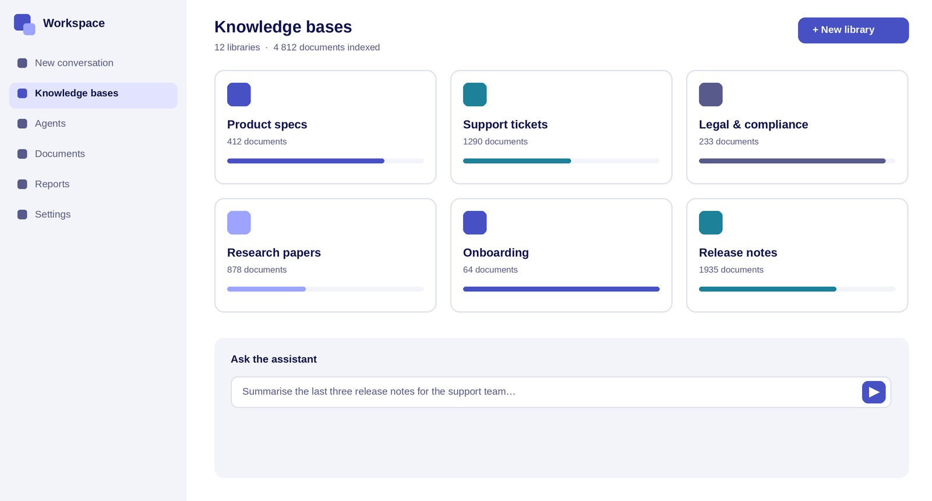
Knowledge bases at a glance
Product tour
Libraries grouped by team, with indexing progress
One click to create a new library
Ask the assistant across all sources
Notes:
Layout: Fred Screenshot. Product or app screenshot in a browser frame, with 2 to 4 numbered callouts on the right (~70 characters each). Screenshot ≈ 1.9:1, it is cropped to fill.

Slide 26
Three numbers worth remembering
In numbers
45
1
0
named layouts cover most business presentations
typeface, Arial, for faithful rendering everywhere
proprietary assets: no logo, photo or embedded font
Figures describe this template.
Notes:
Layout: Fred Key Figures. Three headline numbers. Values of at most 5 characters (42%, 3.2M, x4); labels up to ~70 characters; caption for the source.

Slide 27
Pilot results after twelve weeks
Pilot results
62%
4.6
310
3x
time to produce a first deck draft
average satisfaction out of 5
decks generated by pilot teams
more reviews completed per week
Illustrative figures for the showcase.
Notes:
Layout: Fred Key Figures Four. Four KPIs; the first is highlighted, so put the headline figure there. Values at most 5 characters; labels up to ~60 characters.

Slide 28
Most edits touch wording, not layout
Charts are rarely rebuilt by hand
Users ask for more visual layouts, hence this template
Adoption
87%
of generated decks were kept with minor edits
Notes:
kind: other
label: Big number
One hero number, what it means, and 2 to 4 context bullets. Set aside: the analysis does not read a lone figure beside other text as a one-item figures slide.

Slide 29
Charts stay native and editable
Usage
Charts use theme colours, so a custom template restyles them automatically.
Notes:
Layout: Fred Chart. One native chart and its takeaway. takeaway holds 1 to 3 short sentences (~200 characters). Use theme colours, 12 pt labels.

Slide 30
Generated decks per month grew steadily
Trend
Illustrative data · decks generated per month.
Notes:
Layout: Fred Chart Full. One wide chart (time series, many categories). caption for the source or a reading note; put the message in the title.

Slide 31
Where decks come from, and what they contain
Breakdown
Requests by team
Slides by family
Illustrative data, in percent.
Notes:
Layout: Fred Two Charts. Two charts side by side for comparison. Each chart has a short title (~40 characters); same scale when comparing like with like.

Slide 32
Quality improves as usage grows
Dashboard
87%
decks kept with minor edits in Q4
+35
points since the first quarter
Notes:
Layout: Fred Chart and Figures. Dashboard: a chart with two KPIs alongside. Values at most 5 characters; labels up to ~50 characters.

Slide 33
Layout families at a glance
Reference
Layout family | Layouts | Use it for | Content | Status
Notes:
Layout: Fred Table. Native table, up to 5 columns and 8 rows under the header; the table style colours the header, a total row and highlighted rows. Split larger tables across slides.

Slide 34
Process, people and code
04
Sequences, roadmaps, matrices, teams and snippets
Notes:
Layout: Fred Section Light. Section divider, light variant for document-style decks. Same placeholders as Fred Section.

Slide 35
How the agent builds a deck
How it works
Pick the template
Plan the story
Fill placeholders
Check and deliver
Custom template if the user provided one, otherwise this default.
One message per slide, each mapped to a layout name.
Text, charts and images go into named placeholders.
Validate the file, render a preview, hand it over.
Notes:
Layout: Fred Process. Four-step sequence; the last step (outcome) is highlighted. Titles 1 to 3 words; bodies up to ~110 characters.

Slide 36
Three phases to roll out a team template
Rollout
Prepare
Build
Run
Collect brand assets
Name layouts by intent
Create layouts and placeholders
Document each one in notes
Upload to Fred
Review the first decks together
Notes:
Layout: Fred Process Three. Three phases as arrows (plan, build, run). Titles 1 to 3 words; bodies 2 to 4 short bullets.

Slide 37
Template roadmap
Roadmap
2024
2025
2026
2027
2028
First template
Custom upload
Layout discovery
Rich layouts
Design feedback
15 layouts, one theme.
Teams bring their own template.
Placeholders read automatically.
45 layouts, visual and data.
Users rate and refine slides.
Notes:
Layout: Fred Timeline. Up to 5 milestones, each a date (year or quarter, up to ~10 characters), a title of 1 to 4 words and a body up to ~90 characters; unused milestones and their dots are removed.

Slide 38
Which layouts to build next
Prioritisation
Value ↑
Visual and data layouts give the most value for the least effort, so they come first.
Nice to have
Do now
High value, high effort: animated diagrams.
High value, low effort: visual and data layouts.
Avoid
Quick wins
Low value, high effort: bespoke one-off frames.
Low value, low effort: colour variants.
Effort →
Notes:
Layout: Fred Matrix. 2 × 2 matrix (priority, positioning). The top-right quadrant q2 is highlighted. Axis labels 1 to 3 words; quadrant bodies up to ~80 characters.

Slide 39




The people behind the template
Contributors
Alex Martin
Lina Kader
Sam Roux
Jo Durand
UX designer
Front-end developer
Agent engineer
Product owner
Notes:
Layout: Fred Team. Up to four people with square photos (cropped to circles), name and role. Delete a column’s placeholders for fewer people. Names and portraits in this showcase are fictional placeholders.

Slide 40
Filling a layout by name
For developers
Pick the layout by its name
Find each placeholder by its name
Remove placeholders left empty
layout = layouts["Fred Key Figures"]
slide = prs.slides.add_slide(layout)
for ph in layout.placeholders:
idx = ph.placeholder_format.idx
target = slide.placeholders[idx]
target.text = content[ph.name]
Notes:
kind: other
Code sample for developer decks: the agent does not write code slides.

Slide 41
Dark canvas for diagrams and demos
Free canvas
Sources
Index
Agents
Deck
Notes:
kind: process
label: Four-step flow, short labels
Dark canvas: up to 4 steps of 1 to 3 words each, joined by arrows.

Slide 42
Bring your own template, or use this one
Thank you
github.com/ThalesGroup/fred
Apache-2.0 · contributions welcome
Notes:
Layout: Fred Closing. Final slide: thanks, call to action, contact or next steps. title up to ~40 characters; body up to 4 short lines.

Slide 43
Questions and feedback
Next steps
Try the template on your next deck
Share what layout is missing
Notes:
Layout: Fred Closing Light. Final slide, light variant. Same placeholders as Fred Closing.

Slide 44
Notes:
Layout: Fred Blank. Empty white canvas with slide number, for full custom visuals.

Slide 45
Notes:
Layout: Fred Blank Dark. Empty navy canvas with slide number.

