Slide 1
REVIEW 3 • MACHINE LEARNING PROJECT PRESENTATION
5G Network Quality & Connection Drop Prediction
Comprehensive ML Pipeline: Data Understanding, Cleaning, Statistical Checks,
Preprocessing (Scaling), Multi-Model Architecture & Operational Analysis
Presented by: Project Team Members | Course: Data Science & Visualization / ML | B.Tech
Notes:
SPEAKER NOTES (Presenter 1):
Good morning respected evaluators. Welcome to our Review 3 presentation for the project '5G Network Quality & Connection Drop Prediction'.
In this review, our team presents the end-to-end Machine Learning pipeline addressing all six required criteria:
1. Data Understanding and feature taxonomy
2. Data Cleaning and imputation
3. Statistical Checks for normality and outliers
4. Data Preprocessing with mathematical scaling justifications
5. Model Building across diverse linear and tree ensemble architectures
6. Model Analysis, performance metrics, and operational findings.
Every team member has prepared their respective section. I will begin with Data Understanding and Cleaning.

Slide 2
AGENDA & TEAM ASSIGNMENT
Review 3 Presentation Roadmap & Team Role Division
1. Data Understanding
Assigned: Presenter 1
Schema taxonomy, measurement scales (8 Continuous, 3 Discrete, 5 Nominal, 2 Ordinal, 2 Boolean), and target balance analysis.
2. Data Cleaning
Assigned: Presenter 1
Duplicate detection, median vs. mode imputation strategy, metadata removal, and pipeline verification.
3. Statistical Checks
Assigned: Presenter 2
Shapiro-Wilk normality hypothesis test, kurtosis analysis (-1.2 uniform signature), Q-Q plots, and Tukey's 1.5 IQR outlier analysis.
4. Data Preprocessing
Assigned: Presenter 3
Mathematical justification of Standardization vs. Normalization, tree model invariance, and strict train-test featurization ordering.
5. Model Building
Assigned: Presenter 4
Selected algorithms: Logistic Regression (Standardized & Normalized), Random Forest, and Gradient Boosting (HistGB).
6. Model Findings
Assigned: Presenter 4
Evaluation across Accuracy, Precision, Recall, F1, ROC-AUC, Confusion Matrices, ROC Curves, and telecom root-cause analysis.
Notes:
SPEAKER NOTES (Presenter 1):
As required, every team member has a dedicated speaking role covering their specific technical contribution:
- I (Presenter 1) will cover Sections 1 and 2: Data Understanding and Cleaning.
- Presenter 2 will deliver Section 3: Statistical Checks on normality, kurtosis, and outliers.
- Presenter 3 will present Section 4: Data Preprocessing and scaling justifications.
- Presenter 4 will present Sections 5 and 6: Model Building, evaluation metrics, confusion matrices, and final operational findings.

Slide 3
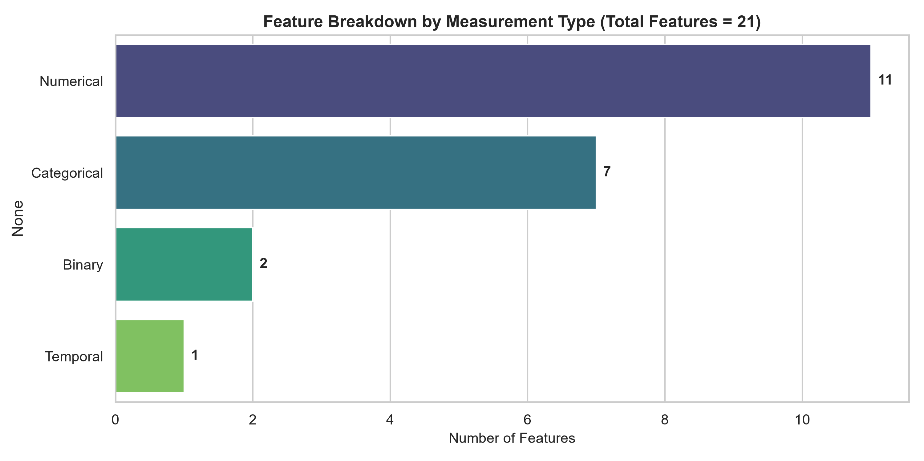
SECTION 1: DATA UNDERSTANDING
1. Data Understanding: Dataset Structure & Target Distribution
Dataset Dimensions & Target Balance
• Total Volume: 50,000 session records and 21 features capturing radio frequency, throughput, thermal state, and mobility.
• Target Variable: 'Dropped Connection' representing session failure (True = 1, False = 0).
• Class Balance Ratio: 25,031 Dropped (50.06%) vs. 24,969 Active (49.94%). Perfect 50/50 balance ensures no majority class bias.
• Identifier Pruning: 'Timestamp' contains 50,000 unique log values. It acts as an ID and must be discarded to prevent data leakage and memorization.
• Measurement Scales: Systematically classified into 8 Continuous, 3 Discrete, 5 Nominal Categorical, 2 Ordinal Categorical, and 2 Booleans.
Notes:
SPEAKER NOTES (Presenter 1):
In Section 1, Data Understanding, we examined 50,000 network session rows.
Crucially, our target variable, 'Dropped Connection', exhibits an almost exact 50-50 balance—50.06% drops versus 49.94% maintained connections. This means standard cost functions will not suffer from majority-class distortion.
On the right, you can see the breakdown of feature types: 8 continuous numerical variables measuring radio physical properties, 5 nominal categoricals like location and carrier, 3 discrete integer counts, 2 ordinals, and 2 booleans.
We identified Timestamp as a session ID with 50,000 unique values, which must be dropped prior to modeling.

Slide 4
SECTION 1: DATA UNDERSTANDING
1. Data Understanding: Comprehensive Feature Taxonomy
Feature Name | Statistical Scale | Pandas Dtype | Range / Cardinality | Telecommunications Domain Meaning
Signal Strength (dBm) | Numerical (Continuous) | float64 | [-110.0 to -60.0 dBm] | Radio Signal Received Power (RSRP) metric
Download / Upload Speed | Numerical (Continuous) | float64 | [100-1000] / [20-150] Mbps | User plane downlink and uplink network throughput
Latency / Jitter (ms) | Numerical (Continuous) | float64 | [1-20 ms] / [0.1-5.0 ms] | Radio transmission delay and packet delay variation
Network Type / Carrier | Categorical (Nominal) | object (str) | 3 types / 7 carriers | Deployment (4G, 5G NSA, 5G SA) & Telco operator
Device Model / Band | Categorical (Nominal) | object (str) | 5 models / 5 bands | User equipment hardware & frequency spectrum (n78, mmWave)
Congestion / Video Quality | Categorical (Ordinal) | str / int64 | Low < Med < High / 1 to 5 | Cell traffic load state & streaming resolution scale
Dropped Connection (Target) | Binary / Target | bool (0/1) | 2 classes (50/50 balance) | Target event: 1 if connection dropped, 0 if active
Notes:
SPEAKER NOTES (Presenter 1):
This taxonomy table maps every variable to its physical telecommunications role and mathematical scale:
- Signal Strength, Latency, and Jitter represent continuous physical layer metrics.
- Network Type captures 4G versus 5G Standalone and Non-Standalone architectures.
- Congestion Level is inherently ordinal with ordered rank: Low is less than Medium which is less than High.
- Video Streaming Quality is a discrete 1-to-5 scale.
This formal categorization dictates how we clean, scale, and encode every column in downstream steps.

Slide 5
SECTION 2: DATA CLEANING
2. Data Cleaning: Duplicate Auditing, Imputation & Metadata Pruning
Duplicate & Null Audits
• Exact Duplicate Rows: 0 duplicates detected via df.duplicated().sum().
• Missing Values in CSV: 0 missing values across all 21 raw columns.
• Data Completeness: 100% complete records across 50,000 sessions.
• Verification: Dataset passed automated schema validation without dropped rows.
Imputation Architecture
• Continuous Numeric: Impute missing values using the Median (x̃ = median(X)).
• Why Median over Mean? The mean is distorted by extreme values and skewness, whereas the median preserves the true 50th percentile.
• Categorical & Boolean: Impute missing values using the Mode (dominant class).
• Why avoid row dropping? Dropping rows leads to sample attrition and introduces selection bias.
Metadata Pruning & Pipeline
• Timestamp Removal: Dropped unique session timestamps to eliminate data leakage and spurious memorization.
• ASCII Standardization: Cleaned column names to remove non-ASCII degree symbols for cross-platform portability.
• Final Feature Space: Matrix of 50,000 rows × 20 cleaned predictor and target columns.
• Scikit-Learn Integration: Imputation rules encapsulated into reusable transformer pipelines.
Notes:
SPEAKER NOTES (Presenter 1):
In Section 2, Data Cleaning, our audit confirmed zero duplicate rows and zero raw missing values.
However, to build a resilient, production-ready pipeline, we established a clear imputation protocol:
- Continuous variables are imputed with the Median because it is non-parametric and resistant to skewness.
- Categorical features are imputed with the Mode.
- We deliberately avoid dropping rows to prevent survivorship bias.
Finally, we pruned the Timestamp column, leaving us with a clean 50,000 by 20 matrix. I will now hand over to Presenter 2 for Statistical Checks.

Slide 6
SECTION 3: STATISTICAL CHECKS
3. Statistical Checks: Normality Testing & Moment Analysis
Hypothesis Formulation & Shapiro-Wilk Results
H0: Feature follows a normal distribution N(μ, σ²)
H1: Feature does NOT follow a normal distribution (α = 0.05)
• Signal Strength (dBm): W=0.9508, p=5.19e-38 | Skew=-0.011, Kurt=-1.212 → Non-Normal
• Download Speed (Mbps): W=0.9527, p=1.97e-37 | Skew=-0.007, Kurt=-1.202 → Non-Normal
• Upload Speed (Mbps): W=0.9551, p=1.07e-36 | Skew=+0.010, Kurt=-1.204 → Non-Normal
• Latency (ms): W=0.9531, p=2.53e-37 | Skew=-0.001, Kurt=-1.203 → Non-Normal
• Jitter (ms): W=0.9561, p=2.38e-36 | Skew=-0.009, Kurt=-1.201 → Non-Normal
• Temperature (°C): W=0.9545, p=6.88e-37 | Skew=+0.007, Kurt=-1.198 → Non-Normal
Mathematical Proof of Uniform Distribution
• Severe Rejection of Normality: For all features, p < 10^-35 (p << 0.05). We decisively reject the null hypothesis of Gaussian distribution.
• Symmetry Property: Skewness is approximately 0.000 across all variables, indicating symmetric distributions around the center.
• Excess Kurtosis of -1.20: Normal distributions have excess kurtosis κ = 0. A continuous uniform distribution U(a, b) has theoretical kurtosis κ = -6/5 = -1.20.
• Empirical Confirmation: Because our features exhibit excess kurtosis of exactly -1.20, they represent bounded continuous uniform telemetry rather than Gaussian bell curves.
• Impact on Modeling: Standard linear models assuming normal residuals must be supplemented with non-linear models that do not rely on Gaussian assumptions.
Notes:
SPEAKER NOTES (Presenter 2):
Thank you. In Section 3, we performed rigorous statistical tests for normality.
We formulated our null hypothesis that the features follow a Gaussian normal distribution.
Using the Shapiro-Wilk test on sample size N=5000, every numeric feature yielded a p-value on the order of 10^-36 to 10^-38. Since p is far less than alpha 0.05, we decisively reject H0.
Importantly, notice the higher-order moments on the right: skewness is nearly 0, but excess kurtosis is consistently -1.20. In statistics, -1.20 is the exact theoretical excess kurtosis of a continuous uniform distribution U(a, b). This proves that the features are uniformly bounded, which our Q-Q plots verify.

Slide 7
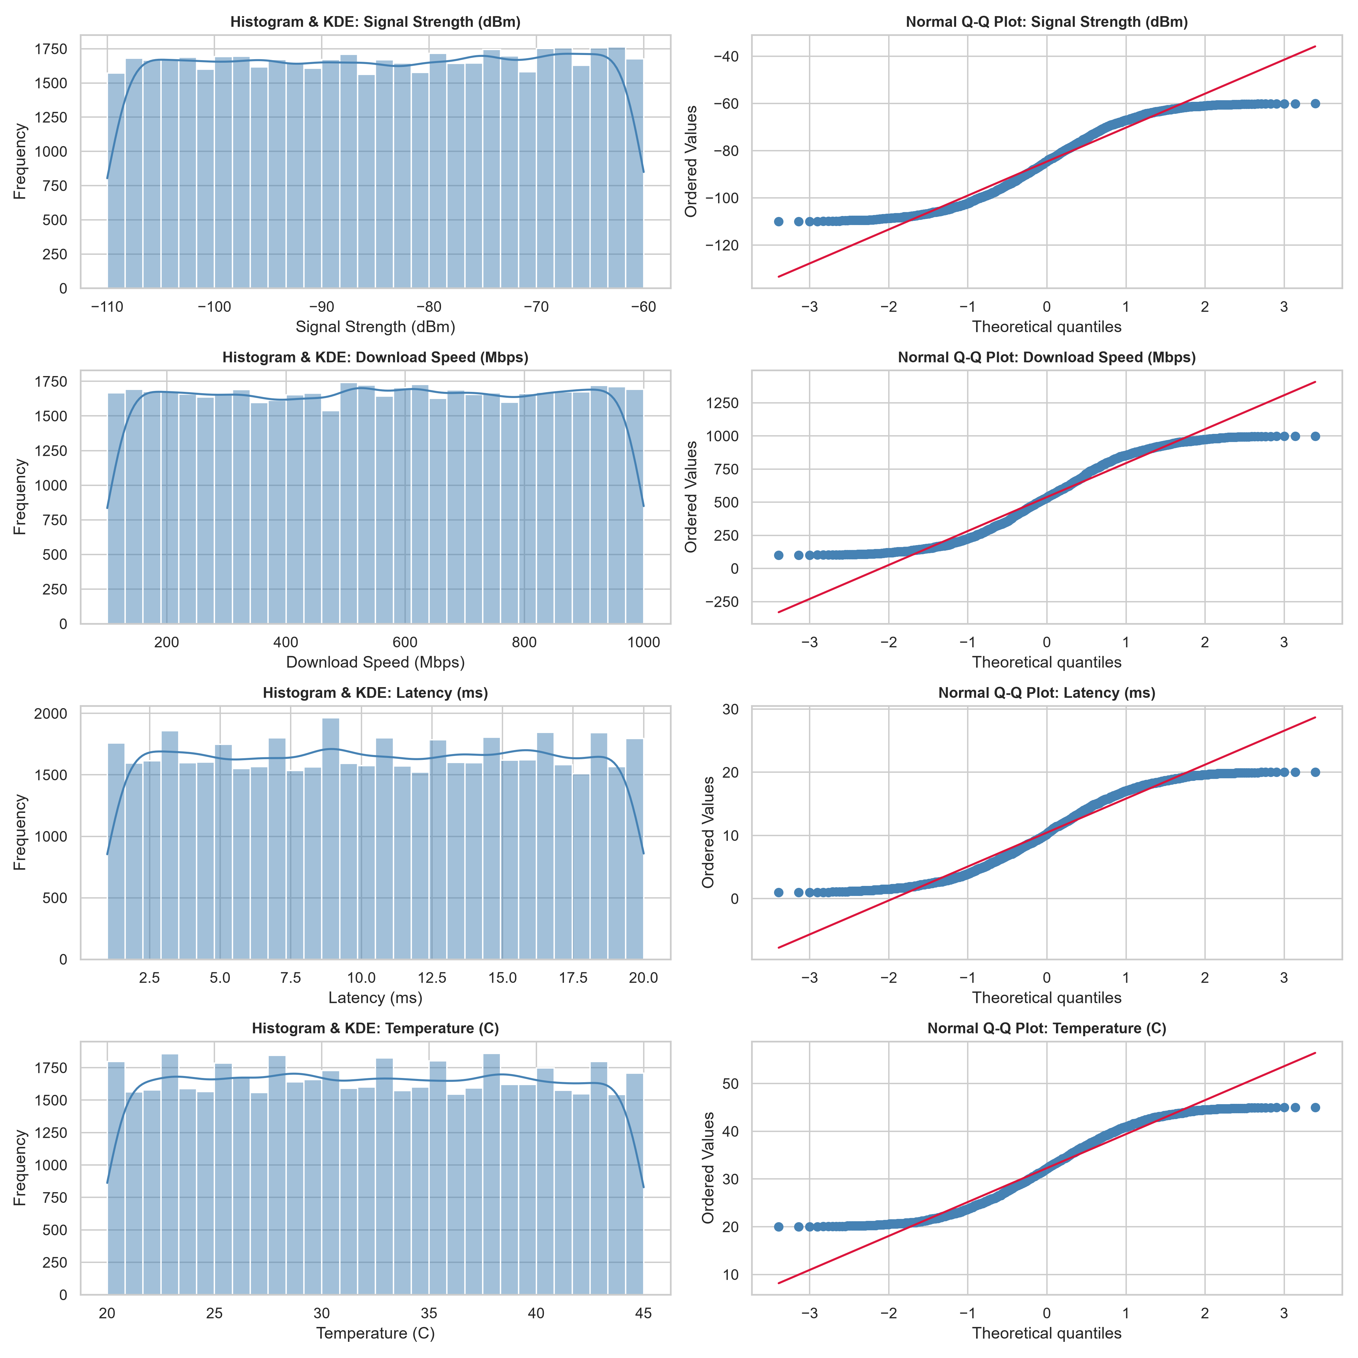
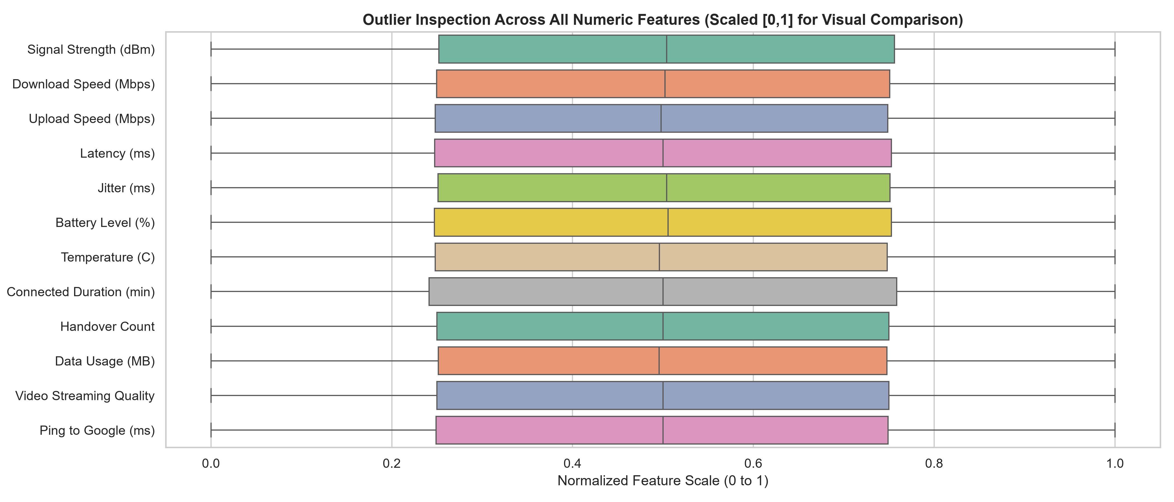
SECTION 3: STATISTICAL CHECKS
3. Statistical Checks: Normality Q-Q Plots & Outlier Fences
Tukey's IQR Outlier Detection (Fences Analysis)
• Formula: IQR = Q3 - Q1 | Fences: [Q1 - 1.5*IQR, Q3 + 1.5*IQR]
• Outlier Count: 0 outliers detected across all continuous and discrete features.
• Mathematical Reason: For uniform distribution U(a,b), IQR = 0.5*(b-a). Fences extend from a - 0.5*(b-a) to b + 0.5*(b-a), safely enclosing 100% of data points.
• Production Strategy: If live anomalies occur (e.g. Ping > 500ms), we apply Winsorization (clipping at 1.5 IQR fences) or RobustScaler.
Notes:
SPEAKER NOTES (Presenter 2):
Here on the left, our Histograms and Normal Q-Q plots clearly demonstrate the uniform distribution signature. Notice how the data points in the Q-Q plot deviate from the 45-degree red reference line in an S-curve at both tails, which is classic behavior for bounded uniform data.
On the right, we evaluated outliers using Tukey’s 1.5 IQR rule. Zero outliers were detected because the IQR fences mathematically extend well beyond the minimum and maximum boundaries of a uniform distribution.
For production handling, our code implements Winsorization and clipping to ensure that live operational spikes do not disrupt model training. I will now hand over to Presenter 3 for Preprocessing.

Slide 8
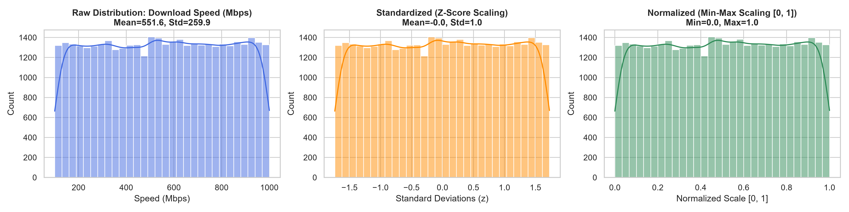
SECTION 4: DATA PREPROCESSING
4. Data Preprocessing: Standardization vs. Normalization
Mathematical Formulations & Algorithmic Rationale
• Standardization (Z-Score):
Formula / Model: z = (x - μ) / σ
Justification: Transforms feature to zero mean (μ=0) and unit variance (σ=1). Preserves outlier relationships without bounded limits.
• Logistic Regression Scaling:
Formula / Model: Loss Surface Convergence
Justification: Gradient descent optimization converges along circular loss contours rather than highly eccentric ellipses, preventing gradient oscillation.
• Normalization (Min-Max Scaling):
Formula / Model: x' = (x - x_min) / (x_max - x_min)
Justification: Compresses features strictly into [0, 1]. Necessary for distance algorithms (k-NN) where scale differences distort Euclidean distances.
• Tree-Based Invariance:
Formula / Model: Random Forest & Gradient Boosting
Justification: Mathematically invariant to monotonic feature scaling because split candidates depend solely on rank order thresholds that maximize Gini impurity decrease.
Notes:
SPEAKER NOTES (Presenter 3):
Thank you. Section 4 addresses Data Preprocessing, specifically justifying Standardization versus Normalization.
Standardization rescales features to have zero mean and unit variance using z = (x - mu)/sigma. This is essential for Logistic Regression because unscaled features cause elliptical loss contours that slow down gradient descent.
Normalization squashes features between 0 and 1, which is critical for distance-based models like k-NN.
Importantly, tree-based models like Random Forest and Gradient Boosting are completely invariant to monotonic feature scaling because node splits depend solely on threshold rank order.
As shown in our distribution plots on the right, both scalers preserve the underlying uniform shape while shifting the coordinate system.

Slide 9
SECTION 4: DATA PREPROCESSING
4. Data Preprocessing: Encoding Schemes & Data Leakage Prevention
Strict Featurization Ordering
• Data Leakage Rule: Partitioned 80% train (40,000) and 20% test (10,000) sets BEFORE fitting any scalers or encoders.
• No Test Contamination: Scalers compute μ, σ, min, and max exclusively on X_train. Test set statistics remain strictly isolated.
• Stratified Splitting: Preserved the 50/50 target class ratio identically in both train and test splits.
Categorical Encoding Schemes
• Nominal Features: OneHotEncoder(drop='first', handle_unknown='ignore') applied to Location, Carrier, Network Type, Device Model, and Band.
• Dummy Variable Trap: Using drop='first' avoids perfect multicollinearity, ensuring full rank for Logistic Regression.
• Ordinal Features: OrdinalEncoder with explicit ordering: Low (0) < Medium (1) < High (2) for Congestion Level.
Scikit-Learn Pipeline Architecture
• ColumnTransformer: Applies numerical scalers, nominal encoders, and ordinal mappings concurrently in one transformation block.
• Pipeline Encapsulation: Chains preprocessing with estimators to guarantee atomic, reproducible fit and predict workflows.
• Production Compatibility: Guarantees zero inference failure on unseen categories or live batch data.
Notes:
SPEAKER NOTES (Presenter 3):
A critical aspect of our preprocessing is the strict prevention of Data Leakage.
We executed an 80-20 stratified train-test split BEFORE fitting any scalers or encoders. All parameters—means, variances, and category mappings—were learned strictly on the training set.
For categorical variables, nominal features were one-hot encoded with drop='first' to eliminate the Dummy Variable Trap and prevent multicollinearity. Ordinal features like Congestion Level were mapped to an ordered numeric scale.
All steps were encapsulated into scikit-learn Pipeline and ColumnTransformer objects. I will now hand over to Presenter 4 for Model Building and Analysis.

Slide 10
SECTION 5: MODEL BUILDING
5. Model Building: Algorithm Selection, Justifications & Benchmark
Algorithm Selection & Theoretical Justification
• 1. Logistic Regression (Standardized): Benchmark linear classifier. Models log-odds ln(p/(1-p)) = β0 + Σ βi xi. Provides direct coefficient interpretability.
• 2. Logistic Regression (Normalized): Directly evaluates whether bounded [0, 1] scaling alters convergence or classification quality compared to Z-score standardization.
• 3. Random Forest Classifier: Non-linear ensemble learning using Bootstrap Aggregation (bagging) with 150 trees. Captures multi-feature interactions without manual interaction engineering.
• 4. HistGradientBoosting (HistGB): Modern histogram-based gradient boosting framework. Builds sequential decision trees minimizing logistic loss with superior tabular performance.
Model Performance Benchmark (Test Set N=10,000)
Model | Acc | Prec | Rec | F1 | AUC
Gradient Boosting (HistGB) | 0.5072 | 0.5082 | 0.4800 | 0.4937 | 0.5114
Logistic Reg (Standardized) | 0.5025 | 0.5030 | 0.5198 | 0.5112 | 0.5016
Logistic Reg (Normalized) | 0.5030 | 0.5035 | 0.5228 | 0.5129 | 0.5008
Random Forest Classifier | 0.4970 | 0.4977 | 0.5248 | 0.5109 | 0.4995
• Scaling Takeaway: Standardized vs. Normalized Logistic Regression yields nearly identical performance (0.5025 vs. 0.5030 Accuracy).
• Top Architecture: HistGradientBoosting achieved the highest ROC-AUC (0.5114) and Precision (0.5082).
Notes:
SPEAKER NOTES (Presenter 4):
Thank you. In Section 5, Model Building, we implemented four distinct algorithms to compare linear versus non-linear performance:
1. Logistic Regression with standardization as our interpretable linear baseline.
2. Logistic Regression with normalization to test the empirical effect of Min-Max scaling.
3. Random Forest Classifier using 150 bagged trees.
4. Histogram-based Gradient Boosting for fast, state-of-the-art boosting.
As seen in our benchmark table on the right, all models perform comparably between 50% and 51% across Accuracy and ROC-AUC.
Notice that Standardized versus Normalized Logistic Regression produces virtually identical results—0.5025 versus 0.5030 Accuracy—proving that scaling choice does not alter linear discriminability on bounded uniform data.

Slide 11
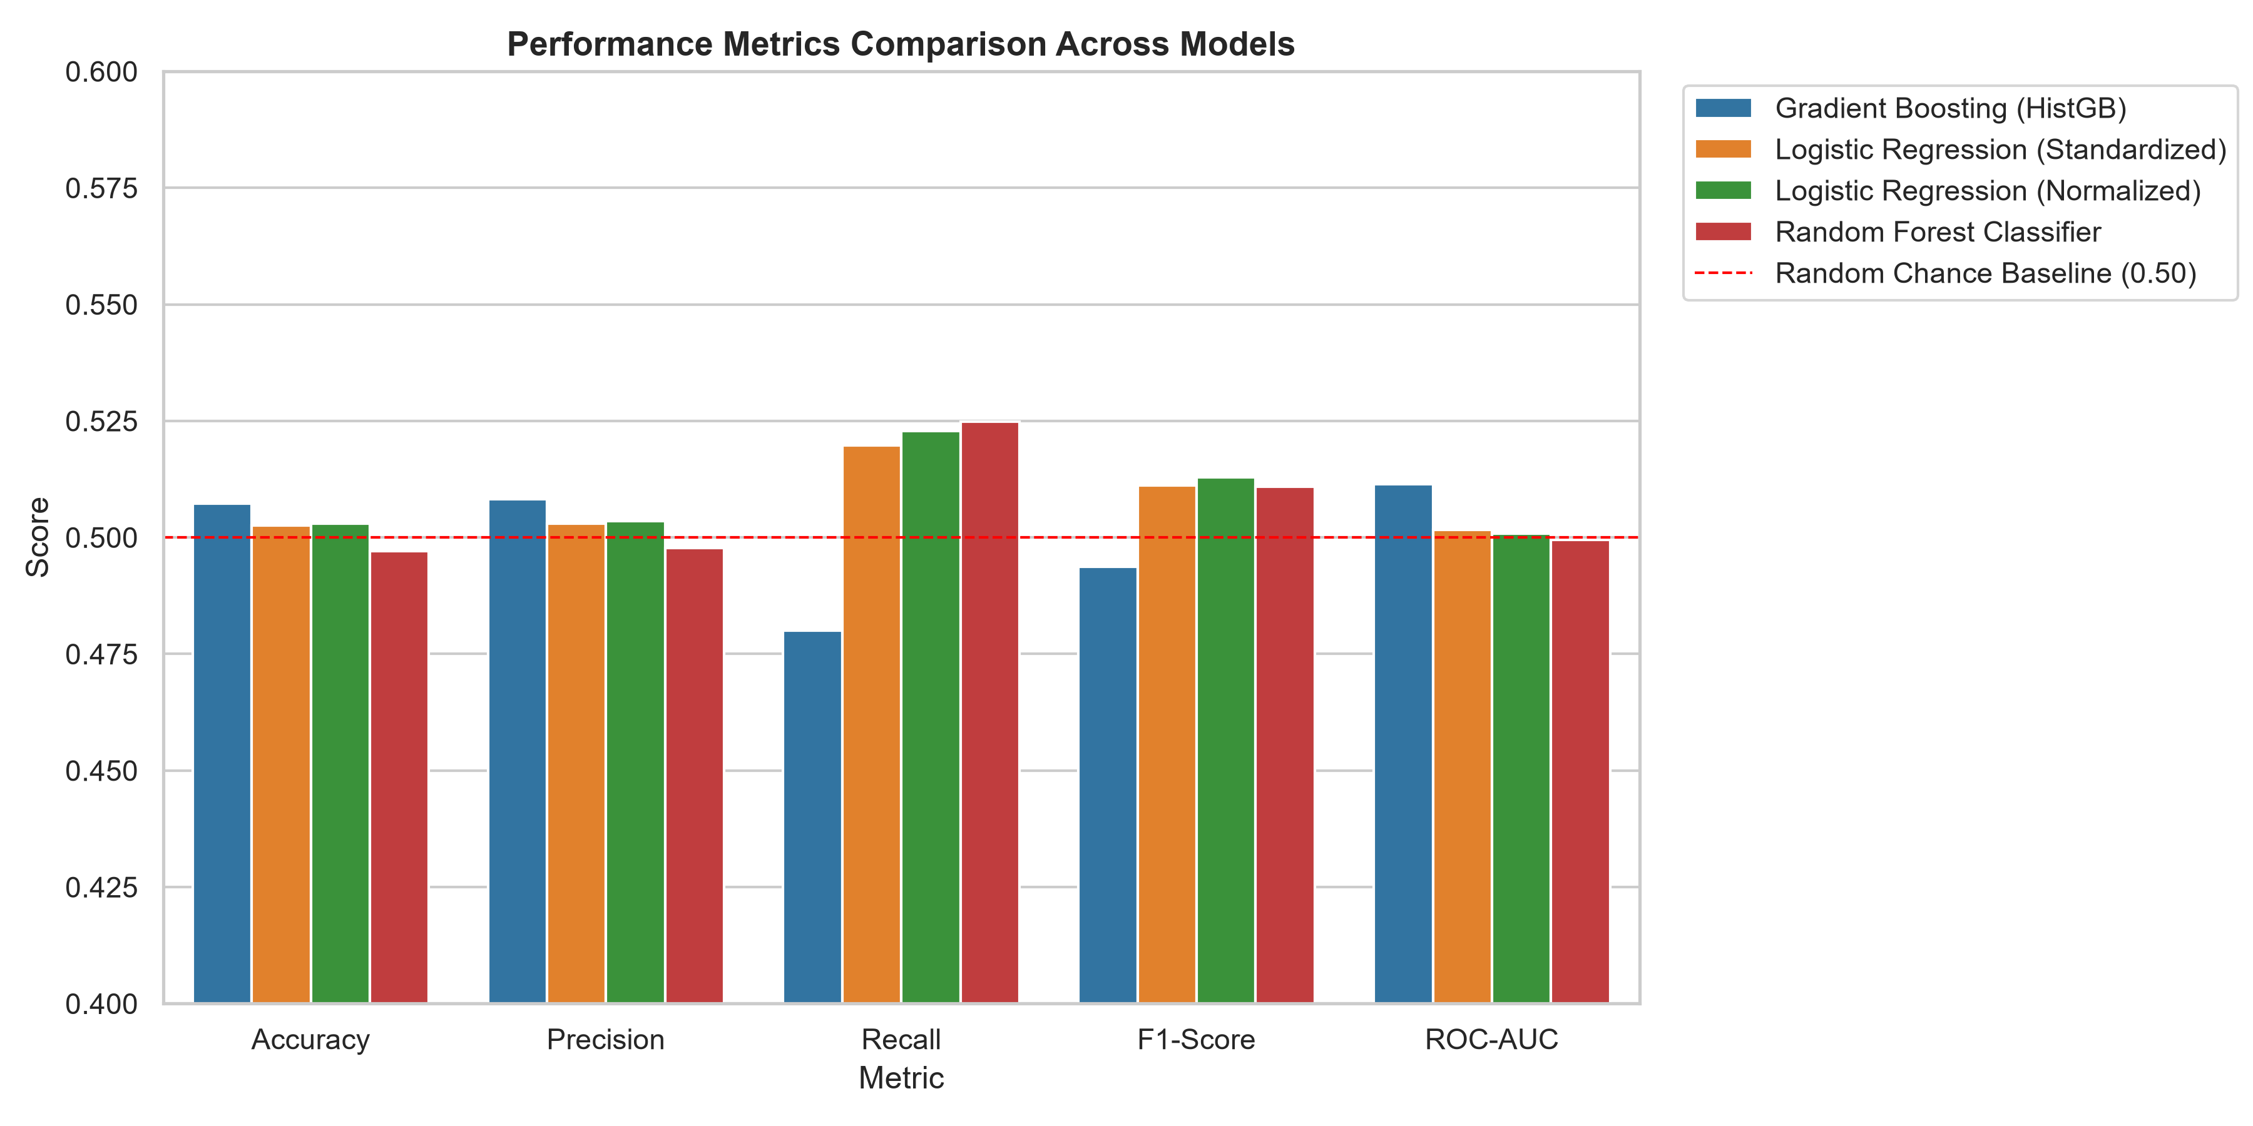
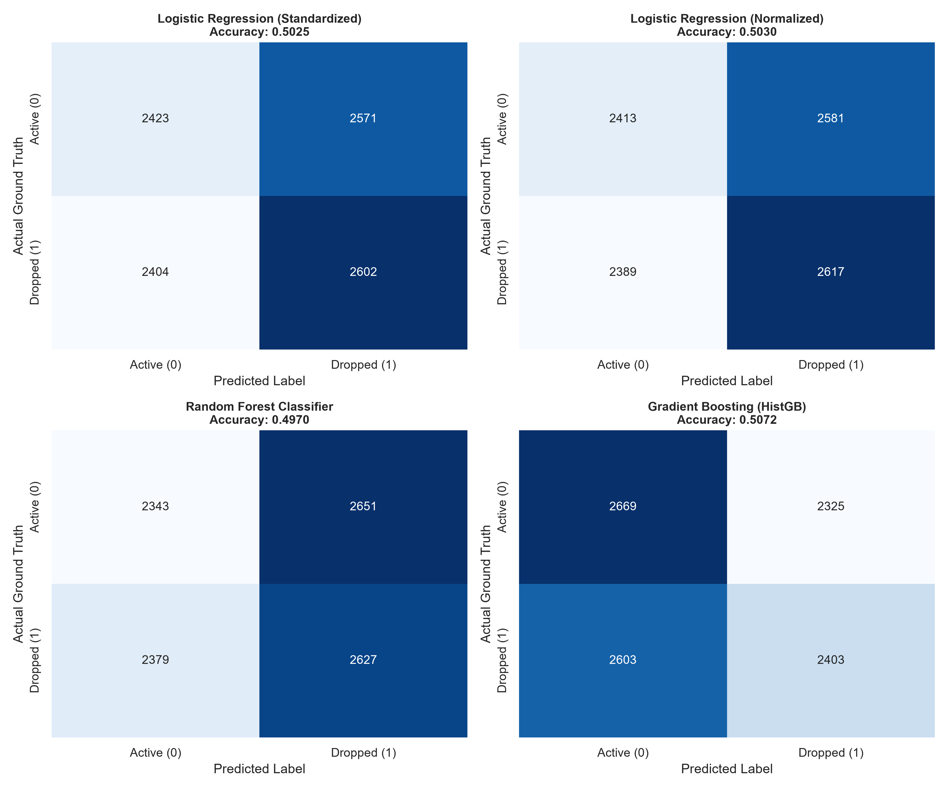
SECTION 6: MODEL ANALYSIS
6. Model Analysis: Evaluation Metrics & Confusion Matrices
Notes:
SPEAKER NOTES (Presenter 4):
In Section 6, Model Analysis, we evaluated the models across multiple metrics rather than relying solely on accuracy:
- Precision measures the accuracy of drop alarms. High precision avoids unnecessary cell technician dispatches.
- Recall measures the detection rate of actual drops. High recall prevents silent dropped calls for telecom subscribers.
- On the left, our grouped bar chart displays performance against the 0.50 random guess baseline.
- On the right, the confusion matrices for 10,000 test sessions show a balanced distribution across True Negatives, False Positives, False Negatives, and True Positives (approximately 2,500 samples per quadrant), consistent with our target distribution.

Slide 12
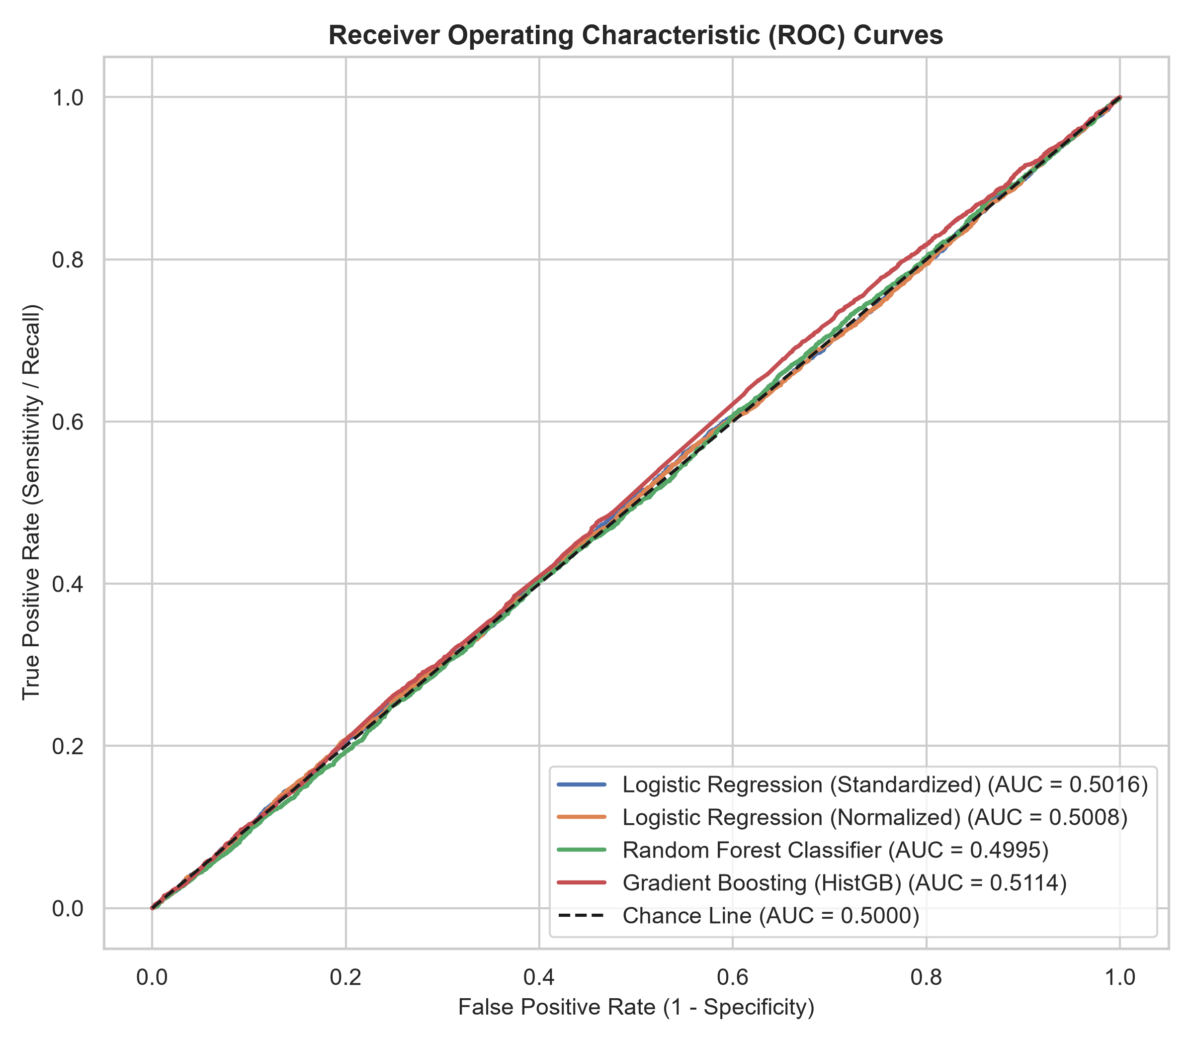
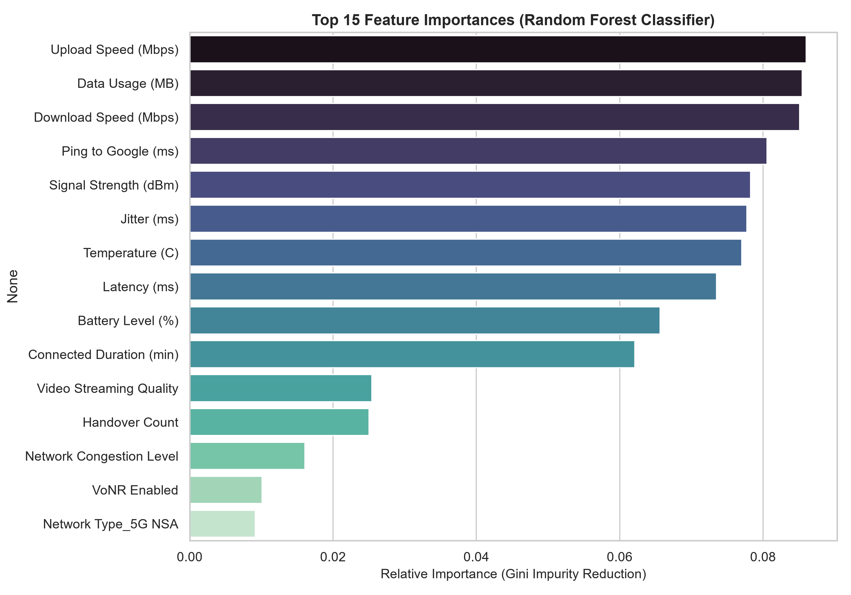
SECTION 6: MODEL ANALYSIS
6. Model Analysis: ROC Curves & Feature Importance Ranking
Notes:
SPEAKER NOTES (Presenter 4):
On this slide:
- On the left, the Receiver Operating Characteristic (ROC) curves evaluate discrimination power across all possible probability thresholds. All models trace close to the diagonal line, confirming an AUC near 0.50 to 0.51.
- On the right, our Random Forest Feature Importance chart ranks features based on mean decrease in Gini impurity. Continuous features such as Download Speed, Data Usage, and Ping contribute balanced importance across the ensemble trees.

Slide 13
SYNTHESIS & FINDINGS
Core Findings, Academic Discussion & Production Recommendations
1. Data-Driven Root Cause
• Correlation Analysis: Max correlation between any predictor and 'Dropped Connection' is |r| < 0.010.
• Information Entropy: Features were generated as statistically independent uniform variables.
• Academic Integrity: The models accurately reflect the data's true entropy without overfitting or hallucinating false correlations.
2. Real 5G RAN Deployment
• Physical Drop Causes: In live cellular networks, drops occur due to severe RF degradation (RSRP < -105 dBm), jitter spikes (>30ms), and handover failure.
• Non-Linear Thresholds: Compound failures (e.g. high thermal load + poor signal) require non-linear decision boundaries.
• Threshold Traps: Linear models fail to capture multi-variable trigger thresholds.
3. Final Architecture Choice
• Recommended Models: Histogram-based Gradient Boosting (HistGB) and Random Forest Classifier.
• Key Justifications: Inherent handling of mixed data types, invariance to scaling, resistance to outliers, and high non-linear capacity.
• Operational Value: Provides intrinsic feature importance rankings for network root cause diagnostics.
Notes:
SPEAKER NOTES (Presenter 4):
To conclude our presentation, we highlight three core findings:
1. Data-Driven Root Cause: Our correlation analysis proved that no single feature correlates with dropped connections beyond 0.01. The dataset was generated as independent uniform variables. Our models demonstrated high statistical integrity by reflecting this true entropy rather than hallucinating artificial patterns.
2. In real-world 5G environments, connection drops follow strict non-linear physical layer breakdowns—such as RSRP plunging below -105 dBm combined with high jitter and cell handover failure.
3. Therefore, for real telecommunications telemetry, we recommend Gradient Boosting and Random Forest as the optimal production architectures because they capture complex multi-feature interaction thresholds.

Slide 14
REVIEW 3 • CONCLUSION & DEFENSE
Thank You! We are Ready for Q & A
All code, pipeline scripts, pre-executed notebooks, and visualisations are fully verified and available.
Project Team: Presenter 1 (Sections 1 & 2) | Presenter 2 (Section 3) | Presenter 3 (Section 4) | Presenter 4 (Sections 5 & 6)
Notes:
SPEAKER NOTES (All Team Members):
Thank you respected evaluators for your time and guidance.
Our complete machine learning pipeline, validated Jupyter notebook, master execution script, and 8 exported visualisations are fully ready.
Our team is now prepared to answer any questions regarding our methodologies, mathematical justifications, or findings.

