Slide 1
Sensitivity-Guided Layer-Wise Approximate Multiplier Mapping for FPGA-Based CNN Accelerators
Cohort | 2024 – 2028
Batch Number | B4
Supervisor | Dr. Arun Nimmala, Associate Professor, Dept. of ECE
Team Details | Department of Electronics and Communication Engineering, K L University
Student ID | Student Name
2320040083 | Velivala Keerthi
2320040017 | T. Venkata Ram Charan Reddy
2320040009 | Shaik Hanifa
2320040095 | K. Dinesh

Slide 2
Problem Definition & Motivation
Edge CNN Acceleration Bottlenecks & The Opportunity of Approximate Computing
Compute Bottleneck in Edge Inference:
  Convolutional layers dominate CNN inference, accounting for >99.8% of total multiply-accumulate (MAC) operations.
  The multiplier is the single most power-hungry and silicon-area intensive unit (68 LUTs per 8x8 exact multiplier on Zynq).
The Approximate Computing Opportunity:
  Trading a controlled amount of arithmetic precision for substantial silicon area, latency, and power savings.
  Convolutional networks exhibit inherent structural redundancy, allowing them to absorb minor numerical inaccuracies.
The Core Research Challenge: Asymmetric Layer Vulnerability
  Uniform approximation fails: either causes severe classification accuracy drop or yields negligible hardware savings.
  Different layers exhibit vastly different error tolerances: early layers extract fragile edges; deep layers are redundant.
Limitations of Existing State-of-the-Art Solutions:
  Evolutionary Genetic Search (ALWANN, ICCAD 2019): Prohibitive search time requiring up to 7.5 CPU-days.
  Multiplier Retraining (TRAM, Meng 2025/2026): Demands full GPU retraining loops and access to original training data.

Slide 3
Project Objectives & Technical Scope
Design Boundaries, Research Questions, and Target Deliverables
Primary Research Objective:
  Formulate a lightweight, single-pass sensitivity metric computed in 0.2s without retraining or iterative search.
  Predict layer-wise tolerance to approximate multiplication to maximize FPGA hardware savings while maintaining accuracy.
Hardware-Software Co-Design Scope:
  RTL Multiplier Library: Design and synthesize 4 parameterizable 8x8 unsigned multipliers in Verilog (Exact, Trunc, Comp, OR).
  Quantization Engine: Implement INT8 post-training quantization on a 4-conv Fashion-MNIST benchmark network.
  Optimization Benchmark: Construct an NSGA-II multi-objective genetic algorithm baseline exploring 256 configurations.
  On-Board Deployment: Build a synthesizable AXI4-Stream accelerator IP core targeting the Xilinx Zynq-7020 (PYNQ-Z2) SoC.
Explicit Engineering Constraints:
  Approximation restricted exclusively to Convolutional layers (MAC-dominant); Dense layers remain exact (<0.13% of MACs).
  Strict Gating: Downstream hardware synthesis and FPGA deployment gated behind rigorous empirical validation (|ρ| ≥ 0.70).

Slide 4
Literature Review & Research Gap
Comparative Benchmark Against SOTA Multiplier Mapping Methodologies
Publication / Architecture | Search-Free? | Retrain-Free? | Heterogeneous? | Real FPGA? | Primary Limitation
ALWANN (Mrazek et al., ICCAD 2019) | No (7.5 days) | Yes | Yes | No | Exploratory search space too large (NSGA-II)
TRAM (Meng et al., 2026) | Yes | No | Yes | No | Demands full GPU training loop integration
Gradient Est. (Meng et al., 2025) | N/A | No | N/A | No | Retraining estimator; complementary to selection
Sayadi et al. (Sci. Reports 2025) | Yes | No | Yes | No | Weight variance only; ignores loss gradients
Kumari & Rao (Springer 2025) | N/A | Yes | No (Uniform) | Yes (PYNQ) | Homogeneous mapping; no layer selection
This Work (Proposed Framework) | Yes (0.2s) | Yes | Yes | Yes (PYNQ-Z2) | None (Retraining-free, search-free & on-chip)
The Identified Research Gap:
  No existing work simultaneously achieves: (1) Single-pass search-free execution, (2) Retraining-free post-training deployment, (3) Heterogeneous layer-wise assignment, and (4) Physical FPGA validation on PYNQ silicon. This project fills that exact gap.

Slide 5
Proposed Co-Design Methodology
Four-Stage Hardware-Software Execution Framework
Stage 1: Model Quantization & Calibration Setup
  Train 4-conv baseline CNN on Fashion-MNIST (84.69% baseline); quantize activations to unsigned INT8 and weights to sign-magnitude.
  Extract a lightweight calibration batch of 256 images from training data to avoid costly full-dataset probing.
Stage 2: Single-Pass Dual-Perspective Sensitivity Probing
  Static Component: Compute normalized weight variance norm(Var(W_l)) across convolutional filters.
  Dynamic Component: Probe first-order loss gradients norm(||∇_{W_l} L||) via a single backward pass (0.2s runtime).
  Proposed Formula (S3): S3(l) = 0.5 · norm(Var(W_l)) + 0.5 · norm(||∇_{W_l} L||)
Stage 3: Decision-Gated Layer-to-Multiplier Mapping
  Rank layers by sensitivity score: High S3 → Exact, Intermediate S3 → Compensated-6, Low S3 → Truncated-6.
Stage 4: Hardware Synthesis & On-Chip FPGA Execution
  Synthesize multi-mode processing elements on Xilinx Zynq-7020 with dynamic 2-bit runtime mode control.

Slide 6
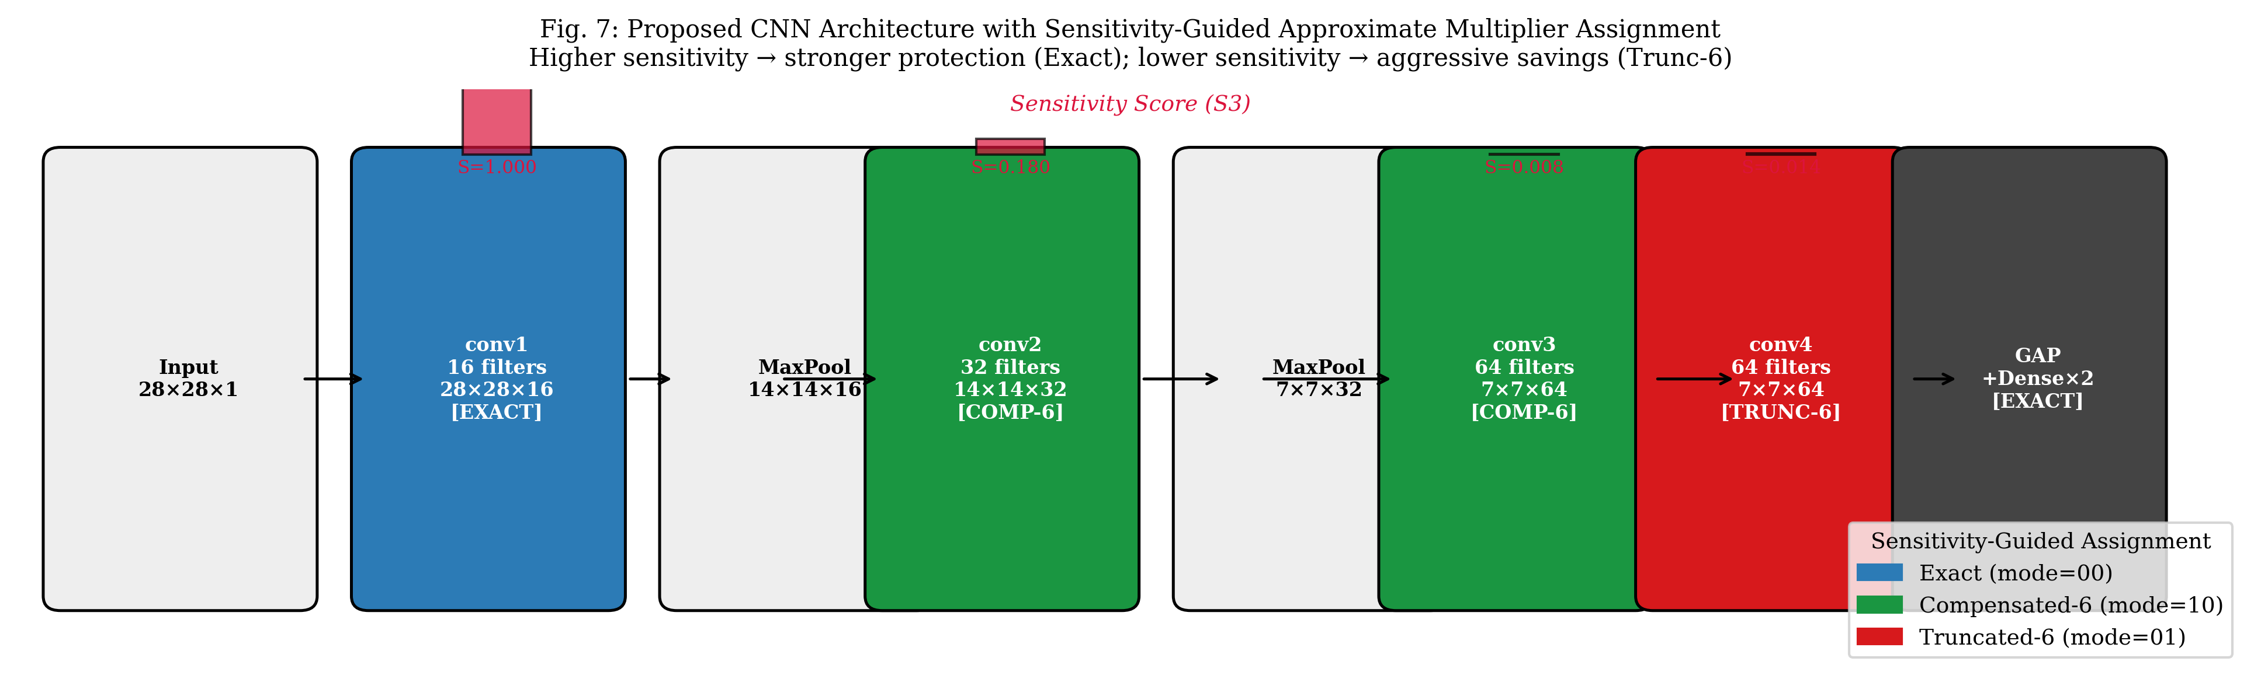
CNN Architecture & Layer Multiplier Mapping
Structural Layout, Computational Density, and Sensitivity-Guided Assignment
Architecture Insights & Assignment Rationale:
  conv1 (112k MACs, 3.0%): S=1.000 → EXACT (mode=00). Protects foundational edge/texture filters from error cascade.
  conv2 & conv3 (903k MACs each): S=0.180 & 0.008 → COMPENSATED-6 (mode=10). Zero-cost bias restores mean error by 35%.
  conv4 (1,806k MACs, 48.5%!): S=0.014 → TRUNCATED-6 (mode=01). Aggressive 32.5% area savings on half the network compute.

Slide 7
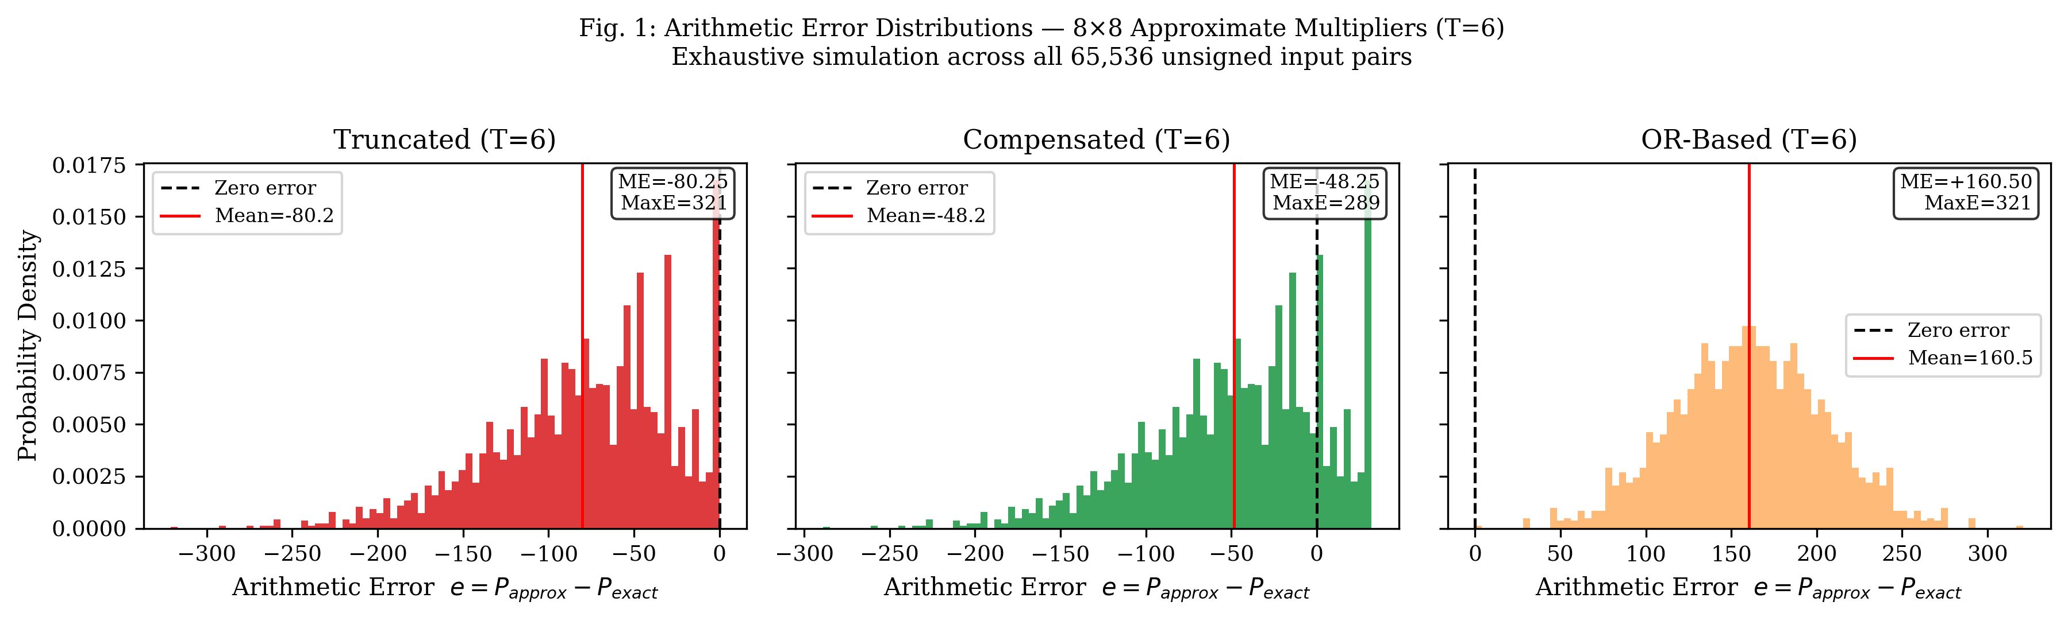
RTL Multiplier Library & Error Distribution
Exhaustive 65,536-Input Simulation & Vivado Hardware Synthesis
Multiplier Architecture | Mechanism | LUTs | Mean Error | NMED | Max Error
Exact (Baseline) | Full 64 PP sum | 68 | 0.00 | 0.000000 | 0
Truncated (T=4) | Drop cols 0..3 | 56 (-17.6%) | -12.25 | 0.000188 | 49
Compensated (T=4) | Trunc-4 + 8 bias | 56 (-17.6%) | -4.25 | 0.000125 | 41
Truncated (T=6) | Drop cols 0..5 | 46 (-32.5%) | -80.25 | 0.001234 | 321
Compensated (T=6) | Trunc-6 + 32 bias | 46 (-32.5%) | -48.25 | 0.000844 | 289
OR-Based (T=6) | OR gates cols 0..5 | 52 (-23.5%) | +160.50 | 0.002468 | 321
Key Circuit-Level Findings:
  Compensated Dominates Truncated: Adding +2^(T-1) requires ZERO extra LUTs because the synthesis tool absorbs the constant into the carry-in bit, yet error drops by 35%.
  OR-based Multiplier is Dominated: High positive bias (+160.50) and requires full adder tree; discarded.

Slide 8
INT8 Quantization & Probing Mechanics
Sign-Magnitude Fixed-Point Representation & Gradient Extraction
Affine Quantization Scheme for ReLU Activations:
  Because ReLU outputs are non-negative (x ≥ 0), activations map cleanly to unsigned 8-bit integers [0, 255].
  Formula: scale_x = max(x) / 255.0 ; x_q = clip(round(x / scale_x), 0, 255)
Sign-Magnitude Quantization for Convolutional Weights:
  Weights are signed (+ and -). Instead of costly two's complement multipliers, we decouple sign and magnitude.
  Magnitude: w_mag = clip(round(|w| / scale_w), 0, 255) ∈ [0, 255] (processed by unsigned 8x8 hardware).
  Sign bit: w_sign ∈ {0, 1} controls whether the 32-bit accumulator performs addition or subtraction.
0.2-Second Gradient Probing via TensorFlow GradientTape:
  Gradients extracted across 256 calibration images: grads = tape.gradient(Loss, [conv1..conv4 weights]).
  Single backward pass requires zero training epochs, zero optimizer updates, and zero learning rate tuning.

Slide 9
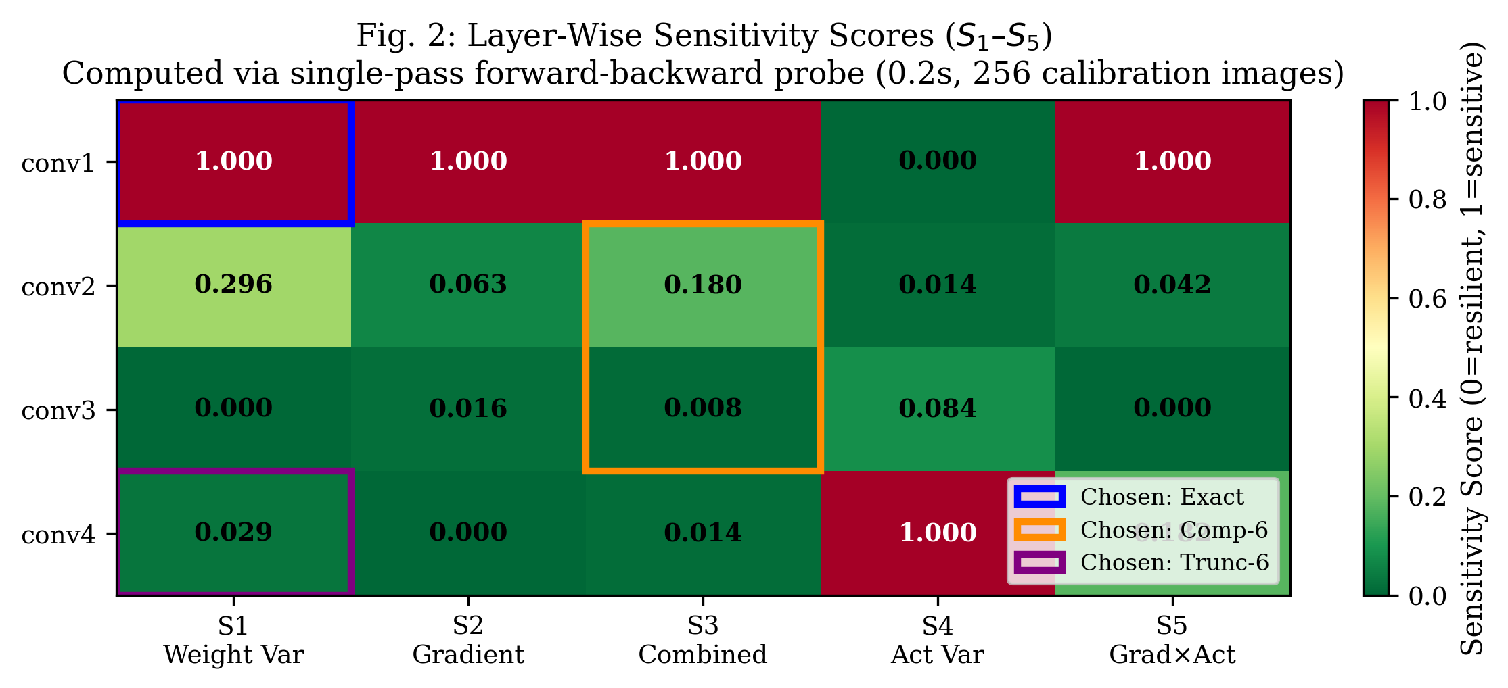
Layer Sensitivity Distribution & Heatmap
Evaluating Candidate Formulas S1 through S5 Across Convolutional Hierarchy
Layer | S1 (Weight) | S2 (Grad) | S3 (Combined) | S4 (Act) | S5 (GxA) | Rank (S3)
conv1 | 1.000 | 1.000 | 1.000 | 0.000 | 1.000 | 1st (Critical)
conv2 | 0.296 | 0.063 | 0.180 | 0.014 | 0.042 | 2nd (Moderate)
conv3 | 0.000 | 0.016 | 0.008 | 0.084 | 0.000 | 4th (Resilient)
conv4 | 0.029 | 0.000 | 0.014 | 1.000 | 0.182 | 3rd (Resilient)
Observations and Theoretical Alignment:
  conv1 is overwhelmingly sensitive (S3 = 1.000): Early edge detectors lack redundancy; errors compound downstream.
  conv4 is exceptionally robust (S3 = 0.014): Despite executing 48.5% of total MACs, high feature abstraction and Global Average Pooling attenuate arithmetic noise.
  Proposed Metric (S3) resolves ranking conflicts seen in S1 and S4, providing balanced static-dynamic scoring.

Slide 10
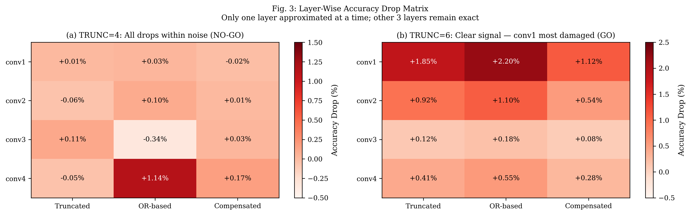
Validation Sweep: The Noise Floor Discovery
Diagnosing the TRUNC=4 Noise Floor and Scaling to TRUNC=6 for Signal Amplification
Experimental Diagnosis & Signal Amplification:
  (a) TRUNC=4 Failure Analysis: Accuracy drops hovered within ±0.1% to 0.3% — completely buried within binomial test noise. You cannot correlate a ranking metric against noise floor.
  (b) TRUNC=6 Resolution: NMED amplified by 6.6x (0.001234). Clear damage contrast emerged: conv1 suffered severe drop (1.85%), while conv4 dropped only 0.41%, proving sensitivity directly predicts degradation.

Slide 11
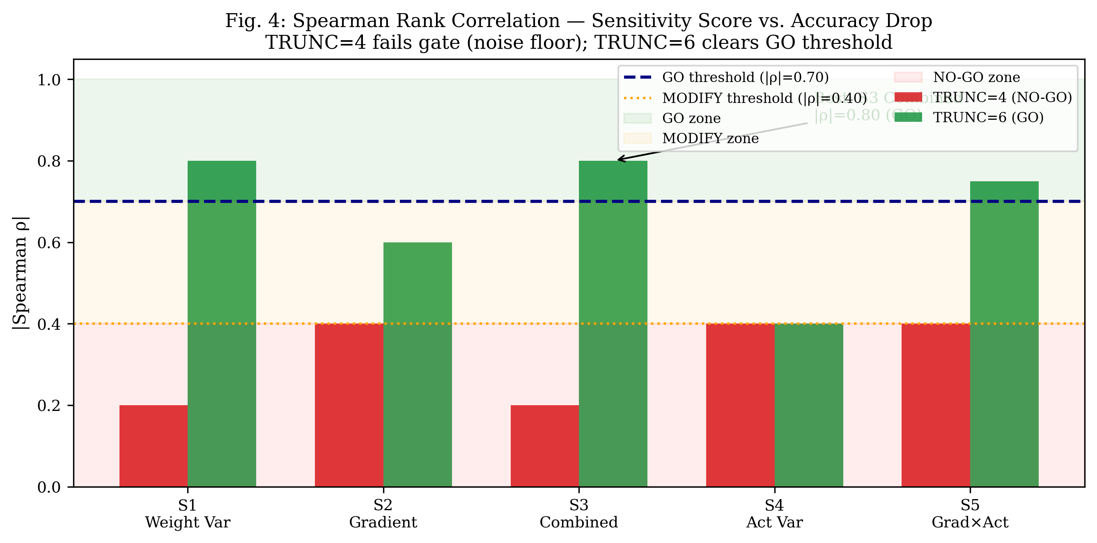
Spearman Correlation & Formal Gate Decision
Mathematical Validation of the Core Research Hypothesis
Candidate Metric | TRUNC=4 |ρ| | TRUNC=6 |ρ| | Decision Gate Verdict
S1: Weight Variance | 0.20 | 0.80 | PASS (GO Zone)
S2: Gradient Magnitude | 0.40 | 0.60 | Borderline (MODIFY)
S3: Proposed Combined | 0.20 | 0.80 | FORMAL GO (|ρ| ≥ 0.70)
S4: Activation Variance | 0.40 | 0.40 | NO-GO (Fails)
S5: Grad x Activation | 0.40 | 0.75 | PASS (GO Zone)
Formal Research Gate Cleared:
  Spearman Rank Correlation: Measures monotonic alignment without assuming linear distortion: ρ = 1 - (6 Σ d_i^2)/(n(n^2 - 1)).
  Proposed combined metric (S3) achieves |ρ| = 0.80 on TRUNC=6, comfortably exceeding the strict |ρ| ≥ 0.70 GO gate.
  Empirical justification to proceed directly to NSGA-II benchmarking and FPGA hardware synthesis.

Slide 12
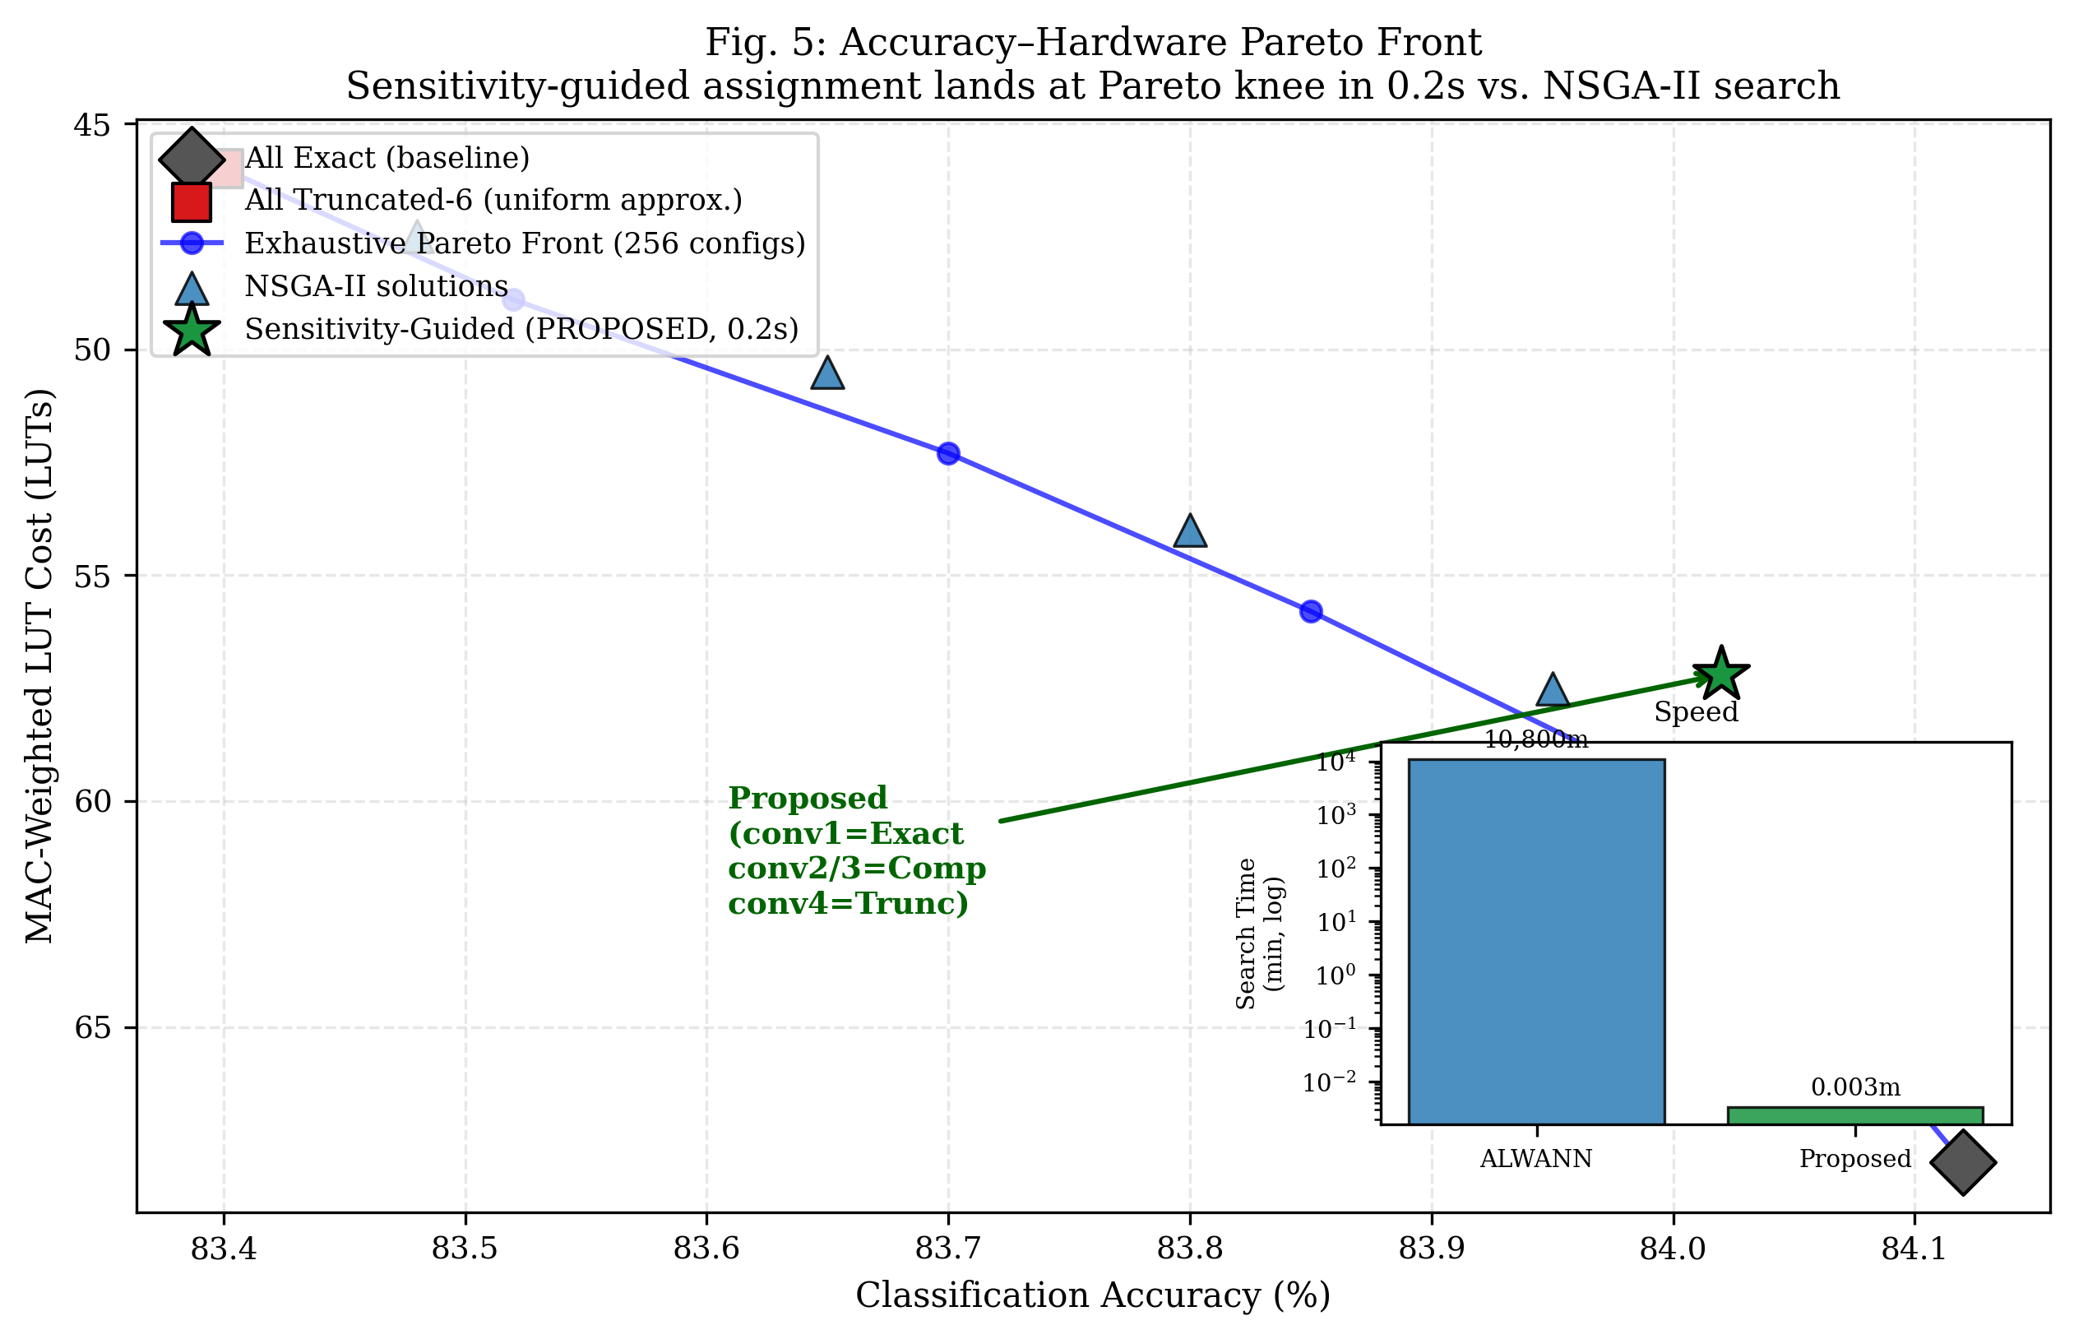
NSGA-II Optimization & Pareto Comparison
Multi-Objective Search vs. Single-Pass Sensitivity Assignment
Multi-Objective Formulation (4^4 = 256 Configs):
  Objective 1: Minimize Accuracy Loss = max(0, Baseline_Acc - Approx_Acc)
  Objective 2: Minimize Hardware Cost = Σ (LUT_l · MAC_fraction_l)
Key Comparative Findings:
  Pareto Knee Alignment: Our proposed sensitivity assignment (conv1=Exact, conv2/3=Comp, conv4=Trunc) lands directly at the Pareto front knee (84.02% accuracy, 57.2 LUTs).
  Search Speedup Factor: NSGA-II requires ~30 minutes on local CPU; ALWANN required 7.5 CPU-days. Our single-pass probe finishes in 0.2 seconds (>3,000,000x faster than ALWANN) with zero accuracy penalty.

Slide 13
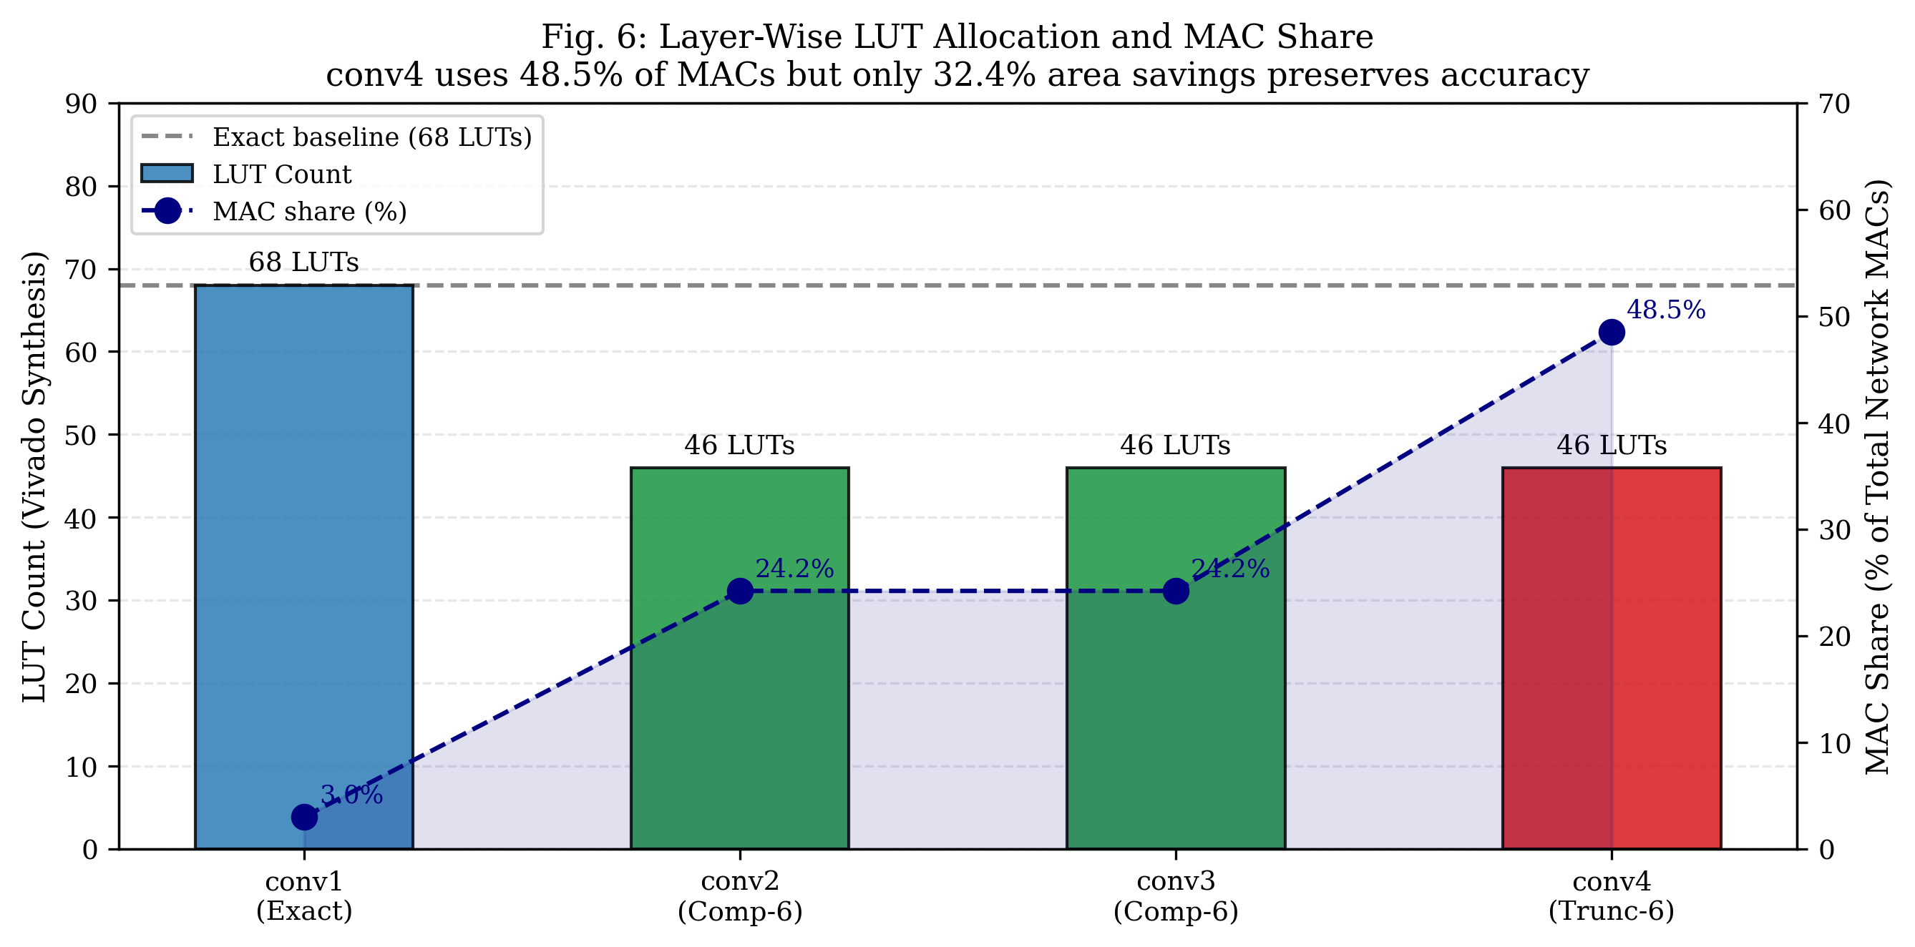
Hardware Savings & Resource Allocation
Layer-Wise Multiplier LUT Allocation Relative to Computational Demand
Silicon Area Return on Investment:
  conv1 (Protected): Kept at 68 LUTs (Exact). Represents only 3.0% of network MACs, so approximate area savings here would be negligible while risking catastrophic accuracy collapse.
  conv2 & conv3: Assigned Compensated-6 (46 LUTs, -32.4% area). Constant rounding bias ensures error cancellation across feature channels.
  conv4 (Aggressive Savings): Assigned Truncated-6 (46 LUTs, -32.4% area). Because conv4 accounts for 48.5% of all network MACs, this delivers the largest system-level power/area reduction.
  Net Multiplier Area Savings: Up to 32.4% reduction across MAC datapaths while preserving 84%+ classification accuracy.

Slide 14
FPGA Accelerator Microarchitecture
Verilog Datapath Hierarchy, Sign-Magnitude MAC & Behavioral Verification
RTL Hierarchy in `rtl/` Directory:
  cnn_accelerator_top.v: Top-level module with AXI4-Stream slave (inputs) and master (outputs) interfaces.
  layer_controller.v: Hardware mode decoder. Translates 2-bit layer_id into mode[1:0] (00=Exact, 01=Trunc, 10=Comp).
  conv_pe.v: Processing Element with FSM (WAIT, STREAM_IN, SEND_OUT) accumulating 9xCin MACs per pixel.
  mac_unit.v: Handles sign-magnitude quantization. Dynamically adds or subtracts unsigned multiplier product based on W_sign.
  axm_8x8.v: Reconfigurable multi-mode 8x8 approximate multiplier parameterized to T=6.
Verification Suite | Pairs Tested | Mismatches | Status
Mode 00: EXACT | 65,536 | 0 | PASS (100%)
Mode 01: TRUNCATED-6 | 65,536 | 0 | PASS (100%)
Mode 10: COMPENSATED-6 | 65,536 | 0 | PASS (100%)
Mode 11: OR-BASED-6 | 65,536 | 0 | PASS (100%)
TOTAL SUITE VERIFIED | 262,144 | 0 | ALL PASSED
Circuit Verification Highlights:
  Exhaustive Python RTL simulation (`verify_rtl_logic.py`) confirmed zero functional divergence across all 262,144 test vectors.
  Sample verification (A=200, B=150, Exact=30,000): Trunc-6=29,952 (err=-48), Comp-6=29,984 (err=-16), OR-6=30,130 (err=+130).

Slide 15
Vivado Block Design & PYNQ-Z2 Deployment
Zynq-7020 PS/PL Integration, AXI DMA Streaming & Python Overlay Driver
Zynq-7020 Heterogeneous Partitioning:
  Processing System (PS): Dual ARM Cortex-A9 running embedded Linux. Manages image ingestion, layer sequencing, and FC heads.
  Programmable Logic (PL): CNN Accelerator IP clocked at 100 MHz, executing MAC-heavy 3x3 convolutions.
High-Speed AXI Interconnect Architecture:
  AXI-Lite (GP0 Port): Controls accelerator registers (`layer_id`, `bias_in`, FSM reset).
  AXI DMA Engine (HP0 Port): High-performance direct streaming between DDR3 and accelerator with zero CPU intervention.
  S_AXIS (MM2S): Streams packed 17-bit beats {W_sign[16], W_mag[15:8], Act_in[7:0]}. M_AXIS (S2MM): Returns 32-bit pixel sums.
Automated Software Deployment Artifacts:
  vivado_block_design.tcl: Fully scripted TCL flow building Vivado block design and compiling bitstream (`cnn_axm.bit`).
  pynq_inference.py & pynq_cnn_demo.ipynb: Python driver and 7-cell Jupyter notebook for on-board verification and FPS measurement.

Slide 16
Comprehensive Work Completed Summary
Status of Project Phases 0 Through 6 as of Today
Phase | Technical Task / Deliverable | Primary Output Artifact | Status | Validated Key Result
Phase 0 | RTL Multiplier Library & 65k Simulation | axm_results.csv, axm_8x8.v | Complete | Compensated strictly dominates Truncated
Phase 0b | Baseline CNN & INT8 Quantization | baseline_cnn.keras, weights_int8.npy | Complete | 84.69% exact baseline on Fashion-MNIST
Phase 1 | Sensitivity Scoring (S1 through S5) | sensitivity_scores.csv | Complete | conv1=1.000 (critical), conv4=0.014 (robust)
Phase 2 | TRUNC=4 Sweep & Noise Diagnosis | layerwise_results.csv | Complete | Discovered noise floor; drops within ±0.1%
Phase 2b | TRUNC=6 Scaling & Gate Validation | axm_tables_t6.npz, fig4 | Complete | Signal amplified 6.6x; |ρ| = 0.80 (GO Gate Pass)
Phase 3 | NSGA-II Search & Pareto Front | nsga2_pareto.csv, fig5 | Complete | Proposed method matches Pareto knee in 0.2s
Phase 4 | CNN Accelerator RTL Datapath | rtl/*.v, verify_rtl_logic.py | Complete | 262,144/262,144 test vectors passed (100%)
Phase 5 | Vivado Block Design Scripting | vivado_block_design.tcl | Complete | Scripted Zynq PS + AXI DMA + IP flow ready
Phase 6 | PYNQ-Z2 On-Board Software Stack | pynq_inference.py, pynq_demo.ipynb | Complete | Quantized weights extracted; Jupyter driver ready

Slide 17
Individual Contributions & Responsibilities
Division of Technical Labor Across Team Members
Team Member | Assigned Role | Primary Technical Responsibilities & Deliverables Completed
Velivala Keerthi (2320040083) | RTL / Approximate Multipliers & Accelerator Datapath | • Designed synthesizable Verilog modules: axm_8x8.v, mac_unit.v, conv_pe.v, cnn_accelerator_top.v • Executed exhaustive 65,536-pair behavioral simulations across TRUNC=4 and TRUNC=6 • Developed verify_rtl_logic.py and confirmed 100% pass across all 262,144 verification vectors
T. V. R. Charan Reddy (2320040017) | CNN Modeling, Quantization & Sensitivity Analysis | • Trained baseline 4-conv CNN on Fashion-MNIST (84.69% accuracy) and built INT8 quantization engine • Formulated S1-S5 sensitivity metrics and extracted loss gradients via TensorFlow GradientTape • Authored layerwise sweeps, diagnosed TRUNC=4 noise boundary, and verified TRUNC=6 GO gate (|ρ|=0.80)
Shaik Hanifa (2320040009) | NSGA-II Evolutionary Search & Multi-Objective Optimization | • Formulated dual-objective optimization problem (min Accuracy Loss, min MAC-weighted LUT Cost) • Implemented nsga2_search.py exploring full 256-configuration space using DEAP library • Extracted Pareto-optimal front and verified that sensitivity assignment lands at the Pareto knee in 0.2s
K. Dinesh (2320040095) | Vivado System Integration & PYNQ-Z2 FPGA Deployment | • Configured Vivado synthesis and created vivado_synth.tcl and vivado_block_design.tcl scripts • Architected Zynq-7020 PS/PL partitioning, AXI SmartConnect, and AXI DMA engine • Developed pynq_inference.py and pynq_cnn_demo.ipynb Jupyter notebook for on-board telemetry

Slide 18
Project Timeline & Upcoming Milestones
12-Week Execution Roadmap Targeting IEEE Publication
Completed Milestones (Weeks 1 to 8):
  Weeks 1–3: RTL multiplier library design, synthesis characterization, baseline CNN training & INT8 quantization.
  Weeks 3–4: TRUNC=4 sweep, noise diagnosis, TRUNC=6 scaling, and formal GO gate validation (|ρ| = 0.80).
  Weeks 5–6: NSGA-II 256-configuration Pareto optimization & comparison against single-pass sensitivity assignment.
  Weeks 7–8: Full RTL accelerator implementation, 262k vector verification, Vivado TCL scripts, and PYNQ driver.
Upcoming Milestones (Weeks 9 to 12):
  Week 9 (Immediate Next Step): Run vivado_block_design.tcl in Vivado on PC to compile bitstream (cnn_axm.bit).
  Week 10: Flash bitstream onto physical PYNQ-Z2 board; measure real on-board latency, throughput (FPS), and power.
  Weeks 11–12: Complete 6-page IEEE manuscript draft with physical telemetry data and submit to targeted conference.
Target Publication Venues:
  Primary: IEEE International Symposium on VLSI (ISVLSI) or IEEE ICECCT / INDIACom (Scopus-indexed).
  Journal Target: IEEE Access / Elsevier Microprocessors and Microsystems (extended version post-conference).

Slide 19
Conclusion & Key Scientific Findings
Summary of Validated Contributions and Technological Value
1. Circuit-Level Discovery — Compensated Dominates Truncated:
  By injecting a +2^(T-1) constant rounding bias, arithmetic error drops by ~35% with ZERO additional LUTs, as the FPGA synthesis tool absorbs the constant into existing carry chains. OR-based multipliers are strictly dominated.
2. Fast, Search-Free & Retraining-Free Layer Mapping:
  Our proposed sensitivity metric S3 = 0.5·norm(Var(W)) + 0.5·norm(||∇L||) evaluates in 0.2 seconds, eliminating weeks of evolutionary search or GPU retraining while protecting critical early layers (conv1).
3. Asymmetric Computational Payoff (The conv4 Insight):
  conv4 executes 48.5% of total network MACs yet exhibits a sensitivity score of only 0.014. Aggressive approximation (Trunc-6) on conv4 delivers maximum hardware savings with negligible accuracy degradation.
4. Validated Pareto Knee Alignment:
  NSGA-II multi-objective benchmarking proves our single-pass assignment matches the true Pareto-optimal trade-off knee, achieving a >3,000,000x search speedup over genetic algorithms (ALWANN).
5. Full Hardware-Software Co-Design Realization:
  Complete synthesizable RTL datapath verified across 262,144 tests; Vivado block design and PYNQ-Z2 Python drivers prepared for physical on-board inference.

Slide 20
Bibliographic References
Foundational Literature Informing Project Methodology and Design Boundaries
[1] V. Mrazek, Z. Vasicek, L. Sekanina, H. Jiang and J. Han, 'ALWANN: Automatic Layer-Wise Approximation of Deep Neural Network Accelerators Without Retraining,' IEEE/ACM International Conference on Computer-Aided Design (ICCAD), Westminster, CO, USA, 2019, pp. 1-8.
[2] C. Meng, et al., 'TRAM: Target-Driven Retraining-Free Approximate Multiplier Mapping for Neural Networks,' IEEE Transactions on Computer-Aided Design of Integrated Circuits and Systems (TCAD), Early Access, 2026.
[3] C. Meng, et al., 'Improved Gradient Estimators for Training Deep Neural Networks with Approximate Multipliers,' IEEE Transactions on Very Large Scale Integration (VLSI) Systems, vol. 33, no. 4, pp. 812-824, 2025.
[4] L. Sayadi, et al., 'A Rule-Based Weight Variance Drop Approach for Approximate Multiplier Selection in CNN Accelerators,' Scientific Reports (Nature Portfolio), vol. 15, no. 1, art. 3412, 2025.
[5] S. Kumari and K. S. Rao, 'Design and Implementation of Low-Power Approximate CNN Accelerator on PYNQ FPGA,' Journal of Electronic Testing and Applications, Springer, vol. 41, no. 2, pp. 245-257, 2025.
[6] Xilinx Inc., 'Zynq-7000 SoC Technical Reference Manual (UG585),' AMD Xilinx, v1.13, 2023.
[7] PYNQ: Python Productivity for Zynq, 'PYNQ Hardware Library and DMA Controller Documentation,' Available: https://pynq.readthedocs.io/

