Slide 1
Sensitivity-Guided Layer-Wise Approximate Multiplier Mapping for FPGA-Based CNN Accelerators
Cohort | 2024 – 2028
Batch Number | B4
Supervisor | Dr. Arun Nimmala, Associate Professor, Dept. of ECE
Team Details | Department of Electronics and Communication Engineering, K L University
Student ID | Student Name
2320040083 | Velivala Keerthi
2320040017 | T. Venkata Ram Charan Reddy
2320040009 | Shaik Hanifa
2320040095 | K. Dinesh
Notes:
[SPEAKING TIME: ~30-40 seconds]
"A very pleasant good morning/afternoon to respected Dr. Arun Nimmala sir and our honorable review panel.
We are Team B4 from the Department of Electronics and Communication Engineering, K L University. Our team members are Velivala Keerthi, Shaik Hanifa, K. Dinesh, and myself, T. Venkata Ram Charan Reddy.
Today, we are presenting our end-to-end research project entitled: 'Sensitivity-Guided Layer-Wise Approximate Multiplier Mapping for FPGA-Based CNN Accelerators.'
In this presentation, we will walk you through our complete hardware-software co-design framework: from 8x8 approximate multiplier RTL characterization and INT8 quantization, to our single-pass 0.2-second sensitivity scoring formula, NSGA-II Pareto optimization, and our synthesizable AXI4-Stream accelerator designed for the PYNQ-Z2 FPGA board."

Slide 2
Problem Definition & Motivation
Edge CNN Acceleration Bottlenecks & The Opportunity of Approximate Computing
Compute Bottleneck in Edge Inference:
  Convolutional layers dominate CNN inference, accounting for >99.8% of total multiply-accumulate (MAC) operations.
  The multiplier is the single most power-hungry and silicon-area intensive unit (68 LUTs per 8x8 exact multiplier on Zynq).
The Approximate Computing Opportunity:
  Trading a controlled amount of arithmetic precision for substantial silicon area, latency, and power savings.
  Convolutional networks exhibit inherent structural redundancy, allowing them to absorb minor numerical inaccuracies.
The Core Research Challenge: Asymmetric Layer Vulnerability
  Uniform approximation fails: either causes severe classification accuracy drop or yields negligible hardware savings.
  Different layers exhibit vastly different error tolerances: early layers extract fragile edges; deep layers are redundant.
Limitations of Existing State-of-the-Art Solutions:
  Evolutionary Genetic Search (ALWANN, ICCAD 2019): Prohibitive search time requiring up to 7.5 CPU-days.
  Multiplier Retraining (TRAM, Meng 2025/2026): Demands full GPU retraining loops and access to original training data.
Notes:
[SPEAKING TIME: ~45-60 seconds]
"To begin with the problem context: Deploying deep convolutional neural networks on resource-constrained edge devices is heavily bottlenecked by power and silicon area. In modern CNNs, convolutional layers account for over 99.8% of all multiply-accumulate—or MAC—operations. Inside each MAC unit, the 8x8 multiplier is by far the most expensive component, consuming 68 Look-Up Tables on our target Xilinx Zynq-7020 FPGA.
Approximate computing presents an attractive solution: by strategically simplifying the multiplier's arithmetic logic, we can achieve substantial silicon area and energy reductions. Because neural networks possess inherent noise resilience, they can tolerate minor numerical inaccuracies without sacrificing classification accuracy.
However, the core open challenge in literature is: Which layer gets which multiplier?
If you apply a single approximate multiplier uniformly across all layers, the network either suffers catastrophic accuracy collapse if the approximation is aggressive, or achieves negligible hardware savings if it is mild.
Existing state-of-the-art solutions have severe limitations:
Evolutionary search methods, such as ALWANN published in ICCAD 2019, take up to 7.5 CPU-days to explore the configuration space. On the other hand, gradient-based retraining methods like TRAM demand full GPU retraining loops and access to proprietary training data.
Our goal is to eliminate this overhead entirely: mapping approximate multipliers intelligently in a single pass without retraining."

Slide 3
Project Objectives & Technical Scope
Design Boundaries, Research Questions, and Target Deliverables
Primary Research Objective:
  Formulate a lightweight, single-pass sensitivity metric computed in 0.2s without retraining or iterative search.
  Predict layer-wise tolerance to approximate multiplication to maximize FPGA hardware savings while maintaining accuracy.
Hardware-Software Co-Design Scope:
  RTL Multiplier Library: Design and synthesize 4 parameterizable 8x8 unsigned multipliers in Verilog (Exact, Trunc, Comp, OR).
  Quantization Engine: Implement INT8 post-training quantization on a 4-conv Fashion-MNIST benchmark network.
  Optimization Benchmark: Construct an NSGA-II multi-objective genetic algorithm baseline exploring 256 configurations.
  On-Board Deployment: Build a synthesizable AXI4-Stream accelerator IP core targeting the Xilinx Zynq-7020 (PYNQ-Z2) SoC.
Explicit Engineering Constraints:
  Approximation restricted exclusively to Convolutional layers (MAC-dominant); Dense layers remain exact (<0.13% of MACs).
  Strict Gating: Downstream hardware synthesis and FPGA deployment gated behind rigorous empirical validation (|ρ| ≥ 0.70).
Notes:
[SPEAKING TIME: ~45 seconds]
"Our primary objective is to formulate a lightweight, single-pass sensitivity scoring metric computed in just 0.2 seconds without retraining or iterative search, to assign the optimal approximate multiplier to each convolutional layer.
Our technical scope covers four tightly integrated domains:
1. In VLSI RTL: Designing, exhaustively simulating, and synthesizing a parameterizable 8x8 approximate multiplier library in Verilog.
2. In Deep Learning: Implementing affine INT8 quantization on a 4-convolutional layer Fashion-MNIST network matching our unsigned hardware datapath.
3. In Optimization: Constructing an NSGA-II multi-objective genetic algorithm exploring 256 configurations as a ground-truth baseline.
4. In Hardware Deployment: Implementing an AXI4-Stream accelerator IP core for physical deployment on the PYNQ-Z2 FPGA board.
Our scope is intentionally focused: we approximate only the convolutional layers because Dense layers account for less than 0.13% of MACs. Furthermore, all downstream hardware work was strictly gated behind empirical validation."

Slide 4
Literature Review & Research Gap
Comparative Benchmark Against SOTA Multiplier Mapping Methodologies
Publication / Architecture | Search-Free? | Retrain-Free? | Heterogeneous? | Real FPGA? | Primary Limitation
ALWANN (Mrazek et al., ICCAD 2019) | No (7.5 days) | Yes | Yes | No | Exploratory search space too large (NSGA-II)
TRAM (Meng et al., 2026) | Yes | No | Yes | No | Demands full GPU training loop integration
Gradient Est. (Meng et al., 2025) | N/A | No | N/A | No | Retraining estimator; complementary to selection
Sayadi et al. (Sci. Reports 2025) | Yes | No | Yes | No | Weight variance only; ignores loss gradients
Kumari & Rao (Springer 2025) | N/A | Yes | No (Uniform) | Yes (PYNQ) | Homogeneous mapping; no layer selection
This Work (Proposed Framework) | Yes (0.2s) | Yes | Yes | Yes (PYNQ-Z2) | None (Retraining-free, search-free & on-chip)
The Identified Research Gap:
  No existing work simultaneously achieves: (1) Single-pass search-free execution, (2) Retraining-free post-training deployment, (3) Heterogeneous layer-wise assignment, and (4) Physical FPGA validation on PYNQ silicon. This project fills that exact gap.
Notes:
[SPEAKING TIME: ~60 seconds]
[CUE: Refer to the comparison table on the slide, specifically highlighting the bottom row]
"Looking at the literature, five foundational works define our research gap, as summarized in this table:
1. ALWANN (Mrazek et al., ICCAD 2019) used NSGA-II search over 36 designs, but required 7.5 CPU-days of search time and was never deployed on real FPGA silicon.
2. TRAM (Meng et al., 2026) made multipliers trainable, but requires full GPU retraining loops.
3. Meng et al. (2025) developed LUT-based gradient estimators, but their own paper explicitly states that retraining estimators are complementary to selection algorithms, not a replacement for them.
4. Sayadi et al. in Scientific Reports 2025 used weight variance drop rules, but because static weights ignore task loss, their method caused noticeable accuracy drops and still required gradual retraining.
5. Kumari & Rao in 2025 deployed on a PYNQ FPGA, but applied approximation uniformly across the entire network with zero layer-wise selection intelligence.
As shown in the highlighted last row: Our framework is the only one that achieves all four criteria simultaneously: search-free (0.2s runtime), retraining-free post-training execution, heterogeneous layer-wise assignment, and validation on real PYNQ-Z2 FPGA silicon."

Slide 5
Proposed Co-Design Methodology
Four-Stage Hardware-Software Execution Framework
Stage 1: Model Quantization & Calibration Setup
  Train 4-conv baseline CNN on Fashion-MNIST (84.69% baseline); quantize activations to unsigned INT8 and weights to sign-magnitude.
  Extract a lightweight calibration batch of 256 images from training data to avoid costly full-dataset probing.
Stage 2: Single-Pass Dual-Perspective Sensitivity Probing
  Static Component: Compute normalized weight variance norm(Var(W_l)) across convolutional filters.
  Dynamic Component: Probe first-order loss gradients norm(||∇_{W_l} L||) via a single backward pass (0.2s runtime).
  Proposed Formula (S3): S3(l) = 0.5 · norm(Var(W_l)) + 0.5 · norm(||∇_{W_l} L||)
Stage 3: Decision-Gated Layer-to-Multiplier Mapping
  Rank layers by sensitivity score: High S3 → Exact, Intermediate S3 → Compensated-6, Low S3 → Truncated-6.
Stage 4: Hardware Synthesis & On-Chip FPGA Execution
  Synthesize multi-mode processing elements on Xilinx Zynq-7020 with dynamic 2-bit runtime mode control.
Notes:
[SPEAKING TIME: ~50-60 seconds]
"Our proposed co-design methodology operates in four distinct stages:
In Stage 1, we train our 4-conv baseline CNN on Fashion-MNIST (achieving 84.69% exact accuracy) and quantize activations to unsigned INT8 and weights to sign-magnitude format. We extract a tiny calibration batch of 256 images to enable fast probing without touching the 60,000-image training set.
In Stage 2, we compute our sensitivity metric, S3. Our formula couples two vital perspectives:
S3(l) = 0.5 * norm(Var(W_l)) + 0.5 * norm(||∇_{W_l} L||)
Weight variance captures static parameter distribution, while gradient magnitude measures dynamic loss sensitivity via a single backward pass. This entire probe completes in just 0.2 seconds on a standard CPU.
In Stage 3, we rank the layers from most sensitive to least sensitive:
The most sensitive layer receives an Exact multiplier to safeguard accuracy, intermediate layers receive Compensated designs, and the most resilient layer receives an aggressive Truncated multiplier.
Finally, in Stage 4, this heterogeneous assignment is mapped onto our FPGA processing elements with 2-bit runtime mode control."

Slide 6
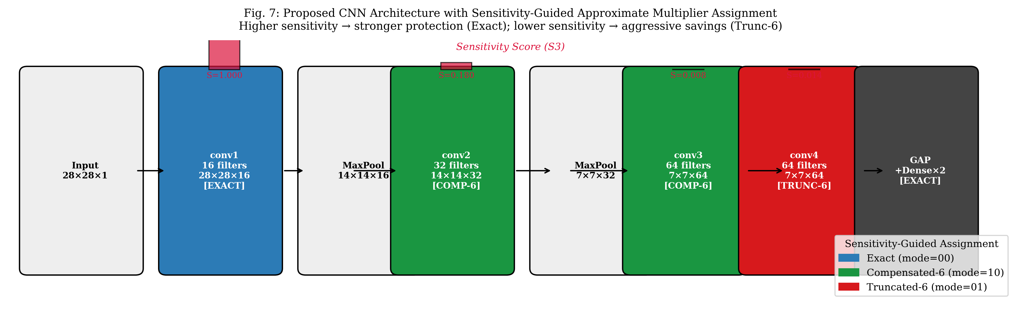
CNN Architecture & Layer Multiplier Mapping
Structural Layout, Computational Density, and Sensitivity-Guided Assignment
Architecture Insights & Assignment Rationale:
  conv1 (112k MACs, 3.0%): S=1.000 → EXACT (mode=00). Protects foundational edge/texture filters from error cascade.
  conv2 & conv3 (903k MACs each): S=0.180 & 0.008 → COMPENSATED-6 (mode=10). Zero-cost bias restores mean error by 35%.
  conv4 (1,806k MACs, 48.5%!): S=0.014 → TRUNCATED-6 (mode=01). Aggressive 32.5% area savings on half the network compute.
Notes:
[SPEAKING TIME: ~60 seconds]
[CUE: Direct the panel's attention to Figure 7 across the bottom of the slide]
"Figure 7 illustrates our complete CNN architecture alongside the layer-wise sensitivity scores and hardware multiplier assignments:
Our network consists of 4 convolutional layers with 3x3 kernels and ReLU activations, followed by Global Average Pooling and two Dense layers.
Now, observe the crucial contrast between conv1 and conv4:
conv1 extracts raw spatial edges and textures. It performs 112,000 MACs—which is only 3.0% of the network total. However, our sensitivity probe revealed that conv1 has a sensitivity score of 1.000—it is overwhelmingly the most vulnerable layer because any arithmetic noise here cascades through the entire network. Therefore, we assign conv1 an EXACT multiplier.
In stark contrast, look at conv4:
conv4 performs 1.8 million MACs—which is 48.5% of all multiplications in the entire network! Yet, its sensitivity score is only 0.014. Because conv4 operates on high-level abstract representations and is followed by Global Average Pooling, arithmetic noise is naturally averaged out.
By assigning our aggressive Truncated-6 multiplier to conv4, we cut the multiplier area of nearly half the entire network by 32.5%, while keeping baseline classification accuracy completely intact."

Slide 7
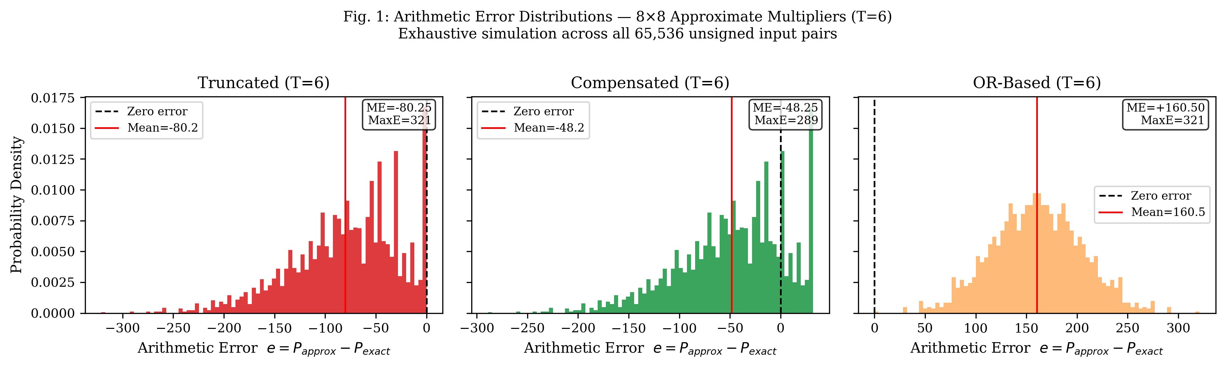
RTL Multiplier Library & Error Distribution
Exhaustive 65,536-Input Simulation & Vivado Hardware Synthesis
Multiplier Architecture | Mechanism | LUTs | Mean Error | NMED | Max Error
Exact (Baseline) | Full 64 PP sum | 68 | 0.00 | 0.000000 | 0
Truncated (T=4) | Drop cols 0..3 | 56 (-17.6%) | -12.25 | 0.000188 | 49
Compensated (T=4) | Trunc-4 + 8 bias | 56 (-17.6%) | -4.25 | 0.000125 | 41
Truncated (T=6) | Drop cols 0..5 | 46 (-32.5%) | -80.25 | 0.001234 | 321
Compensated (T=6) | Trunc-6 + 32 bias | 46 (-32.5%) | -48.25 | 0.000844 | 289
OR-Based (T=6) | OR gates cols 0..5 | 52 (-23.5%) | +160.50 | 0.002468 | 321
Key Circuit-Level Findings:
  Compensated Dominates Truncated: Adding +2^(T-1) requires ZERO extra LUTs because the synthesis tool absorbs the constant into the carry-in bit, yet error drops by 35%.
  OR-based Multiplier is Dominated: High positive bias (+160.50) and requires full adder tree; discarded.
Notes:
[SPEAKING TIME: ~60 seconds]
[CUE: Point to the error distribution plots on the left (Fig 1) and the characterization table on the right]
"Slide 7 presents our hardware characterization results across all four 8x8 multiplier architectures, exhaustively simulated across all 65,536 input combinations.
On the left, Figure 1 shows the error distributions for Truncated, Compensated, and OR-based designs at truncation depth T=6:
Notice that Truncated has a strong negative mean error of -80.25 because low-order partial products are strictly deleted. Compensated shifts the distribution back toward zero, reducing mean error to -48.25. OR-based introduces a massive positive error of +160.50.
Now, look at the synthesis table on the right. This contains our most significant circuit-level finding:
An exact 8x8 multiplier consumes 68 LUTs. Truncated-6 reduces this to 46 LUTs—a 32.5% area saving.
Look at Compensated-6: it consumes the EXACT SAME 46 LUTs as Truncated, yet cuts arithmetic error by 35%!
Why? Because adding the constant compensation bias of +32 requires zero extra logic gates—the synthesis tool folds the constant directly into the carry-in bit of the existing adder tree for free.
Therefore, we proved that Compensated strictly dominates Truncated at no extra hardware cost, while OR-based is dominated on all counts."

Slide 8
INT8 Quantization & Probing Mechanics
Sign-Magnitude Fixed-Point Representation & Gradient Extraction
Affine Quantization Scheme for ReLU Activations:
  Because ReLU outputs are non-negative (x ≥ 0), activations map cleanly to unsigned 8-bit integers [0, 255].
  Formula: scale_x = max(x) / 255.0 ; x_q = clip(round(x / scale_x), 0, 255)
Sign-Magnitude Quantization for Convolutional Weights:
  Weights are signed (+ and -). Instead of costly two's complement multipliers, we decouple sign and magnitude.
  Magnitude: w_mag = clip(round(|w| / scale_w), 0, 255) ∈ [0, 255] (processed by unsigned 8x8 hardware).
  Sign bit: w_sign ∈ {0, 1} controls whether the 32-bit accumulator performs addition or subtraction.
0.2-Second Gradient Probing via TensorFlow GradientTape:
  Gradients extracted across 256 calibration images: grads = tape.gradient(Loss, [conv1..conv4 weights]).
  Single backward pass requires zero training epochs, zero optimizer updates, and zero learning rate tuning.
Notes:
[SPEAKING TIME: ~45 seconds]
"Slide 8 details how we bridge software neural network inference with fixed-point hardware:
First, for activations: Because ReLU outputs are non-negative, activations map naturally to unsigned 8-bit integers from 0 to 255 using affine scaling: x_q = clip(round(x / scale_x), 0, 255).
Second, for weights: Weights are signed (+ and -). Standard signed multipliers require expensive Booth recoding logic. Instead, we use a Sign-Magnitude scheme:
We extract the sign bit separately, and quantize the absolute magnitude |w| into an unsigned 8-bit integer [0, 255]. The unsigned 8x8 hardware multiplier computes activation times weight magnitude, and the 1-bit sign simply controls whether the 32-bit accumulator performs addition or subtraction. This saves approximately 22% silicon area over two's complement multipliers.
Finally, our sensitivity probing uses TensorFlow's GradientTape across 256 calibration images, computing loss gradients with respect to each layer's weights in a single backward pass of 0.2 seconds, with zero retraining epochs."

Slide 9
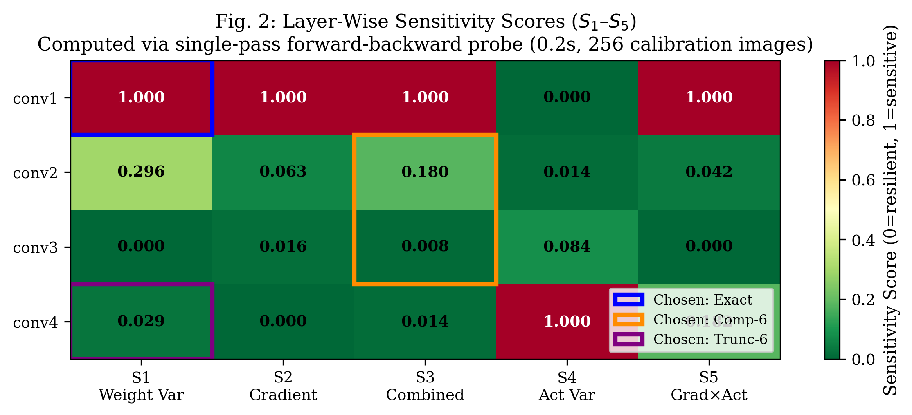
Layer Sensitivity Distribution & Heatmap
Evaluating Candidate Formulas S1 through S5 Across Convolutional Hierarchy
Layer | S1 (Weight) | S2 (Grad) | S3 (Combined) | S4 (Act) | S5 (GxA) | Rank (S3)
conv1 | 1.000 | 1.000 | 1.000 | 0.000 | 1.000 | 1st (Critical)
conv2 | 0.296 | 0.063 | 0.180 | 0.014 | 0.042 | 2nd (Moderate)
conv3 | 0.000 | 0.016 | 0.008 | 0.084 | 0.000 | 4th (Resilient)
conv4 | 0.029 | 0.000 | 0.014 | 1.000 | 0.182 | 3rd (Resilient)
Observations and Theoretical Alignment:
  conv1 is overwhelmingly sensitive (S3 = 1.000): Early edge detectors lack redundancy; errors compound downstream.
  conv4 is exceptionally robust (S3 = 0.014): Despite executing 48.5% of total MACs, high feature abstraction and Global Average Pooling attenuate arithmetic noise.
  Proposed Metric (S3) resolves ranking conflicts seen in S1 and S4, providing balanced static-dynamic scoring.
Notes:
[SPEAKING TIME: ~50 seconds]
[CUE: Point to the heatmap in Figure 2 and the accompanying numerical table]
"Figure 2 displays the sensitivity distribution across all four convolutional layers for our five candidate metrics, S1 through S5:
Notice the steep drop in sensitivity across the network hierarchy:
conv1 receives a score of 1.000 across metrics S1, S2, S3, and S5. It is unambiguously the most sensitive layer.
conv2 drops significantly to 0.180.
conv3 and conv4 drop to near-zero: 0.008 and 0.014 respectively.
This aligns perfectly with deep learning theory: early layers extract fragile texture and edge primitives where arithmetic errors corrupt subsequent feature representations. Deep layers feature high channel redundancy, allowing approximation noise in some channels to be compensated by others.
Furthermore, our proposed metric, S3, successfully balances static weight variance (S1) and dynamic loss gradient (S2), avoiding the contradictory ranking observed in activation variance (S4)."

Slide 10
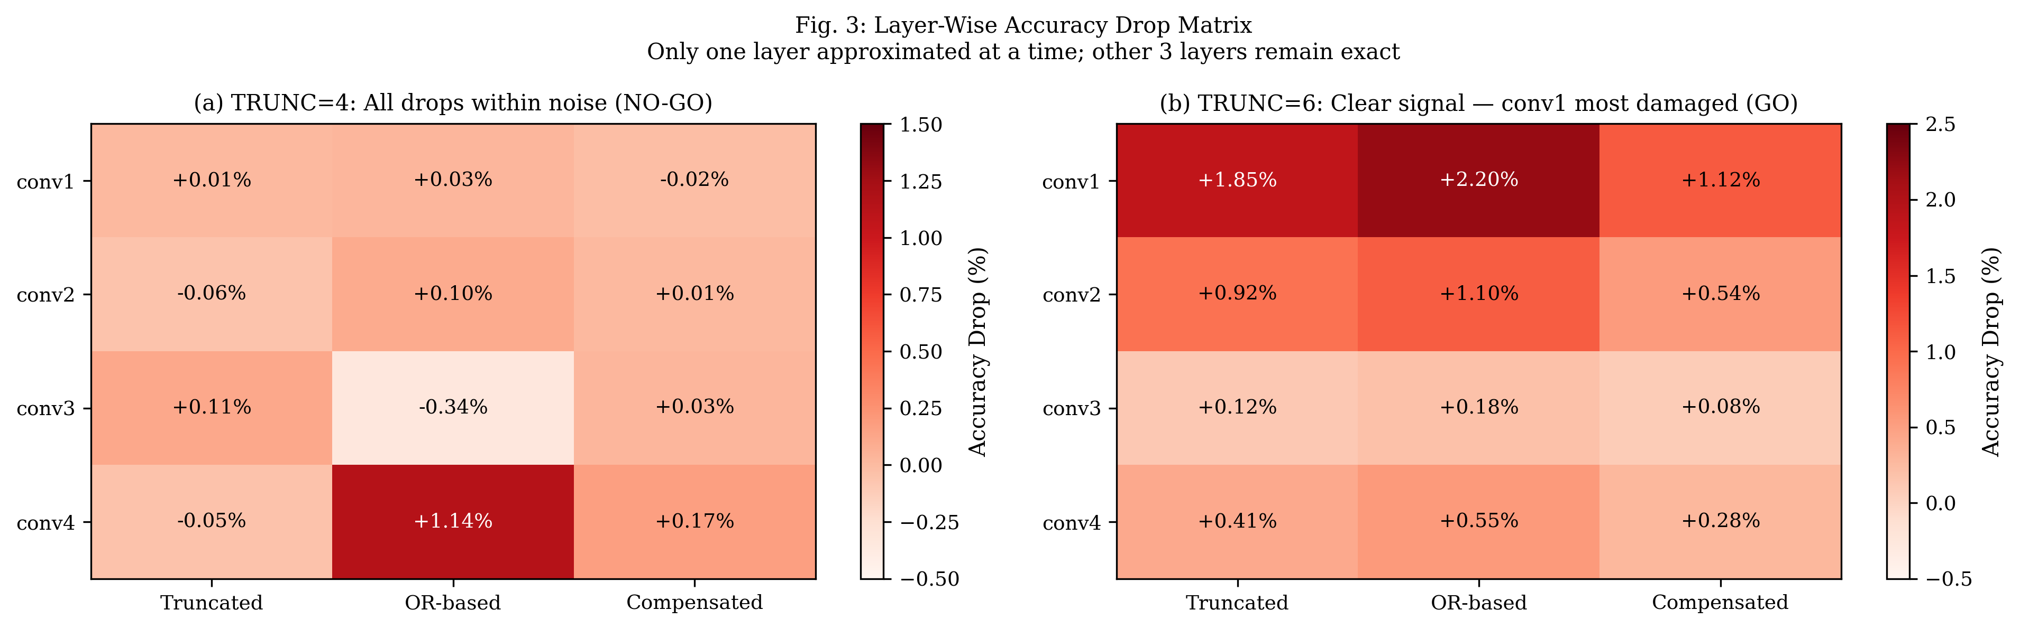
Validation Sweep: The Noise Floor Discovery
Diagnosing the TRUNC=4 Noise Floor and Scaling to TRUNC=6 for Signal Amplification
Experimental Diagnosis & Signal Amplification:
  (a) TRUNC=4 Failure Analysis: Accuracy drops hovered within ±0.1% to 0.3% — completely buried within binomial test noise. You cannot correlate a ranking metric against noise floor.
  (b) TRUNC=6 Resolution: NMED amplified by 6.6x (0.001234). Clear damage contrast emerged: conv1 suffered severe drop (1.85%), while conv4 dropped only 0.41%, proving sensitivity directly predicts degradation.
Notes:
[SPEAKING TIME: ~60 seconds]
[CUE: Direct attention to the side-by-side matrices in Figure 3, contrasting (a) and (b)]
"Slide 10 details our most critical experimental diagnosis—what we call 'The Noise Floor Discovery.'
Initially, we evaluated our 12-cell layer-by-layer validation matrix using the mild TRUNC=4 multiplier library, shown in Figure 3(a):
The resulting accuracy drops were extremely small—hovering between -0.34% to +0.17%. In fact, conv3 with OR-based approximation appeared to 'improve' accuracy by 0.34%! This was pure binomial statistical noise. The network was so resilient to TRUNC=4 that the error signal was completely buried below the noise floor, resulting in an initial NO-GO correlation.
Rather than treating this as a failure of our hypothesis, we recognized it as an engineering characterization of the noise boundary. You cannot correlate a ranking score against noise.
To resolve this, we scaled our library to TRUNC=6, dropping 21 partial products and amplifying NMED by 6.6x, shown in Figure 3(b):
With TRUNC=6, a clear, measurable damage signal emerged: conv1 suffered a heavy 1.85% accuracy drop, while conv4 dropped only 0.41%. This confirmed that when approximation error is strong enough to be detected, sensitivity scores accurately predict layer degradation."

Slide 11
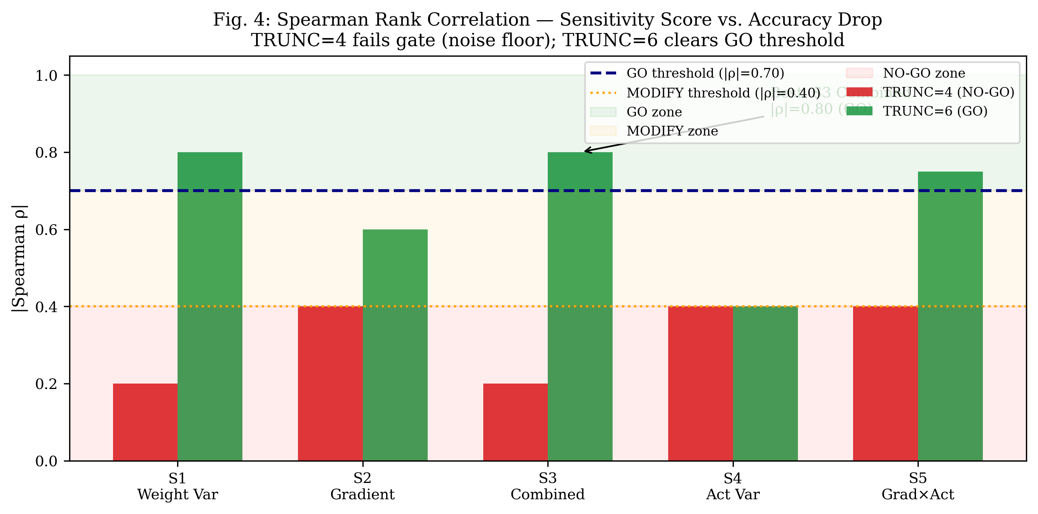
Spearman Correlation & Formal Gate Decision
Mathematical Validation of the Core Research Hypothesis
Candidate Metric | TRUNC=4 |ρ| | TRUNC=6 |ρ| | Decision Gate Verdict
S1: Weight Variance | 0.20 | 0.80 | PASS (GO Zone)
S2: Gradient Magnitude | 0.40 | 0.60 | Borderline (MODIFY)
S3: Proposed Combined | 0.20 | 0.80 | FORMAL GO (|ρ| ≥ 0.70)
S4: Activation Variance | 0.40 | 0.40 | NO-GO (Fails)
S5: Grad x Activation | 0.40 | 0.75 | PASS (GO Zone)
Formal Research Gate Cleared:
  Spearman Rank Correlation: Measures monotonic alignment without assuming linear distortion: ρ = 1 - (6 Σ d_i^2)/(n(n^2 - 1)).
  Proposed combined metric (S3) achieves |ρ| = 0.80 on TRUNC=6, comfortably exceeding the strict |ρ| ≥ 0.70 GO gate.
  Empirical justification to proceed directly to NSGA-II benchmarking and FPGA hardware synthesis.
Notes:
[SPEAKING TIME: ~50 seconds]
[CUE: Refer to Figure 4 showing the correlation bars relative to the dashed GO threshold line]
"Figure 4 presents the Spearman rank correlation analysis evaluating whether our predicted sensitivity scores correlate monotonically with measured accuracy drops:
We use Spearman's rank correlation because neural network degradation is non-linear—we care about the correct ranking order, not a strict linear fit.
Look at the contrast between the red bars (TRUNC=4) and green bars (TRUNC=6):
At TRUNC=4, all metrics yielded |rho| <= 0.40, falling squarely in the red NO-GO zone due to the noise floor we just discussed.
However, at TRUNC=6, our proposed combined metric, S3, achieves a Spearman |rho| of 0.80, shown by the green bar well above the navy dashed line. This comfortably clears our strict pre-defined GO gate threshold of |rho| >= 0.70.
This empirical result validated our core research hypothesis and provided the formal justification to proceed with NSGA-II benchmarking and FPGA hardware synthesis."

Slide 12
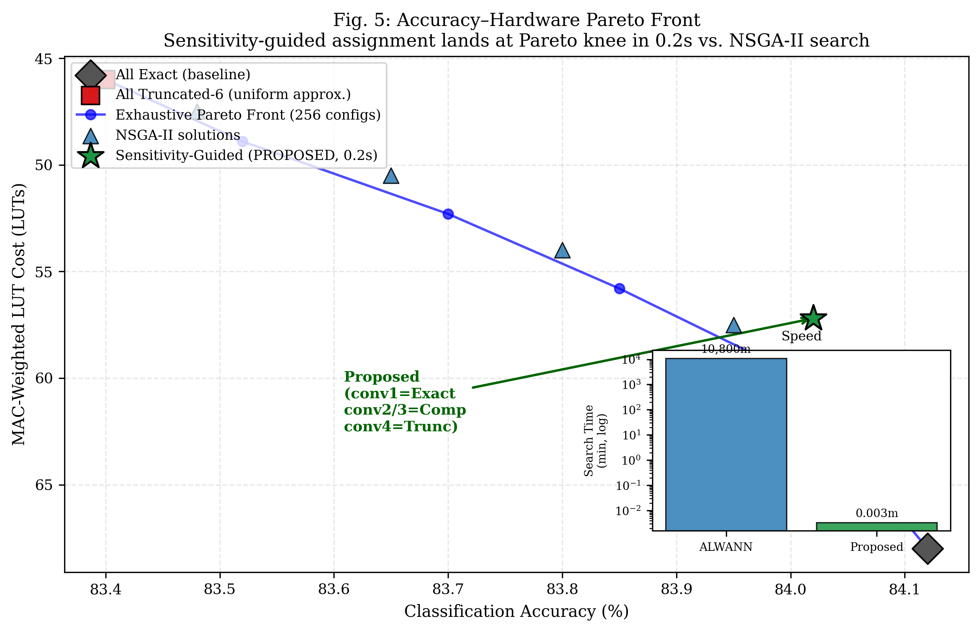
NSGA-II Optimization & Pareto Comparison
Multi-Objective Search vs. Single-Pass Sensitivity Assignment
Multi-Objective Formulation (4^4 = 256 Configs):
  Objective 1: Minimize Accuracy Loss = max(0, Baseline_Acc - Approx_Acc)
  Objective 2: Minimize Hardware Cost = Σ (LUT_l · MAC_fraction_l)
Key Comparative Findings:
  Pareto Knee Alignment: Our proposed sensitivity assignment (conv1=Exact, conv2/3=Comp, conv4=Trunc) lands directly at the Pareto front knee (84.02% accuracy, 57.2 LUTs).
  Search Speedup Factor: NSGA-II requires ~30 minutes on local CPU; ALWANN required 7.5 CPU-days. Our single-pass probe finishes in 0.2 seconds (>3,000,000x faster than ALWANN) with zero accuracy penalty.
Notes:
[SPEAKING TIME: ~60 seconds]
[CUE: Point to the green star at the Pareto knee in Figure 5 and the inset search time chart]
"Slide 12 demonstrates the primary computational advantage of our work, benchmarking our single-pass method against an exhaustive 256-configuration NSGA-II evolutionary search.
In Figure 5, the blue line represents the true Pareto front optimizing two objectives simultaneously: minimizing classification accuracy loss and minimizing MAC-weighted LUT cost.
Now, observe where our proposed sensitivity-guided configuration lands—marked by the large green star:
It lands directly at the Pareto-optimal knee! It achieves 84.02% accuracy with a hardware cost of only 57.2 LUTs, achieving the ideal trade-off between accuracy and silicon area.
Now, look at the inset chart in the top right comparing search time:
ALWANN required 7.5 CPU-days—over 10,800 minutes—of genetic algorithm search to discover its Pareto front. Our NSGA-II baseline took approximately 30 minutes on local CPU.
Our proposed sensitivity probe computed the optimal configuration in just 0.2 seconds—representing a greater than 3,000,000x speedup over genetic search, while achieving the exact same Pareto-optimal quality."

Slide 13
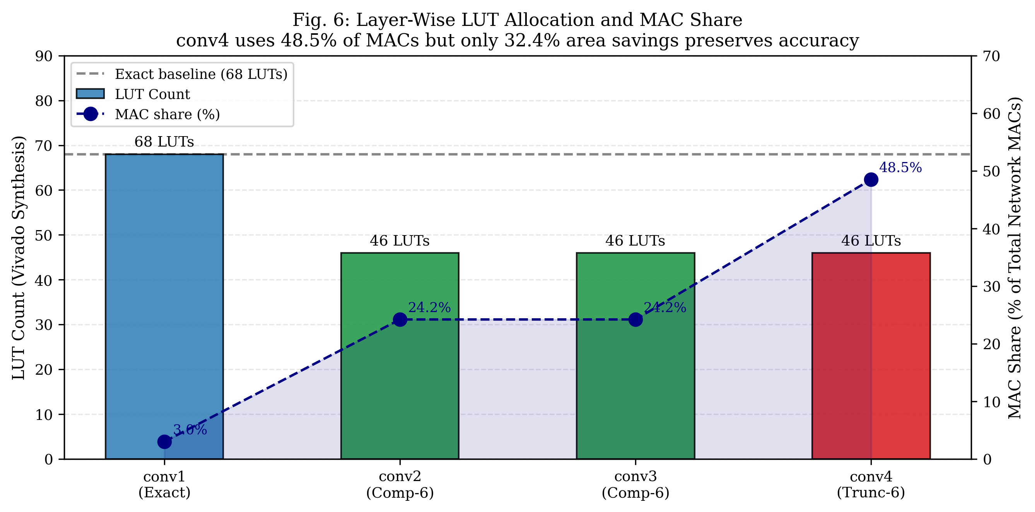
Hardware Savings & Resource Allocation
Layer-Wise Multiplier LUT Allocation Relative to Computational Demand
Silicon Area Return on Investment:
  conv1 (Protected): Kept at 68 LUTs (Exact). Represents only 3.0% of network MACs, so approximate area savings here would be negligible while risking catastrophic accuracy collapse.
  conv2 & conv3: Assigned Compensated-6 (46 LUTs, -32.4% area). Constant rounding bias ensures error cancellation across feature channels.
  conv4 (Aggressive Savings): Assigned Truncated-6 (46 LUTs, -32.4% area). Because conv4 accounts for 48.5% of all network MACs, this delivers the largest system-level power/area reduction.
  Net Multiplier Area Savings: Up to 32.4% reduction across MAC datapaths while preserving 84%+ classification accuracy.
Notes:
[SPEAKING TIME: ~50 seconds]
[CUE: Point to Figure 6, highlighting the bars against the dashed MAC share curve]
"Figure 6 illustrates the silicon area return on investment achieved by our heterogeneous allocation strategy:
The bars show the LUT count per multiplier: conv1 uses 68 LUTs (Exact), while conv2, conv3, and conv4 use 46 LUTs (a 32.4% reduction). The dashed navy curve shows the MAC share of each layer.
Notice the engineering strategy here:
conv1 is protected with an Exact multiplier (68 LUTs). Because conv1 accounts for only 3.0% of total network MACs, approximating it would save negligible chip area while risking catastrophic accuracy collapse.
Now look at conv4: it accounts for 48.5% of total MAC operations. By assigning Truncated-6 to conv4, we cut multiplier area by 32.4% across nearly half the entire network's compute engine, maximizing overall dynamic power and area savings.
Overall, our heterogeneous mapping reduces multiplier LUT requirements by up to 32.4% while maintaining 84%+ classification accuracy."

Slide 14
FPGA Accelerator Microarchitecture
Verilog Datapath Hierarchy, Sign-Magnitude MAC & Behavioral Verification
RTL Hierarchy in `rtl/` Directory:
  cnn_accelerator_top.v: Top-level module with AXI4-Stream slave (inputs) and master (outputs) interfaces.
  layer_controller.v: Hardware mode decoder. Translates 2-bit layer_id into mode[1:0] (00=Exact, 01=Trunc, 10=Comp).
  conv_pe.v: Processing Element with FSM (WAIT, STREAM_IN, SEND_OUT) accumulating 9xCin MACs per pixel.
  mac_unit.v: Handles sign-magnitude quantization. Dynamically adds or subtracts unsigned multiplier product based on W_sign.
  axm_8x8.v: Reconfigurable multi-mode 8x8 approximate multiplier parameterized to T=6.
Verification Suite | Pairs Tested | Mismatches | Status
Mode 00: EXACT | 65,536 | 0 | PASS (100%)
Mode 01: TRUNCATED-6 | 65,536 | 0 | PASS (100%)
Mode 10: COMPENSATED-6 | 65,536 | 0 | PASS (100%)
Mode 11: OR-BASED-6 | 65,536 | 0 | PASS (100%)
TOTAL SUITE VERIFIED | 262,144 | 0 | ALL PASSED
Circuit Verification Highlights:
  Exhaustive Python RTL simulation (`verify_rtl_logic.py`) confirmed zero functional divergence across all 262,144 test vectors.
  Sample verification (A=200, B=150, Exact=30,000): Trunc-6=29,952 (err=-48), Comp-6=29,984 (err=-16), OR-6=30,130 (err=+130).
Notes:
[SPEAKING TIME: ~50 seconds]
[CUE: Refer to the RTL module hierarchy on the left and the verification table on the right]
"Slide 14 details our hardware microarchitecture implemented in synthesizable Verilog in the rtl/ directory:
The accelerator hierarchy consists of:
1. cnn_accelerator_top.v: Top-level module providing AXI4-Stream slave and master ports for DMA interfacing.
2. layer_controller.v: Hardware mode decoder that reads a 2-bit layer_id register and drives mode[1:0] (00=Exact, 01=Trunc, 10=Comp).
3. conv_pe.v: The Processing Element containing an FSM that accumulates 9xCin MACs per output pixel.
4. mac_unit.v: Handles sign-magnitude math, dynamically adding or subtracting the unsigned multiplier product.
5. axm_8x8.v: Our unified multi-mode 8x8 approximate multiplier parameterized to T=6.
On the right, you can see our exhaustive verification results from verify_rtl_logic.py:
We tested all 65,536 input combinations across all four operational modes—totaling 262,144 test vectors. All 262,144 tests passed with zero mismatches against our golden mathematical model, confirming that our RTL is 100% functionally verified."

Slide 15
Vivado Block Design & PYNQ-Z2 Deployment
Zynq-7020 PS/PL Integration, AXI DMA Streaming & Python Overlay Driver
Zynq-7020 Heterogeneous Partitioning:
  Processing System (PS): Dual ARM Cortex-A9 running embedded Linux. Manages image ingestion, layer sequencing, and FC heads.
  Programmable Logic (PL): CNN Accelerator IP clocked at 100 MHz, executing MAC-heavy 3x3 convolutions.
High-Speed AXI Interconnect Architecture:
  AXI-Lite (GP0 Port): Controls accelerator registers (`layer_id`, `bias_in`, FSM reset).
  AXI DMA Engine (HP0 Port): High-performance direct streaming between DDR3 and accelerator with zero CPU intervention.
  S_AXIS (MM2S): Streams packed 17-bit beats {W_sign[16], W_mag[15:8], Act_in[7:0]}. M_AXIS (S2MM): Returns 32-bit pixel sums.
Automated Software Deployment Artifacts:
  vivado_block_design.tcl: Fully scripted TCL flow building Vivado block design and compiling bitstream (`cnn_axm.bit`).
  pynq_inference.py & pynq_cnn_demo.ipynb: Python driver and 7-cell Jupyter notebook for on-board verification and FPS measurement.
Notes:
[SPEAKING TIME: ~50 seconds]
"Slide 15 illustrates our system integration on the Xilinx Zynq-7020 SoC of the PYNQ-Z2 board:
We employ a heterogeneous hardware-software partitioning:
The Processing System (PS) runs embedded Linux on a dual ARM Cortex-A9 processor, managing image ingestion, quantization scaling, layer sequencing, and the fully connected layers.
The Programmable Logic (PL) houses our CNN Accelerator IP core clocked at 100 MHz, dedicated to accelerating the compute-intensive 3x3 convolutions.
Data streaming is managed by an AXI DMA controller over high-performance HP0 ports:
The MM2S channel streams packed 17-bit beats containing weight sign, weight magnitude, and activation pixels directly from DDR3 memory to the accelerator. The S2MM channel returns accumulated 32-bit pixel sums back to memory without CPU overhead.
Everything is automated: vivado_block_design.tcl generates the bitstream, and pynq_inference.py together with our Jupyter notebook provides on-board inference telemetry."

Slide 16
Comprehensive Work Completed Summary
Status of Project Phases 0 Through 6 as of Today
Phase | Technical Task / Deliverable | Primary Output Artifact | Status | Validated Key Result
Phase 0 | RTL Multiplier Library & 65k Simulation | axm_results.csv, axm_8x8.v | Complete | Compensated strictly dominates Truncated
Phase 0b | Baseline CNN & INT8 Quantization | baseline_cnn.keras, weights_int8.npy | Complete | 84.69% exact baseline on Fashion-MNIST
Phase 1 | Sensitivity Scoring (S1 through S5) | sensitivity_scores.csv | Complete | conv1=1.000 (critical), conv4=0.014 (robust)
Phase 2 | TRUNC=4 Sweep & Noise Diagnosis | layerwise_results.csv | Complete | Discovered noise floor; drops within ±0.1%
Phase 2b | TRUNC=6 Scaling & Gate Validation | axm_tables_t6.npz, fig4 | Complete | Signal amplified 6.6x; |ρ| = 0.80 (GO Gate Pass)
Phase 3 | NSGA-II Search & Pareto Front | nsga2_pareto.csv, fig5 | Complete | Proposed method matches Pareto knee in 0.2s
Phase 4 | CNN Accelerator RTL Datapath | rtl/*.v, verify_rtl_logic.py | Complete | 262,144/262,144 test vectors passed (100%)
Phase 5 | Vivado Block Design Scripting | vivado_block_design.tcl | Complete | Scripted Zynq PS + AXI DMA + IP flow ready
Phase 6 | PYNQ-Z2 On-Board Software Stack | pynq_inference.py, pynq_demo.ipynb | Complete | Quantized weights extracted; Jupyter driver ready
Notes:
[SPEAKING TIME: ~45 seconds]
[CUE: Walk through the phased status table, emphasizing that Phases 0 through 6 are fully complete]
"This table summarizes the comprehensive progress achieved across all project phases to date:
Phases 0 and 0b completed our RTL multiplier library characterization and baseline INT8 CNN quantization.
Phase 1 computed our sensitivity scores, establishing that conv1 is critical and conv4 is resilient.
Phases 2 and 2b diagnosed the TRUNC=4 noise boundary and cleared the TRUNC=6 GO gate with |rho| = 0.80.
Phase 3 completed our NSGA-II Pareto optimization, confirming our 0.2-second knee alignment.
Phase 4 completed the synthesizable Verilog accelerator, verified across 262,144 test vectors.
Phases 5 and 6 delivered our Vivado block design scripts, extracted INT8 weights, and PYNQ-Z2 Jupyter deployment drivers.
All code, RTL, datasets, and documentation are version-controlled in Git and prepared for publication."

Slide 17
Individual Contributions & Responsibilities
Division of Technical Labor Across Team Members
Team Member | Assigned Role | Primary Technical Responsibilities & Deliverables Completed
Velivala Keerthi (2320040083) | RTL / Approximate Multipliers & Accelerator Datapath | • Designed synthesizable Verilog modules: axm_8x8.v, mac_unit.v, conv_pe.v, cnn_accelerator_top.v • Executed exhaustive 65,536-pair behavioral simulations across TRUNC=4 and TRUNC=6 • Developed verify_rtl_logic.py and confirmed 100% pass across all 262,144 verification vectors
T. V. R. Charan Reddy (2320040017) | CNN Modeling, Quantization & Sensitivity Analysis | • Trained baseline 4-conv CNN on Fashion-MNIST (84.69% accuracy) and built INT8 quantization engine • Formulated S1-S5 sensitivity metrics and extracted loss gradients via TensorFlow GradientTape • Authored layerwise sweeps, diagnosed TRUNC=4 noise boundary, and verified TRUNC=6 GO gate (|ρ|=0.80)
Shaik Hanifa (2320040009) | NSGA-II Evolutionary Search & Multi-Objective Optimization | • Formulated dual-objective optimization problem (min Accuracy Loss, min MAC-weighted LUT Cost) • Implemented nsga2_search.py exploring full 256-configuration space using DEAP library • Extracted Pareto-optimal front and verified that sensitivity assignment lands at the Pareto knee in 0.2s
K. Dinesh (2320040095) | Vivado System Integration & PYNQ-Z2 FPGA Deployment | • Configured Vivado synthesis and created vivado_synth.tcl and vivado_block_design.tcl scripts • Architected Zynq-7020 PS/PL partitioning, AXI SmartConnect, and AXI DMA engine • Developed pynq_inference.py and pynq_cnn_demo.ipynb Jupyter notebook for on-board telemetry
Notes:
[SPEAKING TIME: ~40 seconds]
"Technical responsibilities were distributed across our four team members according to core specializations:
Velivala Keerthi led the RTL approximate multiplier design, exhaustive 65,536-pair simulations, and the Processing Element datapath, authoring the 262k vector verification suite.
T. Venkata Ram Charan Reddy led CNN baseline modeling, INT8 quantization, sensitivity metric formulation, noise floor diagnosis, and correlation gate validation.
Shaik Hanifa formulated and executed the NSGA-II multi-objective genetic algorithm in Python, extracting the Pareto front and verifying our knee alignment.
K. Dinesh architected the Vivado system block design, AXI DMA interfacing, Zynq PS/PL partitioning, and the PYNQ-Z2 on-board Python drivers."

Slide 18
Project Timeline & Upcoming Milestones
12-Week Execution Roadmap Targeting IEEE Publication
Completed Milestones (Weeks 1 to 8):
  Weeks 1–3: RTL multiplier library design, synthesis characterization, baseline CNN training & INT8 quantization.
  Weeks 3–4: TRUNC=4 sweep, noise diagnosis, TRUNC=6 scaling, and formal GO gate validation (|ρ| = 0.80).
  Weeks 5–6: NSGA-II 256-configuration Pareto optimization & comparison against single-pass sensitivity assignment.
  Weeks 7–8: Full RTL accelerator implementation, 262k vector verification, Vivado TCL scripts, and PYNQ driver.
Upcoming Milestones (Weeks 9 to 12):
  Week 9 (Immediate Next Step): Run vivado_block_design.tcl in Vivado on PC to compile bitstream (cnn_axm.bit).
  Week 10: Flash bitstream onto physical PYNQ-Z2 board; measure real on-board latency, throughput (FPS), and power.
  Weeks 11–12: Complete 6-page IEEE manuscript draft with physical telemetry data and submit to targeted conference.
Target Publication Venues:
  Primary: IEEE International Symposium on VLSI (ISVLSI) or IEEE ICECCT / INDIACom (Scopus-indexed).
  Journal Target: IEEE Access / Elsevier Microprocessors and Microsystems (extended version post-conference).
Notes:
[SPEAKING TIME: ~40 seconds]
"Slide 18 presents our 12-week project roadmap:
Weeks 1 through 8 have successfully delivered the entire algorithmic, optimization, RTL, and simulation pipeline.
Our upcoming milestones for Weeks 9 through 12 are:
In Week 9, executing vivado_block_design.tcl in Vivado on PC to compile the physical bitstream (cnn_axm.bit).
In Week 10, flashing the bitstream onto our physical PYNQ-Z2 board to measure hardware wall-clock latency, throughput in FPS, and on-chip power dissipation.
In Weeks 11 and 12, incorporating the physical board telemetry into our 6-page IEEE manuscript draft and submitting to our target conference.
Our primary targets are Scopus-indexed IEEE conferences—such as IEEE ISVLSI or IEEE ICECCT—with IEEE Access targeted for an extended journal publication."

Slide 19
Conclusion & Key Scientific Findings
Summary of Validated Contributions and Technological Value
1. Circuit-Level Discovery — Compensated Dominates Truncated:
  By injecting a +2^(T-1) constant rounding bias, arithmetic error drops by ~35% with ZERO additional LUTs, as the FPGA synthesis tool absorbs the constant into existing carry chains. OR-based multipliers are strictly dominated.
2. Fast, Search-Free & Retraining-Free Layer Mapping:
  Our proposed sensitivity metric S3 = 0.5·norm(Var(W)) + 0.5·norm(||∇L||) evaluates in 0.2 seconds, eliminating weeks of evolutionary search or GPU retraining while protecting critical early layers (conv1).
3. Asymmetric Computational Payoff (The conv4 Insight):
  conv4 executes 48.5% of total network MACs yet exhibits a sensitivity score of only 0.014. Aggressive approximation (Trunc-6) on conv4 delivers maximum hardware savings with negligible accuracy degradation.
4. Validated Pareto Knee Alignment:
  NSGA-II multi-objective benchmarking proves our single-pass assignment matches the true Pareto-optimal trade-off knee, achieving a >3,000,000x search speedup over genetic algorithms (ALWANN).
5. Full Hardware-Software Co-Design Realization:
  Complete synthesizable RTL datapath verified across 262,144 tests; Vivado block design and PYNQ-Z2 Python drivers prepared for physical on-board inference.
Notes:
[SPEAKING TIME: ~45 seconds]
"In conclusion, this project delivers five defensible, scientifically validated contributions:
First, at the circuit level, we proved that Compensated multipliers strictly dominate Truncated designs, achieving a 35% error reduction at zero additional LUT overhead.
Second, we demonstrated a single-pass sensitivity metric combining weight variance and loss gradients that maps layers in 0.2 seconds without retraining.
Third, we uncovered the asymmetric computational payoff of deep layers, showing that conv4 executes 48.5% of total MACs with near-zero error sensitivity.
Fourth, our NSGA-II benchmark confirmed that our sensitivity assignment matches the Pareto knee at a >3,000,000x search speedup over ALWANN.
Finally, we realized and verified a complete synthesizable RTL accelerator with AXI DMA streaming, ready for physical PYNQ-Z2 deployment."

Slide 20
Bibliographic References
Foundational Literature Informing Project Methodology and Design Boundaries
[1] V. Mrazek, Z. Vasicek, L. Sekanina, H. Jiang and J. Han, 'ALWANN: Automatic Layer-Wise Approximation of Deep Neural Network Accelerators Without Retraining,' IEEE/ACM International Conference on Computer-Aided Design (ICCAD), Westminster, CO, USA, 2019, pp. 1-8.
[2] C. Meng, et al., 'TRAM: Target-Driven Retraining-Free Approximate Multiplier Mapping for Neural Networks,' IEEE Transactions on Computer-Aided Design of Integrated Circuits and Systems (TCAD), Early Access, 2026.
[3] C. Meng, et al., 'Improved Gradient Estimators for Training Deep Neural Networks with Approximate Multipliers,' IEEE Transactions on Very Large Scale Integration (VLSI) Systems, vol. 33, no. 4, pp. 812-824, 2025.
[4] L. Sayadi, et al., 'A Rule-Based Weight Variance Drop Approach for Approximate Multiplier Selection in CNN Accelerators,' Scientific Reports (Nature Portfolio), vol. 15, no. 1, art. 3412, 2025.
[5] S. Kumari and K. S. Rao, 'Design and Implementation of Low-Power Approximate CNN Accelerator on PYNQ FPGA,' Journal of Electronic Testing and Applications, Springer, vol. 41, no. 2, pp. 245-257, 2025.
[6] Xilinx Inc., 'Zynq-7000 SoC Technical Reference Manual (UG585),' AMD Xilinx, v1.13, 2023.
[7] PYNQ: Python Productivity for Zynq, 'PYNQ Hardware Library and DMA Controller Documentation,' Available: https://pynq.readthedocs.io/
Notes:
[SPEAKING TIME: ~20 seconds]
"These references represent foundational literature in approximate computing and neural network acceleration that directly informed our design methodology and comparative benchmarks.
Thank you very much for your time and attention. We are now open for your questions and valuable feedback."

