Slide 1
classFactoryEntity (Node2D)
entitySize
imageDirectory = “res://Assets/FactoryEntity”
Deletable
classFactoryStructure
imageDirectory += “/Structure”
Placed in the Scene and Movable
classFactoryConnector
imageDirectory += “/Connector”
Drawn in the Scene
objProcessor
imageDirectory += “/Processor”
internalStorage = [x,x]
Resources -> Resources
objHolder
imageDirectory += “/Holder”
internalStorage = [x]
Stores Resources
objEnhancer
imageDirectory += “/Enhancer”
internalStorage = [x]
Resources -> Effects
objConveyor
imageDirectory += “/Conveyor”
sends solid resource to position
objPipe
imageDirectory += “/Pipe”
holds fluid resource
push/pull to/from adjacent
objCable
imageDirectory += “/Cable”
instant transmit power resource

Slide 2
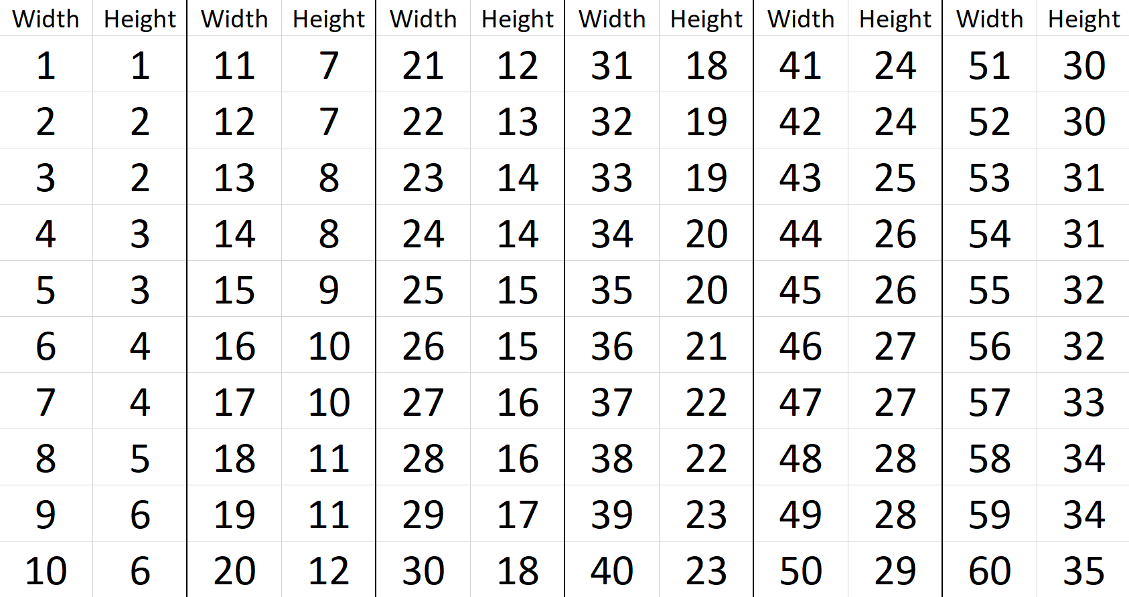

Slide 3


