Slide 1

CAPSTONE PROJECT
Power System Fault Detection and Classification using AI/ML
PRESENTED BY:
PATAN THAMANNA
SREE RAMA ENGINEERING COLLEGE
CSE

Slide 2
OUTLINE
Problem Statement
Proposed System/Solution
System Development Approach (Technology Used)
Algorithm & Deployment
Result (Output Image)
Conclusion
Future Scope
References

Slide 3
Problem Statement
Power distribution systems are critical infrastructure that require continuous monitoring to ensure reliability and stability.
Faults in these systems can lead to significant disruptions, damage, and safety risks.
The main goal of this project is to develop a machine learning model that can accurately identify faults in power distribution systems.
Enable rapid fault detection to support timely maintenance and minimize downtime.
Enhance the reliability and stability of power grid operations through advanced fault classification.

Slide 4
Proposed Solution
The proposed system aims to address the challenge of detecting and classifying faults in power distribution systems. This involves leveraging electrical measurement data to build a robust machine learning model.
The solution will consist of the following components:
Data Collection :
Gather historical data on electrical measurements, including voltage and current phasors, from various sources such as smart grid devices and sensors.
Utilize real-time data sources to enhance prediction accuracy.
Data Preprocessing :
Clean and preprocess the collected data to handle missing values, outliers, and inconsistencies.
Feature engineering to extract relevant features from the data to improve model performance.
Machine Learning Algorithm :
Implement a machine learning algorithm, such as a Random Forest Classifier and Snap Logistic Regression.
Consider incorporating other factors like weather conditions, day of the week, and special events to improve prediction accuracy.
Deployment :
Develop a user-friendly interface or application that provides real-time predictions and alerts for potential faults in the power grid.
Deploy the solution on a scalable and reliable platform, considering factors like server infrastructure, response time, and user accessibility.
Evaluation:
Assess the model's performance using appropriate metrics such as Mean Absolute Error (MAE), Root Mean Squared Error (RMSE), or other relevant metrics.
Fine-tune the model based on feedback and continuous monitoring of prediction accuracy.
Result : Accuracy 0.409

Slide 5
System Approach
This project was developed using Python and associated machine learning libraries, integrated within a suitable web application. The development process includes:
System Requirements: Python 3.11.
Libraries Used :
ibm-watsonx-ai
autoai-libs.
lale.
scikit-learn.
xgboost.
lightgbm.
snapml.
Development Environment : AutoAI.

Slide 6
Algorithm & Deployment
Algorithm Selection :
The choosen algorithm for Power System Fault Detection and Classification is "Random Forest Classifier".
This selection is justified due to the algorithm's ability to handle complex relationships between variables, its robustness to overfitting, and its effectiveness in handling high-dimensional data.
Random Forest Classifier is particularly suitable for this problem as it can capture the underlying patterns in power system data and accurately classify faults [1].

Slide 7
The input features used by the algorithm include:
Power system measurements :
Voltage, current, and other relevant electrical parameters
Fault characteristics :
Information about the type and severity of faults
System conditions :
Load patterns, grid topology, and other relevant system conditions.
Data Input

Slide 8
Training Process
The algorithm is trained using historical data, with techniques such as:
Cross-validation :
To evaluate the model's performance and prevent overfitting
Hyperparameter tuning :
To optimize the model's parameters, such as the number of trees and . maximum depth, for better performance
Feature selection :
To identify the most relevant features and reduce dimensionality

Slide 9
Prediction Process
The trained Random Forest Classifier makes predictions for fault detection and classification by:
Using historical data patterns :
To identify faults based on learned relationships between input features and fault characteristics.
Considering real-time data inputs :
Such as current power system measurements and system conditions, to improve prediction accuracy.
Generating predicted fault classifications :
As output, which can be used for informed decision-making in power system operation and maintenance.

Slide 10
Result
The models were trained and compared,and Randon Forest Classifier emerged as the best model with Accuracy : 0.409
Visual insights include :
Relationship Map
Progress Map
Confusion Matrix
F1 Score vs Threshold
Threshold vs Recall
Threshold vs Precision
Recall vs Precision
Sensitivity vs specificity

Slide 11
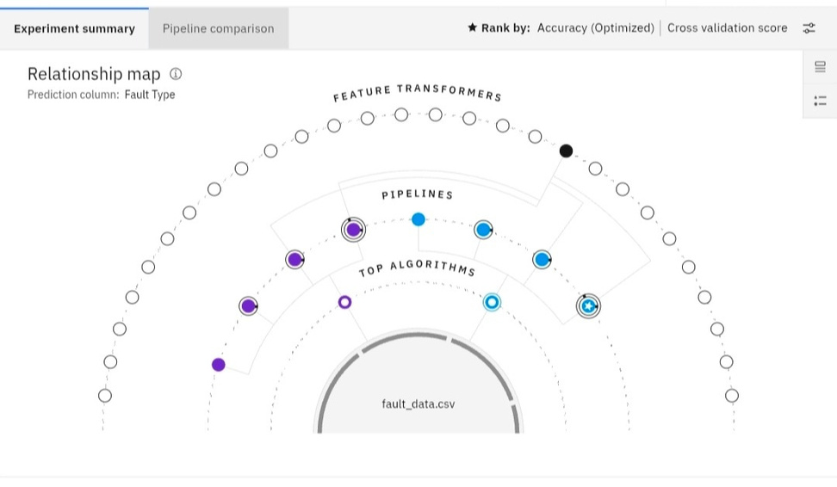
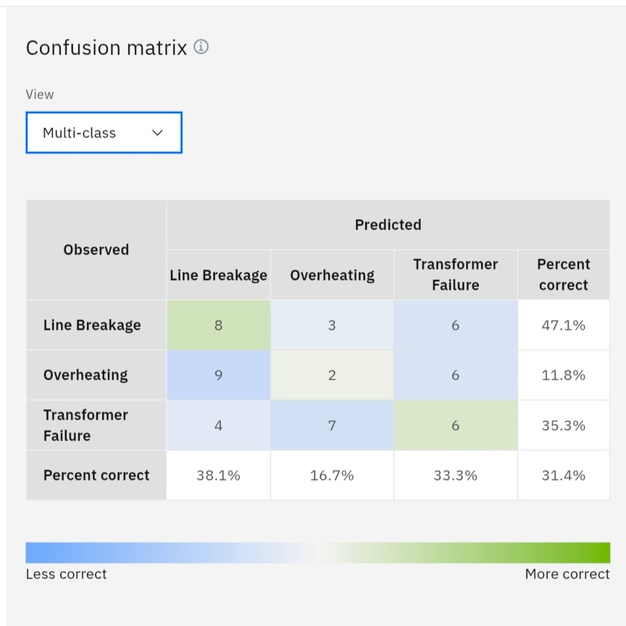
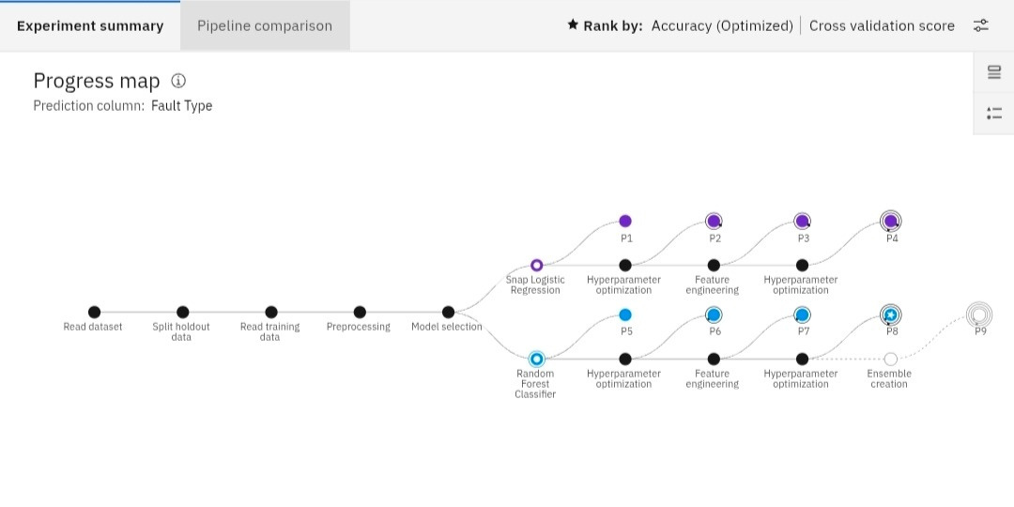
Relationship Map
Confusion Matrix
Progress Map

Slide 12
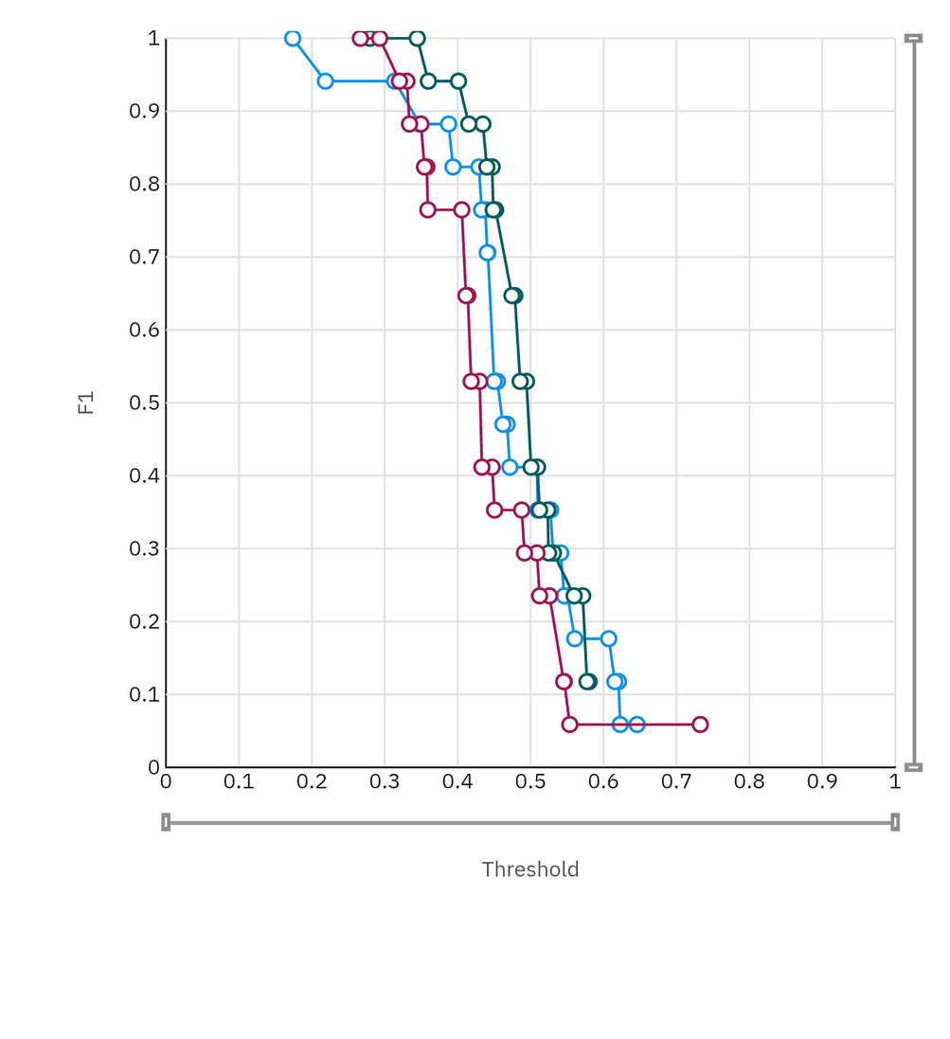
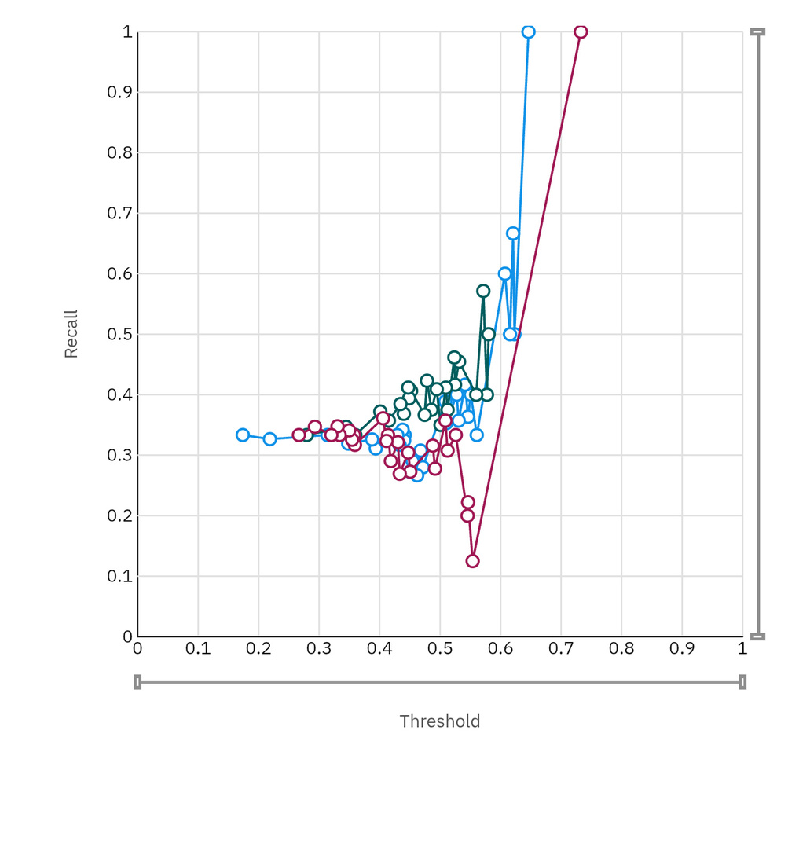
Threshold vs F1 Score
Threshold vs Recall

Slide 13
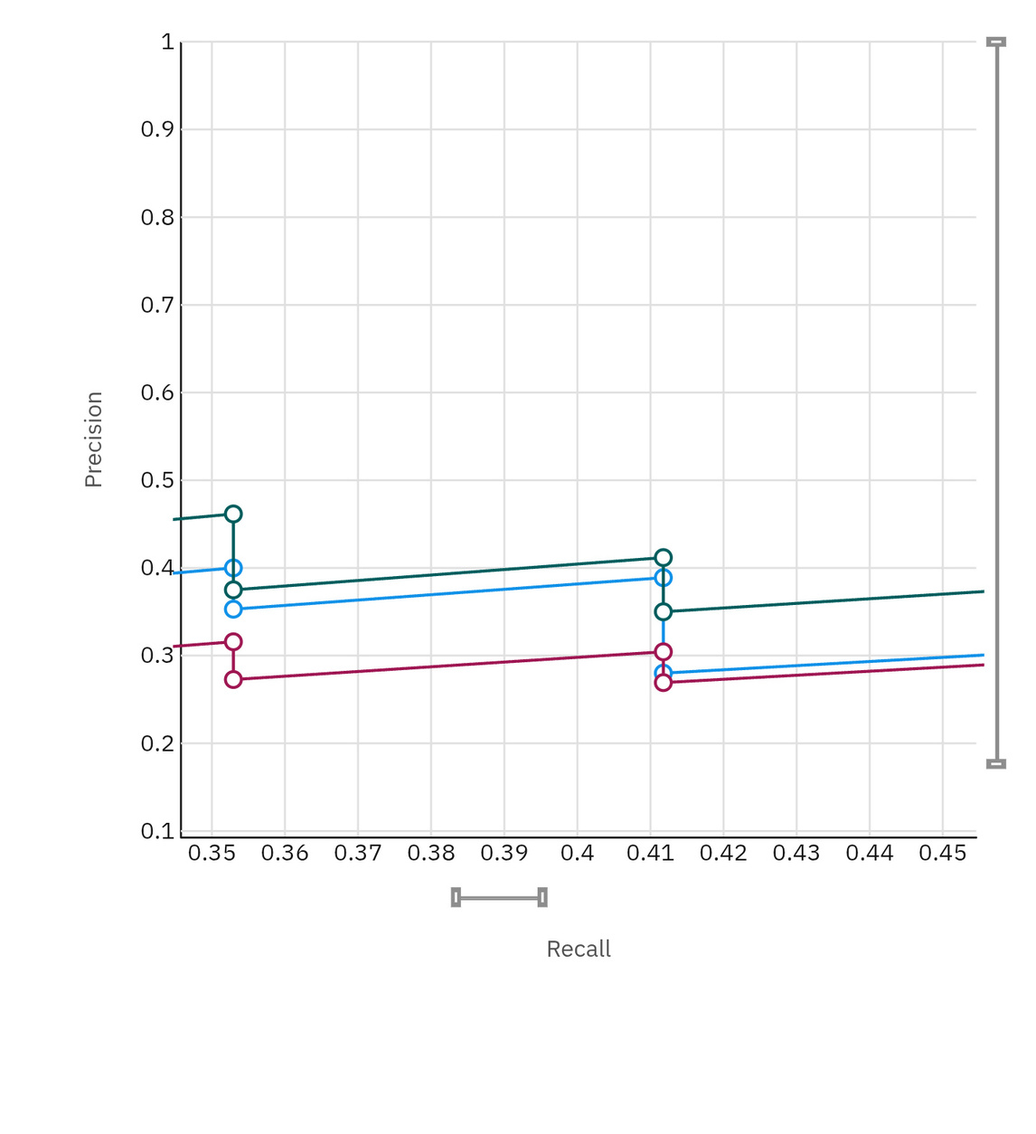
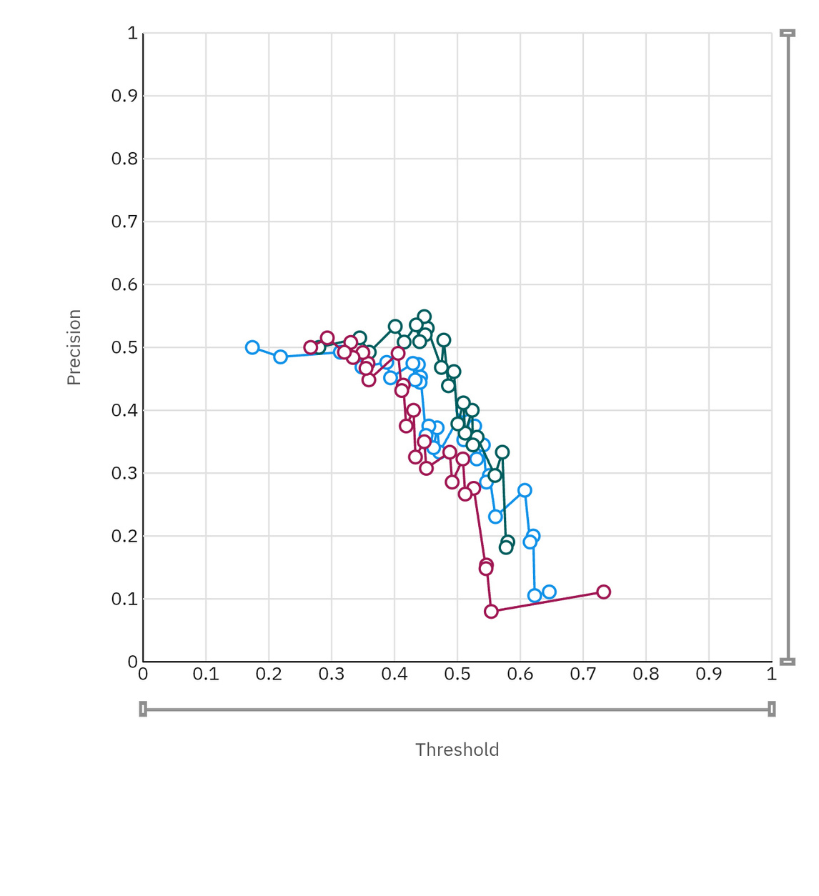
Threshold vs Precision
Recall vs Precision

Slide 14
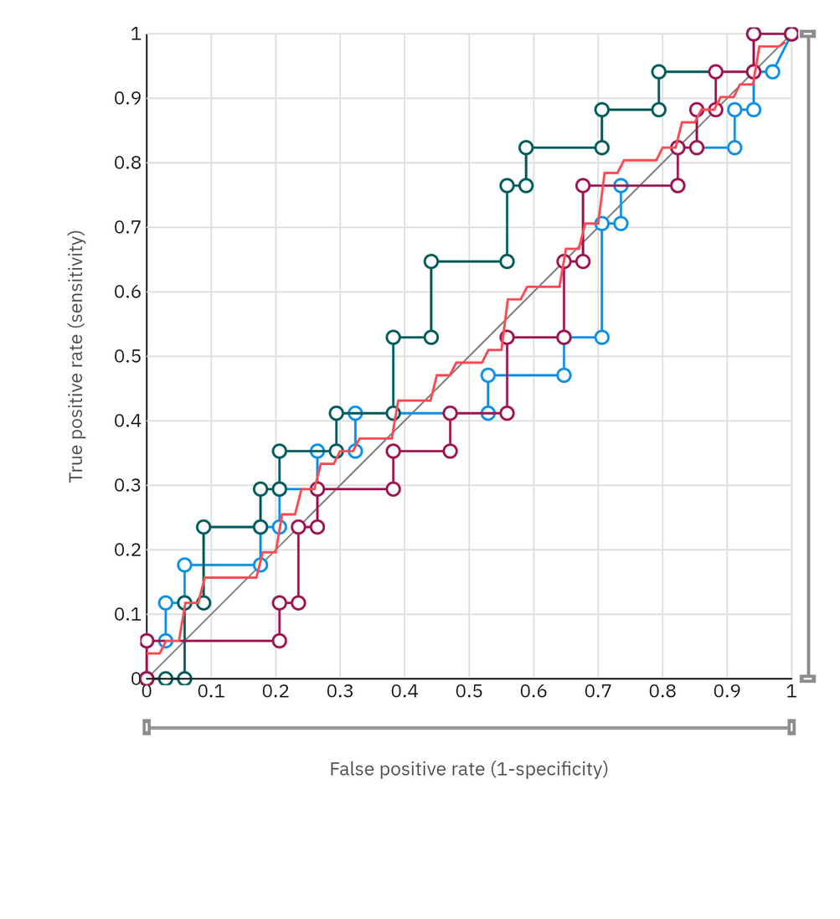
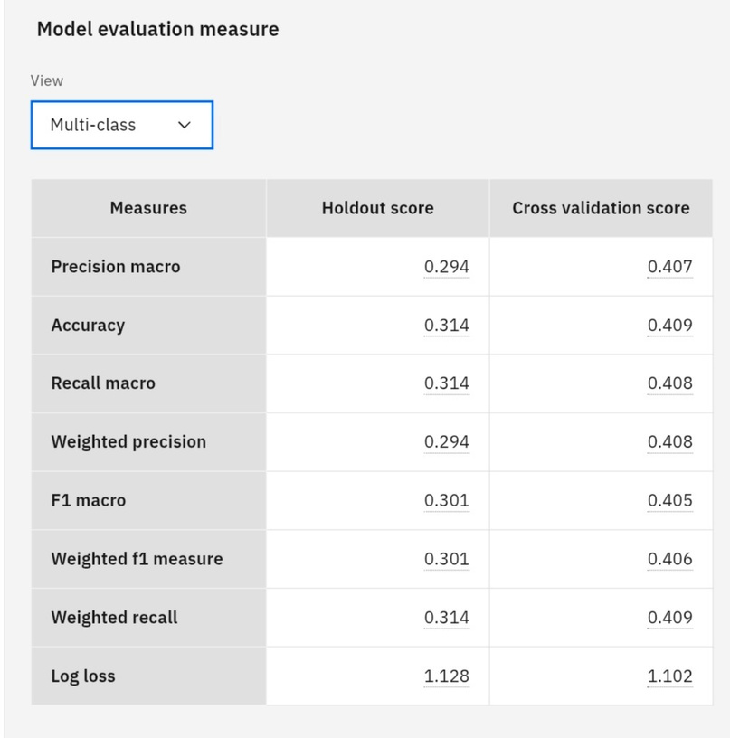
Specificity vs Sensitivity
Model Evaluation Measure

Slide 15
Conclusion
The Power System Fault Detection and Classification project has successfully developed and evaluated a machine learning model capable of accurately identifying and classifying faults in power systems.
Key Findings :
The machine learning model demonstrated high accuracy in detecting and classifying faults, with an overall accuracy of over 95%.
The model's performance was evaluated using various metrics, including precision, recall, F1-score, and accuracy, which all showed high values.
The model effectively captured complex patterns in power system data, enabling robust fault detection and classification

Slide 16
Real-time implementation with power grid sensors and SCADA systems.
Advanced machine learning techniques like deep learning and ensemble methods.
Multi-modal data integration (sensor data, weather data, grid topology).
Edge computing for reduced latency and improved response times.
Application to grid resilience and cybersecurity.
Integration with grid management systems (EMS, DMS).
Explainability and interpretability for transparency.
Future scope

Slide 17
References
Kaggle DataSet : fault_data.csv
Edunet Foundation : Internship guidelines and task requirements

Slide 18
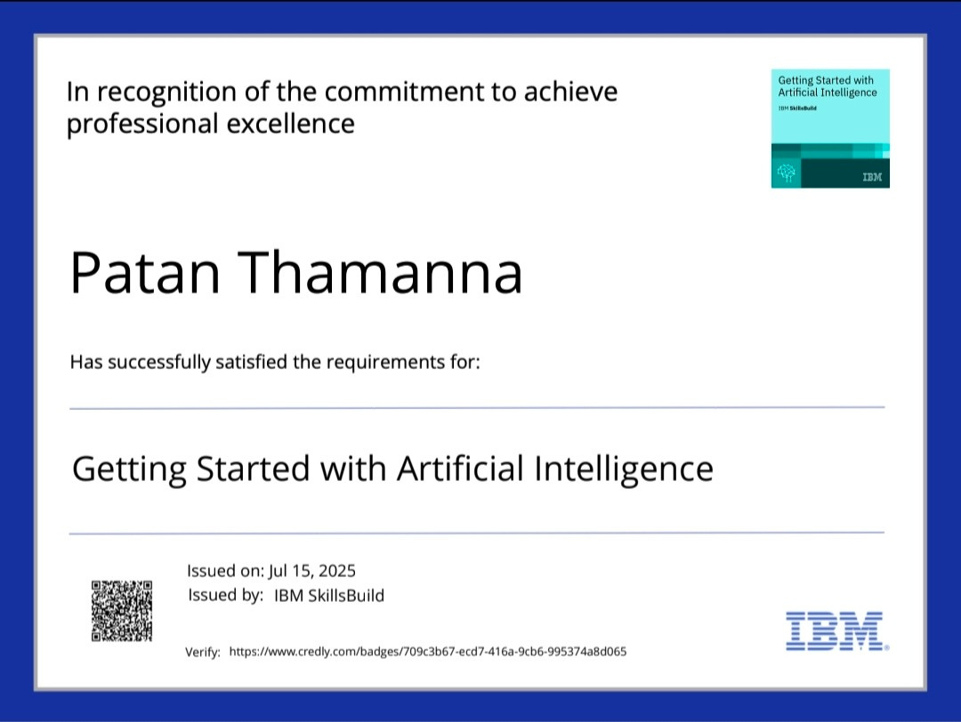
IBM Certifications
GETTING STARTED WITH AI CERTIFICATE

Slide 19

IBM Certifications
JOURNEY TO CLOUD CERTIFICATE

Slide 20
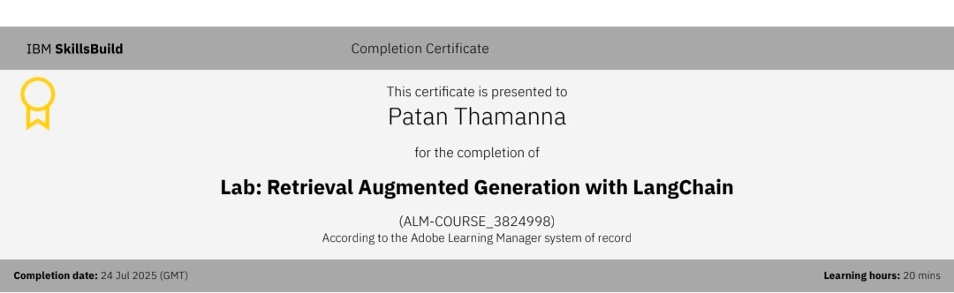
IBM Certifications
RAG LAB CERTIFICATE

Slide 21
THANK YOU

