Slide 1
INDIAN PREMIER LEAGUE
Comprehensive Analysis of IPL DATA
(2008 – 2025)

Slide 2
INTRODUCTION
The Indian Premier League (IPL), launched in 2008, is one of the most thrilling and commercially successful T20 cricket leagues in the world. Featuring a mix of international stars and domestic talent, the IPL delivers high-energy entertainment and fiercely competitive matches every season. With each game producing a rich set of statistics, analyzing IPL data opens doors to meaningful insights into player performance, team strategies, and game dynamics. This project explores 13 seasons of IPL data — from 2008 to 2020 — using match and ball-by-ball datasets to uncover patterns, trends, and valuable information for analysts, coaches, and cricket enthusiasts alike..

Slide 3
DATASET OVERVIEW
Source: Kaggle – IPL Matches & Deliveries Dataset
Time Range: IPL Seasons from 2008 to 2020
Total Matches: 816
Primary Files:
matches.csv: Match-level information (teams, venue, toss, winner, umpires, etc.)
deliveries.csv: Ball-by-ball events (runs scored, batsman, bowler, dismissals, etc.)
Purpose: Supports overall match outcome prediction, performance analysis, and detailed event-level tracking
.

Slide 4

TEAM PLAYING
CHENNAI SUPER KINGS
MUMBAI INDIANS
DELHI CAPITALS
PUNJAB KINGS
GUJRAT TITANS
RAJASTHAN ROYALS
ROYAL CHALLENGERS BANGALORE
KOLKATA KNIGHT RIDERS
LUCKNOW SUPER GIANTS
SUNRISERS HYDERABAD

Slide 5
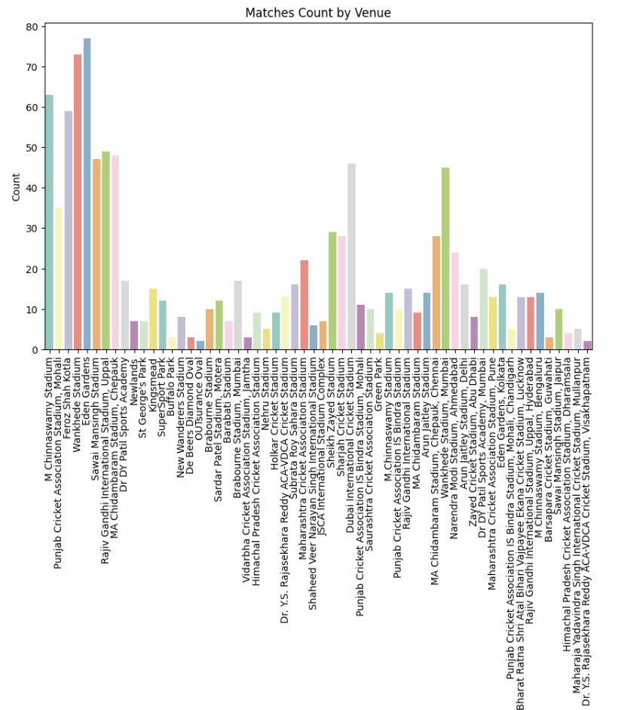
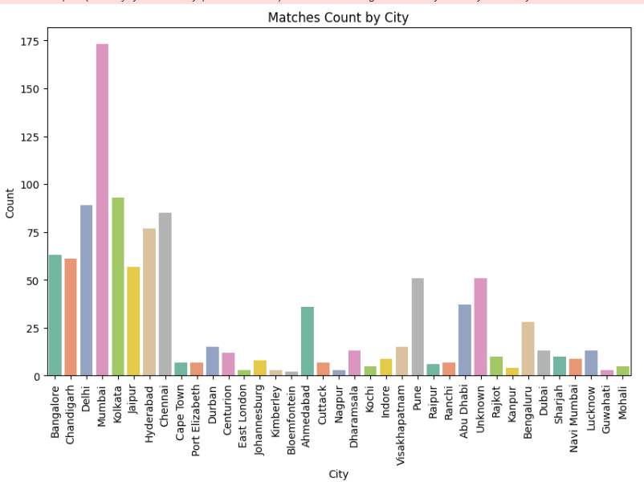
Exploratory Data Analysis
Season Overview
IPL Dataset Overview
Matches Count by City
Includes match and ball-by-ball data (2008–2020) for 816 games. Supports both season-level and in-game analysis.
Mumbai hosted the most IPL matches, followed by Delhi and Kolkata. Matches were also held in international locations.

Slide 6
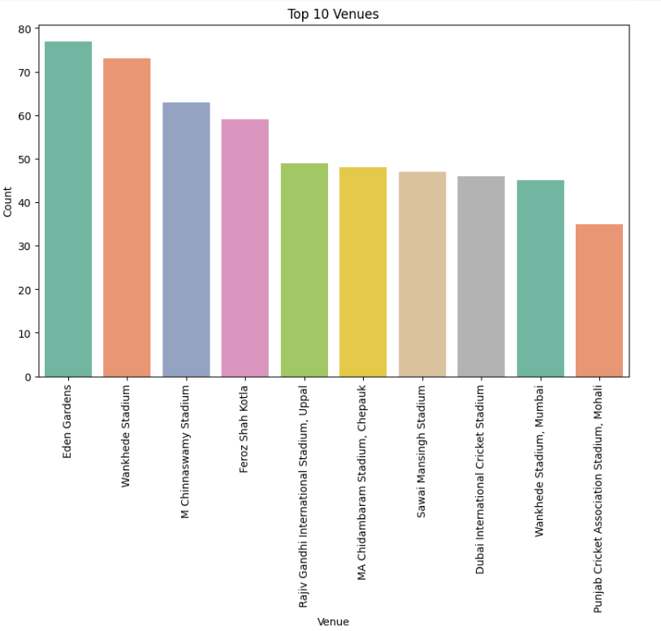
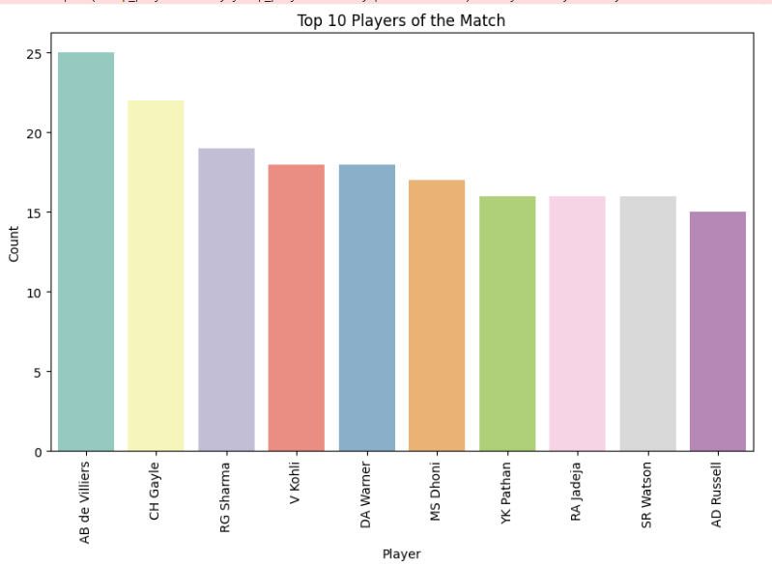
Exploratory Data Analysis
Top 10 IPL Venues
Top 10 Players of the Match
Eden Gardens leads in hosting the most IPL matches. Wankhede, Chinnaswamy, and Dubai stadiums also feature in the top 10 venues.
AB de Villiers has won the most Player of the Match awards in IPL. He is followed by CH Gayle, RG Sharma, and other top performers.

Slide 7
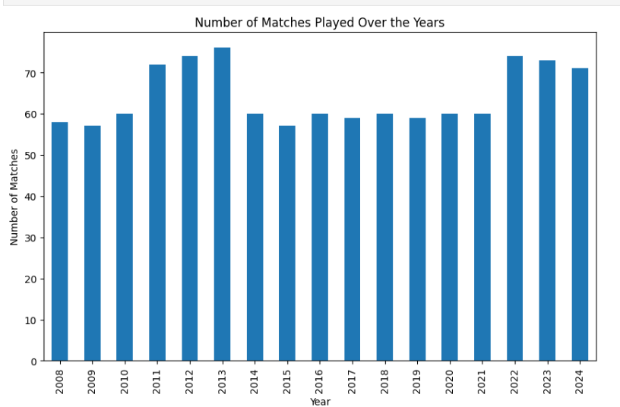
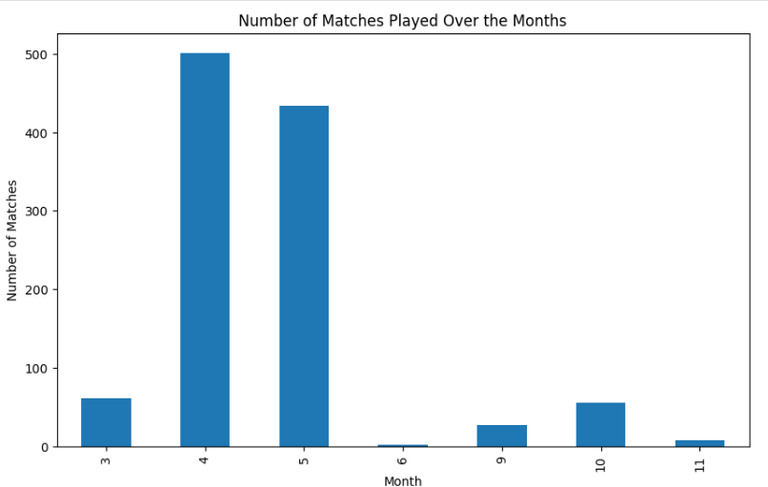
Exploratory Data Analysis
IPL Matches Trend by Year
IPL Matches Distribution by Month
The number of IPL matches increased till 2013, dipped slightly in later years, and peaked again in 2022, showing an overall stable trend.
Most IPL matches are played in April and May, with very few matches in other months.

Slide 8
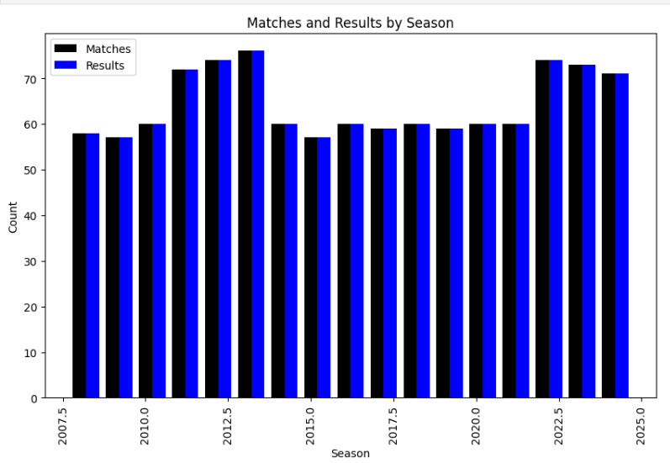
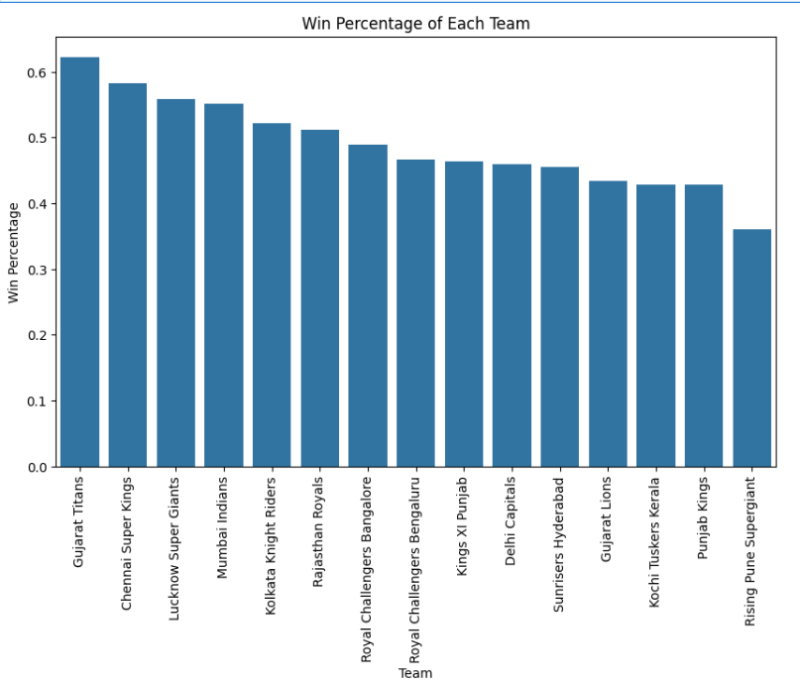
Exploratory Data Analysis
IPL Matches Distribution by Month
Team-wise IPL Win Percentage
Most IPL matches are played in April and May, with very few matches in other months.
Gujarat Titans have the highest win percentage, followed by CSK and LSG. Most teams maintain competitive and consistent performance levels.

Slide 9
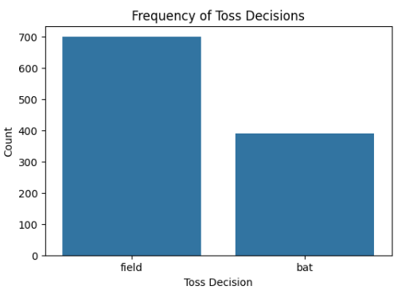
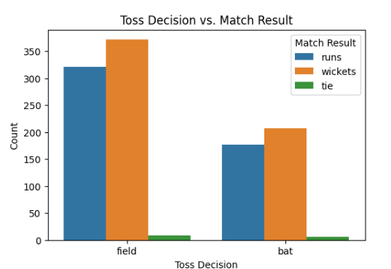
Exploratory Data Analysis
Toss Choice vs Match Outcome
Choice vs Match Outcome
Teams choosing to field after the toss have more wins, especially by wickets. Bat-first decisions show fewer wins overall.
Most teams prefer to field first after winning the toss, with significantly fewer choosing to bat.

Slide 10
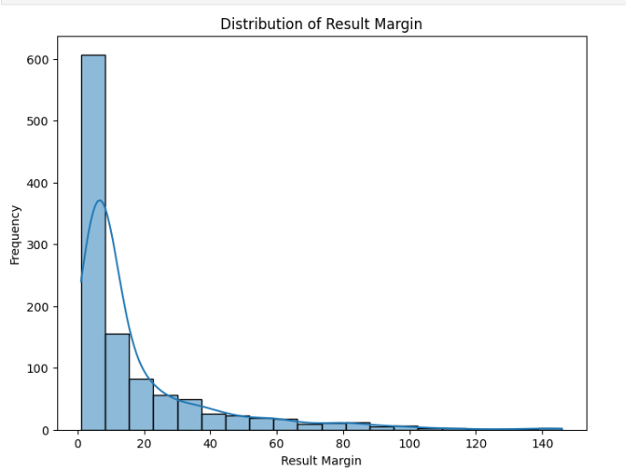
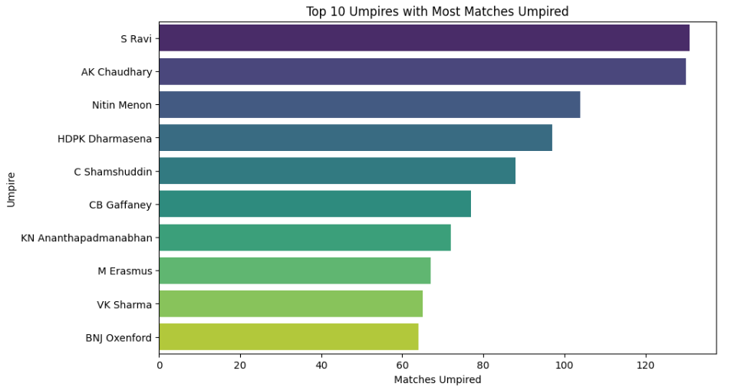
Exploratory Data Analysis
Result Margin Distribution
Leading Cricket Umpires by Match Count
Most IPL matches are won by small margins, with very few games having large winning gaps.
The chart displays the top 10 umpires with the highest number of matches officiated. S Ravi and AK Chaudhary are the most experienced among them.

Slide 11
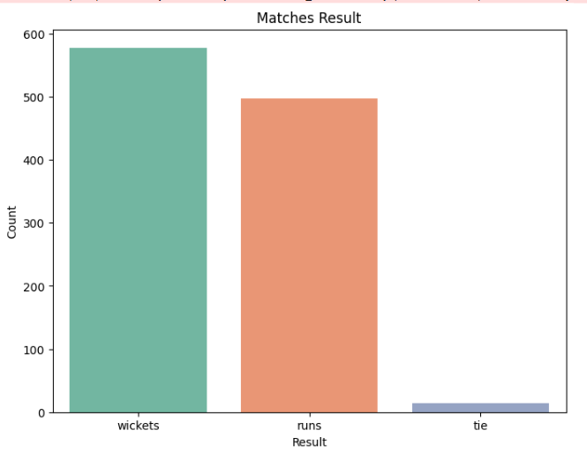
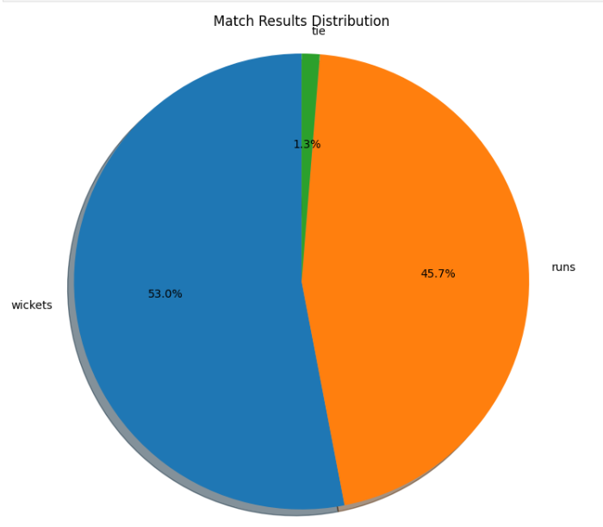
Exploratory Data Analysis
Distribution of Match Results by Outcome Type
Percentage Breakdown of Match Outcomes
The chart shows match outcomes categorized by result type: most matches were won by wickets, followed by runs, with very few ending in a tie.
The pie chart illustrates that most matches were won by wickets (53%), followed by runs (45.7%), while only a small fraction (1.3%) ended in a tie.

Slide 12
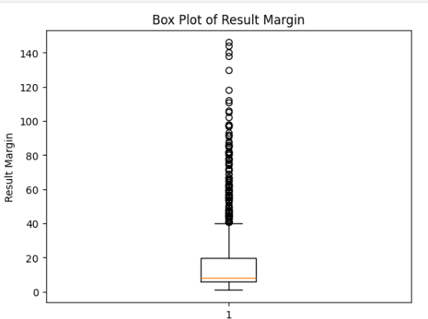
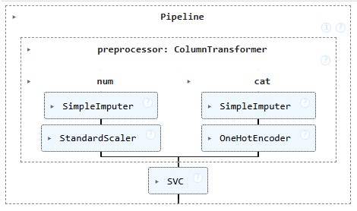
Exploratory Data Analysis
Machine Learning Pipeline with Preprocessing and SVC
Distribution of Match Result Margins
The box plot shows that most result margins are clustered below 25, with several high outliers indicating matches won by large margins.
This pipeline preprocesses data and applies a Support Vector Classifier. Numerical and categorical features are handled separately using imputation, scaling, and encoding.

Slide 13
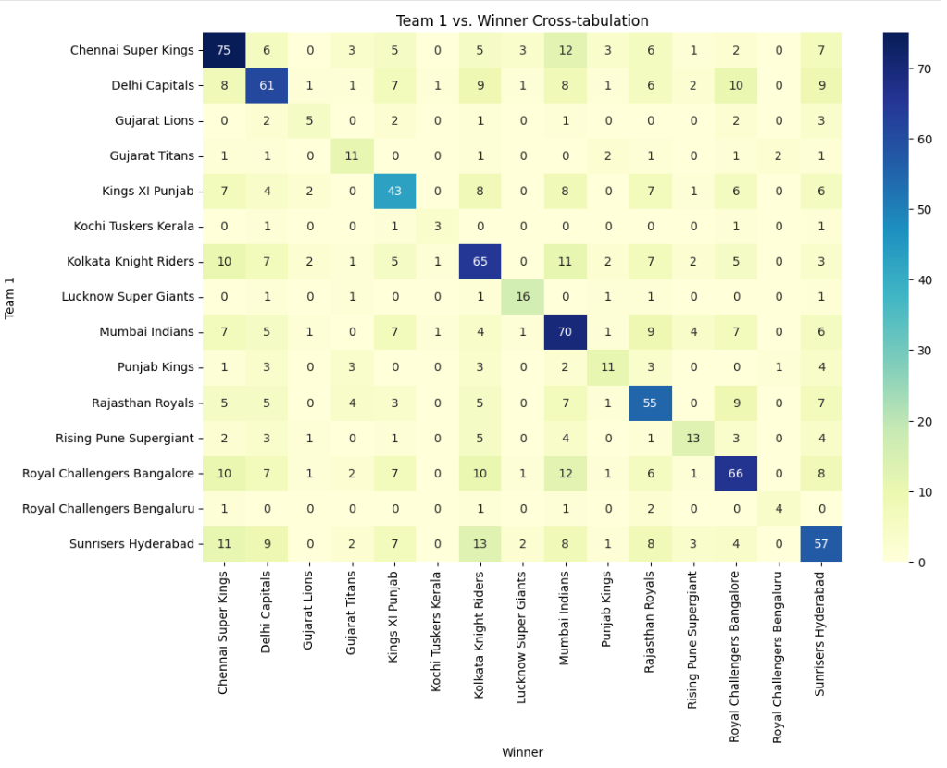
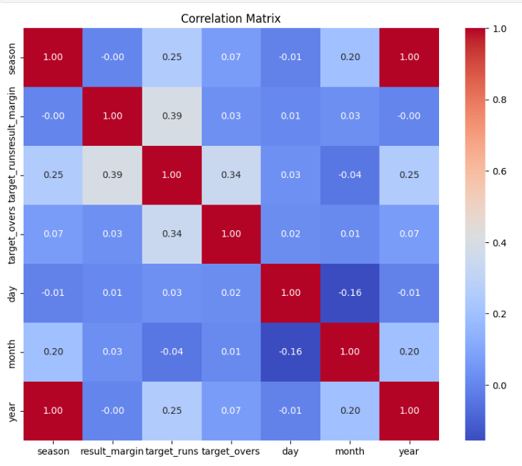
Exploratory Data Analysis
IPL Teams: Match Wins Cross-tabulation
Heatmap of Feature Correlations
The heatmap shows IPL teams' win counts against each other, with darker diagonal cells indicating more wins.
This heatmap displays how strongly numerical features are correlated, with darker colors indicating higher correlation.

Slide 14
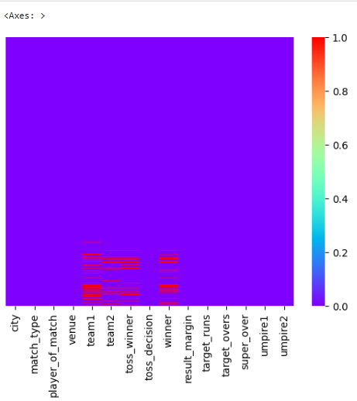
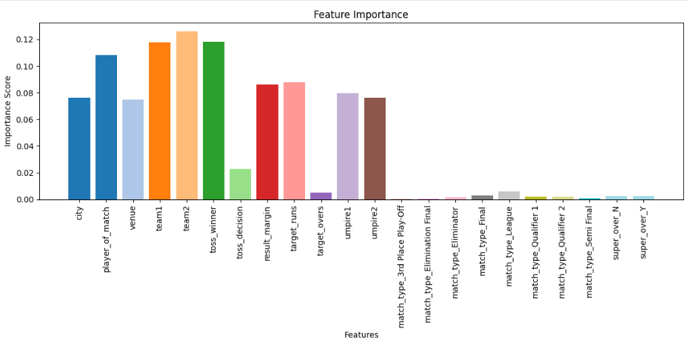
Exploratory Data Analysis
Heatmap of Missing Values in Dataset
Key Features Influencing Match Outcome
This heatmap shows missing data across columns. Red lines indicate rows with missing values in specific features.
This bar chart highlights the most important features affecting match outcomes. Factors like teams, venue, and player of the match have the highest influence.

Slide 15
MODEL OVERVIEW
Objective:
To predict the winning team of an IPL match using key match features before or during the match using a machine learning model.
Input Features (X):
Venue
Batting Team
Bowling Team
Toss Winner
Toss Decision (bat/field)
Runs Left
Balls Left
Wickets
Total Runs (Target)
Current Run Rate (CRR)
Required Run Rate (RRR)
Output (Y):
Predicted Winner of the match
(Binary Classification: 1 = Batting Team Wins, 0 = Bowling Team Wins)
Model Used:
We used a LightGBM Classifier, a powerful gradient boosting model, to predict match outcomes. The model is trained on both categorical (e.g., teams, venue) and numerical (e.g., run rates, balls left) features.
It estimates the probability of a team winning based on real-time match context and historical patterns.

Slide 16
SAMPLE I/0
Sample Input (Match Situation)
Feature Value
Venue Wankhede Stadium
Batting Team Mumbai Indians
Bowling Team Chennai Super Kings
Toss Winner Mumbai Indians
Toss Decision Bat
Runs Left 60
Balls Left 36
Wickets Remaining 6
Total Runs Target 180
Current Run Rate (CRR) 8.33
Required Run Rate (RRR) 10.0
Sample Output
Output Label Meaning
1 Batting Team is predicted to win
0 Bowling Team is predicted to win
Prediction: 1 → Mumbai Indians are likely to win the match based on current conditions.

Slide 17
CONCLUSION
This predictive model captures essential match dynamics in IPL, leveraging factors such as venue, toss outcomes, run rates, and team strengths. The use of LightGBM enhances accuracy by learning from historical patterns and live match contexts. These insights empower teams, analysts, and management to make informed, data-driven decisions in strategy planning, in-game tactics, and player evaluations—offering a competitive edge in high-stakes environments like the IPL.

Slide 18
THANK YOU

