Slide 1
Asymptotic Notations
R.vidhyalakshmi

Slide 2
Asymptotic Notations
Asymptotic notations are the mathematical notations used to describe the complexity of an algorithm .

Slide 3
Big-O Notation (O-notation)
Big-O notation represents the upper bound of the running time of an algorithm.
Thus, it gives the worst case complexity of an algorithm.
For any value of n, the running time of an algorithm does not cross time provided by O(g(n)).
O(g(n)) = { f(n): there exist positive constants c and n₀ such that 0 ≤ f(n) ≤ cg(n) for all n ≥ n₀ }
O(g(n)) = { f(n): there exist positive constants c and n₀ such that 0 ≤ f(n) ≤ cg(n) for all n ≥ n₀ }

Slide 4
Big-O Notation (O-notation)
O(g(n)) = { f(n): there exist positive constants c and n₀ such that 0 ≤ f(n) ≤ cg(n) for all n ≥ n₀ }
O(g(n)) = f(n)
f(n) ≤ cg(n) for all n ≥ n_{0}}
O(g(n)) = { f(n): there exist positive constants c and n₀ such that

Slide 5
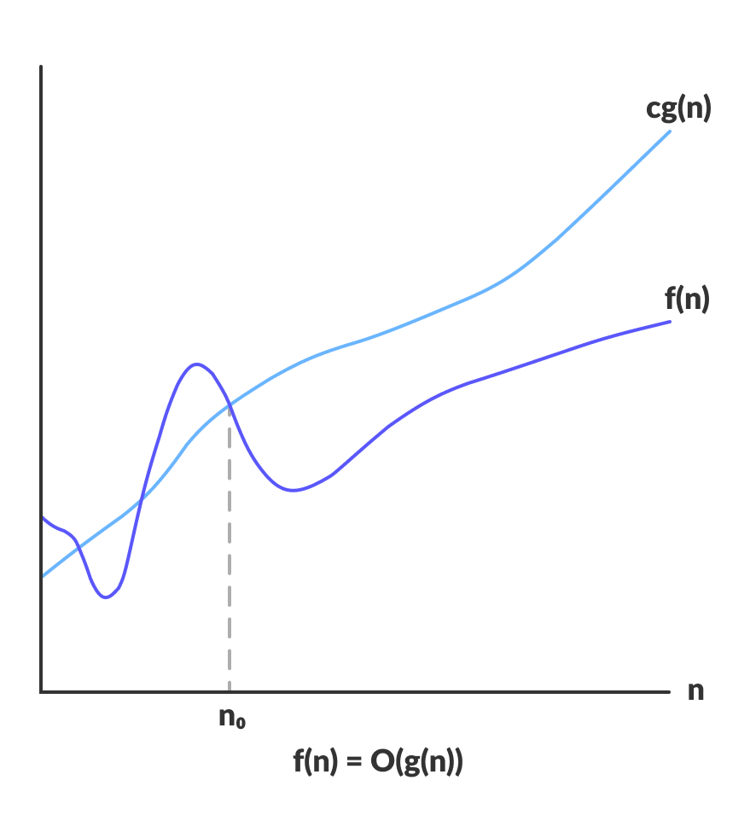
Big-O Notation (O-notation)

Slide 6
Omega Notation (Ω-notation)
Omega notation represents the lower bound of the running time of an algorithm.
Thus, it gives the best case complexity of an algorithm.
For any value of n minimum value of complexity is given by omega.

Slide 7
Omega Notation (Ω-notation)
O(g(n)) = { f(n): there exist positive constants c and n₀ such that 0 ≤ f(n) ≤ cg(n) for all n ≥ n₀ }
Ω(g(n)) = f(n)
f(n) ≥ cg(n) for all n ≥ n_{0}}
Ω(g(n)) = { f(n): there exist positive constants c and n₀ such that

Slide 8
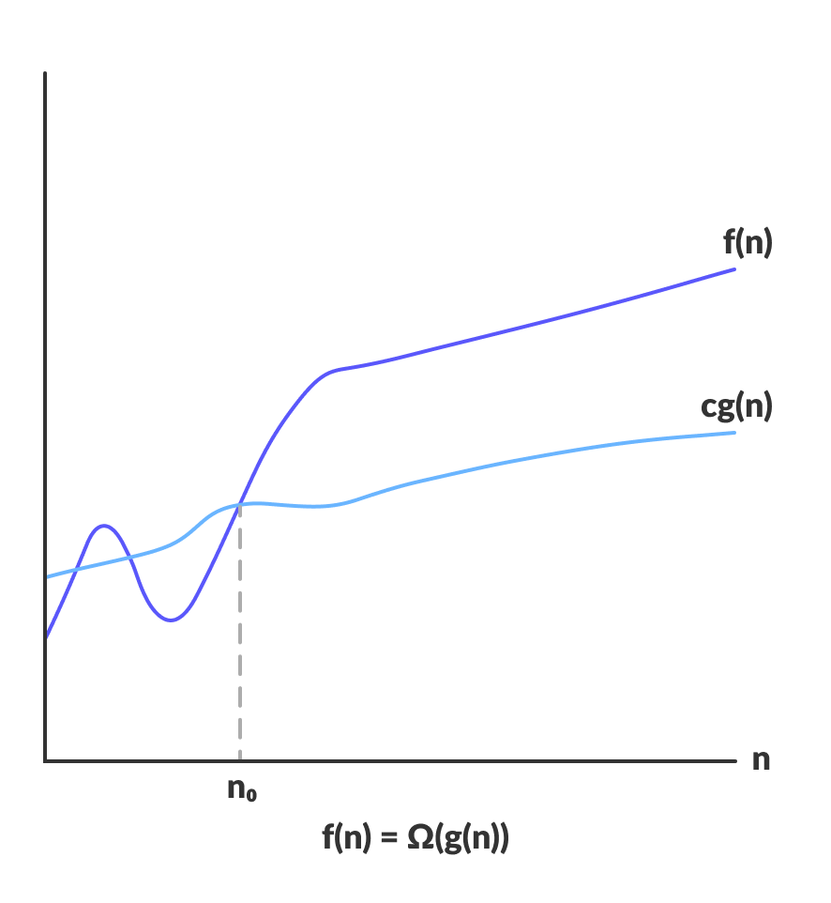
Omega Notation (Ω-notation)

Slide 9
Theta Notation (Θ-notation)
Theta notation represents the lower bound and as well as upper bound of the running time of an algorithm.
Thus, it gives the average case complexity of an algorithm.
For any value of n average value of complexity is given by Theta.

Slide 10
Theta Notation (Θ-notation)
O(g(n)) = { f(n): there exist positive constants c and n₀ such that 0 ≤ f(n) ≤ cg(n) for all n ≥ n₀ }
Θ(g(n)) = f(n)
C1g(n)≤ f(n)≤ c2g(n) for all n ≥ n_{0}}
Θ(g(n)) = { f(n): there exist positive constants c1 ,c2 and n₀ such that

Slide 11
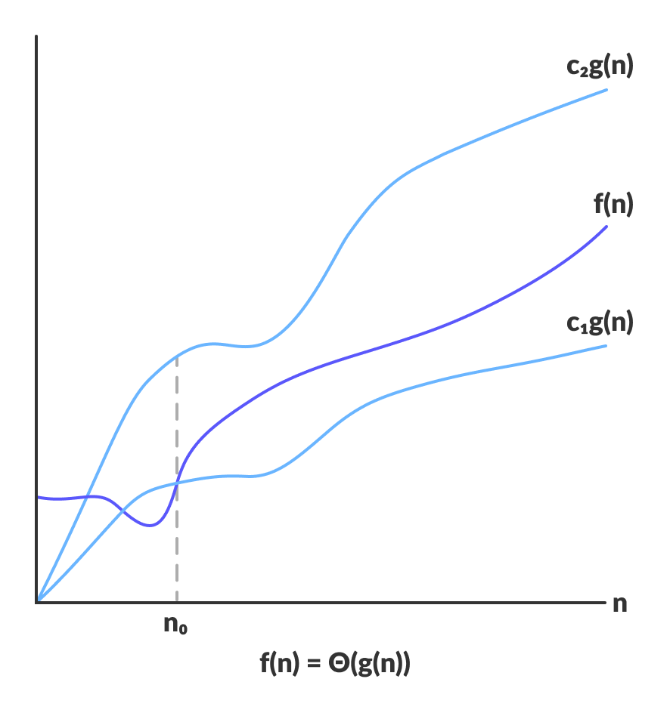
Theta Notation (Θ-notation)

Slide 12
Small-o Notation (o-notation)
small-o notation represents the upper bound of the running time of an algorithm.
Thus, it gives the worst case complexity of an algorithm.
For any value of n, the running time of an algorithm does not cross time provided by o(g(n)).
O(g(n)) = { f(n): there exist positive constants c and n₀ such that 0 ≤ f(n) ≤ cg(n) for all n ≥ n₀ }
O(g(n)) = { f(n): there exist positive constants c and n₀ such that 0 ≤ f(n) ≤ cg(n) for all n ≥ n₀ }

Slide 13
Small-o Notation (o-notation)
O(g(n)) = { f(n): there exist positive constants c and n₀ such that 0 ≤ f(n) ≤ cg(n) for all n ≥ n₀ }
O(g(n)) = f(n)
f(n) <cg(n) for all n ≥ n_{0}}
O(g(n)) = { f(n): there exist positive constants c and n₀ such that

Slide 14
Small-Ω Notation (Ω -notation)
small- Ω notation represents the lower bound of the running time of an algorithm.
Thus, it gives the best case complexity of an algorithm.
O(g(n)) = { f(n): there exist positive constants c and n₀ such that 0 ≤ f(n) ≤ cg(n) for all n ≥ n₀ }
O(g(n)) = { f(n): there exist positive constants c and n₀ such that 0 ≤ f(n) ≤ cg(n) for all n ≥ n₀ }

Slide 15
Small-Ω Notation (Ω -notation)
O(g(n)) = { f(n): there exist positive constants c and n₀ such that 0 ≤ f(n) ≤ cg(n) for all n ≥ n₀ }
Ω(g(n)) = f(n)
f(n) >cg(n) for all n ≥ n_{0}}
Ω(g(n)) = { f(n): there exist positive constants c and n₀ such that

Slide 16
small-O Notation (O-notation)

Slide 17
small- Ω Notation (Ω -notation)

