Slide 1
Sjctnc - bca department
Subject :Computer Algorithms
Class :II BCA
Staff :R.vidhyalakshmi.

Slide 2
COMPUTER ALGORITHM
Computer algorithm
step by step procedure to solve computer problems.

Slide 3
Computer algorithms
System
algorithms
solutions

Slide 5
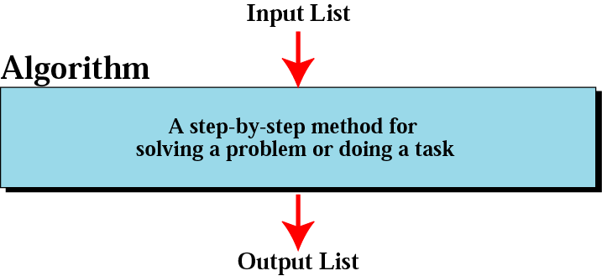
Figure 8-1
Informal definition of an algorithm
used in a computer

Slide 6
Computer algorithm
COMPUTER PROBLEMS:
LET TAKE EXAMPLE
Addition of two numbers in any programming language.

Slide 7
Addition of two numbers
Step 1: Create memory location -----------(eg. int a,b)

Slide 8
Addition of two numbers
Step 2: get values from user-----------(6,7)

Slide 9
Addition of two numbers
Step 3: Add two values--------(6+7=13).

Slide 10
Addition of two numbers
Step 4:print the output.

Slide 11
Addition of two numbers
Step 1: create memory location -----------(.int a,b)
Step 2: get values from user-----------(6,7)
Step 3:add two values--------(6+7=13).
Step 4:print the output.

Slide 12
Computer algorithm
Some example problems
Finding a record from 10,000 entry.
Searching algorithm-binary search, linear search, sequential search etc…..

Slide 13
example
Semester Result?
College server
Phone/computer
Bca II

Slide 14
Computer algorithm
Some example problems
Finding a record from 10,000 entry.
Searching algorithm-binary search, sequential search etc…..

Slide 15
Definition: computer algorithm
An algorithm is a systematic method containing a sequence of instructions to solve a computational problem.
input
Algorithm
o
output

Slide 16
Definition: computer algorithm
An algorithm takes some inputs performs a well defined sequence of steps and produce some output

Slide 17
Property of algorithm
Finite--------number of steps ------finite.
Definite------clear and unambiguous.
Effective-----basic and essential.
Input----------operates an input.
Output----------produce output.

Slide 18
Addition of two numbers---property
Step 1: create memory location
Step 2: get values from user-----------(6,7)
Step 3:add two values--------(6+7=13).
Step 4:print the output.
Finite--------number of steps ------finite.
Definite------clear and unambiguous.
Effective-----basic and essential operations.
Input----------operates an input.
Output----------produce output.

Slide 19
Property
Input--------------a,b
Ouput-------------a+b===13
Finite----------total steps----4
Definite-------clear
Effective--------(+).

Slide 20
summary
Algorithm: step by step finite steps to solve computer problems.
Algorithm should has properties.
Finite
Definite
Effective
Input
output

Slide 21
Sample algorithm
Algorithm : to add two numbers
Algorithm add(a,b)
//input:a,b
//output:sum of a and b
Read a;
Read b;
Result 0;

