Slide 1
Amazon S3 Bucket Static Web Hosting
Tech stack : AWS ( S3 ) , HTML , CSS .

Slide 2
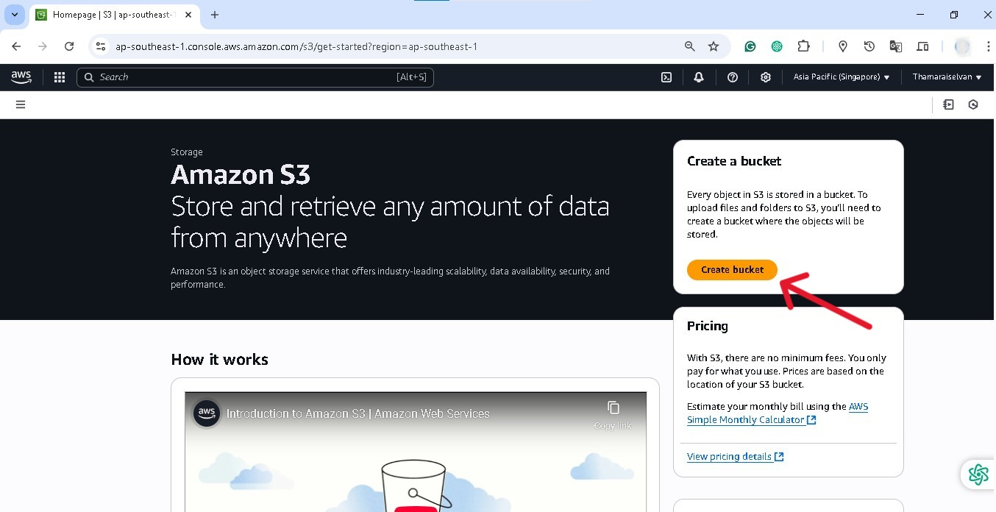
S3 Bucket Creation and Configuration :

Slide 3
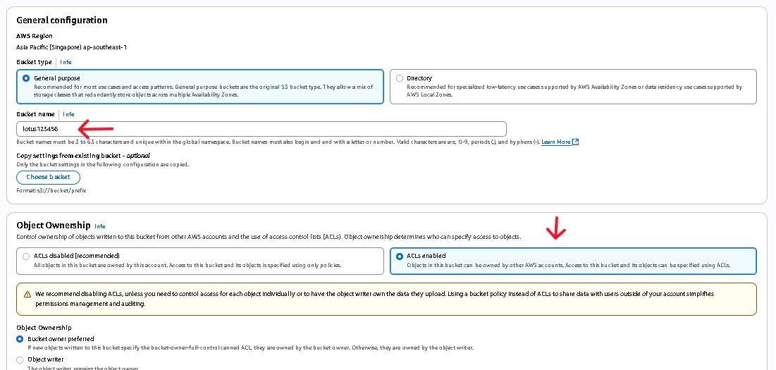

Slide 4
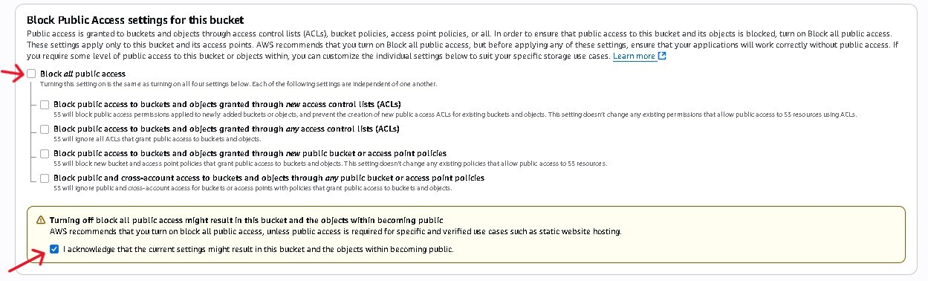
Unlocking Public Access :

Slide 5
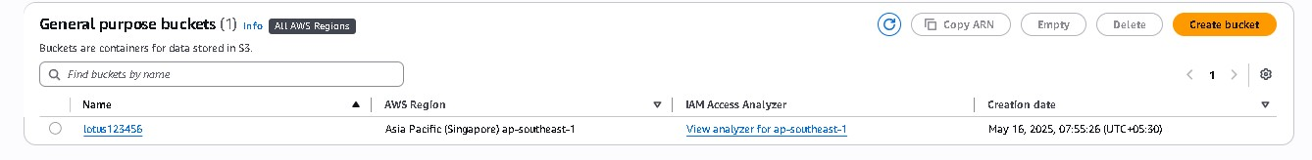
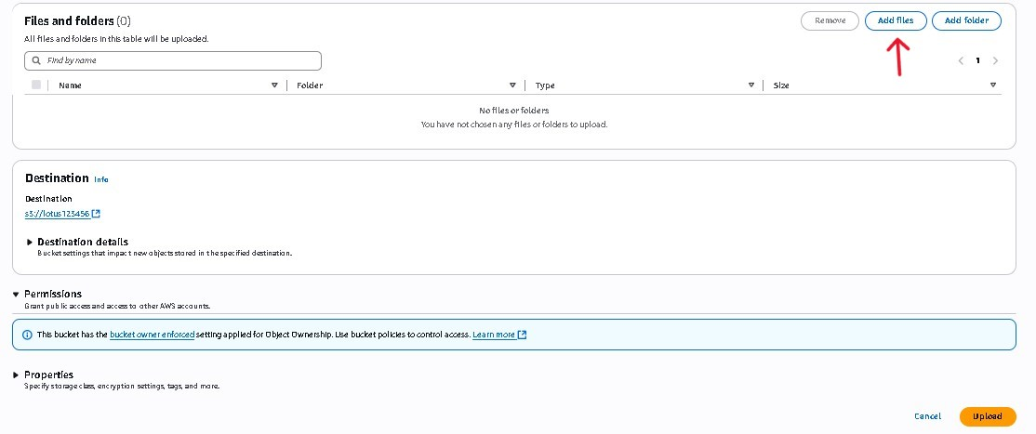
S3 Files Upload :

Slide 6
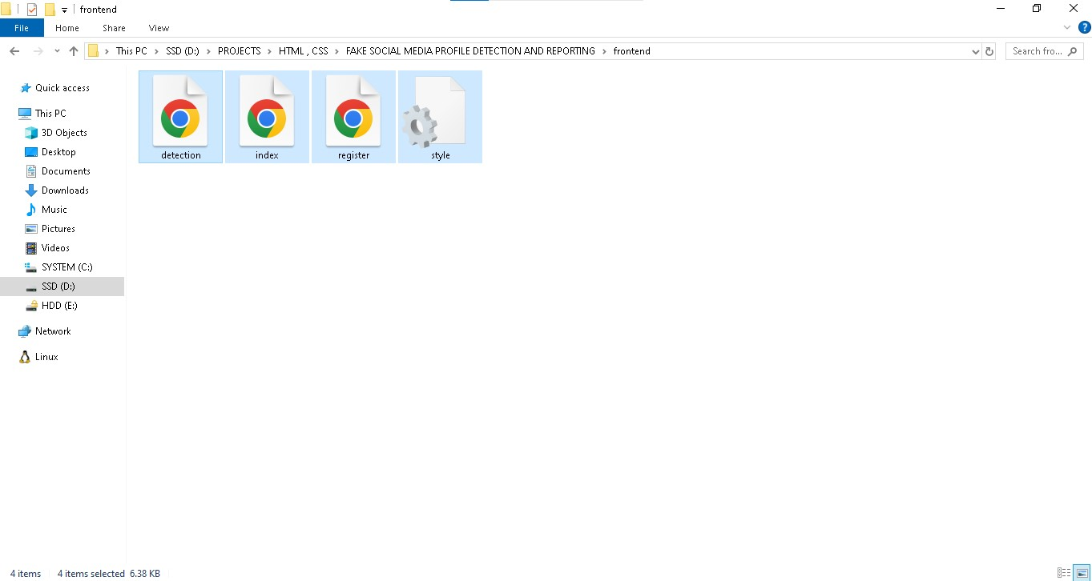

Slide 7
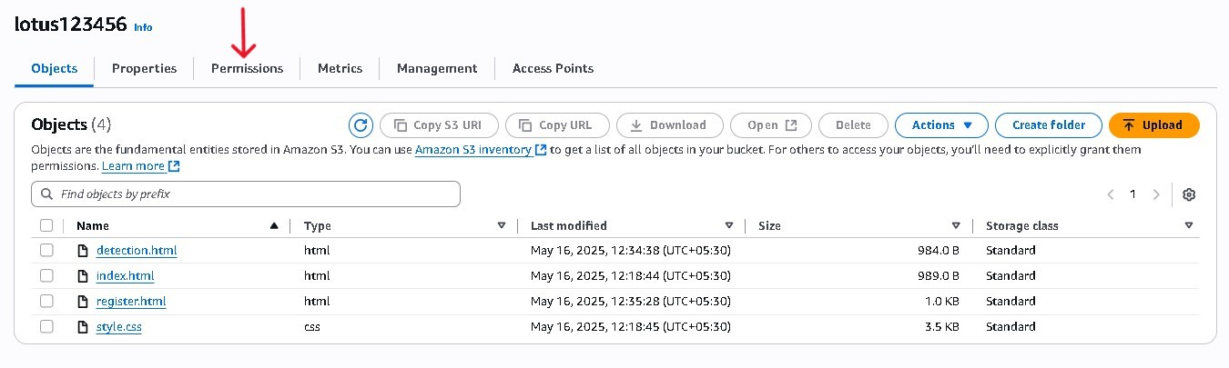
Changing Permissions on S3 Buckets :

Slide 8
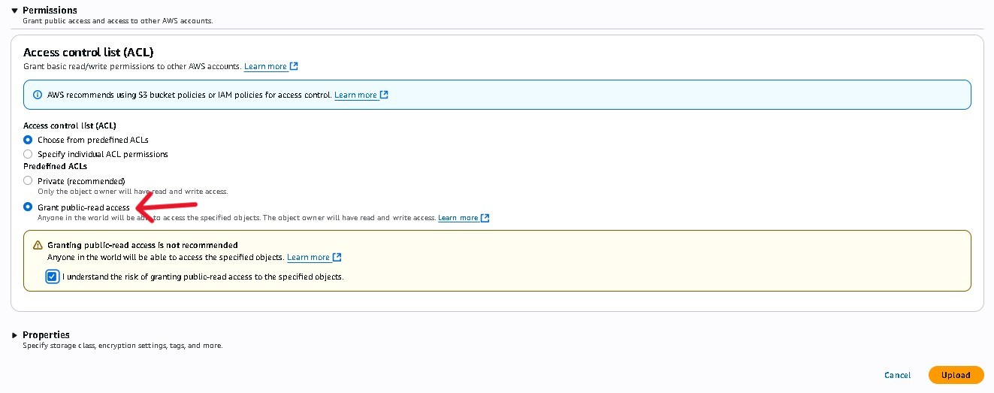
Making S3 Buckets Publicly Accessible :

Slide 9
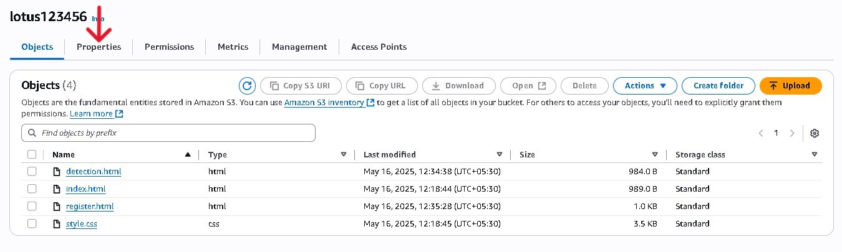
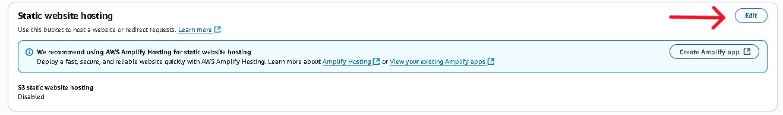
Enabling Static Website Hosting on S3 :

Slide 10
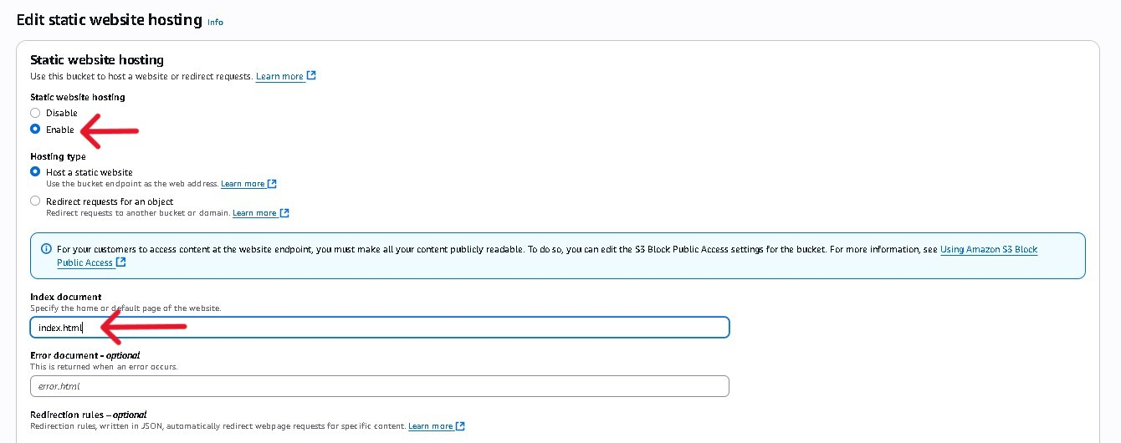
Configuring Index Document for S3 Static Website :

Slide 11
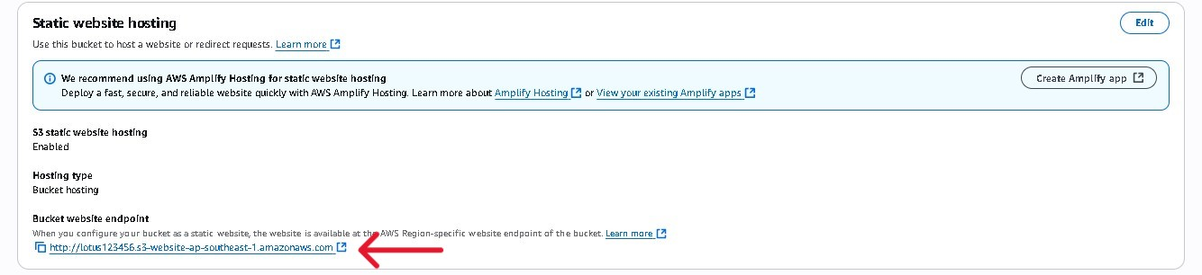
Accessing Your S3 Static Website URL :

Slide 12
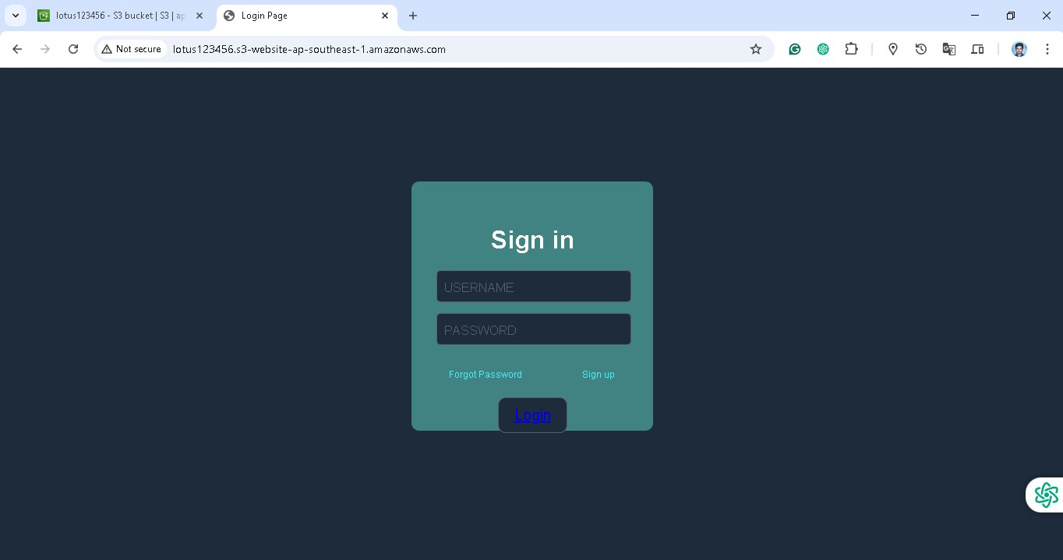
S3 Static Website Hosting :

Slide 13
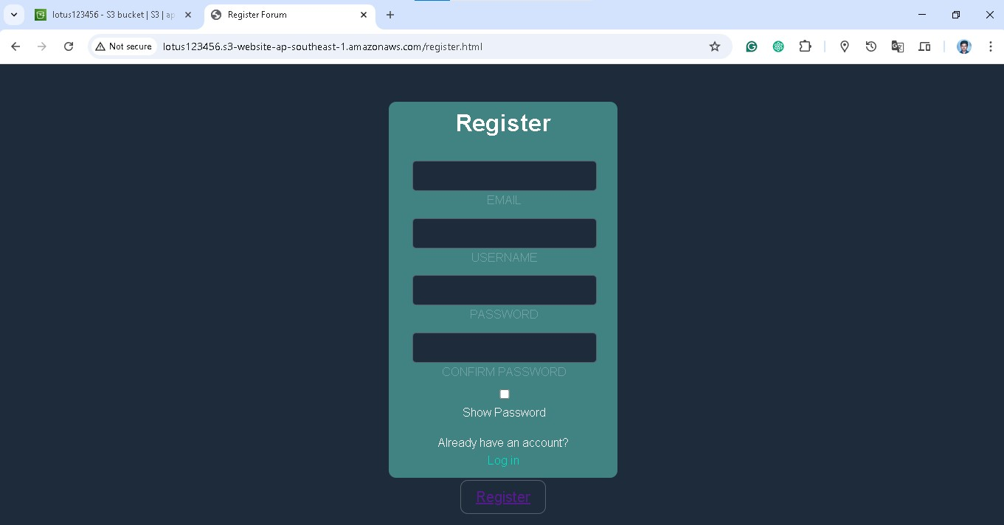

Slide 14
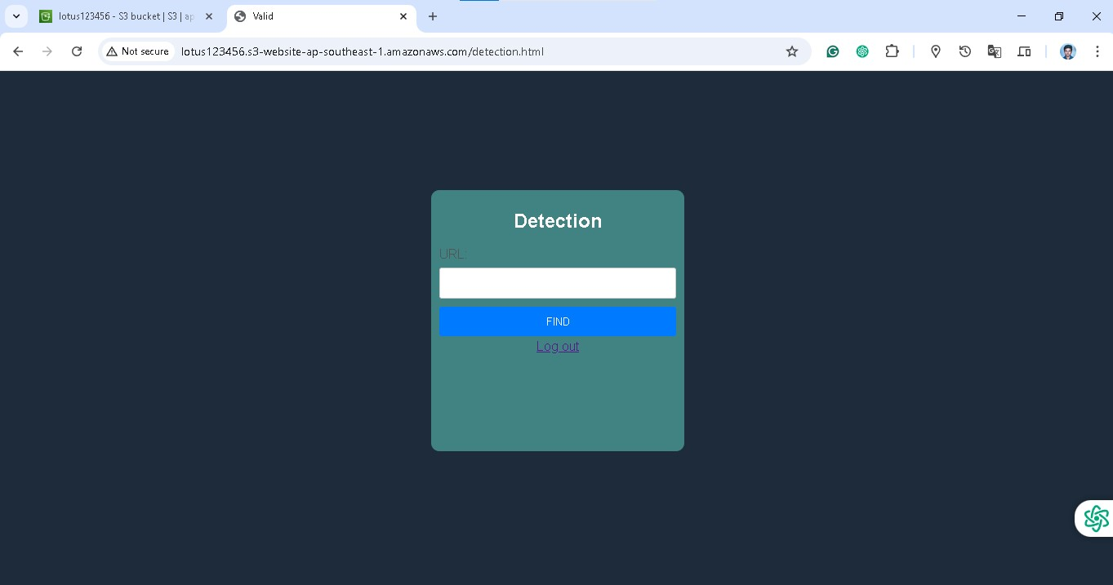

Slide 15
THANK YOU

