Slide 1
T. G . Sahithi
Final Project
3/21/2024 Annual Review

Slide 2
Keylogger & Security
Keyloggers are a particularly insidious type of spyware that can record and steal consecutive keystrokes (and much more) that the user enters on a device. The term keylogger, or “keystroke logger,” is self-explanatory: Software that logs what you type on your keyboard. However, keyloggers can also enable cybercriminals to eavesdrop on you, watch you on your system camera, or listen over your smartphone’s microphone.
3/21/2024 Annual Review

Slide 3


AGENDA
1.Introduction to Keyloggers
2.Problem statement
3.Project overview
4.Who are the end users?
5.Solution and its value proposition
6.The wow in your solution
7.Detection of Keyloggers
8.Prevention and Protection Strategies
9.Modelling
10.Results
3/21/2024 Annual Review

Slide 4

PROBLEM STATEMENT
The main danger of keyloggers is that malicious users can identify and exploit your personal information. The following examples illustrate some of the risks of a keylogger attack: Hackers can steal credit card information and make unauthorized purchases.
Hardware keyloggers are challenging to detect because they do not interact with the computer's operating system and, as a result, often go unnoticed by antivirus or security software.
3/21/2024 Annual Review

Slide 5
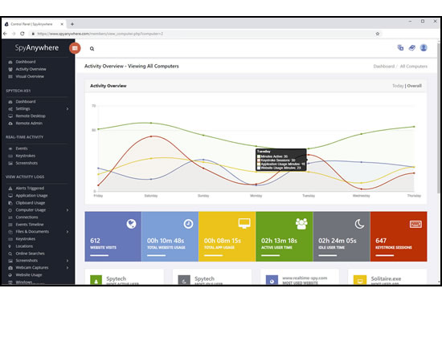

PROJECT OVERVIEW
Benefits of Using SpyAgent:
SpyAgent's unmatched all-seeing eye can bring an array of benefits to your family or business environment. With the ability to log all keystrokes, track web and program usage down to the second, and show you everything that has happened with screenshots, SpyAgent helps you learn the truth and put your mind at ease.
3/21/2024 Annual Review

Slide 6

WHO ARE THE END USERS?
Ethical Hackers and Security Professionals:
Ethical hackers and security professionals may use keyloggers as part of penetration testing or security assessments to identify vulnerabilities in systems and applications. This helps organizations improve their security posture by addressing potential weaknesses before they can be exploited by malicious actors.
IT Administrators:
IT administrators may utilize keyloggers to troubleshoot technical issues, diagnose problems, or monitor system usage within their organization's network.
Cybercriminals:
Unfortunately, cybercriminals may also be end users of keyloggers, employing them for malicious purposes such as stealing sensitive information like passwords, financial details, or personal data. This stolen information can be used for identity theft, financial fraud, or other illicit activities.
3/21/2024 Annual Review

Slide 7

YOUR SOLUTION AND ITS VALUE PROPOSITION
Use a firewall. A firewall is a security system that helps monitor network traffic for suspicious activity. Firewalls can help prevent keylogging by intercepting data that a keylogger attempts to send through the internet.
Use a password manager and update passwords frequently. A password manager stores passwords from all your accounts so you only need to remember the master password.
Update your system frequently. System updates to your operating system and applications keep malicious users from exploiting known issues. Make sure that you install updates as soon as they are available to keep your system protected.
3/21/2024 Annual Review

Slide 8

THE WOW IN YOUR SOLUTION
Web page scripts:
Hackers can insert malicious code on a web page. When you click an infected link or visit a malicious website, the keylogger automatically downloads on your device.
Phishing:
Hackers can use phishing emails, which are fraudulent messages designed to look legitimate. When you click an infected link or open a malicious attachment, the keylogger downloads on your device.
Social engineering:
Phishing is a type of social engineering, which is a strategy designed to trick victims into divulging confidential information. Cybercriminals might pretend to be a trusted contact to convince the recipient to open an attachment and download malware.
3/21/2024 Annual Review
8

Slide 9
Advantages of keylogger:
Monitoring and Surveillance: Keyloggers can be used for legitimate monitoring purposes, such as parental control to ensure children's online safety or employee monitoring to track productivity and adherence to company policies.
Data Recovery: In situations where data is accidentally lost, keyloggers can sometimes help recover the lost information by capturing keystrokes before they are deleted.
Investigative Tool: Law enforcement agencies and legal professionals can use keyloggers as part of their investigative toolkit to gather evidence in criminal cases or track suspicious activities.

Slide 10
MODELLING
Import Required Modules:
Use Python's keyboard module to capture keystrokes.
Optionally, use other modules for logging, encryption, or network communication.
Set Up Logging:
Configure logging settings to specify the format and destination of log files.
Define Keylogger Function:
Create a function to capture and log keystrokes.
Use the keyboard.on_press() method to register a callback function to capture each key press event.
Main Function:
Create a main function to start the keylogger and keep it running indefinitely.
3/21/2024 Annual Review
10

Slide 11
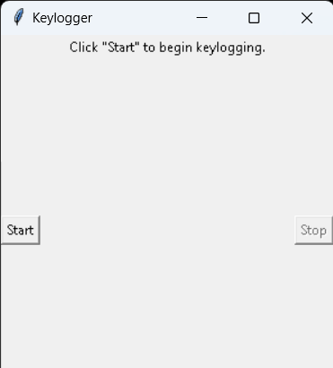
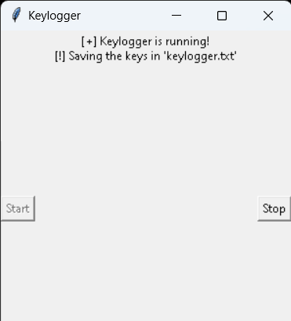
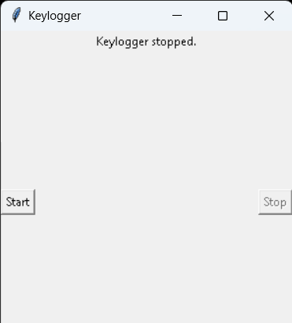
RESULTS
The result of a keylogger program typically involves capturing and logging keystrokes entered by a user on a keyboard. These logged keystrokes can then be used for various purposes, depending on the intent of the keylogger user.
3/21/2024 Annual Review
11

