Slide 1
Machine Learning Model Development
Assignment–2 | AD25C01 – Exploratory Data Analysis
SRM TRP Engineering College, Tiruchirappalli
Department of Artificial Intelligence and Data Science
Project: Online Shopping Purchase Prediction
Team 6 | Academic Year 2026–2027
Faculty: V. Ezhil Swanly, Assistant Professor

Slide 2
1. Problem Definition
Objective: predict whether an online browsing session generates revenue.
Target variable: Revenue (1 = purchase/revenue; 0 = no revenue).
Type: supervised binary classification.
Use: support e-commerce analysis and understand purchase-related browsing behaviour.

Slide 3
2. Dataset Overview
9,864 records and 27 columns in the supplied cleaned sheet.
26 predictor features and one target variable (Revenue).
Target distribution: 8,288 no-revenue sessions; 1,576 revenue sessions.
Data quality report: 0 missing cells and 0 duplicate rows after cleaning.
Existing numeric scaling and encoded values were preserved.

Slide 4
3. Data Preparation
Separated Revenue as y and all other columns as X.
Stratified train-test split: 80% training and 20% testing.
Training set: 7,891 rows; test set: 1,973 rows.
Random state = 42 for reproducibility.
Class weighting used to address the minority purchase class.

Slide 5
4. Models Developed
Logistic Regression: interpretable linear classification baseline.
Decision Tree: rule-based model with constrained depth and leaf size.
Random Forest: ensemble of 250 decision trees.
All models evaluated on the same held-out test set.

Slide 6
5. Evaluation Metrics
Accuracy: overall fraction of correct predictions.
Precision: reliability of predicted purchase sessions.
Recall: fraction of actual purchase sessions detected.
F1-score: balance between precision and recall.
ROC-AUC: ability to rank purchase sessions above non-purchase sessions.
Confusion matrix and ROC curve provide additional diagnostic views.

Slide 7
6. Model Comparison
Best by F1-score, with ROC-AUC as tie-breaker: Logistic Regression.
Accuracy: 0.7182
Precision: 0.2995
Recall: 0.5714
F1-score: 0.3930
ROC-AUC: 0.7223

Slide 8
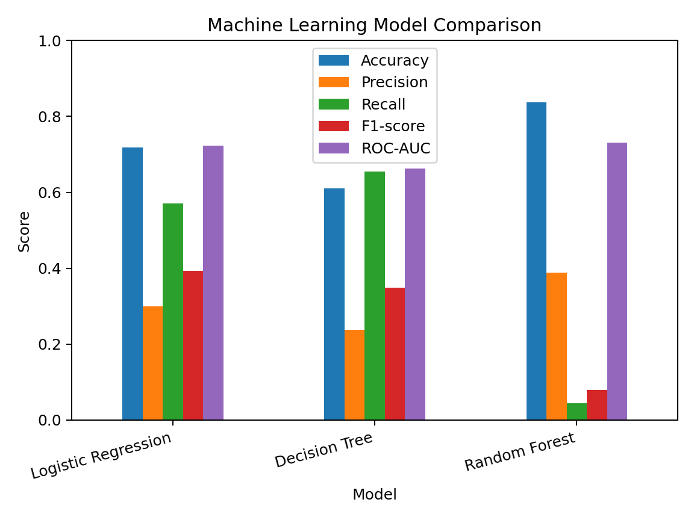
7. Performance Comparison
Figure: all models are compared using held-out test metrics.

Slide 9
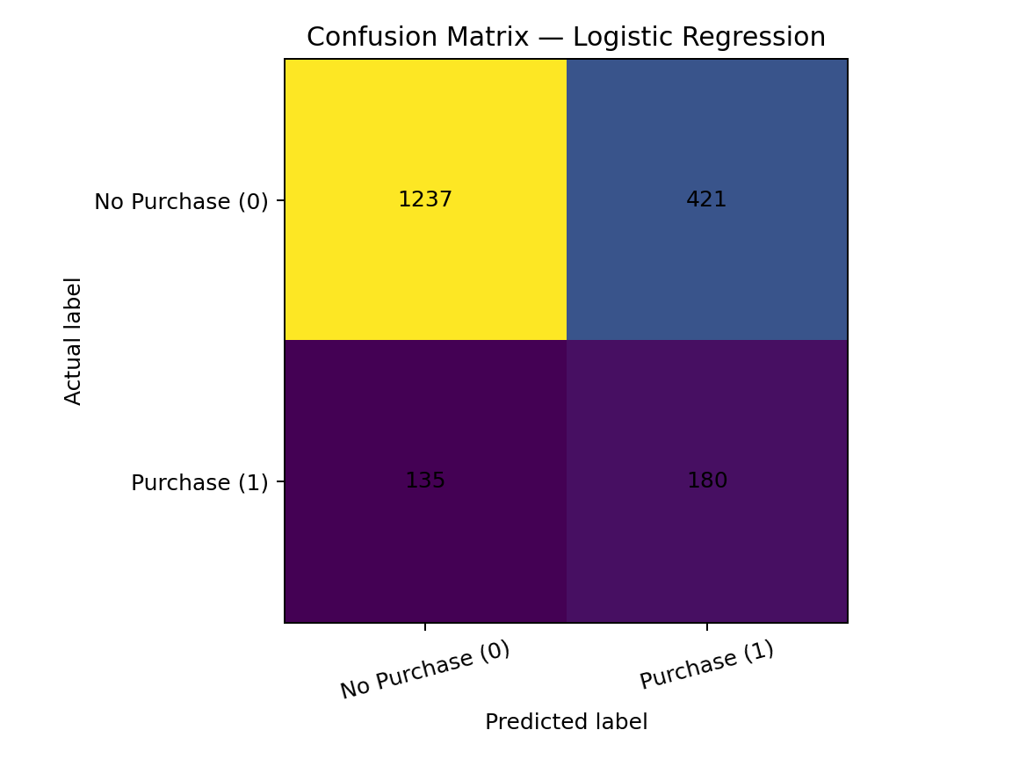
8. Confusion Matrix
Figure: test-set confusion matrix for Logistic Regression.

Slide 10
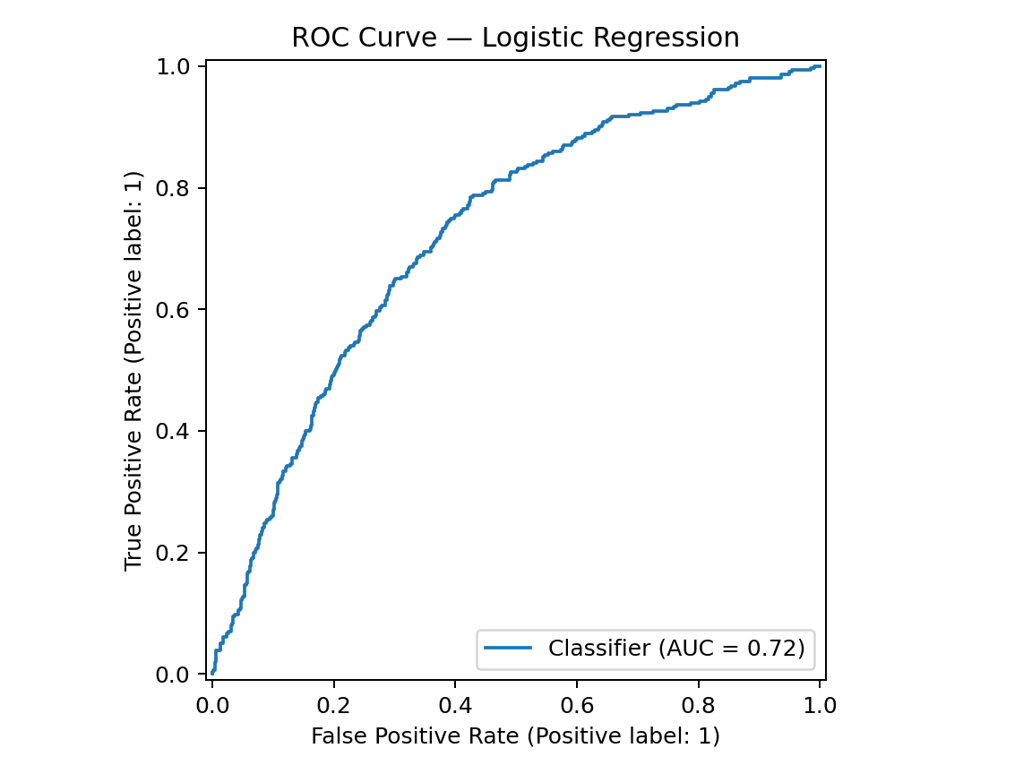
9. ROC Curve
Figure: ROC curve for Logistic Regression.

Slide 11
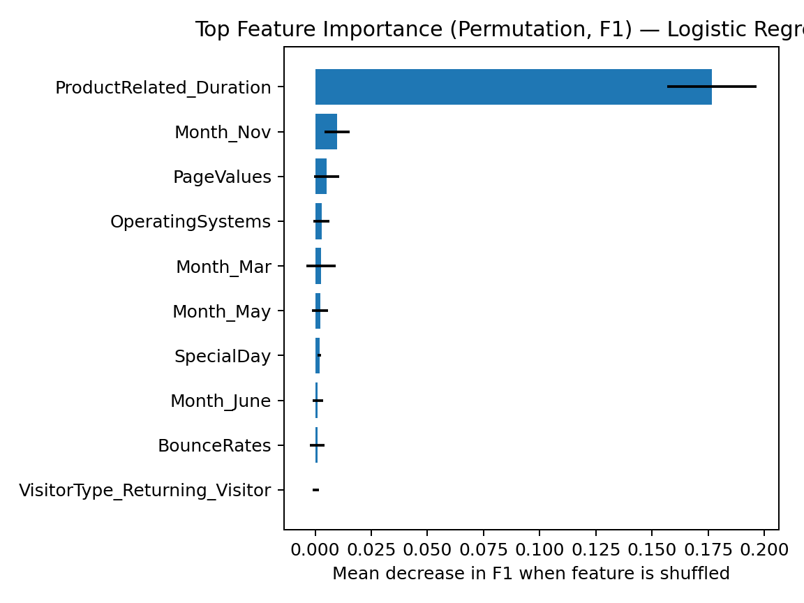
10. Feature Importance
Permutation importance shows how test F1 changes when a feature is shuffled.

Slide 12
11. Conclusion & Future Work
Logistic Regression is the recommended model under the selected F1-score-first criterion.
The target is imbalanced; accuracy alone can be misleading.
Top permutation feature: ProductRelated_Duration. This is association, not causation.
Limitations: one split, pre-encoded/scaled data, and no external validation dataset.
Future work: cross-validation, hyperparameter tuning, threshold calibration, drift checks, and independent validation.

