Slide 1
AIDC BOOTCAMP CAPSTONE · TEAM 7
RFP AI BENCHMARK
Built for Beam Data
WHAT IT IS
A benchmarking platform for Beam Data advisors that compares LLMs on extracting key fields from RFP documents, so clients can choose the right model with evidence.
TEAM 7 PRESENTERS
TEAM 7 · PRESENTER 1
Mohanad Babgi
TEAM 7 · PRESENTER 2
Abdullah Almithn
TEAM 7 · PRESENTER 3
Thamer Alotaibi
TEAM 7 · PRESENTER 4
Amer Alsenani

Slide 2
02 / 13 · PROBLEM LANDSCAPE
Current Challenges
Choosing an LLM for RFP work is guesswork without task-specific evidence.
BEAM DATA ADVISORS
Consultants who recommend which LLM a client should use for RFP work.
CLIENT BID TEAMS
Procurement and proposal teams who read long RFPs to find deadlines, requirements and terms.
PLATFORM TEAMS
Engineers who deploy and serve models on the shared AI infrastructure.
PAIN POINTS
Model advice rests on vendor claims and generic leaderboards
No RFP-specific evidence to show clients
Accuracy, speed and cost are hard to weigh together
PAIN POINTS
Manual review of long RFPs is slow
Key fields are easy to miss or misread
Unclear whether an LLM answer can be trusted
PAIN POINTS
Self-hosted models must fit a 16 GB VRAM budget
No proof a 7–8B model matches a hosted API
No shared test harness for new models
Beam Data · RFP AI Benchmarking Platform
Slide 2 of 13

Slide 3
03 / 13 · MARKET CONTEXT
Market Analysis
Many ways to process documents, few ways to compare models on RFPs.
THE MARKET
Field: Businesses are using LLMs to read and summarise procurement documents such as RFPs.
Trend: The model landscape is moving fast, from hosted APIs to open-weight models that companies can run themselves.
Why now: Teams must choose between accuracy, speed, cost and data control, but rarely have RFP-specific results to decide with.
EXISTING OPTIONS
Manual RFP review — slow and varies by reviewer
Public LLM leaderboards — generic tasks, not RFP fields
Vendor demos and claims — one model, no shared test set
Cloud document-AI services — single vendor, no self-hosted comparison
MARKET GAP
No easy way to compare hosted and self-hosted LLMs side by side on the same RFPs, with evidence-checked accuracy, speed and cost.
Beam Data · RFP AI Benchmarking Platform
Slide 3 of 13

Slide 4
04 / 13 · CORE PLATFORM
Proposed Solution
Upload an RFP, compare three models, see which one extracts best.
OUR SOLUTION
An advisor uploads an RFP PDF. The platform extracts its text and sends the same prompt to three models: Llama 3.1 8B and Qwen2.5 7B (both self-hosted, 4-bit) plus OpenAI. Each returns 17 key fields, such as the submission deadline, as structured JSON with a supporting quote from the document. Every answer is then scored against human-annotated ground truth and compared on accuracy, hallucination rate, latency, tokens and cost across 10 documents: 5 RFPs in English and the same 5 in Arabic.
IN ONE LINE
We run three LLMs on the same RFPs and show which one extracts the most accurately, quickly and cheaply.
Beam Data · RFP AI Benchmarking Platform
Slide 4 of 13

Slide 5
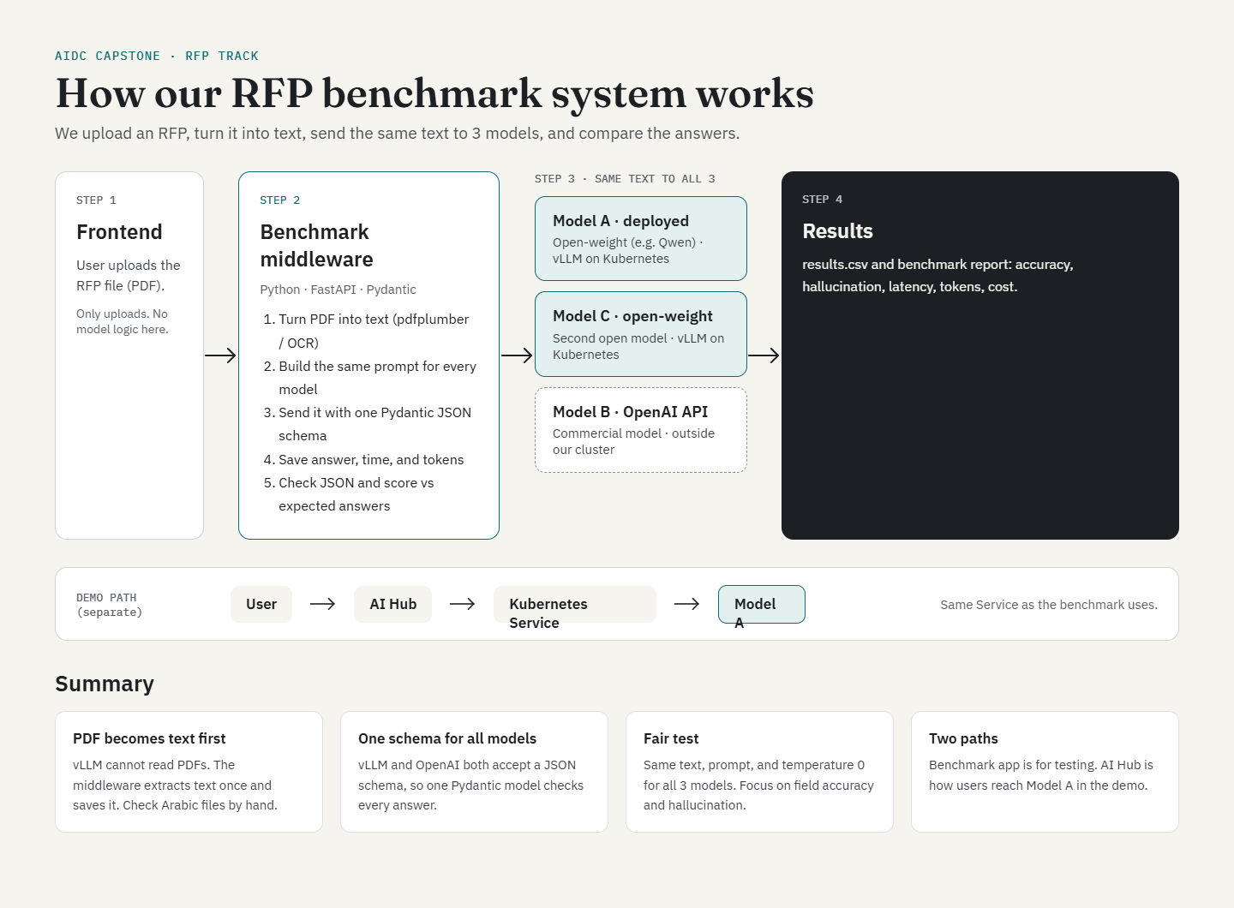
05 / 13 · SYSTEM ARCHITECTURE
Beam Data · RFP AI Benchmarking Platform
Slide 5 of 13

Slide 6
06 / 13 · MULTI-MODEL EXTRACTION
Key Feature 1: Multi-Model Extraction
Same document, three models, one view.
HOW IT WORKS
Upload: an RFP PDF is converted to text with PyMuPDF and combined with a fixed extraction prompt.
Parallel calls: the identical prompt goes to all 3 models through one OpenAI-compatible client. One GPU: the self-hosted pair run in separate passes.
Structured output: each model returns 17 fields as JSON with a status (found or not stated), a value and an evidence quote.
Resilient: if one model fails or times out, the others still return, and every raw answer is saved before parsing.
WHY IT MATTERS
Advisors see all three models’ answers on the same RFP side by side, with no scripts to run.
Beam Data · RFP AI Benchmarking Platform
Slide 6 of 13

Slide 7
07 / 13 · EVIDENCE SCORING
Key Feature 2: Evidence-Based Scoring
Every answer is checked against ground truth and its quoted evidence.
HOW IT WORKS
Ground truth: the team annotates the correct value for each field in every sample RFP.
Field-by-field check: each model answer is normalised (dates, values) and compared with the ground truth.
Five outcomes: correct, miss, correct abstention, extraction error (wrong but quoted from the text) or fabrication (wrong and unsupported).
Macro accuracy: the 17 field scores are averaged per document and model.
WHY IT MATTERS
Separates honest misreads from made-up answers. Measured across the ten documents: gpt-4o-mini invented nothing, Llama invented 6 values and Qwen 8.
Beam Data · RFP AI Benchmarking Platform
Slide 7 of 13

Slide 8
08 / 13 · BENCHMARK DASHBOARD
Key Feature 3: Benchmark Dashboard
From individual answers to a defensible recommendation.
HOW IT WORKS
One-click runs: start a full benchmark of the sample RFPs across all 3 models and watch its progress.
Key metrics: accuracy, hallucination rate, latency, token usage and estimated cost for each model.
Results page: summary table, charts and per-field accuracy to show where each model is strong or weak.
Export: download results as CSV to feed the benchmark report.
WHY IT MATTERS
Turns raw model output into evidence. Running gpt-4o-mini twice put run-to-run variation at 0.032 — which is how we know a 0.033 gap between two models means nothing.
Beam Data · RFP AI Benchmarking Platform
Slide 8 of 13

Slide 9
09 / 13 · SELF-HOSTED VS API
Key Feature 4: Self-Hosted vs OpenAI
Hosted and self-hosted models tested on the same documents.
HOW IT WORKS
Self-hosted: Meta-Llama-3.1-8B-Instruct and Qwen2.5-7B-Instruct, both 4-bit AWQ, run on vLLM on our own Kubernetes cluster within the 16 GB VRAM budget. Matched context, batching and memory settings, so differences reflect the models.
Hosted reference: OpenAI is added as the benchmark for what a commercial API achieves.
One interface: every model sits behind an OpenAI-compatible API, so the same code and prompt test them all.
Live demo: the deployed model can also be shown in the AI Hub playground.
WHY IT MATTERS
The answer: close on English — 0.492 and 0.459 against 0.550 — but not on Arabic, where the self-hosted models lose 40% and 63% of their accuracy against 13%.
Beam Data · RFP AI Benchmarking Platform
Slide 9 of 13

Slide 10
10 / 13 · EVALUATION RESULTS
Benchmark Results
Three models, 10 documents, 17 fields each. Accuracy is the mean field score against human-annotated ground truth.
BENCHMARK LEADER
GPT-4O-MINI
OpenAI API
RESULTS
English 0.550 · Arabic 0.477 — highest of the three
0 fabrications in 20 runs · 19.6 s · $0.044 per 10 documents
LLAMA 3.1 8B
Self-hosted, 4-bit AWQ
RESULTS
English 0.492 · Arabic 0.295 — a 40% drop on Arabic
6 fabrications · 26.3 s · no per-token cost
QWEN2.5 7B
Self-hosted, 4-bit AWQ
RESULTS
English 0.459 · Arabic 0.169 — a 63% drop on Arabic
8 fabrications · 41.5 s · no per-token cost
Beam Data · RFP AI Benchmarking Platform
Slide 10 of 13

Slide 11
11 / 13 · ACCESS ARCHITECTURE
How Users Access It
A web app for people, a REST API underneath.
WEB APP (STREAMLIT)
Three pages: try one document, run a full benchmark, and review results. It talks only to the middleware, never directly to the models.
REST API (FASTAPI MIDDLEWARE)
Endpoints for health, models, document upload and extraction. It handles PDF parsing, model calls, validation, scoring and saving results.
SCOPE & CONSTRAINTS
Demo focus: the web app and API running 10 documents across 3 models.
Language: English and Arabic. The 5 RFPs were translated and annotated, and all 3 models were benchmarked on both.
Not included yet: OCR for scanned PDFs. Fine-tuning and RAG are out of scope.
Beam Data · RFP AI Benchmarking Platform
Slide 11 of 13

Slide 12
12 / 13 · STAKEHOLDER IMPACT
Benefits for All Stakeholders
Problem, solution, benefit for each group.
BEAM DATA ADVISORS
Recommend the right model to clients
CLIENT BID TEAMS
Read long RFPs for key terms
PLATFORM TEAMS
Deploy and serve models
THE BENEFIT THEY GET
Evidence-based model advice for clients
Accuracy, speed and cost from real RFPs in one report
THE BENEFIT THEY GET
Faster extraction of key RFP fields
A quoted source for every answer, so it can be verified
THE BENEFIT THEY GET
Both self-hosted models fit the 16 GB budget at 4-bit, but trail the API
A reusable harness for testing more models
Beam Data · RFP AI Benchmarking Platform
Slide 12 of 13

Slide 13
13 / 13 · EXECUTIVE SYNTHESIS
What We Found
Three models, ten documents, seventeen fields each.
THE FINDINGS
Accuracy: gpt-4o-mini leads in both languages — 0.550 English, 0.477 Arabic — and is also the fastest.
Trust: gpt-4o-mini never invented a value. Llama invented 6 and Qwen 8. It abstains when unsure; they do not.
Arabic: every model degrades, but the self-hosted pair far more — losing 40% and 63% of their English accuracy against 13% for gpt-4o-mini.
Confidence: run-to-run variation measured at 0.032, so Llama and Qwen cannot be separated from each other.
THE RECOMMENDATION
Recommend gpt-4o-mini for RFP extraction. Self-hosting stays viable where data control outweighs accuracy — but on Arabic that trade costs roughly half of it.
Beam Data · RFP AI Benchmarking Platform
Slide 13 of 13

