Slide 1
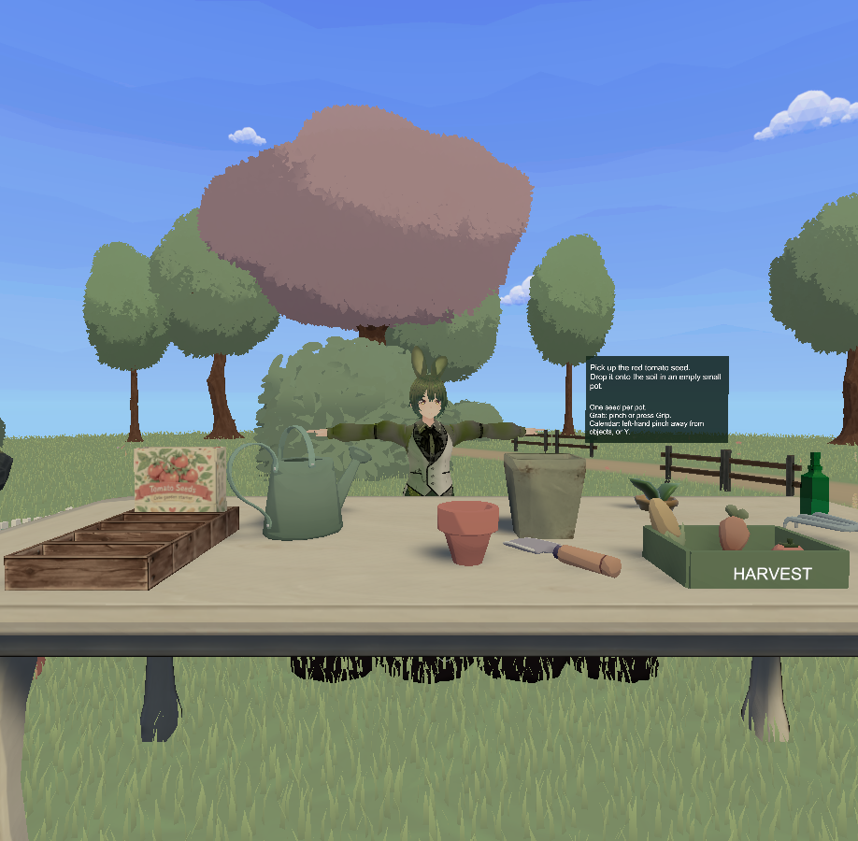
Cozy VR
Garden
A guided gardening experience
for Meta Quest 3
Thamara Gonzalez
Jonathan Guasco
01
Notes:
PRESENTER: Thamara
TIME: 0:00–0:30 (30 seconds)
Welcome. We are Thamara Gonzalez and Jonathan Guasco. Cozy VR Garden is a guided gardening experience for Meta Quest 3. We will introduce the concept, explain what changed through two rounds of user testing, and demonstrate the gardening loop. We will focus on what users found difficult and how those observations changed our design.
SOURCES
Conceptual design and requirements specification.pdf, pp. 1–2. Project screenshot: Docs/Validation/Pastelday.png, an existing development capture.

Slide 2
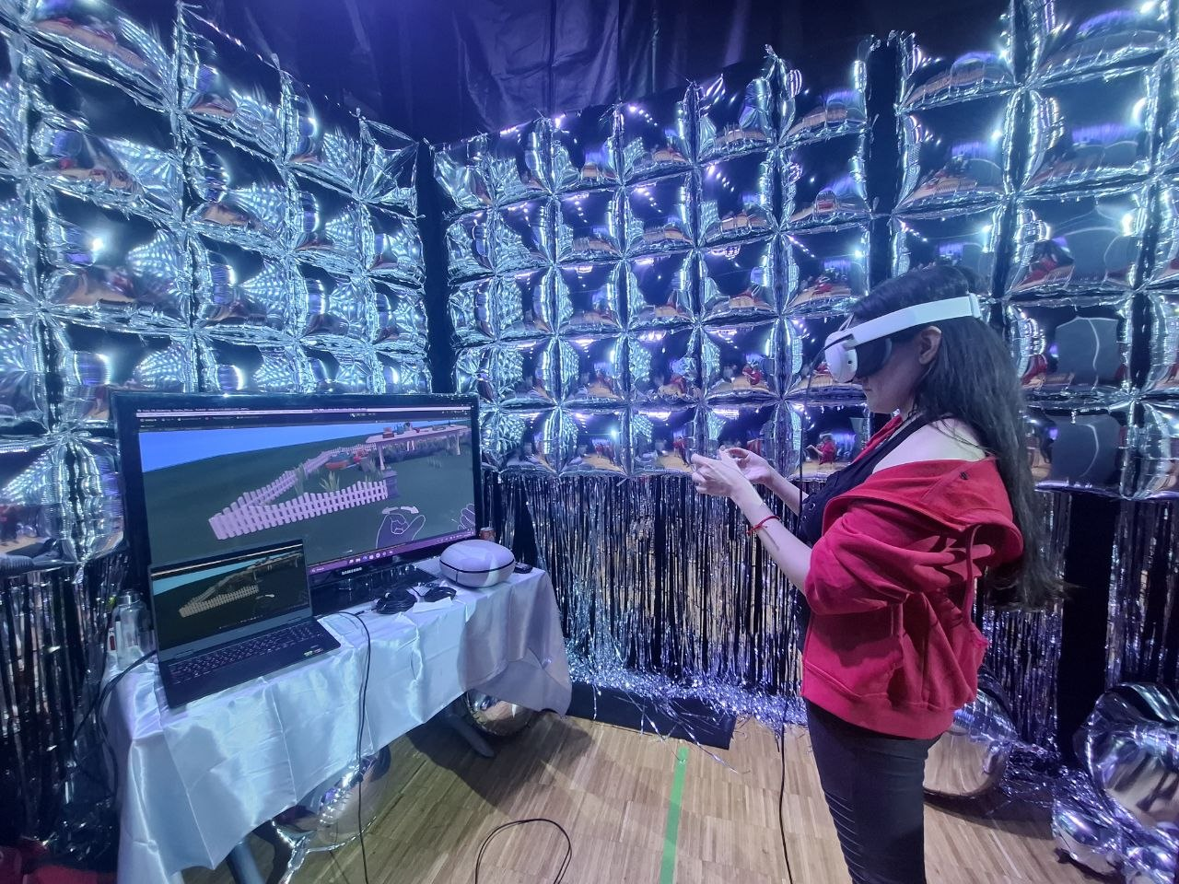
Learning through gardening
For people new to VR
and gardening
Gronny guides the player through
a small, hands-on garden.
The goal is to practise plant care
and responsible water use.
02
Notes:
PRESENTER: Thamara
TIME: 0:30–1:30 (1 minute)
Our starting point was an accessible learning experience for people with little or no VR or gardening experience. Gardening gives us familiar physical actions: picking up a seed, using a tool and pouring water. Gronny is the virtual instructor who explains the next activity and responds to the player's progress. The original concept also covered biodiversity and a final independent task. Our prototype concentrates on a tomato-growing loop and water use. We treat educational benefit as a design goal, because these surveys do not establish that users retained gardening knowledge. The photo shows a real playtest supplied by our team.
SOURCES
Design specification, pp. 2, 7–10. Docs/AhorroAgua.md. Team-supplied playtest photo photo_2026-11-08_23-54-38.jpg.

Slide 3
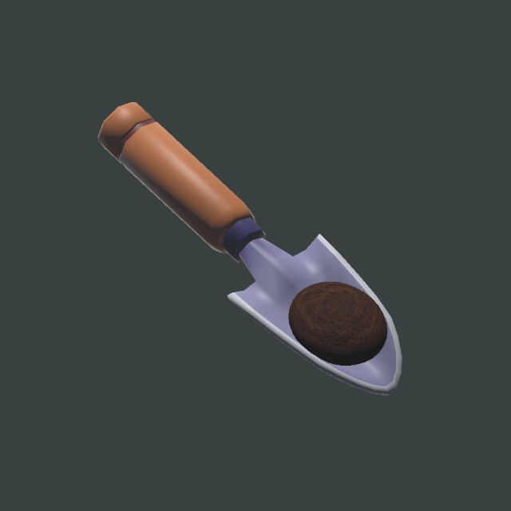
The gardening loop
01 Plant the seed
02 Cover it with soil
03 Water to the target
04 Advance time and observe growth
05 Cut, pick up and deliver the tomato
Physical actions with visible feedback
03
Notes:
PRESENTER: Thamara
TIME: 1:30–2:30 (1 minute)
This is the loop in the current prototype. First, the player releases a seed into a pot and uses a shovel to cover it with soil. Next, they water the plant and stop at the target. The calendar advances the growing process so the consequences of care become visible in a short session. At maturity, the player cuts the stem, picks up the tomato and releases it in the harvest tray. Covering the seed and cutting the fruit extend the original loop. The project supports hand tracking and controllers, while our revised walking experience uses tracked physical movement. We will demonstrate the input mode that we rehearse before class.
SOURCES
Team clarification in this chat. Docs/PlantingSoilCover.md, Docs/TomatoStemHarvest.md, Docs/AhorroAgua.md. Image: Docs/Validation/ShovelSoilPlacement.png, tool preview.

Slide 4
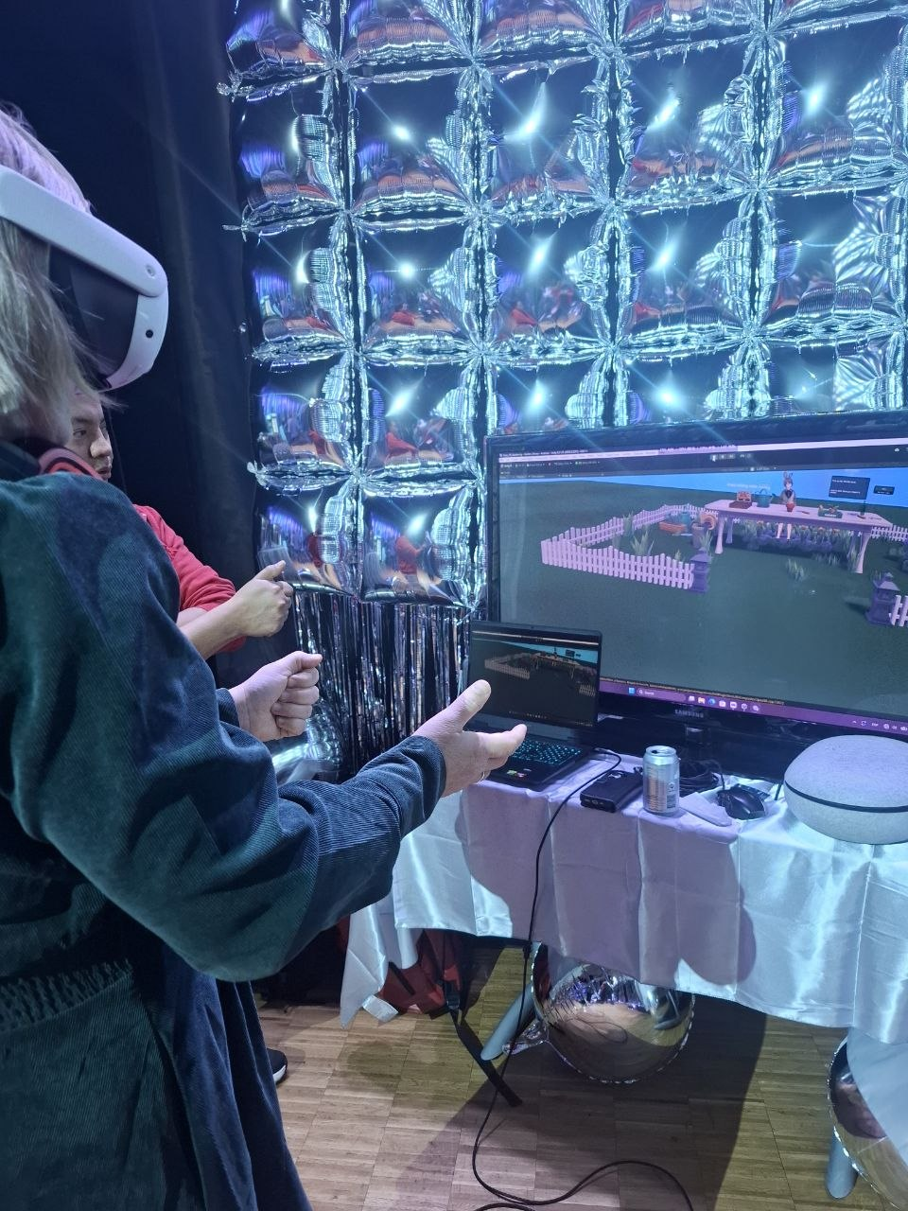
Two rounds of user testing
Round 1 / 21 October
5 survey responses
Full prototype interactions and comfort
Round 2 / 2 November
1 survey response
Physical walking, table distance and Gronny
Different questions and sample sizes limit comparison
04
Notes:
PRESENTER: Thamara
TIME: 2:30–3:15 (45 seconds)
We have two documented rounds. The first export contains five responses from 21 October and covers the prototype's main interactions, guidance and comfort. Three participants used hands only, one used controllers only and one used both. The second export contains one response from 2 November, focused on physical walking, the table and Gronny. These are response counts, not a claim about everyone who visited the playtest. The questionnaires differ, so we cannot use them as a controlled before-and-after comparison.
SOURCES
First Prototype Feedback workbook, Sheet1, rows 2–6, columns B and G–AA. Walking & Gronny’s Guidance workbook, Sheet1, row 2. Team-supplied photo photo_2026-11-08_23-54-48.jpg.

Slide 5
Round 1: movement needed the most help
Responses rating an action difficult or very difficult (out of 5)
4/5
found the garden
moderately or
very relaxing
Harvest: 0 of 4 who tried it rated it difficult; 1 did not try
05
Notes:
PRESENTER: Thamara
TIME: 3:15–4:45 (1 minute 30 seconds)
The clearest issue in round one was moving around the garden. Three of five respondents rated it difficult or very difficult. The calendar was difficult for two. One person rated each of picking up objects, planting and watering difficult. Harvest was easy or very easy for the four respondents who tried it, while one did not try it. We keep that missing response out of a task-specific denominator. At the same time, four of five found the garden moderately or very relaxing. This suggests we should preserve the atmosphere while making interaction easier to understand. Comfort also needs attention: two respondents reported mild dizziness, one moderate eye strain and two some arm or hand fatigue. This small mixed-input sample cannot tell us which input mode caused those symptoms.
SOURCES
First Prototype Feedback workbook, Sheet1, I2:N6 and T2:X6. Count Difficult or Very difficult only. Moving=3, Calendar=2, Grab=1, Plant=1, Water=1. Relaxation: Moderately relaxing or Very relaxing=4. Harvest N2=Did not try, N3:N6=Easy/Very easy.

Slide 6
First iteration: clearer, slower guidance
What users told us
What we changed
“too much cognitive load when
audio, hand and texts came
together at the same time.”
A slower instruction pace
More spoken instructions
Shorter UI prompts that match
the current activity
Round 1, respondent 5
The aim: give the player time to understand and act
06
Notes:
PRESENTER: Thamara
TIME: 4:45–6:15 (1 minute 30 seconds)
A participant described the opening as too much cognitive load when audio, hands and text appeared together. Others did not know how to move or what to do next. Our first response was to slow the instruction pace and add more voice guidance. We also shortened the UI prompts and aligned them with the activity currently taking place. Slower pacing means giving the player time to see and practise an instruction. The documented revisions retain the voice's normal tone and use slower visual practice after the spoken demonstration. We also made the seed label more explicit and provided clearer feedback for watering. The design principle is to make the next action understandable at the moment it matters. Jonathan will now explain the second iteration.
SOURCES
Team clarification in this chat: slower instructions and additional voice after round 1. First Prototype Feedback workbook, Y2:AA6, especially AA6. Docs/RevisionInstruccionesGronny.md and Docs/AhorroAgua.md distinguish instruction pacing from unchanged voice tone/speed.

Slide 7
Round 2: encouraging feedback, one response
Tracked walking
Still too much to remember
“Very well”
“There is a lot of controlls
to remember.”
Movement matched real steps
Table distance: “About right”
Gronny: “Very clear”
Finding the seed: “Very easy”
Discomfort: “None”
One participant’s feedback.
The final additions need further testing.
07
Notes:
PRESENTER: Jonathan
TIME: 6:15–7:15 (1 minute)
In the second round, the walking design used position tracking, where virtual movement follows physical movement in the play area. The one recorded respondent said movement matched their real steps very well, the table distance felt about right, Gronny was very clear and the tomato seed was very easy to find. They reported no discomfort. However, they still felt there were many controls to remember. This gives us a useful direction but does not prove the experience is comfortable or clear for all users. The survey focuses on walking and instructions. It does not validate the later soil and cutting additions or demonstrate learning outcomes.
SOURCES
Walking & Gronny’s Guidance workbook, Sheet1, G2:L2. Quotation preserves respondent spelling. Team clarification: second iteration replaced hand-controlled walking with position tracking.

Slide 8
Second iteration: physical actions and one style
Walking through position tracking
Physical steps replace hand-controlled walking in the revised flow
A more complete gardening sequence
Cover the seed with soil, then cut the mature tomato before harvesting
A unified visual style
A shared pastel palette and consistent presentation across the garden
08
Notes:
PRESENTER: Jonathan
TIME: 7:15–8:15 (1 minute)
The second iteration has three concrete areas. First, position tracking replaces hand-controlled walking in the revised flow, reducing the need to learn a walking gesture before reaching the table. This also means the room layout and clear physical play area matter. Second, we included explicit instructions and interactions for covering the seed with soil and cutting the mature tomato. These actions make the sequence more complete, but they also add things to learn, so their clarity needs follow-up testing. Third, we improved the visuals and unified the style. We used a shared pastel treatment so the environment feels coherent. These are implemented design changes reported by the team, rather than improvements proven by the single second-round response.
SOURCES
Team clarification in this chat. Docs/DesplazamientoFisico.md, Docs/PlantingSoilCover.md, Docs/TomatoStemHarvest.md, Docs/GardenPastelStyle.md.

Slide 9
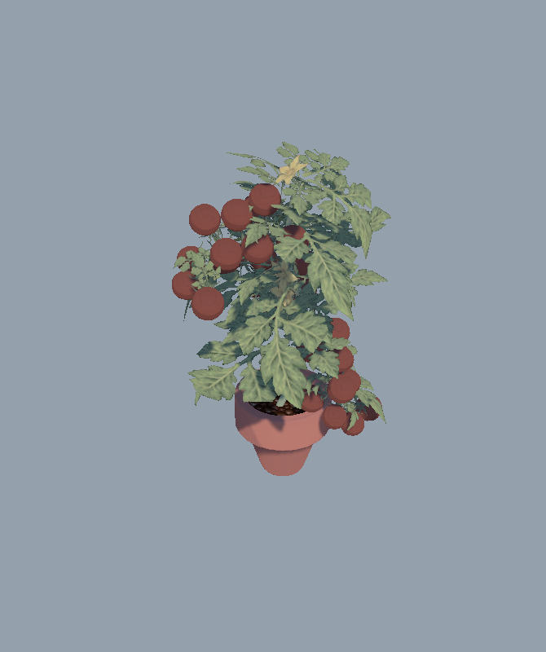
The current prototype
Unity + Meta SDK
Meta Quest 3
Hands and controller interactions
Gronny’s voice and visual guidance
Water targets and accelerated growth
Soil covering and tool-based harvesting
09
Notes:
PRESENTER: Jonathan
TIME: 8:15–9:15 (1 minute)
The prototype uses Unity and the existing Meta SDK integration for Quest 3. It supports hand and controller interactions, spoken and visual guidance, and a calendar to accelerate plant growth. The current loop includes soil covering and tool-based harvesting. Water feedback shows when the target is reached, while the limited supply makes water use part of the activity. We have kept the scope focused on the tomato cycle. The broader biodiversity and independent assessment ideas in the original specification should not be presented as completed learning results. Existing project checks cover parts of the logic, but they do not replace a full rehearsal on the headset. We will now show the playable flow.
SOURCES
Project AGENTS.md. Docs/AhorroAgua.md, Docs/PlantWaterProgress.md, Docs/PlantingSoilCover.md, Docs/TomatoStemHarvest.md. Image: Docs/Validation/PastelMatureTomatoReview.png, development model preview.

Slide 10
Live demo
7 minutes in the garden
Walk to the table and follow Gronny
Plant the seed and cover it with soil
Water, advance time and observe growth
Cut the stem and deliver the ripe tomato
One presenter plays. The other explains the design choices.
10
Notes:
PRESENTER: Both
TIME: 9:15–16:15 (7 minutes)
PROPOSED ROLES: Jonathan wears the headset and performs the actions. Thamara narrates minutes 0–3, then Jonathan comments on the remaining actions while Thamara manages the display and time. Adjust after rehearsal if speaking while wearing the headset is awkward. Both members have speaking sections outside the demo.
0:00–0:45 Start Play, listen to Gronny and walk to the gardening table within the clear physical play area. Explain position tracking briefly.
0:45–1:30 Find Tomato seed, pick it up and release it into the pot.
1:30–2:15 Scoop soil and tilt the loaded shovel over the pot. Show the seed becoming covered.
2:15–3:15 Pick up the watering can, pour onto the soil and stop at the visible target. Explain why we made the feedback simple.
3:15–5:30 Open the calendar, advance growth and repeat the required care. Show at least one clear growth transition. Explain that virtual time compresses a real growing process.
5:30–6:30 At maturity, align the pruning shears with the stem, close them, pick up the detached tomato and release it in the harvest tray.
6:30–7:00 Show completion and connect the loop to careful water use.
BEFORE CLASS: Rehearse the actual end-to-end loop on Quest 3 and confirm it fits seven minutes. Set audio so the class can hear Gronny. Check the displayed headset view and clear play area. Use whichever input mode is most reliable in rehearsal. Have a short recording of the actual final prototype available if the live display fails. Existing screenshots are development captures and do not replace the functional demo. No recording is embedded in this deck.
SOURCES
Assignment screenshot: 20 minutes total, including 5–10 minute application demo, both members present, submit slides on Canvas. Demo actions from project documentation and team clarification. Proposed timing and roles are presentation planning, not measured completion times.

Slide 11
What we learned and what remains
The environment supports the intended mood
4 of 5 first-round respondents found the garden moderately or very relaxing
Guidance is part of the interaction
Pacing and a clear next action matter as much as the tool itself
The next test needs the complete revised loop
More beginners, both input modes, task completion and independent plant care
11
Notes:
PRESENTER: Jonathan
TIME: 16:15–17:30 (1 minute 15 seconds)
The first lesson is to preserve the relaxing garden while reducing the effort needed to understand controls. The second is that voice, UI and demonstrations form one interaction. Adding instructions alone can still overwhelm the player if they arrive at the wrong time. The third is about evidence. We have five broad first-round responses and one focused second-round response. We do not have a controlled measure of learning improvement, and the final soil and cutting additions need a complete user test. Our next evaluation would recruit more beginners, observe the entire loop with both input modes, record task completion and assistance, and check whether users can care for a plant independently. We would also revisit reach, comfort and water feedback on the real headset.
SOURCES
First Prototype Feedback workbook, X2:X6 and open comments. Walking & Gronny’s Guidance workbook, G2:L2. Design specification, pp. 8–10. Proposed future evaluation is a recommendation.

Slide 12
Cozy VR Garden
A tomato-growing prototype shaped
by real playtest feedback
Clearer guidance. Physical walking. A fuller gardening loop.
Questions
12
Notes:
PRESENTER: Thamara, then both
TIME: 17:30–18:00 (30 seconds), then Q&A 18:00–20:00
Cozy VR Garden began as a guided learning concept. User testing helped us identify where beginners needed more support, especially at the start. We responded with a slower instruction pace, more voice guidance, tracked physical walking and a fuller gardening sequence, alongside a unified visual style. Our next step is to test the complete revised loop with more users and check learning directly. Thank you. We are happy to take questions.
Keep two minutes for questions. Both members answer. The source slide is an appendix, not an additional timed talk section.
SOURCES
Team clarification, supplied testing exports and project design documentation. Closing statement describes design evolution, not a quantified or proven usability gain.

Slide 13
Sources and evidence
Concept and requirements
Conceptual design and requirements specification, 31 August 2026
Thamara Gonzalez and Jonathan Guasco
User testing
First Prototype Feedback, 21 October 2026: 5 responses
Walking & Gronny’s Guidance, 2 November 2026: 1 response
Development evidence
Team clarification, playtest photos and existing project captures
Project notes on guidance, walking, water, soil, harvest and visual style
13
Notes:
PRESENTER: Appendix
TIME: Not part of the timed talk
SOURCE FILES
C:/Users/Trole/Documents/Conceptual design and requirements specification.pdf
C:/Users/Trole/Downloads/Cozy VR Garden First Prototype Feedback(1-5).xlsx
C:/Users/Trole/Downloads/Cozy VR Garden_ Walking & Gronny's Guidance(1-1).xlsx
Team-supplied playtest photographs dated 8 November 2026. The photographs are not independently assigned to a numbered testing round.
PROJECT EVIDENCE
Docs/DesplazamientoFisico.md
Docs/RevisionInstruccionesGronny.md
Docs/AhorroAgua.md
Docs/PlantWaterProgress.md
Docs/PlantingSoilCover.md
Docs/TomatoStemHarvest.md
Docs/PrunerCutComfort.md
Docs/GardenPastelStyle.md
The team's clarification in this chat establishes the iteration narrative. Development captures illustrate the project and may precede the final build. No external images or web claims are used.
SOURCES
Supplied materials and project documentation.

