Slide 1
CI/CD Job for Simple DevOps Project

Slide 2
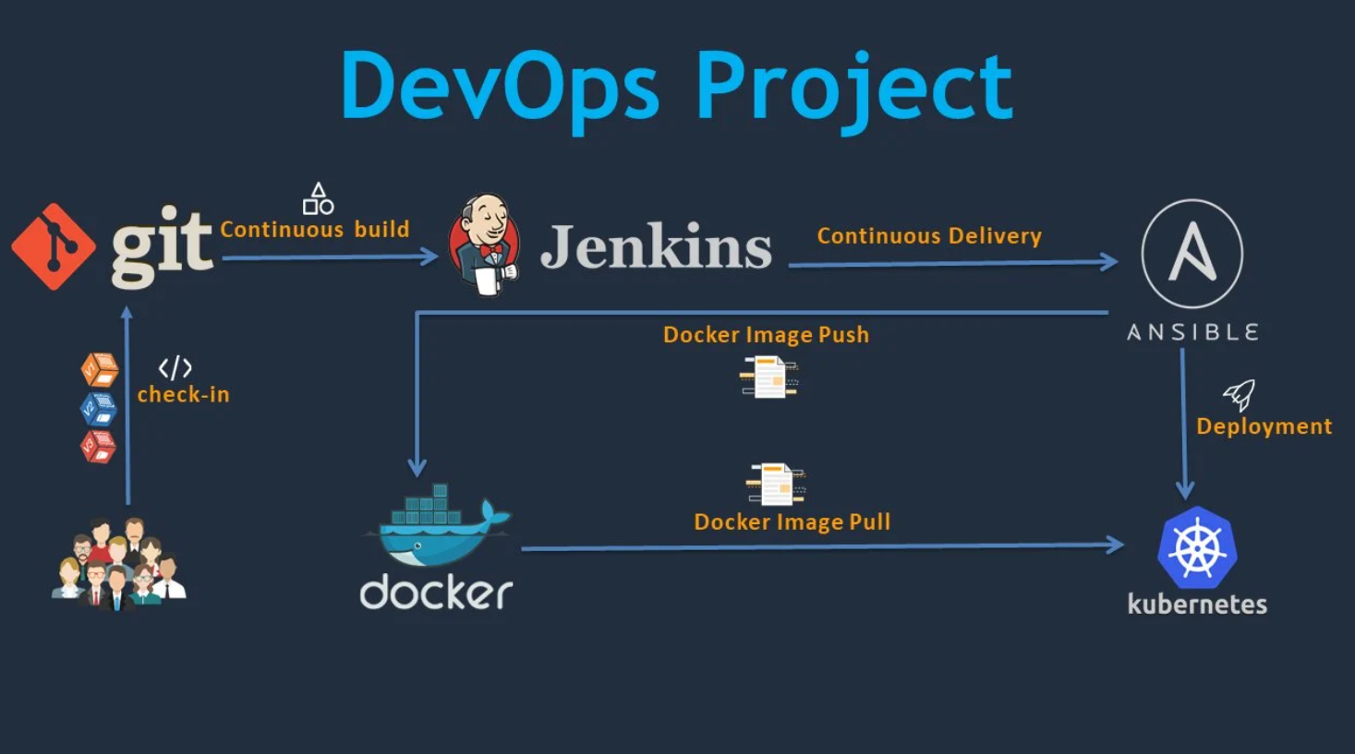
CI/CD using Git, Maven, Tomcat, Ansible, Jenkins, Docker & Kubernetes

Slide 3
EC2 Instances
Five Instances are required
1st Instance has applications- Git, Maven, Jenkins
2nd Instance has applications- Ansible, Docker
3rd Instance has applications- Kubernetes Master
4th & 5th Instance are Worker Nodes with Kubernetes connected together in Kubernetes Cluster

Slide 4
Plugins required in Jenkins
Maven Invoker
Maven Integration
Publish Over SSH

Slide 5
CI Job
CI job is created as Maven Project.
It has to be configured to pull code from the Git repository once there is any change using Poll SCM
It will build from a POM.xml file pulled from the Git repository with the goal of “clean install”
Once the build is done, the artifact will be sent to the Ansible server over SSH. The Ansible server will create an image using Dockerfile and push it to the DockerHub as instructed in the ansible playbook.
Once this is done, the CI job will automatically trigger the CD job.

Slide 6
CD Job
The CD job will send instructions over SSH to Ansible Server.
The Ansible server will instruct the Kubernetes Master server to pull the image from DockerHub and create the Pod with image pulled from DockerHub and service using .YAML files. They are deployed to Kubernetes cluster using Ansible-Playbook.
Once the Pod is created, and deployed, we can view the output using <public_IP of WorkerNodes>:<port>/webapp

