Slide 1
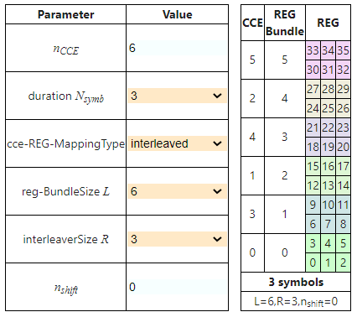
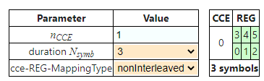
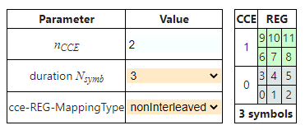
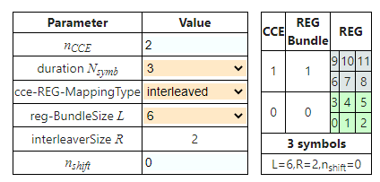
Configure the CCE to REG mapping with different CCE with the PDCCH toolbox?
CCE Value 1 Symbols 3 and REG mapping type nonInterleaved
CCE Value 2 Symbols 3 and REG mapping type nonInterleaved
CCE Value 6 Symbols 3 and REG mapping type Interleaved
CCE Value 2 Symbols 3 and REG mapping type nonInterleaved

Slide 2
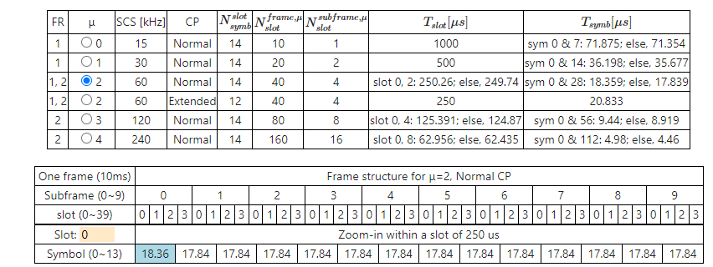
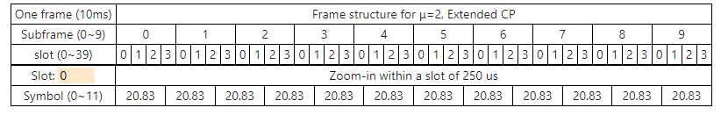
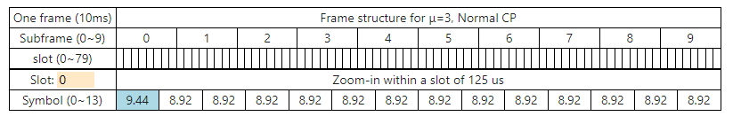
Design the NR Frame structure with different numerology (0,1,2,3,4)?
m=2, SCS=60kHz and Slot=0
Cyclic Prefix= Normal
m=2, SCS=60kHz and Slot=0
Cyclic Prefix= Extended
m=3, SCS=60kHz and Slot=0
Cyclic Prefix= Normal

Slide 3
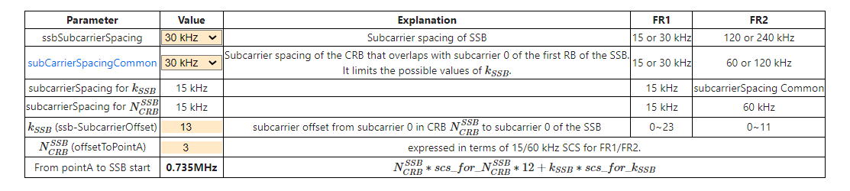
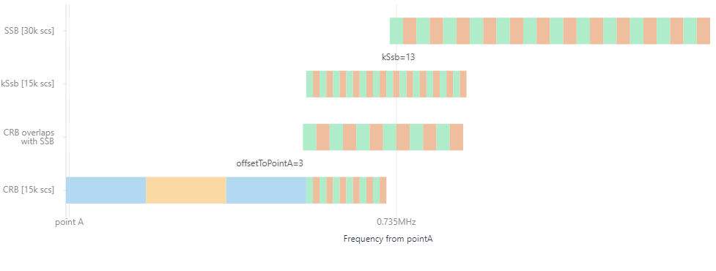
To find the point A location in 5G NR?

Slide 4
Which information shows about numerology in BWP?
BWP ::= SEQUENCE {
locationAndBandwidth INTEGER (0..37949),
subcarrierSpacing SubcarrierSpacing,
cyclicPrefix
Answer
CyclicPrefix
Explain about below RRC message for PDCCH Layer

