Slide 1
PDSCH Assignment
Prepared By
Thammineni Satish

Slide 2
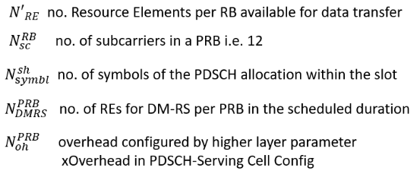

Transport block CRC attachment
Error detection is provided on each transport block through a Cyclic Redundancy Check (CRC)
The entire transport block is used to calculate the CRC parity bits. Denote the bits in a transport block delivered to layer 1 by a0,a1,a2,…….aA-1 , and the parity bits by p0,p1,p2……pL-1, where A is the payload size and L is the number of parity bit.
The lowest order information bit a0 is mapped to the most significant bit of the transport block.
The parity bits are computed and attached to the DL-SCH transport block according to Clause 5.1, by setting L to 24 bits and using the generator polynomial ( ) DgCRC24A if A > 3824; and by setting L to 16 bits and using the generator polynomial ( ) DgCRC16 otherwise.
The bits after CRC attachment are denoted by b0,b1,b2,…..bB-1, where B =A+L.
Calculating Transport Block Size

Slide 3


Steps to Calculate Transport Block Size
The UE determines the no. of Res which are available for data transfer within the bandwidth of a single Resource Block using following formula.
If the value of is greater than 156 then is rounded down to 156, i.e. the UE never assumes a resource allocation of more than 156 REs within the bandwidth of a single Resource Block. The total number of REs within the bandwidth of a single RB is 12 x 14 = 168 using normal cyclic prefix.
The final value is multiplied by the number of allocated Resource Blocks to generate a value for . The number of allocated RBs is extracted from the DCI available through PDCCH, i.e. it is part of the resource allocation.
The value of represents the total no. of REs available for data transfer

Slide 4
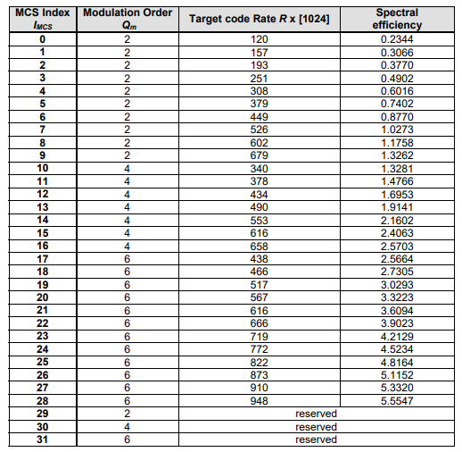
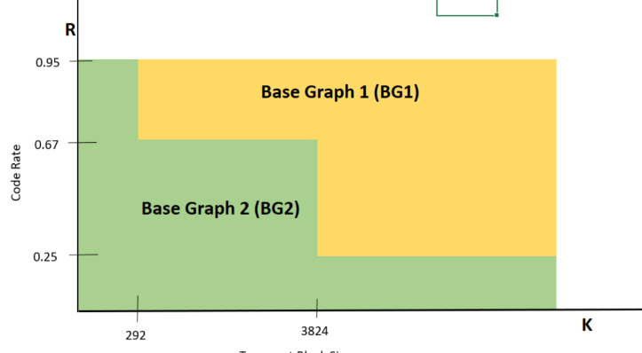
LDPC base graph selection
MCS Index
For initial transmission of a transport block with coding rate R indicated by the MCS index and subsequent re-transmission of the same transport block, each code block of the transport block is encoded with either LDPC base graph 1 or 2 according to the following:
if A≤ 292, or if A ≤ 3824 and R ≤ .0 67, or if R ≤ .0 25, LDPC base graph 2 is used;
otherwise, LDPC base graph 1 is used. where A is the payload size.
For LDPC base graph 1, the maximum code block size is:8448
For LDPC base graph 2, the maximum code block size is:3840

Slide 5
Code block segmentation and code block CRC attachment
The bits input to the code block segmentation are denoted by b0,b1,b2……bB-1 where B is the number of bits in the transport block (including CRC).
The bits after code block segmentation are denoted by , where r is the code block number and Kr is the number of bits for code block number r.

Slide 6
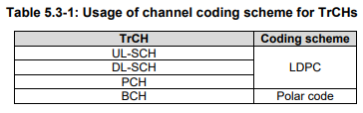
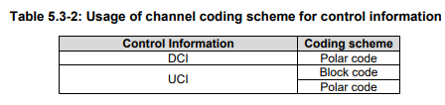
Channel coding
Code blocks are delivered to the channel coding block. The bits in a code block are denoted by where r is the code block number, and Kr is the number of bits in code block number r
The total number of code blocks is denoted by C and each code block is individually LDPC encoded.
After encoding the bits are denoted by

Slide 7
Rate matching
Coded bits for each code block, denoted as are delivered to the rate match block, where r is
the code block number, and Nr is the number of encoded bits in code block number r . The total number of code
blocks is denoted by C and each code block is individually rate matched by setting
After rate matching, the bits are denoted by where Er is the number of rate matched bits for
code block number r .
Rate matching for Polar code
The rate matching for Polar code is defined per coded block and consists of sub-block interleaving, bit collection, and bit interleaving. The input bit sequence to rate matching is The output bit sequence after rate matching is denoted as

Slide 8
Code block concatenation
The input bit sequence for the code block concatenation block are the sequences for r=0,..., C−1 and where Er is the number of rate matched bits for the r-th code block.
The bits after code block concatenation are denoted by , where G is the total number of coded bits for transmission.
The code block concatenation consists of sequentially concatenating the rate matching outputs for the different code blocks. Therefore,
Set k = 0 and r = 0
while r < C
set j = 0
while j< Er
gk = frj
k=k +1
j=j +1
end while
r= r +1
end while

