Slide 1

Gaming Through the Ages: Sales Evolution of Popular Titles
An analysis of why people spend money to sit at home
By Rohan Thampi

Slide 2
Why this?
Personal interest
How do they make money out of this?
Source dataset: Global Video Game Sales - https://www.kaggle.com/datasets/thedevastator/global-video-game-sales/data
Notes:
In order to tell a story, I needed a personal starting point – video games!
I’ve been an avid gamer since middle school with my brother, playing on ----
Always wondered how people made money by making video games that my mom called “waste of time”
So I found dataset of top games released since early 1980s, trying to understand the success of this business

Slide 3

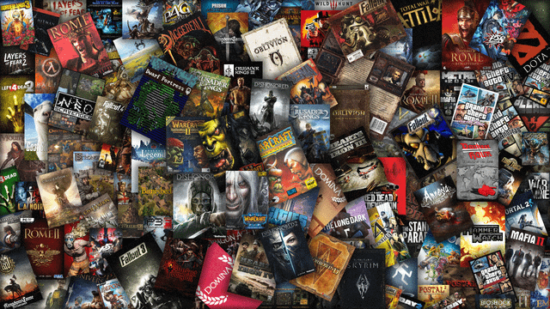
Digging into the data
Across 16.5k records – 11.5k unique games, across 579 publishers and 31 platforms
Notes:
My starting point to dig into the data was get a brief overview. With about 16500 records, with 11.5k games across 579 publishers and 31 platforms, I needed to get a better idea of the “best” ones.

Slide 4
Sales of the top games of all time (across all platforms)
75% of the data
Main focus
Global Sales (in millions)
Mean | SD | Min - Max | 25% | 50% | 75%
0.537 | 1.555 | 0.01 – 82.74 | 0.06 | 0.17 | 0.47
Across 16.5k records – 11.5k unique games, across 579 publishers and 31 platforms
Notes:
A boxplot of the global sales told me that the data was very skewed, where most sales were less than 1 million, but had outliers going up to 80 million.
The lowest is about 0.01 million million, while highest goes up to 80 million. The median is about 0.17 and mean at 0.5, with 75% of the data less than 0.5 million
As my interest is mainly in the ”most” successful games, I wanted to look at the top 20 games that made above 20 million, to see what is so special about them

Slide 5
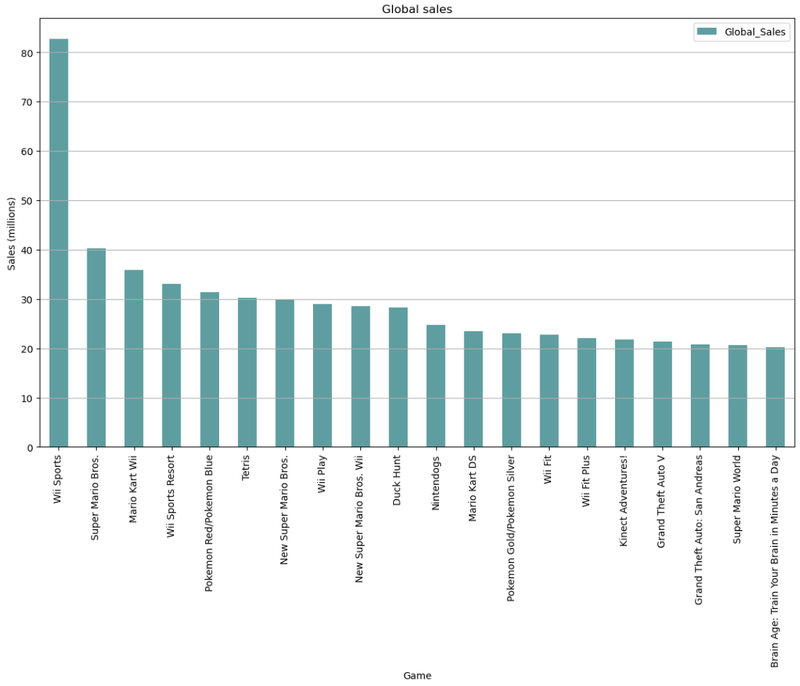


Sales of the top 20 games of all time (across all platforms)
Rank | Name | Publisher | Platform
1 | Wii Sports | Nintendo | Wii
2 | Super Mario Bros. | Nintendo | NES
3 | Mario Kart Wii | Nintendo | Wii
4 | Wii Sports Resort | Nintendo | Wii
5 | Pokemon Red/Pokemon Blue | Nintendo | GB
6 | Tetris | Nintendo | GB
7 | New Super Mario Bros. | Nintendo | DS
8 | Wii Play | Nintendo | Wii
9 | New Super Mario Bros. Wii | Nintendo | Wii
10 | Duck Hunt | Nintendo | NES
11 | Nintendogs | Nintendo | DS
12 | Mario Kart DS | Nintendo | DS
13 | Pokemon Gold/Pokemon Silver | Nintendo | GB
14 | Wii Fit | Nintendo | Wii
15 | Wii Fit Plus | Nintendo | Wii
16 | Kinect Adventures! | Microsoft Game Studios | X360
17 | Grand Theft Auto V | Take-Two Interactive | PS3
18 | Grand Theft Auto: San Andreas | Take-Two Interactive | PS2
19 | Super Mario World | Nintendo | SNES
20 | Brain Age: Train Your Brain in Minutes a Day | Nintendo | DS
5th in EU Sales
Notes:
Here are the top 20 games from that boxplot. Plotting them by their sales, Wii sports clearly is the most earning, double of the second.
--But even excluding this, looking at the top 15, you can see that all of them are by Nintendo. They are across different platforms, like Wii, Gameboy, etc, but they must be doing something right to no leave space for anyone else in the top.
Interestingly GTA 5 made it at 5th place in EU Sales, the only non-Nintendo games in top 10 in sales in any region

Slide 6
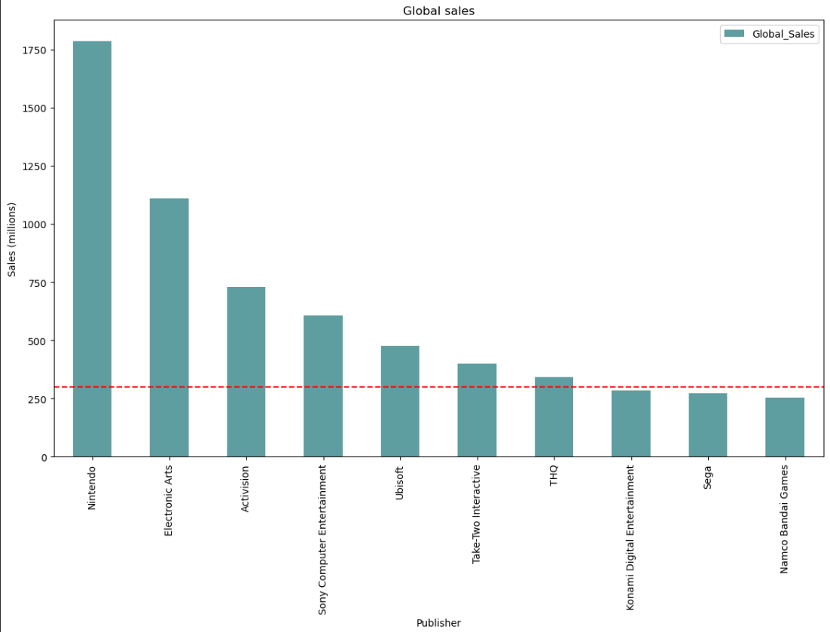
Sales of the top 10 publishers
300
Notes:
As Nintendo is dominating the top 20, I wanted to see what other publishers were make the bestsellers. I wanted to compare what was so different between Nintendo and these top ones.
So I chose these 6 highlighted here

Slide 7
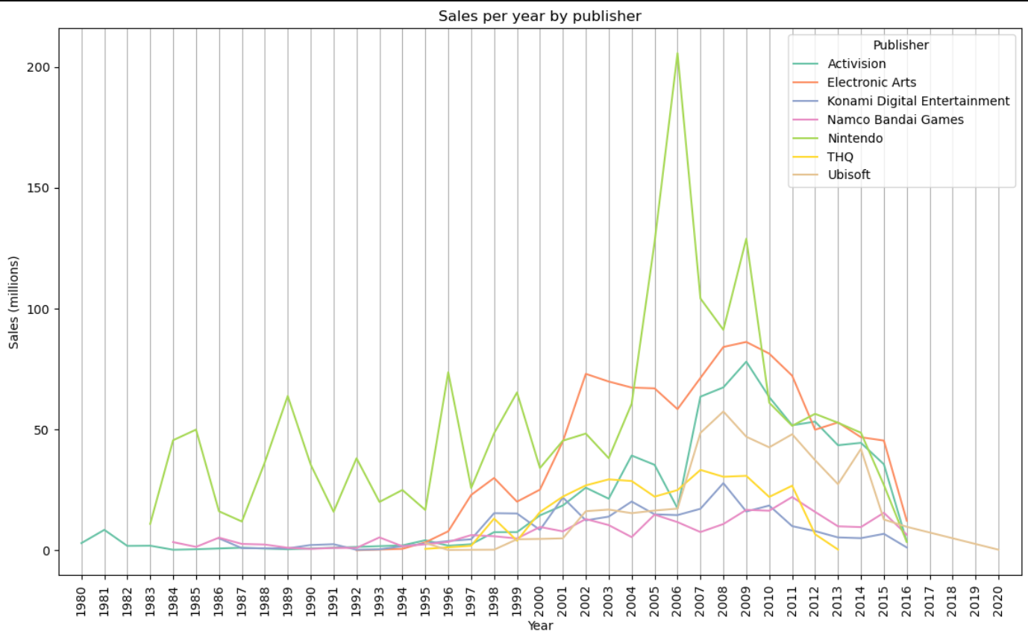
Global sales trends (per publisher)
205.6
128.9
86.2
78
Notes:
Looking at the global sales through the years, you can see that Nintendo, in green has had very good years with sales of 205 and 129 million in 2006 and 2009.
While other top publishers like EA and Activision only made a maximum of 85 and 78 million.
They started a few years later than Activision, but consistently had better sales than all other publishers

Slide 8
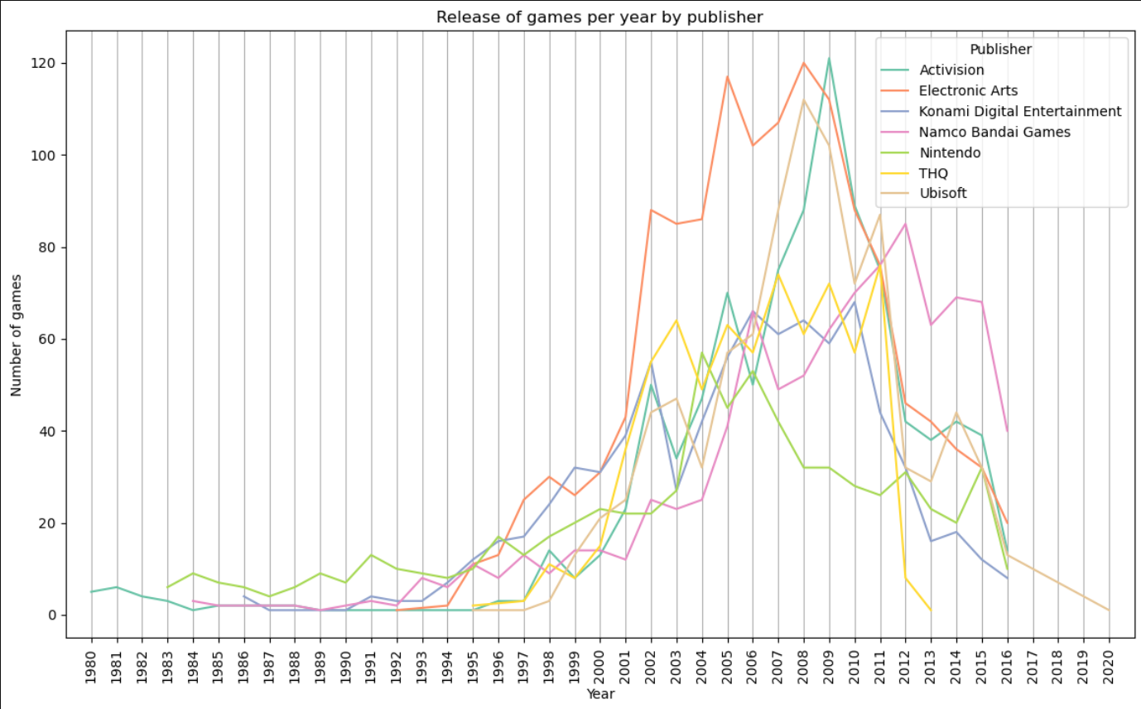
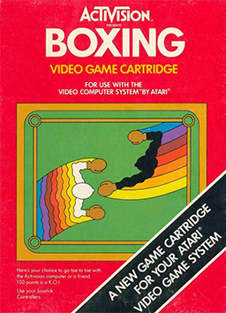
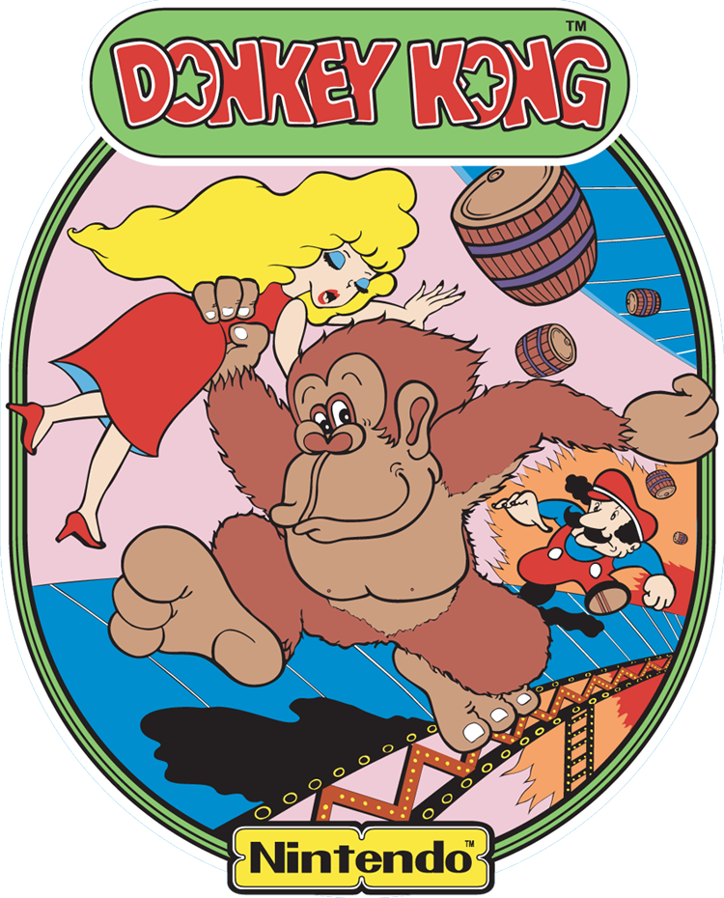
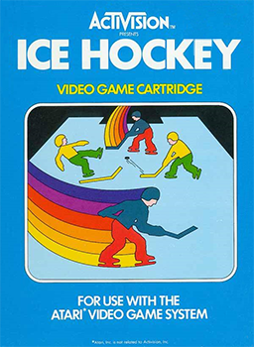

Number of games release per year (per publisher)
120
121
More games ≠ More sales
57
53
6
5
Notes:
I thought maybe this would be reflected by number of games released per year, but looking at this graph, you can see that highest games releases in a year are by EA and Activision, while Nintendo only released half the number of games maximum in 2004 and 2006.
So clearly more number of games is not equal to more sales
Interesting to note here is that Activision started off first in 1980 with generic games like Boxing and Ice hockey, while Nintendo’s earliest games in 1983 were Mario Bros and Donkey Kong
Note that Nintendo released most number of games in 2004, but their sales were very low

Slide 9
Global sales trends (per publisher)
205.6
128.9
86.2
78

Slide 10
Success of Nintendo
Name | Platform | Year | Genre | Publisher | GlobalSales
Pokemon FireRed/Pokemon LeafGreen | GBA | 2004.0 | Role-Playing | Nintendo | 10.49
Super Mario 64 | DS | 2004.0 | Platform | Nintendo | 10.42
Pokémon Emerald Version | GBA | 2004.0 | Role-Playing | Nintendo | 6.41
WarioWare Touched! | DS | 2004.0 | Puzzle | Nintendo | 2.31
Paper Mario: The Thousand-Year Door | GC | 2004.0 | Role-Playing | Nintendo | 2.25
Wii Sports | Wii | 2006.0 | Sports | Nintendo | 82.74
New Super Mario Bros. | DS | 2006.0 | Platform | Nintendo | 30.01
Wii Play | Wii | 2006.0 | Misc | Nintendo | 29.02
Pokemon Diamond/Pokemon Pearl | DS | 2006.0 | Role-Playing | Nintendo | 18.36
The Legend of Zelda: Twilight Princess | Wii | 2006.0 | Action | Nintendo | 7.31
Wii Sports Resort | Wii | 2009.0 | Sports | Nintendo | 33.00
New Super Mario Bros. Wii | Wii | 2009.0 | Platform | Nintendo | 28.62
Wii Fit Plus | Wii | 2009.0 | Sports | Nintendo | 22.00
Pokemon HeartGold/Pokemon SoulSilver | DS | 2009.0 | Action | Nintendo | 11.90
Dragon Quest IX: Sentinels of the Starry Skies | DS | 2009.0 | Role-Playing | Nintendo | 5.84
Notes:
So taking a look at how Nintendo made such a change from 2004 to 2006 and 2009, here you can see the top selling games in those year. In 2004, their sales were comparatively very low. But in 2006 and 2009, the numbers are much higher. Taking a look at the games themselves, you can see some repetitions. This shows the starting of franchises which contributed to their success, with Pokemon, Mario, and Wii. So they knew what was top selling and perfected them through their franchises

Slide 11
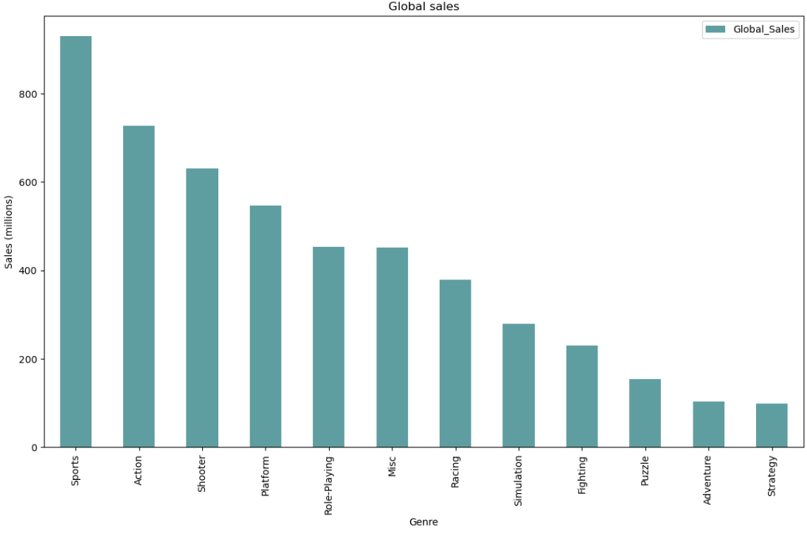
Global sales by genre
Notes:
Now just looking at the different types of games that are best selling, you can see these 4 categories are what people are most interested in – Sports, Action, Shooter, Platform

Slide 12
Conquering all top genres
Name | Platform | Genre | Publisher | Global_Sales
Wii Sports | Wii | Sports | Nintendo | 82.74
Super Mario Bros. | NES | Platform | Nintendo | 40.24
Wii Sports Resort | Wii | Sports | Nintendo | 33.00
New Super Mario Bros. | DS | Platform | Nintendo | 30.01
New Super Mario Bros. Wii | Wii | Platform | Nintendo | 28.62
Duck Hunt | NES | Shooter | Nintendo | 28.31
Wii Fit | Wii | Sports | Nintendo | 22.72
Wii Fit Plus | Wii | Sports | Nintendo | 22.00
Super Mario World | SNES | Platform | Nintendo | 20.61
Super Mario Land | GB | Platform | Nintendo | 18.14
Super Mario Bros. 3 | NES | Platform | Nintendo | 17.28
Call of Duty: Modern Warfare 3 | X360 | Shooter | Activision | 14.76
Call of Duty: Black Ops | X360 | Shooter | Activision | 14.64
Call of Duty: Black Ops 3 | PS4 | Shooter | Activision | 14.24
Call of Duty: Black Ops II | PS3 | Shooter | Activision | 14.03
Call of Duty: Black Ops II | X360 | Shooter | Activision | 13.73
Call of Duty: Modern Warfare 2 | X360 | Shooter | Activision | 13.51
Call of Duty: Modern Warfare 3 | PS3 | Shooter | Activision | 13.46
Call of Duty: Black Ops | PS3 | Shooter | Activision | 12.73
Pokemon HeartGold/Pokemon SoulSilver | DS | Action | Nintendo | 11.90
Notes:
And you can see that for all 4 of these genres, Nintendo seems to have conquered them all

Slide 13

Conclusion
With over 11 billion USD in sales as of 2024, Nintendo has mastered the game of sales
…by bringing the
NOSTALGIA
and
MAKING YOU WANT TO STAY ACTIVE
Notes:
So in conclusion ….. Mario (old nostalgic games) and Wii (making you feel outside even at home)

