Slide 1
Part One
Part Two
Part Three
Part Four
Part Five
2.1 A Geometric Way of Thinking
Technique: interpret ODE as a vecter field
Consider the following nonlinear differential equation:
seperate variables and then integrate
To evaluate the constant , suppose that
Then
Hence the solution is
The result is exact.
But how about some questions?
Nonlinear Dynamics and Chaos: With Applications to Physics, Biology, Chemistry, and Engineering Speaker: Yichen Lu

Slide 2
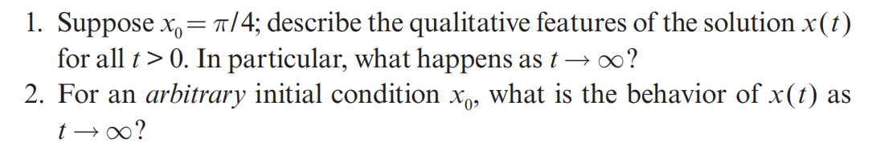
Part One
Part Two
Part Three
Part Four
Part Five
2.1 A Geometric Way of Thinking
The result is exact. But how about some questions?
Nonlinear Dynamics and Chaos: With Applications to Physics, Biology, Chemistry, and Engineering Speaker: Yichen Lu

Slide 3
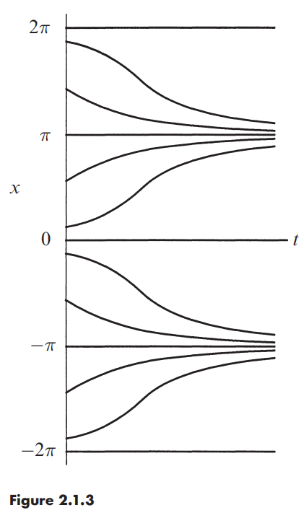
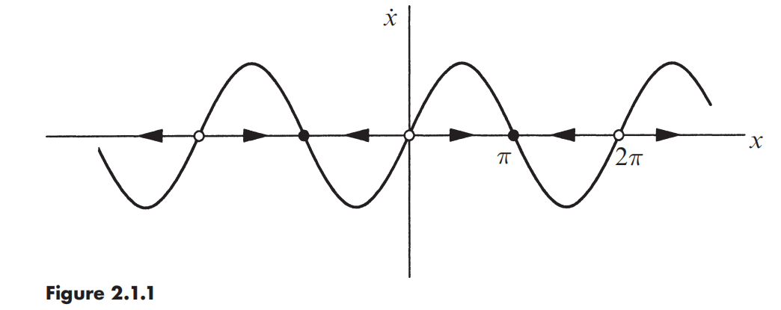
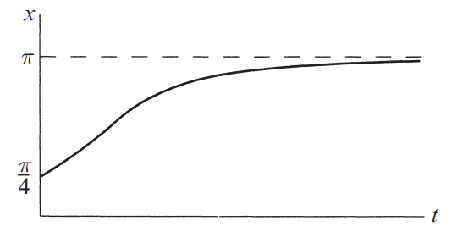
2.1 A Geometric Way of Thinking
Part One
Part Two
Part Three
Part Four
Part Five
Nonlinear Dynamics and Chaos: With Applications to Physics, Biology, Chemistry, and Engineering Speaker: Yichen Lu

Slide 4
Part One
Part Two
Part Three
Part Four
Part Five
2.2 Fixed Points and Stability
Glossary | Definition / Notes
one-dimensional / first-order systems
fixed points | Which satisfy , aka equilibrium
stable fixed points | The fix points which the flow is toward, aka attractors or sinks
unstable fixed points | Aka repellers or sources
phase point | An imaginary particle
trajectory
phase portrait / | which shows all the qualitatively different trajectories of the system, aka phase diagram
Nonlinear Dynamics and Chaos: With Applications to Physics, Biology, Chemistry, and Engineering Speaker: Yichen Lu

Slide 5
Part One
Part Two
Part Three
Part Four
Part Five
2.4 Linear Stability Analysis
Consider the following nonlinear differential equation:
Let
be a small perturbation away from
we derive a differential equation for
Now using Taylor’s expansion we obtain
Hence
the terms are negligible and we may write the approximation
This is a linear equation in , and is called the linearization about .
 | grows | unstable
 | decays | stable
Nonlinear Dynamics and Chaos: With Applications to Physics, Biology, Chemistry, and Engineering Speaker: Yichen Lu

Slide 6
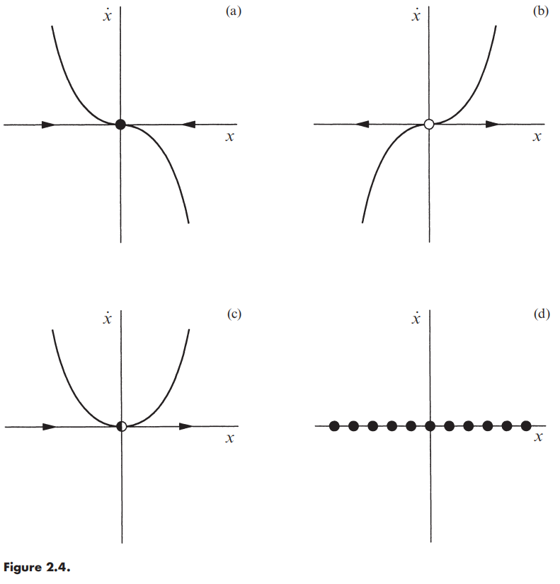
Part One
Part Two
Part Three
Part Four
Part Five
2.4 Linear Stability Analysis
What can be said about the stability of a fixed point when
Nonlinear Dynamics and Chaos: With Applications to Physics, Biology, Chemistry, and Engineering Speaker: Yichen Lu

Slide 7
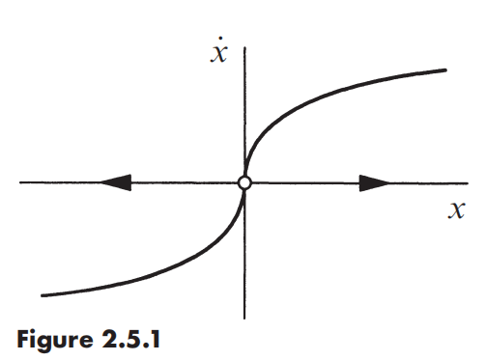
2.5 Existence and Uniqueness
2.6 Impossibility of Oscillations
Part One
Part Two
Part Three
Part Four
Part Five
Example 2.5.1 Show that the solution to
starting from is not unique.
Solution: The point is a fixed point, so one obvious solution is for all .
The surprising fact is that there is another solution. To find it we separate variables and integrate:
Hence
Imposing that yields
which is also a solution.
Nonlinear Dynamics and Chaos: With Applications to Physics, Biology, Chemistry, and Engineering Speaker: Yichen Lu

Slide 8
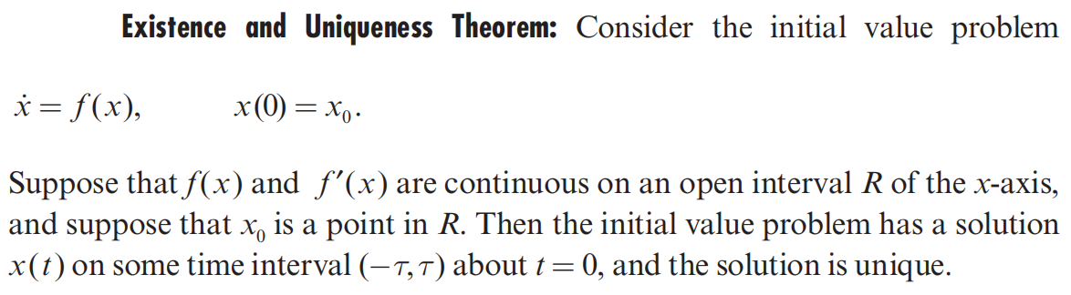
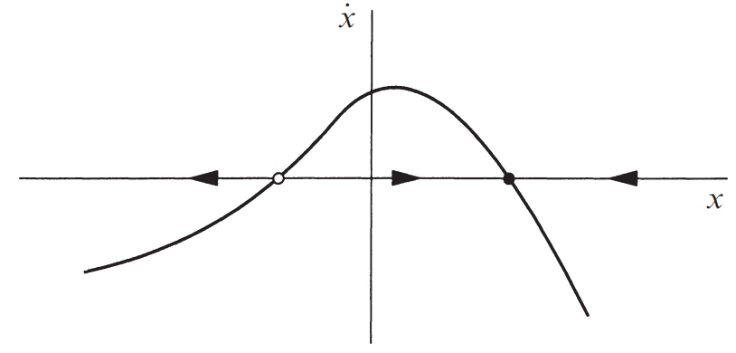
2.5 Existence and Uniqueness
2.6 Impossibility of Oscillations
Part One
Part Two
Part Three
Part Four
Part Five
Dominant of 1st-order systems
all trajectories either approach a fixed point monotically, or diverged to ±∞
phase point never reverses direction.
Overshooting is impossible.
damped oscillation is impossible
undamped oscillation is impossible (no periodic solutions)
Nonlinear Dynamics and Chaos: With Applications to Physics, Biology, Chemistry, and Engineering Speaker: Yichen Lu

Slide 9
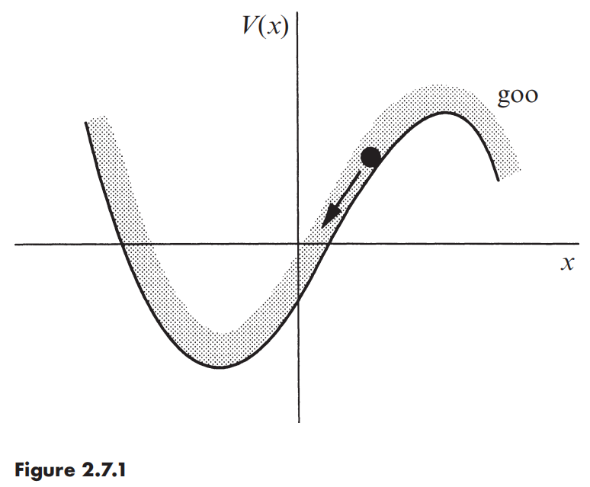
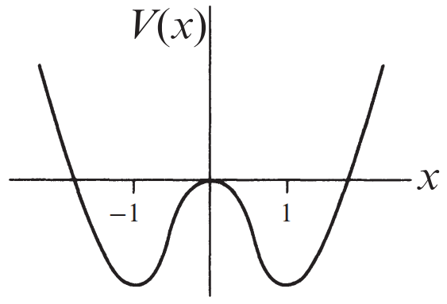
2.7 Potentials
Part One
Part Two
Part Three
Part Four
Part Five
We picture a particle sliding down the walls of a potential well, where the potential V(x) is defined by
Using the chain rule, calculate the time-derivative of V(x(t))
since , we obtain
Graph the potential for the system , and identify all equilibrium points.
Nonlinear Dynamics and Chaos: With Applications to Physics, Biology, Chemistry, and Engineering Speaker: Yichen Lu

Slide 10
Exercise
Part One
Part Two
Part Three
Part Four
Part Five
2.4.9 Critical slowing down
2.5.2 Blow up
Nonlinear Dynamics and Chaos: With Applications to Physics, Biology, Chemistry, and Engineering Speaker: Yichen Lu

