Slide 1
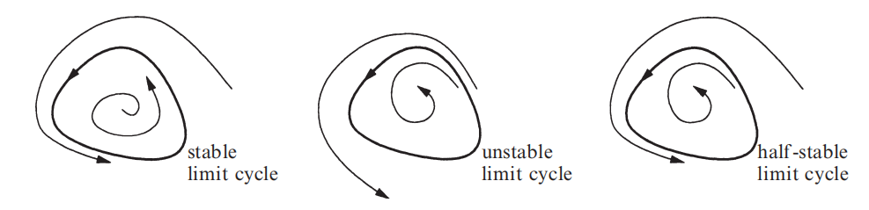
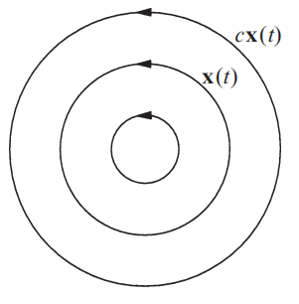
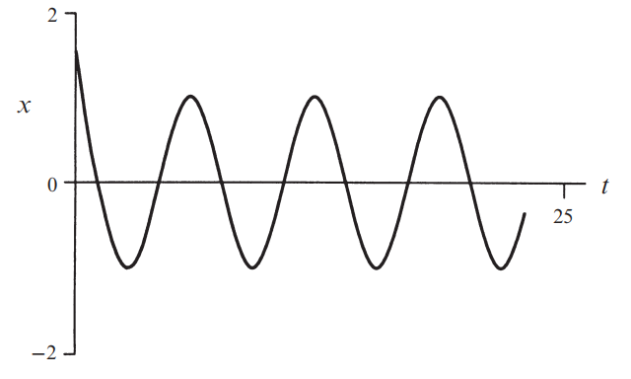
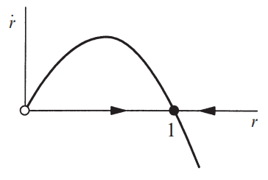
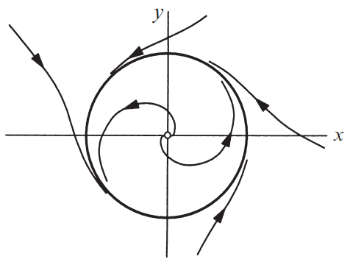
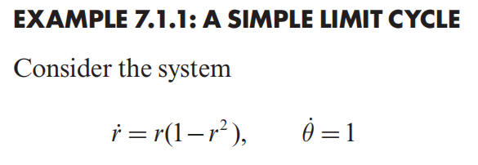
7.0 Introduction & Examples
A limit cycle is an isolated closed trajectory.
Limit cycles are inherently nonlinear phenomena
If is a periodic solution, then so is for any constant
Nonlinear Dynamics and Chaos: With Applications to Physics, Biology, Chemistry, and Engineering Speaker: Yichen Lu

Slide 2


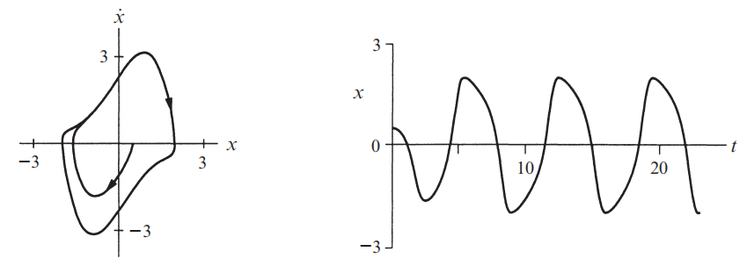
7.0 Introduction & Examples
VAN DER POL OSCILLATOR
this looks like a simple harmonic oscillator, but with a nonlinear damping term
Nonlinear Dynamics and Chaos: With Applications to Physics, Biology, Chemistry, and Engineering Speaker: Yichen Lu

Slide 3
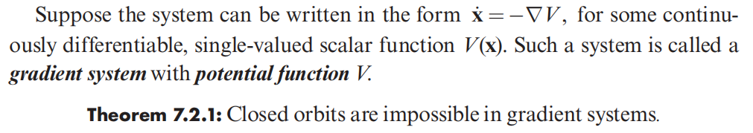
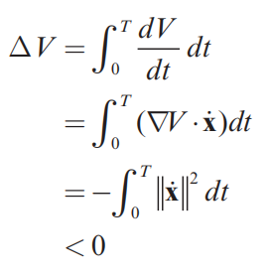
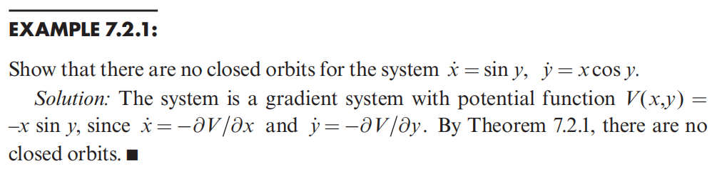
7.2 Ruling Out Closed Orbits
Gradient Systems
Nonlinear Dynamics and Chaos: With Applications to Physics, Biology, Chemistry, and Engineering Speaker: Yichen Lu

Slide 4
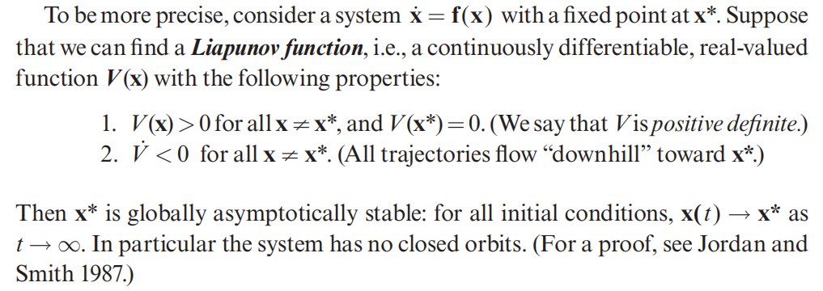
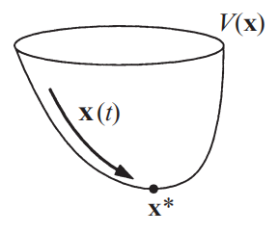
7.2 Ruling Out Closed Orbits
Liapunov Functions
Nonlinear Dynamics and Chaos: With Applications to Physics, Biology, Chemistry, and Engineering Speaker: Yichen Lu

Slide 5
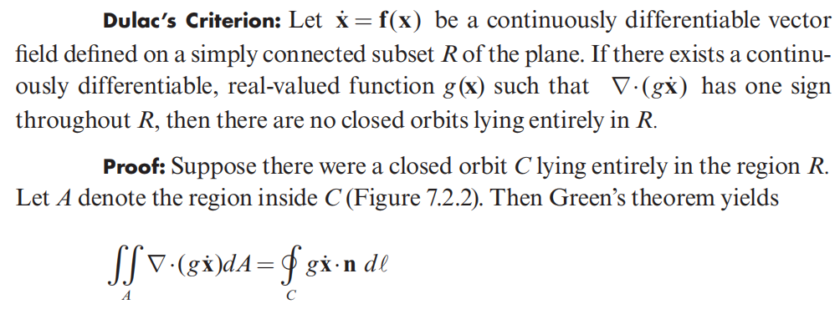
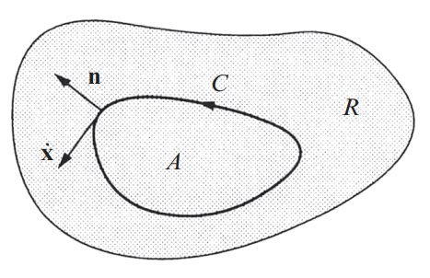

7.2 Ruling Out Closed Orbits
Dulac’s Criterion
Nonlinear Dynamics and Chaos: With Applications to Physics, Biology, Chemistry, and Engineering Speaker: Yichen Lu

Slide 6
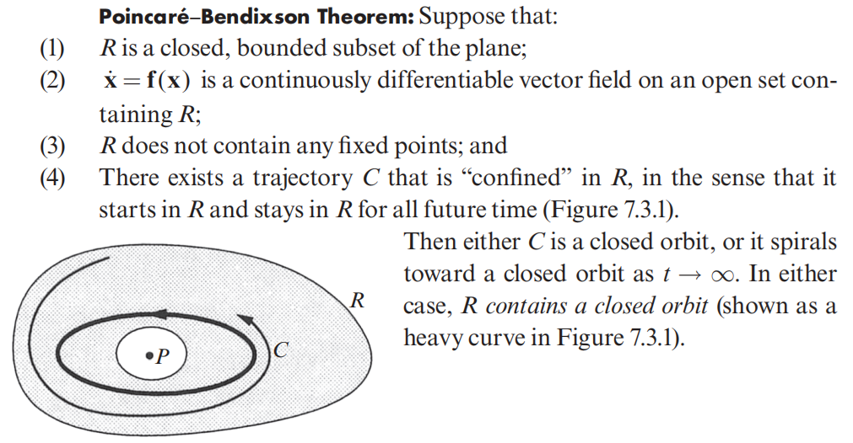
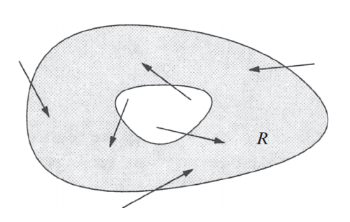
7.3 Poincaré−Bendixson Theorem
a trapping region R
Nonlinear Dynamics and Chaos: With Applications to Physics, Biology, Chemistry, and Engineering Speaker: Yichen Lu

Slide 7
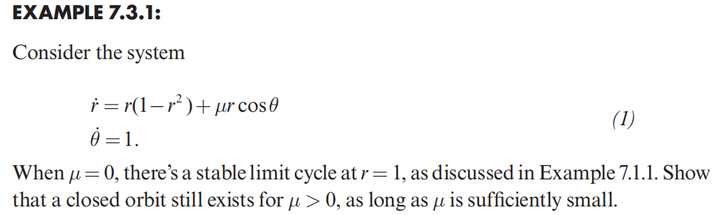
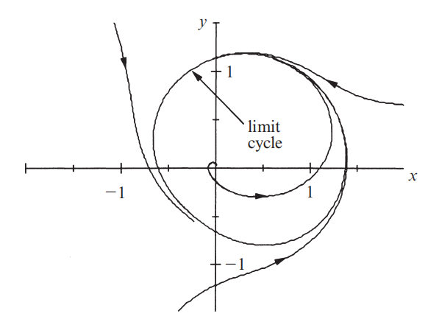
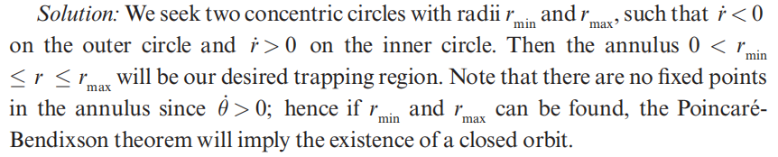
7.3 Poincaré−Bendixson Theorem
In fact, the closed orbit can exist even if
Nonlinear Dynamics and Chaos: With Applications to Physics, Biology, Chemistry, and Engineering Speaker: Yichen Lu

Slide 8
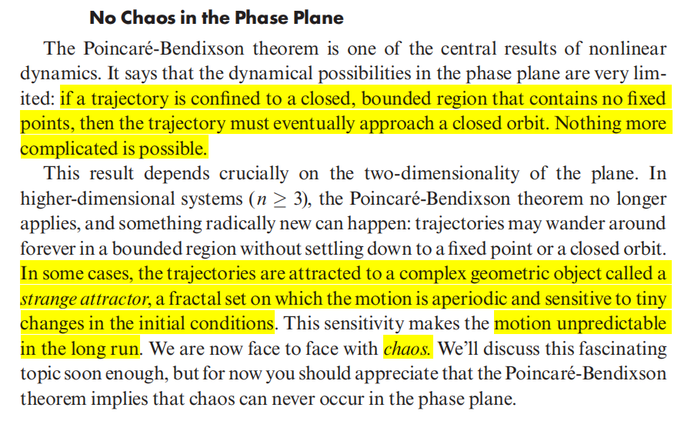
7.3 Poincaré−Bendixson Theorem
Nonlinear Dynamics and Chaos: With Applications to Physics, Biology, Chemistry, and Engineering Speaker: Yichen Lu

Slide 9

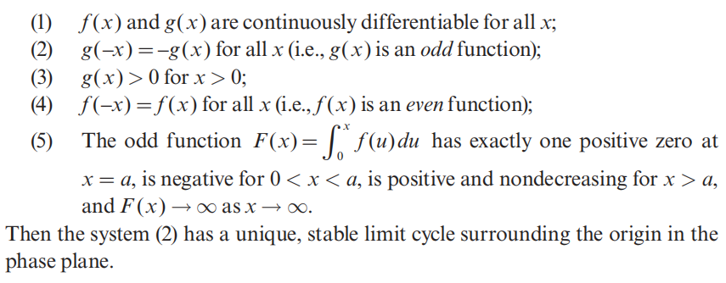
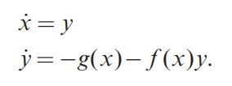
7.4 Liénard Systems
Nonlinear Dynamics and Chaos: With Applications to Physics, Biology, Chemistry, and Engineering Speaker: Yichen Lu

Slide 10
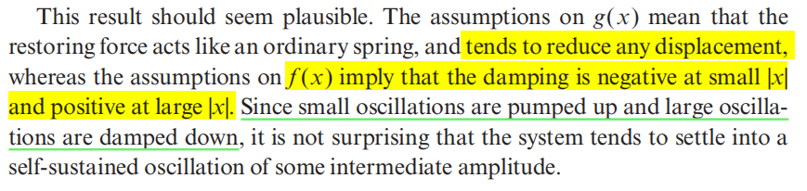
7.4 Liénard Systems
Nonlinear Dynamics and Chaos: With Applications to Physics, Biology, Chemistry, and Engineering Speaker: Yichen Lu

Slide 11
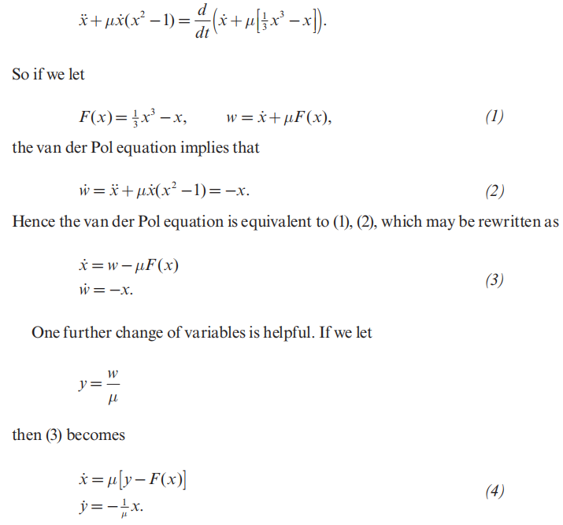
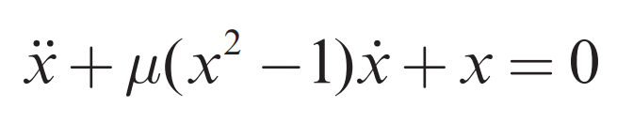
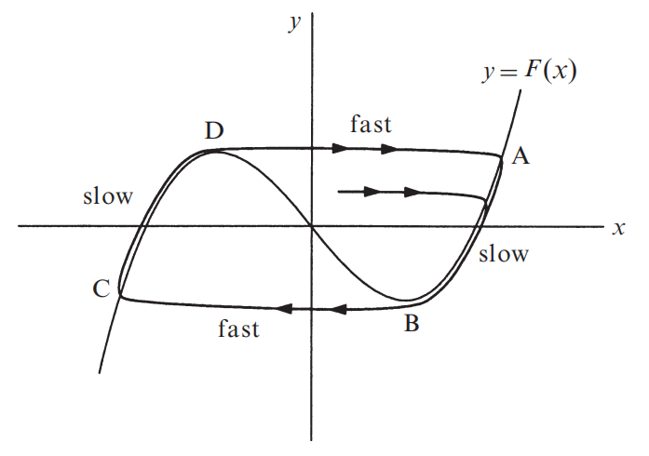
7.5 Relaxation Oscillations
We begin by considering the van der Pol equation for
Nonlinear Dynamics and Chaos: With Applications to Physics, Biology, Chemistry, and Engineering Speaker: Yichen Lu

Slide 12
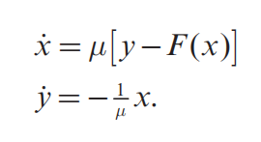

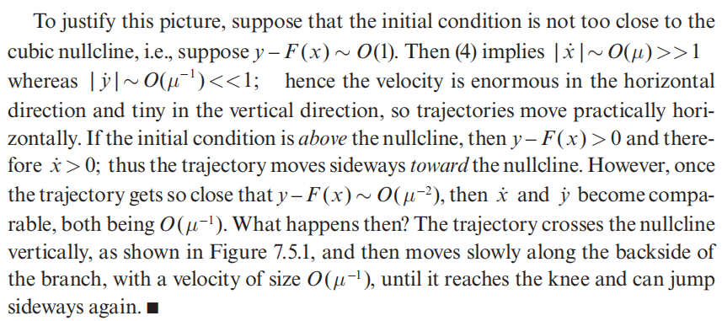
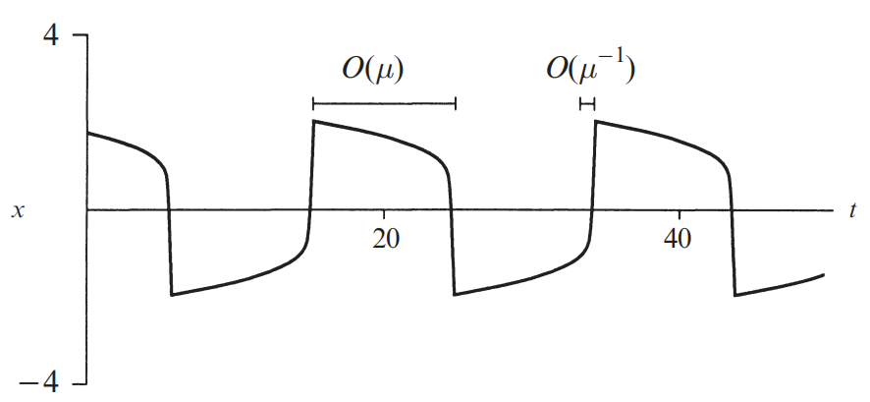
7.5 Relaxation Oscillations
Nonlinear Dynamics and Chaos: With Applications to Physics, Biology, Chemistry, and Engineering Speaker: Yichen Lu

Slide 13
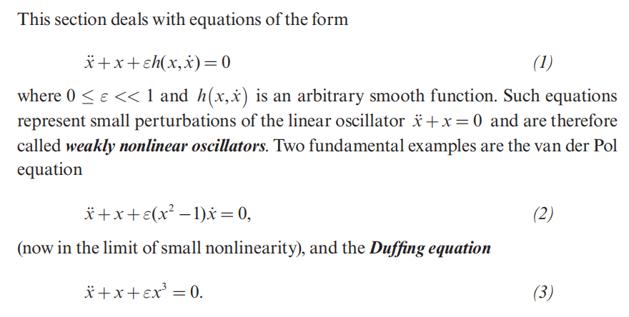
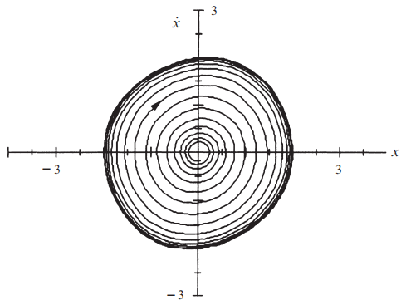

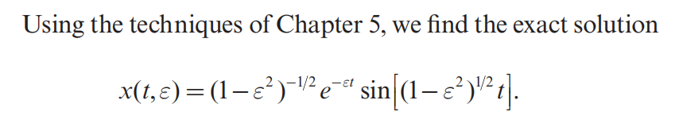
7.6 Weakly Nonlinear Oscillators
Nonlinear Dynamics and Chaos: With Applications to Physics, Biology, Chemistry, and Engineering Speaker: Yichen Lu

Slide 14
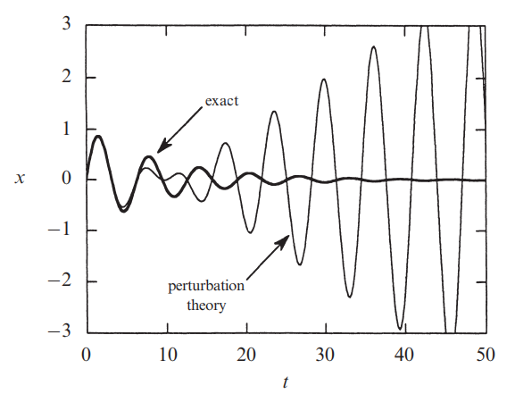
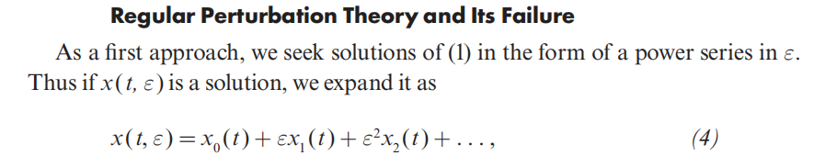
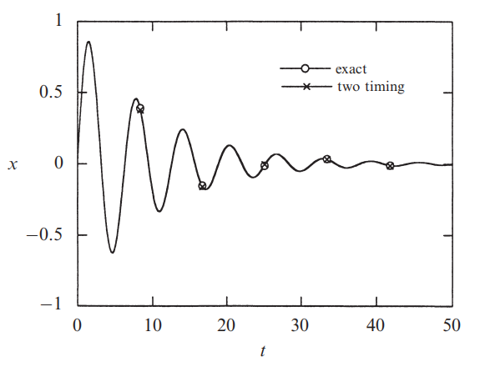
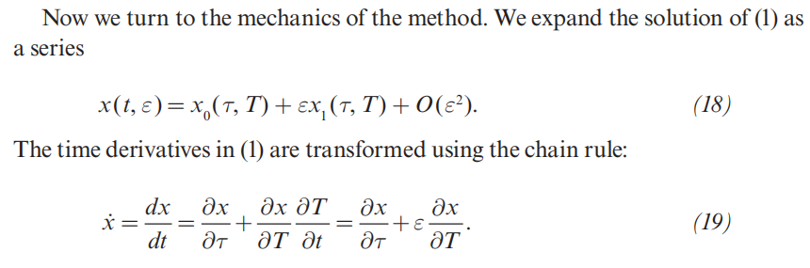
7.6 Weakly Nonlinear Oscillators
Regular Perturbation Theory and Its Failure
Two-Timing
Nonlinear Dynamics and Chaos: With Applications to Physics, Biology, Chemistry, and Engineering Speaker: Yichen Lu

Slide 15
Exercise
7.4.1 Solve a Liénard Systems and classify its stability
7.5.7 Cell cycle
Nonlinear Dynamics and Chaos: With Applications to Physics, Biology, Chemistry, and Engineering Speaker: Yichen Lu

