Slide 1
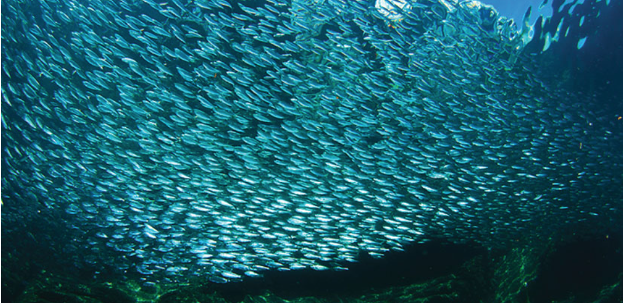
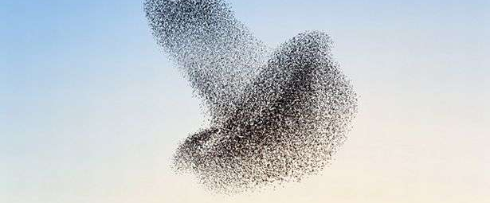
Active Matter
Flocking, Self-propelled, Chiral & Chemotactic

Slide 2
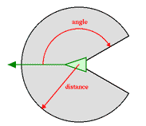
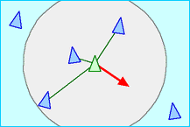
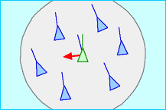
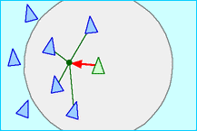
Boids Model
Simulated Flocks
Collision Avoidance:
avoid collisions with nearby flockmates
Velocity Matching:
attempt to match velocity with nearby flockmates
Flock Centering:
attempt to stay close to nearby flockmates
a boid's neighborhood
J. Toner and Y. Tu, Flocks, Herds, and Schools: A Quantitative Theory of Flocking, Phys. Rev. E 58, 4828 (1998).
C. W. Reynolds, Flocks, Herds, and Schools: A Distributed Behavioral Model, Computer Graphics 21, 25 (1987).

Slide 3
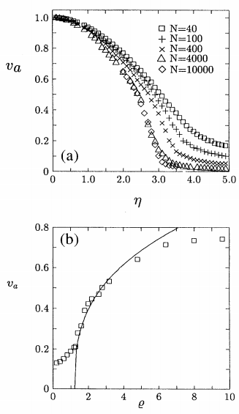
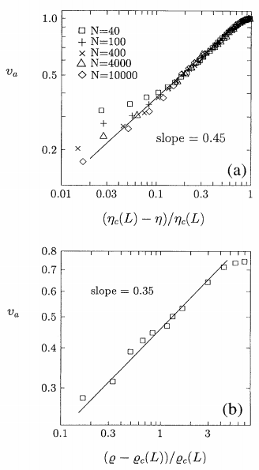
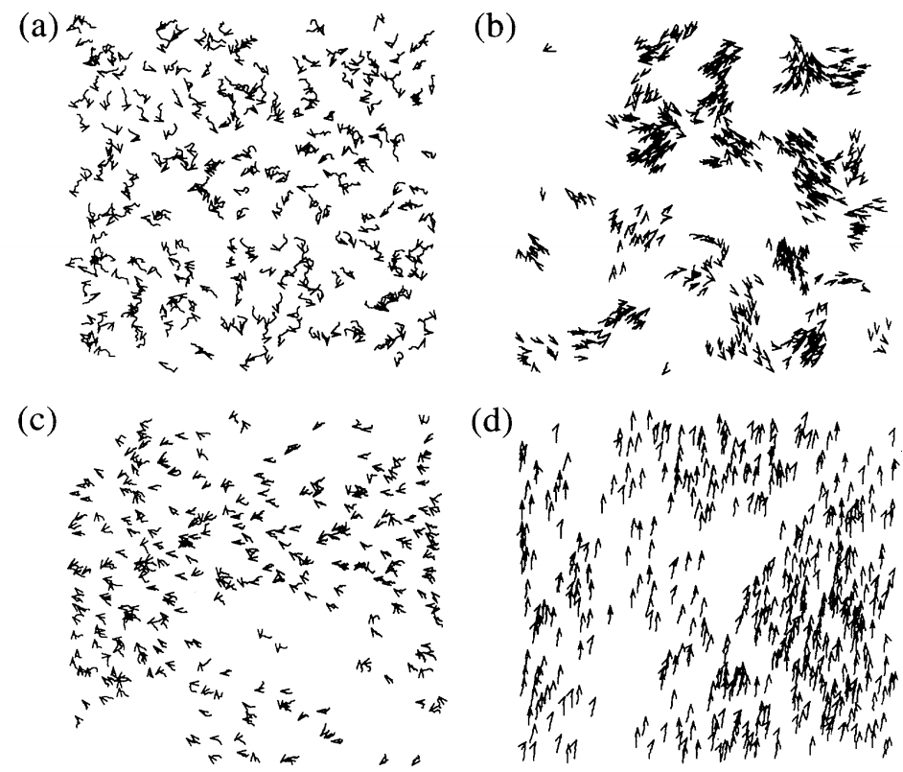
Vicsek Model
T. Vicsek, A. Czirók, E. Ben-Jacob, I. Cohen, and O. Shochet, Phys. Rev. Lett. 75, 1226 (1995).

Slide 4
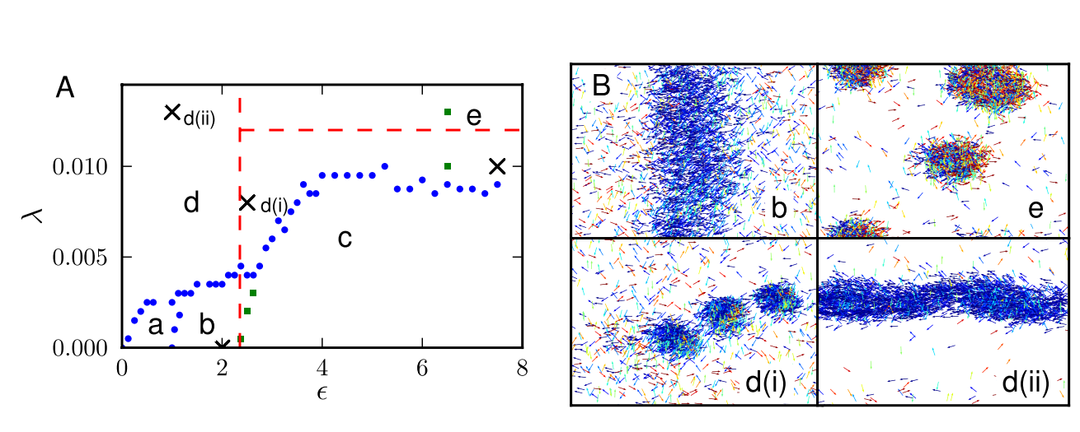
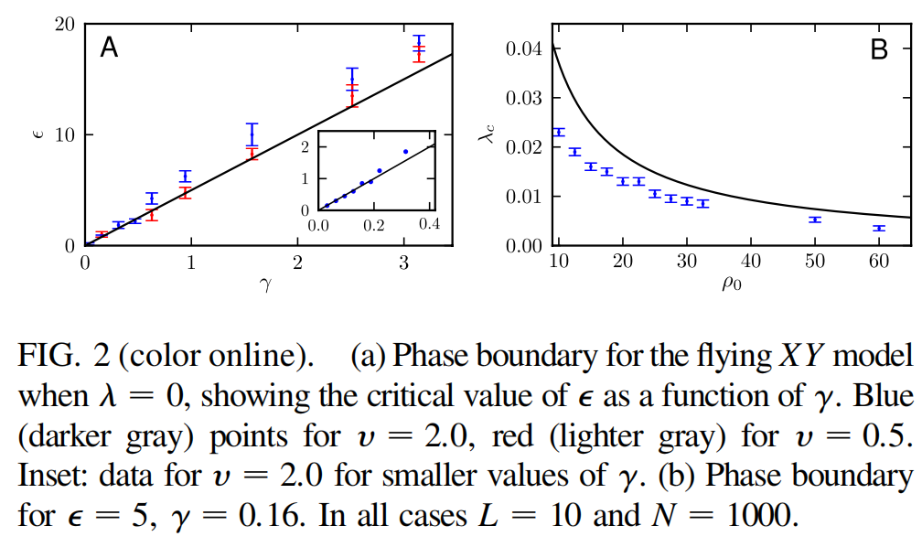
Self-Propelled Particles
F. D. C. Farrell, M. C. Marchetti, D. Marenduzzo, and J. Tailleur, Pattern Formation in Self-Propelled Particles with Density-Dependent Motility, Phys. Rev. Lett. 108, 248101 (2012).

Slide 5
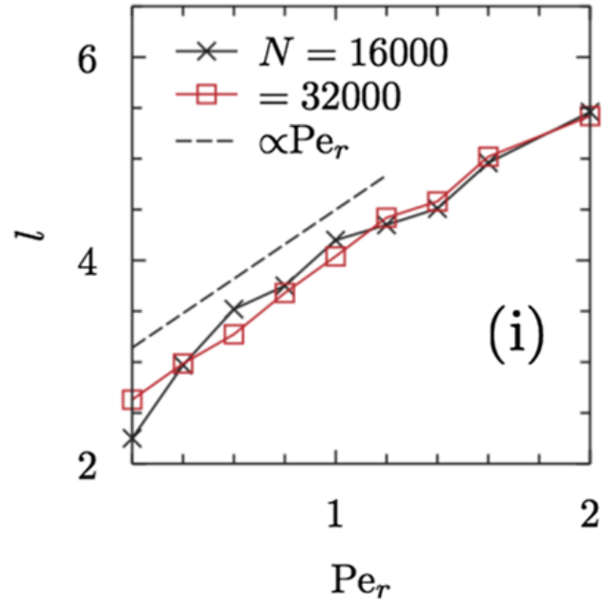
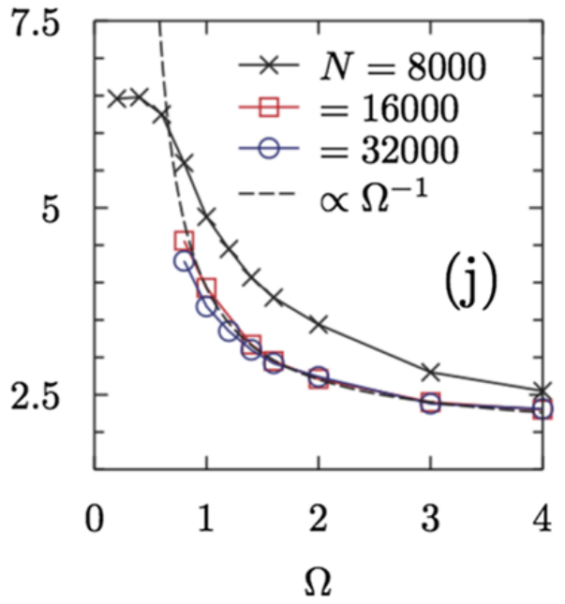
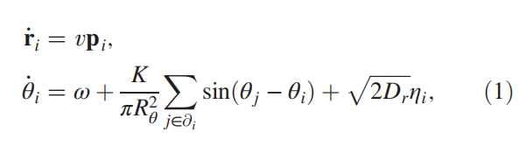
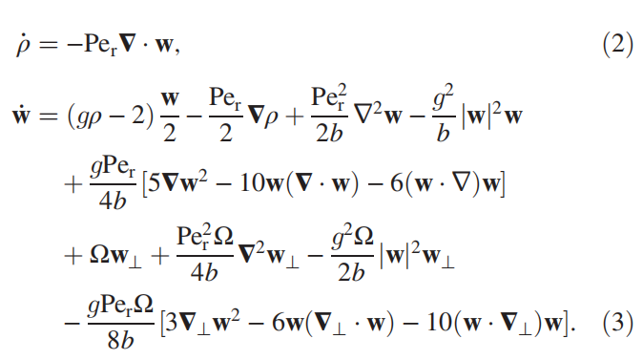
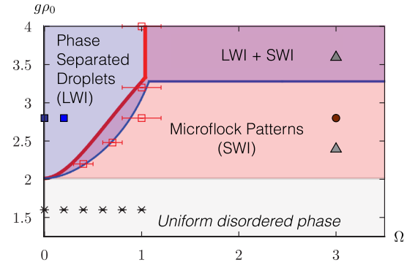
CAPs Model
B. Liebchen and D. Levis, Collective Behavior of Chiral Active Matter: Pattern Formation and Enhanced Flocking, Phys. Rev. Lett. 119, 058002 (2017).

Slide 6
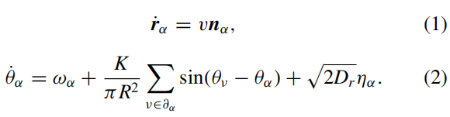
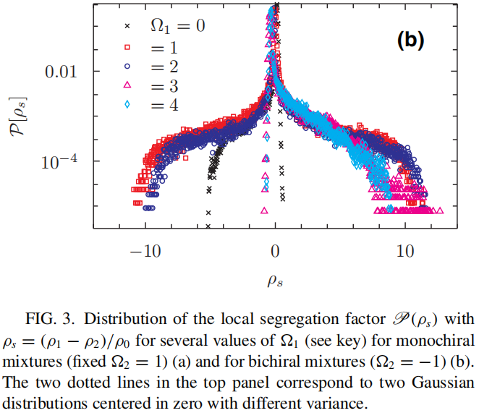
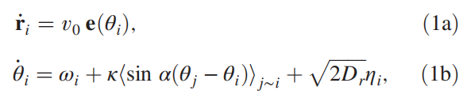
More CAPs Models
[1] D. Levis, I. Pagonabarraga, and B. Liebchen, Activity Induced Synchronization: Mutual Flocking and Chiral Self-Sorting, Phys. Rev. Research 1, 023026 (2019).
[2] D. Levis and B. Liebchen, Simultaneous Phase Separation and Pattern Formation in Chiral Active Mixtures, Phys. Rev. E 100, 012406 (2019).
[3] B. Ventejou, H. Chaté, R. Montagne, and X. Shi, Susceptibility of Orientationally Ordered Active Matter to Chirality Disorder, Phys. Rev. Lett. 127, 238001 (2021).

Slide 7
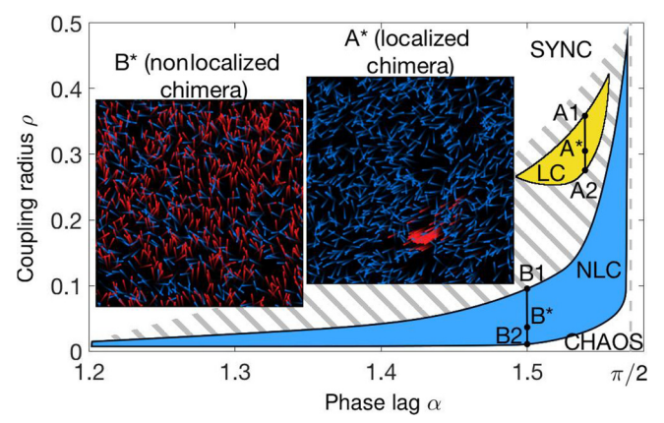
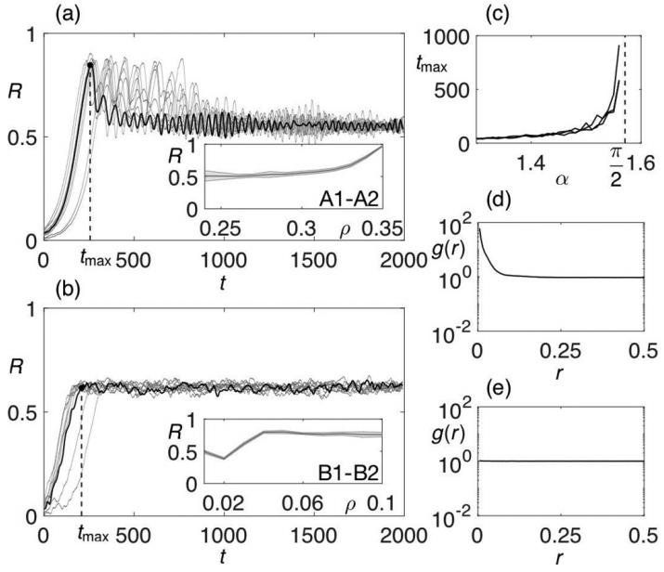
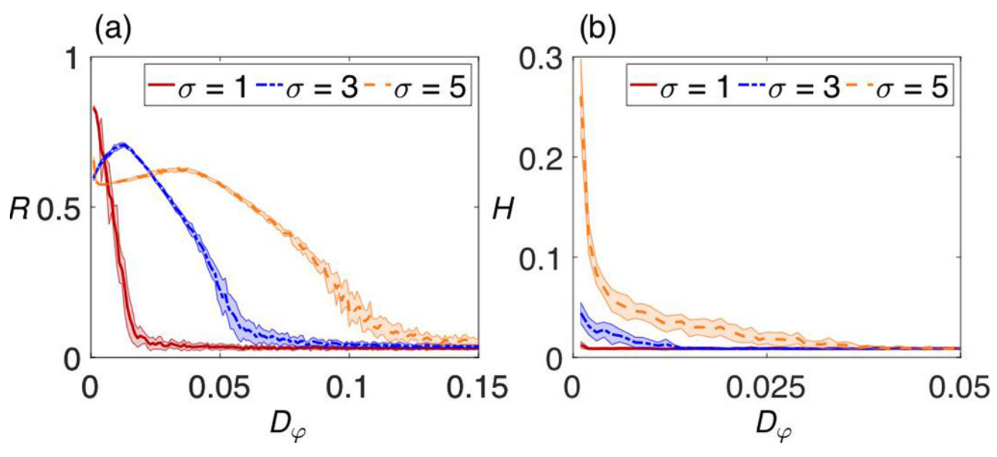
Self-propelled chimeras
N. Kruk, Y. Maistrenko, and H. Koeppl, Self-Propelled Chimeras, Phys. Rev. E 98, 032219 (2018).

Slide 8
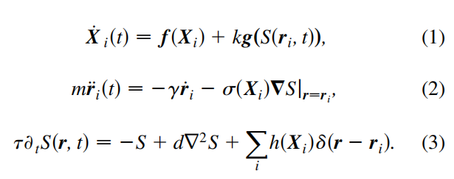
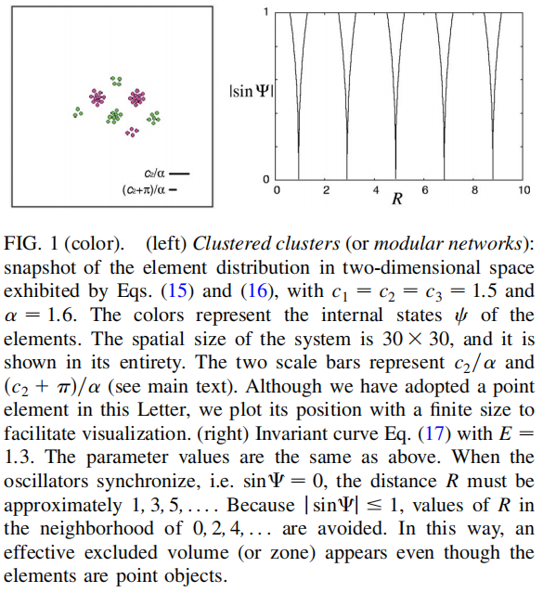
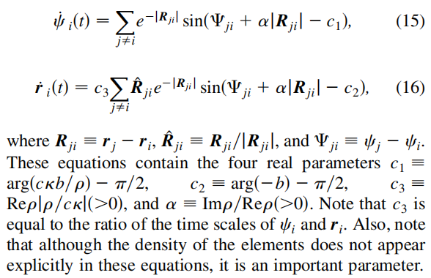
General Chemotactic Model of Oscillators
D. Tanaka, General Chemotactic Model of Oscillators, Phys. Rev. Lett. 99, 134103 (2007).

Slide 9
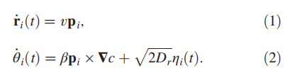
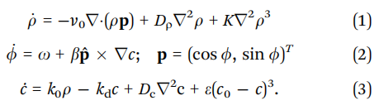

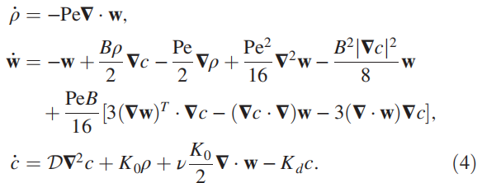
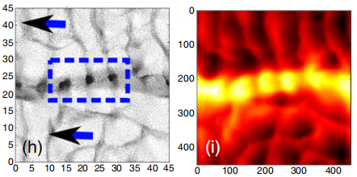
Chemotactic Active Matter
[1] B. Liebchen, D. Marenduzzo, I. Pagonabarraga, and M. E. Cates, Clustering and Pattern Formation in Chemorepulsive Active Colloids, Phys. Rev. Lett. 115, 258301 (2015).
[3] B. Liebchen, D. Marenduzzo, and M. E. Cates, Phoretic Interactions Generically Induce Dynamic Clusters and Wave Patterns in Active Colloids, Phys. Rev. Lett. 118, 268001 (2017).
[2] B. Liebchen, M. E. Cates, and D. Marenduzzo, Pattern Formation in Chemically Interacting Active Rotors with Self-Propulsion, Soft Matter 12, 7259 (2016).

Slide 10
Overview

