Slide 1
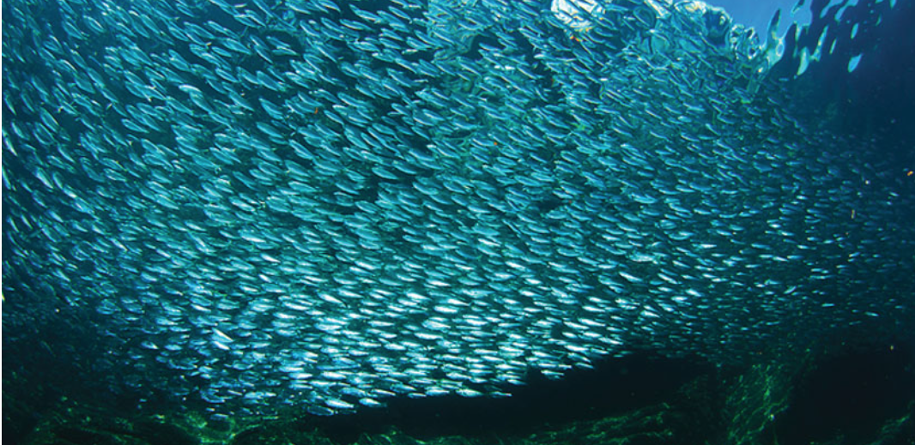
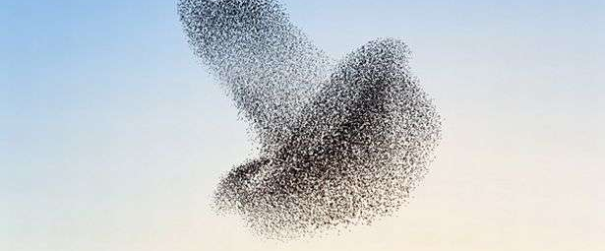
Active Matter
Flocking, Self-propelled, Chiral & Chemotactic

Slide 2
Agent-base model
C. W. Reynolds, Flocks, Herds, and Schools: A Distributed Behavioral Model, Computer Graphics 21, 25 (1987).

Slide 3
Boids Model
a neighborhood
C. W. Reynolds, Flocks, Herds, and Schools: A Distributed Behavioral Model, Computer Graphics 21, 25 (1987).

