Slide 1
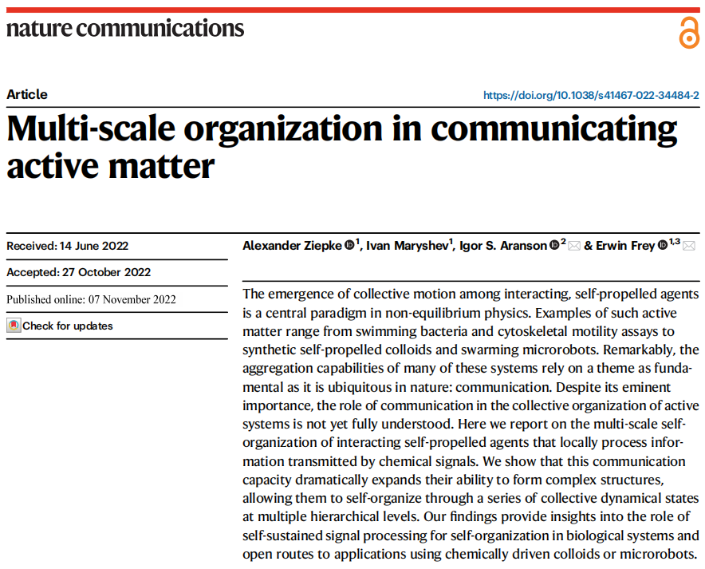

Slide 2
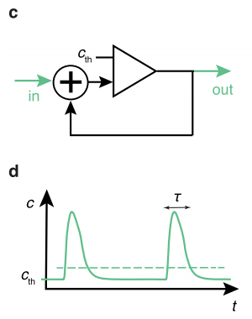
The Model
The hydrodynamic model:
Multi-scale organization in communicating active matter

Slide 3
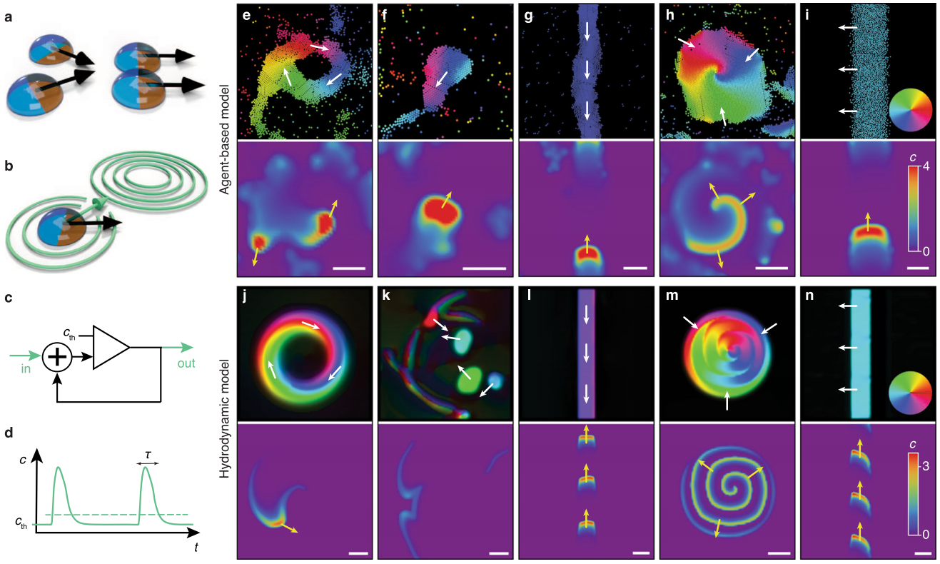
Results
Synthetic Chemotaxis and Collective Behavior in Active Matter

Slide 4
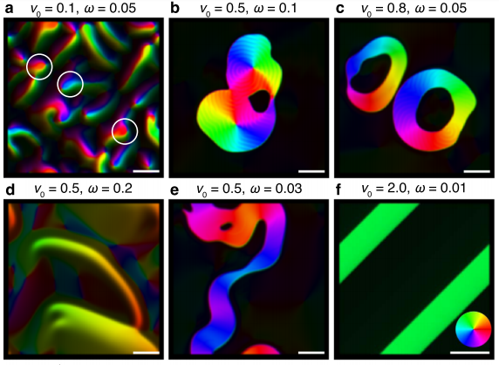
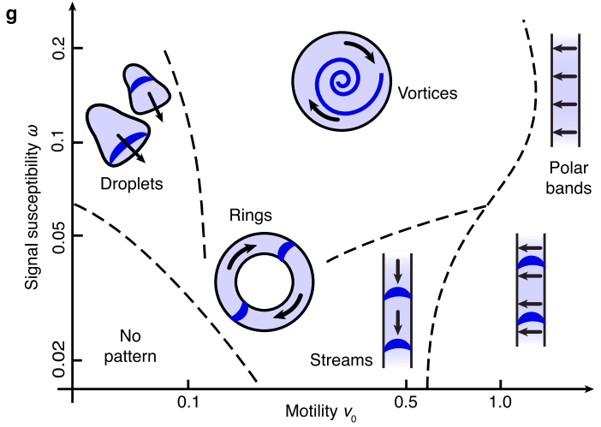
Results
Synthetic Chemotaxis and Collective Behavior in Active Matter

Slide 5
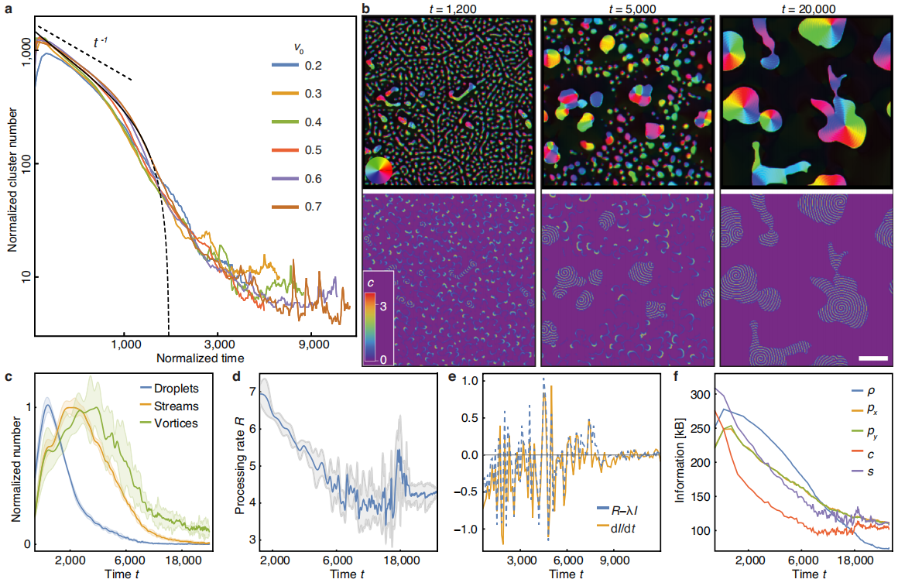
Results
Synthetic Chemotaxis and Collective Behavior in Active Matter

Slide 6
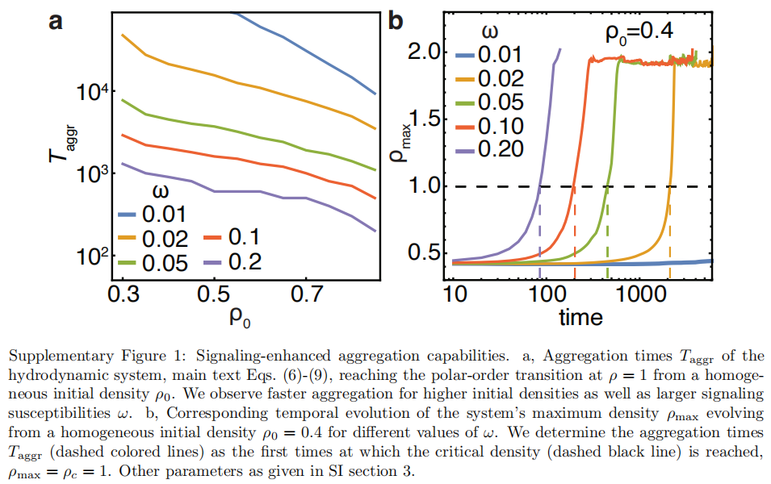
Results
Synthetic Chemotaxis and Collective Behavior in Active Matter

Slide 7
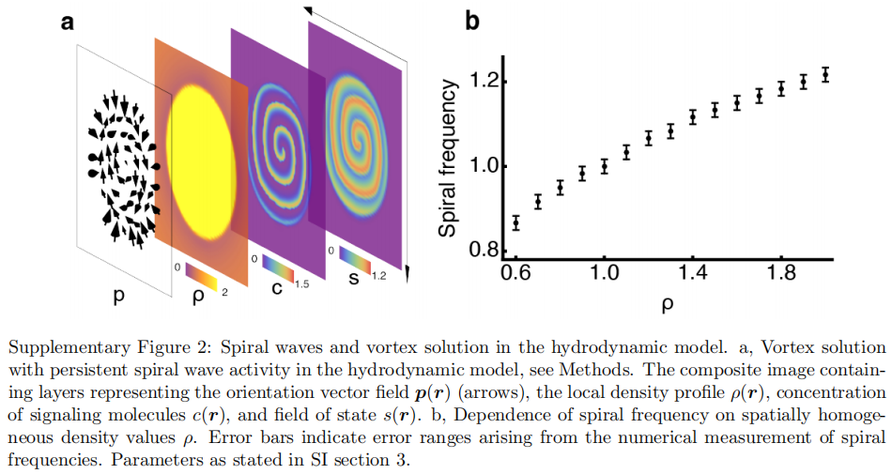
Results
Synthetic Chemotaxis and Collective Behavior in Active Matter

Slide 8
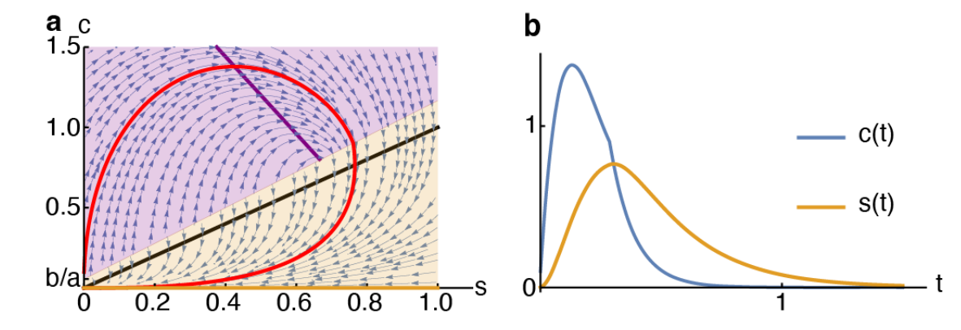


Results
Synthetic Chemotaxis and Collective Behavior in Active Matter

Slide 9
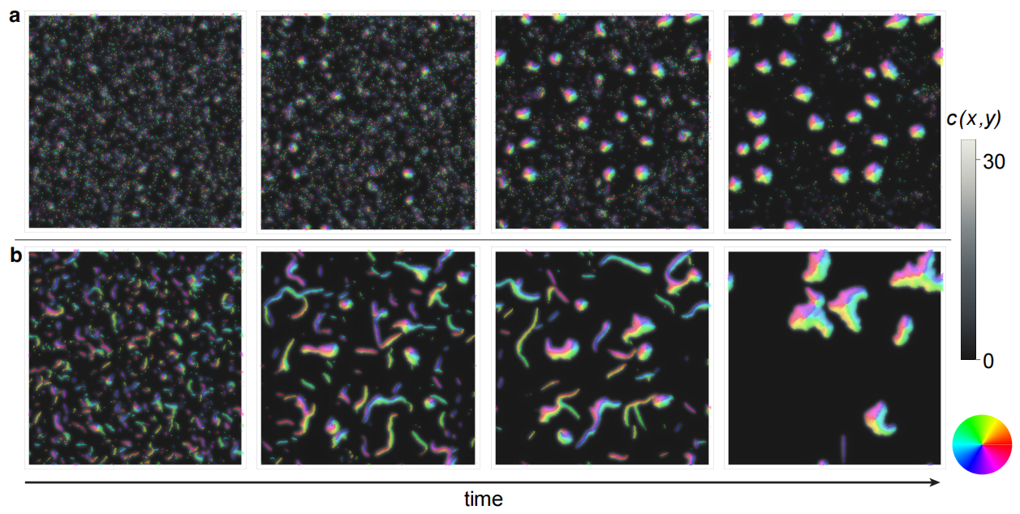

Results
Synthetic Chemotaxis and Collective Behavior in Active Matter

Slide 10
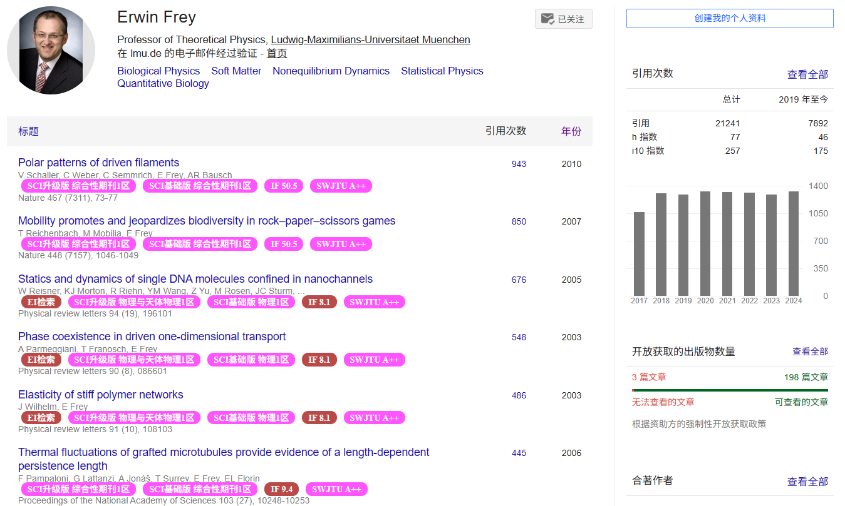
By the way
Synthetic Chemotaxis and Collective Behavior in Active Matter

