Slide 1
DSCI6003:
Ultimatum Game
A machine learning approach to maximizing your earnings
Jonathan Hilgart

Slide 2
Overview
What is the ultimatum game?
What does the data look like?
How to maximize how much money we make?

Slide 3
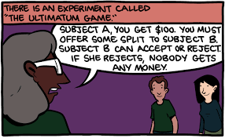
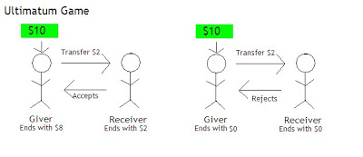
Traditional Ultimatum Game
Notes:
The ultimatum game is an economic thought experiment that is an extension of the Prisoner’s Dilemma
The basic premise, explained more on the next slide, is that there are two people in this game. Both players choose whether to ‘push’ (give money to the other player) or ‘pull’ (take money for themself from the pot). The catch is that you can only pull $3-$4 while you can push $6-$7. Best option is for both players to push to the other player.

Slide 4
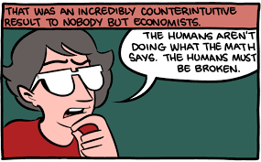
Empirical Results
Cooperation is very low (15-50%) even though nash equilibrium suggests responder should accept any offer.
What is the accuracy for predicting our payoff playing this game?
Notes:
Cooperation here is defined as reaching the maximum monetary outcome for each player (i.e. for this game it would be both players pushing money to the other player).
The reason why cooperation is not reached 100% o the time is due to a concept of fairness and people being greedy.
If I offer you $1 and keep $9 for myself, that may be viewed as not fair. (This concept is not applicable in this version of the game because each player selects their move at the same time (i.e. you do not observe the opponent’s choice before making your own choice).
On the flip side, you may be greedy and want to only take money for yourself (pull) instead of giving money to the other player (push)

Slide 5
Overview of game structure
Two rounds of experiments.
1) First 15 rounds
Push : Give the other player money from the pot of money($6 or $7)
Pull : Take money from the pot ($3 or $4)
2) Rounds past 15 allowed each player to make a side payment for the other to push
Typically offer between $1-$3 for other player to push
Three rounds of analysis
1) Rounds without a side payment (rounds 1-15)
2) Rounds with a side payment (rounds past 15)
3) All rounds
Players played multiple rounds
Original Paper: http://www.pnas.org/content/96/19/10933.full
Notes:
Push here means that you are giving money from the pot to the other player
Each player played ~ 8 rounds

Slide 6
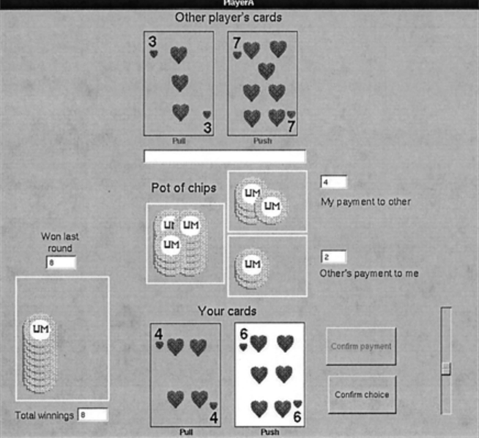
The experiment
Notes:
First stage players are not able to give side payments (‘My payment to other’, ‘Other’s payment to me’). Players decision to push or pull happen simultaneously.
Second stage, players are able to give side payments
Side payments are given first. Then, players decide whether to pull or push
If a side payment is present and a player pulls, the side payment goes back to the opposite player.
If a side payment is present and a player pushes (gives money to the opposite player), then this player receives the side payment amount
Each subject played ~8 rounds (between these two options - side payment / no side payment).
This setup is such that is your are greedy, want to pull, you make $3-$4 less than if you push (and the other player pushes).

Slide 7


The Data
In total 1,920 rows. Each row was a full game experiment.
720 without a side payment
1200 with a side payment
Features used (only use features available to you in the game).
Rd 1-15
Past rd 15
Goal: Predict mypayoff
*Data was scaled for GLMnet due to binary choice for mychoice (0,1). All other features were in dollars.
Notes:
In the later rounds, the myside and opptside columns are not empty.
I removed the opptchoice, and opptchoicecard columns because you would not have access to this information during the game.

Slide 8
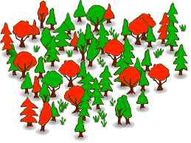
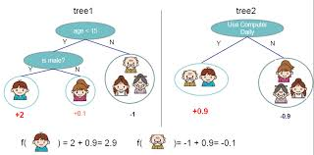
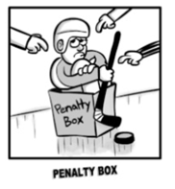
Algorithms Used
Random Forest
2) Boosting
3) GLM/Elastic net
Random Forest
KNNregression
Gradient Boosting
Extreme Gradient Boosting
GLM/Elastic Net
Ensembles
Linear ensemble of all models
GB ensemble of all models and all original features
http://xgboost.readthedocs.io/en/latest/model.html
Notes:
Different results throughout the rounds.
However, it is easiest to predict your payoff in the later rounds (with a sidepayment).
Each algorithm has a different approach to find the answer.
Clustering
Regression
Trees / Boosted Trees

Slide 9
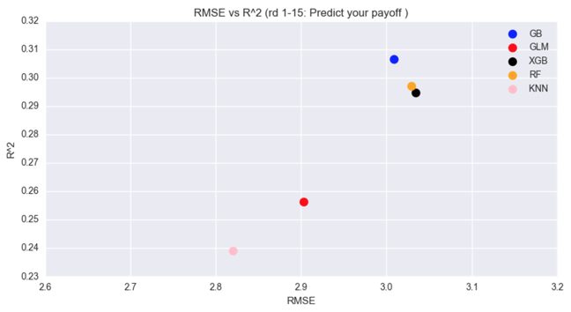
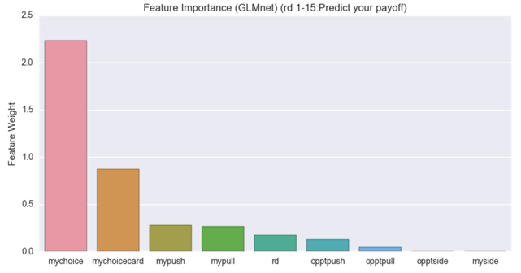
Rounds 1-15
Results vary slightly based upon train test split
* Best parameters found from randomized gridsearch. Feature importance from glmnet.
Notes:
Best model in terms of RMSE is KNN
However, KNN can not give us feature importances. Therefore, GLMnet is used for the graph to the right.
Takeaway, whether you pull or push is the most important feature for determining your payoff in the game (dominant option is to push money to the other player).

Slide 10
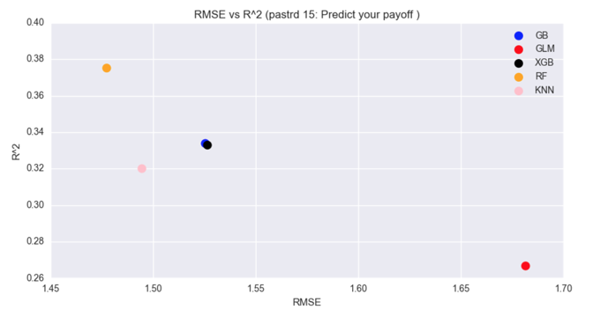
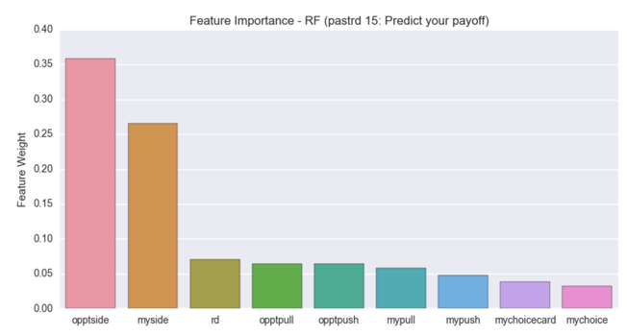
Rounds past 15
Results vary slightly based upon train test split
* Best parameters found from randomized gridsearch. Feature importance from RF.
Notes:
Best model here is Random Forest. This is likely due to the small training data set and the potential of gradient boosting / xgboost overfitting. Also, GLMnet probably did not perform well due to a non-linear decision boundary.
Big takeaway here is that the features importances have changed from the first 15 rounds. Now, the amount that your opponent offers to you is the best predictor of how much you will make (i.e. if you opponent offers you more money, you are likely to make more money).
In addition, how much money you offer to your opponent is the second most important feature for determining how much money you will make. If you offer money to your opponent, you are more likely to make more money in your total payoff.
This is likely due to both players being more inclined to ‘push’ money to the other player in the presence of a side payment (incentives here are changing decisions.
In addition, we have much higher prediction accuracy (in terms of RMSE) compared to the first 15 rounds. This means it is easier to predict how much money a person will make if there is an option to make side payments.

Slide 11
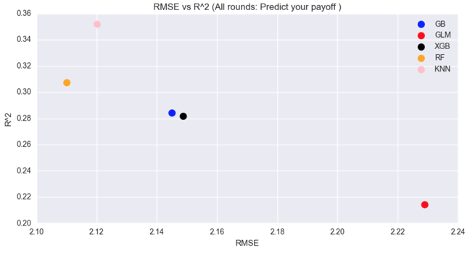
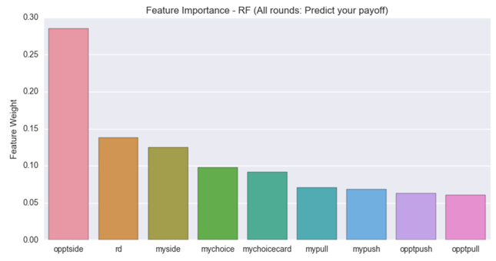
All rounds
Results vary slightly based upon train test split
* Best parameters found from randomized gridsearch. Feature importance from RF.
Notes:
Again, the best model here if random forest (in terms of RMSE).
The features importances for the top three stay the same. However, rd tops my side as the second most important factor to predict your payoff over all rounds.
This means that after seeing how much a player has offered you to ‘push’ (opptside), the next feature to investigate is the rd. In later rounds, players have learned how to cooperate with each other to achieve a maximum payout.

Slide 12



Ensemble
Dataframe (linear):
Dataframe (meta):
Weights per model (linear):
Weights (meta):
Notes:
Here, combine the predicted results of each individual model into a linear regression ensemble.
The idea is that by assigning weights to each model, we can combine the strengths of multiple approaches.
I.e. a linear decision boundary from regression, clustering techniques from KNN, and non-linear boundaries from trees.
Above, our linear regression model gives the most weight to GB.
Interesting, since GB does not perform the best in any of the models
Meta dataframe just means that we are combining the original features alongside the predictions from each model as features
For the meta dataframe, the best feature from the original features is the rd number.
Scaled data was used here to keep the original features on the same scale

Slide 13
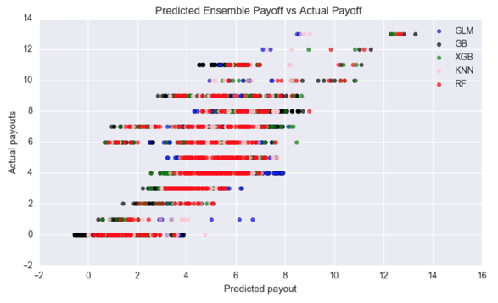
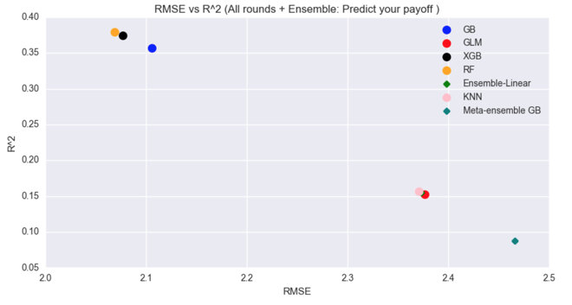

Ensemble results
*Neither ensemble method could beat the final RF model.
Notes:
RF again wins as the best model (but barely).
Hypothesis here is that the ensemble method would perform best on new incoming data because of the combination of models used.
The meta ensemble did worse than the linear ensemble of model predictions
Chart on left shows the predicted values vs actual values for each model that went into the ensemble

Slide 14
Questions

