Slide 1

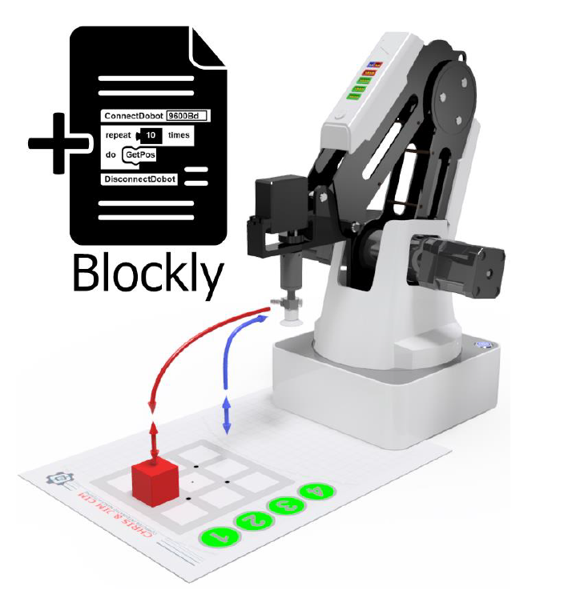
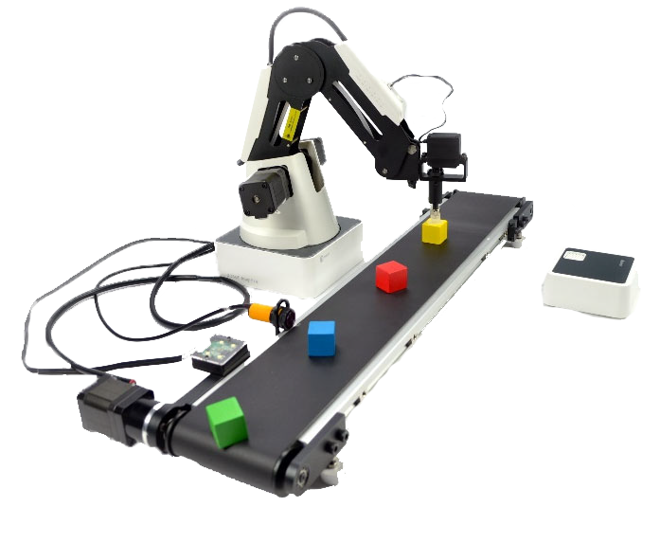
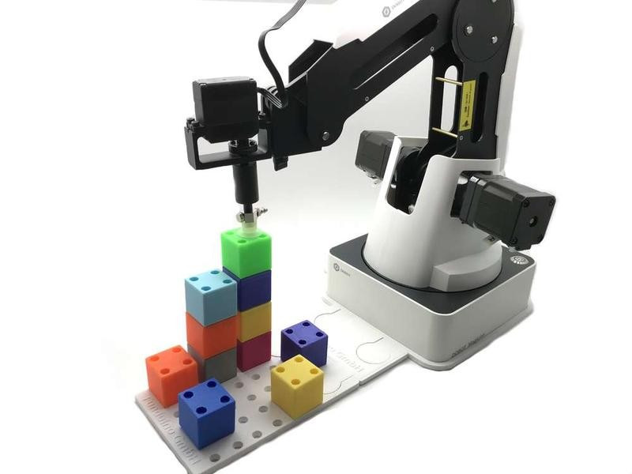
Mini Project
010243109 Introduction to Engineering
Asst. Prof. Dr. AMORNPHUN PHUNOPAS, DEPARTMENT OF PRODUCTION AND ROBOTICS ENGINEERING FACULTY OF ENGINEERING - KMUTNB

Slide 2
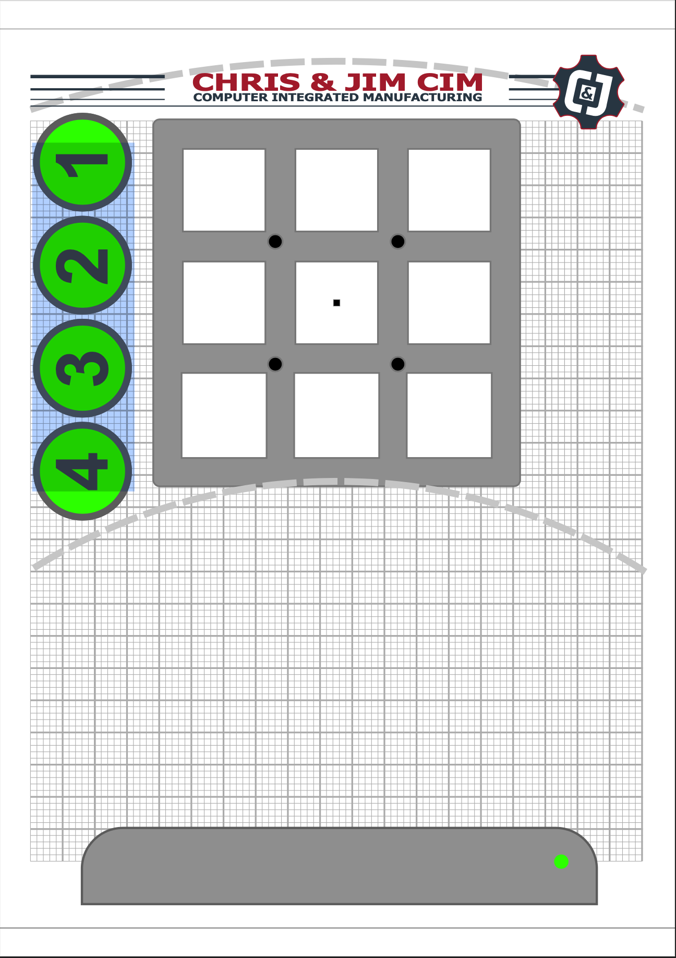
Robot setup
Field template
Move Dobot to the field template
Asst. Prof. Dr. AMORNPHUN PHUNOPAS, DEPARTMENT OF PRODUCTION AND ROBOTICS ENGINEERING FACULTY OF ENGINEERING - KMUTNB

Slide 3

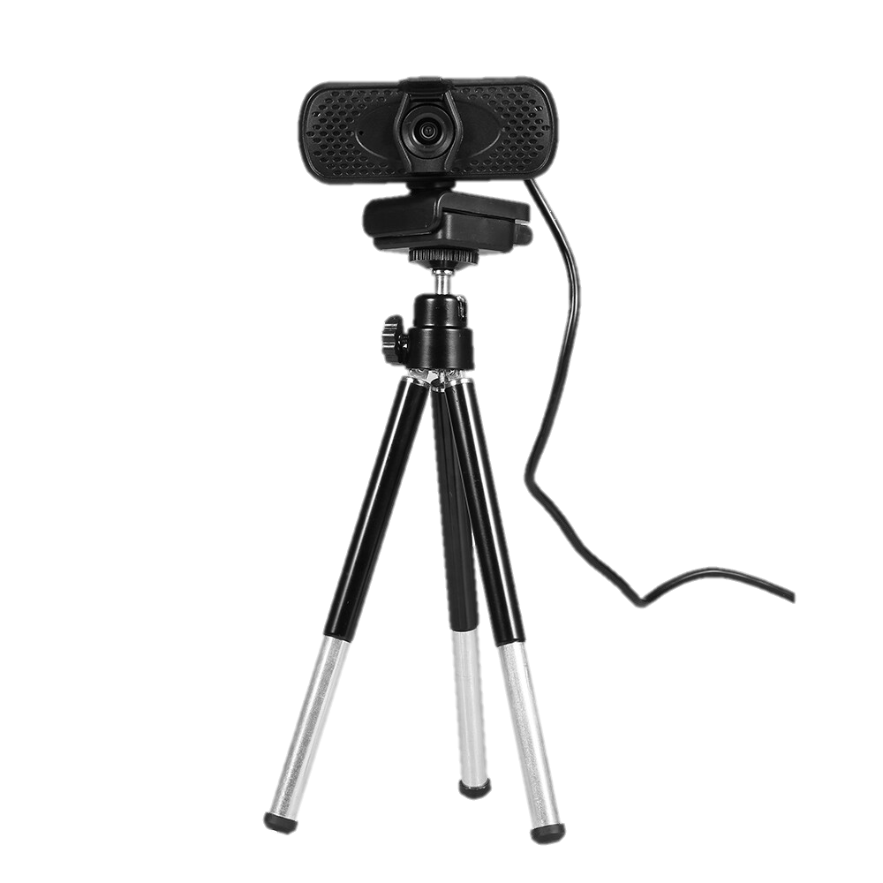

Setup the scene
USB Camera
USB Dobot
Asst. Prof. Dr. AMORNPHUN PHUNOPAS, DEPARTMENT OF PRODUCTION AND ROBOTICS ENGINEERING FACULTY OF ENGINEERING - KMUTNB

Slide 4
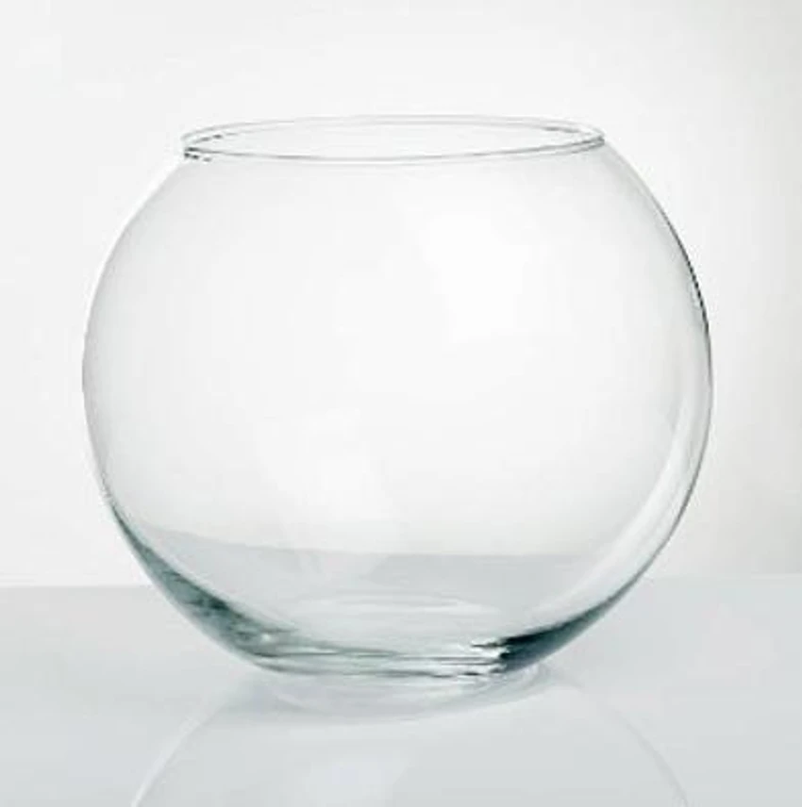
Rules to play
There are 8 cubes with 4 colors in the bowl.
Randomly pick a cube and place it one by one on the field template.
Team A and B have the same pattern.
Lucky Bowl
Asst. Prof. Dr. AMORNPHUN PHUNOPAS, DEPARTMENT OF PRODUCTION AND ROBOTICS ENGINEERING FACULTY OF ENGINEERING - KMUTNB

Slide 5
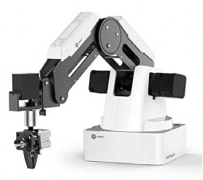
Rules to play
Team A selects two cubes for stacks 1 and 3. They may be the same or a different color.
Team B selects two cubes for stacks 2 and 4. They may be the same or a different color.
4
3
Team B
2
Team A
1
Cube Stack Tower
Asst. Prof. Dr. AMORNPHUN PHUNOPAS, DEPARTMENT OF PRODUCTION AND ROBOTICS ENGINEERING FACULTY OF ENGINEERING - KMUTNB

Slide 6
Rules to play
4
The final target is to pick and place 4 cubes in the order of the cube stack tower.
3
Team A
2
Team B
1
Preparing time 3 minutes,
Team A and Team B start to pick and place the cubes as the final target. The winner is who finishes first without collapsing.
Asst. Prof. Dr. AMORNPHUN PHUNOPAS, DEPARTMENT OF PRODUCTION AND ROBOTICS ENGINEERING FACULTY OF ENGINEERING - KMUTNB

Slide 7
Rules to play
4
3
Team A
2
Team B
1
The final target
The time limit to finish all tasks is 5 minutes.
If neither team can do it, we will count the total score.
If something is wrong, you can reset the new game within a limited time.
Asst. Prof. Dr. AMORNPHUN PHUNOPAS, DEPARTMENT OF PRODUCTION AND ROBOTICS ENGINEERING FACULTY OF ENGINEERING - KMUTNB

Slide 8
Rules to play
Workspace
You may need to make a plan for stack placement to avoid the tower collapse.
Positions 1, 2, 3, and 4 are the temporary positions to place.
Asst. Prof. Dr. AMORNPHUN PHUNOPAS, DEPARTMENT OF PRODUCTION AND ROBOTICS ENGINEERING FACULTY OF ENGINEERING - KMUTNB

Slide 9
Rubrics
Date | Target | Team______________ |  |  | Team______________
Stack order | color | Pick | Place | Point | Pick | Place | Point
1st floor (25%)
2nd floor (25%)
3rd floor (25%)
4th floor (25%)
 | Total (100%)
 |  | Try 1 | Try 2 | Try 3 | Try 1 | Try 2 | Try 3
 | Start time
 | End time
 | Total time
 | Winner
Asst. Prof. Dr. AMORNPHUN PHUNOPAS, DEPARTMENT OF PRODUCTION AND ROBOTICS ENGINEERING FACULTY OF ENGINEERING - KMUTNB

Slide 10
Group
Group | Member (1) ID | Member (1) First name - Last name | Member (2) ID | Member (2) First name - Last name | Member (3) ID | Member (3) First name - Last name
1 | 6801023611157 | Palawat Kamjaroen | 6801023611076 | Winyupol suvisit | 6801023611301 | Suwannapoom thatkeson
2 | 6801023610291 | นภัตสร คำนวน | 6801023610312 | กัญจน์ญรัญ นาดี | 6801023611017 | ศิริพรรณ หาญเชิงชัย
3 | 6801023611319 | Benjaphorn Boonsrisut | 6801023611327 | May Thiri Kyaw | 6801023611289 | Suchanan Chaobuakhao
4 | 6801023611238 | Siraphat Sritrakoon | 6801023611297 | Suthida Rodthananchai | 6801023611271 | Phattharapoom Jaingam
5 | 6801023611211 | Physics Worachaiswad | 6801023611131 | Saranyaphat Ruangsin | 6801023611033 | Fasai Marnnoi
6 | 6801023610274 | Kittikarn Amnuaywattanakul | 6801023610118 | Sanhanat Sukprasroed | 6801023610134 | Thirawat Sangkhahattakorn
7 | 6801023610231 | Thunwa Malaiwalee | 6801023610240 | Rutnatee Toasabush | 6801023610321 | Nidchakul Kuljirajaroon
8 | 6801023611050 | Puree Tantipanichkul | 6801023611203 | Ariya Prathum | 6801023611165 | Porriphat Kenpucha
9 | 6801023611254 | Phaethong Rattanasopa | 6801023611122 | Warissara Uta | 6801023611041 | Tharitawan Sorsomboon
10 | 6801023611025 | Seelawit Limvanichnattakit | 6801023611246 | Teachin Rinthong | 6801023611181 | Pongsathorn Onfong
11 | 6801023611092 | Mr.Silpachai Thongsri | 6801023610282 | Ms.yaowares Rungraveekittipaisarn | 6801023610266 | Thitaphan Chinchumakorn
12 | 6801023610061 | Pirawit Techapanyarak | 6801023610096 | Pattaragorn. Oonsomlee | 6801023610100 | Jinnaphat. Traimontree
13 | 680102310088 | Jakree prosirigul | 6801023610223 | Kittitat Munpetch | 6801023610215 | Nanthawat Putthong
14 | 6801023610169 | ธนากร พุ่มจิ๋ว | 6801023610045 | สมภพ ขาวนวล | 6801023610347 | Heinthant Zaw
15 | 6801023610053 | Witsawachot Jongbunvatana | 6801023610177 | Werapat Phochareon | - | -
16 | 6801023610011 | Soe Thu Tun | 6801023610037 | Zin Lin Htet | 6801023610029 | Aw Myat Thiri Min Thein
17 | 6801023611084 | Wongwnich Kengpimanmueng | 6801020000000 | achira rattanasinchaiboon | - | -
18 | 6801023611190 | นิติรัฐ พรมฤทธิ์ | 6801023611106 | ณฐพงศ์ สุขคลีวนัติ | 6801023611262 | นภัสสร จำปีหอม
19 | 6801023610151 | Pakonkit Datratikun | 6801023610304 | Sukrit Wongjinda | 6801023610339 | Thanathip Sangbuakaew
20 | 6801023610126 | Lannara jaiphet | 6801023610185 | Iyakarn Moryadee | 6801023610258 | Purimprach Yooyen
21 | 6801023610053 | Pantakron Priwanrung-arun | 6801023610177 | Werapat Phochareon | 6801023610053 | Witsawachot Jongbunvatana
22 | 6801023610207 | Kanyapak Fongnoi | 6801023610070 | Pannarata masathian | - | -
23 | 6801023611149 | Atthavit Methasasipat | 6801023611173 | Theeraphat Ounkai |  | Phurinut

Slide 11

Competition
1st place
2nd place
3rd place
Winner
G6
G9
G18
G1
G6
G9
G16
G18
G23
G1
G3
G6
G9
G14
G16
G18
G21
G1
G2
G3
G4
G5
G6
G7
G8
G9
G
10
G
11
G
12
G
13
G
14
G
15
G
16
G
17
G
18
G
19
G
20
G
21
G
22
G
23

Slide 12
Schedule
September 27, 2025
Room 89-506 Robot Academy
time | Field 1 | Field 2 | Field 3 | Field 4
9.00-9.10 | G1 vs G2 | G3 vs G4 | G5 vs G6 | G7 vs G8
9.10-9.20 | G9 vs G10 | G11 vs G12 | G13 vs G14 | G15 vs G16
9.20-9.30 | G17 vs G18 | G19 vs G20 | G21 vs G22 | X1 vs X2
9.30-9.40 | X3 vs X4 | X5 vs X6 | X7 vs X8 | X9 vs X10
9.40-9.50 | X11 vs G23 | Y1 vs Y2 | Y3 vs Y4 | Y5 vs Y6
9.50-10.00 | Z1 vs Z2 Vs Z3
Note: preparation 5 minutes and competition 5 minutes
- An absent member will receive a half score or zero, referencing the score of the member who attended.
- There is only a reward for the winner.

