Slide 1
HOME

Slide 2
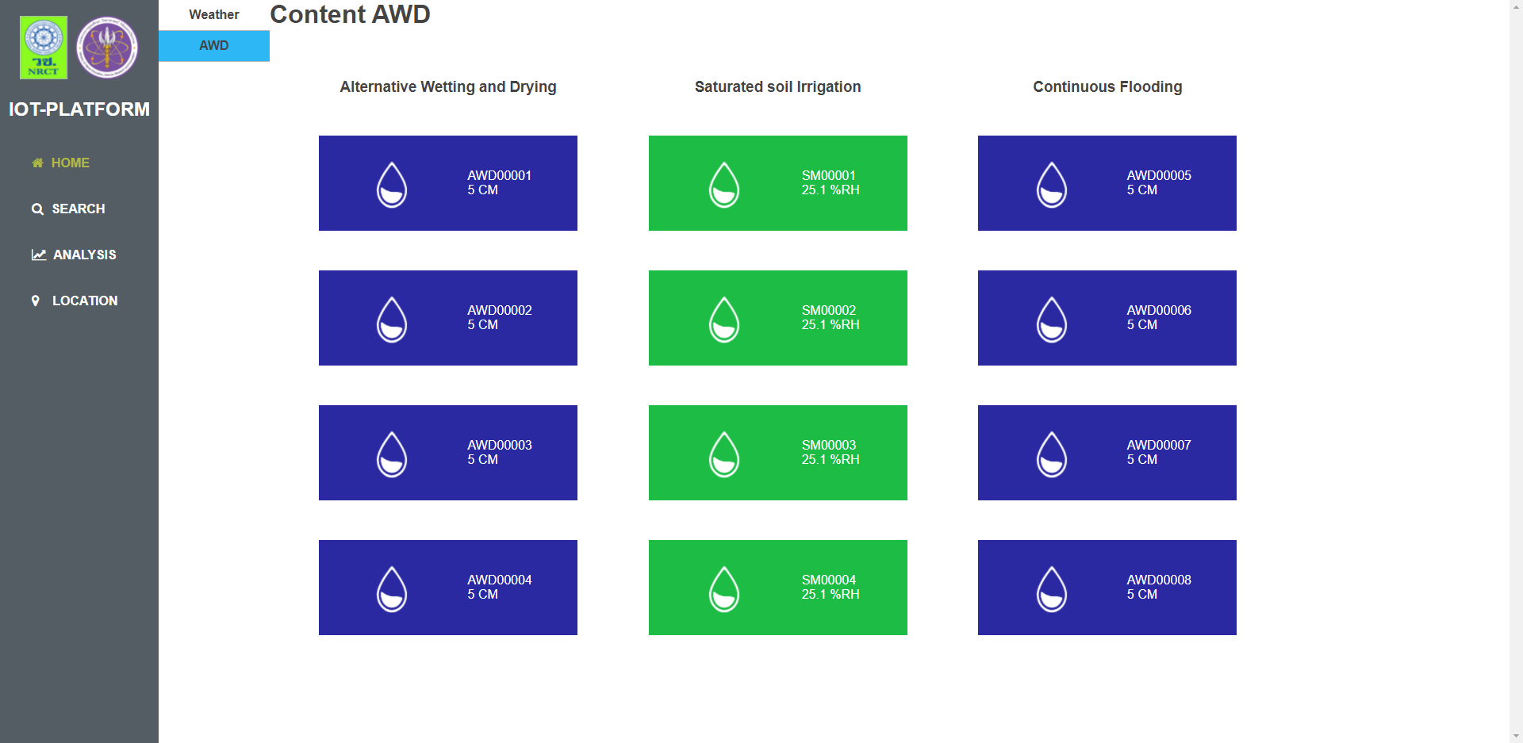
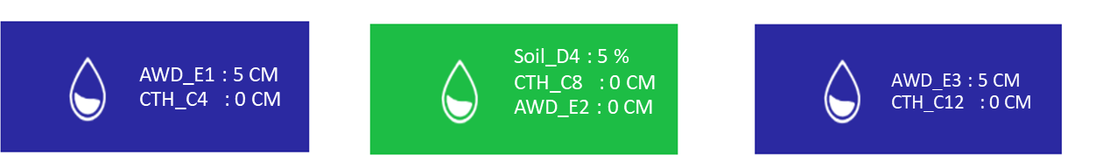
Irrigation
Weather
Lysimeter
AWD_A1 : 5 CM
CTH_C9 : 0 CM
Soil_D1 : 5 %
CTH_C5 : 0 CM
AWD_B1 : 0 CM
AWD_A1 : 5 CM
CTH_C1 : 0 CM
AWD_A2 : 5 CM
CTH_C10 : 0 CM
Soil_D2 : 5 %
CTH_C6 : 0 CM
AWD_B2 : 0 CM
AWD_A2 : 5 CM
CTH_C2 : 0 CM
AWD_A3 : 5 CM
CTH_C11 : 0 CM
Soil_D3 : 5 %
CTH_C7 : 0 CM
AWD_B3 : 0 CM
AWD_A3 : 5 CM
CTH_C3 : 0 CM
AWD_E3 : 5 CM
CTH_C12 : 0 CM
Soil_D4 : 5 %
CTH_C8 : 0 CM
AWD_E2 : 0 CM
AWD_E1 : 5 CM
CTH_C4 : 0 CM
CAP_F3
Water : 5 CM
Wind : 0 m/s
Temp : 0 c
Humi : 0 %
CAP_F2
Water : 5 CM
Wind : 0 m/s
Temp : 0 c
Humi : 0 %
CAP_F1
Water : 5 CM
Wind : 0 m/s
Temp : 0 c
Humi : 0 %

Slide 3
URL
AWD : https://docs.google.com/spreadsheets/d/1_bsC2smL3dhC5GsTlJMKHftN0cZHQSVHnGH1DBfkQRI/edit#gid=2003208410
FLOODED : https://docs.google.com/spreadsheets/d/1hsirFggd02iRq50E_vJxNl9UyJpLYVWdyhtCb9z3Was/edit#gid=2089177584
Saturat : https://docs.google.com/spreadsheets/d/1O2mlME4rW6s5klb92ZgSnn2k6UVYdthzZJnfF3MkwdM/edit#gid=1601617006
Class A Pan : https://docs.google.com/spreadsheets/d/1gLAXQ4iRo55USK4pvjuv_jwbWbZWHl2O09G7VFbZj8E/edit#gid=175771411
Rainfall : https://docs.google.com/spreadsheets/d/17BVp42uRo8MoJrmfVndtMXueouFG-HWqhKM14Vap7N8/edit#gid=2018974332
Lysimeter : Lysimeter (Responses) - Google ชีต
AWD (Responses) : https://script.google.com/macros/s/AKfycbxxE23SBHICIiZaASF6iRKcHh5aunewTXz5kL0RGZJLa-sOAABHNBCwy-GlehVh8wQ/exec?action=getData
FLOODED (Responses): https://script.google.com/macros/s/AKfycbyq992sG-XkLy8pbwkRnhVRuNBB5Dl7Chkb5fz14rKQ2FgbxreLb3cVqQp20B_6sg2l-A/exec?action=getData
SATURATED (Responses): https://script.google.com/macros/s/AKfycbwncKxwj-oUBRCj-kWwBdrmPxeaYo8QBdkGdKlRIWoADVrt4SNe_KxdO5d40uCK5UfHfg/exec?action=getData
Class A Pan (Responses): https://script.google.com/macros/s/AKfycbyS_6UXRFkw3DGNoXa-kk1cFY725ncq_7FpZmC-xXlNP6rp4iLe60ZSQV2t-BsXhHce/exec?action=getData
Raingauge (Responses): https://script.google.com/macros/s/AKfycbwYpwwX04KrwZ0e5b03lK1gN4htHHv-rkv7ukYOX6XzHcuFGo70owx0kP_Dr12l0wcY/exec?action=getData
Lysimeter (Responses): https://script.google.com/macros/s/AKfycbyQvjhX67GAjurkBrO__i5qPuFCqZfC0_h4MLinQbmU82L7fWJE1M8GlcPfn938L08sxw/exec?action=getData

Slide 4
Alternative Wetting and Drying (Responses) - Google ชีต
Saturated soil Irrigation (Responses) - Google ชีต
Continuous Flooding (Responses) - Google ชีต
Alternative Wetting and Drying (Responses) :
https://script.google.com/macros/s/AKfycbxpWEZxEVvlvMEJzUBq89y00ML9dpe71J7jYkQ_qyFPc35c-iPg5uszfr7Dzld6z02c/exec?action=getData
Saturated soil Irrigation (Responses) :
https://script.google.com/macros/s/AKfycbxN3VT7K0Bxw4N6breKfuvvLZQW-j9TFTQdLkGapB7REpBiJQ5ICWUWVB2UdNGiiVKsYw/exec?action=getData
Continuous Flooding (Responses) : https://script.google.com/macros/s/AKfycbw9VEh3hp0KtFrRbfs8PdkG_0ufleVaQE8c9MnDBDKeeeqVkBkMcUrCZYi6TJxonw2VXg/exec?action=getData

Slide 5
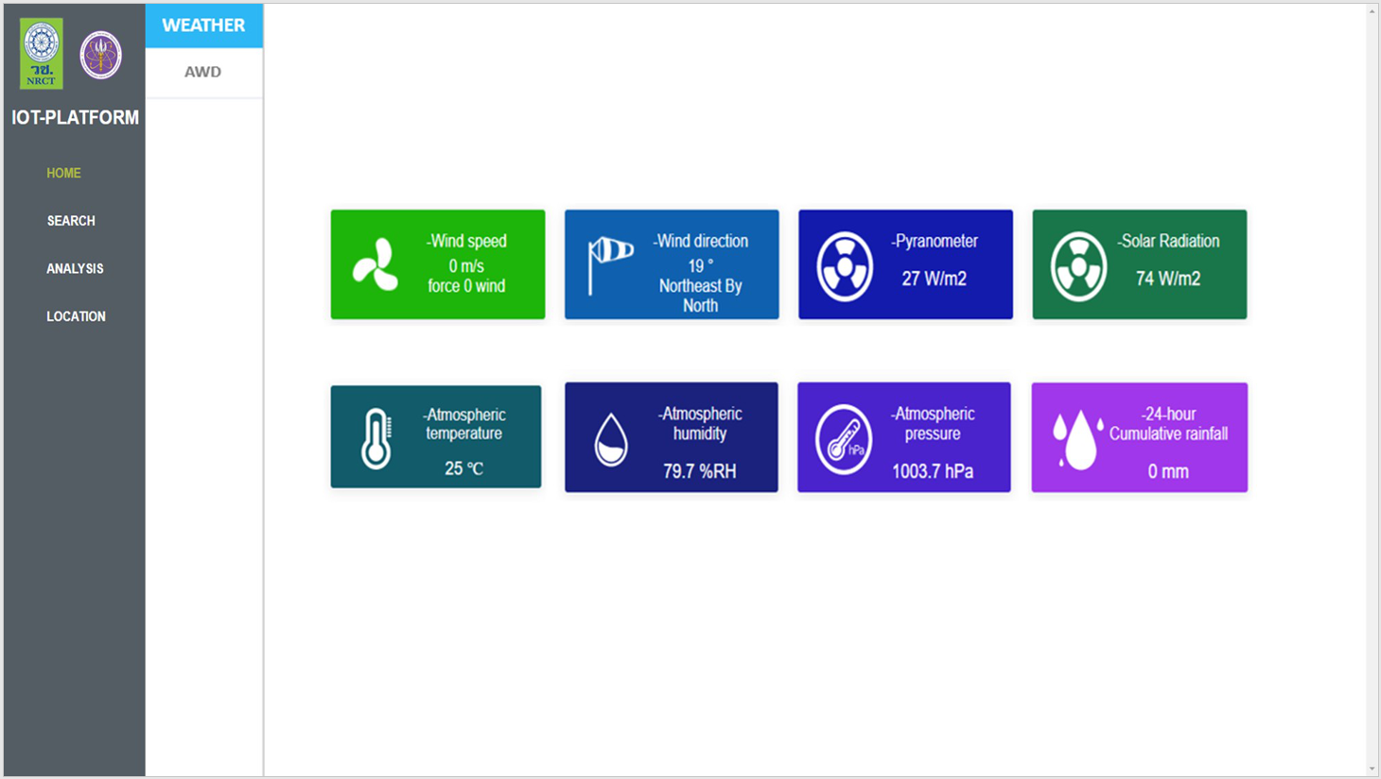
Irrigation
Weather
Lysimeter
Rainfall
Tipping : 000
Value : 000 mm
ดึงข้อมูล Class A Pan (F2) มาแสดงก่อน
: Wind Speed
: temp
: Humi
ส่วน Rainfall มี url

Slide 6
Irrigation
LYSIMETER
Weather
Lysimeter
A
AWD_Z1 : 5 CM
B
AWD_Z5 : 5 CM
A
AWD_Z9 : 5 CM
A
AWD_Z13 : 5 CM
C
AWD_Z2 : 5 CM
D
AWD_Z6 : 5 CM
C
AWD_Z10 : 5 CM
C
AWD_Z14 : 5 CM
B
AWD_Z3 : 5 CM
A
AWD_Z7 : 5 CM
B
AWD_Z11 : 5 CM
B
AWD_Z15 : 5 CM
D
AWD_Z4 : 5 CM
C
AWD_Z8 : 5 CM
D
AWD_Z12 : 5 CM
D
AWD_Z16 : 5 CM

Slide 7
SEARCH

Slide 8
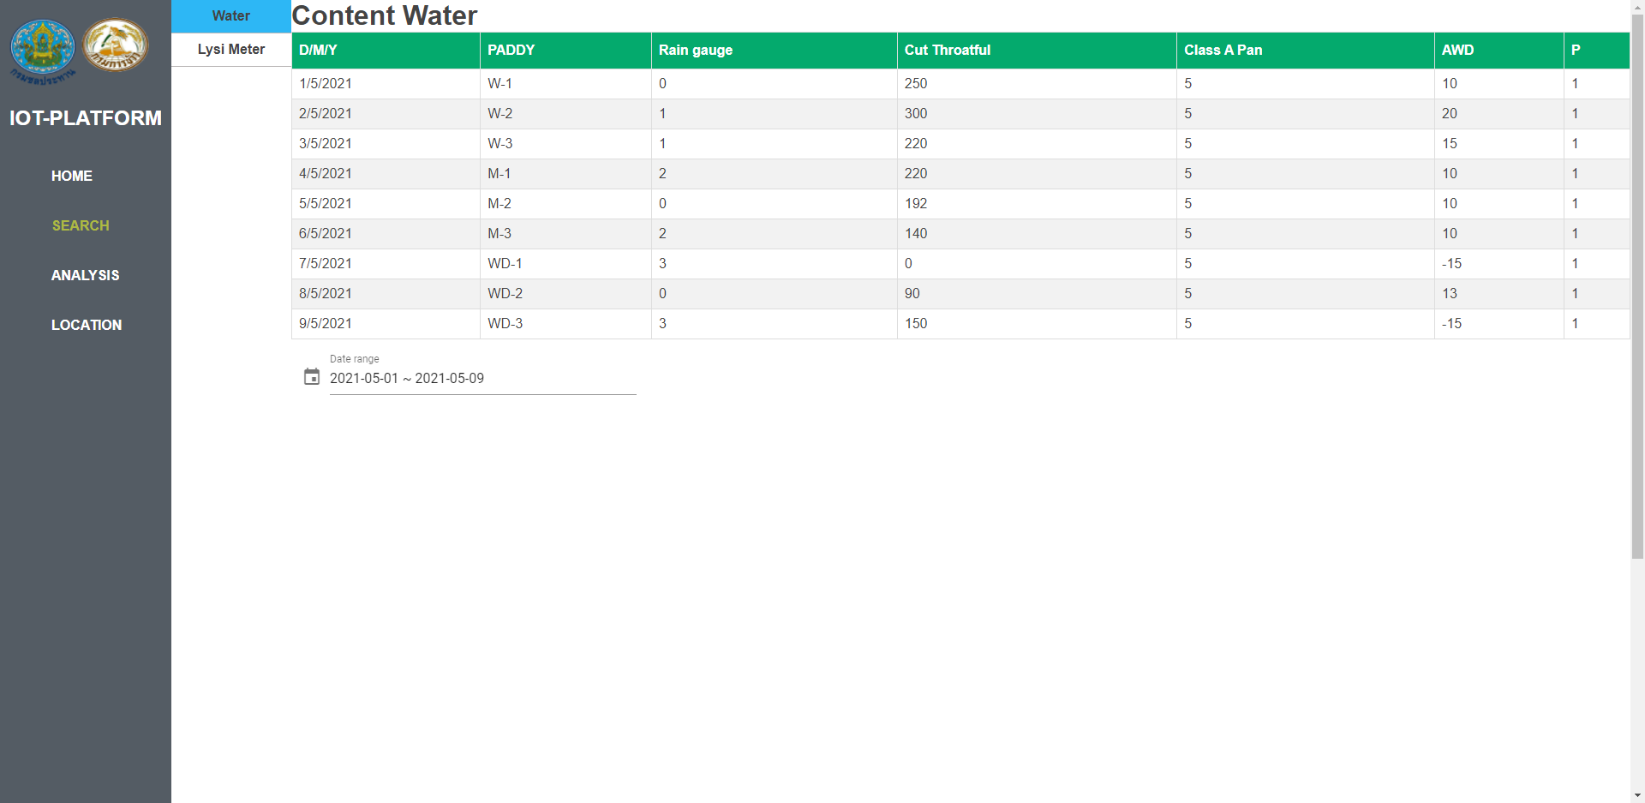

Alternative Wetting and Drying
Saturated soil Irrigation
Continuous Flooding
UNIT
CTH,AWD : CM
SOIL : %
WATER : CM, Wind : m/s, Temp : C,Humi : %
HEADER : Alternative Wetting and Drying
D/M/Y | AWD_A4 | AWD_A5 | AWD_A6 | AWD_E3 | CTH_C9 | CTH_C10 | CTH_C11 | CTH_C12 | Water_F1 | Wind_F1 | Temp_F1 | Humi_F1
HEADER : Saturated soil Irrigation
D/M/Y | AWD_B1 | AWD_B2 | AWD_B3 | AWD_E2 | Soil_D1 | Soil_D2 | Soil_D3 | Soil_D4 | CTH_C5 | CTH_C6 | CTH_C7 | CTH_C8 | Water_F2 | Wind_F2 | Temp_F2 | Humi_F2
HEADER : Continuous Flooding
D/M/Y | AWD_A1 | AWD_A2 | AWD_A3 | AWD_E1 | CTH_C1 | CTH_C2 | CTH_C3 | CTH_C4 | Water_F3 | Wind_F3 | Temp_F3 | Humi_F3

Slide 9
Irrigation
Weather
Lysimeter
HEADER : Weather Station
D/M/Y | Wind Speed(m/s) | Wind direction(delta) | Pyranometer(W/m2) | Solar Radiation(W/m2) | Temperature(C) | Humidity(%) | Rainfall(mm)

Slide 10
Irrigation
Weather
Lysimeter
HEADER : Lysimeter
D/M/Y | Lysim_Z1 | Lysim_Z2 | Lysim_Z3 | Lysim_Z4 | Lysim_Z5 | Lysim_Z6 | Lysim_Z7 | Lysim_Z8 | Lysim_Z9 | Lysim_Z10 | Lysim_Z11 | Lysim_Z12 | Lysim_Z13 | Lysim_Z14 | Lysim_Z15 | Lysim_Z16
UNIT
Lysim : CM

Slide 11
ANALYSIS

Slide 12
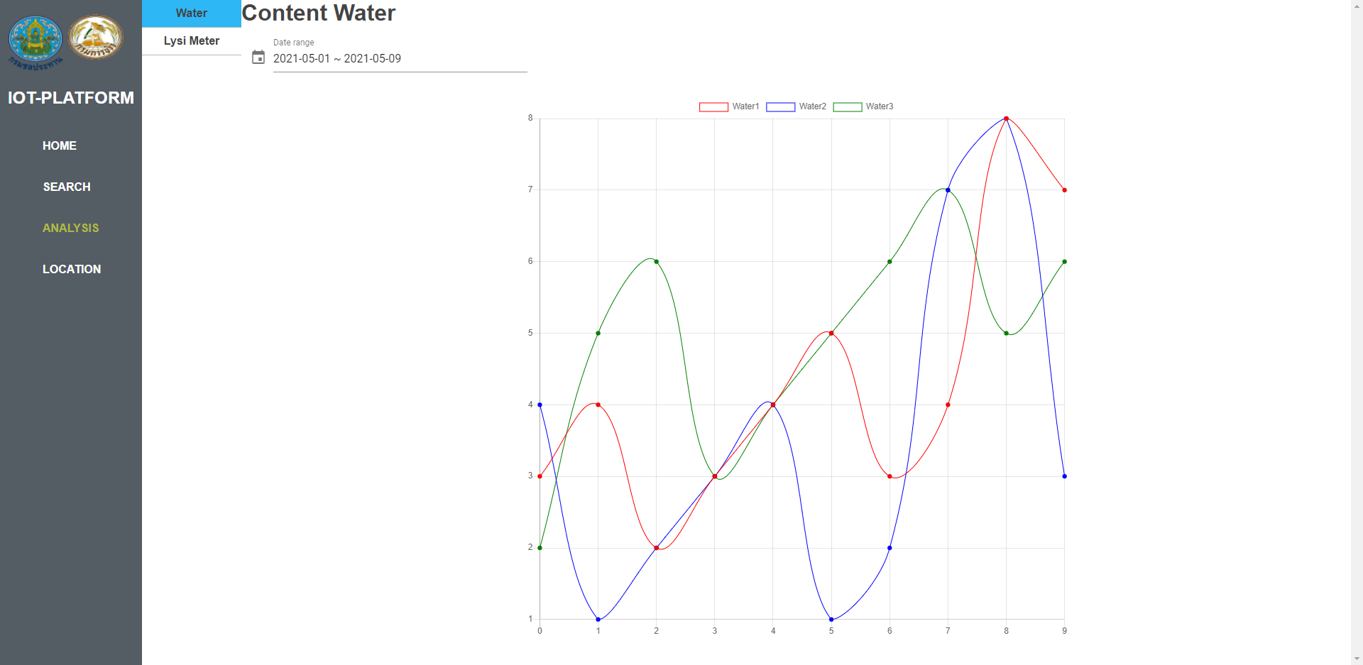
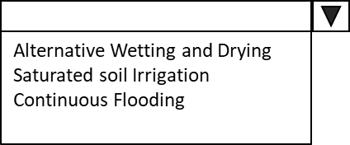
Data
D/M/Y

Slide 13
Irrigation
Weather
Data :
1.Windspeed
2.Paranometer
3.Radiation
4.Temperature
5. Humidity
6.Rainfall
7.Wind Direction
Lysimeter
Data
D/M/Y

Slide 14
Irrigation
Weather
Data : 16 Parameter
Lysim_Z1-Lysim_Z16
Lysimeter
Data
D/M/Y

Slide 15
LOCATION

Slide 16
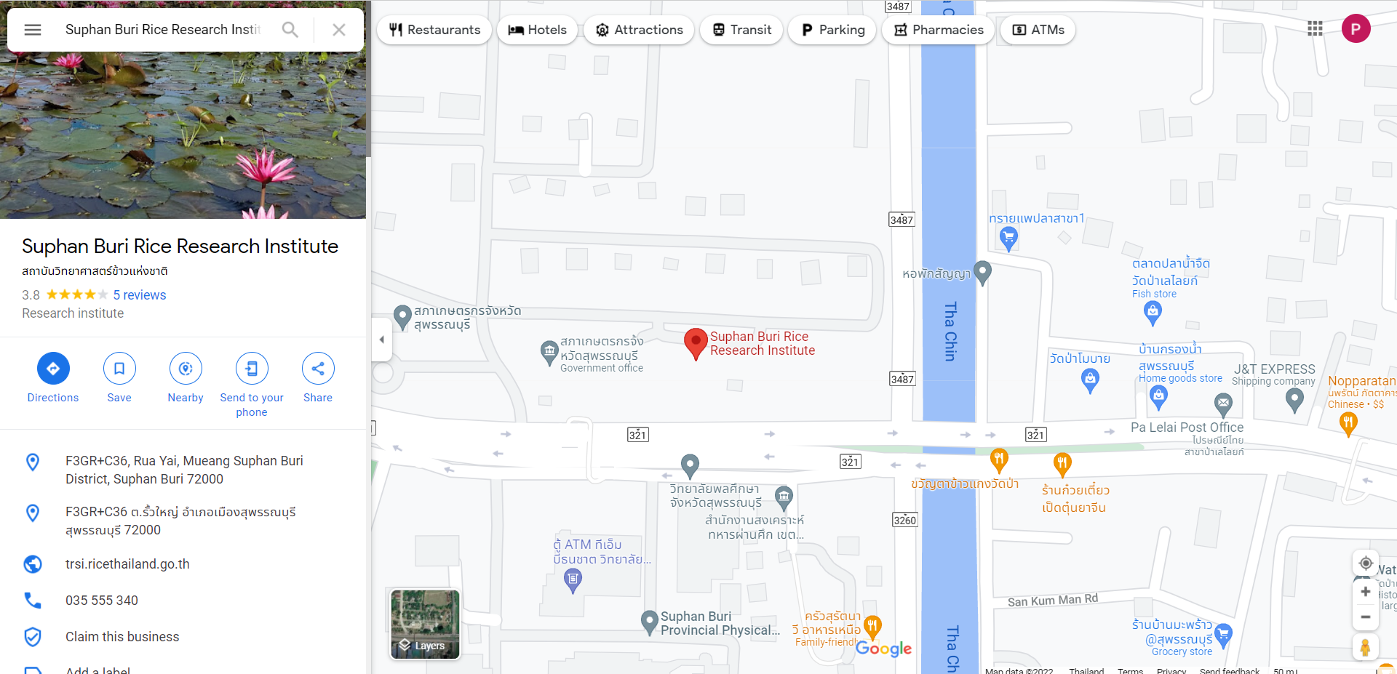

Slide 17
URL
AWD : https://docs.google.com/spreadsheets/d/1_bsC2smL3dhC5GsTlJMKHftN0cZHQSVHnGH1DBfkQRI/edit#gid=2003208410
FLOODED : https://docs.google.com/spreadsheets/d/1hsirFggd02iRq50E_vJxNl9UyJpLYVWdyhtCb9z3Was/edit#gid=2089177584
Saturat : https://docs.google.com/spreadsheets/d/1O2mlME4rW6s5klb92ZgSnn2k6UVYdthzZJnfF3MkwdM/edit#gid=1601617006
Class A Pan : https://docs.google.com/spreadsheets/d/1gLAXQ4iRo55USK4pvjuv_jwbWbZWHl2O09G7VFbZj8E/edit#gid=175771411
Rainfall : https://docs.google.com/spreadsheets/d/17BVp42uRo8MoJrmfVndtMXueouFG-HWqhKM14Vap7N8/edit#gid=2018974332

