Slide 1
Adaptive TCP
Load Balancer
COMPUTER NETWORKS PROJECT, TEAM 5
SDN programmable data plane with OpenFlow 1.3 and low-level Python sockets
Thanas R PES1UG25AM427
T N Pranav PES1UG25AM421
PES UNIVERSITY
Sushveen Kaur PES1UG25AM416
Department of Computer Science and Engineering (AI&ML)

Slide 2
A load balancer that reads the network
OVERVIEW
1
2
3
The problem
The approach
The outcome
Round-robin ignores backend state, so slow or dead servers keep receiving the same share of traffic.
An OpenFlow 1.3 controller polls live telemetry from every backend and scores each one.
Each new flow goes to the best backend. Failed nodes are isolated and recovered nodes are re-warmed.
Built with Mininet, Open vSwitch, a Ryu controller and plain Python TCP sockets.
Adaptive TCP Load Balancer
2 / 9

Slide 3
What the SRS requires
SYSTEM FEATURES
REQ-1 TO REQ-5
REQ-6 TO REQ-10
Dynamic Layer 4 balancing
Telemetry and health probing
Every new TCP flow is intercepted at the switch and sent to the lowest-scoring backend through the VIP 10.0.0.100:8000.
Each backend answers a JSON poll on its own port every 5 seconds with active connections, latency and error rate.
REQ-11 TO REQ-15
REQ-16 TO REQ-19
Degradation and failure handling
Recovery and re-warming
Three failed polls mark a backend unhealthy and remove it. If every backend is down, new connections are rejected.
A recovered backend carries reduced traffic for a 5 second cooldown before it is fully healthy again.
Benchmarking (REQ-20 to REQ-24): light, medium and heavy load with 5, 20 and 50 clients, compared with static round-robin.
Adaptive TCP Load Balancer
3 / 9

Slide 4


Mininet SDN topology
ARCHITECTURE
Backend h2
VIRTUAL SERVICE
10.0.0.2:8000
10.0.0.100:8000
Client h1
Switch s1
Backend h3
One entry point and virtual MAC for every client. The backends stay hidden.
10.0.0.1
OpenFlow 1.3
10.0.0.3:8000
Datapath ID 0x1
SOCKET PROGRAMS
Backend h4
10.0.0.4:8000
A client worker, a multi-threaded server on port 8000 and a telemetry daemon on ports 9002 to 9004.
Ryu controller
TCP port 6653
Adaptive TCP Load Balancer
4 / 9

Slide 5
From first packet to wire speed
HOW A REQUEST FLOWS
1
ARP interception
The controller answers ARP for the VIP with the virtual MAC.
THE TWO RULES
2
TCP SYN table miss
Client to server
The first packet reaches the controller as a PacketIn.
Match client IP and port. Rewrite the destination IP and MAC to the chosen backend. Output to its port.
3
Adaptive assignment
The scoring engine picks the best backend server.
Server to client
4
Bidirectional Flow-Mod
Match backend IP and port. Rewrite the source IP and MAC to the VIP and virtual MAC. Output to port 1.
Two rules are installed, one for each direction.
5
Wire speed forwarding
Later packets in the stream bypass the controller.
Adaptive TCP Load Balancer
5 / 9

Slide 6
Scoring and backend health
ADAPTIVE SCORING
0.50
0.35
0.15
Active connections
Smoothed latency
Error rate
Each metric is min-max normalized. Latency uses an EMA (0.25 × new + 0.75 × old) so spikes do not cause route thrashing. The healthy backend with the lowest score gets the next flow.
Healthy
Degraded
Unhealthy
Recovering
Fully eligible for new flows.
Error rate 0.25 or more, or latency 500 ms or more. Score is penalized.
Three telemetry failures in a row. Excluded from new flows.
First success after failure. Penalized for 5 seconds before returning.
Adaptive TCP Load Balancer
6 / 9

Slide 7
Running the live demo
MININET DEMO
1. Terminal 1: start the controller
python3 -m controller.ryu_controller
WHAT TO SHOW
Start the controller first so the switch connects on startup.
2. Terminal 2: start the topology as root
sudo python3 -m topology.mininet_topo
While h1 sends requests, show the controller installing and changing flow rules live.
3. Mininet CLI: send traffic from h1
No Mininet? Run python -m scenarios.run_all_scenarios for all six scenarios on the standalone testbed.
mininet> h1 python3 -m client.load_generator --vip 10.0.0.100 --port 8000 --requests 100 --concurrency 10
Needs Ubuntu 20.04 or later, Mininet 2.3+, Open vSwitch 2.13+, Ryu 4.34+ and Python 3.8+.
Adaptive TCP Load Balancer
7 / 9

Slide 8
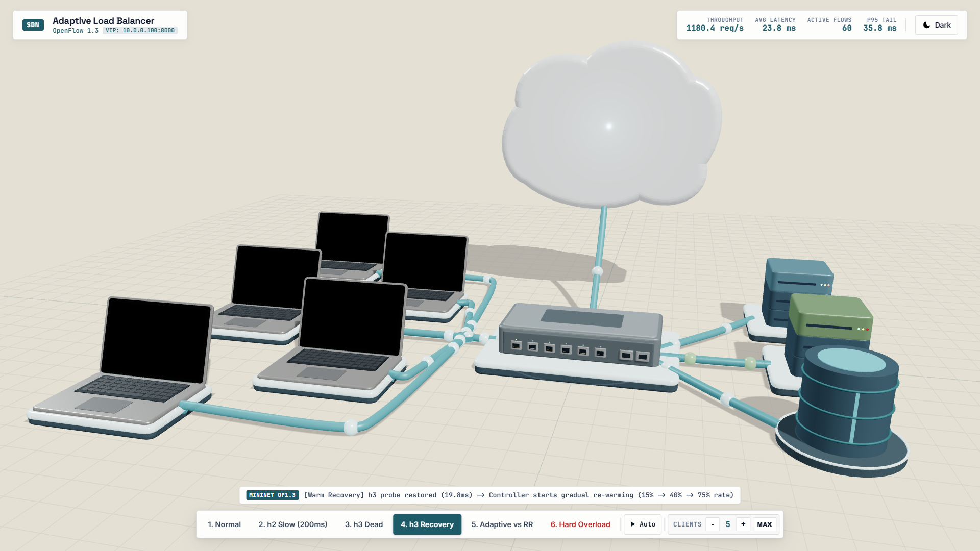
The network, in motion
3D ANIMATION DEMO
Open it
Open visualization/animation.html in any browser. It is built with Three.js.
What you see
Client laptops, an Open vSwitch, backend servers and a floating controller cloud.
Scenario buttons
Normal, h2 slow, h3 dead, h3 recovery, adaptive versus round-robin and hard overload.
Live view
Packets reroute as backend health changes. A bar tracks throughput, latency and flows.
Adaptive TCP Load Balancer
8 / 9

Slide 9
Adaptive versus round-robin
RESULTS
NORMAL LOAD
H2 SLOWED TO 200 MS
TRAFFIC TO SLOW H2
H3 KILLED MID-RUN
+10.5%
−63.2%
8.5%
0%
Throughput rises from 285 to 315 req/s
Average latency falls from 84.8 ms to 31.2 ms
Round-robin still sends it 33.3%
Dropped connections. Round-robin fails 33%
Measured in Mininet with 10 concurrent clients. Six scenarios cover normal load, slowdown, crash, recovery, a benchmark and a hard overload plus kill.
Adaptive TCP Load Balancer
9 / 9

