Slide 1
Class models
Software Requirements and Design
CITS4401
Week 5 Lectures 9 and 10
Notes:
Revised Feb 2020 RCO
Earlier Versions: RCO, DH, GMH

Slide 2
Key Topics this week
UML Class diagrams (what they are for and how to read them)
Discovering objects (noun discovery method)
Discovering associations (Class, Responsibilities, Collaboration (CRC) method)

Slide 3
1. UML Class diagrams
In this section we will learn how to READ and understand a UML class diagram

Slide 4
UML class diagram for an online shop (Example 1)
Order
*
1
Customer
1
*
CorporateCustomer
PersonalCustomer
OrderLine
*
*
0..1
1
Employee
Product

Slide 5
UML Class diagram interpretation
1 customer has 0 or more orders, but each order has a single customer
An order comprises one or more order lines
Many order lines refer to a product
Corporate customer and personal customer are special types of customer
A corporate customer is supported by 0 or 1 sales reps who are order company employees – that is they may have a sales rep or may not

Slide 6
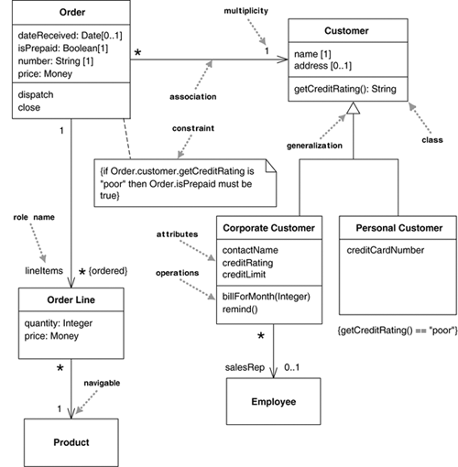
Example 1 with more detail
Source: Fowler, UML Distilled, Figure 3.1 https://learning.oreilly.com/library/view/uml-distilled-a/0321193687
Notes:
“Figure 3.1 shows a simple class model that would not surprise anyone who has worked with order processing. The boxes in the diagram are classes, which are divided into three compartments: the name of the class (in bold), its attributes, and its operations. Figure 3.1 also shows two kinds of relationships between classes: associations and generalizations.” [Fowler]
Note these components: classes, associations, attributes, generalization, and constraints

Slide 7
Example 2
Class
Multiplicity
Association
SimpleWatch
1
1
1
1
2
1
2
1
PushButton
state
push() release()
LCDDisplay
Battery
load()
Time
now()
blinkIdx
blinkSeconds()
blinkMinutes()
blinkHours()
stopBlinking()
referesh()
Attributes
Operations
Class diagrams represent the structure of the system
Notes:
An example class diagram.
SimpleWatch has 2 PushButton, 1 LCDDisplay, 2 Batteries, and 1 Time.
Talk about the attributes (from the association with the other 4 classes) under the class SimpleWatch
Depending what needs to be emphasized in the class diagram, attributes can sometimes be omitted, e.g. Battery and Time (they might have attributes but not being shown)
Sometimes the return types of the methods (operations) are shown also.

Slide 8
classes
classes, associations, attributes, generalization, and constraints

Slide 9
Class Diagrams
TariffSchedule
Trip
Enumeration getZones()
Price getPrice(Zone)
is_calculated_from
zone:Zone
price:Price
Class diagrams represent the structure of the system.
Class diagrams are used
during requirements analysis to model problem domain concepts
during system design to model subsystems and interfaces
during object design to model classes.
Notes:
Associations can have names to help identify their roles, e.g. is_calculated_from
Many problem domain concepts are captured by the nouns and noun phrases in the requirement specification. These nouns and noun phrases are identified as classes in class diagrams.
The goal of
System design is to define the design goal of the project and decompose the system into smaller subsystems so that they can be realized by individual project teams
Object design is to define solution domain objects to bridge the gap between the analysis model and the hardware/software platform that is defined in the system design stage, e.g. the activities include describing the object and subsystem interfaces, what are off-the-shelf components that are needed for the project, consideration about performance issues, extensibility of the system.

Slide 10
Classes
TariffSchedule
Table zone2price
Enumeration getZones()
Price getPrice(Zone)
Name
TariffSchedule
Signature
zone2price
getZones()
getPrice()
Attributes
Operations
TariffSchedule
A class represent a concept.
A class encapsulates state (attributes) and behavior (operations).
Each attribute has a type.
Each operation has a signature.
The class name is the only mandatory information.

Slide 11
associations
classes, associations, attributes, generalization, and constraints

Slide 12
Associations
TariffSchedule
TripLeg
Enumeration getZones()
Price getPrice(Zone)
1..*
1..*
price zone
Associations denote relationships between classes
A is associated with B is: A has to know about B
The multiplicity of an association end denotes how many objects the source object can legitimately reference.
Notes:
The association between two classes can be derived from the collaboration of the two classes in the CRC cards
Responsibilities in the CRC card of a class become the methods of that class
Talk about 1..* versus 0..*

Slide 13
1-to-1 and 1-to-Many Associations
Has-capital
Country
1
1
City
name:String
name:String
1-to-1 association
Polygon
1
1..*
Point
x:Integer
y:Integer
draw()
1-to-many association
Notes:
A couple more examples on the multiplicity.
Example 1:
the position of the two classes: Country is to the left of City (so the association Has-capital is meaningful)
Multiplicity 1 to 1. Can a City be the capital of several Country
Example 2:
Can a polygon contain 1 point only? If a polygon must have a non-zero area, then we want 3..* labelled on the association
Can a point belong to more than 1 polygon?

Slide 14
Multiplicity (cont)
The multiplicity of a property is an indication of how many objects may fill the property.
The most common multiplicities you will see are
1 (An order must have exactly one customer.)
0..1 (A corporate customer may or may not have a single sales rep.)
* (A customer need not place an Order; there is no upper limit to the number of Orders. That is, zero or more orders.)
If I have a multivalued property, I prefer to use a plural form for its name.

Slide 15
Multiplicity (cont)
In attributes, you come across various terms that refer to the multiplicity.
Optional implies a lower bound of 0.
Mandatory implies a lower bound of 1 or possibly more.
Single-valued implies an upper bound of 1.
Multivalued implies an upper bound of more than 1: usually *.

Slide 16
Practice example: Multiplicities
Source: Fowler, UML Distilled, Figure 3.1 https://learning.oreilly.com/library/view/uml-distilled-a/0321193687
Notes:
Explain each of the multiplicities shown in this diagram in English
Eg. Many orderliness refer to a product
1 customer has 0 or more orders, but each order has a single customer
A corporate customer has 0 or 1 salesRep Employees – that is they may have a salesRep or may not.

Slide 17
attributes
classes, associations, attributes, generalization, and constraints

Slide 18
Attributes
Properties represent structural features of a class. As a first approximation, you can think of properties as corresponding to fields in a class
The attribute notation describes a property as a line of text within the class box itself.
Properties are a single concept, but they appear in two quite distinct notations: attributes and associations.
Although they look quite different on a diagram, they are really the same thing.

Slide 19
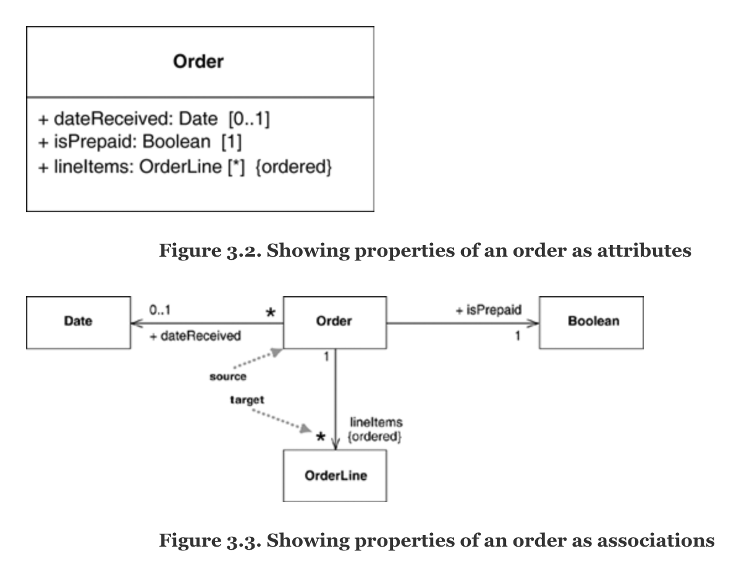
Attributes or Associations
Source: Fowler, UML Distilled https://learning.oreilly.com/library/view/uml-distilled-a/0321193687

Slide 20
Which to use? [Fowler]
With two notations for the same thing, the obvious question is,
Why should you use one or the other?
In general, I tend to use
attributes for small things,
such as dates or Booleans—in general, value types (page 73)—and
associations for more significant classes, such as customers and orders.
I also tend to prefer to use class boxes for classes that are significant for the diagram, which leads to using associations, and attributes for things less important for that diagram.
The choice is much more about emphasis than about any underlying meaning.

Slide 21
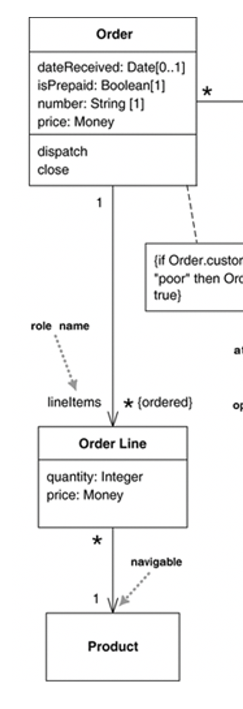
Programming Interpretation
As with anything else in the UML, there’s no one way to interpret properties in code.
The most common software representation is that of a field or property of your programming language.
So the Order Line class from Figure 3.1 would correspond to something like the following in Java:
public class OrderLine...
private int quantity;
private Money price;
private Order order;
private Product product
If an attribute is multivalued, this implies that the data concerned is a collection (ArrayList etc in Java)

Slide 22
generalization
classes, associations, attributes, generalization, and constraints

Slide 23
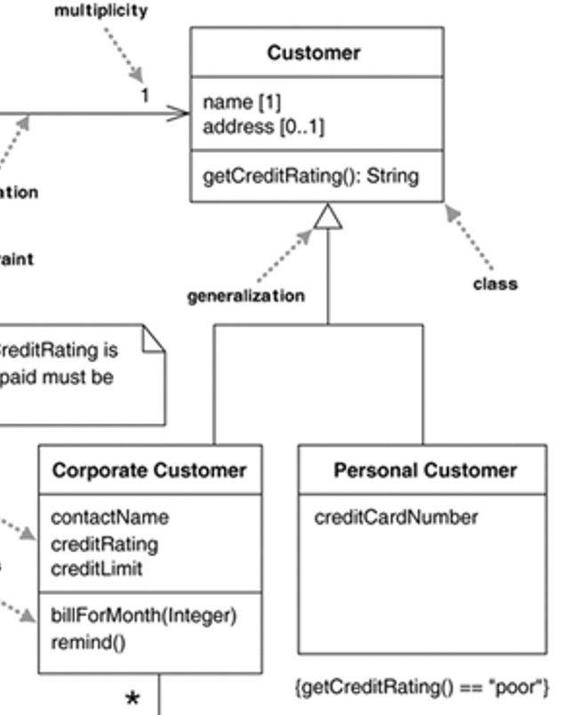
What is generalization?
A typical example of generalization involves the personal and corporate customers of a business.
They have differences but also many similarities.
The similarities can be placed in a general Customer class (the supertype),
Personal Customer and Corporate Customer are subtypes.

Slide 24
Generalization
Button
CancelButton
ZoneButton
Generalization relationships denote inheritance between classes.
The children classes inherit the attributes and operations of the parent class.
Generalization simplifies the model by eliminating redundancy.
Notes:
Talk about the Is a relationship.
The is-a relationship is always 1-to-1. So no need to label multiplicity.

Slide 25
constraints
classes, associations, attributes, generalization, and constraints

Slide 26
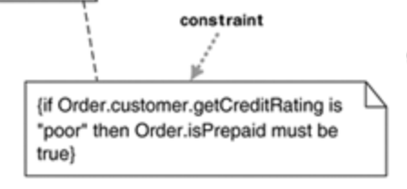
Constraints
UML class diagrams indicate constraints via association, attributes and generalizations
But other types of constraints may also need to be capture
UML allows you to use anything to describe constraints
The only rule is you put them inside curly braces {}
Natural or formal language can be used to describe the constraint

Slide 27
2. Discovering objects and associations
Now we know how to READ UML class models, we’ll look at how to discover classes and associations from problem descriptions. Then you’ll be able to WRITE UML class models.

Slide 28
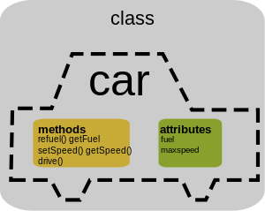
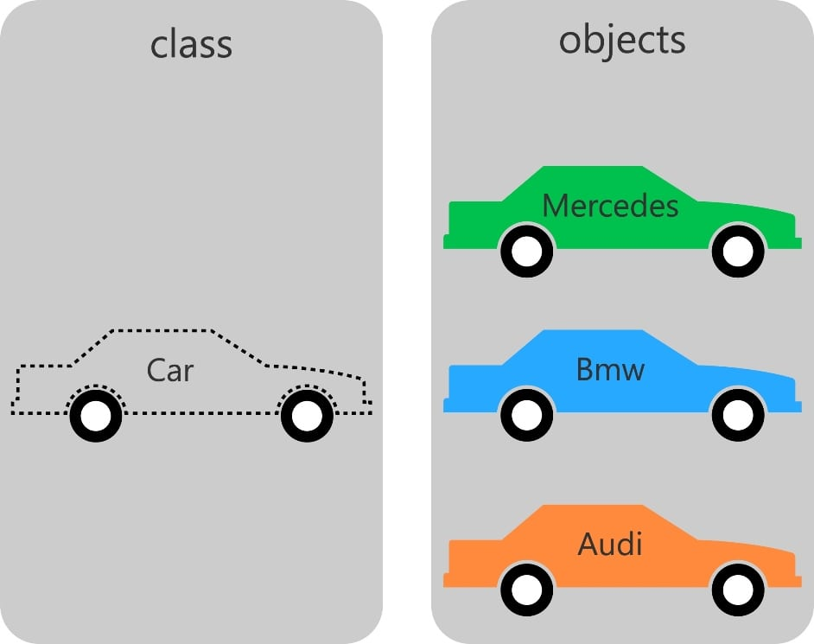
OOP concept

Slide 29
Actors, Objects and Classes
What is the difference between an actor and a class and an object?
Actor:
An entity outside the system to be modeled, interacting with the system (“Driver”)
Class:
An abstraction modeling of an entity in the problem domain, inside the system to be modeled (“Car”)
Object:
A specific instance of a class (“my white Toyota Corolla hybrid”).

Slide 30
Examples of Class Components
Name: employee
Attributes: name, address, dateofbirth, employeenum, department, manager, salary, status, taxcode
Operations: join, leave, retire, changedetails
Notes:
Operations – verbs or verb phrases
Attributes and names – nouns or noun phrases

Slide 31
Video References
Barnes and Kolling, Objects First with Java
Chapter 1: VN 1.1 Introduction to key concepts (in object oriented design)
https://www.youtube.com/watch?v=CPUaTT0Xoo4&t=7s
Chapter 13: VN 13.1 Using the noun-verb method for application design
https://www.youtube.com/watch?v=sbQqb_XXOK8

Slide 32
Noun-Verb Method
In a problem description …
NOUNS may represent
Objects and Attributes
VERBS may represent
operations or services
The noun-verb method throws up noise
So it needs to be used alongside other methods
Notes:
Natural language analysis has the advantage of focusing on the users’ terms. However, it suffers from several limitations:
The quality of the object model depends highly on the style of writing of the analyst
Natural language is an imprecise tool. Many nouns correspond to attributes or synonyms for other nouns

Slide 33
Heuristics
Heuristics for Mapping parts of speech to model components Source Abbot 1983 quoted in Bruegge and Dutoit Object-Oriented SW Eng
Part of Speech | Model component | Examples
Proper noun | Instance | Alice
Common noun | Class | Field officer
Doing verb | Operation | Creates, submits, selects
Being verb | Inheritance | Is a kind of
Having verb | Aggregation | Has, includes
Modal verb | Constraints | Must be
Adjective | Attribute | Incident description

Slide 34
Case Study: Cinema booking system
The cinema booking system should store seat bookings for multiple theatres. Each theatre has seats arranged in rows.
Customers can reserve seats and are given a row number and a seat number. They may request bookings of several adjoining seats.
Each booking is for a particular show (that is a screening of a given movie at a certain time).
Shows are at an assigned date and time and are scheduled for a theatre where they are screened.
The system stores the customer’s telephone number.
Reference Barnes and Kolling Objects First Chapter 15
Video Notes: VN 13.1 Using the noun-verb method for application design

Slide 35
Cinema Booking System Nouns = potential classes
Customer
Booking
Movie
Theatre
Show
Seat
row
seatnumber
Date
Time

Slide 36
Cinema Booking System
Customer
Verbs = potential associations
stores (seat booking)
has (seats)
reserves (seats)
Is given (row and seat number)
Requests (seat booking)
is scheduled (in theatre)
Booking
Movie
Theatre
Show
Seat
row
seatnumber
Date
Time

Slide 37
Class-Responsibility-Collaborator Model
the class name of an object
creates a vocabulary for discussing a design
responsibilities of an object
identify problems to be solved
a handful of short verb phrases, each containing an active verb
collaborators of an object are
other objects which will send or be sent messages in the context of satisfying responsibilities
CRC cards are a brainstorming tool for OO design
Recommended for Extreme Programming XP methodology
Notes:
Participating objects form the basis of the analysis model. A class name is the name of the abstraction of a set of objects with the same attribute, operations, relationships and semantics. You use a singular noun for each class name because each class represents a generalized version of a singular object.
The verb phrases associated with an object often, after refinement, become the set of methods or services supplied by the object. These are the responsibility of the object or the problems that the object need to solve.
A responsibility is anything that a class knows or does. For example, students have names, addresses, and phone numbers. These are the things a student knows. Students also enroll in seminars, drop seminars, and request transcripts. These are the things a student does
Sometimes a class has a responsibility to fulfill, but not have enough information to do it. For example, students enroll in seminars. To do this, a student needs to know if a spot is available in the seminar and, if so, he then needs to be added to the seminar. However, students only have information about themselves (their names and so forth), and not about seminars. What the student needs to do is collaborate/interact with the card labeled Seminar to sign up for a seminar. Therefore, Seminar is included in the list of collaborators of Student.
Collaborators of an object are those other objects which will send messages or receive messages in the context of satisfying responsibilities

Slide 38
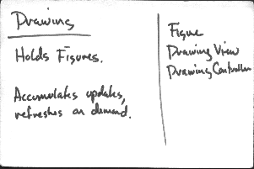
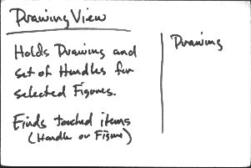
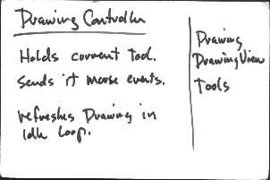
CRC Example
class name
collaborators
responsibilities
Notes:
An example here.
Drawing has 3 collaborator classes: Figure, Drawing View, and Drawing Controller. Two of its collaborators are shown in the diagram.
Drawing View has 1 collaborator.
Drawing Controller has 3 collaborator classes: Drawing, Drawing View, and Tools.
Note that collaborations are not symmetric. Thus, in the example here, we see that Drawing View is a collaborator of Drawing Controller; however, Drawing Controller is not a collaborator of Drawing View. The reason for this is, as described before, a responsibility of an object is what the object knows or does. In this example, Drawing Controller needs to collaborate with Drawing View to fulfill its responsibility; the class Drawing View, on the other hand, has a lower level of responsibility and does not need to collaborate with Drawing Controller.

Slide 39
Cinema Booking Scenario CRC
Alice selects the movie Star Wars at the Apollo Theatre
She requests the 8pm showing on 24 March 2020
The booking system sends the request to Apollo
Alice is allocated seat R18
Theatre
Receives booking request | Customer, Show
Allocates tickets | Customer, Show
Customer
Selects theatre, movie and show date and time | Show
Receives tickets | Theatre

Slide 40
Cinema Booking System UML class diagram (version 0)
Customer
1
*
Booking
PhoneNum
1
1
1
1
Seat
row
seatnumber
Movie
DateTime
Theatre
1
1..*
This is a model in progress Ideas and changes welcome
BookingSystem
(could store a collection of shows to book)
Notes:
One customer makes 0 or more bookings
A customer has a phone number
A booking comprises 1 seat, one movie and one date,time (haven’t decided linked bookings yet)
A movie theatre has many seats (not sure whether booking links through theatre or seat)

Slide 41
Summary
UML Class diagrams (what they are for and how to read them)
Discovering objects (noun discovery method)
Discovering associations (Class, Responsibilities, Collaboration (CRC) method)

Slide 42
Requirements Analysis Framework
Requirements analysis results in an analysis model of 3 parts
functional model: use cases & scenarios
static analysis object model: class & object diagrams
dynamic model: statechart & sequence diagrams (later in the unit)
This week we will look at static class models
Aim to investigate the problem domain as far as possible before moving to the solution domain (for design & implementation)

Slide 43
UML class diagrams
UML Class Diagrams describe the static structure of the system
classes,
class attributes,
associations between classes,
association roles and multiplicity
classes: features and facts about the problem domain which matter in the system we are building to support it
Reference: UML Distilled by Martin Fowler, Chapter 3
Notes:
Class diagrams describe the static structure of the system, ie. The spatial connectivity of objects.
Class diagrams do not describe the dynamic behaviour of the system.
Class diagrams describe the structure of the system in terms of classes and objects
Recall that a class is a collection of objects that share a set of attributes.
In a class diagram, you will find, of course, classes and their attributes. Not only so, between classes, there are associations that describe how the classes are related. The associations have roles (this is just a short phrase that describes what the association is). Often you will find multiplicity of the association.

Slide 44
Our focus
Class diagrams are the backbone of the UML, so you will find yourself using them all the time.
But the trouble with class diagrams is that they are so rich, they can be overwhelming to use.
In CITS4401 we will study these elements:
classes, associations, attributes,
generalization, and constraints
For more detail: see UML Distilled by Martin Fowler, Chapter 3 & 5
And some info on the hidden slides – not examinable but for interest

Slide 45
Why build class models?
Why do we build class models? In order to …
Build, as quickly and cheaply as possible, a system which satisfies our current requirements;
Build a system which will be easy to maintain and adapt to future requirements

Slide 46
What properties support those objectives?
Every piece of behavior which is required of the system must be able to be provided in a sensible way, by objects of the classes we choose in the model
A good class model consists (as far as possible) of classes which represent enduring classes of domain objects, which don’t depend on the particular functionality required today.

Slide 47
When to Use Class Diagrams [Martin Fowler]
Class diagrams are the backbone of the UML, so you will find yourself using them all the time.
The trouble with class diagrams is that they are so rich, they can be overwhelming to use. Here are a few tips.
Don’t try to use all the notations available to you. Start with the simple stuff: classes, associations, attributes, generalization, and constraints. Introduce other notations only when you need them.
I’ve found conceptual class diagrams very useful in exploring the language of a business. For this to work, you have to work hard on keeping software out of the discussion and keeping the notation very simple.

Slide 48
When to use (2)
Don’t draw models for everything; instead, concentrate on the key areas. It is better to have a few diagrams that you use and keep up to date than to have many forgotten, obsolete models.
The biggest danger with class diagrams is that you can focus exclusively on structure and ignore behavior. Therefore, when drawing class diagrams to understand software, always do them in conjunction with some form of behavioral technique. If you’re going well, you’ll find yourself swapping between the techniques frequently.

Slide 49
B&D Heuristics for Identifying Objects
For each scenario or use case, try to identify objects
Entity Objects: persistent data
Boundary Objects: interaction between actors and system
Control Objects: tasks performed by users and supported by the system
Notes:
Earlier on, we saw that we could use the Grammatical Analysis Method to identify objects. We need to identify objects for each scenario or use case. There are 3 types of objects that need to be identified:
Entity objects. These objects are persistent data in the system. They can be identified quite easily in most systems. For instance, in a student enrolment system, where students can select units to enrol in, typical entity objects are Student, Unit, Enrolment.
Boundary objects represent the system interface with the actors. In each use case, each actor interacts with at least one boundary object.
Control objects are responsible for coordinating boundary and entity objects. Control objects usually do not have a concrete counterpart in the real world. Control objects describes the tasks performed by the users and supported by the system

Slide 50
Heuristics to Identify ENTITY objects
terms that developers or users need to clarify in order to understand the use case e.g. ReportEmergency
recurring nouns in the use cases e.g. Incident
real-world entities the system needs to track e.g. FieldOfficer, Dispatcher, Resources
real-world activities the system needs to track e.g. EmergencyOperationPlan
data sources or sinks e.g. Database, Printer
always use the user’s terms for entity objects
Notes:
Refer to the FRIEND use case diagram where there are 2 actors (FieldOfficer and Dispatcher) and 3 use cases (ReportEmergency, openIncident, and AllocateResources). Consider the use case ReportEmergency
Bullet pt 1: in the use case, the “information submitted by the FieldOfficer” is referred to as the report emergency. After review with the client, it is decided to name the corresponding object ReportEmergency
Bullet pt 2: the noun Incident would appear again and again in the use case ReportEmergency, Incident should then be an entity object.
Bullet pt 3: real-world entities the system needs to track include, e.g., FieldOfficer, Dispatcher, Resource
Bullet pt 4: Real-world activities the system needs to track include, e.g., EmergencyOperationsPlan
Bullet pt 5: Data sources or sinks, e.g., Printer
Bullet pt 6: To avoid misunderstanding, always use the names used by the end user and application domain for entity objects. Do not substitute them by any synonyms.

Slide 51
Heuristics to Identify BOUNDARY objects
Forms and windows needed to enter data into the system e.g. EmergencyReportForm
Notices and messages that the system uses to respond to the user e.g. AcknowledgementNotice
Do not model visual aspects of the interface with boundary objects (use screen mock-ups instead)
Always use the user’s terms, and not implementation technology terms
Notes:
Again, refer to the ReportEmergency use case:
Bullet pt 1: e.g., EmergencyReportForm
Bullet pt 2: e.g., AcknowledgmentNotice
Bullet pt 3: as is
Bullet pt 4: again, this is to avoid misunderstanding

Slide 52
Heuristics to Identify CONTROL objects
Control Objects hold state information for a period of time
Try one control object per use case (or subflow)
OR Identify one control object per actor in the use case e.g.
ReportEmergencyControl (FieldOfficer)
ManageEmergencyControl (Dispatcher)
Life span of a control object is the extent of the use case or of a user session –the use case must have clear entry and exit conditions
Notes:
Consider the ReportEmergency use case again, recall that there are 2 actors, the FieldOfficer and Dispatcher, we can model the control flow of the use case with a control object for each actor: ReportEmergencyControl for the FieldOfficer and ManageEmergencyControl for the Dispatcher. For instance, the ReportEmergencyControl object manages the ReportEmergency reporting function. The object is created when the FieldOfficer select the “Report Emergency” button. It then creates an EmergencyReportForm and presents it to the FieldOfficer. After the FieldOfficer submits the completed form, the object collects the information from the form and creates an EmergencyReport, and so on.
So, Control objects hold the state information for a period of time. They are responsible for the flow of information in a use case. One can therefore analyse each use case and the associated actors to identify the necessary control objects.
As control objects are responsible for the flow of information in a use case, their life span is the extent of the use case. The use case must have clear entry and exit conditions, i.e., conditions that are true when the use case begins and conditions that are satisfied when the use case ends.

Slide 53
Drawing Options
There are many free and paid software tools for drawing UML diagrams
See https://www.guru99.com/best-uml-tools.html for a list
I tried out StarUML, UML designer and Lucidchart.
But I found all of them were hard to use and had too much detail for our purposes.
ArgoUML was popular in the past but is not supported in modern Java
Option: you can use any editor with text boxes and arrows – as I have done with powerpoint in the notes
Option: you can draw class diagrams by hand
If you find an easy to use and free tool, or good ppt template do let me know!

Slide 54
Recommended reading
UML Distilled by Martin Fowler, Chapter 3
UWA Unit Readings or
https://my.safaribooksonline.com/book/software-engineering-and-development/uml/0321193687
Barnes and Kolling, Objects First with Java, Chapter 15
B. Bruegge and A. H. Dutoit, Object-Oriented Software Engineering – Using UML, Patterns, and Java, 3rd ed., Prentice Hall, 2010
Section 2.2
Section 2.4
Section 5.3

