Slide 1
Quantized Neural-Network Acceleration on RV64IMC
  Midterm report
114165502
潘公維謙

Slide 2
Overview
  Introduction
  Performance Comparison
  Architecture
  Memory Wall
  Custom ISA Extensions
  Non-GEMM Limits
  Verification
  Analytical Performance Model
  Conclusion
Notes:
Slide 1: Tiêu đề: Tên đề tài, Tên nhóm, Giảng viên hướng dẫn.
Slide 2: Tổng quan bài toán & Ranh giới Baseline: Giới thiệu cấu hình vi xử lý RV64IMC chạy bare-metal, nhấn mạnh việc 0 lệnh Floating-Point và phân bổ bộ nhớ tĩnh.
Slide 3: Khảo sát Khối lượng công việc (Workload Profiling): Minh chứng việc nhóm đã quét và phân tích thành công Toàn bộ 21 layers. Đưa ra biểu đồ tỷ lệ lệnh mix (Load/Store chiếm bao nhiêu %, ALU chiếm bao nhiêu %).
Slide 4: Định vị 3 Điểm nghẽn: Trình bày trực quan 3 rào cản tốc độ (Scalar Multiply, Load/Store overhead, Loop overhead) phát hiện được từ Spike.
Slide 5: Đề xuất giải pháp - Kiến trúc lệnh Xqmac8: Minh họa bằng hình vẽ khối dữ liệu 64-bit chứa 8 phần tử INT8 nhân chập song song.
Slide 6: Đề xuất giải pháp - Kiến trúc lệnh qreq: Sơ đồ khối chuỗi xử lý Fused Requantization. Nhấn mạnh việc tiết kiệm ~47 câu lệnh trên mỗi phần tử đầu ra.
Slide 7: Quy trình tích hợp & Kiểm thử (Verification): Nêu bật hai con số chứng minh độ tin cậy: 4,824 golden vectors và đạt độ chính xác Bit-Exact với TFLite.
Slide 8: Kết quả thực nghiệm - Cải tiến cấp độ Layer: Bảng số liệu hoặc biểu đồ cột thể hiện mức giảm lệnh đồng đều từ 5.56x đến 5.81x trên toàn bộ các tầng mạng xử lý.
Slide 9: Kết quả thực nghiệm - Cấp độ Hệ thống: Công bố con số Tăng tốc 5.70x trên vi chuẩn bench_dot.c và tổng mức giảm tải luồng lệnh 10.01x.
Slide 10: Kế hoạch triển khai giai đoạn Cuối kỳ: Lộ trình viết mã RTL cho lõi CV-Wally và sử dụng công cụ kiểm thử phần cứng Synopsys.

Slide 3
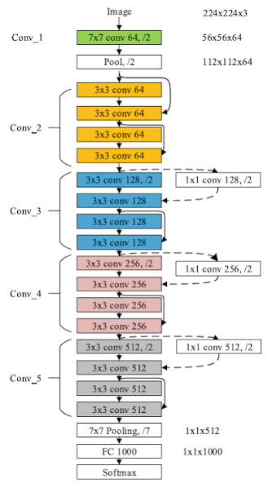
Introduction
Why ResNet-18?
Model: ResNet-18 consists of 18 layers with learnable parameters. It is composed of a series of convolutional layers, followed by batch normalization and activation functions, culminating in fully connected layers for classification.
Model | Approx. Parameters | Approx. Compute
DeiT-Tiny | 5.7 M | ~1.3 GMAC
MobileViT | 4.9 M | ~1.8 GMAC
EfficientFormer-L1 | ~6 M | ~1.3 GMAC
LeViT-128S | ~8 M | ~0.8 GMAC
MobileNetV3-Large | 5.4 M | ~0.22 GMAC
EfficientNet-Lite0 | 4.7 M | ~0.39 GMAC
ResNet-18 | 11.7 M | ~1.8 GMAC
Notes:
Technical Details:
Extreme Stress on Compute & Memory: 11.7M Parameters, 1,814 GMAC (Heaviest Model on Recommended List).
Hardware Features: The Skip-Connection (Residual) fork structure drains the cache bandwidth by having to store activations in parallel.

Slide 4
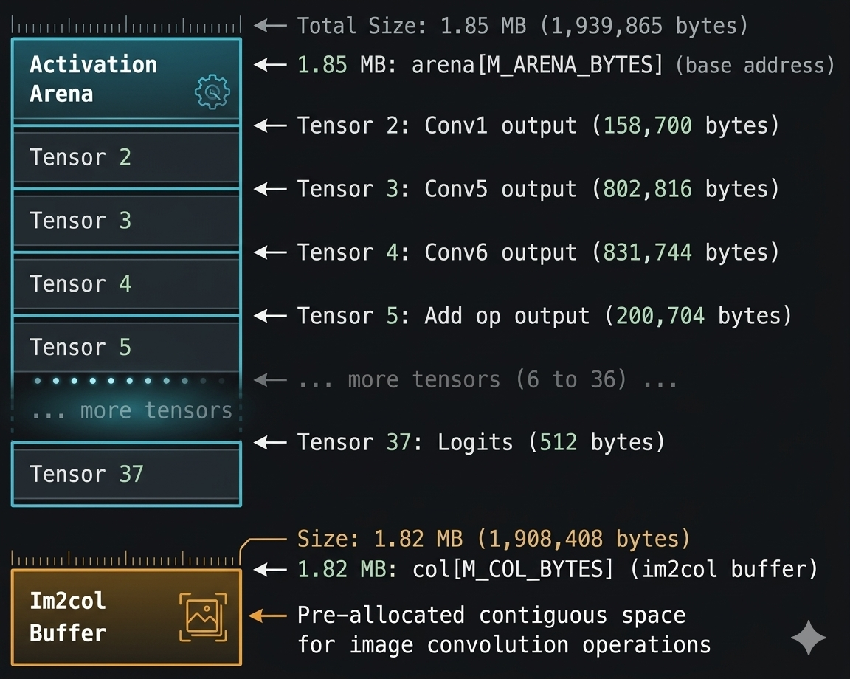
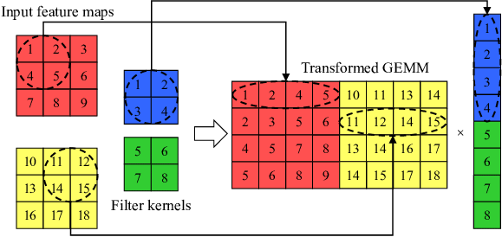

Architecture
Software Solution (B1 Configuration):
im2col GEMM Lowering: Converts all 20 layers of CONV_2D and 1 floor FC to a pure cube matrix kernel.
Zero-point Folding: Completely suppresses the zero-point addition in the loop by pooling it straight into the integer Bias value.
Extreme Memory Management: Uses 1.85 MB of Static Activation Arena planned offline (liveness analysis).
Imm2col gemm lowering

Slide 6
Custom ISA Extensions
Instruction | Encoding | Semantics
qmac8 rd,rs1,rs2 | custom-0 (0x0b), R, funct7=1 | rd = sext32(int32(rd) + sum_{i<8} int8(rs1[i]) * int8(rs2[i]))
qreq rd,rs1,rs2 | custom-0 (0x0b), R, funct7=2 | rd = clamp(RDivPOT(SRDHM(acc << max(s,0), mult), max(-s,0)) + zp, lo, hi);parameters packed in rs2 (mult 32, shift 8, zp 8, lo 8, hi 8 bits)
ldpi rd,imm(rs1) | custom-1 (0x2b), I | rd = mem64[rs1]; rs1 += imm after the load succeeded
qmac8 rd, rs1, rs2: Parallel cumulative multiplication of 8 INT8 number pairs on a 64-bit compression class.
qreq rd, rs1, rs2: Packing Requantization (Shift, Mult, Rounding, Clamp).
ldpi rd, imm(rs1): Load 64-bit data while automatically increasing the address pointer (Post-increment).
Notes:
Architectural decision: 32-bit Accumulator (TFLite match). Actual layer measurement shows that the peak value only touches 50% of the threshold \(2^{31}\), ensuring the safety of No Overflow.
Architectural Decision: Achieve Bit-exact accuracy with TFLite's gemmlowp semantics (2 roundings, ties away from zero).
Architectural Decision: Precise Trap/Exception Design (If load error, do not change the register state).
Design decisions. The accumulator is 32 bit, identical to the TFLite accumulator; its range was checked on the exported layers (largest dot product 2.9e6; the accumulator seeded with the folded bias peaks at 50% of 2^31 in conv1, so no overflow).
qreq is bit-exact with gemmlowp (two roundings, ties away from zero); an earlier single-rounding draft disagreed with TFLite on 0.11% of outputs and was replaced.
ldpi has precise exceptions (a trapping load changes neither register), reserves rd == rs1 as illegal and allows rd = x0.
Hardware costs the RTL milestone must quantify: a third read port (or accumulator register) for qmac8, a 32x32 multiplier with rounding for qreq, a second register-file write port for ldpi.

Slide 7
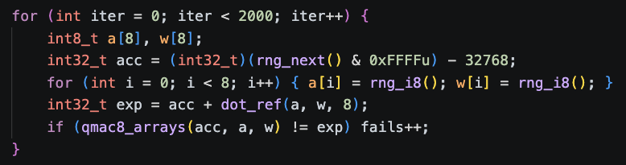
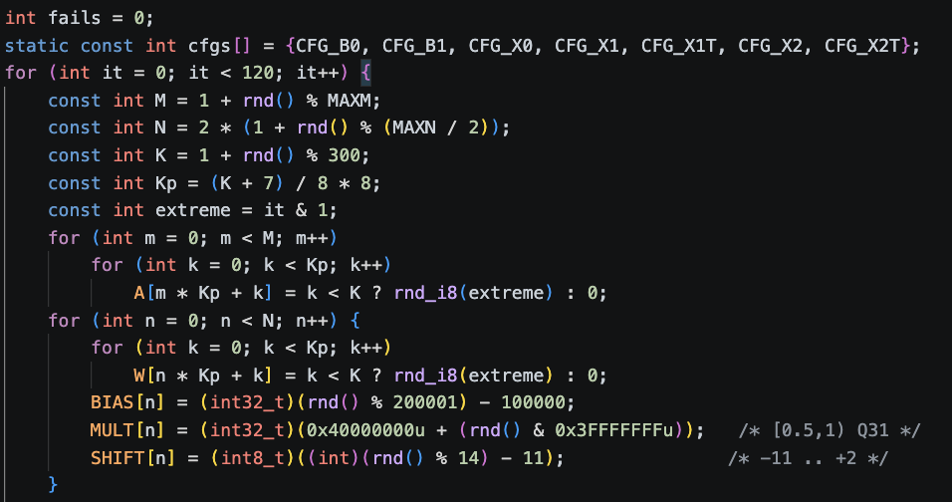
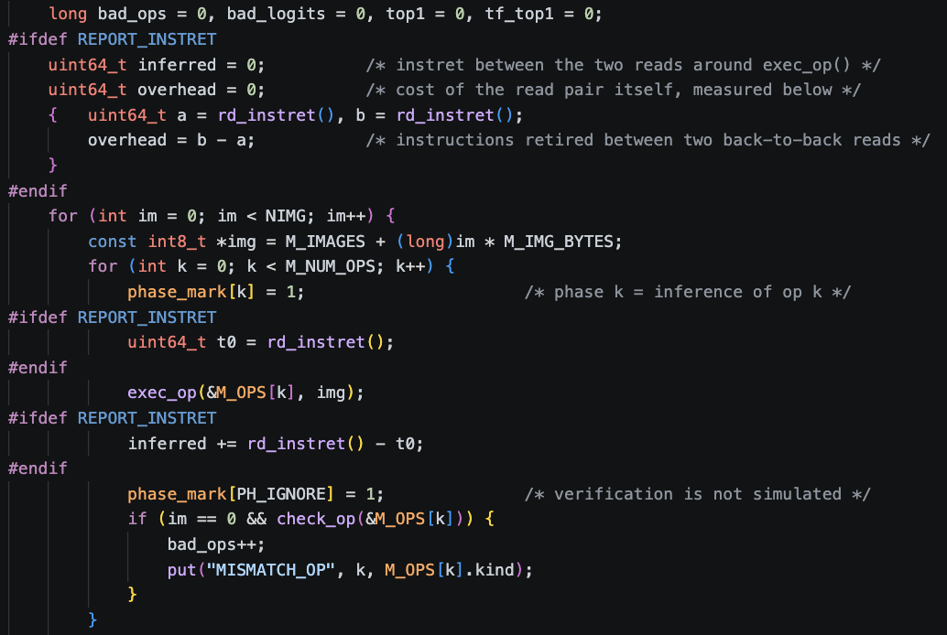
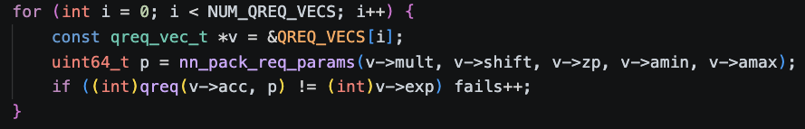
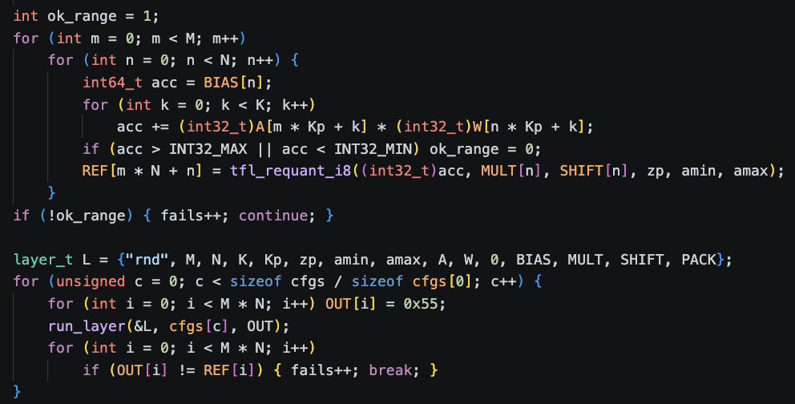
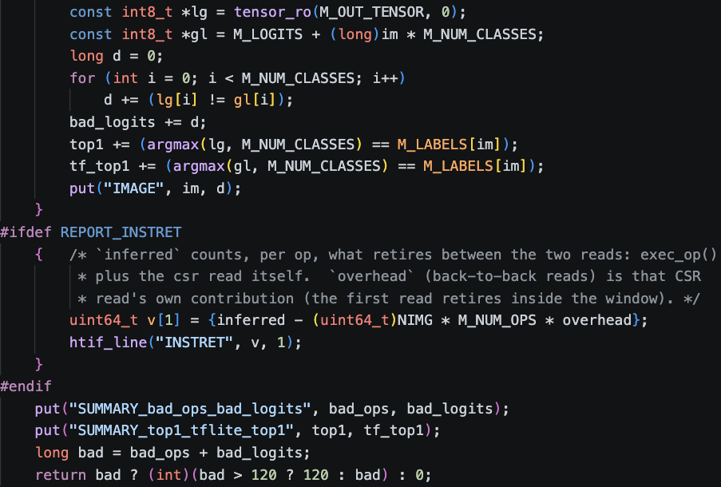
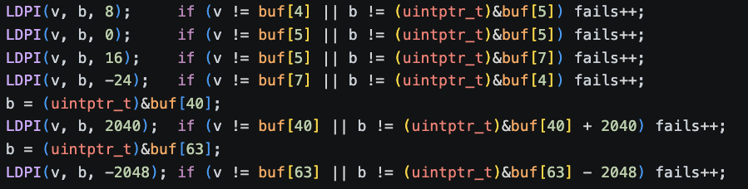
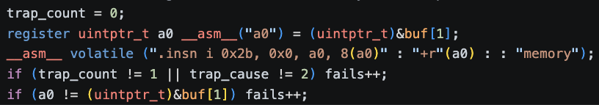
Verification
Tier 1
Tier 2
Tier 3
qmac 8
GEMM Randomize test
End-to-end model
qreq
ldpi
Notes:
Bottlenecks identified from the measurements (the brief asks for at least three).
(1) Scalar multiply and MAC loop: 14.0% multiplies and 2.0 loads per MAC in B0; removed by qmac8 (multiplies 0.2%).
2) Load/store pressure: 1.5 loads+stores per MAC in B1, 0.20 after qmac8. (3) Loop and address overhead: branches are 14.3% of B0; in X1 the 9-instruction inner loop
(3 ld, 3 addi, 2 qmac8, 1 bne) does MACs in only 2 of 9 instructions; ldpi removes the three pointer bumps (6 instructions per 16 MACs).
(4) Requantization: 48 instructions per output, small once K is large. (
5) Non-GEMM operators: 111 M instructions, constant across configurations: 9.5% of X1 and 13.5% of X2 (ADD 8.0%, im2col 2.8%, max-pool 2.4% of X2).
This is the Amdahl limit: B1 to X1 is 6.45x for the whole model against 7.02x for the GEMMs alone.
(6) The data cache, next section.

Slide 8
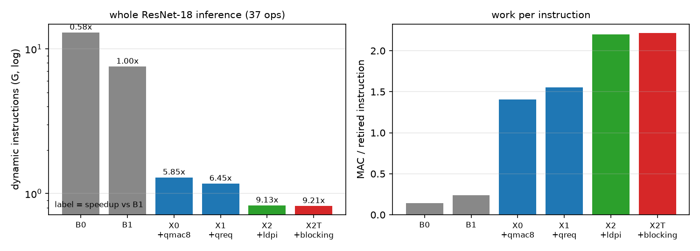
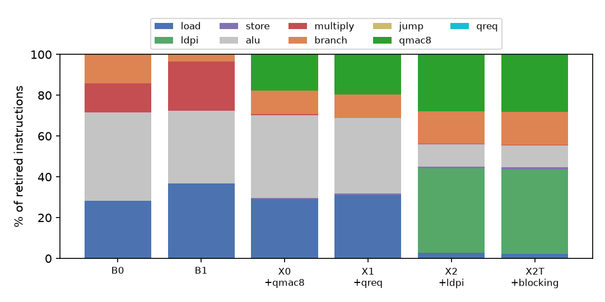
Performance Comparison
Config | Instructions (whole model) | MAC | vs B0 | vs B1 | step
B0 | 12.971 G | 0.140 | 1.00x | 0.58x
B1 | 7.540 G | 0.241 | 1.72x | 1.00x
X0 (+qmac8) | 1.289 G | 1.407 | 10.06x | 5.85x | 5.85x
X1 (+qreq) | 1.169 G | 1.552 | 11.09x | 6.45x | 1.10x
X2 (+ldpi) | 0.826 G | 2.197 | 15.71x | 9.13x | 1.42x
X2T (+blocking) | 0.819 G | 2.216 | 15.84x | 9.21x
Notes:
Target check. The brief asks for >= 2x fewer dynamic instructions on a GEMM kernel: met on every one of the 21 layers (B1 to X1: 6.44x to 7.10x; B1 to X2: 8.7x to 10.6x).
Microbenchmark: a 64-element dot product x 1000 drops from 462 001 to 81 001 instructions (5.70x, qmac8 + qreq).
Requantization: qreq removes 48 instructions per output element (47.7 to 49.0 in every layer): 49% of the K = 64 layer but 1.8% of the K = 4608 layers, so 1.10x for the whole model.
Per output element the GEMM code retires 5175 (B0), 2990 (B1), 474 (X0), 426 (X1) and 288 (X2) instructions.
Code size of the GEMM function: 370, 814, 608, 234 and 206 bytes (B0, B1, X0, X1, X2).

Slide 9
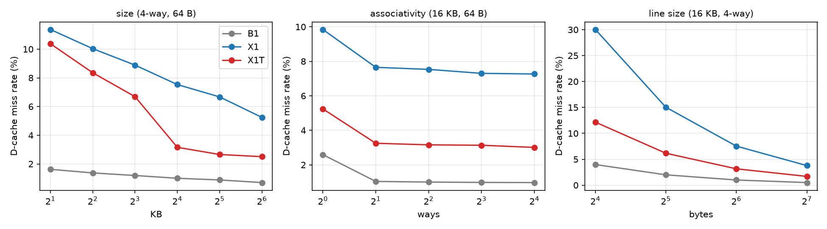
Memory wall
Emergence of New Bottlenecks (Workload Sensitivity):
In the software configuration (B1), the CPU is too slow, so the miss cache rate is very low (1.0%).
When speeding up the computation with a custom command (X1), the CPU consumes data too quickly, causing the cache miss rate to jump to 7.53% (Memory Wall).
Cause: Continuous scanning of large size weighted matrices (36 KB to 2.3 MB) breaks the storage mechanism of the default configuration.
Design Space Sweep Analysis:
Loop Blocking (Software): Clustering computational channels helps reduce the miss rate to 3.16%.
Cache Sweep: Survey of 31 parallel cache configurations on the Spike core (Size, Number of Associativity Links, Line size, and 4 alternative algorithms). Demonstrate that CV-Wally's default PLRU circuit works optimally (error less than 2% compared to True LRU).
D-cache miss rate versus size, associativity and line size.
16 KB, 4-way, 64 B, PLRU | B1 | X1 | X1T
miss rate | 1.00% | 7.53% | 3.16%
misses per 1000 instructions | 3.7 | 23.9 | 10.0
memory traffic | 1797 MB | 1810 MB | 768 MB
Notes:
An instruction-level tool cannot see memory stalls, so we added a Spike extension that feeds every data access of the chained inference to 31 set-associative write-back caches at once (LRU, tree-PLRU as in CV-Wally’s cacheLRU.sv, FIFO, random), with per-operator counters. It reproduces spike --dc exactly on four geometries and five hand-computed access patterns.
B1 hardly notices its cache, but after qmac8 the program touches the same bytes in 6.5x fewer instructions, so the miss rate rises 7.5x. The cause: each output row streams the whole weight matrix (36 KB to 2.3 MB), a cyclic scan that LRU-like policies turn into misses. Processing a block of rows per channel pair (X1T, bit-exact) cuts misses 2.4x; the three K = 4608 layers leave no room for a block and stay streaming (documented limitation).
Geometry. X1T has a sharp knee between 8 and 16 KB (6.7% to 3.2%) because the 8 KB block plus the weight pair then fits; X1 improves slowly with size. Direct-mapped to 2-way is the only large associativity step (a direct-mapped cache has +29% misses for X1 and +61% for X1T). The miss rate halves with each doubling of the line (streaming) while total traffic stays constant, so the best line size depends on bus width and latency (RTL). Replacement policy. The best-to-worst spread of four policies at one geometry is 9-14% for B1 and X1 but 15-44% for X1T: the policy matters most for the program tuned to fit the cache. PLRU stays within 2% of true LRU for B1 and X1 (+4% to -7% for X1T), and FIFO or random lose to PLRU in 34 of 36 cells, so CV-Wally’s cheap PLRU is adequate.

Slide 10
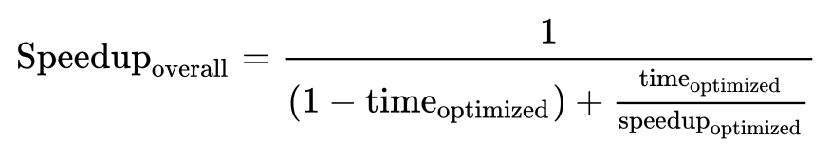
Non-GEMM Limits
Amdahl theory:
Due to the Amdahl limit of 16 non-GEMM operators (ADD, PAD, pooling, im2col overhead, etc.). These operators occupy a fixed 111 million orders that cannot be reduced.
As the GEMM calculation is faster, the proportion of non-GEMM orders increases from negligible to 13.5% of the total number of remaining orders in the X2 configuration.

Slide 11
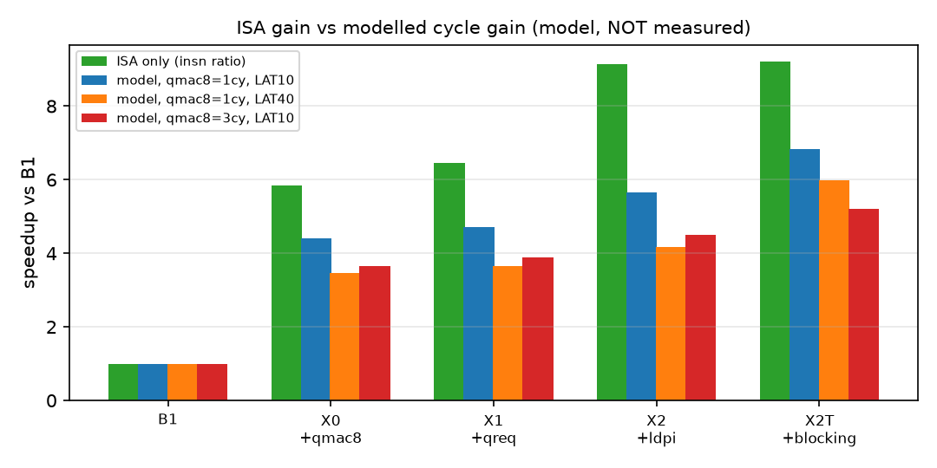
Analytical Perfomance Model
Separation of Instruction Sets (ISA) and Microarchitecture:
  Build a calculus model assuming clock cycles (In-order, 1 cycle/ALU, +2 cycles for 90% branch bubble, +1 cycle for load-use stall, memory latency configuration LAT=10 and LAT=40).
  The model retains 62% – 85% of the script's theoretical acceleration.
  The shorter the loop (X2), the greater the latency weight of the branch bubble and the cache lag.
Config | ISA-only vs B1 | modelled cycles vs B1 | cycle / ISA
X0 | 5.85x | 4.40x | 0.75
X1 | 6.45x | 4.72x | 0.73
X1T | 6.50x | 5.53x | 0.85
X2 | 9.13x | 5.67x | 0.62
X2T | 9.21x | 6.84x | 0.74
Notes:
The model keeps 62-85% of the instruction-count gain: the shorter the loop, the larger the relative weight of the branch bubble (an argument for a hardware loop) and of the cache. Across the stated unknowns (qmac8 1 to 4 cycles, LAT 10 or 40, with or without misses) the B1 to X2T gain ranges from 4.3x to 7.6x. This interval is what the RTL milestone has to narrow: the qmac8 latency and a measured CPI replace the assumptions.

Slide 12
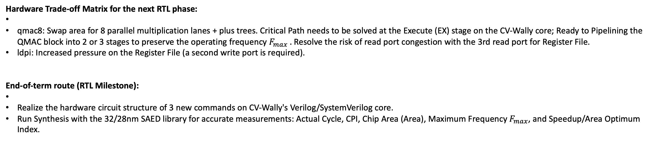
Conclusion
Hardware Trade-off Matrix for the next RTL phase:
qmac8: Swap area for 8 parallel multiplication lanes + plus trees. Critical Path needs to be solved at the Execute (EX) stage on the CV-Wally core; Ready to Pipelining the QMAC block into 2 or 3 stages to preserve the operating frequency $F_{max} .$Resolve the risk of read port congestion with the 3rd read port for Register File.
ldpi: Increased pressure on the Register File (a second write port is required).
End-of-term route (RTL Milestone):
Realize the hardware circuit structure of 3 new commands on CV-Wally's Verilog/SystemVerilog core.
Run Synthesis with the 32/28nm SAED library for accurate measurements: Actual Cycle, CPI, Chip Area (Area), Maximum Frequency $F_{max}$, and Speedup/Area Optimum Index.
Notes:
What is the workload bottleneck? The scalar multiply/MAC loop (B0, B1), then address arithmetic and loop overhead, then (after the extensions) the data cache and the non-GEMM operators.
Which feature addresses it? qmac8 for the MAC loop, qreq for requantization, ldpi for pointer arithmetic, loop blocking (software) for the cache.
How much does it provide? 5.85x, 1.10x and 1.42x incrementally, 9.13x in total for the whole model by instruction count (modelled cycles: 4.3x to 7.6x).
What hardware cost? Not yet measured: qmac8 adds an 8-lane multiplier array, an adder tree and a third read port for the accumulator; qreq a 32x32 multiply with rounding; ldpi a second write port. Synthesis with the SAED 32/28 nm libraries is the next milestone.
What is the next bottleneck? After X2: the loop branch (16% of the GEMM code), the three loads per two qmac8 (a 4-channel tile or a fused load-MAC would reduce them), the 13.5% non-GEMM operators and, in hardware, the qmac8 latency and the cache.

