Slide 1
coding
presentation

Slide 2
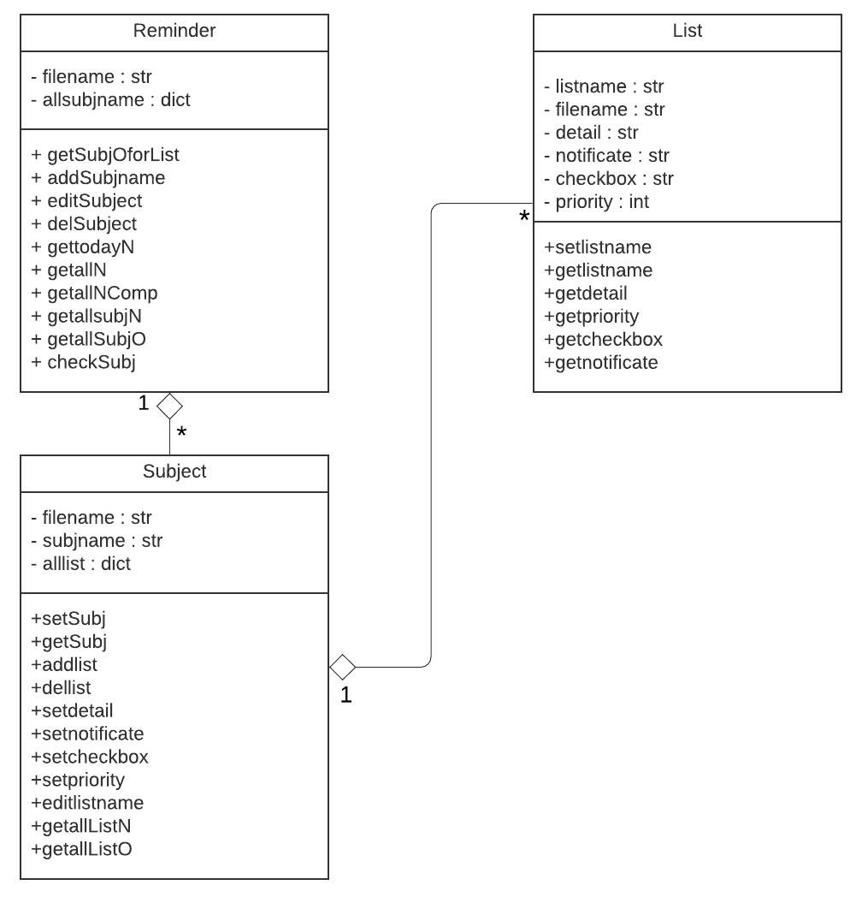
Class diagram
Class diagram

Slide 3
What have we did last Monday?
Login
logout
register
Add list
Delete list
Open list
Edit list
Search list
Complete list
See completed list
See today work
See all list
SeT deadline
See date
Graph
Import file
Export file
Red text mean didn’t done

Slide 4
What have we done ?
Login
logout
register
Add list
Delete list
Open list
Edit list
Search list
Complete list
See completed list
See today work
See all list
SeT deadline
See date
Graph
Import file
Export file

Slide 5
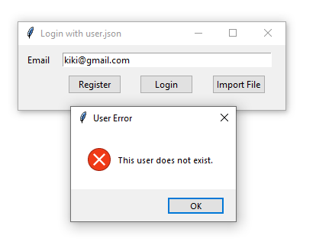
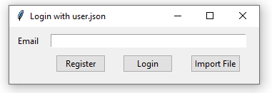
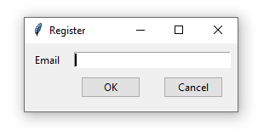
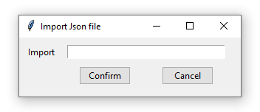
Login Page

Slide 6
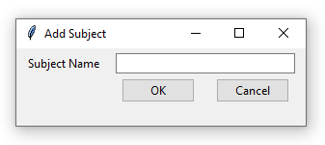
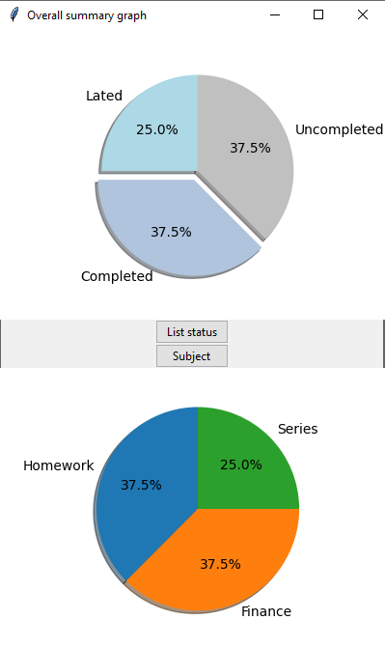
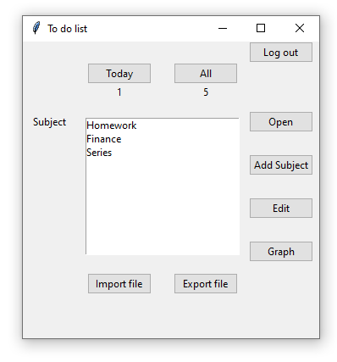
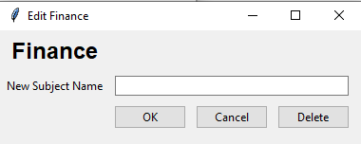
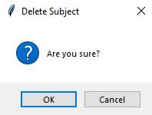
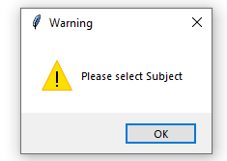
PAGE 1

Slide 7
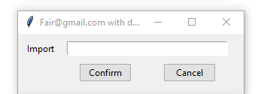
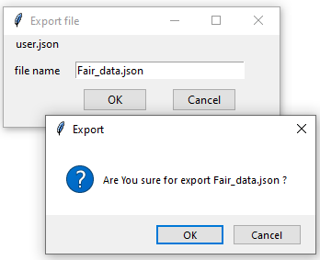
PAGE 1 Import & Export

Slide 8
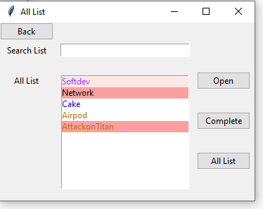
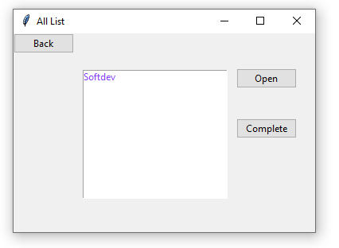
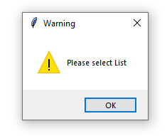
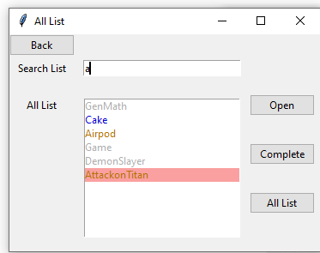
ALL List Page
Today Page

Slide 9







Color
Font
Late
Complete
Normal
Due today
Priority 1 to 3
Background

Slide 10
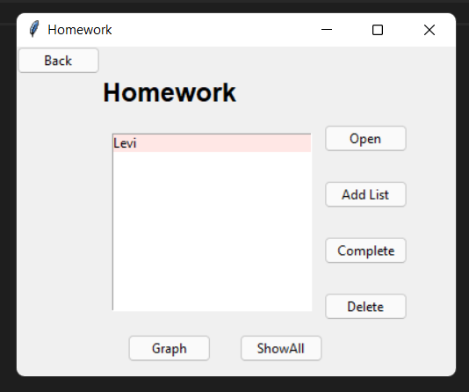
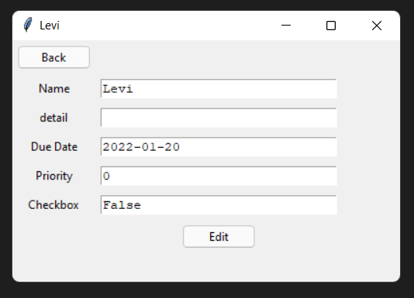
Page 2
Open

Slide 11
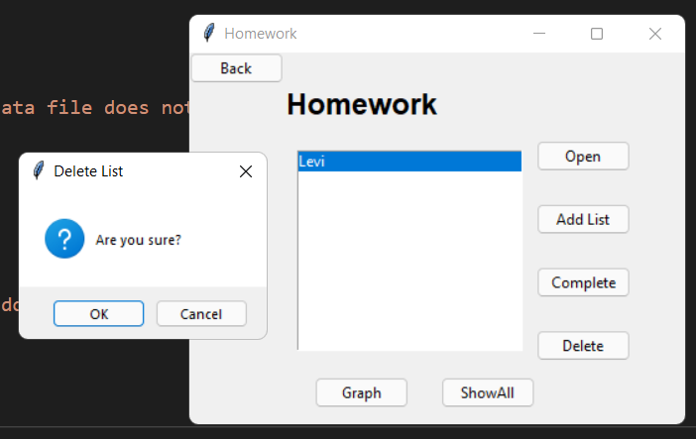
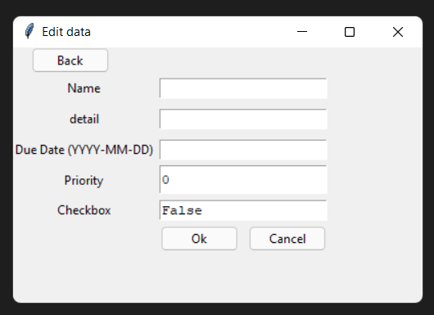
Press add list
Press delete

Slide 12
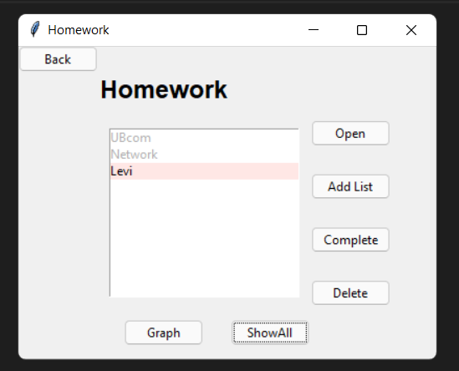
Press showall

Slide 13
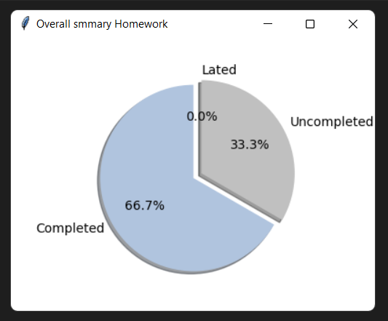
Press graph (Subject)

Slide 14
THANKS!
Any questions?

