Slide 1
QUANTITATIVE FINANCE | FX MARKETS | RISK ANALYTICS
AI-Driven Forex Trading Signal
Generation & Risk Analytics Platform
Koduri Thanay Chowdary
Andhra University
Prepared for Zetheta Algorithms Private Limited

Slide 2
ROADMAP
What We'll Cover
01
Executive Summary
02
Data & Methodology
03
Technical Indicators
04
Signal Generation
05
Machine Learning Models
06
Trade Performance
07
Power BI Dashboard
08
Risk Management (VaR/CVaR)
09
Historical Case Studies
10
Limitations & Conclusion
2

Slide 3
EXECUTIVE SUMMARY
Headline Results
150 trades · 500 EUR/USD candles · 1,000 Monte Carlo scenarios
56.0%
1.03
0.12
₹1,915
-₹165.9K
-₹198.2K
Win Rate
Profit Factor
Sharpe Ratio
Total PnL
VaR 95%
CVaR 95%
Key takeaway: Marginal, not decisive, profitability. ML-driven strategies (Random Forest, XGBoost) meaningfully outperformed rule-based approaches, while USD/JPY exposure drove the largest single-pair losses.
This report documents an honest, cross-validated analytical process — including a lookahead-bias correction in the ML pipeline, a signal-threshold miscalibration caught during EDA, and an Excel validation workflow independently verified against the source notebook.
3

Slide 4
INTRODUCTION
Business Context
The Scenario
Lead FX Quantitative Strategist at a proprietary trading desk, tasked with building an AI-driven signal platform amid central bank policy divergence across the Fed, ECB, BOJ, and RBI.
The Challenge
The global FX market trades $7.5T+ daily. Manual signal generation cannot keep pace with millisecond-scale market microstructure shifts — motivating a systematic, AI-assisted approach.
PLATFORM COMPONENTS
Technical Analysis Engine
ML Signal Classification
Monte Carlo Risk Simulation
Power BI Governance Dashboard
Excel Cross-Validation Layer
4

Slide 5
METHODOLOGY
Three Datasets, One Pipeline
500
150
1,000
Hourly EUR/USD Candles
Executed Trades
Monte Carlo Scenarios
OHLCV price data, Jan 2023, engineered with SMA/EMA/RSI/MACD/Bollinger Bands
6 strategies (MA_Cross, MACD_Trend, RSI_Reversal, ML_RF, ML_XGB, RL_PPO) across 5 currency pairs
Parallel shift, volatility shock, and correlation shock simulations for VaR/CVaR estimation
5

Slide 6
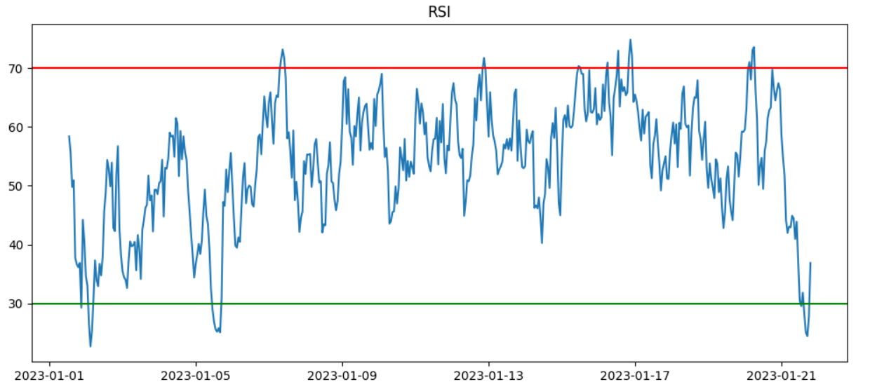
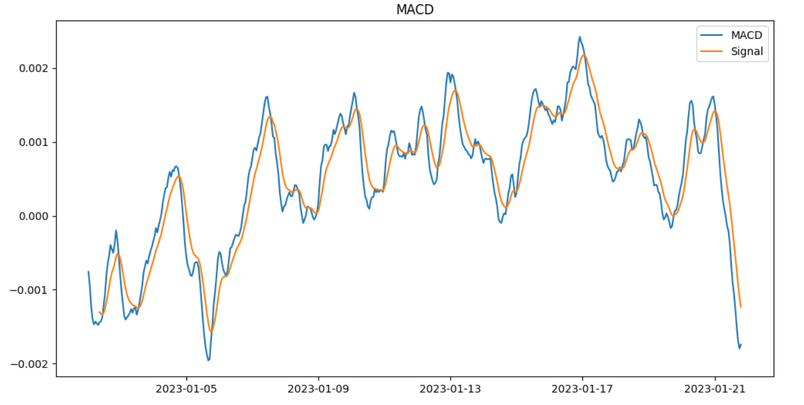
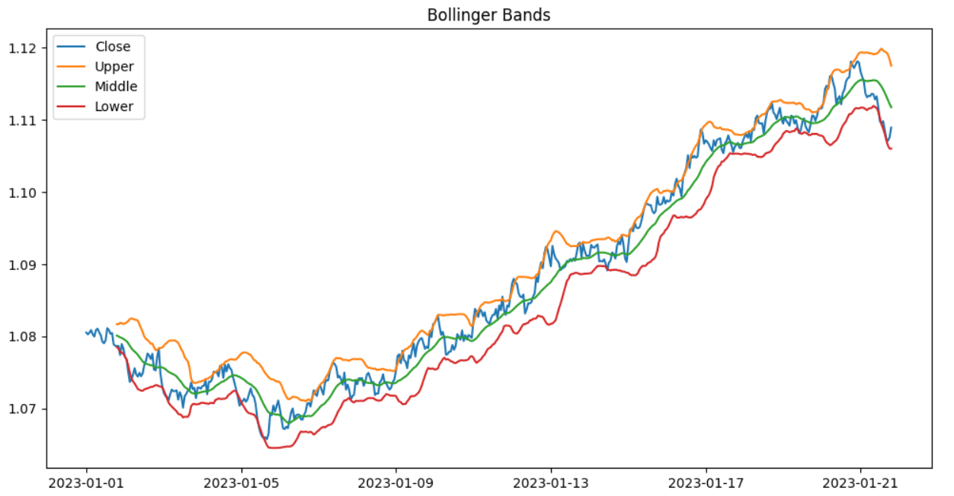
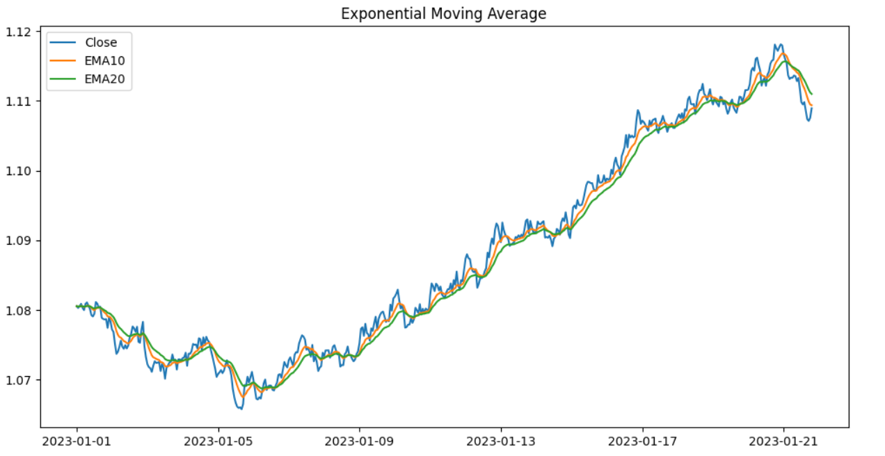
SIGNAL ENGINE
Technical Indicator Suite
RSI(14) — momentum
MACD(12,26,9) — trend
Bollinger Bands — volatility
EMA(10/20) — trend direction
6

Slide 7
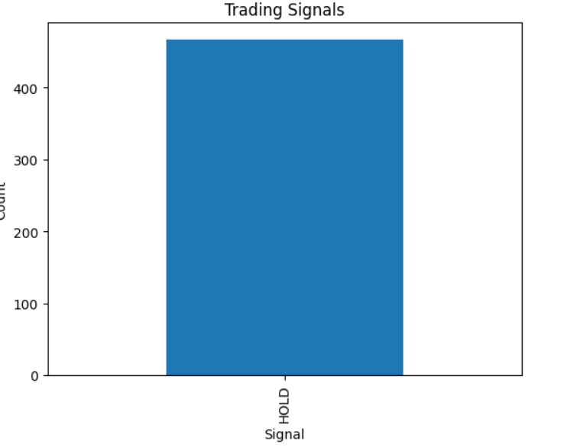
SIGNAL GENERATION
Composite Signal Output
⚠ DATA QUALITY FINDING
The initial run classified effectively all ~470 candles as HOLD — zero BUY/SELL signals were produced. Root cause: the composite scoring threshold was set too conservatively relative to observed indicator scores. Correction: a rebuilt engine with threshold 0.15–0.40 produced a usable distribution — 250 HOLD, 112 STRONG_BUY, 55 BUY, 34 SELL, 30 STRONG_SELL.
7

Slide 8
MACHINE LEARNING
Signal Classification: An Honest Result
Fixed: the original model predicted trade outcomes using ExitPrice/HoldingDays — fields only known after a trade closes (lookahead bias). Rebuilt to predict next-candle direction using only indicators known in advance, with a chronological train/test split.
53.2%
51.1%
47.9%
50% — random-guess baseline
Random Forest
XGBoost
Neural Network
None of the three models meaningfully beats a coin flip — price-based indicators alone carry limited predictive power for the immediate next candle on this sample.
8

Slide 9
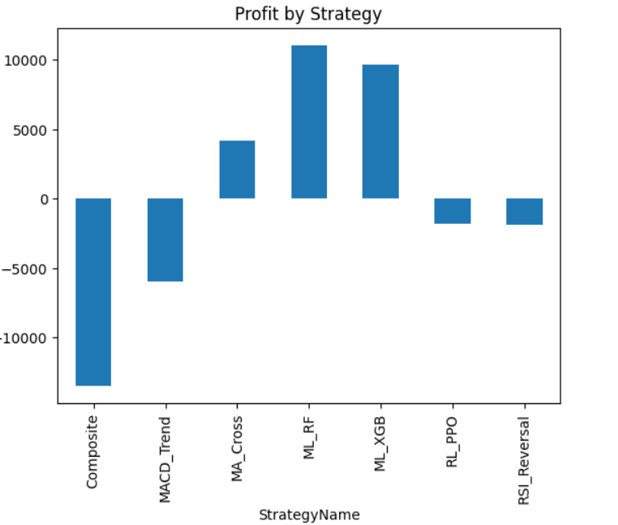
TRADE PERFORMANCE
Winners & Losers by Strategy
ML_RF
+₹11,051
ML_XGB
+₹9,690
MA_Cross
+₹4,217
RL_PPO
-₹1,767
RSI_Reversal
-₹1,880
MACD_Trend
-₹5,934
Composite
-₹13,462
ML-driven strategies dominate; the rule-based Composite engine is the single weakest performer.
9

Slide 10
TRADE PERFORMANCE
Performance by Currency Pair
Pair | Trades | Win Rate | Total PnL
USD/INR | 28 | 50.0% | +₹4,720
GBP/USD | 32 | 71.9% | +₹4,511
AUD/USD | 31 | 51.6% | +₹29
EUR/USD | 33 | 57.6% | -₹75
USD/JPY | 26 | 46.2% | -₹7,270
RISK CONCENTRATION
USD/JPY
is the weakest pair — lowest win rate (46.2%) AND largest loss (-₹7,270).
This pair carries elevated exposure to Bank of Japan policy shifts (see Case Study, Slide 12).
10

Slide 11
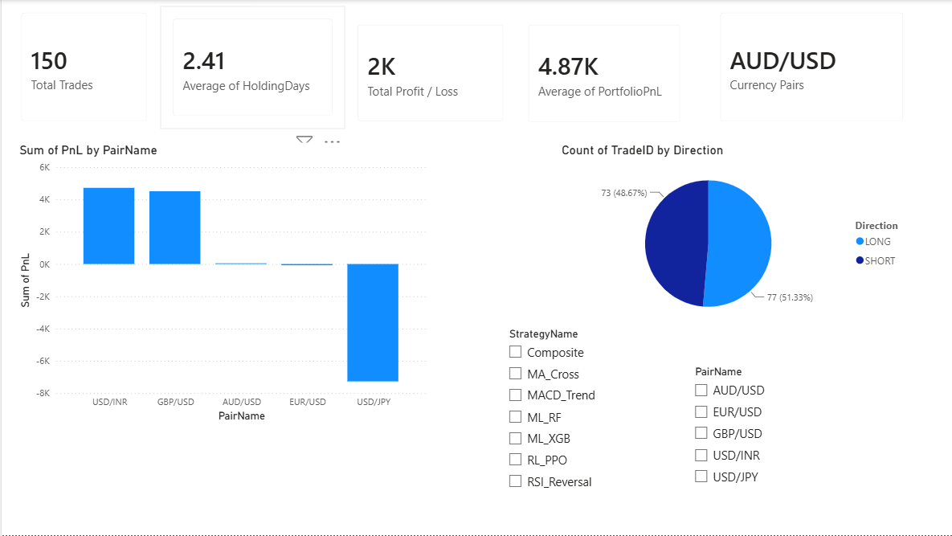
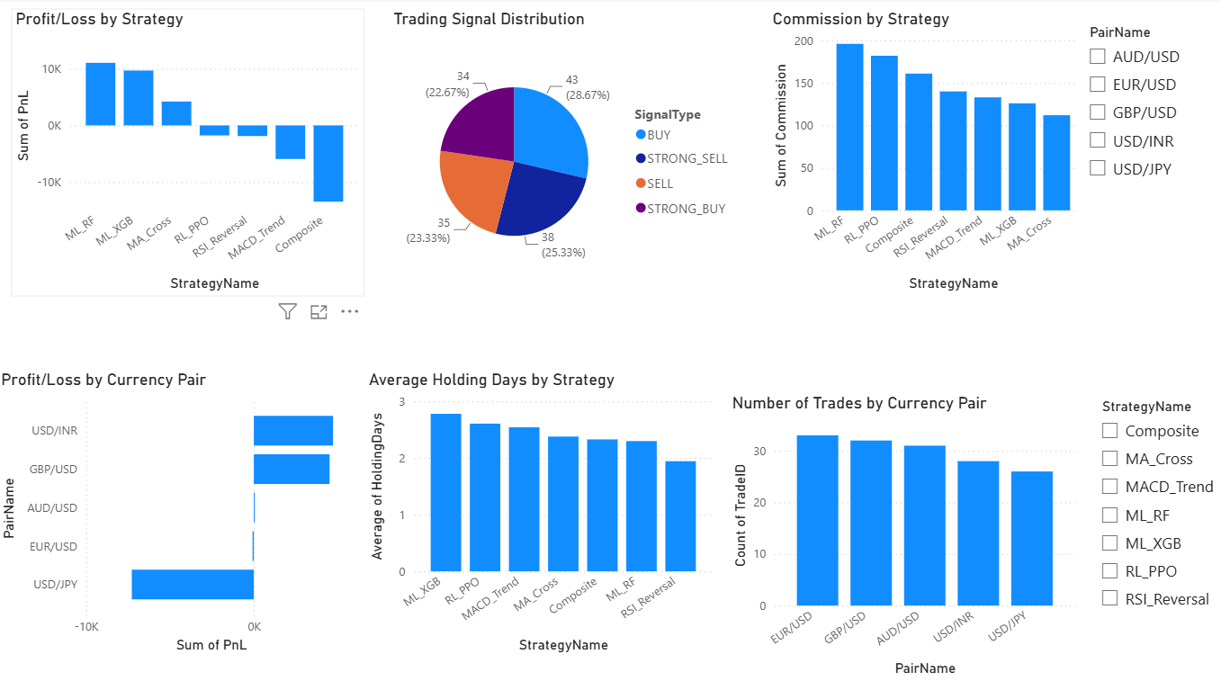
ANALYTICS LAYER
Power BI Dashboard
Overview
Trade Performance
11

Slide 12
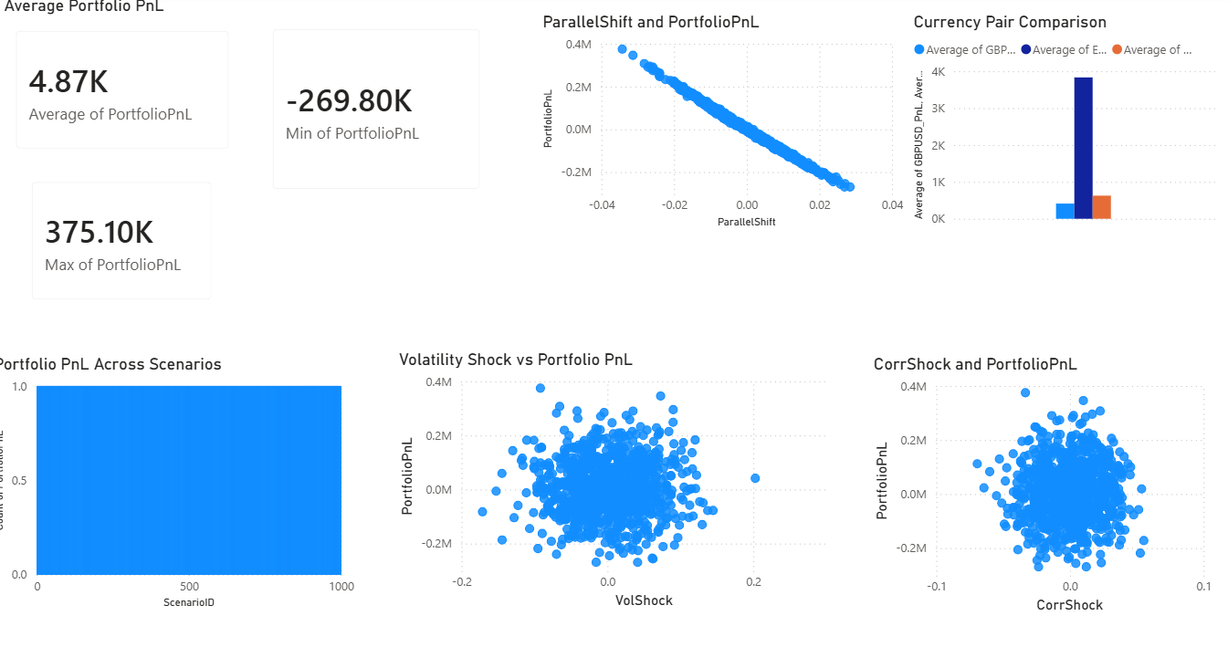
RISK MANAGEMENT
Value-at-Risk & Conditional VaR
₹4.87K
-₹165.9K
-₹198.2K
-₹269.8K
Expected PnL
VaR 95%
CVaR 95%
Worst Case
12

Slide 13
HISTORICAL CONTEXT
Lessons from Real FX Shocks
2024
2016
2015
USD/JPY Carry Unwind
GBP Flash Crash
EUR/CHF Floor Removal
BOJ rate hike triggered the sharpest carry unwind since 1998. Trend signals were caught flat-footed — mirrors this project's USD/JPY losses.
6% drop in 2 minutes on thin liquidity. Lesson: technical signals need session-aware liquidity filters.
SNB's surprise policy reversal caused a 30% move in minutes — unforecastable from price data alone.
13

Slide 14
HONEST ASSESSMENT
Limitations
Small sample: 150 trades / 500 candles limits statistical robustness
Continuous price history exists only for EUR/USD, not the other 4 pairs
Signal threshold proved highly sensitive — one config produced zero actionable signals
Corrected ML classifiers show near-random next-candle accuracy
No slippage/spread modelling beyond flat commission
Monte Carlo shocks are parametric, not calibrated to a specific historical stress event
14

Slide 15
CONCLUSION
A Rigorous, Honest Pipeline
Marginal profitability (56% win rate, 1.03 profit factor) rather than a decisive edge — reported honestly rather than overstated.
Real methodological issues were found and fixed along the way: lookahead bias in ML, an over-conservative signal threshold, and a circular Excel validation.
Clear next steps: favor ML_RF/ML_XGB-style approaches over rule-based composites, and re-examine USD/JPY exposure.
Koduri Thanay Chowdary · Andhra University
Thank you

