Slide 1

Group 15 Predict
Energy Shortfall Regression Modelling

Slide 2

OVERVIEW
The supply of electricity has a huge role in our lives on earth. This is because we use electricity to cook, work, play, health purposes and a lot of other things. Our electric centered lives means we rely on electrical infrastructure to have a good and sustainable life.
However, over the past few years, we have noticed that electricity as the only form of energy is not sustainable. Looking into investing into other forms of energy sources is a necessity.
In this project, we are tasked to model shortfall between energy generated by means of fossil fusels and other various sources. The daily shortfall is our target variable and will be modelled as a function of various city-specific weather features.

Slide 3




OBJECTIVE
The objective is to build a model that predicts into the future the three hourly load shortfall for Spain. This difference is between the energy generated by means of fossil fuels and renewable sources.
We'll be using features in our dataset to try predict the load-shortfall that is weather based:
Temperatures,
Windspeed
Wind degree
Rainfall
Clouds
Humidity,
Atmospheric pressure
Snow
We will be using regression model to achieve this objective.

Slide 4

PREPROCESSING DATA
We converted the time column from object to datetime
Created columns year, month ,week, day , hour form time columns
We filled the null columns of the Valencia pressure with the mean of the column.
We converted Seville pressure and Valencia wind deg column from object to numeric

Slide 5

EXPLORATORY DATA ANALYSIS
Understand and get to grips with DATA

Slide 6

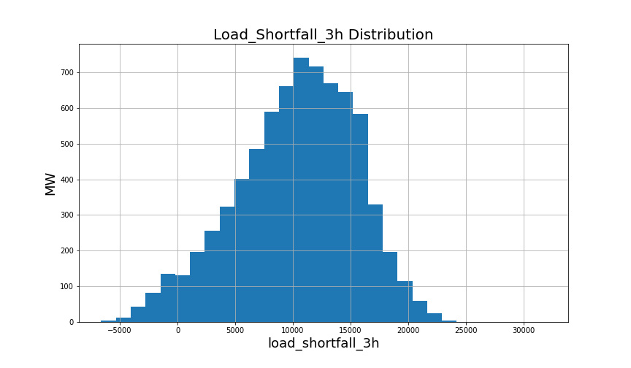
EDA
Load_shortfall_3h column in normally distributed

Slide 7
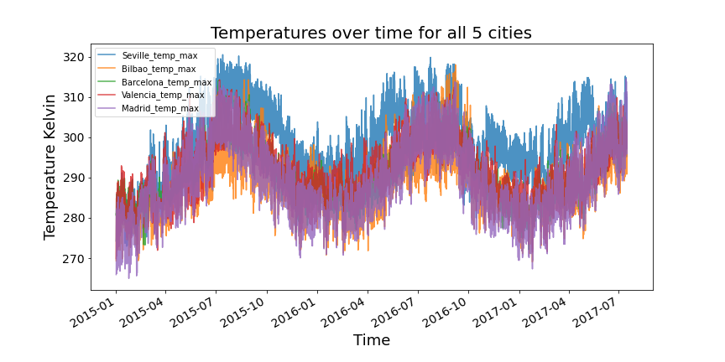
EDA
Temperature vs years

Slide 8

DATA ENGINEERING
Features – TIME Standardisation / Normalisation

Slide 9

MODELLING
Linear regression Decision Tree Random Forrest Lasso + Ridge
KNeighborsRegressor XGB Regressor

Slide 10

HYPERPARAMETER TUNING

Slide 11

FEATURE SELECTION

Slide 12

RESULTS COMPARISON

Slide 13

CONCLUSION

Slide 14
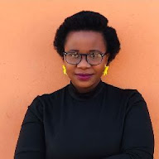
TEAM
The dream team

