Slide 1

Netflix Country Contribution Analysis
Thembela Thandokazi (Thando) Voyizana
LIFT HORIZON PRESENTATION
Notes:
AI-generated content may be incorrect. ---

Slide 2
Understanding Netflix Content Contributions by Country

Slide 3

Project Overview and Research Question
Research Objective
Analyze which country contributes the most titles to Netflix and how this has changed over time.
Data and Methodology
Utilize Netflix's public dataset, clean data, handle multi-country titles, and extract year added to platform.
Strategic Implications
Understanding content origins reveals Netflix’s international expansion and audience targeting strategies.
Motivation and Insights
Challenge assumptions about US dominance and track growth of international markets like India and South Korea.
Notes:
This presentation explores a central question in Netflix content analysis: which country contributes the most titles to Netflix, and how that contribution has changed over time. As Netflix has evolved from a U.S.-centric streaming platform into a global entertainment provider, understanding the geographic origins of its content helps explain broader strategic decisions, such as international expansion, audience targeting, and investment priorities. The analysis uses Netflix’s publicly available titles dataset, which includes information on movies and TV shows, their countries of origin, and the dates they were added to the platform. By focusing on the country attribute and tracking additions over time, we can identify patterns in dominance, growth, and diversification. The motivation behind this analysis is twofold. First, it provides empirical evidence to support or challenge the common assumption that the United States overwhelmingly dominates Netflix’s catalog. Second, it examines whether this dominance has weakened or strengthened as Netflix has invested heavily in international markets such as India, South Korea, and Europe. To answer the research question, the project applies systematic data cleaning steps, including converting date fields, extracting the year of addition, and properly handling titles associated with multiple countries. This ensures that each contributing country is fairly represented in the counts. The presentation is structured to guide the audience from the problem statement to clear, data-driven insights. It begins with the objective, then highlights the key findings, followed by an examination of trends over time, and concludes with implications for Netflix’s global strategy. Overall, this overview sets the foundation for understanding why country-level analysis matters and how it can reveal meaningful trends in global content production and distribution within a major streaming platform.

Slide 4
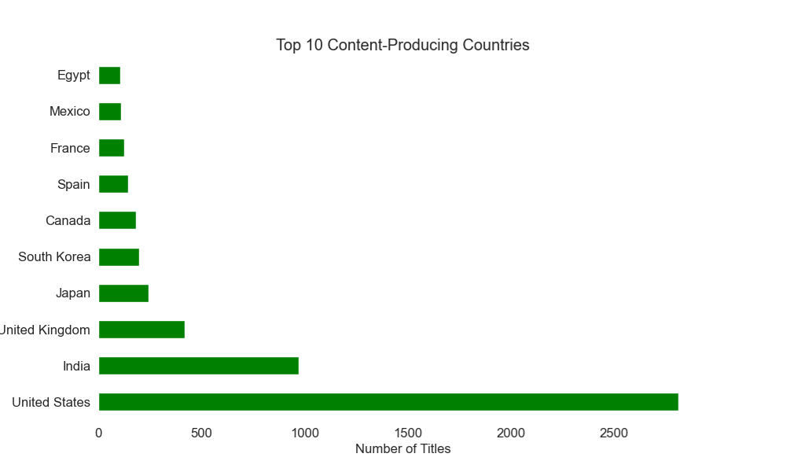

Analysis Objective and Methodological Approach
Objective and Data Preparation
Identify top contributing country by Netflix titles and prepare data by converting dates and cleaning missing values.
Handling Multi-country Titles
Split multi-country titles so each country receives individual counts reflecting true contributions.
Frequency and Trend Analysis
Count titles per country and analyze trends over time to reveal changes in contributions.
Visualization for Interpretation
Use bar charts for country comparison and line charts to illustrate temporal trends clearly.
Notes:
The primary objective of this analysis is to identify the country that contributes the highest number of titles to Netflix and to assess how this contribution has evolved over time. Achieving this objective requires a structured methodological approach that ensures accuracy, consistency, and interpretability of results. The first methodological step involves preparing the dataset by converting the date_added field into a proper datetime format. This allows the extraction of the year each title was added to Netflix, which is critical for time-series analysis. Next, records with missing country information are removed to avoid ambiguous attribution. A key methodological challenge arises from titles associated with multiple countries, such as co-productions between the United States and other nations. To address this, the country field is split and expanded so that each country receives an individual count for a shared title. This approach reflects contribution rather than ownership and provides a more realistic picture of global collaboration. Once the data is cleaned, frequency analysis is applied to count the total number of titles per country, enabling identification of the top contributor. Grouping the data by both year and country then allows the analysis of trends over time, revealing whether dominance is stable, increasing, or declining. Visualization plays a crucial role in this methodology. Bar charts are used to compare total contributions across countries, while line charts illustrate temporal trends for the leading country. This combination of descriptive statistics and visual analysis ensures that results are not only statistically sound but also easily interpretable. Overall, the methodological approach is designed to be transparent and reproducible, making the findings suitable for academic discussion, professional reporting, or portfolio presentation.

Slide 5
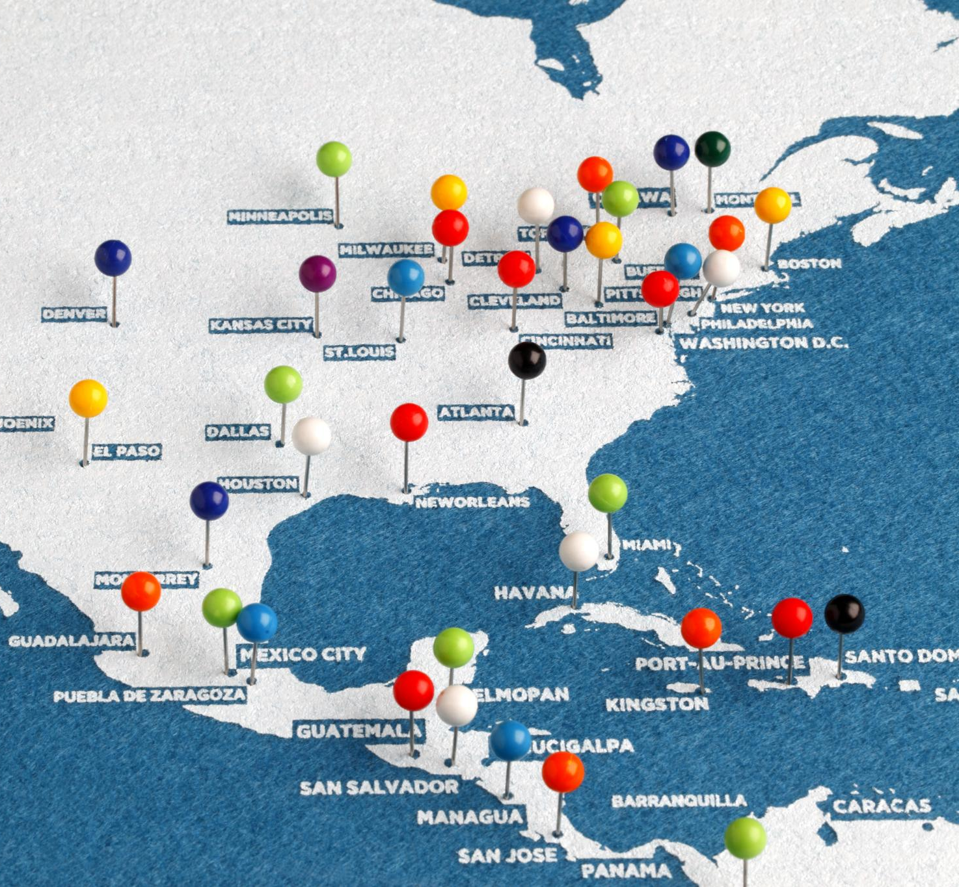
Key Finding: The Leading Content-Contributing Country
U.S. Dominance in Content
The United States leads significantly in content contribution to Netflix, dominating both movies and TV shows globally.
Factors Behind U.S. Lead
Hollywood’s mature infrastructure, extensive studios, and Netflix’s U.S. origins drive high U.S. content volume.
Comparison with Other Countries
India, the United Kingdom, and Japan contribute strongly but remain far behind the U.S. volume of titles.
Strategic Implications
Understanding U.S. dominance is crucial for analyzing global content trends and Netflix’s evolving strategy.
Notes:
The analysis clearly identifies the United States as the country contributing the most titles to Netflix. When all titles are counted and properly attributed, the United States emerges as the dominant contributor by a significant margin compared to all other countries. This dominance spans both movies and TV shows, reflecting the long-established strength of the U.S. entertainment industry in producing globally distributed content. The high volume of U.S.-origin titles can be attributed to several factors, including Hollywood’s mature production infrastructure, extensive studio networks, and Netflix’s origins as a U.S.-based company. From a strategic perspective, this finding aligns with Netflix’s early content acquisition strategy, which relied heavily on licensing American films and television series to build its initial catalog and subscriber base. Even as Netflix has shifted toward producing original content, the United States continues to play a central role due to its access to talent, technology, and financing. The bar chart of the top ten content-producing countries reinforces this conclusion visually, with the United States clearly outperforming other major contributors such as India, the United Kingdom, and Japan. While these countries show strong representation, none approach the overall volume of U.S. contributions. This key finding establishes a baseline for the remainder of the analysis, setting up the next logical question: has this dominance remained constant over time, or has it been challenged as Netflix expands internationally? Understanding this baseline dominance is essential for interpreting subsequent trend analyses and drawing meaningful conclusions about Netflix’s global content strategy.

Slide 6

Trend Analysis: How Contributions Have Changed Over Time
Consistent US Content Dominance
The US has maintained high content contributions over the years, reflecting sustained dominance in Netflix’s catalog.
Growth During Original Programming Era
Mid-to-late 2018s saw a spike in US original productions as Netflix invested heavily in exclusive content.
Rising Contributions from Other Countries
India and South Korea show increasing content additions, reflecting Netflix’s focus on local-language and regional content.
Additive Global Strategy
International expansion complements rather than replaces US dominance, expanding Netflix’s global footprint.
Notes:
Examining how the top contributing country’s output has changed over time provides deeper insight into Netflix’s evolving content strategy. The time-series analysis shows that the United States has maintained consistently high levels of content additions across the years. While there are natural fluctuations from year to year, the overall trend indicates sustained dominance rather than decline. Notably, there is a visible increase in U.S. content additions during the mid-to-late 2010s, a period that coincides with Netflix’s aggressive push into original programming. This growth reflects increased investment in original U.S. productions, including exclusive series and films designed to attract and retain subscribers. At the same time, the trend analysis reveals that while the United States remains dominant, contributions from other countries have grown steadily. Countries such as India and South Korea show upward trajectories, particularly in recent years, signaling Netflix’s commitment to local-language content and regional storytelling. However, despite this growth, no other country surpasses or overtakes the United States at any point in the observed timeframe. The line graph visualization makes this pattern clear by highlighting both stability and scale. The U.S. line remains well above others, reinforcing the conclusion that international expansion has complemented rather than replaced U.S. content dominance. This trend analysis underscores the idea that Netflix’s strategy is additive, expanding its global footprint while maintaining a strong core of U.S.-produced content.

Slide 7

Conclusion and Strategic Implications for Netflix
US Content Dominance
The United States remains the largest and consistent contributor to Netflix’s global content library.
International Expansion
Netflix is growing its international content from countries like India, UK, and South Korea to diversify offerings.
Strategic Dual Approach
Netflix balances a strong US content core with expanding international catalogs to appeal to varied audiences.
Business and Analytical Insights
Insights emphasize managing risk and exploring new growth markets while maintaining dominance in established ones.
Notes:
In conclusion, the analysis demonstrates that the United States is the largest contributor of titles to Netflix and has maintained this position consistently over time. Despite Netflix’s increasing investment in international markets and the growing visibility of content from countries such as India, the United Kingdom, and South Korea, U.S. contributions remain dominant. This finding has important strategic implications. It suggests that Netflix continues to rely heavily on U.S. content as a foundation for its global catalog, leveraging the international appeal and production capacity of American entertainment. At the same time, the steady growth of non-U.S. contributions highlights Netflix’s dual strategy: maintaining a strong domestic core while expanding its international offerings to appeal to diverse audiences. From a business perspective, this balance allows Netflix to manage risk, capitalize on established markets, and explore growth opportunities in emerging regions. For analysts and stakeholders, these insights emphasize the importance of viewing Netflix’s global expansion not as a shift away from U.S. content, but as a diversification layered on top of an already dominant base. Future analyses could build on this work by comparing multiple top countries over time, examining genre-specific trends, or analyzing the relationship between country contributions and subscriber growth. Overall, the findings provide a clear, data-driven answer to the research question and contribute to a deeper understanding of Netflix’s global content strategy.

