Slide 1
Weather App Practicum

Slide 2

Purpose of App
The name of my App is Weather Intel. I’ve designed this app for a local weather organisation that will provide users with average temperature of the week

Slide 3
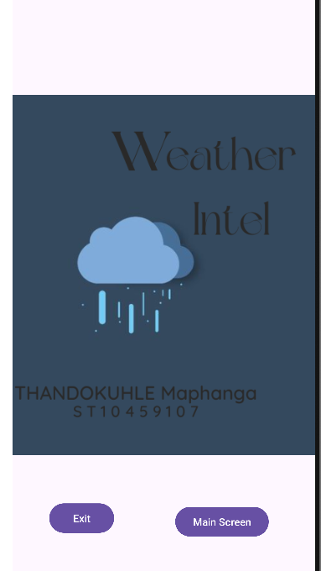
The splash screen The Splash Screen has two buttons. The Exit Button that allows the User to leave the app, and the Main Screen Button which will take the user to the Main Screen

Slide 4
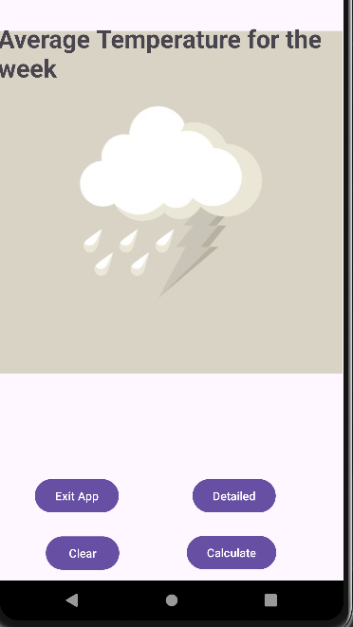
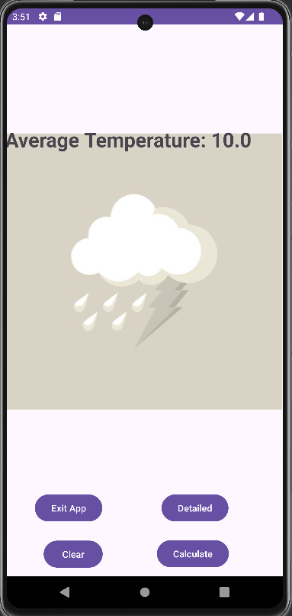
The Main Screen
The main screen has four buttons. The calculate Button Allows the user to see the average weather. The detailed button allows the user to go to the detailed screen, which will show the weather information in detail for the week. The clear Button will clear the average temp entering a new one.

Slide 5
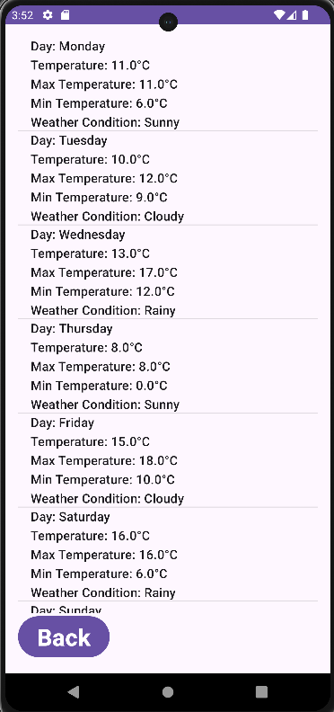
Engaging the audience
This is the detailed screen showing the weather in detailed format for all the seven days of the week.

Slide 6
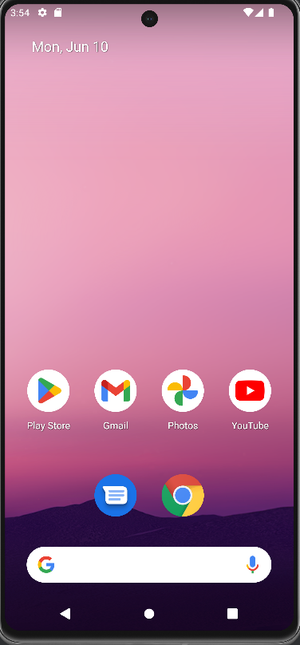
exit
Once the users presses exit, the will go out of the app
Thank you

