Slide 1

Database Management Systems Cornerstone Project
Project review - 2
E COMMERCE ORDER MANAGEMENT SYSTEM
Presented by
T.HARSHA (25B11AIB93)
T.JAYANTH (25B11AIB70)
R.DEVESH (25B11AIA75)
S,ANITHA (25B11AIB17)
Guided by : Mrs. G. L. Narasamba Vanguri
Co-Guided by : Dr. P. V. V. S. D. Nagendrudu
Department of Artificial Intelligence & Machine Learning

Slide 2




Presentation Outline
Abstract
Introduction & Problem Definition
Objectives
Entities & Attributes
ER Diagram & Relationships
Relational Database Schema
Normalization (1NF – 3NF)
Primary & Foreign Keys
GitHub Repository & Team
Database Creation & Constraints
11. Sample Data Insertion
12. DDL, DML & DQL Operations
13. CRUD, Joins & Aggregate Functions
14. Views, Integrity & Validation
15. Documentation, Demo & Conclusion

Slide 3
ABSTRACT
An E-Commerce Management Order System is a DBMS project used to store and manage online shopping information digitally. It reduces manual work, avoids duplicate records, improves order tracking, and helps administrators access information quickly and accurately.
It maintains details of:
Customers
Products
Orders
Payments
Shipments
Reviews

Slide 4
INTRODUCTION
The E-Commerce Management Order System is a database-based application designed to manage online shopping activities. It stores and organizes customer, product, order, payment, shipment, and review details in a centralized database. The system helps to manage orders efficiently, reduce manual work, avoid data duplication, and provide accurate information quickly.
Manages online shopping activities.
Stores customer and product details.
Manages orders, payments, and shipments.
Maintains customer reviews.

Slide 5
ENTITIES & ATTRIBUTES
PROBLEM STATEMENT
Managing hospital activities manually can be difficult and time-consuming. Patient records may be lost or duplicated, appointments can be difficult to manage, and billing and medical information may contain errors. Therefore, a Hospital Management System is needed to organize and manage patient, doctor, appointment, treatment, and billing information efficiently.

Slide 6
OBJECTIVES
Store customer and product details.
Manage orders and order items.
Maintain payment information.
Track order and delivery status.
Reduce data duplication.
Provide quick access to required information using SQL queries
Track product availability
Monitor order status

Slide 7
ENTITIES & ATTRIBUTES DETAIL
Entity | Attributes | Description
CUSTOMER | Customer_ID, Customer_Name, Email, Phone, Address | Every customer registered on the e-commerce platform
PRODUCT | Product_ID, Product_Name, Category, Price, Stock | Products available for purchase
CATEGORY | Category_ID, Category_Name, Description | Groups products such as Electronics, Clothing, Books, etc.
ORDERS | Order_ID, Customer_ID, Order_Date, Total_Amount, Status | Order placed by a customer
ORDER_ITEM | Order_Item_ID, Order_ID, Product_ID, Quantity, Subtotal | Products included in each order
PAYMENT | Payment_ID, Order_ID, Payment_Date, Amount, Payment_Method, Payment_Status | Payment details associated with an order
DELIVERY | Delivery_ID, Order_ID, Delivery_Address, Delivery_Date, Delivery_Status | Delivery information for an order
CART | Cart_ID, Customer_ID, Created_Date, Total_Amount | Shopping cart maintained by a customer

Slide 8
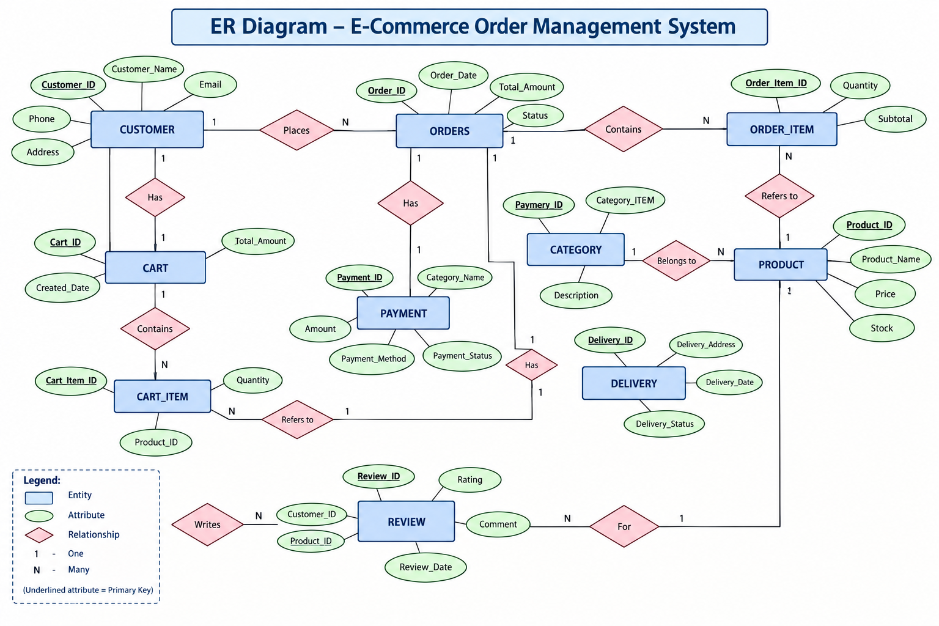
ER DIAGRAM
Rectangles = entities, ellipses = attributes, diamonds = relationships, 1 / N / M = cardinality, underlined = primary key.

Slide 9
RELATIONSHIPS & CARDINALITY
Relationship | Between entities | Cardinality | Foreign key placed in
has | CUSTOMER – CART | 1 : 1 | CART.Customer_ID
contains | CART – CART_ITEM | 1 : N | CART_ITEM.Cart_ID
refers to | CART_ITEM – PRODUCT | N : 1 | CART_ITEM.Product_ID
contains | ORDERS – ORDER_ITEM | 1 : N | ORDER_ITEM.Order_ID
refers to | ORDER_ITEM – PRODUCT | N : 1 | ORDER_ITEM.Product_ID
belongs to | CATEGORY – PRODUCT | 1 : N | PRODUCT.Category_ID
has | ORDERS – PAYMENT | 1 : 1 | PAYMENT.Order_ID
has | ORDERS – DELIVERY | 1 : 1 | DELIVERY.Order_ID
writes | CUSTOMER – REVIEW | 1 : N | REVIEW.Customer_ID
for | PRODUCT – REVIEW | 1 : N | REVIEW.Product_ID

Slide 10
ENTITIES & ATTRIBUTES
RELATIONAL DATABASE SCHEMA
Relation | Relational schema | Keys
Customer | Customer (Customer_ID, Customer_Name, Email, Phone, Address) | PK: Customer_ID
Category | Category (Category_ID, Category_Name, Description) | PK: Category_ID
Product | Product (Product_ID, Product_Name, Category_ID, Price, Stock) | PK: Product_ID FK: Category_ID
Orders | Orders (Order_ID, Customer_ID, Order_Date, Total_Amount, Status) | PK: Order_ID FK: Customer_ID
Order_Item | Order_Item (Order_Item_ID, Order_ID, Product_ID, Quantity, Subtotal) | PK: Order_Item_ID FK: Order_ID, Product_ID
Payment | Payment (Payment_ID, Order_ID, Amount, Payment_Date, Payment_Method, Payment_Status) | PK: Payment_ID FK: Order_ID
Delivery | Delivery (Delivery_ID, Order_ID, Delivery_Address, Delivery_Date, Delivery_Status) | PK: Delivery_ID FK: Order_ID
Cart | Cart (Cart_ID, Customer_ID, Created_Date, Total_Amount) | PK: Cart_ID FK: Customer_ID
Cart_Item | Cart_Item (Cart_Item_ID, Cart_ID, Product_ID, Quantity) | PK: Cart_Item_ID FK: Cart_ID, Product_ID

Slide 11
NORMALIZATION (1NF – 3NF)
1NF (First Normal Form)
• Each column contains only one value.
• No repeating groups are present in a table.
• In our system, multiple products in one order are stored separately in ORDER_ITEM.
• CUSTOMER, PRODUCT, ORDERS, PAYMENT, and DELIVERY maintain separate records.
2NF (Second Normal Form)
• The table must be in 1NF.
• Every non-key attribute must depend on the whole primary key.
• ORDER_ITEM separates order details and product details to avoid partial dependency.
• ORDERS stores order information, while PRODUCT stores product information.
3NF (Third Normal Form)
• The table must be in 2NF
• Remove unnecessary or transitive dependencies.
• CATEGORY stores category information separately from PRODUCT.

Slide 12
PRIMARY & FOREIGN KEYS
Child table | Foreign key | References
Product | Category_ID | Category (Category_ID)
Orders | Customer_ID | Customer (Customer_ID)
Order_Details | Order_ID | Orders (Order_ID)
Order_Details | Product_ID | Product (Product_ID)
Payment | Order_ID | Orders (Order_ID)
Shipping | Order_ID | Orders (Order_ID)
Review | Customer_ID | Customer (Customer_ID)
Review | Product_ID | Product (Product_ID)
Cart | Customer_ID | Customer (Customer_ID)
PRIMARY KEY (PK)
Uniquely identifies each record in the table
Cannot contain null values
Only one primary key in one table
FOREIGN KEY (FK)
References a primary key in another table
Establishes a relationship between the tables

Slide 13
DATABASE & CONSTRAINTS
Constraints applied
• PRIMARY KEY — Uniquely identifies each customer, product, and order record.
• FOREIGN KEY — Links orders with valid customers and order items with valid products and orders.
• NOT NULL — Customer name, phone, product name, price, order date and quantity cannot be empty.
• UNIQUE — No two customers can have the same email or phone number.
• CHECK — Quantity and price must be greater than 0, and order status accepts only valid values such as 'Pending', 'Shipped', 'Delivered', or 'Cancelled'.
• DEFAULT — Order status defaults to 'Pending' and product availability defaults to 'Yes'.
--Create Database
CREATE DATABASE EcommerceDB;
USE EcommerceDB;
-- CUSTOMER TABLE
CREATE TABLE CUSTOMER (
Customer_ID INT PRIMARY KEY,
Name VARCHAR(50) NOT NULL,
Email VARCHAR(100) UNIQUE NOT NULL,
Phone VARCHAR(15) UNIQUE,
Address VARCHAR(150) );
CATEGORY TABLE
CREATE TABLE CATEGORY (
Category_ID INT PRIMARY KEY,
Category_Name VARCHAR(50) NOT NULL UNIQUE,
Description VARCHAR(150) );

Slide 14
SAMPLE DATA INSERTION
USE EcommerceDB;
-- CUSTOMER DATA
INSERT INTO CUSTOMER VALUES
(1, 'Rahul', 'rahul@gmail.com', '9876543210', 'Hyderabad’),
(2, 'Priya', 'priya@gmail.com', '9876543211', 'Vijayawada’),
(3, 'Arjun', 'arjun@gmail.com', '9876543212', 'Chennai’),
(4, 'Sneha', 'sneha@gmail.com', '9876543213', 'Bangalore’),
(5, 'Kiran', 'kiran@gmail.com', '9876543214', 'Visakhapatnam’);
--CATEGORY DATA
INSERT INTO CATEGORY VALUES
(101, 'Electronics', 'Electronic devices’),
(102, 'Mobiles', 'Smartphones and accessories’),
(103, 'Computers', 'Laptops and computer products’),
(104, 'Audio', 'Headphones and speakers');
Insertion order follows the foreign-key dependency:
Department → Doctor / Nurse → Patient → Room → Appointment → Medical_Record → Medicine → Prescription → Billing

Slide 15
DDL, DML & DQL OPERATIONS
DDL commands : CREATE , ALTER , TRUNCATE , DROP
CREATE TABLE SUPPLIER ( Supplier_ID INT PRIMARY KEY, Supplier_Name VARCHAR(100) NOT NULL, Contact VARCHAR(15) );
ALTER TABLE PRODUCT ADD Brand VARCHAR(50);
TRUNCATE TABLE SUPPLIER;
DROP TABLE SUPPLIER;
DML — adds, changes and removes the data
INSERT INTO CUSTOMER VALUES (6, 'Vikram', 'vikram@gmail.com', '9876543215', 'Mumbai’);
UPDATE UPDATE PRODUCT SET Price = 52000 WHERE Product_ID = 201;
DELETE DELETE FROM CUSTOMER WHERE Customer_ID = 6;
DQL — retrieves the data
SELECT * FROM CUSTOMER;
; SELECT Product_Name, Price FROM PRODUCT;
SELECT Product_Name, Price FROM PRODUCT WHERE Price > 1000;
SELECT Product_Name, Price FROM PRODUCT ORDER BY Price DESC;
SELECT DISTINCT Status FROM ORDERS;

Slide 16
CRUD, JOINS & AGGREGATE FUNCTIONS
C CREATE
INSERT INTO CUSTOMER VALUES (7, 'Anil', 'anil@gmail.com', '9876543216', 'Delhi');
R READ
SELECT *
FROM CUSTOMER
WHERE Customer_ID = 7;
U UPDATE
UPDATE CUSTOMER
SET Address = 'Mumbai’
WHERE Customer_ID = 7;
D DELETE
DELETE FROM CUSTOMER
WHERE Customer_ID = 7;
JOIN : Orders with ORDER_ITEM and PRODUCT
SELECT
O.Order_ID,
P.Product_Name,
OI.Quantity,
OI.Unit_Price
FROM ORDERS O
INNER JOIN ORDER_ITEM OI
ON O.Order_ID = OI.Order_ID
INNER JOIN PRODUCT P
ON OI.Product_ID = P.Product_ID;
Aggregate functions on Billing
SELECT COUNT(*) AS Total_Customers FROM CUSTOMER;
SELECT SUM(Total_Amount) AS Total_Sales FROM ORDERS;

Slide 17
VIEWS, SUBQUERIES & INDEXES
VIEW : a reusable virtual table for the reception desk
CREATE VIEW Customer_Order_View AS
SELECT
C.Customer_ID,
C.Name,
O.Order_ID,
O.Order_Date,
O.Total_Amount,
O.Status
FROM CUSTOMER C
JOIN ORDERS O ON
C.Customer_ID = O.Customer_ID;
SUBQUERY :
USE EcommerceDB;
--Products having price greater than average price
SELECT
Product_Name, Price
FROM PRODUCT
WHERE Price >
(
SELECT AVG(Price)
FROM PRODUCT );
Why views help
Hide complex joins from everyday users
Give read-only access without exposing base tables
Indexes created
CREATE INDEX idx_pat_name ON Patient(Patient_Name);
CREATE INDEX idx_app_date ON Appointment(Appointment_Date);

Slide 18
GITHUB REPOSITORY & TEAM
Team member | Roll number | Responsibility
T.HARSHA | 25B11AIB93 | ER diagram, schema design and normalisation
T.JAYANTH | 25B11AIB70 | Table creation, constraints and sample data
S.ANITHA | 25B11AIB17 | DML / DQL queries, joins and aggregate functions
R.DEVESH | 25B11AIA75 | Views, validation checks, documentation and demo
Repository structure
/sql/01_create_tables.sql
/sql/02_insert_data.sql
/sql/03_queries.sql /sql/04_views.sql
/docs/ER_diagram.png, /docs/report.pdf
/screenshots/ — query output images
Version control practice
One GitHub repository shared by all four members
Separate branch per member, merged through pull requests
Meaningful commit messages for every change
README file explains how to run the scripts
Guides: Mrs. G. L. Narasamba Vanguri, Dr. P. V. V. S. D. Nagendrudu
GITHUB REPOSITORY LINK : https://github.com/Thandra-Sriharsha/E-COMMERCE-ORDER-MANAGEMENT-SYSTEM/blob/main/app.py

Slide 19
ENTITIES & ATTRIBUTES
CONCLUSION
The E-Commerce Order Management System provides an efficient way to manage customers, products, orders, payments, deliveries, carts, and reviews using a relational database. The project demonstrates important DBMS concepts such as constraints, data insertion, DDL, DML, DQL, CRUD operations, joins, aggregate functions, views, subqueries, indexes, and data validation.
Overall, the system provides a structured and reliable database solution for managing e-commerce operations and demonstrates the practical application of SQL and database management concepts.

Slide 20
THANK YOU

