Slide 1

Project Title – Seasonal-Agriculture-performance –Analysis
[ Thaneeru Varshitha
Sreenidhi Institute of Science and Technology ]
AICTE STU ID : (STU6a61c9c79fc021784793543)

Slide 2

PROBLEM STATEMENT
The problem is to analyze the given agriculture data set and investigate seasonal differences in agricultural performance by identifying meaningful patterns, Trends, relationships and variations within the available data.

Slide 3
PROJECT DESCRIPTION This project is about understanding how agricultural performance changes from one season to another. I worked with 4000 firm records containing information about Crops, location, environmental conditions, irrigation, resources, Yield, production and financial performance. I cleaned the data and performed different types of analysis ,including EDA outliner analysis, correlation analysis, seasonal comparisons Crop Analysis, irrigation analysis finally, I used the findings to identify important patterns and provide practical recommendations for better crop ,irrigation, and resource planning.

Slide 4

WHO ARE THE END USERS?
So, the end users are farmers, agricultural planners, agricultural organizations ,agricultural analyst and researchers.

Slide 5

Technology Used
Python
Pandas
NumPy
Matplotlib
Google collab
GitHub

Slide 6
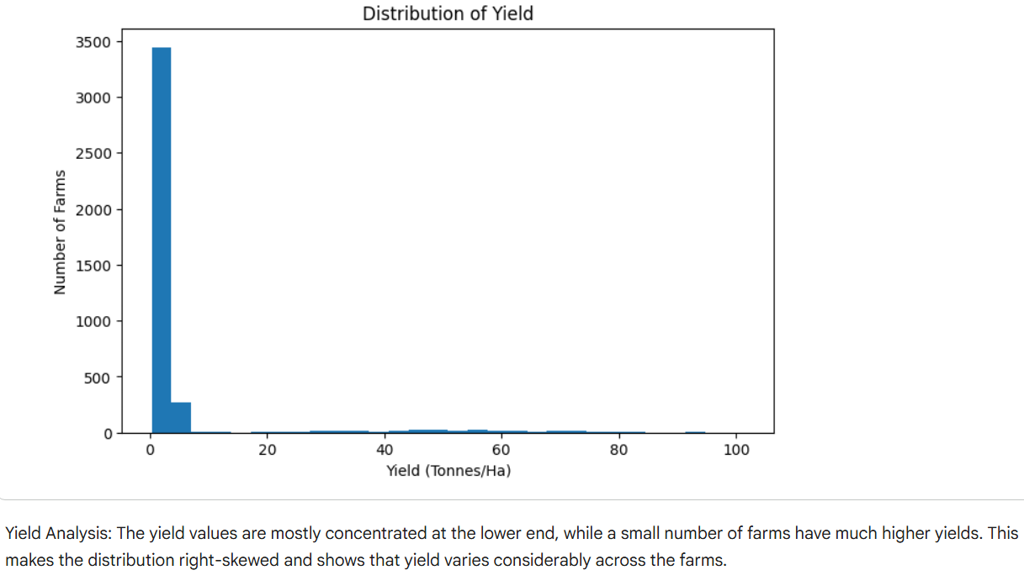
RESULTS

Slide 7
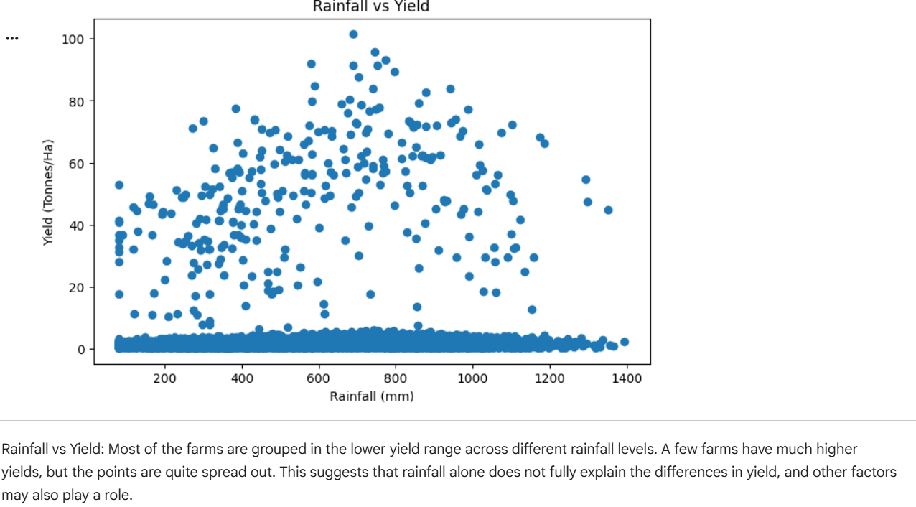
RESULTS

Slide 8
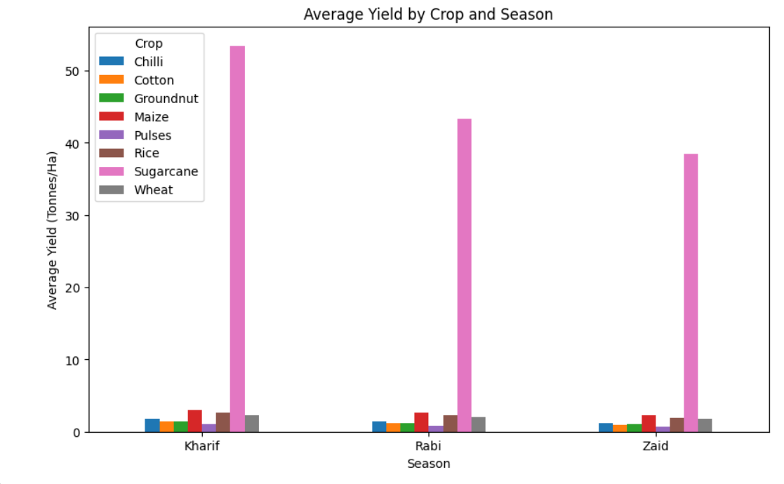
RESULTS
[Add screen shots of your code ]

Slide 9
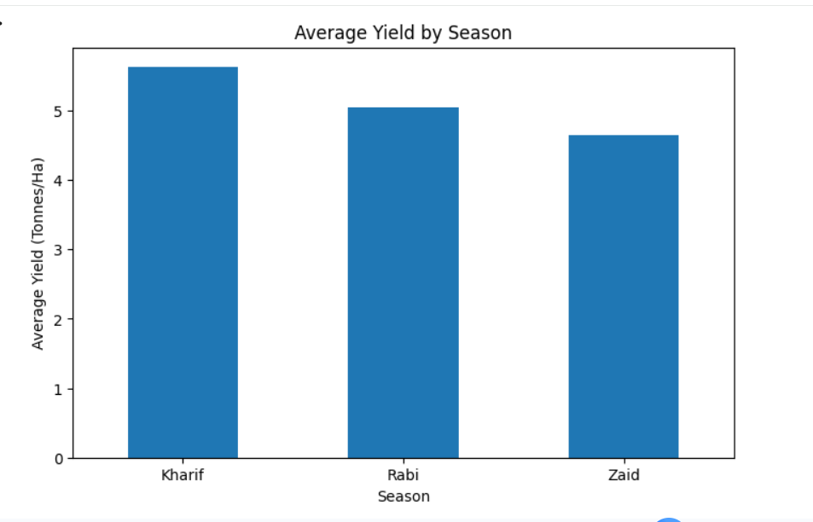
RESULTS
[Add screen shots of your code ]

Slide 10
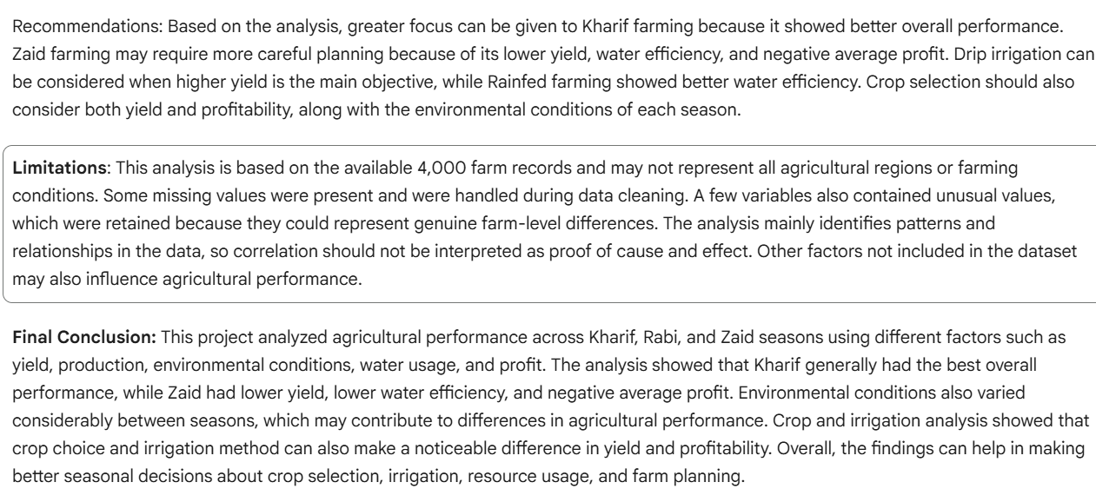
RESULTS
[Add screen shots of your code ]

Slide 11
Future scope
In the future, this project can be taken further by using more agricultural data from different years, regions, and crops to get a better understanding of seasonal performance. More detailed information about weather, soil conditions, market prices, and resource usage can also be included to study their impact on yield, production, water usage, and profit. The analysis could also be presented through an interactive dashboard so that farmers and agricultural planners can easily compare seasons, crops, regions, and farming practices. This would make the analysis more useful for better crop selection, irrigation planning, resource management, and seasonal decision-making.

Slide 12
_{GitHub link}
https://github.com/Thaneeru-varshitha/Seasonal-Agriculture-performance-Analysis.git

Slide 13
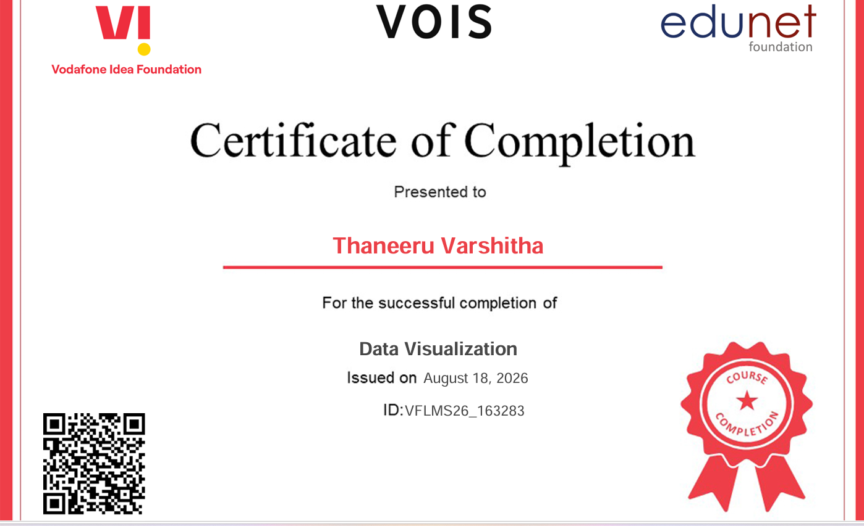
VOIS Course completion certificate - Course name- Data Visualization

Slide 14
THANK YOU
.
.

