Slide 1

AN EFFICIENT IMAGE RESTORATION METHOD WITH TEMPORAL INFORMATION FOR A CORRUPTED IMAGE IN A NOISY ENVIRONMENT
Domain : COMPUTER VISION
Area : Image Restoration
Team Members
THANUSH KUMAR V (211418104292)
THANESH N T (211418104291)
SRINIVASAN M (211418104265)
Guided by
Mrs.V.ANITHA MOSES, M.E(CSE)
Professor,
Panimalar Engineering College

Slide 2
ABSTRACT
Deep learning algorithms are used to improve image quality by discretizing corrupted photos from high-quality photos.
During the image capture process, the image becomes corrupted due to the presence of haze, motion blur, and lens blur, resulting in low quality images with noise.
Photographing in less-than-ideal conditions necessitates post-processing, such as JPEG image corruption occurs as a result of compression.
The blurred images are restored along with the temporal relationship in video frames due to the presence of noisy, compressed, and downscaled images.

Slide 3
introduction
Image denoising refers to the process of removing noise from a noisy image in order to recover the original image.
However, because of some components like noise, edges, and texture which is difficult to differentiate them throughout the denoising process and the denoised pictures may unavoidably lose some features.
The recovery of useful information from noisy pictures during noise reduction to create high-quality photographs has become a significant issue in recent years.

Slide 4
literature survey
TITLE | OBJECTIVE | METHODOLOGY & OUTCOME
Multispectral Image Restoration From Color Images Using Enhanced Variational Autoencoder and Generative Adversarial Network | Combining the advantages of the Generative adversarial Network (GAN) and the Variational Autoencoder(VAE). | One input image with random latent space vectors can be created out of the lost possible multiple outputs. Even with less training data they got accurate and quality reconstructed results.
3D Contrast Image Restoration from Human Activity | Reconstruct 3D visual images by constructing three decoding models are contrast-decoding, disparity decoding and contrast-disparity-decoding models, and testing these models with fMRI data from humans viewing 3D contrast images. | The outputs of the decoders were combined by a linear model of the corresponding local image elements using the same method to reconstruct contrast images. The combination of the early and dorsal visual regions showed predominant advantages in decoding both the contrast and disparity for the contrast-disparity decoding model

Slide 5
EXISITING METHOD
Use of variational auto encoders results in low quality images in noisy condition.
Use of Gaussian Filter remove noise linearly without preserving the edges in a good manner.
Use of Curvelet Transforms has useful geometric features with sparse representations. Using transformation based on unequally-spaced fast Fourier transforms (USFFT).

Slide 6
PROPOSED METHOD
The proposed VRT (Video Restoration Transformer)used for video restoration (e.g., video super-resolution) seeks to recover high-quality frames from low-quality frames.
capable of parallel frame prediction as well as long-range temporal dependency modelling.
Dense Reconstruction of images along with geometric features.
compression module to filter the noise and keep the most useful information in features for video restoration.

Slide 7



Technology stack
Jupyter Colab Notebook
Keras & CV
Python
Virtual Environment

Slide 8
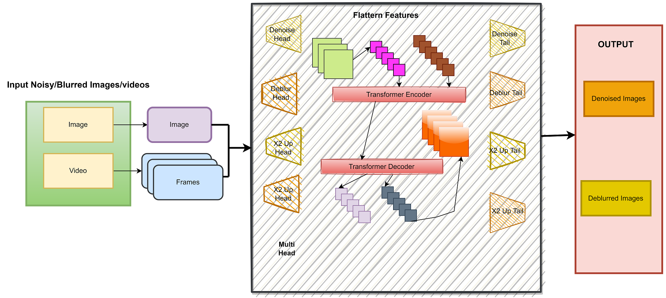
Architecture diagram

Slide 9
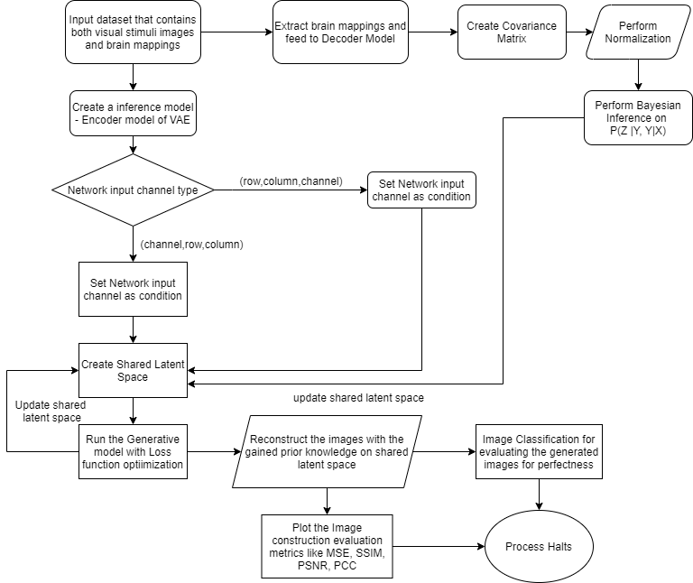
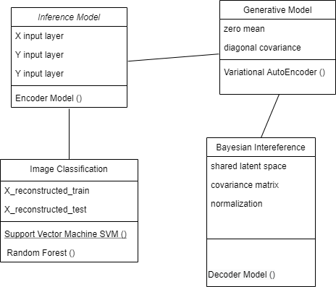
Class diagram activity Diagram

Slide 10
METHOD derived
For noise-robust feature representations. neural codec is the method used for denoising images.
Other methods based on the task are
cv2.fastNlMeansDenoising() --Works for single Grayscale Image
cv2.fastNlMeansDenoisingColored() --Works for Colored Image
cv2.fastNlMeansDenoisingMulti() --Works for a sequence of Grayscale Image
cv2.fastNlMeansDenoisingColoredMulti() --Works for a sequence of Colored Image
charbonnier loss for JPEG Denoising.
Inverse filter for deblurring

Slide 11
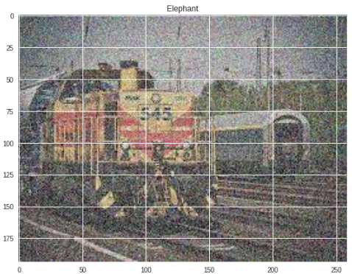
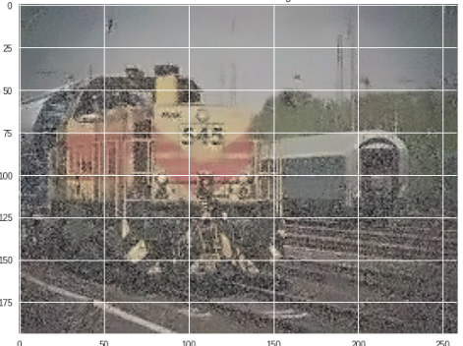
SCREEN CAPTURES
Screen Capture 1
Screen Capture 2 Fast Denoising

Slide 12
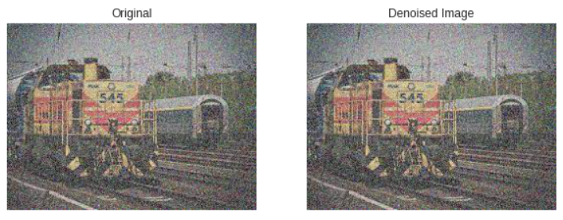
SCREEN CAPTURES
Screen Capture 3 Denoise of Chambolle

Slide 13
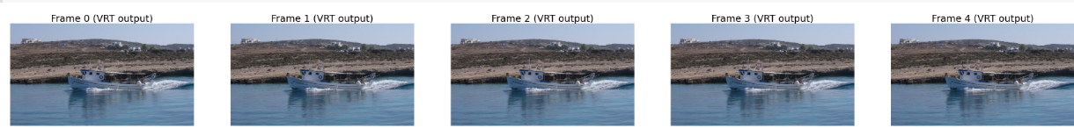
SCREEN CAPTURES
Screen Capture 4 Frames of Input Video

Slide 14
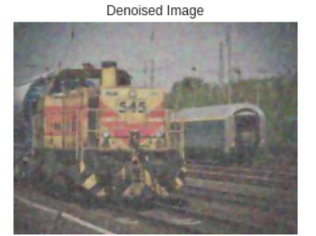
SCREEN CAPTURES
Screen Capture 5 VRT Method

Slide 15
CONCLUSION
Video Restoration Transformer (VRT)extracts the useful information, aligns, and fuses them from different frames at multiple resolutions using two types of modules: multiple temporal mutual self attention (TMSA) and parallel warping.
Specifically, TMSA is made up of mutual and self-attention. Mutual attention enables collaborative implicit flow estimation and feature warping, whereas self attention is in charge of feature extraction.
Parallel warping can also be used to improve feature alignment and fusion.

Slide 16
FUTURE WORK
Computational overhead of aligning several high quality images are being reduced .
Parallel computation and long- range dependency in alignment of frames with larger window size are aimed to reduce based on temporal relation.

Slide 17
REFERENCES
Changde du, Huiguang, Lijie huan, “Restorating Perceived Images from Human Activities with Bayesian Deep Multiview Learning.” IEEE Transactions on Neural Network and Learning Systems.
Cong Huang, Jiahao Li, Bin Li, Dong Liu, “Neural Compression-Based Feature Learning for Video Restoration”, Computer Vision and Pattern Recognition
Eero p. simoncelli, Irene epifanio, Jesus malo and Rafael Navarro, “Nonlinear Image Representation for Efficient Perceptual Coding” IEEE Transactions on Image Processing, VOL. 15, NO. 1
Floris de lange, Marcel van gervan and Tom heskes, “Neural Decoding with Hierarchical Generative Models” P1: QPU NECO_a_00047-Gerven NECO.cls
Gomathi, Rathi “Human Vision Restoration using Activity Profiles” 4th International Conference on Computing Communication and Automation (ICCCA).

Slide 18

Thank You

